Slide 1
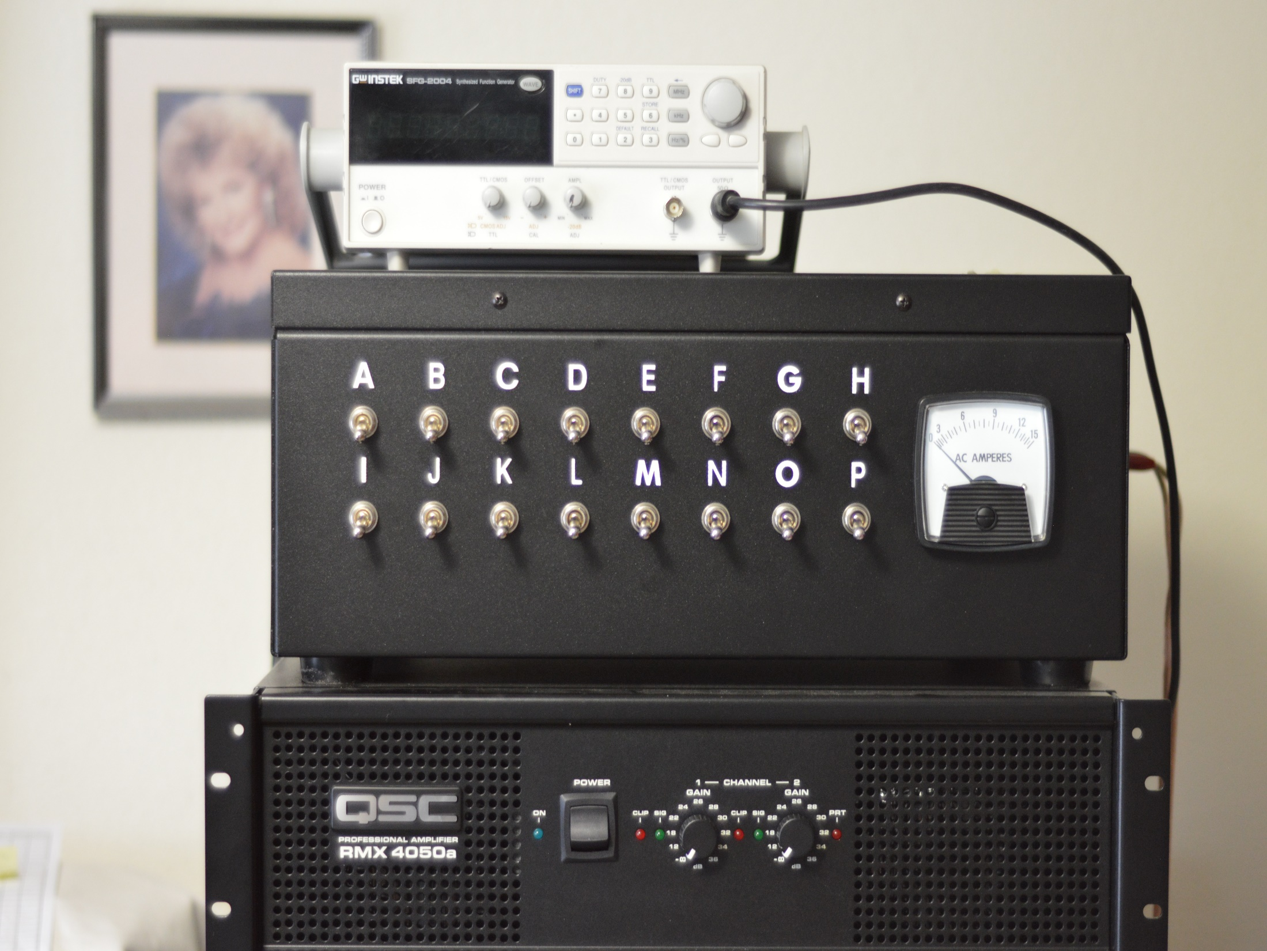

Slide 2
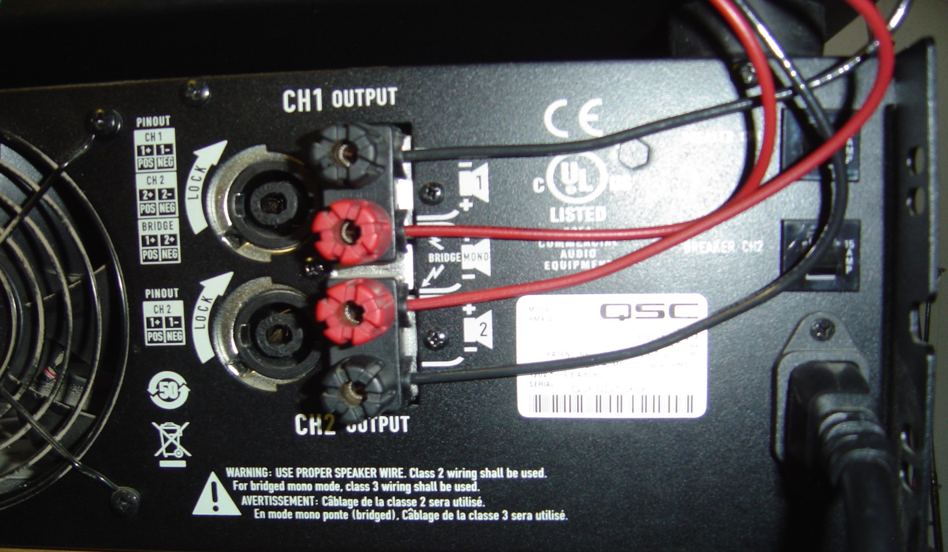
To install the four wires from the back of the capacitor cabinet, loosen the four knobs. Insert each of the four wires from the side under the knobs. Keep each wire in center under each knob, off to the side will allow for a poor connection. Insert the two black wires under the top and bottom knobs, and the two red wires under the center knobs, either red can go under either knob and either black can go under either black knob . Finger tighten securely, wiggle the wire as you tighten for more secure connection.

Slide 3
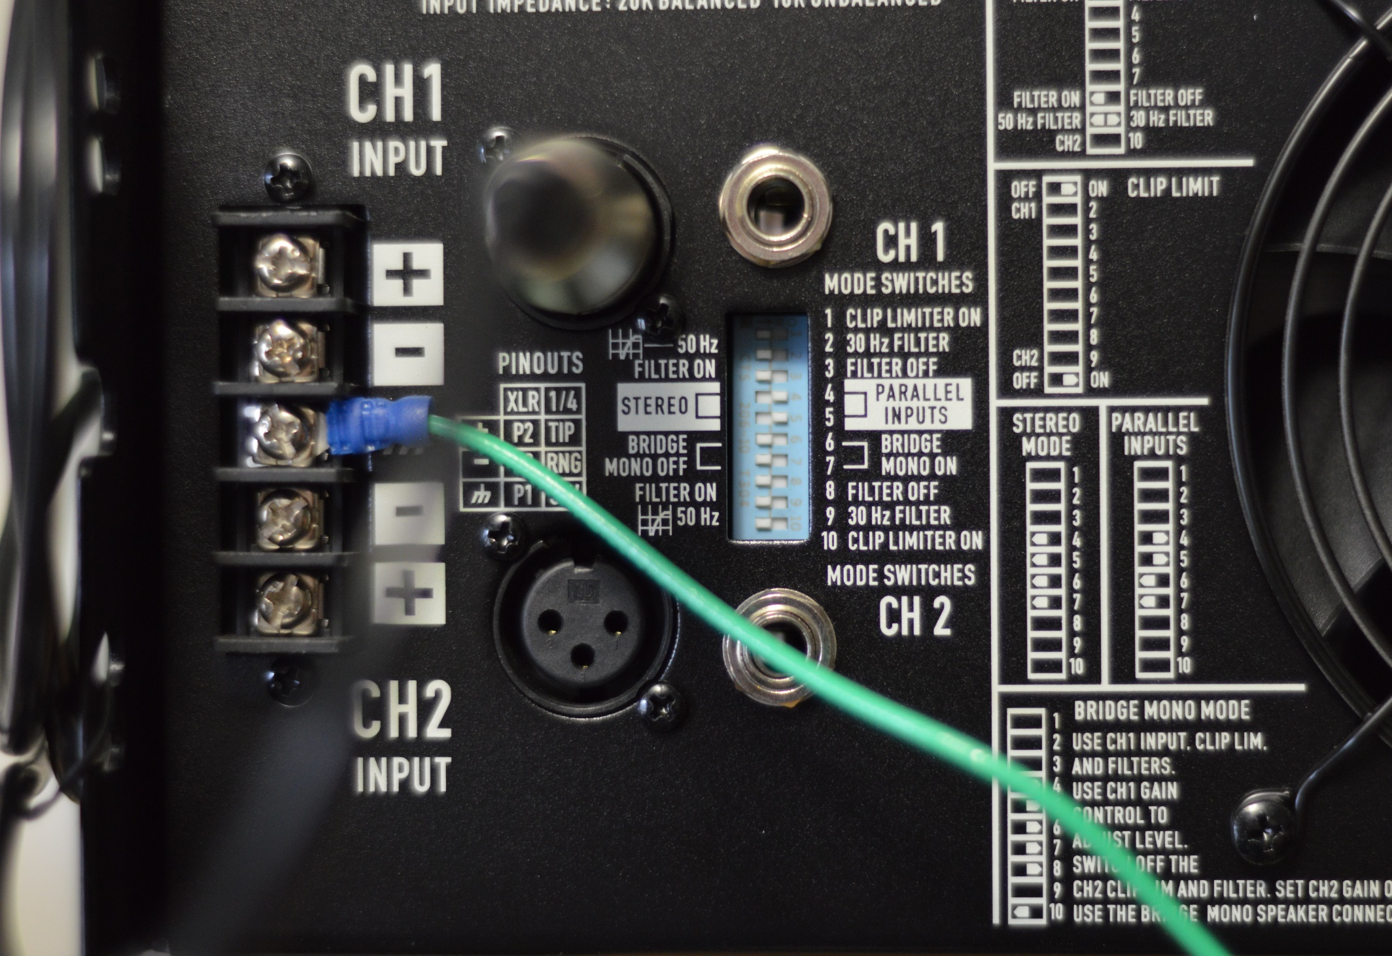
Note: move all MODE switches to the left except for 4 and 5 which are to the right!
Put green ground wire under the third screw down marked with ground symbol.

Slide 4
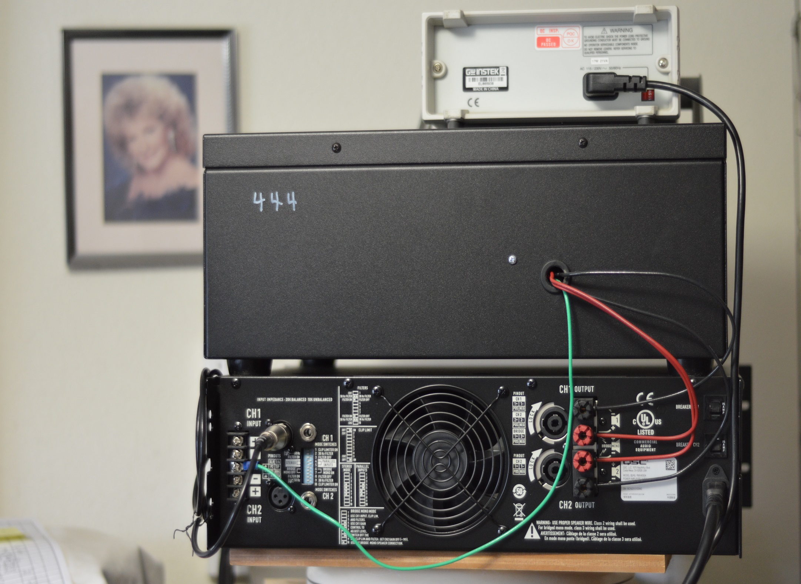
Notes:
Insert the chrome adapter into Channel 1 Input. Install the coax cable by inserting and twisting to lock connection into the Output 50 ohms plugin on the frequency generator and into the end of the chrome adapter. Put the green ground wire from the capacitor cabinet under the third screw down which a symbol like a pitchfork.

Slide 5
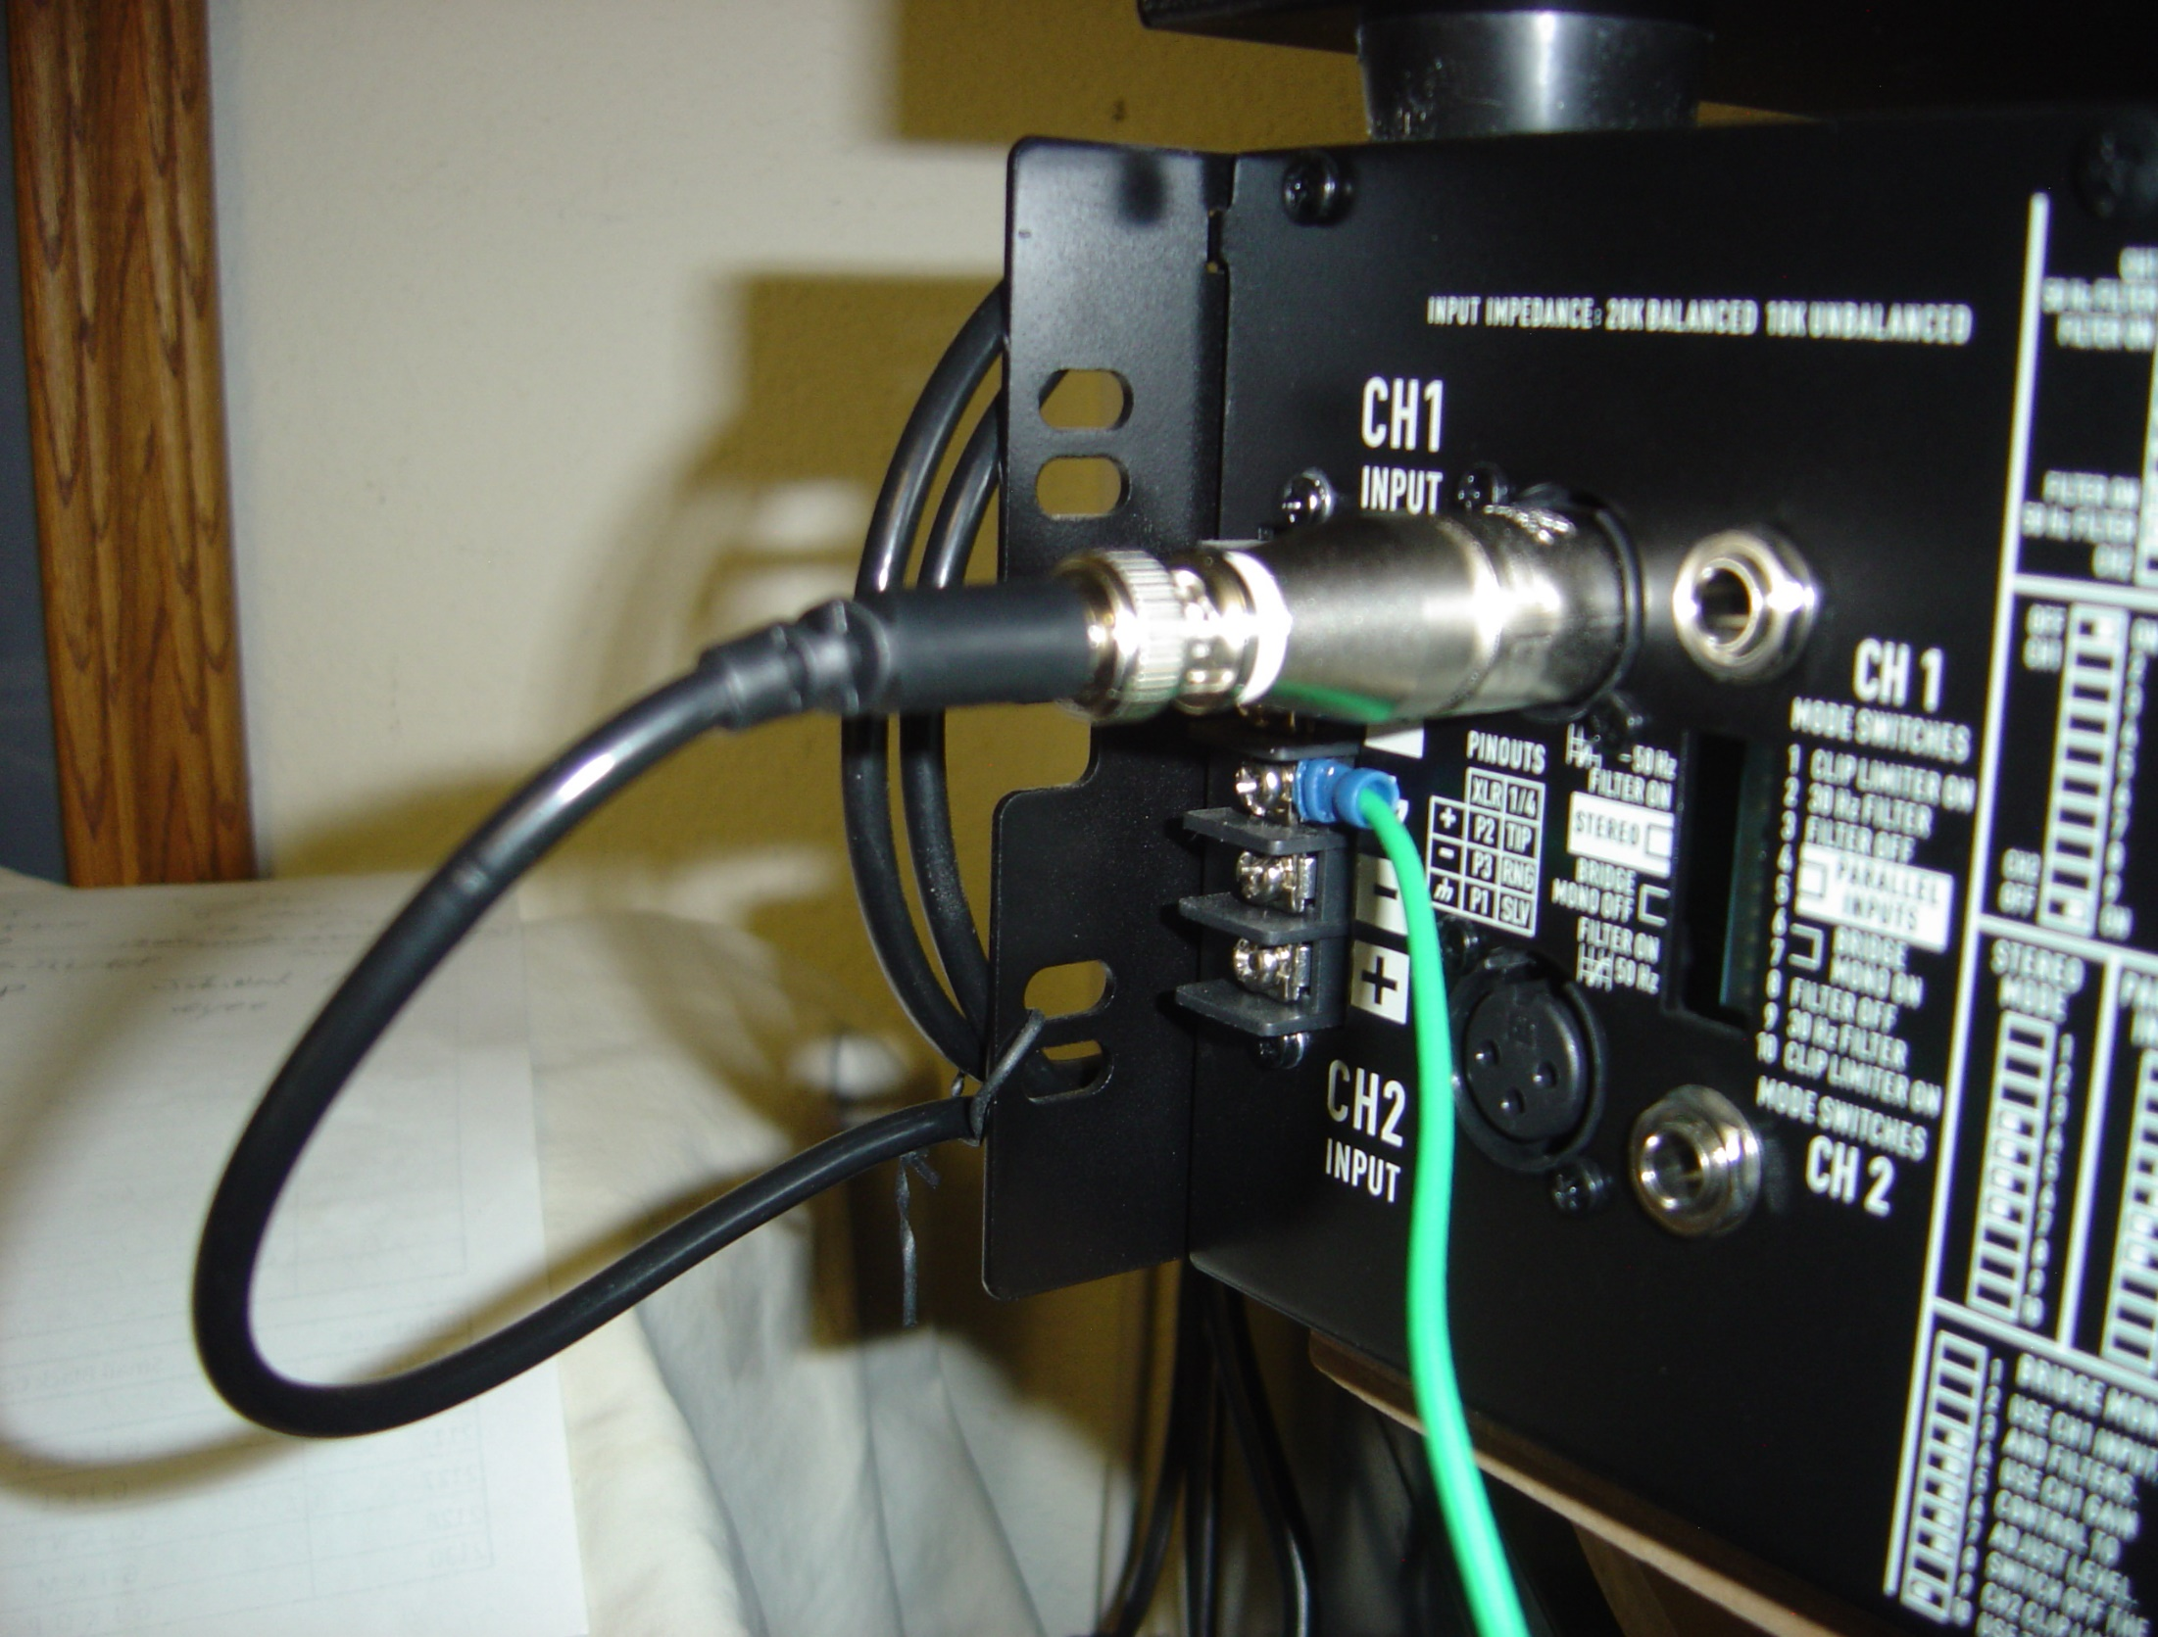
Insert coax cable into chrome adapter then plug adapter into Ch1 Input

Slide 6
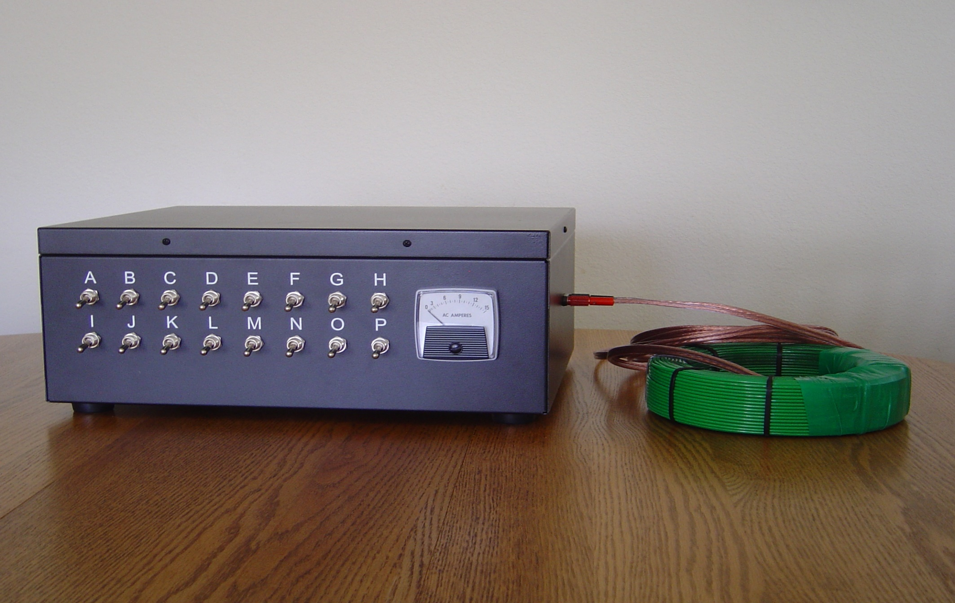
The speaker wire from the coil plugs into the right side of the Doug coil machine.

