Slide 1
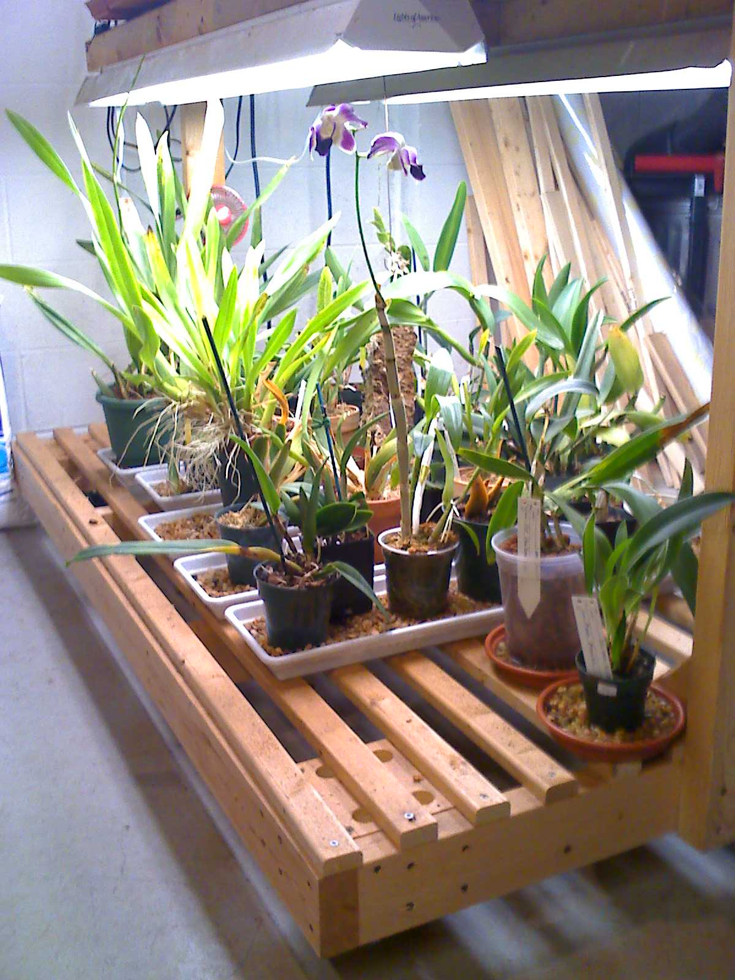
GAOS Grower’s Club
Basics of lighting for Orchids
© Greater Akron Orchid Society

Slide 2
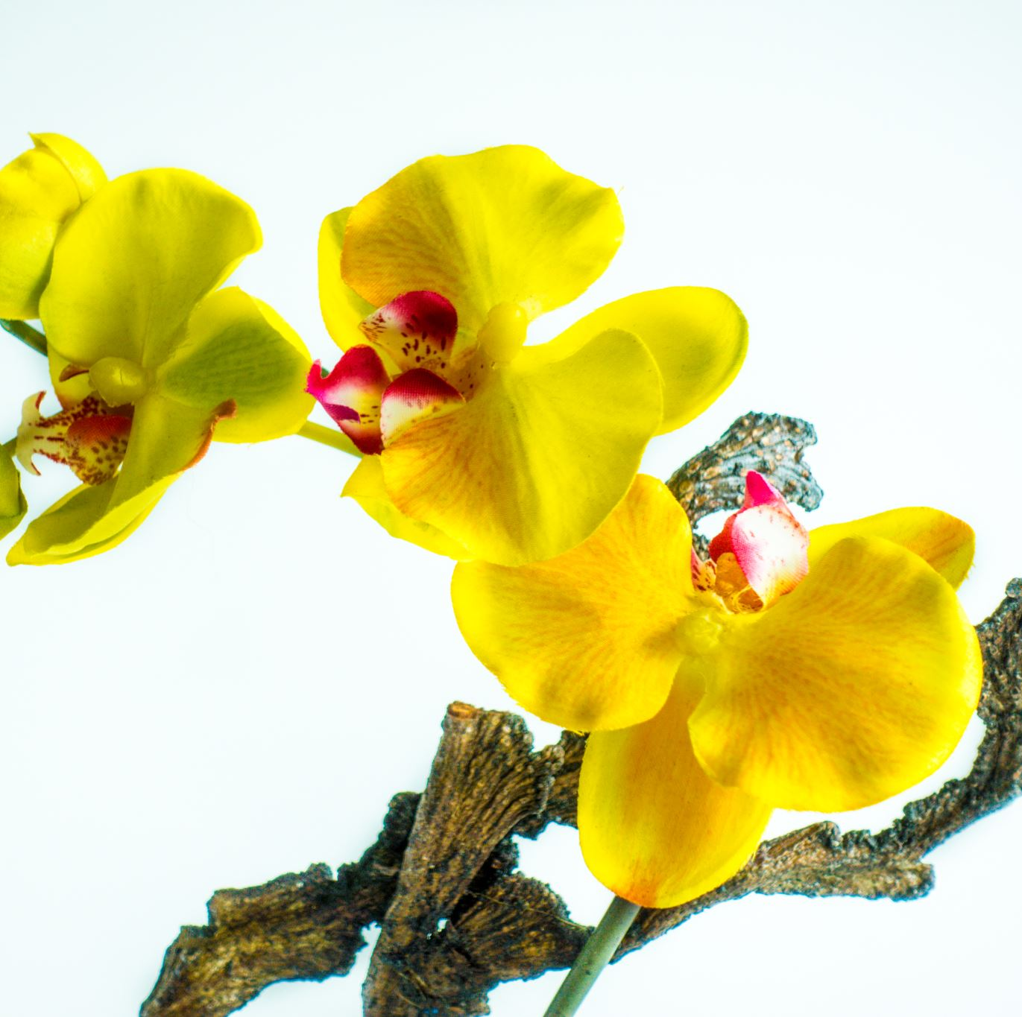
It’s no secret that orchids need the right light to grow and bloom. There are many different sources one can use to provide the right amount of light to your orchids. Sources vary from very sophisticated and expensive to very simple and economical. In this presentation we will gain a basic understanding of grow lights.

Slide 3
Light sources
Flourescent lighting
T12
T8
T5
LED lighting
High Pressure Sodium

Slide 4
Florescent Lighting
1. Three basics types
T12 (code for 1 ½ inch tubes)
Older design – going obsolete – supplies harder to find
Less efficient – older ballasts are less efficient
Less light – still good enough to grow orchids needing less light
Cooler operating temperature
T8 (code for 1 inch tubes)
Newer and more efficient than T12 - quieter
Brighter light
Operate at a higher temp.
T5 (code for 5/8 inch tubes)
Newest and most energy efficient florescent light
Provide brightest light – but still might not be bright enough for some orchids
Operate at a higher temperature – may need to provide cooling to offset heat
Many options available and probably best economical for new lights

Slide 5
LED (Light Emitting Diode)
Newest lighting solution
More expensive to purchase but the most energy efficient
Some lights can be easily changed to adjust spectrum
Very cool operating temperature
Many different sizes and shapes to fight your budget or lighting needs
Can be purchased at local box stores – more commercial versions online
Should use arrays designed for growing

Slide 6
HPS (High Pressure Sodium)
High cost and high energy usage
Provide very high intensity of light
Very warm operating temp.
Were in high favor years ago but not so much now

