Slide 1
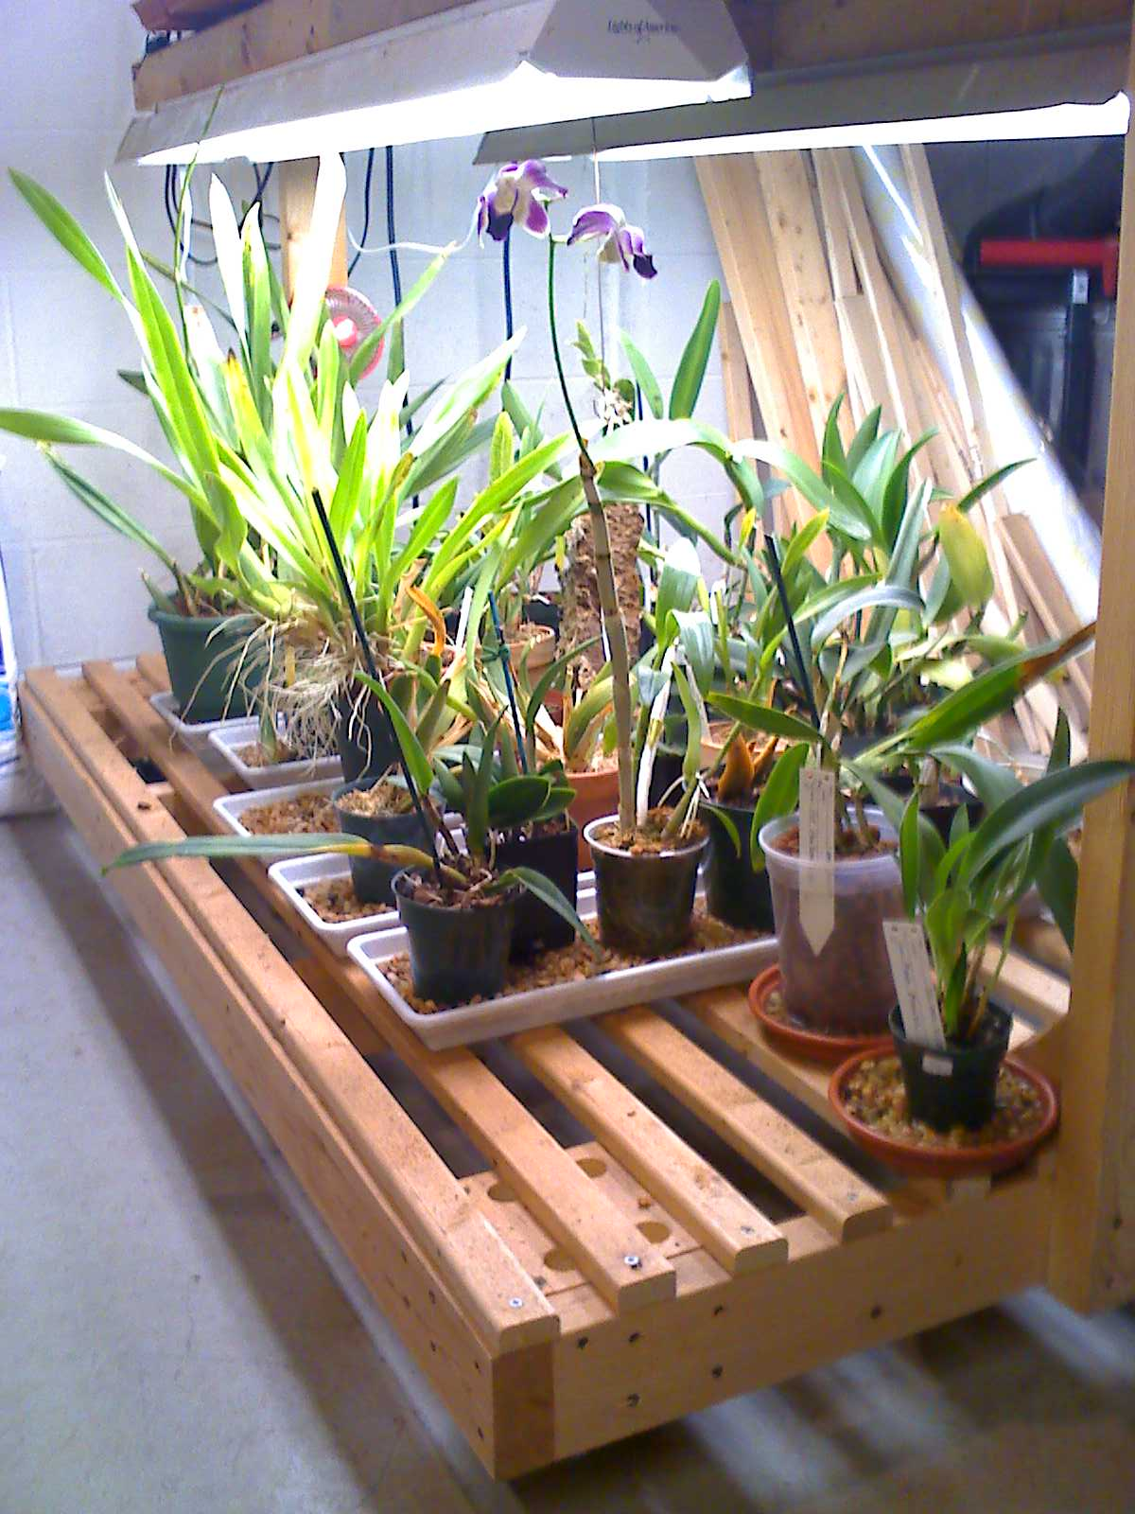
GAOS Grower’s Club
Internet Resources
© Greater Akron Orchid Society

Slide 2
The internet is an invaluable resource for finding vast amounts of information concerning orchids. Almost every topic concerning orchids will yield many sites and sources for your viewing pleasure.

Slide 3
Types of internet resources
Orchid Societies
Orchid vendors
Video clips
Facebook pages

Slide 4
Orchid Societies
American Orchid Society
https://aos.org
Greater Akron Orchid Society
https://thegaos.com
St. Augustine Orchid Society
https://staugorchidsociety.org/

Slide 5
Orchid Vendors
Commercial Growers
https://Marketplace.aos.org
Commercial Suppliers
https://Repotme.com
https://OrchidSupply.com
Etsy
https://www.etsy.com/market/orchids
Ebay
https://www.ebay.com/b/Orchids/19617/bn_7775310

Slide 6
Video Clips
YouTube
MissOrchidGirl
https://www.youtube.com/channel/UC84mfcCFGDPeeBhKbG8dijQ

Slide 7
Facebook Pages
Orchid Growing Under Lights
https://www.facebook.com/groups/1880585768915072
Love for Orchids
https://www.facebook.com/groups/1557219514344832
Orchid Growing For Dummies
https://www.facebook.com/groups/169662454628799
Beginner Orchid Growers
https://www.facebook.com/groups/971064523078328

