Slide 1
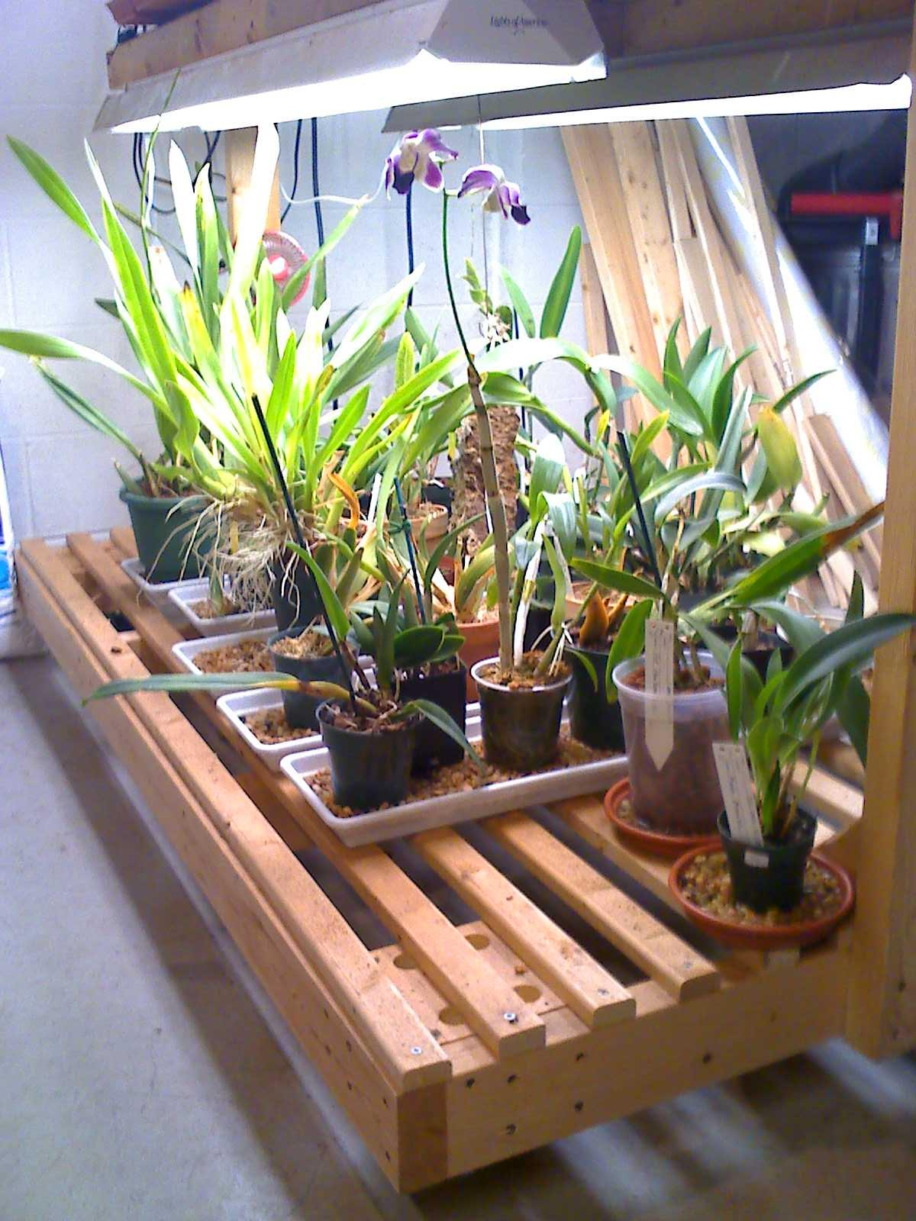
GAOS Grower’s Club
Basics of Pots
© Greater Akron Orchid Society

Slide 2
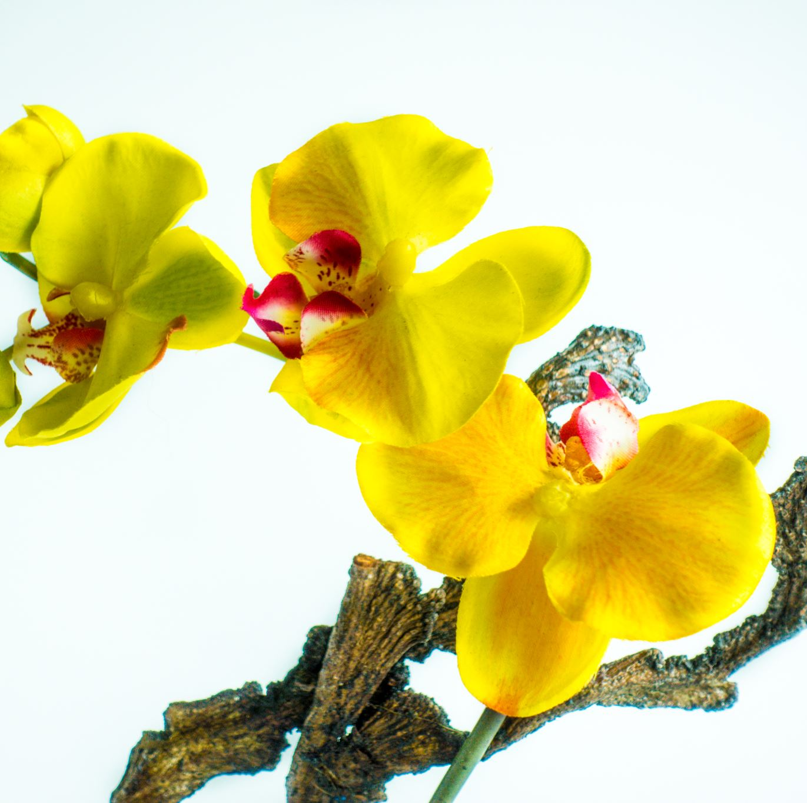
There are many choices to make when selecting new pots for when it come time to report your favorite orchid. Having a wide variety of choices can be a blessing but it can also make your choice a difficult one. Things like size, shape aeration and material all play an important part in the success of healthy orchids.

Slide 3
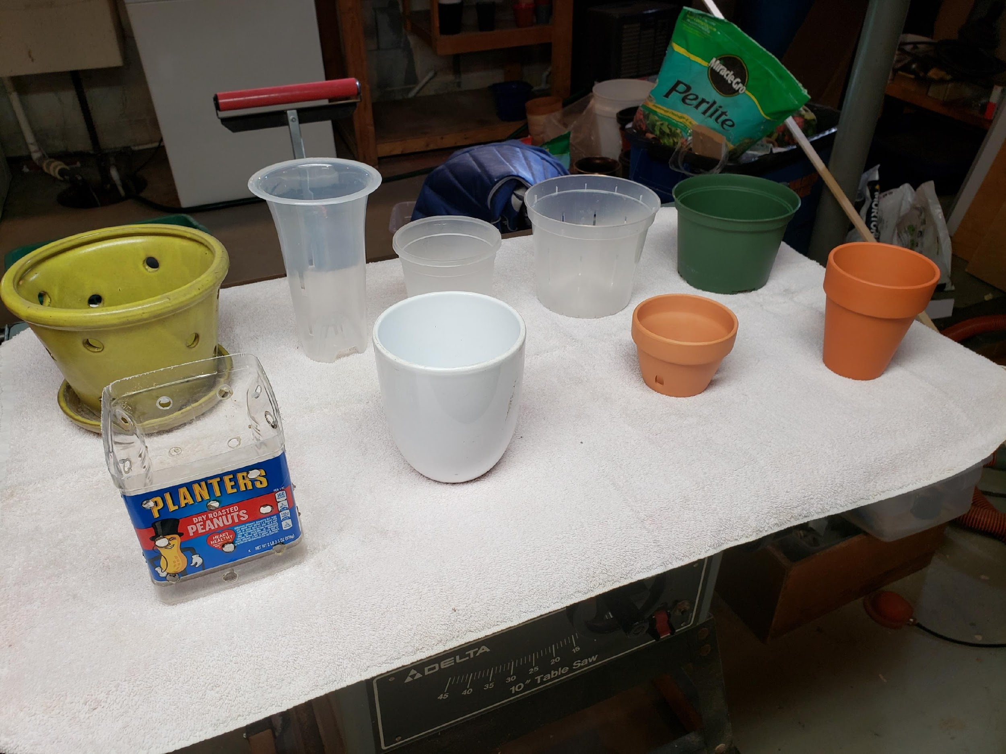
Types of Pots
Plastic .vs. Ceramic
Aerated .vs. Non-aerated
Translucent .vs. Solid
Retail .vs. DIY
Big .vs. Small
Potted .vs. Mounted

Slide 4
Plastic .vs. Ceramic
Plastic is more durable than Ceramic
Ceramic pots can break when dropped, banged.
Plastic is usually more economical than Ceramic
Plastic pots can be found everywhere and are cheaper to produce
Plastic is cheaper to ship.
Plastic is not porous and can be re-used after thorough sanitizing
Soaking in a 5 gallon bucket of bleach water (several tablespoons/5 gallons)
Plastic has large selection in size and color
Plastic pots are manufactured in every color and style
Sizes range from very small to very large and all sizes/shapes in between
Ceramic is porous and will provide additional moisture/humidity to plants.
Water will soak into the pot itself and extends the water cycle for the plant
Ceramic pots are typically one plant pots.
Roots will adhere to pot, forcing you to break pot when repotting
Orchid maladies (virus, disease) can be spread to other orchids when you re-use pot.

Slide 5
Aerated .vs. Non-aerated
Aerated pots allow more air circulation into the plant’s roots (shorten the water cycle)
Non-aerated pots allow no air circulation into the plant’s roots (lengthens the water cycle)
Can be as minimal as poking a couple holes in the pot to using a net pot
The most extreme example of aeration is mounting the plant (no pot)

Slide 6
Translucent .vs. Solid
Translucent pots allow light to penetrate into the roots
Many plants have roots that provide photosythesis
Translucent pots allow you to inspect the roots at all times
New root growth is very noticable
Solid pots are generally cheaper and will do as good as translucent

Slide 7
Retail .vs. DIY
Retail has lots of selection but can be pricey
Retail has much nicer looking pots.
DIY is much less expensive
Repurposing plastic that was already paid for by some other product purchase
DIY takes more time and imagination
Usually, some work must be done to make the pot useful for plants
DIY is much more satisfying
Repurposing plastic that would find it’s way into a landfill

Slide 8
Big .vs. Small
Size is determined by the plant you’re planning to put in the pot
If a plant has outgrown its pot, move up one size.
You don’t want to oversize a plant in its pot.
Most orchids favor their roots being more root-bound.

Slide 9
Potted .vs. Mounted
Mounted plants use no pot at all
Provides a very short watering cycle, typically one day
Many orchids can survive being mounted if they get enough water

