Slide 1
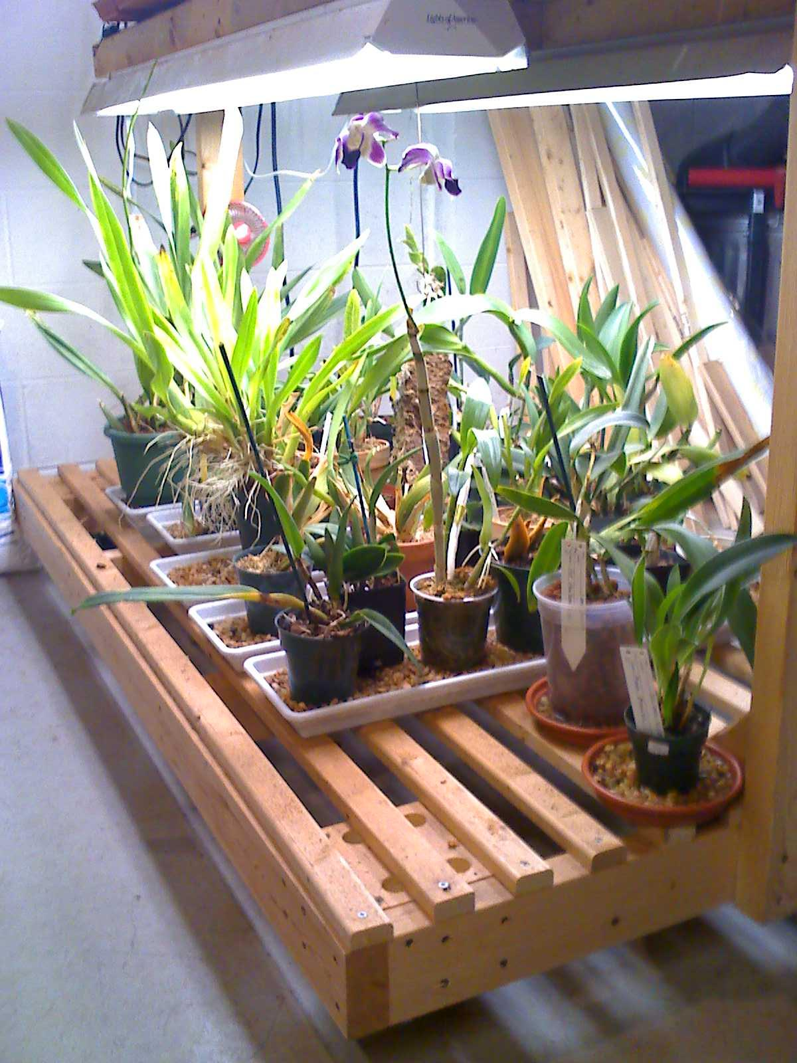
GAOS Grower’s Club
Basics of Water
© Greater Akron Orchid Society

Slide 2

As simple as water sounds, when we use it to nourish our orchids there are some important things to understand when making the decision which type of water is right for your situation. Choosing the right and knowing how to use it can make a big difference for the health of your orchid. Make the right decisions and you’ll be on the road to raising beautiful, blooming orchids!

Slide 3

Types of Water
Rain water
Tap water
Distilled water
Reverse Osmosis (RO) water

Slide 4
Rain Water
Natural, inexpensive source
  Comes from the sky!
  Can be as simple as placing a bucket in the rain
Considered pure (no mineral content)
  Minimizes salt buildup
Choice of fertilizer
  Should use fertilizer specifically formulated for pure water
Considered by many to be the best

Slide 5
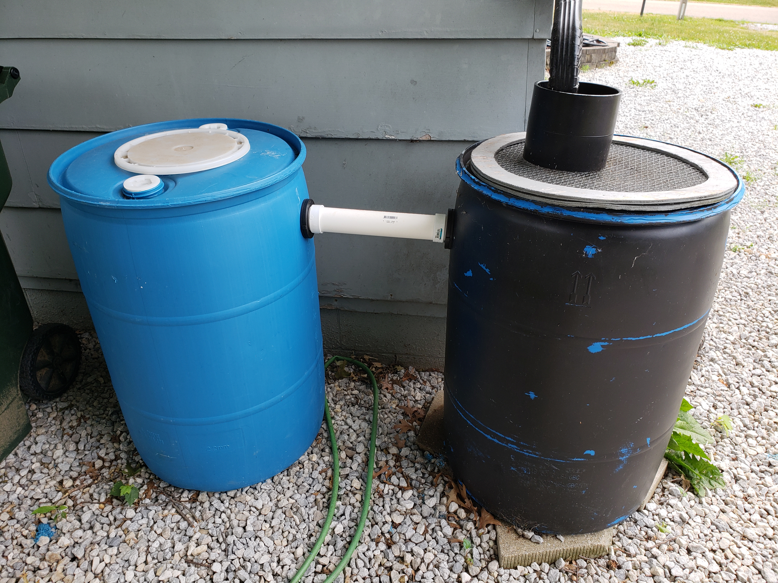

Slide 6
Tap water (well or city)
Easiest source
  Comes right out of your faucet
Not considered pure
  Has varying degrees of mineral content (salts)
  Can lead to burning from salt buildup
  Plants must be flushed periodically to reduce salt buildup
Choice of fertilizer
  Should use fertilizer specifically formulated for tap water

Slide 7
Distilled Water
Considered pure
  Contains a minimum of minerals
Sources include:
  Bottled distilled water from the store
  De-humidifier water
Choice of fertilizer
  Should use fertilizer specifically formulated for pure water

Slide 8
Reverse Osmosis (RO) Water
Most expensive source
  Equipment is required to produce RO water
Considered pure (no mineral content)
  Minimizes salt buildup
Choice of fertilizer
  Should use fertilizer specifically formulated for pure water

Slide 9
Water No-No’s
Softened water
Ice cubes

