Slide 1
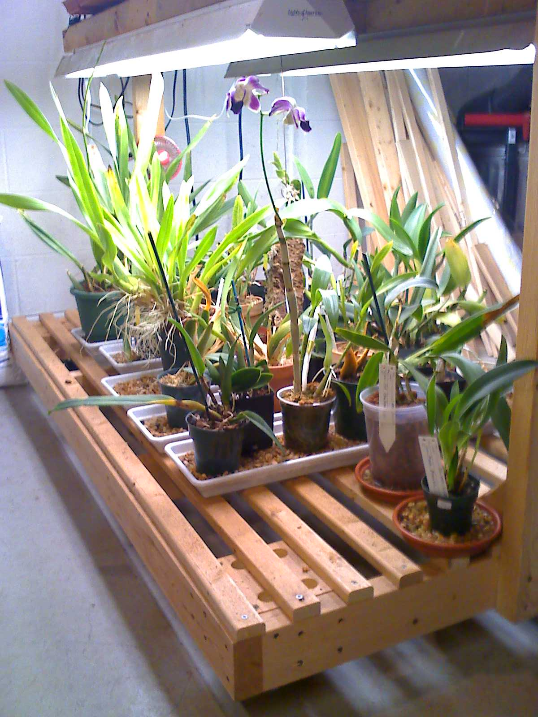
GAOS Grower’s Club
Orchid Pest and Problems
© Greater Akron Orchid Society

Slide 2
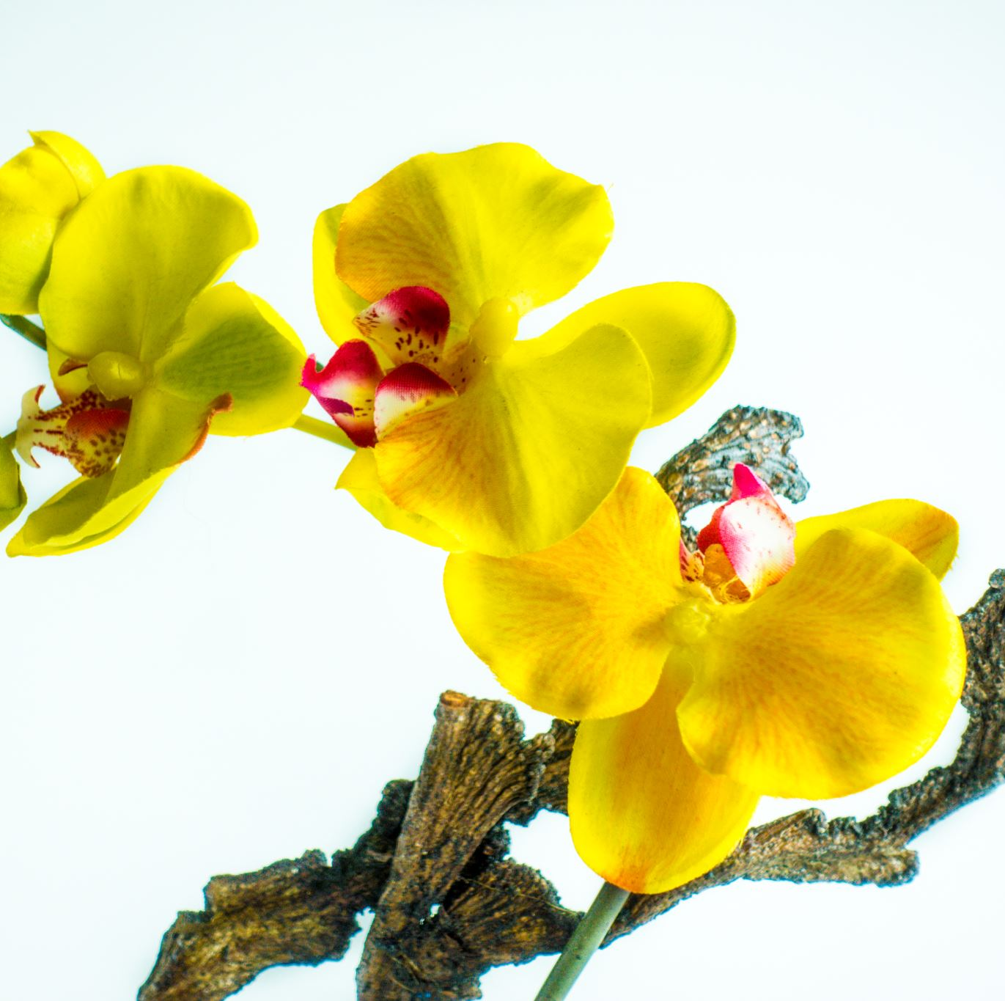
Orchid Ailments
Aphids
Black Rot
Botrytis
Bud Blast
Caterpillars
Cold Damage
Coming in From the Cold
Fertilizer Burn
Fungus Gnats
Growing Under Lights
Handling Damage
Heat Stress
Home Remedies
Lubber Grasshoppers
Mealybugs
Mesophyl Cell Collapse
Mites I
Mites II
Miticides
Neem Oil
Orchid Blossom Midges
Phyllosticta Leaf Spot
Roaches
Rugose Spiraling Whitefly
Scale
Snails and Slugs
Sow Bugs and Pill Bugs
Thrips
Virus
Weeds
White Phalaenopsis Ringspots
Whiteflies

Slide 3

Insects (6 legs)
Mealy bugs, Aphids, Thrips, White flies
Common Insecticides
Topical
Systemic
Rubbing alcohol
Hydrogen peroxide

Slide 4
Arachnids (8 legs)
Mites
Red spider mites
Miticides
Soap based treatments

Slide 5
Slugs or Snails
Are mostly nocturnal so hard to diagnose
Metaldehyde
Iron Phosphate
Copper tape
OTC products may have harmful side effects

Slide 6
Fungus

Slide 7
Virus
Som 30 different virus among orchids
Many different symptoms (too many to list!)
Testing can be done at home but most often done by a service
Most case only cure is to discard the plant
Placing new plants in ‘quarantine’ helps

Slide 8
Presentation
https://register.gotowebinar.com/recording/1793939383962416129

