Slide 1
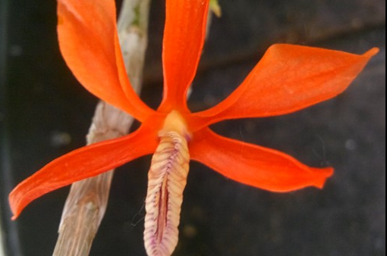
Orchid Basics Series What’s In a Name
© Ohio Orchids 2018

Slide 2
All content may be used without permission for any not-for-profit endeavor focused on educating the public about orchids.
Contact Us at OhioOrchids@gmail.com
© Ohio Orchids 2018

Slide 3
What’s In An Orchid Name
Genus
The first part of any orchid name. Any one of more than 1000 names: Yikes! It always starts with a capital but many times an abbreviation is used.
species or “Grex”
Grex is also known as “Hybrid”. Either of theses is always the second part of the orchid name. Species names start in lowercase, hybrid names start with a capital, most natural hybrids are denoted by a lowercase “x” prior to Grex name and starts lowercase.
Cultivar
Also known as “clonal” name, always enclosed with ‘single quotes’. This epithet is uncontrolled unless an award designation follows the name meaning it has been officially recognized and recorded by a sanctioned organization.
Award Designation
Plants that have been recognized by an official orchid organization, for example the American Orchid Society.
© Ohio Orchids 2018

Slide 4
American Orchid Society (AOS) Flower & Plant Awards
Quality
Awarded to a plant based on high quality flowers. Notation stays with plant, divisions, clones and seedlings. 100 point scale.
Highly Commendable Certificate HCC 75-79 points
Award of Merit AM 80-89 points
First Class Certificate FCC 90-100 points
Cultural
Awarded to a plant based on quality flowers and plant. Award goes to GROWER not plant. 100 point scale.
Certificate of Cultural Merit CCM 80-89 points
Certificate of Cultural Excellence CCE 90-100 points
more information on AOS awards for the American Orchid Society at www.aos.org
© Ohio Orchids 2018

Slide 5
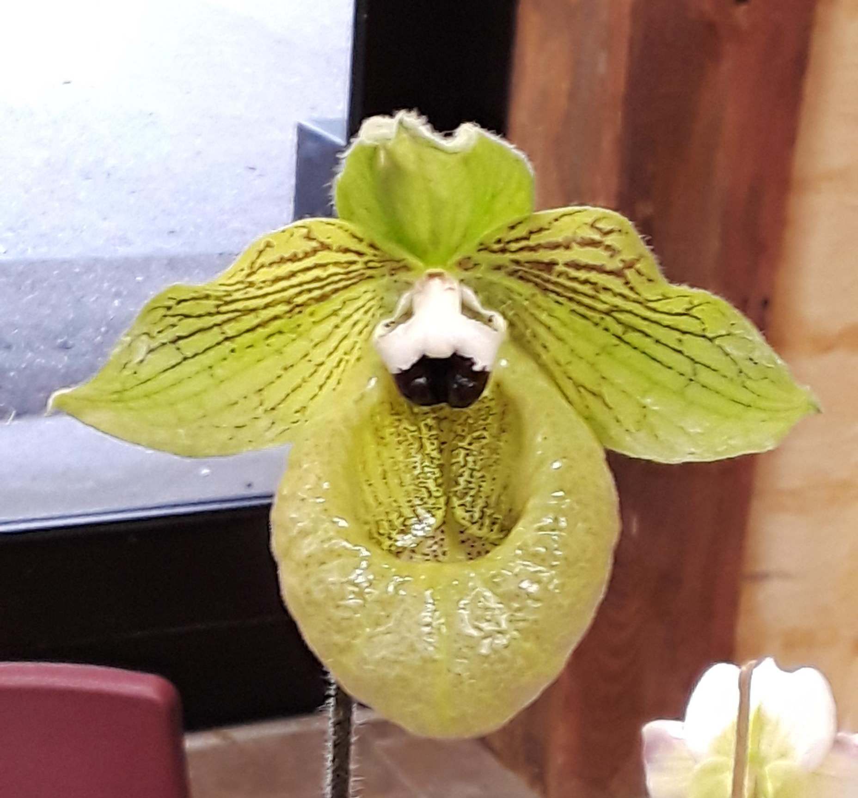
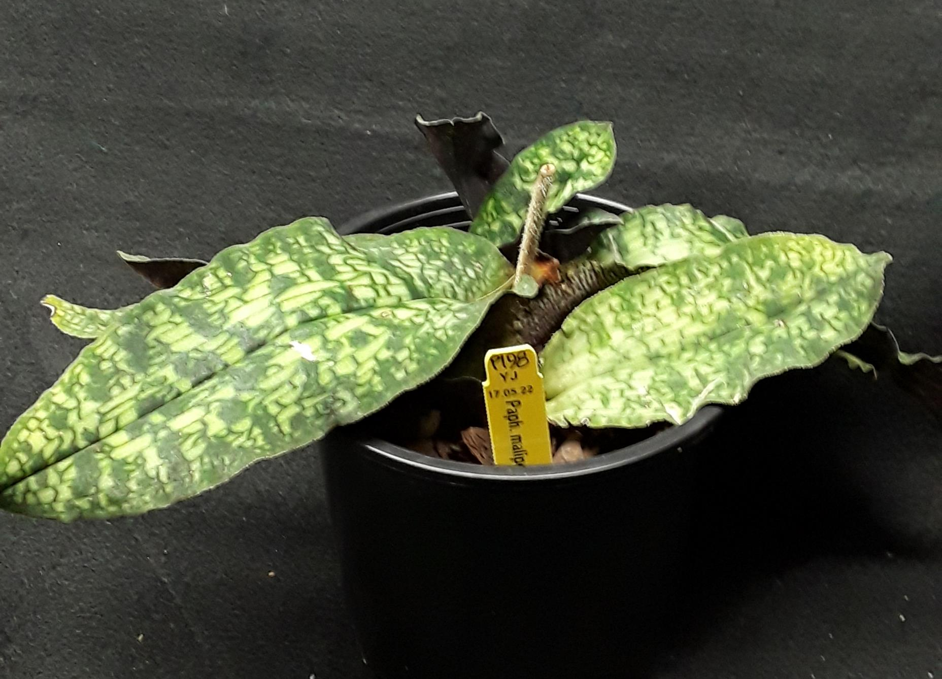
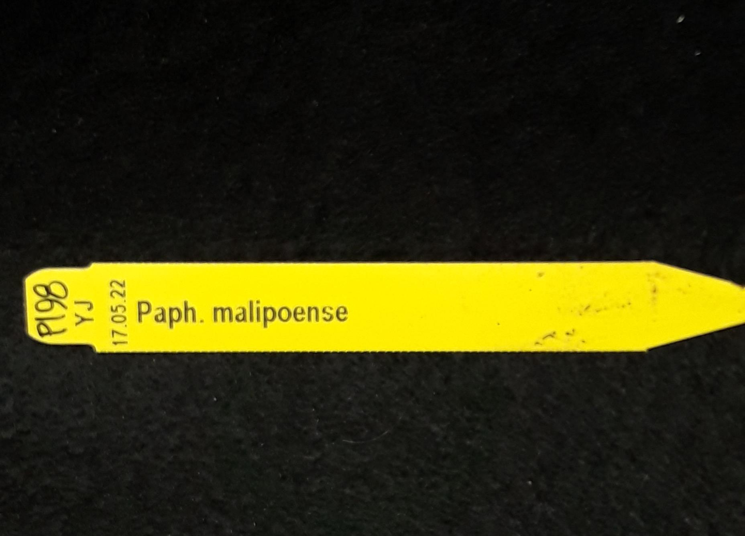
Genus:
Paphiopedilum (Paph.)
species:
malipoense
© Ohio Orchids 2018

Slide 6
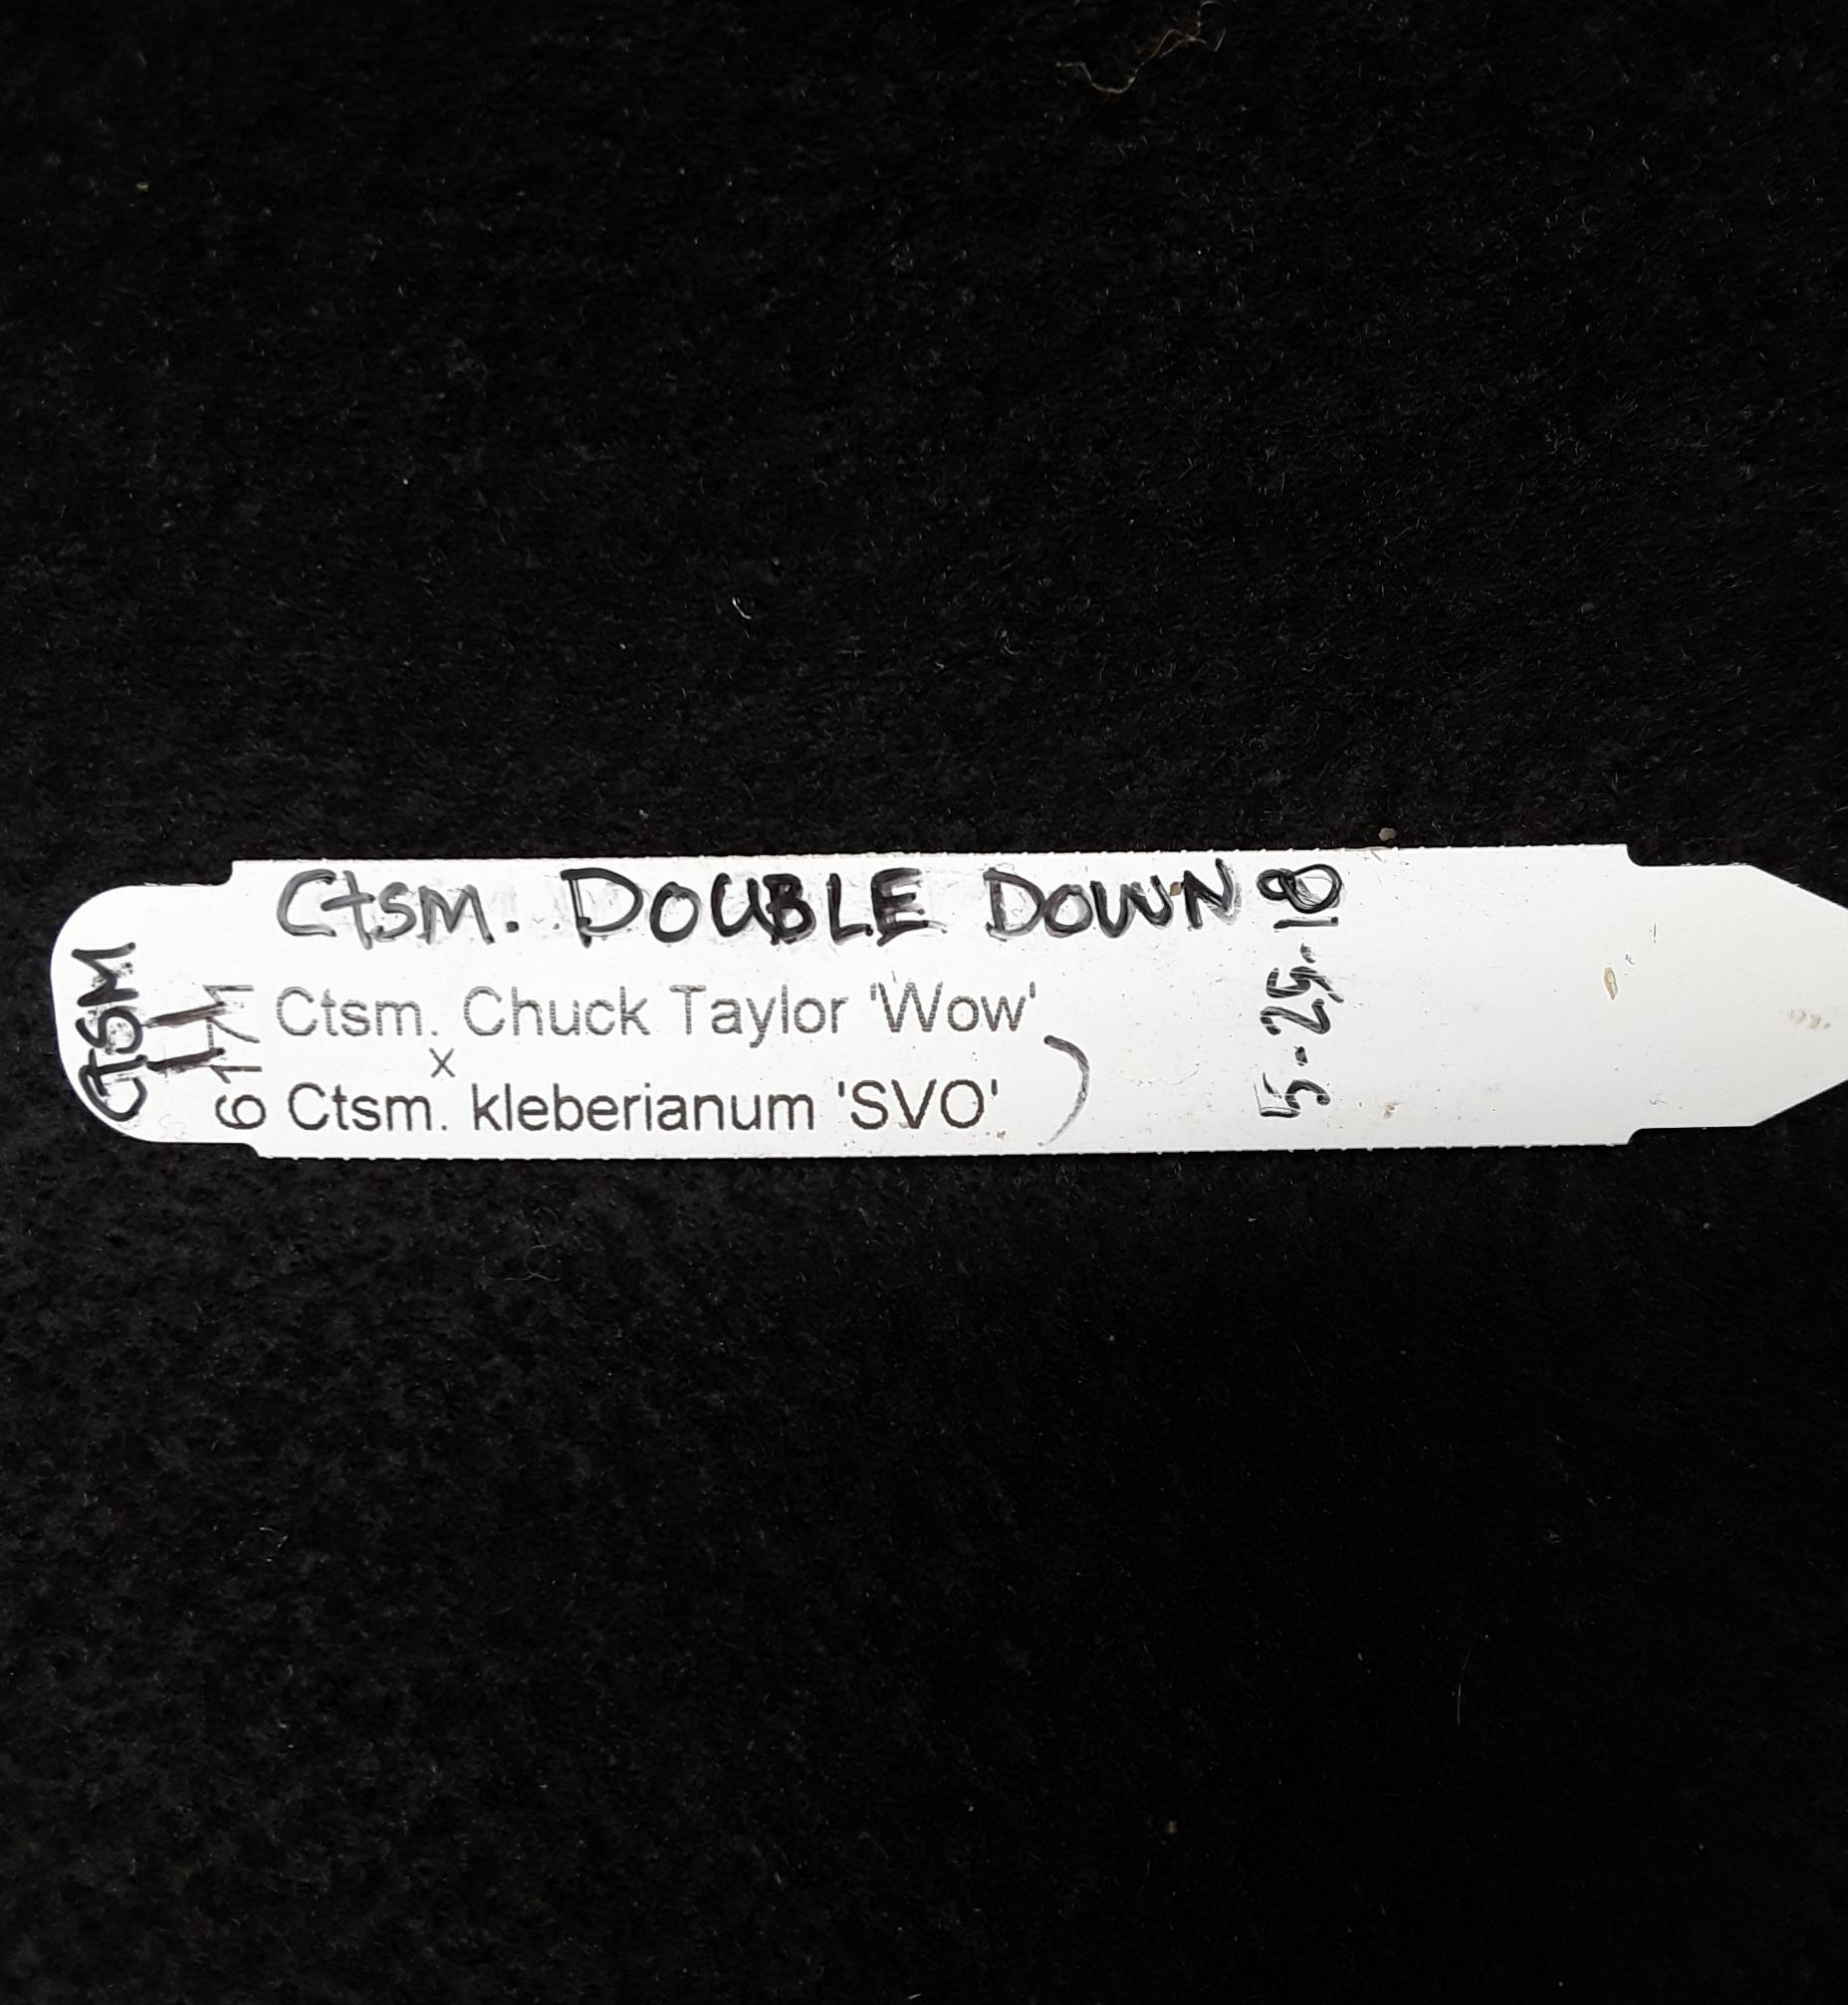
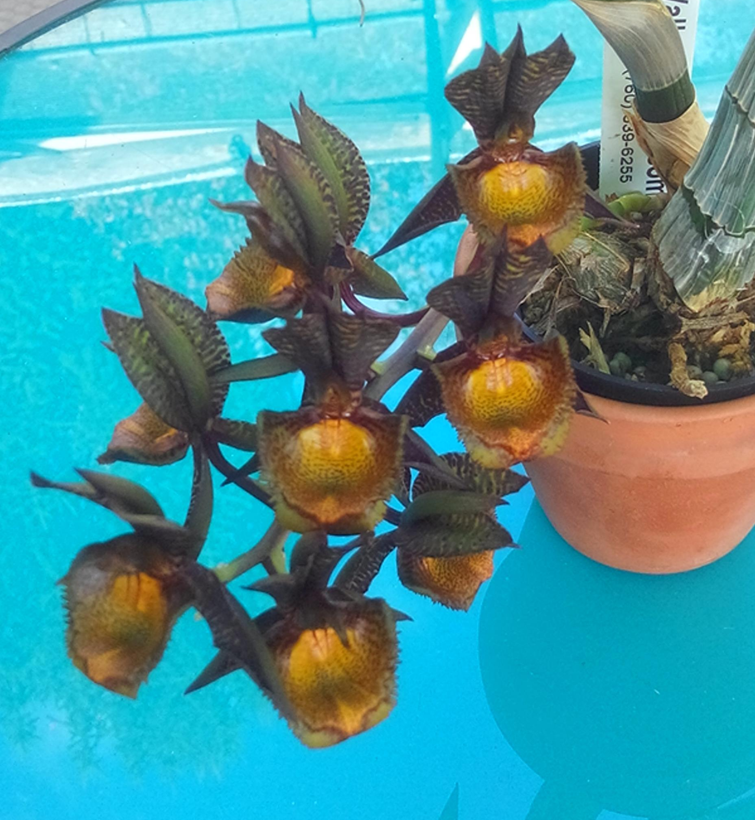
Catasetum Double Down
Genus:
Catasetum (Ctsm.)
Hybrid/Grex:
Double Down
Parents:
Catasetum Chuck Taylor ‘Wow’
crossed with
Catasetum kleberianum ‘SVO’
© Ohio Orchids 2018

Slide 7
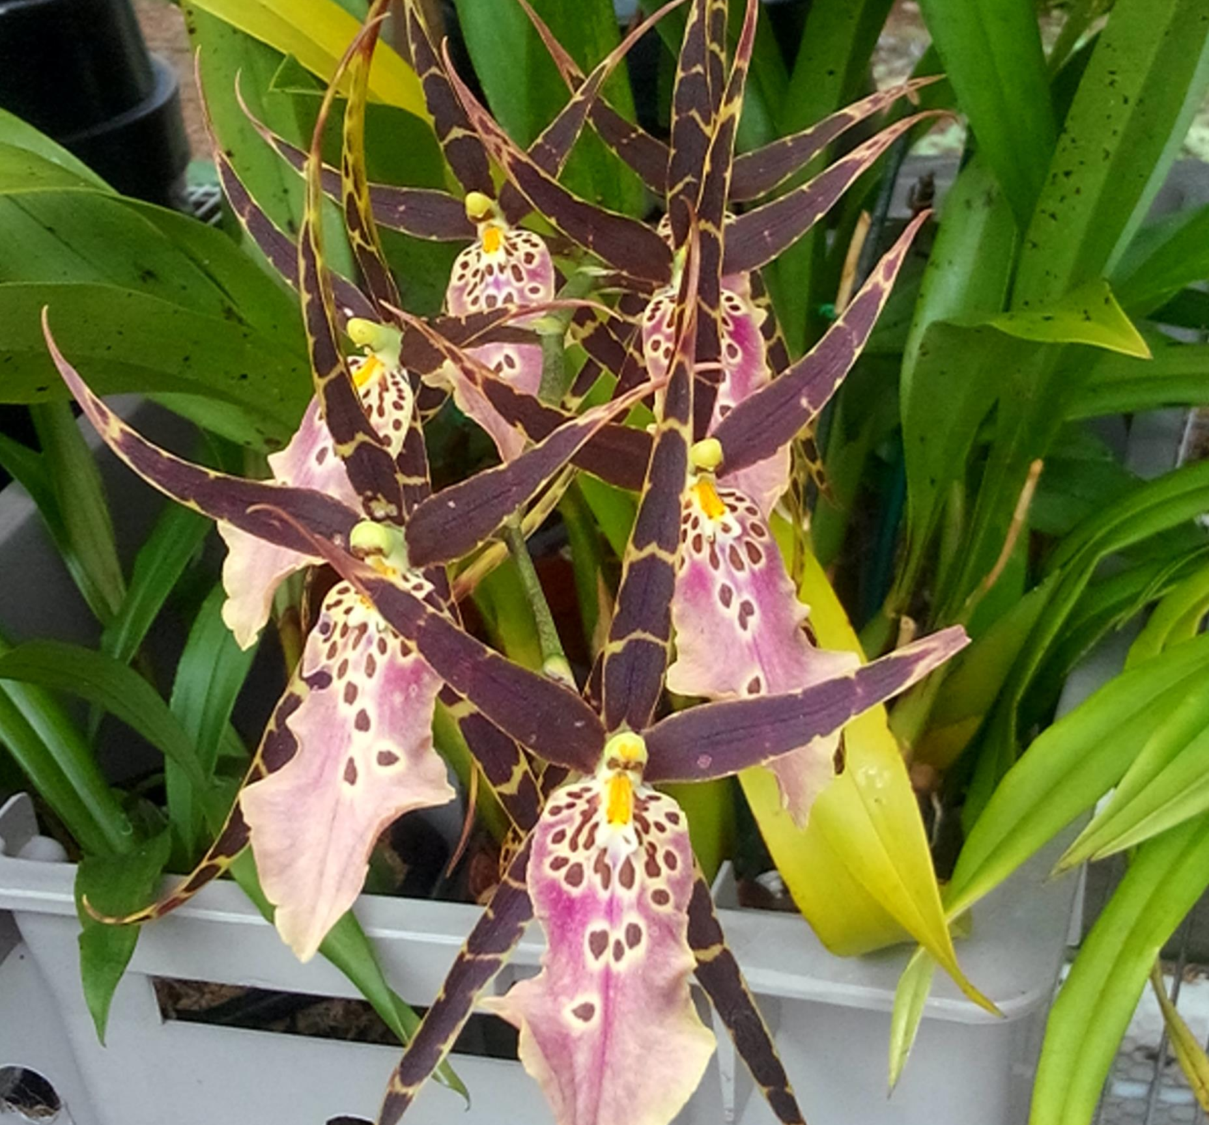
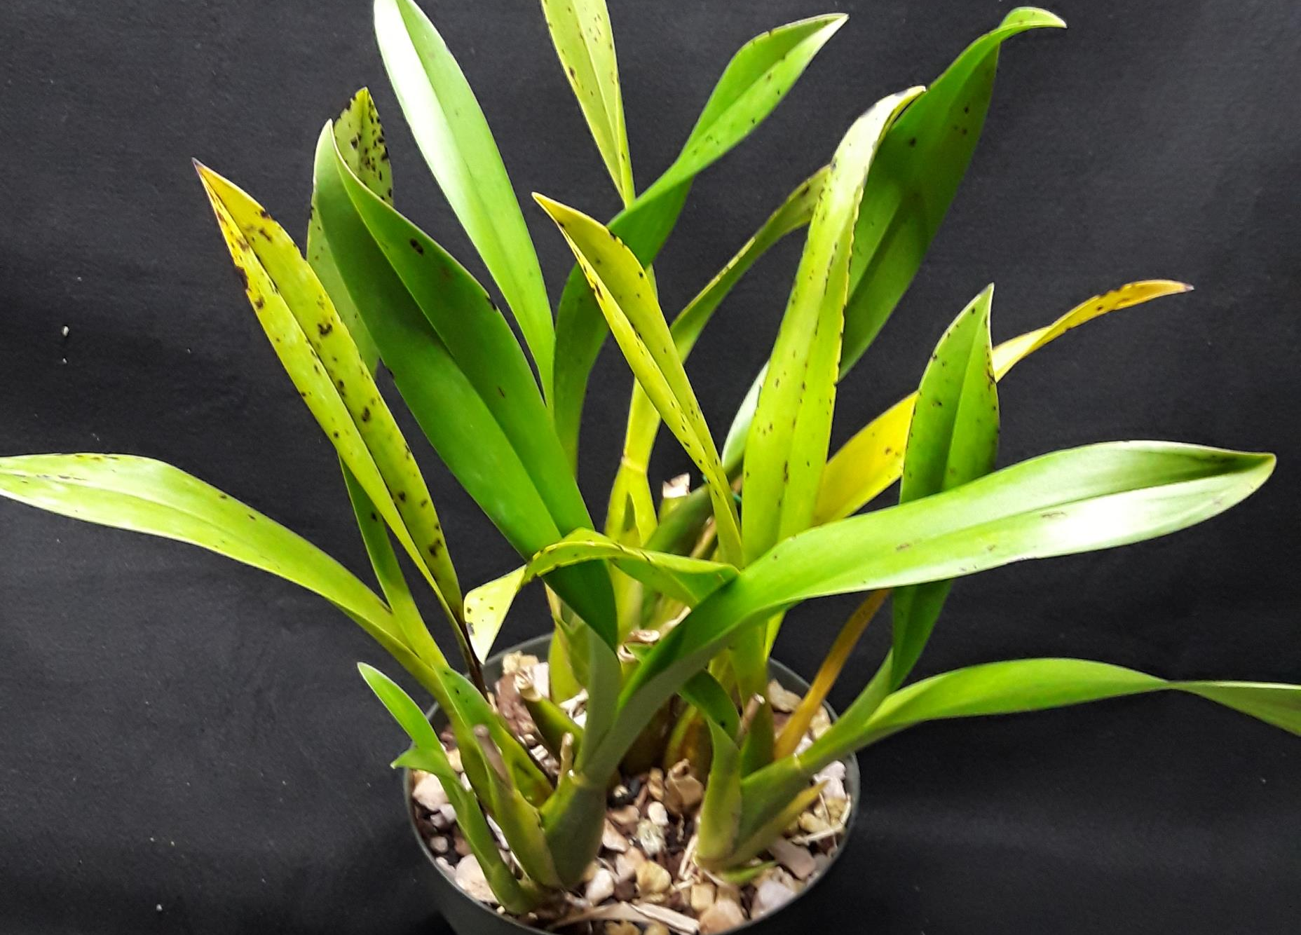
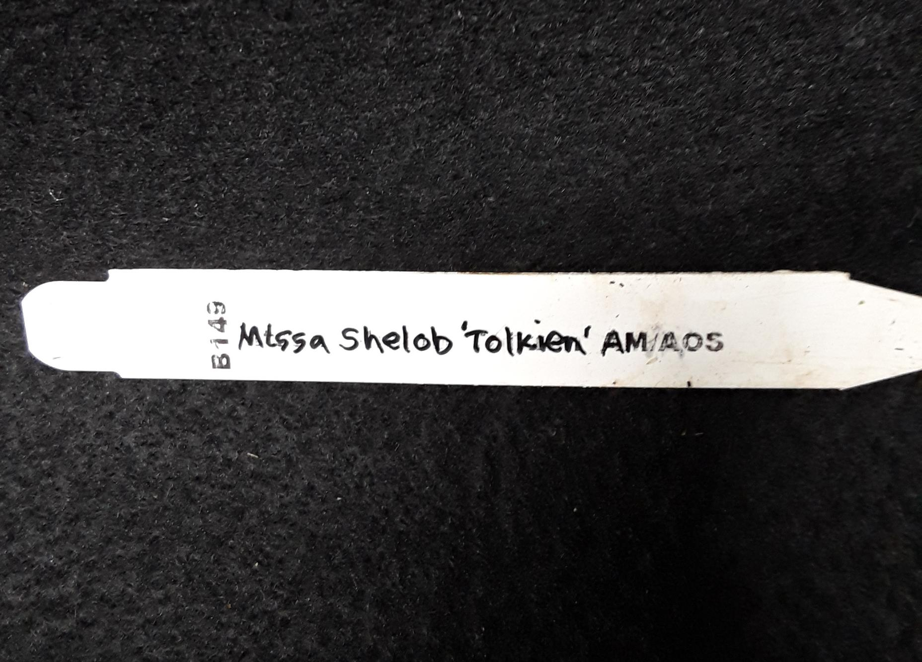
© Ohio Orchids 2018
Genus:
Miltassia (Mtssa.)
Hybrid/Grex:
Shelob
Clonal/Cultivar:
Tolkien
after being recognized as AM quality by American Orchid Society

Slide 8
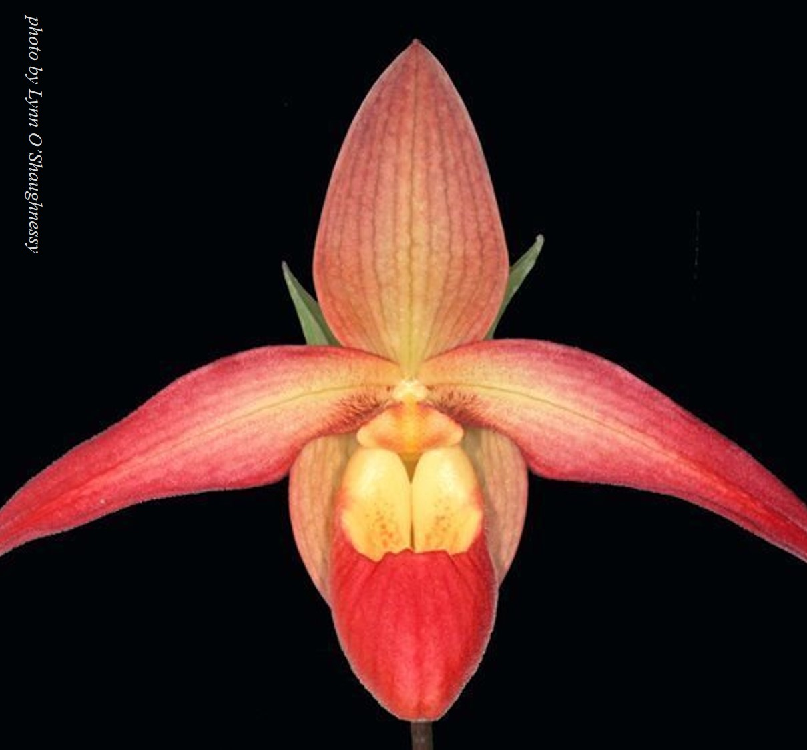
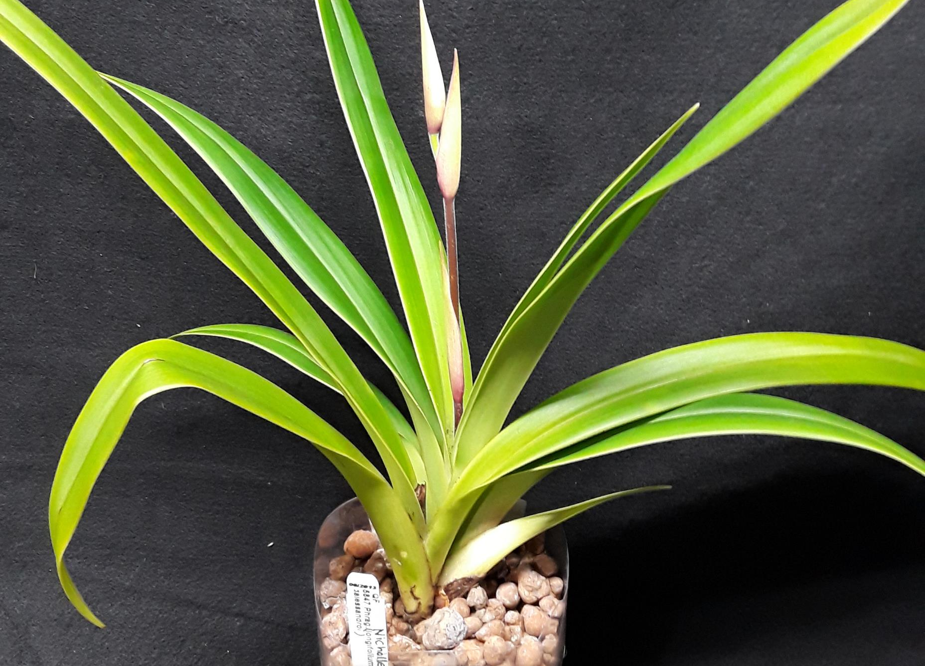
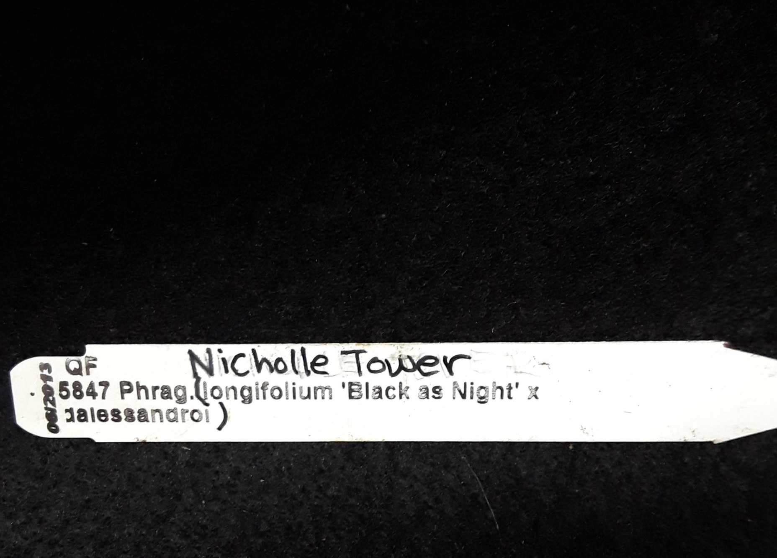
Genus:
Phragmipedium (Phrag.)
Hybrid/Grex:
Nicholle Tower
© Ohio Orchids 2018
Parents are in (parentheses)

Slide 9
Further Reading on Public Internet
International Orchid Register hosted by Royal Horticultural Society
American Orchid Society at www.aos.org
Mid-America Orchid Congress at www.midamericanorchids.org under the Judging menu tab
Happy Orchiding
from Ohio Orchids
© Ohio Orchids 2018

