Slide 1
Be a Paleoanthropologist for a Day!
Paleoanthropology: The study of human origins includes two main branches:
Paleontology → the study of ancient life
Physical Anthropology → the study of human development in the context of primates

Slide 2
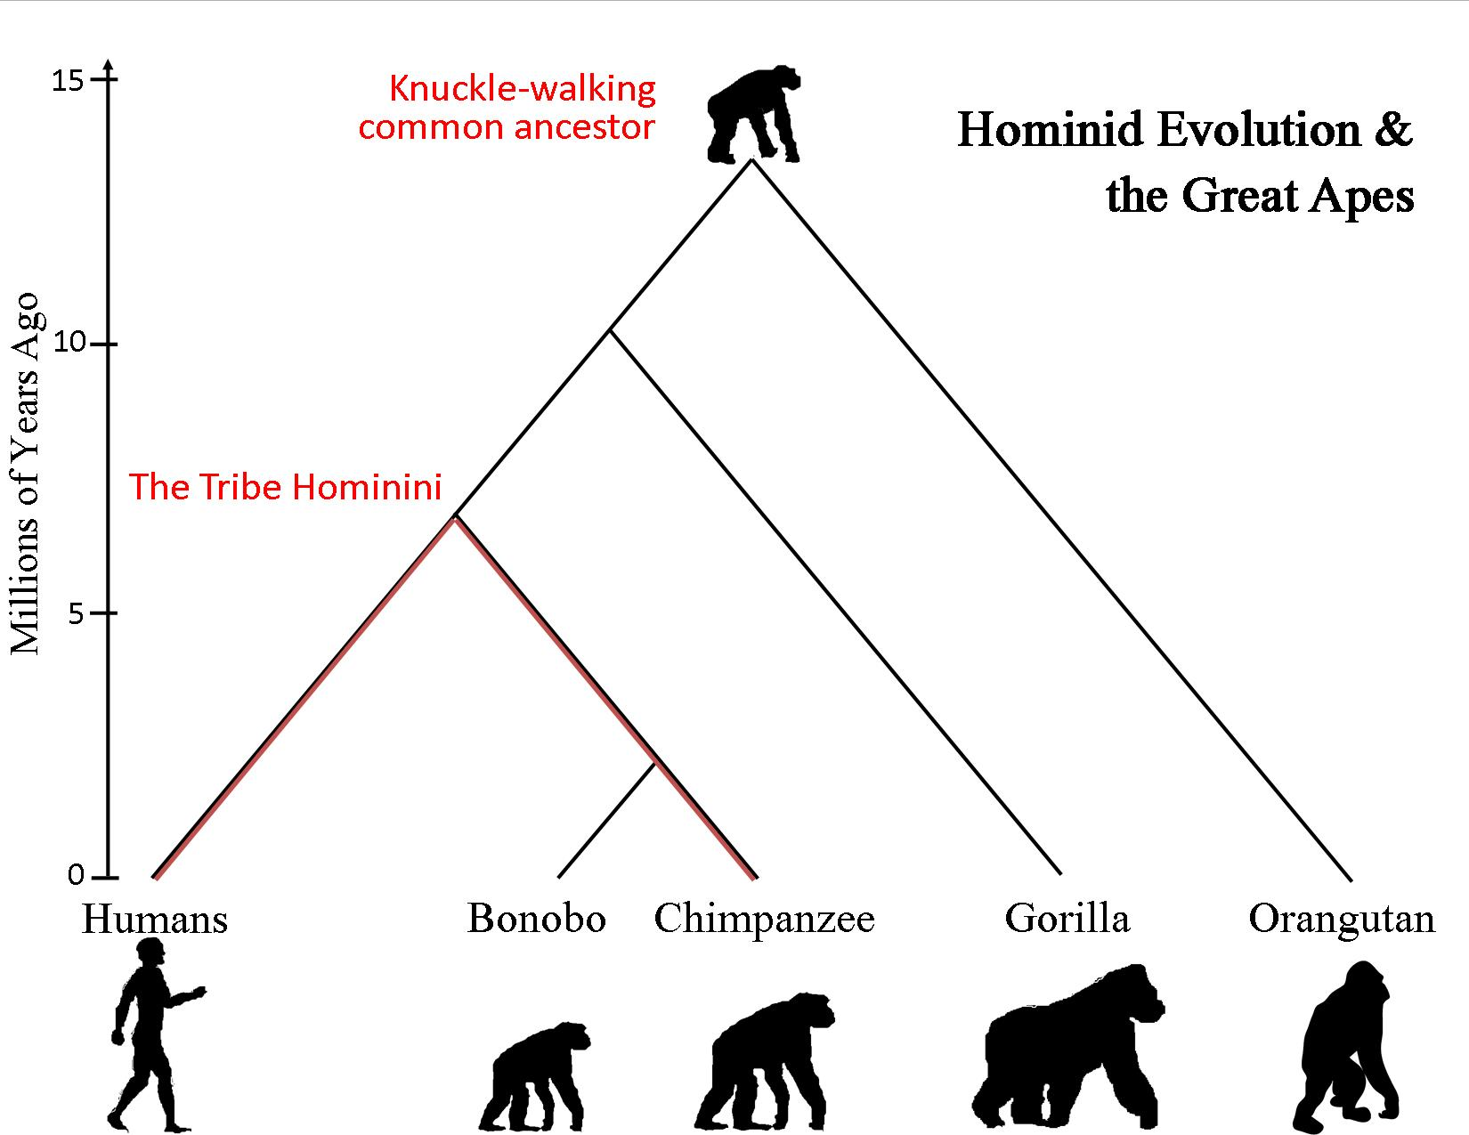
Hominid or Hominin?
Hominids descend from the common ancestor of all Great Apes
Hominins are a part of the lineage leading to Homo sapiens

Slide 3
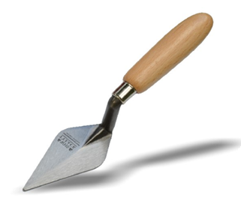
Fossilization and Excavation
Permineralization- most common process where minerals in the sediment seep into broken down bone and soft tissue
Excavation process:
Survey (Test Pits and Geomapping: A. Sebida)
Excavation (Planning and Gridding)
Lab Analysis
A trowel

Slide 4
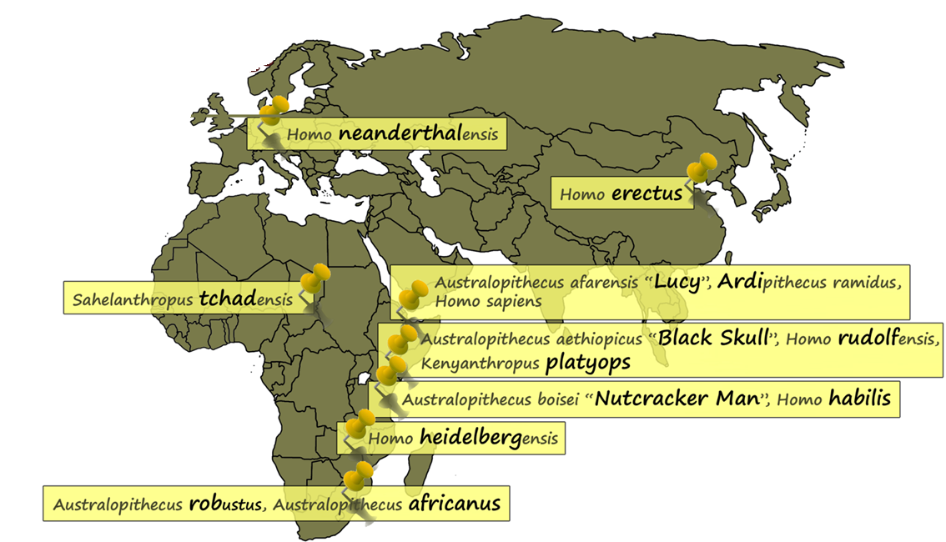
Hominin Species and Site Locations
The Great Rift Valley

Slide 5
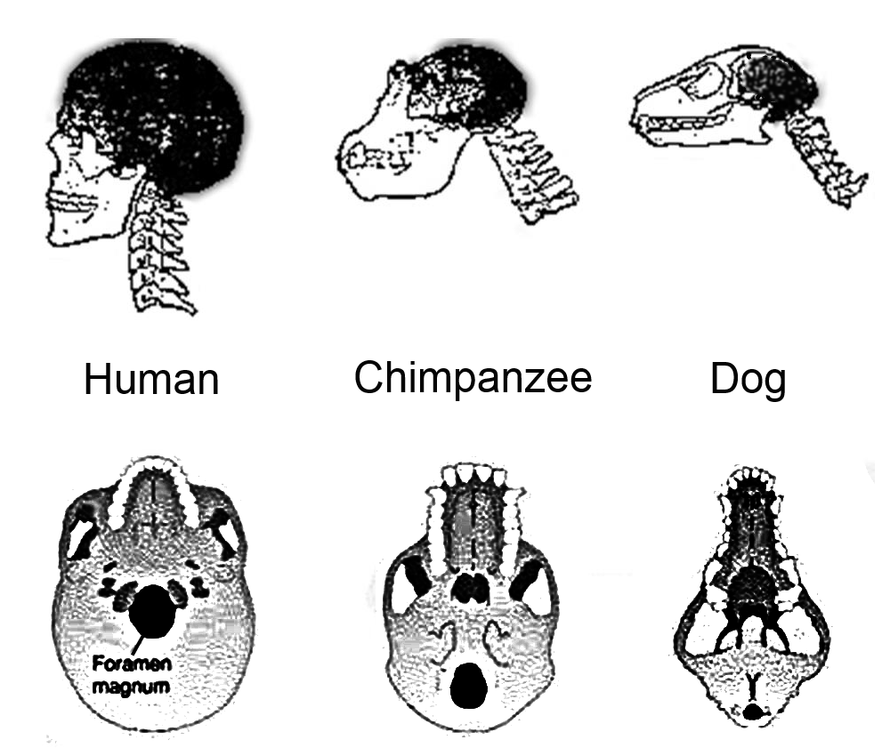
Morphological Changes – Upright Stature
Spine and position of Foramen Magnum

Slide 6
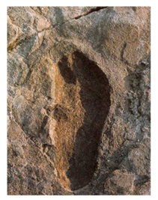
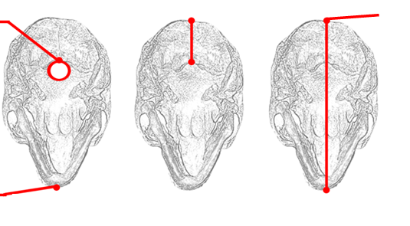
Morphological Changes – Upright Stature
Quadrapedalism → Bipedalism
Arborealism- Living in trees
Laetoli Footprints (3.6 MYA) →
Foramen Magnum- The “Big Hole”, meeting point of spine and cranium
Opisthion Index- Ratio of the Foramen Magnum position to the total cranial length
Opisthion
Opisthiocranion
Orale

Slide 7
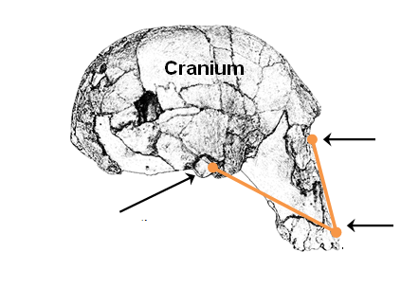
Morphological Changes – Facial Prognathism
Prognathism- The protrusion of the face and jaw, pronounced in the genus Australopithecus
Orthognathism- tendency for a flat face, seen in humans
Maxilla- A paired bone that forms the upper jaw
Zygomatic Process- Facial bone connecting the cheek bones to the side of the cranium
Nasion- Concavity at the bridge of the nose
Maxillary Angle: Acute angle formed by 3 points of upper jaw
Nasion
Meeting of lower jaw, below zygomat
Tip of Maxilla, above teeth

Slide 8
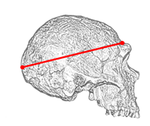
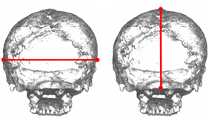
Morphological Changes – Cranial Capacity
Cranium- Portion of the skull housing the brain
Frontal Lobe- Brain region responsible for problem solving, memory, and language
Estimation Technique- A sphere within a cube:
-spherical volume = 0.524 x cubic volume
Length
Width
Height

Slide 9
 | Bipedalism |  |  | Prognathism | CC
Name | Opisthocranion- opisthion distance (cm) | Opisthocranion- orale distance (cm) | Opisthion index | Maxillary angle (°) | Height | Width | Length | Cranial capacity (cm³)
Ardipithecus ramidus | 3.4 | 14.5 | 23 | 33 | 7.5 | 8.7 | 10.3 | 268
Australopithecus aethiopicus | 4.5 | 21.6 | 21 | 20 | 6.9 | 10.4 | 13.7 | 393
Australopithecus afarensis | 3.2 | 16 | 20 | 37 | 8.5 | 9.4 | 12.6 | 402
Australopithecus africanus | 3 | 16.8 | 18 | 30 | 9.4 | 8.8 | 12.5 | 413
Australopithecus boisei | 4 | 19.8 | 20 | 35 | 9 | 11.3 | 15 | 610
Australopithecus robustus | unmeasurable |  |  | 33 | unmeasurable
Homo erectus | 5.2 | 20 | 26 | 51 | 10.5 | 13.2 | 17.4 | 964
Homo habilis | 3.3 | 15.4 | 21 | 44 | 10 | 10.2 | 12.8 | 522
Homo heidelbergensis | 4.8 | 19.5 | 25 | 44 | 11 | 12.7 | 16 | 894
Homo neanderthalensis | 5.8 | 22.2 | 26 | 48 | 14 | 14.5 | 17.8 | 1445
Homo rudolfensis | unmeasurable |  |  | 38 | 9 | 11.5 | 16 | 662
Homo sapiens | 5.5 | 18.6 | 30 | 54 | 14.5 | 14 | 17.5 | 1421
Kenyanthropus platyops | 3.2 | 17.7 | 18 | 37 | 9.5 | 11 | 11.8 | 493
Sahelanthropus tchadensis | 2.5 | 17.2 | 15 | 46 | 8.2 | 9.5 | 13.3 | 414

Slide 14
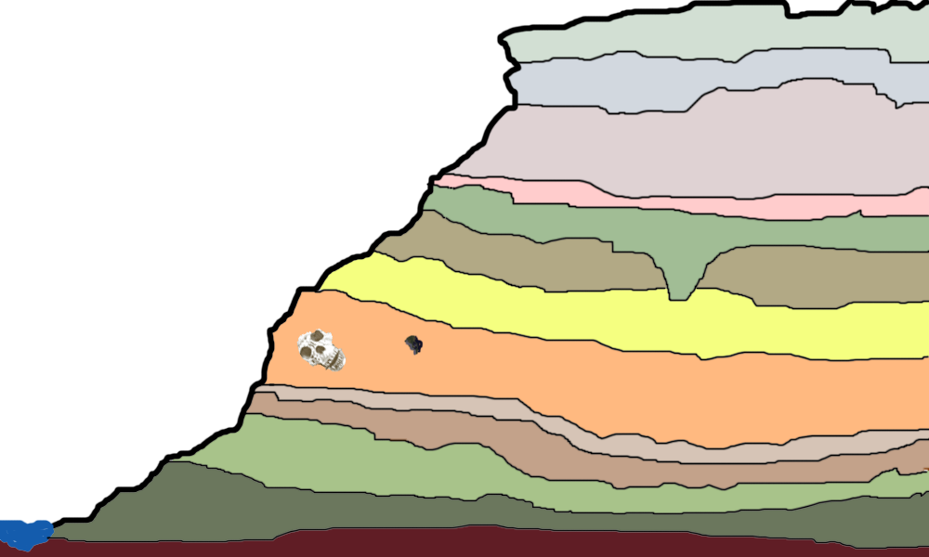
Dating Methods:
-Radio Carbon Dating
-Carbon14-carbon12 ratio decays overtime in terms of half-lives
-Argon-Argon Dating
-Relative method measuring adjacent mineral isotopes
Stratigraphy:
Radioactive Mineral
Artifact

Slide 15
