Slide 1
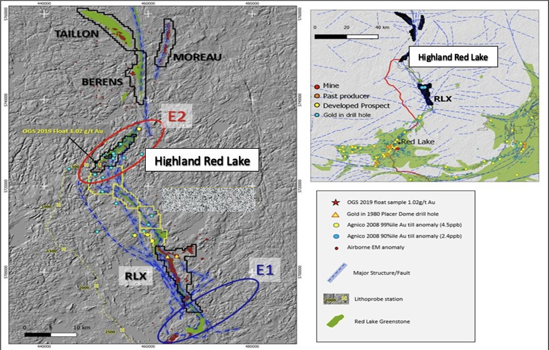
Figure 1: Land position in the northern extension of the Red Lake Gold Camp

Slide 2
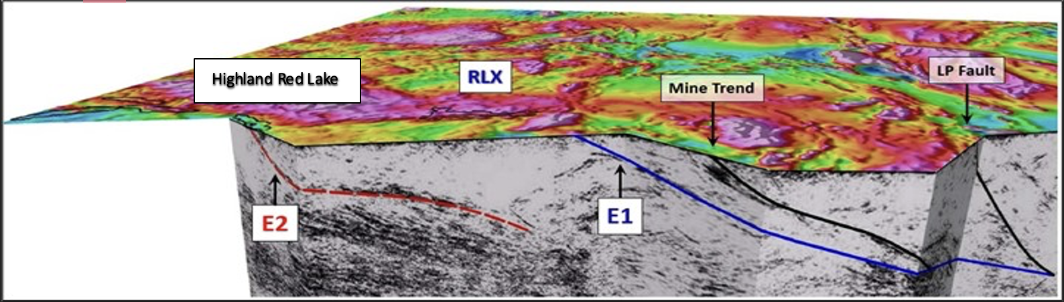
Figure 2: Regional section of interpreted seismic data (1) and major structures that underline;
  the LP Fault discovered by Great Bear Resources and used as their exploration model resulting in a major discovery, Great Bear then taken-over by Kinross Gold
  the Mine Trend (currently the richest Red Lake gold mining & production area) and
  the E1/ E2 structures that come to surface at the northern extensions of the Camp.

