Slide 1
The Pursuit of Perfection
“You shall be perfect with Yahuah your Alahym.”
Dabarym 18:13

Slide 2
Pursuit
the act of following or pursuing someone or something)
chasing or following in order to catch or attack
pursuit suggests a trade, profession, or a vocation followed with zeal or steady interest

Slide 3
What is Perfection?
Completing the requirements
To be complete; to be whole, fully developed, totally righteous
Lacking nothing

Slide 4
Tamym
There are nine scriptural Hebraic words for perfect. The perfect in the record of Abraham in Barashyth 17:1 is tamym and this word is used ninety-one times in the biblical text. (blueletterbible.org)
H8549 Tamym: entire, integrity, truth – without blemish, complete, full, perfect, sincerely, undefiled, upright, etc.
H8552 Tamam: to complete – accomplish, cease, be clean (pass-)ed, consume, have done, come up the full, etc.
“You shall be perfect with Yahuah your Alahym.”
Dabarym 18:13
“Mark the perfect the man and behold the upright, for the end of that man is peace.”
Tahalym 37:37

Slide 5
Enoch Barashyth Chapter 5:19-24
And after he brought forth Enoch, Yereḏ lived eight hundred years, and brought forth sons and daughters. So all the days of Yereḏ were nine hundred and sixty-two years, and he died. And Enoch lived sixty-five years, and brought forth Methushelah. And after he brought forth Methushelah, Enoch walked with Alahym three hundred years, and brought forth sons and daughters. So all the days of Enoch were three hundred and sixty-five years. And Enoch walked with Alahym. Then he was no more, for Alahym took him.

Slide 6
Nuach Barashyth 6:4-9
The Nephilim were on the earth in those days, and also afterward, when the sons of Elohim came in to the daughters of men and they bore children to them. Those were the mighty men who were of old, the men of name. And Yahuah saw that the wickedness of man was great in the earth, and that every inclination of the thoughts of his heart was only evil continually. And Yahuah was sorry that He had made man on the earth, and He was grieved in His heart. And Yahuah said, “I am going to wipe off man whom I have created from the face of the ground, both man and beast, creeping creature and birds of the heavens, for I am sorry that I have made them.” But Nuach found favour in the eyes of Yahuah. This is the genealogy of Nuach. Nuach was a righteous man, perfect in his generations. Nuach walked with Alahym.

Slide 7
Abraham Barashyth 17:1-6
And it came to be when Abram was ninety-nine years old, that Yahuah appeared to Abram and said to him, “I am Al Shaddai – walk before Me and be perfect. “And I give My covenant between Me and you, and shall greatly increase you.” And Abram fell on his face, and Alahym spoke with him, saying, “As for Me, look, My covenant is with you, and you shall become a father of many nations. “And no longer is your name called Abram, but your name shall be Abraham, because I shall make you a father of many nations. “And I shall make you exceedingly fruitful, and make nations of you, and sovereigns shall come from you. “And I shall establish My covenant between Me and you and your seed after you in their generations, for an everlasting covenant, to be Alahym to you and your seed after you. “And I shall give to you and your seed after you the land of your sojournings, all the land of Kena'an, as an everlasting possession. And I shall be their Alahym.” And Alahym said to Abraham, “As for you, guard My covenant, you and your seed after you throughout their generations.

Slide 8
Iyob Iyob 1:1
There was a man in the land of Uts, whose name was Iyob. And that man was perfect, and straight, and one who feared Alahym and turned aside from evil.

Slide 9
Yahuah is Perfect
Tahalym 19:7
“The Turah of Yahuah is perfect, bringing back the being; The witness of Yahuah is trustworthy, making wise the simple…”
Iyob 1:1
“Do you know the balancing of the clouds, the wonders of the One perfect in knowledge?”
2nd Qorintym
“And He said to me, “My favour is sufficient for you, for My power is perfected in weakness...”
Yahuah’s Turah is perfect. Yahuah’s knowledge is perfect. Yahuah’s strength is perfect. Praise Yah!

Slide 10
Dabarym 32:1-9
“Give ear, O heavens, and let me speak; and hear, O earth, the words of my mouth. “Let my instruction fall as rain, my speech drop down as dew, as fine rain on the tender plants, and as showers on the grass. “For I proclaim the Name of Yahuah, ascribe greatness to our Alahym. “The Rock! His work is perfect, For all His ways are right-ruling, An al of truth and without unrighteousness, Righteous and straight is He.” “A twisted and crooked generation has corrupted itself, Their blemish, they are not His children. “Do you do this to Yahuah O foolish and unwise people? Is He not your Father, who bought you, who created you and established you? “Remember the days of old, consider the years of many generations. Ask your father and let him show you, your elders, and let them say to you: “When the Most High gave the nations their inheritance, when He separated the sons of Aḏam, He set the boundaries of the peoples according to the number of the children of Yasharal. “For the portion of Yahuah is His people, Ya‛aqoḇ His allotted inheritance.””

Slide 11
Perfection from the Garden
“And Alahym created the man in His image, in the image of Alahym He created him – male and female He created them.” Barashyth 1:27
Habal’s lineage was the lineage of perfection because it was the lineage of righteousness. Since the standard of perfection exists, the war of righteousness against unrighteousness exists. We want to be on the side of righteousness and have the testimony that we have completed the requirements.

Slide 12
Perfection, A Prerequisite for Kingdom Entry
Ten Commandments
Righteous Mentality – Philippians 4:8
The Fruit of the Spirit
Showing Goodwill
Micah 6:6-8
“With what shall I come before Yahuah and bow myself before the high Alahym? Shall I come before Him with ascending offerings, with calves a year old? Is Yahuah pleased with thousands of rams or ten thousand rivers of oil? Shall I give my first-born for my transgression, the fruit of my body for the sin of my being? He has declared to you, O man, what is good. And what does Yahuah require of you but to do right, and to love loving-commitment (justice), and to walk humbly with your Alahym?””

Slide 13
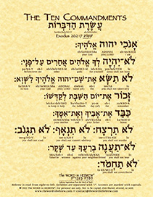
Ecclesiastes 12:13
“Let us hear the conclusion of the
whole matter: Fear Alahym, and keep His commandments: for this is the whole
duty of man.”

Slide 14
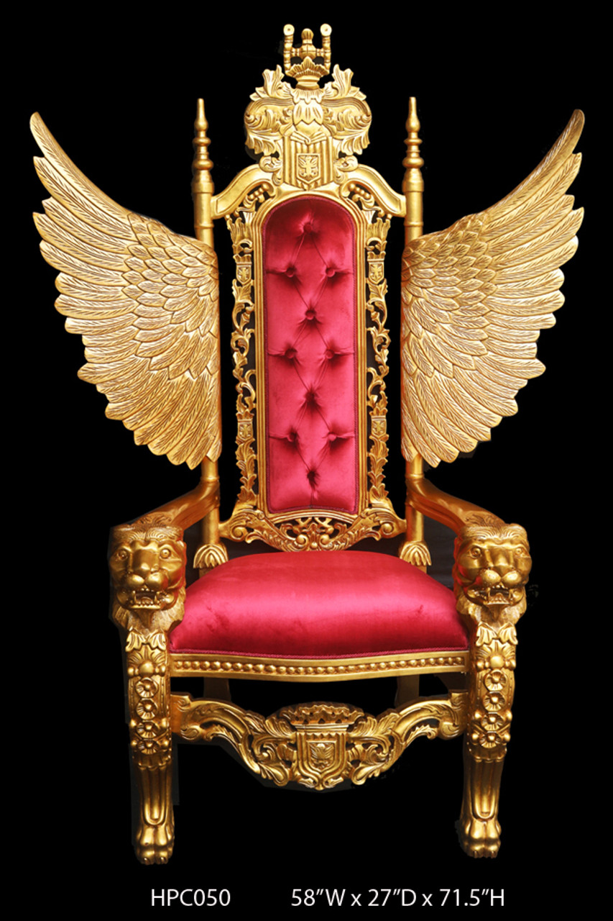
Will You Sit on the Throne of Perfection?

