Slide 1
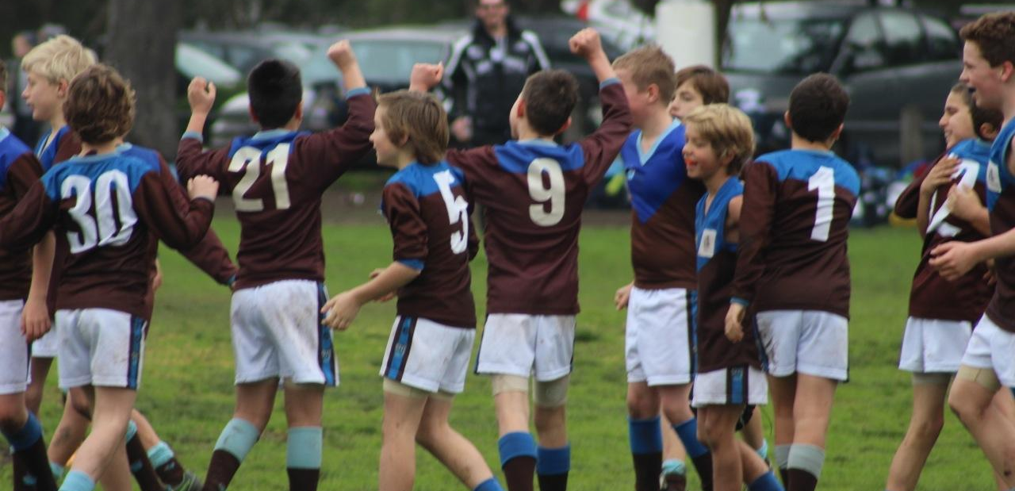
OJFC
Return to Play Covid-19 Protocols

Slide 2
Club Protocols
Club has implemented and gained approval from the SMJFL and Glen Eira Council to start matches in accordance with
AFL Victoria Guidelines – Return to Play Protocols
Key Points
Club appointed COVID Safety Officer is overseeing protocol adherence and compliance.
A Covid-19 grounds manager to be in attendance at games
Public interface and engagement – child safety – keeping public outside of oval
Management of arrival and departure of players and parents
Enforcing that players ‘get in, train and get out’
Club will thoroughly clean and disinfect facilities before use (prior to player arrival) and ensure that
frequently touched surfaces and objects are cleaned regularly between matches.
Club will ensure that only players and critical team officials enter change rooms and ovals.

Slide 3
Player Protocols
It is the choice of participants to play, noting that even with adherence to protocols there is some increased risk
of exposure to COVID-19 (compared to staying at home), which for some people if contracted, has serious
health consequences
If you are sick or been in contact with sick people, DO NOT ATTEND GAMES.
Players to follow the Get In Get Out principle.
Player are to go straight to change rooms on arrival to ground.
Shower and wash hands and clothes prior to and after matches. Players arrive and leave in football gear.
No sharing of water bottles, food, towels, no swapping of jumpers or wrist bands.
No spitting no high fives, handshakes or other physical contact during after and prior to games
No sharing of food – no oranges or lollies at breaks

Slide 4
Spectator Protocols
Parents/guardians are encouraged to limit drop-off/pick-up to only one parent/guardian and other dependents as required
and necessary. For those staying at venues, social distancing and gathering regulations must be adhered to.
If you are sick or been in contact with sick people, DO NOT ATTEND GAMES.
Spectators for training and competitions must abide by public gathering restrictions – spectators should be in
groups of no more than 10 people in open, outdoor venues and spread out around the ground or venue.
Do not touch or retrieve footballs that go outside of play.
Spectators must keep 1.5 meters apart.
No spectators are allowed on the oval prior, during breaks or after matches.
No spectators or parents or other family members can enter change rooms.
Do not congregate around change room entry, club rooms or behind coaching and player benches.
Where venues allow access for vehicles surrounding the oval spectators are encouraged to remain in vehicles

