Slide 1
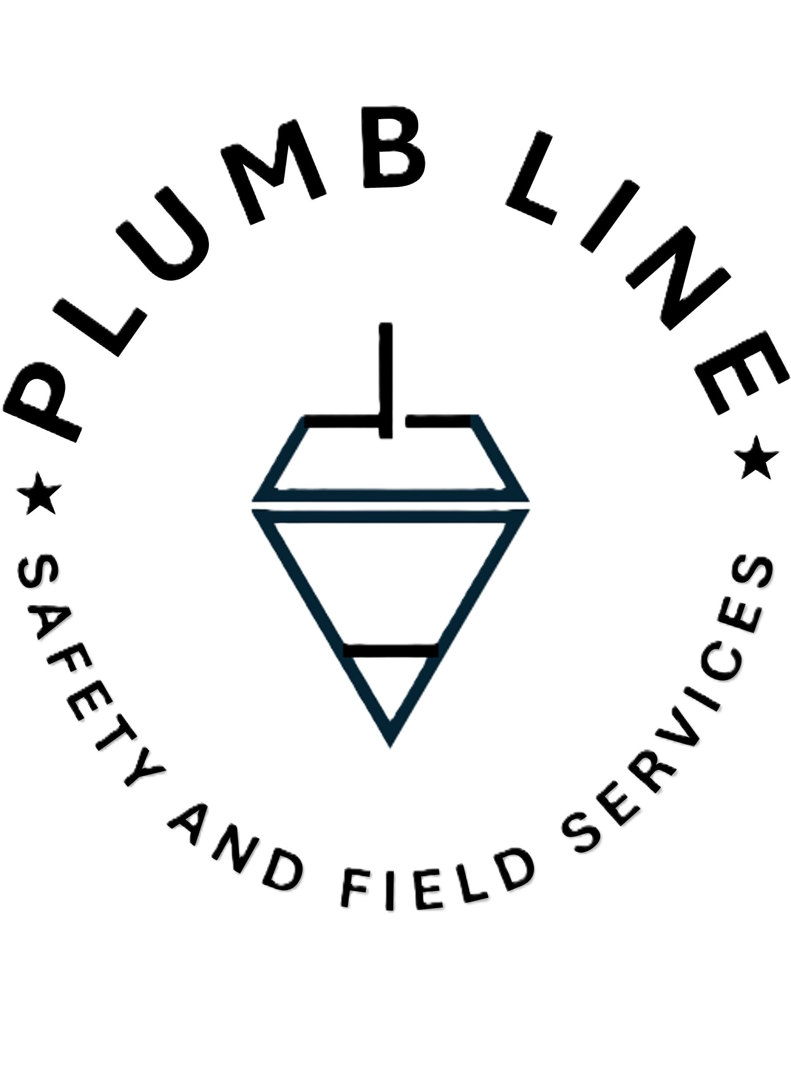
OSHA Inspection Preparedness
Essential strategies for successful safety compliance inspections
Notes:
This presentation focuses on essential strategies to prepare for OSHA inspections, ensuring your workplace meets safety compliance standards. We'll cover practical steps to help you navigate inspections successfully and maintain a safe work environment.
This presentation guides midsize construction companies lacking a full-time safety officer on how to effectively prepare for OSHA inspections. We will cover what to expect during inspections, immediate actions when OSHA arrives, best practices during the inspection, understanding your rights, and proactive compliance measures.

Slide 2

Key Topics on OSHA Inspection Preparedness
Understanding OSHA Inspections: What to Expect
Immediate Actions When OSHA Arrives Onsite
Best Practices During the Inspection
Knowing Your Rights and Responsibilities
Proactive Measures for Future OSHA Compliance
Notes:
We'll explore key topics including what to expect during OSHA inspections, immediate actions to take when inspectors arrive, best practices throughout the inspection, understanding your legal rights and responsibilities, and proactive measures to maintain ongoing compliance.
We will begin by understanding OSHA inspections and their triggers. Next, learn the immediate actions when OSHA arrives onsite. Then explore best practices during the inspection, followed by knowing your rights and responsibilities. Finally, we will discuss proactive measures for future OSHA compliance without a full-time safety officer.

Slide 3

Understanding OSHA Inspections: What to Expect
Notes:
Understanding the OSHA inspection process is crucial. Knowing what triggers inspections, how inspectors operate, and what they look for can help you prepare effectively and reduce surprises during the visit.
It is crucial to understand why OSHA inspections occur, the types of inspections, and the inspection process. This knowledge helps companies prepare and respond effectively to OSHA visits.

Slide 4

Common Reasons for OSHA Inspections
Workplace Accidents
  Accidents at work sites frequently trigger OSHA inspections to ensure safety compliance and prevent future hazards.
Employee Complaints
  Employee-reported safety concerns can initiate OSHA visits to investigate and address potential violations.
Referrals
  Referrals from other agencies or organizations often prompt OSHA to conduct targeted inspections.
Programmed Inspections
  Scheduled inspections based on industry risk factors help OSHA proactively monitor workplace safety standards.
Notes:
Common reasons OSHA conducts inspections include workplace accidents, employee complaints, referrals from other agencies, and programmed inspections based on industry risk. Recognizing these triggers helps organizations anticipate and prepare for potential inspections.
OSHA inspections often stem from workplace accidents, employee complaints, referrals, or scheduled programmed inspections. Being aware of these common triggers helps companies anticipate potential visits and stay prepared.

Slide 5

Types of OSHA Inspections and Triggers
Imminent Danger Inspections
  These inspections address conditions posing immediate risk of death or severe injury, requiring urgent action.
Fatality and Catastrophe Inspections
  Triggered by workplace fatalities or severe accidents, these inspections focus on investigating causes to prevent recurrence.
Complaint, Referral and Programmed Inspections
  Inspections are also conducted based on employee complaints, referrals from other agencies, or scheduled safety programs.
This Photo by Unknown Author is licensed under CC BY
Notes:
OSHA inspections vary by type: imminent danger inspections address urgent risks, fatality and catastrophe inspections investigate serious incidents, and complaint, referral, or programmed inspections focus on specific concerns or scheduled reviews. Each requires a tailored response.
OSHA conducts several types of inspections, including imminent danger, fatality/catastrophe, complaint, referral, and programmed inspections. Each type has unique triggers and priorities that companies should understand.

Slide 6

The Inspection Process: Stages and Procedures
Opening Conference
  The inspection begins with an opening conference to outline the inspection scope and expectations.
Walk-Around Inspection
  Inspectors conduct a walk-around to observe workplace conditions and identify hazards.
Employee Interviews
  Interviewing employees helps gather insights on safety practices and workplace concerns.
Closing Conference
  The closing conference summarizes findings and discusses necessary corrective actions.
Notes:
The inspection process typically starts with an opening conference to set expectations, followed by a walk-around to observe conditions, employee interviews to gather insights, and concludes with a closing conference summarizing findings and required corrective actions.
The inspection process involves opening conferences, walk-around inspections, employee interviews, and closing conferences. Familiarity with these stages ensures smoother interactions during OSHA visits.

Slide 7
Immediate Actions When OSHA Arrives Onsite
Notes:
Immediate actions when OSHA arrives are critical to setting the tone for the inspection. Prompt, professional engagement and clear communication can facilitate a smoother process and demonstrate your commitment to safety.
How a company responds when OSHA arrives sets the tone for the inspection. Immediate, calm, and informed actions are essential, especially when there is no full-time safety officer available.

Slide 8

Initial Response and Greeting Inspectors
Professional Greeting
  Always greet OSHA inspectors promptly and with professionalism to set a positive tone.
Designate Point of Contact
  Assign a clear point of contact to manage the inspection and ensure smooth communication.
Notes:
Greet OSHA inspectors professionally and promptly to establish a positive interaction. Designate a specific point of contact to manage communications and coordinate the inspection efficiently.
Greet OSHA inspectors professionally and promptly. Designate who will be the point of contact to manage the inspection and maintain clear communication.

Slide 9

Designation of a Company Representative
Role of Representative
  The company representative accompanies the inspector and communicates on behalf of the company during inspections.
Knowledge Requirements
  The representative must be familiar with the company’s safety policies and the specific site conditions.
Inspection Responsibilities
  The representative ensures clear communication and assists in facilitating the inspection process effectively.
Notes:
A knowledgeable company representative should accompany the inspector throughout the inspection. This person must understand safety policies and site conditions to effectively communicate and assist in addressing any concerns.
Appoint a knowledgeable company representative to accompany the inspector and speak on behalf of the company. This person should be familiar with safety policies and site conditions.

Slide 10
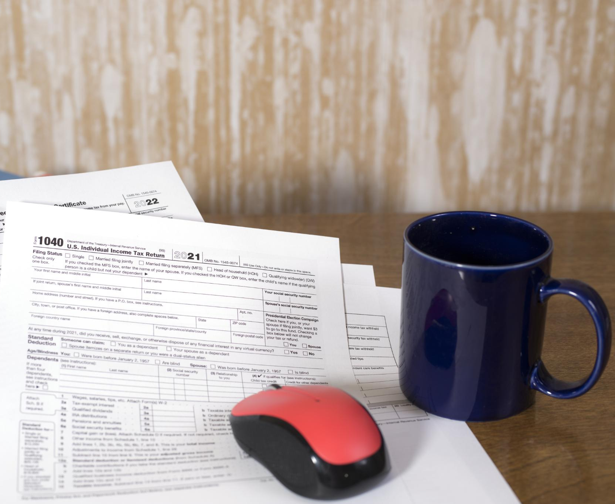
Essential Documentation to Provide and Withhold
Prepare OSHA Documents
  Ensure all required OSHA documents, including injury logs and safety records, are accurately prepared before inspection.
Document Sharing Guidelines
  Understand which documents to share and which to withhold to maintain compliance and protect company interests.
Notes:
Prepare all required OSHA documentation in advance, such as injury logs and safety records. Know which documents to share and which to withhold to comply with regulations while protecting company interests.
Prepare required OSHA documents like injury logs and safety records. Know which documents to share and which to withhold to protect company interests during the inspection.

Slide 11
Best Practices During the Inspection
Notes:
During the inspection, maintaining professionalism and clear communication is essential. Following best practices helps build trust and ensures the process proceeds smoothly without unnecessary complications.
Maintaining professionalism and transparency during the inspection supports a positive outcome. Effective communication and documentation are key throughout the process.

Slide 12

Conduct and Communication Guidelines
Courtesy and Honesty
  Always be polite and truthful in interactions to build trust and respect.
Cooperation Without Oversharing
  Provide necessary information without volunteering extra details that may complicate matters.
Clear and Factual Communication
  Keep communication straightforward and based on facts to avoid misunderstandings.
Avoiding Confrontations
  Steer clear of conflicts by staying calm and neutral in discussions.
Notes:
Be courteous and honest in all interactions with inspectors. Provide necessary information without oversharing, communicate clearly and factually, and avoid confrontations to maintain a cooperative atmosphere.
Be courteous, honest, and cooperative without volunteering unnecessary information. Avoid confrontations and keep communication clear and factual.
Image source: Microsoft 365 content library

Slide 13

Managing Interviews with Employees
Employee Rights Awareness
  Employees must understand their rights to participate during interviews and how to answer OSHA questions confidently.
Monitoring Interview Fairness
  Company representatives should oversee interviews to maintain fairness and transparency throughout the process.
Notes:
Employees should be aware of their rights during interviews and feel confident in responding to OSHA questions. Company representatives should monitor interviews to ensure fairness and transparency throughout the process.
Ensure employees understand their right to participate and how to respond to OSHA questions. Company representatives should monitor interviews to ensure fairness.
Image source: Microsoft 365 content library

Slide 14

Accompanying the Inspector and Taking Parallel Notes
Importance of Accompanying Inspectors
  Being present during inspections allows immediate clarification and better understanding of safety concerns.
Taking Detailed Parallel Notes
  Documenting observations in detail ensures accurate records to verify findings and resolve issues later.
Notes:
Accompanying inspectors allows immediate clarification of issues and better understanding of safety concerns. Taking detailed parallel notes ensures accurate documentation to support findings and address any discrepancies later.
Always accompany OSHA inspectors during site inspections and take detailed parallel notes. This helps in verifying findings and addressing concerns later.

Slide 15
Knowing Your Rights and Responsibilities
Notes:
Knowing your rights and responsibilities during an OSHA inspection empowers your organization to engage effectively, protect your interests, and ensure a fair and transparent inspection process.
Understanding legal rights during OSHA inspections empowers companies to protect themselves while complying with regulations.

Slide 16

Your Legal Rights During an OSHA Inspection
Right to Understand Inspection Purpose
  Companies must be informed about the reason and scope of the OSHA inspection to engage effectively.
Right to Representation
  Businesses have the right to have legal or employee representatives present during OSHA inspections.
Right to Appeal Findings
  Companies can challenge and appeal OSHA inspection findings to ensure fair evaluation.
Notes:
You have the right to understand the purpose and scope of the inspection, to have representation present, and to appeal any findings. These rights help ensure inspections are conducted fairly and that your company can respond appropriately.
Companies have the right to understand the purpose of the inspection, be represented, and appeal findings. Knowing these rights is vital to avoid misunderstandings.

Slide 17

Handling Requests for Private Interviews or Documents
Responding to OSHA Requests
  Understand the proper procedures to respond to OSHA's requests for private interviews or documents promptly and professionally.
Ensuring Compliance
  Ensure all responses comply with OSHA regulations while maintaining company policies and legal obligations.
Protecting Confidentiality
  Balance compliance with protecting sensitive company and employee information during interviews and document sharing.
Notes:
When OSHA requests private interviews or documents, respond promptly and professionally. Ensure compliance with regulations while protecting sensitive information and maintaining confidentiality.
Know how to respond to OSHA requests for private employee interviews or additional documents to ensure compliance without compromising company confidentiality.

Slide 18
Responding to Citations and Follow-Up Actions
Effective Citation Response
Companies should respond promptly to citations to demonstrate commitment to compliance and resolve issues efficiently.
Requesting Informal Conferences
Informal conferences provide an opportunity to discuss citations and negotiate resolutions before formal penalties.
Implementing Corrective Actions
After citations, companies must take corrective actions promptly to fix violations and maintain ongoing compliance.
Notes:
Responding to citations quickly shows your commitment to compliance. Utilize informal conferences to discuss and negotiate citations, and implement corrective actions promptly to address violations and prevent recurrence.
After the inspection, companies may receive citations. Learn how to respond effectively, request informal conferences, and implement corrective actions to maintain compliance.

Slide 19
Proactive Measures for Future OSHA Compliance
Notes:
Proactive measures are key to maintaining OSHA compliance. Regularly reviewing safety practices, training employees, and fostering a culture of safety help prevent violations and prepare your organization for future inspections.
Preparing for future OSHA inspections requires ongoing effort, especially without a full-time safety officer. Establishing a strong safety culture and documentation practices is essential.

Slide 20
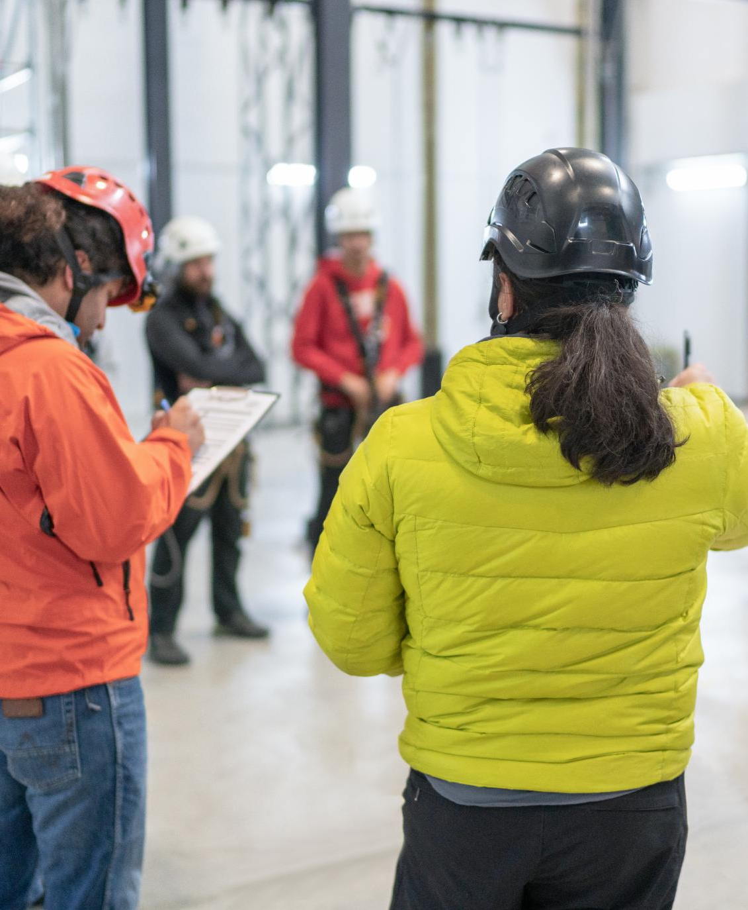
Creating a Culture of Safety without a Full-Time Officer
Employee Ownership of Safety
  Empowering team leaders and employees to take responsibility fosters a safety-first mindset throughout the organization.
Regular Safety Training
  Consistent training equips staff with the knowledge to identify and mitigate hazards effectively.
Effective Communication
  Open communication channels promote hazard awareness and encourage proactive safety measures.
Notes:
Even without a full-time safety officer, empowering employees to take ownership of safety, providing regular training, and encouraging open communication create a strong safety culture that supports compliance and reduces risks.
Empower team leaders and employees to take ownership of safety. Regular training, communication, and hazard awareness build a proactive safety environment.

Slide 21

Essential Documentation and Training Practices
Maintain Updated Records
  Keep safety records, training logs, and policies current to ensure compliance and readiness.
Regular Safety Training
  Conduct frequent training sessions to keep employees informed and prepared for inspections.
Notes:
Keep safety documentation and training records up to date to demonstrate compliance readiness. Regular training sessions ensure employees remain informed and prepared for inspections and daily safety challenges.
Maintain updated safety records, training logs, and policies. Conduct regular safety training sessions to keep employees informed and prepared for OSHA inspections.

Slide 22
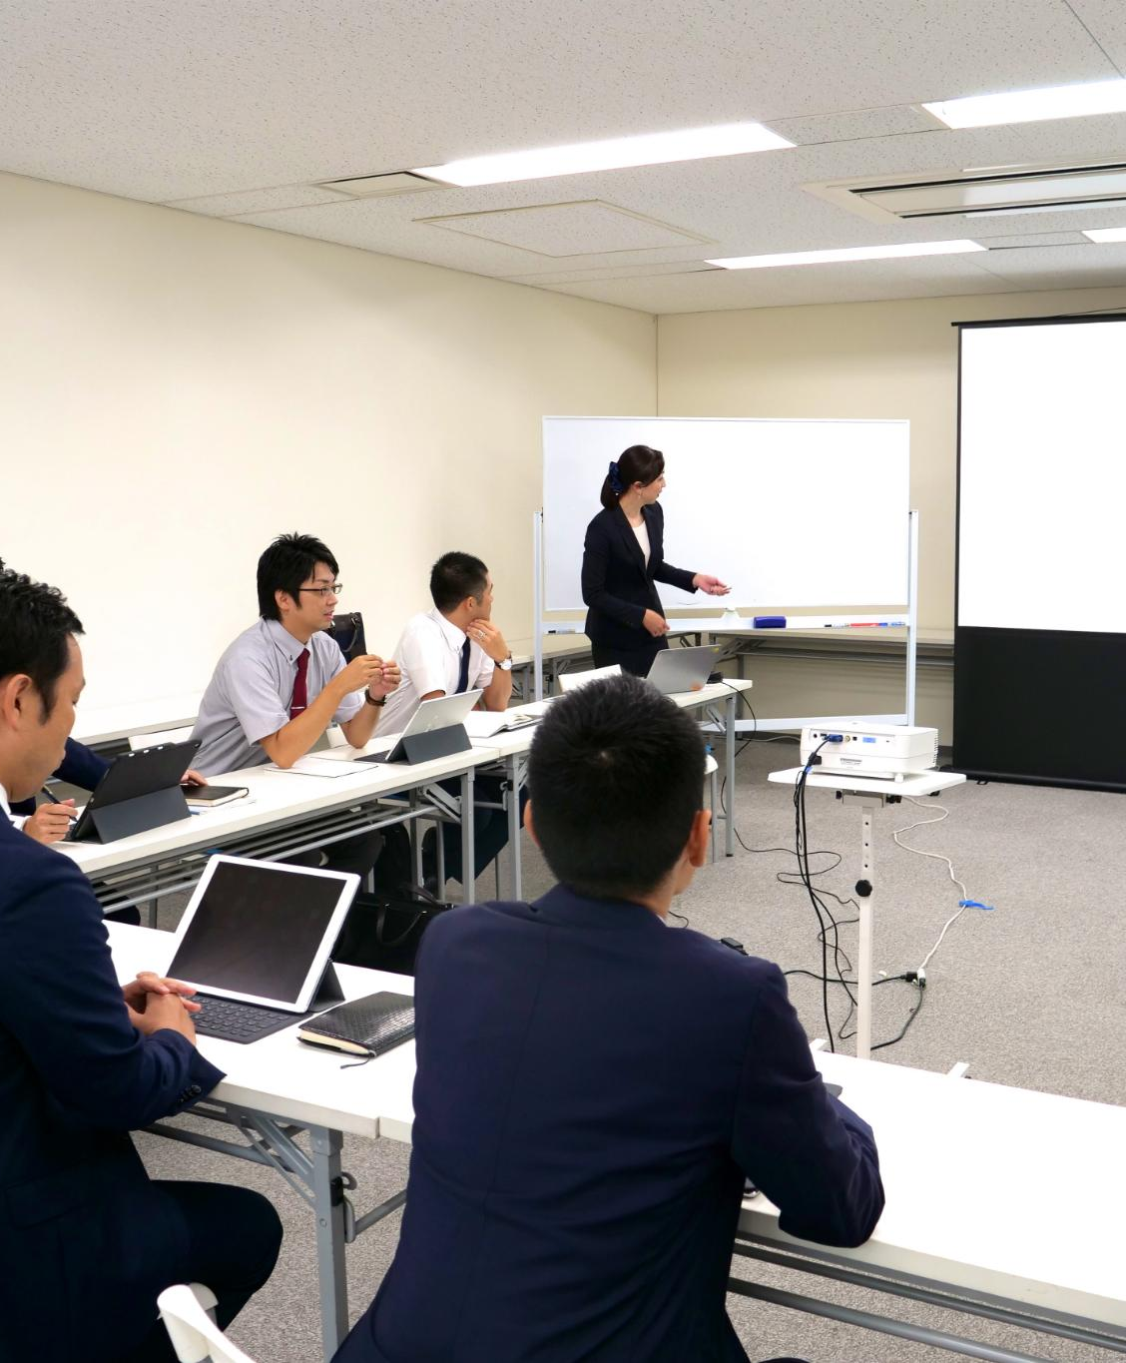
Resources for Ongoing Compliance and Support
Plumb Line Safety and Field Services
  OSHA consultation services provide expert guidance to help organizations maintain health and safety compliance effectively. Visit us at www.plumblinesafet.com to get started.
Industry Associations
  Industry associations offer networking, best practices, and regulatory updates to support compliance efforts.
Online Training Tools
  Online training tools provide accessible, flexible learning solutions for ongoing compliance education. Visit us at www.plumblinesafet.com to get you learning management system into compliance.
Notes:
Leverage resources like plumb Line Safety and Field Services, industry associations, and online training tools to support ongoing compliance efforts. These resources provide expert guidance, networking opportunities, and flexible learning options.

Slide 23
Conclusion: Confidently Navigating OSHA Inspections
Understanding Inspection Processes
Knowing OSHA inspection steps helps midsize companies prepare effectively and reduce compliance risks.
Responding Appropriately
Proper responses during inspections promote smoother interactions and better outcomes for construction firms.
Knowing Legal Rights
Awareness of company rights ensures fair treatment and informed decision-making during OSHA inspections.
Fostering Safety Culture
Building a culture of safety encourages proactive risk management and workplace well-being.
Notes:
Confidently navigating OSHA inspections involves understanding the process, responding appropriately, knowing your legal rights, and fostering a proactive safety culture. These elements together help reduce risks and promote workplace well-being.
While lacking a full-time safety officer presents challenges, midsize construction companies can successfully prepare for OSHA inspections by understanding processes, responding appropriately, knowing their rights, and fostering a culture of safety.

