Slide 1


Slide 2
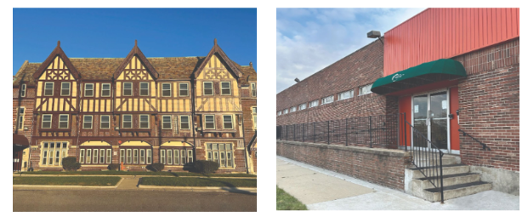
Content Index
03
05
07
About Us
Executive Summary
Demographics
Our mission, vision, and organizational foundation
Overview of comprehensive quality assurance process
Population characteristics and funding sources
13
23
42
Clinical Reviews
Satisfaction Surveys
Administrative Reviews
Case record reviews, audits, and live observations, supervision, and follow up
Consumer feedback across multiple programs
Personnel records and organizational compliance
50
51
54
Medication Reviews and External Audits
Prevention
Outcomes & Recommendations
Compliance audits and prescriber peer reviews
Prevention strategies
Evaluation results and improvement strategies
Quality Assurance Program Plan - Annual Report CY2025

Slide 3


About Us
Serving the community for over 53 years, Elmhurst Home, Inc. (EHI) is a non-profit 501(c)3 organization that provides "Recovery with Dignity" for men and women who are addressing substance abuse, mental health, and criminal conduct issues. Born from the vision and passion of James and Naomi Oden to help those in need, Elmhurst Home, Inc. has delivered high-quality, effective addiction treatment since 1972. We aim to serve our clients' physical, mental, and emotional needs on the road to recovery. At Elmhurst Home, we believe that everyone deserves to live their best life, free from the constraints of substance abuse, mental health challenges, and unstable housing.
We are here to listen, support, and empower you!
No one is turned away for an inability to pay, and there is a discounted/sliding fee schedule available based on family size and income. Call today for more information: (313) 867-1090, ext. 101
Quality Assurance Program Plan - Annual Report CY2025

Slide 4
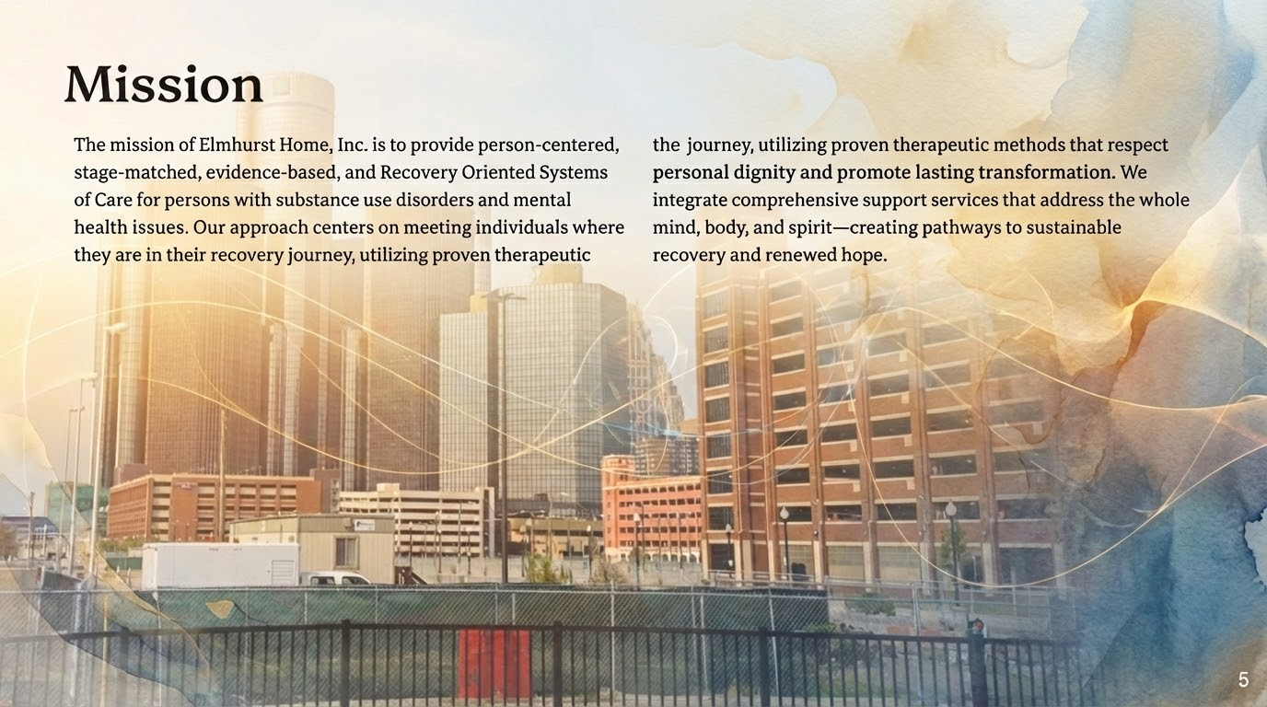
Quality Assurance Program Plan - Annual Report CY2025

Slide 5

This comprehensive report presents the findings of Elmhurst Home, Inc.'s Quality Assurance Program Plan (QAPP) for calendar year 2025. Our robust quality assurance framework represents a commitment to excellence in behavioral health services, encompassing systematic evaluation across clinical, administrative, satisfaction, and medication domains.
The QAPP provides continuous monitoring and improvement mechanisms that ensure our services meet the highest standards of care, regulatory compliance, and consumer satisfaction. Through quarterly reviews across all clinical programs—serving both men and women—we maintain accountability, transparency, and a relentless focus on improving outcomes for the individuals we serve.
Quality Assurance Program Plan - Annual Report CY2025

Slide 6
QAPP Review Framework
EHI has a very robust quality assurance process known as the QAPP (Quality Assurance Program Plan). Reviews are conducted across four themes: clinical, satisfaction, administrative, and medication. Reviews were conducted in CY2025 across four quarterly periods for all clinical programs (men and women) to include representative samples of client files as denoted in the Clinical Reviews - Case Record Review.
Monthly monitoring is provided to ensure quality reporting. The results of the QAPP and its findings for CY2025 are aggregated to inform this report. The full annual report is detailed and 33 pages in length containing comprehensive information across all review categories.
Clinical Reviews
Satisfaction Surveys
Administrative Reviews
Medication & External
Case Record Reviews
Audit Checklist
Live Observation Evaluations
Supervision Records
Post-Discharge Follow-up
ACT Consumer Surveys
MHSIP Consumer Survey
Exit Treatment Surveys
Food Services Satisfaction
Consumer Advisory Group
Medication Compliance Audit
Peer Review - Prescribers
External Audits
Outcome Evaluation
Personnel Record Review
Community Health Needs Assessment
Organizational Culture Evaluation
Quality Assurance Program Plan - Annual Report CY2025

Slide 7

Demographics
Understanding the characteristics of the population we serve is fundamental to delivering effective, culturally responsive care. This section provides a comprehensive overview of the individuals served by Elmhurst Home, Inc. in 2025, including funding sources, treatment modalities, diagnostic profiles, and demographic distributions.
Our demographic data informs program design, resource allocation, and quality improvement initiatives, ensuring that services remain responsive to the evolving needs of our community.
Quality Assurance Program Plan - Annual Report CY2025

Slide 8
Individuals Served and Funding Sources
1,602
Funding Source Distribution
Our funding structure reflects a strong commitment to serving Medicaid-eligible populations, ensuring access to care for those who need it most.
Total Individuals Served
Across all programs and service modalities in 2025
88.8%
10%
Medicaid & Eligible
Healthy Michigan & MI Health Link
1,421 individuals
160 individuals
1.2%
Commercial & Medicare
20 individuals

Slide 9






Treatment Modalities
Elmhurst Home, Inc. offers a comprehensive continuum of care designed to meet individuals at every stage of their recovery journey. Our multi-level service approach ensures that clients receive the appropriate intensity of treatment based on their unique needs and circumstances.
Outpatient SUD
Intensive Outpatient
Residential Treatment
12.9%
engaging in outpatient substance use disorder treatment
19.9%
participating in intensive structured outpatient treatment
71.7%
of clients served through immersive, structured residential programming
Recovery Housing
SUD Health Home
Outpatient Mental Health
12.9%
supported through stable recovery housing
11.5%
receiving integrated behavioral and SUD health home services
25.6%
receiving individualized mental health services
Quality Assurance Program Plan - Annual Report CY2025

Slide 10

Top 5 Primary Substance Use Diagnoses
Understanding the primary substances driving treatment admissions helps us tailor our clinical programming and allocate resources effectively. Alcohol continues to be the most prevalent primary diagnosis, followed by cocaine and opioid use disorders.
Clinical Implications
The predominance of alcohol use disorder reflects national trends and underscores the need for comprehensive alcohol treatment programming. The significant presence of cocaine-related admissions highlights the ongoing impact of stimulant use in our community.
Alcohol 27%
Cocaine 15%
Opioid 5%
Cannabis 2%
Our evidence-based treatment protocols are specifically designed to address these primary diagnose, cognitive-behavioral interventions, and relapse prevention strategies tailored to each substance class.
Other Stimulant 2%
Quality Assurance Program Plan - Annual Report CY2025

Slide 11
Top 5 Mental Health Primary Diagnoses
Co-occurring mental health conditions are prevalent among individuals seeking substance use treatment. Our integrated treatment approach addresses both substance use disorders and mental health needs simultaneously, recognizing the complex interplay between these conditions.
27%
19%
17%
15%
Depression (Unspecified)
Major Depressive Disorder
Post-Traumatic Stress Disorder
Generalized Anxiety Disorder
11%
2%
Bipolar Disorder
These diagnoses inform our clinical staffing needs, training priorities, and partnership development with psychiatric providers. Our trauma-informed care approach is particularly critical given the prevalence of PTSD among our population.
Quality Assurance Program Plan - Annual Report CY2025

Slide 12




Demographic Profile
Special Populations
Racial/Ethnic Distribution
Veterans: 1.9% of total population served
Women's Specialty Program: 2.8% participation
66% Black or African American
21% White
11% Unknown
1% More than one race, American Indian/Alaskan Native, Native Hawaiian/Pacific Islander
Gender Distribution
Age Range Distribution
18-19 years: <.1%
20-29 years: 12.7%
30-39 years: 30%
40-49 years: 22.8%
50-59 years: 19.6%
60-69 years: 13.5%
70-79 years: 3%
58%
41.9%
Quality Assurance Program Plan - Annual Report CY2025

Slide 13

Clinical Reviews
Clinical reviews form the backbone of our quality assurance program, providing systematic evaluation of treatment documentation, clinical practice adherence, and service delivery quality. These comprehensive reviews ensure that clinical staff maintain the highest standards of professional practice while delivering evidence-based, person-centered care.
Our clinical review process includes case record audits, live observations of clinical sessions, supervision documentation, and post-discharge follow-up contacts—creating a 360-degree view of clinical quality and effectiveness.
Quality Assurance Program Plan - Annual Report CY2025

Slide 14
Case Record Reviews: Overview
Case record reviews represent the most comprehensive evaluation of clinical documentation quality, treatment planning effectiveness, and adherence to regulatory standards. These detailed reviews examine every aspect of the clinical record—from initial assessment through discharge planning.
28
16
8
Total Reviews
Clinicians Reviewed
Programs Evaluated
Conducted across 12 months
Representing all clinical programs
Across service continuum
Programs Reviewed
IOP (Intensive Outpatient): 28.5%
OP-MH (Outpatient Mental Health): 21.4%
OP-SUD (Outpatient SUD): 14.2%
Residential (SUD DWIHN): 10.7%
Residential (PA511): 10.7%
RH SUD (Recovery Housing SUD): 7.1%
Residential (RRS): 3.5%
36th District Court: 3.5%
Quality Assurance Program Plan - Annual Report CY2025

Slide 15


Case Record Review Demographics
Gender Distribution
Record Status
Review included both active treatment episodes and closed cases to evaluate documentation across the full treatment continuum.
46.4%
71%
29%
Open Records
Closed Records
20 active treatment episodes
8 completed treatment episodes
Men's Program
The distribution of open versus closed records in our review sample ensures comprehensive evaluation of documentation practices throughout the entire treatment cycle. Open records allow us to assess ongoing clinical processes and real-time documentation quality, while closed records provide insight into discharge planning, transition services, and treatment completion documentation.
This balanced approach to record selection enables quality reviewers to identify strengths and opportunities for improvement across all phases of treatment delivery, from admission through successful discharge or appropriate transfer of care.
13 records reviewed at John Oden Center
53.5%
Women's Program
15 records reviewed at Naomi Nest
Quality Assurance Program Plan - Annual Report CY2025

Slide 16
Case Record Review
Intake & Documentation Standards
Areas of Excellence
96.4%
Our highest compliance area demonstrates exceptional attention to foundational documentation requirements that protect both clients and the organization while ensuring transparency and regulatory adherence.
Compliance Rate
Financial determination forms completed, signed, and dated appropriately
Timely provision of admission/orientation materials within 72 hours
Proper identification on all chart documents (name, MHWIN number, dates)
Original signatures throughout treatment records without erasures or white-out
Evidence of active recovery planning during treatment episodes
Proper documentation of information sharing with clients
Appropriate coordination with probation/parole when applicable
Intake and general documentation standards
Quality Assurance Program Plan - Annual Report CY2025

Slide 17
Case Record Review
Consent & Confidentiality
92.8%
Compliance Rate
Consent and confidentiality documentation
Key Compliance Areas
Strong performance in this critical area demonstrates our commitment to informed consent, client autonomy, and protection of confidential health information.
Current consent to treatment forms signed within 72 hours and updated annually
Documented consent for telemedicine services
Timely provision and acknowledgment of grievance and appeal process information
Member handbook receipt and signature documentation
Current support services list provided to members
Signed notice of confidentiality by member or legal representative
Use of current MDHHS-approved Consent to Exchange Information forms (5515)
Proper release of information documentation including all required elements
Discharge plans containing specific referrals and recommendations for continuing care
Quality Assurance Program Plan - Annual Report CY2025

Slide 18
Case Record Review: Clinical Process Compliance
Assessment & ASAM: 85.7%
Treatment Planning: 89.2%
The assessment process was thorough, complete, and within guidelines for timely completion using the ASAM continuum criteria.
Objectives are specific, measurable, attainable, realistic/relevant, and timely. Service plans include specific action steps for members and clinicians. Case management initiated within 3 days and care coordination documented.
Case Management Needs: 82.1%
Service Plan Interventions: 78.5%
Case Management Needs Assessment completed within 15 days of admission. Progress notes reflect integration of services when appropriate.
Service plans document specific interventions and actions clinicians will take to assist members in achieving treatment goals.
These compliance rates demonstrate solid clinical documentation practices with identified opportunities for improvement in service plan specificity and intervention documentation. Targeted training and supervision will address these areas in the coming year.
Quality Assurance Program Plan - Annual Report CY2025

Slide 19
Audit Checklist Reviews
Purpose and Scope
491
The Audit Checklist is a streamlined version of the comprehensive Case Record Review, designed for more frequent monitoring by leadership and ancillary staff. This quality assurance tool enables continuous improvement in chart compliance between formal quarterly reviews.
Audits Completed
Comprehensive chart compliance monitoring
By conducting nearly 500 audit checklists throughout the year, we maintain vigilant oversight of documentation quality, identify emerging compliance issues early, and provide timely feedback to clinical staff. This frequent touchpoint approach has significantly improved our overall documentation standards and reduced compliance gaps.
The high volume of audit checklists reflects our commitment to real-time quality monitoring rather than relying solely on retrospective quarterly reviews.
Quality Assurance Program Plan - Annual Report CY2025

Slide 20
Live Observation Evaluations
61
32
16
81.1%
Total Observations
Clinical Groups
Staff Observed
Exceeded or Met Standard
Conducted across programs
Therapeutic group sessions
Individual clinician sessions
Fidelity adherence rate
Observation Categories
Fidelity Excellence
14 Individual Sessions observed for clinical skill and rapport
12 Didactic Groups evaluated for educational content delivery
3 Staff Supervision Sessions reviewed for quality mentoring
5 Evidence-Based Practices assessed for fidelity (ACT, IDDT, CBT, DBT, Motivational Interviewing)
The exceptional 81.1% rate of staff exceeding or meeting standards demonstrates our commitment to evidence-based practice implementation with fidelity. Live observations provide invaluable insight into actual clinical practice beyond documentation review.
This direct observation approach ensures that evidence-based interventions are delivered as intended, maximizing treatment effectiveness and client outcomes.
Quality Assurance Program Plan - Annual Report CY2025

Slide 21
Clinical Supervision Records
858
Universal Supervision Coverage
100% of all clinical staff receive individual supervision. This unwavering commitment to professional development and clinical oversight ensures that every clinician receives consistent guidance, support, and accountability.
Supervisions Documented
Across both program sites
100% of clinical leadership conducted both individual and group supervision. Our leadership team actively engages in supervision delivery, modeling best practices and maintaining direct connection to frontline clinical work.
Supervision Focus Areas
Treatment Planning Skills
Areas of Opportunity
Training Requirements
Developing individualized, goal-oriented plans
Identifying and addressing skill gaps
Ensuring compliance with continuing education
Productivity Monitoring
Performance Reviews
Quality Assurance
Tracking clinical productivity and efficiency
Conducting comprehensive evaluations
Reviewing documentation and clinical quality
EBP Fidelity
Ensuring adherence to evidence-based protocols
Quality Assurance Program Plan - Annual Report CY2025

Slide 22
Post-Discharge Follow-Up Outcomes
756
Post-discharge follow-up represents one of our most valuable outcome measures, providing insight into sustained recovery beyond treatment completion. These contacts track critical indicators of recovery stability and long-term wellbeing.
Follow-Up Contacts
Tracking long-term recovery success
Program Distribution
70.7% of follow-up contacts conducted with women's program clients (63% completed in 2024 - an 11.52% increase)
45.7% of follow-up contacts conducted with men's program clients (36.7% completed in 2024 - a 21.8% increase)
Key Outcome Improvements from 2024
No Arrest
Maintained Sobriety
38.7% remained arrest-free (88.27% increase from 15% in 2024)
36.9% abstinent 30+ days (90% increase from 14% in 2024)
Care Satisfaction
Reduced Crises
27.1% satisfied with care (57.4% increase from 15% in 2024)
23% no suicide attempts, 22.4% no SUD hospitalization, 21.6% no psychiatric hospitalization
Quality Assurance Program Plan - Annual Report CY2025

Slide 23

Satisfaction Surveys
Consumer satisfaction surveys provide direct feedback from the individuals we serve, offering invaluable perspective on service quality, accessibility, respect, and treatment effectiveness. These surveys represent the voice of our clients and guide continuous improvement efforts.
Our comprehensive satisfaction measurement approach includes multiple survey instruments administered at different points in the treatment journey, capturing feedback from consumers, families, and caregivers across all program levels.
Quality Assurance Program Plan - Annual Report CY2025

Slide 24
ACT Consumer Satisfaction Survey: Service Quality
43
The ACT Consumer Satisfaction Survey evaluates satisfaction with Assertive Community Treatment services, focusing on accessibility, staff responsiveness, and perceived quality of care. Results demonstrate exceptionally high satisfaction across all measured domains.
Survey Responses
Assertive Community Treatment program
Highest-Rated Service Aspects
Staff Returned Calls
Staff Believe in Recovery
Rights Information
98%
98%
98%
Within 24 hours
Clients can grow and change
Given information about rights
Peer Support Encouraged
95%
95%
Multiple High-Rated Areas
Consumer-run program participation
Services available at good times, comfortable asking questions, respected confidentiality wishes, decided own goals, helped manage illness
Quality Assurance Program Plan - Annual Report CY2025

Slide 25
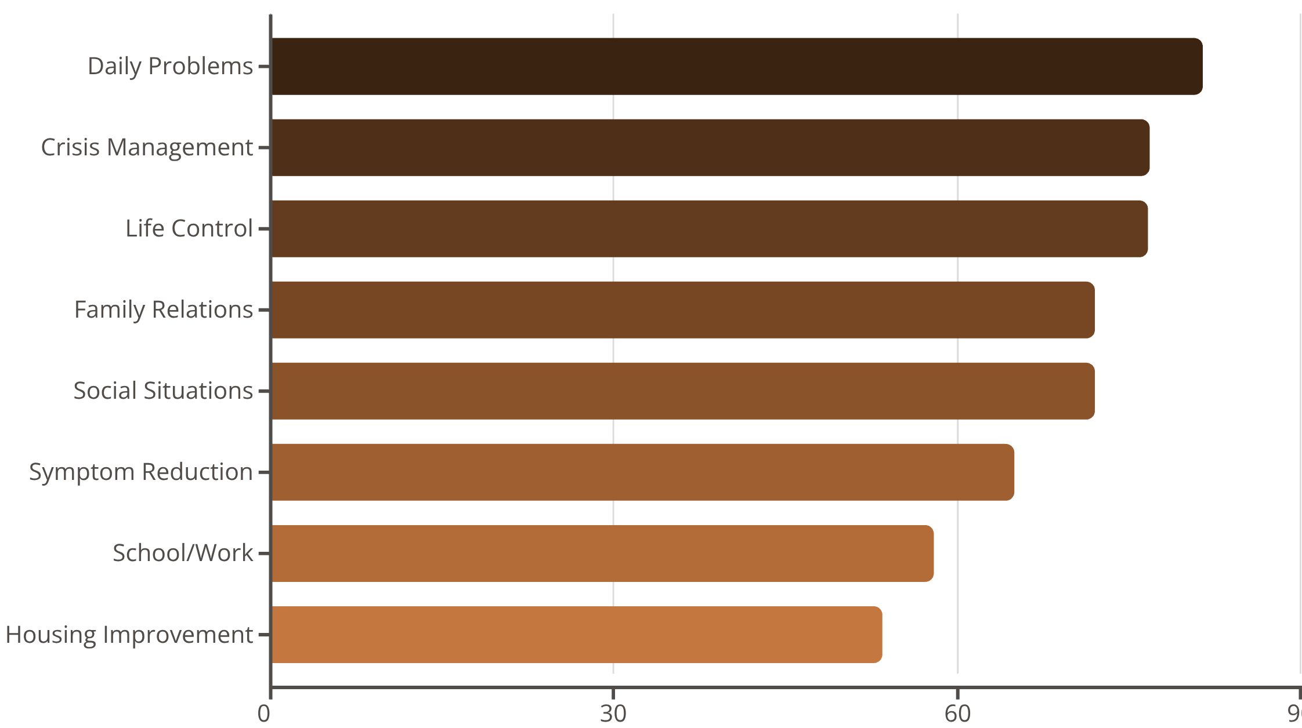
ACT Consumer Satisfaction: Personal Outcomes
Beyond service delivery satisfaction, the ACT Consumer Satisfaction Survey assesses perceived improvements in functioning and quality of life resulting from treatment. These outcome measures reflect the real-world impact of services on clients' daily lives.
Clients report substantial improvements in managing daily challenges, handling crises, and maintaining control over their lives. The data shows that ACT services effectively support functional recovery across multiple life domains.
Quality Assurance Program Plan - Annual Report CY2025

Slide 26
ACT Quality of Life Assessment: Life Domains
38
The ACT Quality of Life and Program Assessment measures satisfaction across life domains and program effectiveness. While responses vary by domain, they provide important baseline data and identify areas requiring enhanced support.
Survey Responses
Quality of Life Assessment
Quality of Life Satisfaction by Domain
Higher Satisfaction Domains
Growth Opportunity Domains
Level of Education: 84.2%
Amount of Money: 76.3%
Housing: 55.3%
Self-Care Ability: 55.2%
Independence: 52%
Mental Health Symptoms: 25.7%
Physical Health: 28.3%
Work/Employment: 28.3%
Access to Transportation: 28.9%
Community Participation: 31.6%
Alcohol/Drug Effects: 34.3%
Social Life: 34.2%
These findings highlight the need for enhanced support in symptom management, physical health integration, employment services, and community connection opportunities.
Quality Assurance Program Plan - Annual Report CY2025

Slide 27
ACT Quality of Life Assessment: Program Evaluation
Clients evaluate specific aspects of the ACT program, including staff relationships, emergency access, medication management, and choice in recovery. These ratings provide actionable feedback on program operations.
Staff Best Interest: 63.2%
Prescriber Listens: 57.9%
Right Medications: 60.5%
Emergency Access: 54.6%
Clients believe staff have their best interest in mind
Doctor listens to concerns and values opinions
Doctor tries to find medications that work best
Can get help during nights and weekends
Recovery Choices: 55.3%
Staff Follow Through: 52.6%
Staff Know Me: 52%
Employment Support: 50%
Free to make choices without fear of losing help
Staff know clients well enough to support individual recovery
Staff fulfill promises made to clients
Staff help overcome barriers to getting and keeping jobs
Service Choices: 50%
Offered alternatives if recommended services not desired
Quality Assurance Program Plan - Annual Report CY2025

Slide 28
Exit Survey: Demographics and Administration
100
Survey Administration
Exit surveys are administered 3-6 months post-discharge from Residential, Outpatient SUD, and Intensive Outpatient treatment. This timing allows clients to reflect on treatment impact from the perspective of early recovery.
Exit Surveys
Consumer satisfaction with treatment (DWIHN)
Administration increased by 72.4% from 2024, demonstrating enhanced follow-up capacity and commitment to outcome tracking.
Gender Distribution
Race Distribution
72% Male
28% Female
66% African American
29% Caucasian
<1% Native American
<1% Hispanic
Quality Assurance Program Plan - Annual Report CY2025

Slide 29

Exit Survey: Treatment Satisfaction Results
The Exit Survey - Consumer Satisfaction with Treatment Services assesses overall satisfaction and key service dimensions. Of 1,300 total responses, 99.3% indicated "Strongly Agree" or "Agree" across confidentiality, participation in treatment planning, service availability, timeliness, and information provision for decision-making.
50%
50%
Overall Satisfaction
Overall Satisfaction
Strongly Agree with satisfaction
Agree with satisfaction
Active Treatment Involvement
Provider Recommendation
57% Strongly Agree they were actively involved in deciding treatment goals
63% Agree they were actively involved in deciding treatment goals
45% Strongly Agree they would recommend their provider to others
53% Agree they would recommend their provider to others
These exceptional satisfaction ratings reflect client-centered treatment planning, respectful care delivery, and effective communication throughout the treatment episode.
Quality Assurance Program Plan - Annual Report CY2025

Slide 30
Food Service Survey: Quality Ratings
213
Food quality significantly impacts residential treatment experience and client wellbeing. Our food service satisfaction survey demonstrates exceptional performance in this critical area of care.
Program Distribution
Survey Responses
82.6% Women's Program responses
18.3% Men's Program responses
Food services satisfaction
Food Quality Rating Scale
75.5%
17.3%
6%
Good
Sometimes Good
Very Good
<1%
<1%
Not Good
Bad
Specific food service staff, Ms. Angie and Ms. Darnell, were mentioned by name and praised as "wonderful" and "great" in client comments.
Quality Assurance Program Plan - Annual Report CY2025

Slide 31

Food Service Survey: Operational Excellence
100%
Universal Compliance Across All Food Service Dimensions
Every respondent indicated satisfaction across all operational aspects of food service delivery, demonstrating exceptional consistency and reliability in this essential service area.
Menu Followed
Fair Serving
Planned menu consistently served as intended
Staff fair and consistent in portion distribution
Safe Serving
Timely Delivery
Food served in safe, hygienic manner
Meals received at appropriate scheduled times
Adequate Portions
Portions received were sufficient
This perfect operational performance reflects strong management systems, well-trained staff, and consistent quality control in food service operations—a testament to the dedication of our food service team.
Quality Assurance Program Plan - Annual Report CY2025

Slide 32
Client and Family/Caregiver Satisfaction Survey
328
This comprehensive survey captures satisfaction with facilities, safety, timeliness, staff interactions, and overall treatment environment. Results demonstrate consistently high satisfaction across all measured dimensions.
Survey Responses
72% Men's Program,
28% Women's Program
Facility and Safety Excellence
73%
23%
77%
20%
Always Clean
Usually Clean
Always Feel Safe
Usually Feel Safe
Buildings clean and comfortable
Clean most of the time
Inside and outside building
Safe most of the time
Service Delivery and Staff Interaction
75.6% report appointments always begin on schedule (21% most of the time)
76.8% always find staff helpful and courteous
79.2% always feel treated with dignity and respect
75% confirm services available at convenient times
77.4% feel comfortable asking about treatment and medications
Quality Assurance Program Plan - Annual Report CY2025

Slide 33


Family Orientation Survey
428
Family orientation provides essential education and support to family members and caregivers of individuals in treatment. This survey evaluates the effectiveness of family orientation sessions in improving understanding and engagement.
Survey Responses
63.3% Men's Program
36.9% Women's Program
99%
99.2%
99.2%
Orientation Helpful
Understand Addiction
Virtual Visit Clarity
Found the orientation session valuable
Better understand family and addiction dynamics
Understand when and how to have virtual visits
These exceptional satisfaction rates demonstrate that family orientation effectively prepares family members to support their loved ones' recovery journey while understanding treatment processes, visiting procedures, and the nature of addiction as a family disease.Engaging families as partners in recovery improves treatment outcomes and supports long-term recovery success
Quality Assurance Program Plan - Annual Report CY2025

Slide 34
MHSIP Consumer Survey: Demographics
355
The MHSIP Consumer Survey is a standardized national measure assessing satisfaction with mental health services across multiple domains. This survey provides benchmarkable data on service quality and consumer experience.
CCBHC MHSIP
Mental Health Statistics Improvement Program survey
Demographic Profile
Gender
66.1% Male
35.4% Female
<1% Nonbinary or Gender Nonconforming
<1% Choose to self-describe
<1% Prefer not to answer
Ethnicity
91.2% Not Spanish, Hispanic, or Latino
1.41% Spanish, Hispanic, or Latino
7.6% Prefer not to answer
Age Distribution
Race
88.1% 18-29 years old
7.6% 65+ years old
5.6% 18-29 years old
72.9% African American
16.6% Caucasian
4.5% More than one race
3% Other
1.9% Prefer not to answer
<1% Asian, Native Hawaiian or Pacific Islander
Quality Assurance Program Plan - Annual Report CY2025

Slide 35
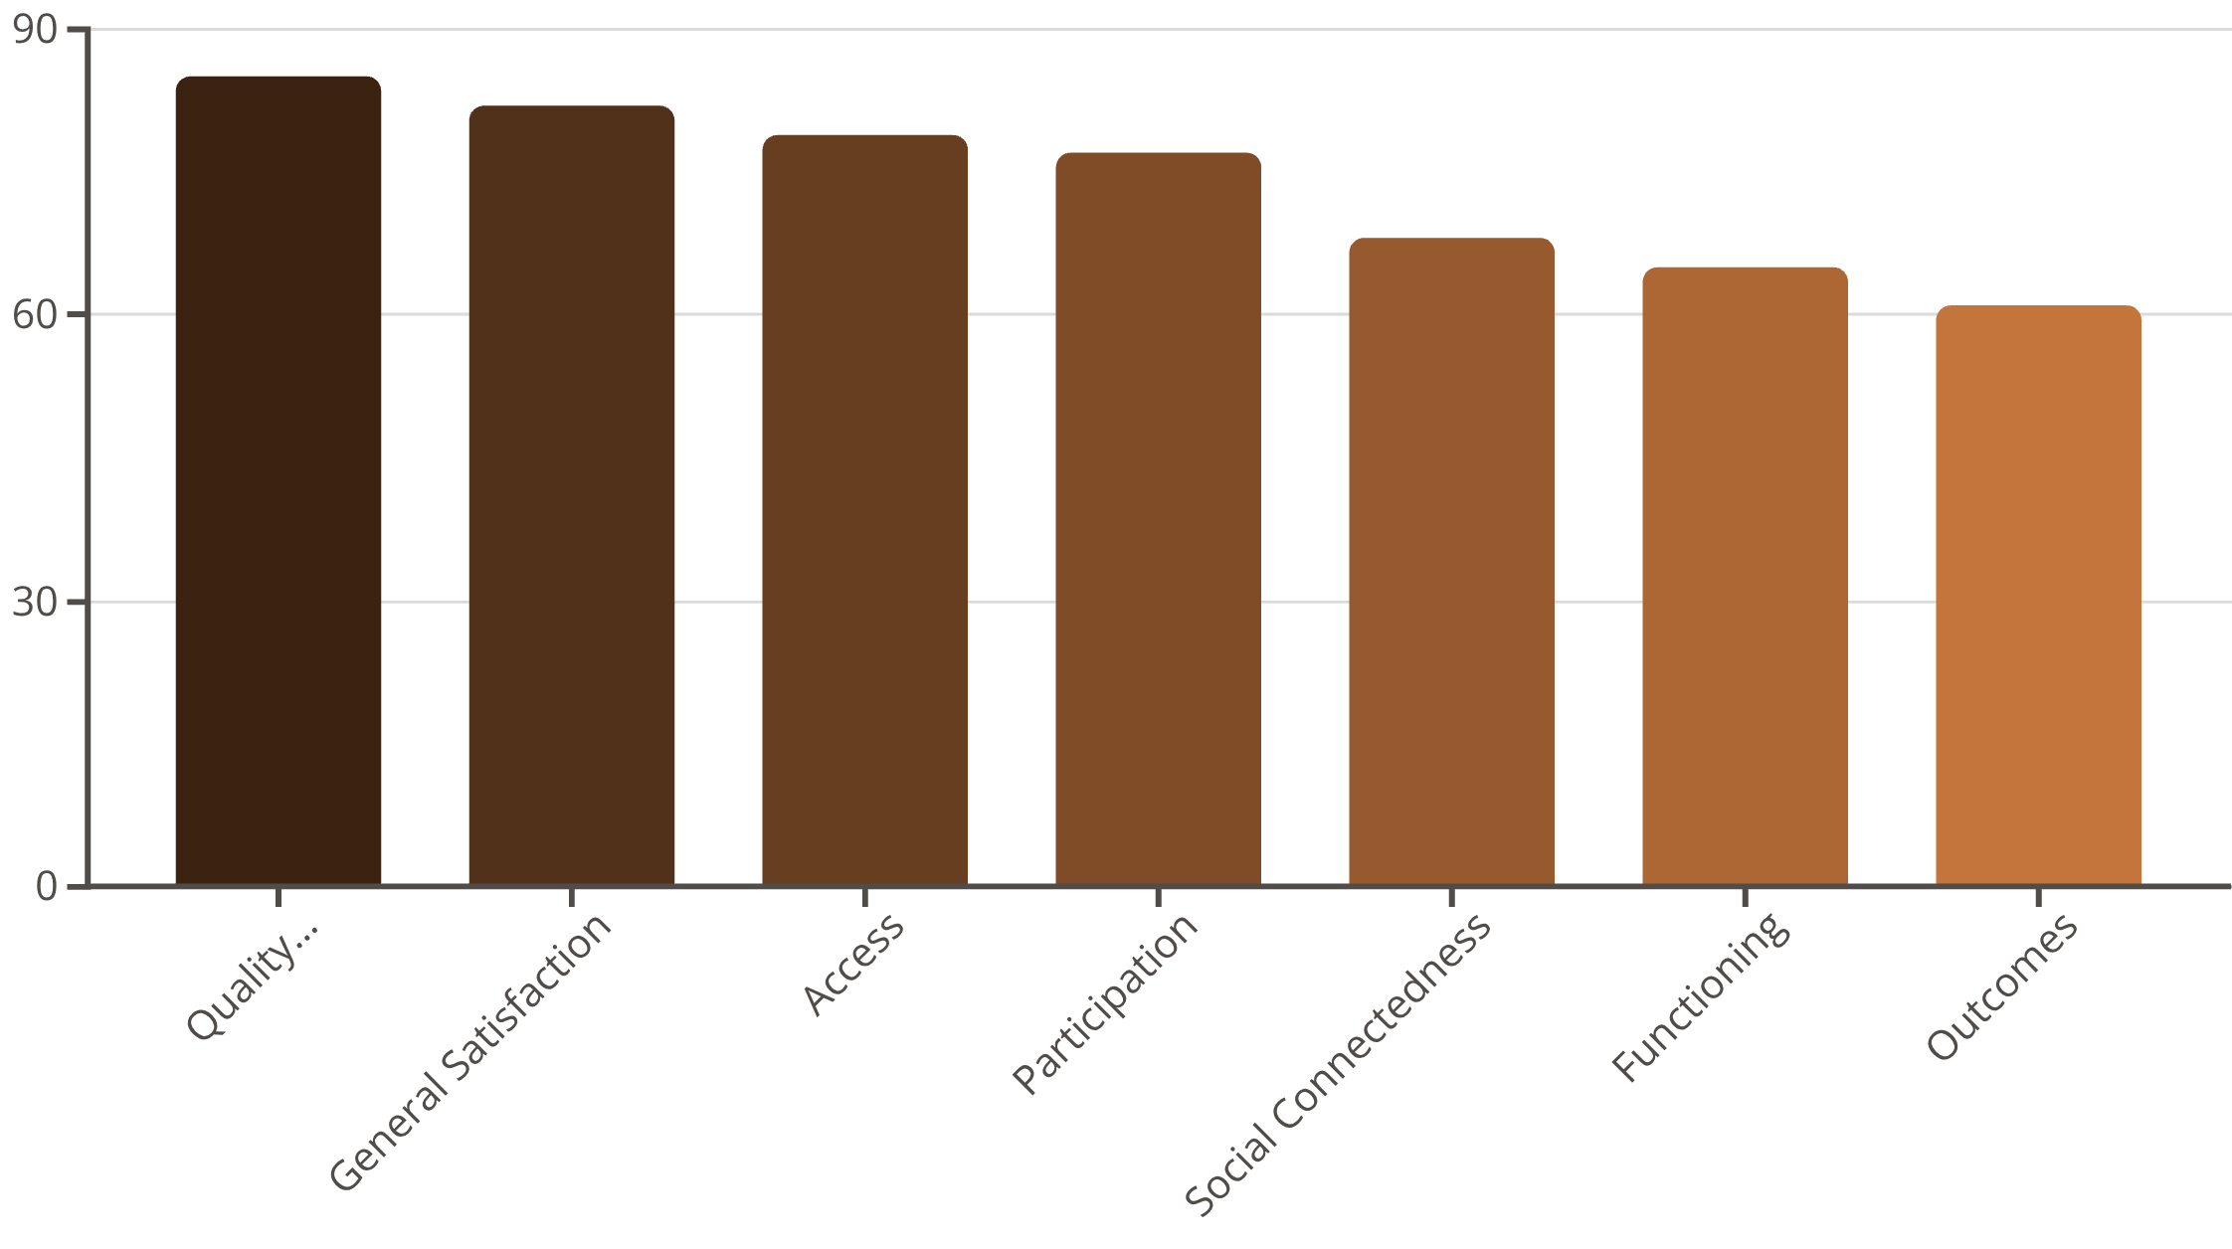
MHSIP Consumer Survey: Domain Results
The MHSIP assesses seven key domains of mental health service quality. Results demonstrate strong performance in staff quality, appropriateness of services, and general satisfaction, with opportunities for improvement in outcomes and functioning domains.
The Quality/Appropriateness domain (85%) and General Satisfaction (82%) represent our strongest areas, reflecting staff competence, respect, and service effectiveness. The Access domain (79%) indicates good availability of services when needed.
Quality Assurance Program Plan - Annual Report CY2025

Slide 36

MHSIP Consumer Survey: Strengths and Opportunities
Areas of Excellence
Opportunities for Improvement
Consumer feedback highlights exceptional staff performance and respectful, supportive interactions as core strengths:
Lower-scoring items identify specific areas where enhanced service delivery could improve consumer experience:
90%
88%
55%
58%
"Staff treat me with respect"
"I feel comfortable asking questions about my treatment"
"I was able to get an appointment when I needed one"
"Services helped me deal more effectively with my daily problems"
85%
"I was able to get the help I needed"
52%
"I know what to do if I have a crisis"
These findings demonstrate that consumers experience staff as respectful, approachable, and effective in delivering needed services.
These findings indicate needs for improved appointment availability, enhanced functional outcome focus, and clearer crisis planning education.
Quality Assurance Program Plan - Annual Report CY2025

Slide 37

Psychiatric Evaluation Access
257
80%
Psychiatric Evaluations
of persons served was able to see a Psychiatrist when they wanted to
Completed for clients in SUD and Mental Health programs
Access to psychiatric evaluation is essential for comprehensive co-occurring disorder treatment. Our integrated behavioral health approach ensures that clients with both substance use disorders and mental health conditions receive thorough psychiatric assessment and appropriate medication management. This substantial volume of psychiatric evaluations demonstrates our commitment to addressing the full spectrum of client needs through integrated, evidence-based care.
Quality Assurance Program Plan - Annual Report CY2025

Slide 38

Program Participant Satisfaction Survey: Demographics
300
The Program Participant Satisfaction Survey provides detailed feedback from individuals actively engaged in treatment across multiple levels of care. This comprehensive assessment evaluates service quality, staff interactions, and program effectiveness.
Survey Responses
Program Distribution
Level of Care
Men's Program: 76.3%
Recovery Housing: 69.9%
Women's Program: 24%
Outpatient: 16%
Residential: 14.6%
The high proportion of recovery housing participants reflects our significant investment in safe, supportive transitional living environments that bridge intensive treatment and independent living.
Quality Assurance Program Plan - Annual Report CY2025

Slide 39
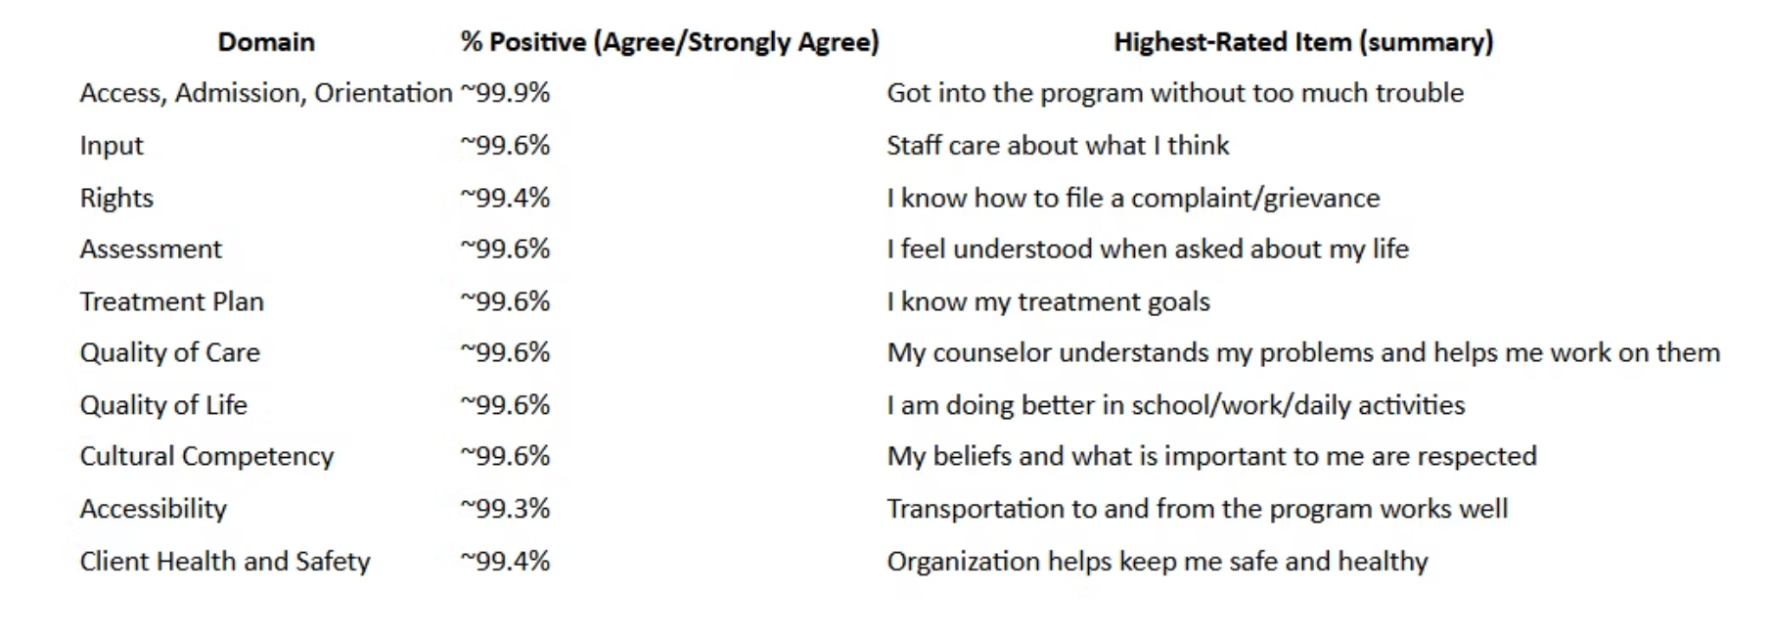
Program Participant Satisfaction: Universal Excellence
The Program Participant Satisfaction Survey reveals exceptional performance across all evaluated domains. Remarkably, every domain had at least one item with 100% of respondents reporting "Agree" or "Strongly Agree," underscoring consistently strong performance in accessibility, cultural responsiveness, safety, and service impact.
Quality Assurance Program Plan - Annual Report CY2025

Slide 40
Program Participant Satisfaction: Universal Excellence
Key Satisfaction Themes
Feeling Understood
Respect and Dignity
Participants consistently report feeling heard and understood by staff
Universal experience of respectful, dignified treatment
Staff Support
Rights Awareness
Strong staff support reported across all programs
Clear knowledge of treatment rights and goals
These findings validate our person-centered, recovery-oriented approach and demonstrate that our core values of dignity, respect, and empowerment are successfully embedded in daily practice across all service settings.
Quality Assurance Program Plan - Annual Report CY2025

Slide 41


Consumer Advisory Survey: Qualitative Insights
The Consumer Advisory Survey provides rich qualitative feedback through open-ended responses, offering deeper insight into client experiences beyond numerical ratings. These narrative responses reveal both strengths and opportunities in service delivery.
Staff Appreciation
Group Effectiveness
"Most respondents expressed satisfaction, particularly with their case managers and peer coaches, citing their helpfulness, effectiveness in dealing with concerns, and assistance with resources and scheduling medical appointments."
"Groups are frequently described as very effective, helpful, thought-provoking, and insightful, with participants learning a lot and finding them relatable to their situation and recovery journey."
Food Quality
Facility Cleanliness
"Respondents generally expressed high satisfaction, frequently describing the food as 'great,' 'delicious,' 'amazing,' and the 'best part of this place.' Specific cooks, Ms. Angie and Ms. Darnell, were mentioned and praised."
"The facility is consistently described as very clean, with everything being clean and satisfactory. The women who do their detail do a good job, and the girls keep up with the daily cleaning."
Quality Assurance Program Plan - Annual Report CY2025

Slide 42

Administrative Reviews
Administrative reviews evaluate organizational infrastructure, ensuring that personnel qualifications, documentation, and compliance systems meet regulatory standards and support high-quality service delivery. These reviews examine the foundational elements that enable clinical excellence.
Personnel record reviews and training compliance monitoring ensure that our staff meet professional standards and maintain current competencies essential for effective practice.
Quality Assurance Program Plan - Annual Report CY2025

Slide 43
Personnel Record Review: Credentials and Compliance
99
Personnel record reviews verify that all staff meet minimum qualifications, maintain current credentials, and have proper documentation on file. These reviews protect both clients and the organization by ensuring qualified professionals deliver services.
Personnel Records
Reviewed for compliance
Job Descriptions: 92.9%
JD Endorsement: 100%
JD Evidence: 100%
Education: 100%
Current job descriptions on file and updated yearly
Job descriptions signed by employees
Evidence of signed job descriptions documented
Copy of degree or transcript on file
Credentials: 98.9%
Current License: 98.9%
Current certification/licensure on file
Certifications and licenses remain current
Near-universal compliance in credential documentation demonstrates strong human resources systems and proactive credential monitoring. The organization maintains robust processes for ensuring staff qualifications meet professional and regulatory standards.
Quality Assurance Program Plan - Annual Report CY2025

Slide 44
99
Training Compliance Monitoring
35
Training compliance data demonstrates comprehensive staff development across essential competency areas. Mandatory training completion rates reflect organizational commitment to maintaining workforce capabilities aligned with best practices and regulatory requirements.
This visual representation provides transparency into training completion rates across multiple required competency domains, enabling identification of high-performance areas and opportunities for enhanced training support.
EHI incorporated the Relias platform that focuses on reducing risk, improving compliance, and enhancing staff performance through specialized, evidence-based training, assessments, and analytics.
Required Trainings
Reviewed for compliance
Quality Assurance Program Plan - Annual Report CY2025

Slide 45
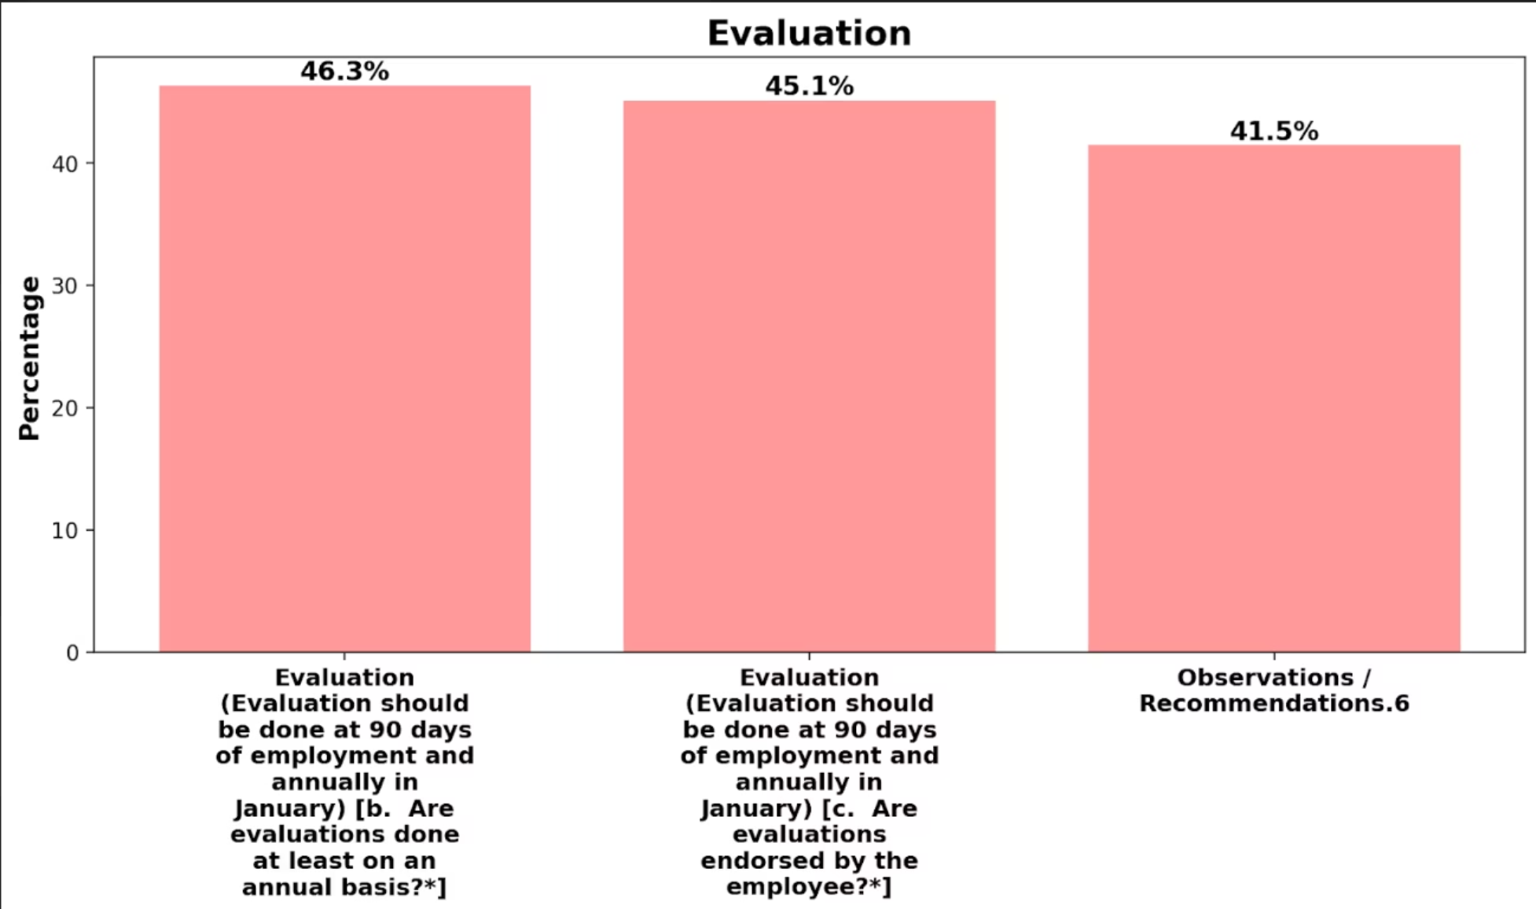
Training Compliance Dashboard
Our comprehensive training dashboard tracks completion rates across all required training domains, providing real-time visibility into organizational training compliance. This systematic approach ensures that staff maintain current knowledge and skills essential for effective practice.
Training categories encompass clinical competencies, safety protocols, cultural responsiveness, regulatory compliance, and evidence-based practice implementation.
The dashboard enables proactive identification of training gaps and timely remediation. High training compliance rates reflect our organizational culture of continuous learning and professional development, ensuring that staff are equipped to deliver high-quality, evidence-based service.
Quality Assurance Program Plan - Annual Report CY2025

Slide 46
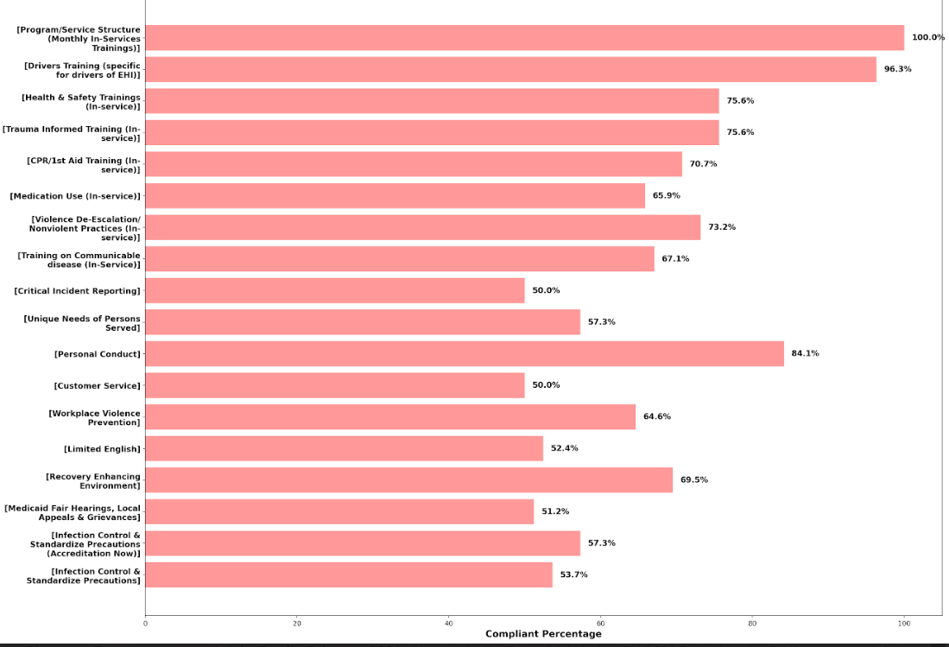
Training Compliance Dashboard
Quality Assurance Program Plan - Annual Report CY2025

Slide 47
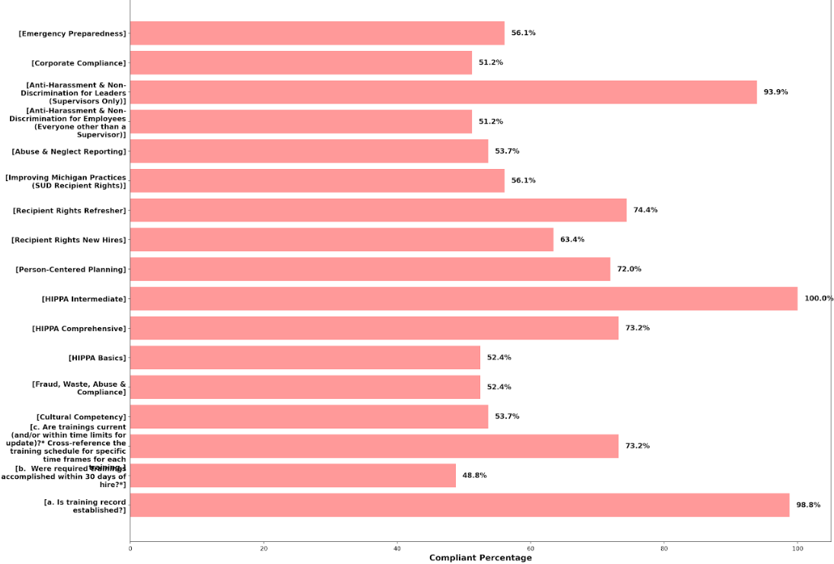
Training Compliance Dashboard
Quality Assurance Program Plan - Annual Report CY2025

Slide 48

Community Health Needs Assessment 2023-2026
The Community Health Needs Assessment 2023-2026 expands on SAMHSA and MDHHS requirements for a Community Health Needs Assessment (CHNA) for Certified Community Behavioral Health Clinics (CCBHCs). It is designed to help Elmhurst Homes, Inc. (EHI) leadership identify service gaps, reduce health disparities, strengthen partnerships, enhance behavioral health services, and plan strategic growth.
The assessment focuses on residents of Wayne County, Michigan, with emphasis on mental health, substance use disorders, co-occurring disorders, and social determinants of health. It recognizes current challenges facing healthcare organizations—such as COVID-19 impacts, workforce shortages, technology demands, and an aging population—which make efficient use of limited resources critical.
The CHNA aims to identify community needs, ensure services are accessible, comprehensive, and evidence-based, anticipate future service expansion, evaluate staffing adequacy, and maintain compliance with SAMHSA, MDHHS, and state CMH standards. To support this effort, Lakeview Consultants was engaged to analyze existing data and conduct additional research specific to Wayne County to inform funding priorities and resource allocation.
Quality Assurance Program Plan - Annual Report CY2025

Slide 49

Organizational Climate and Culture Survey
Organizational Climate and Culture Survey
For CY2025, all EHI employees were invited to participate in the agency’s climate and culture survey. Participation was voluntary and anonymous. Participation was sought via email during July and August. Data was collected through a digital survey.
A mixed methods approach was used, combining quantitative and qualitative data.
•29 agency-specific quantitative questions
•27 unit-specific quantitative questions
•3 open-ended qualitative questions
The survey results achieved a 46% (n=51) response rate, representing a 28% increase compared to the CY2024. Findings are presented through graphics, percentages, numerical values, and thematic analysis, inclusive of narrative feedback. Specific staff names are redacted when included in qualitative comments. Responses were consolidated (strongly agree and agree) to show overall agreement percentages, which are displayed graphically. A 4-point rating scale is applied throughout, e.g., exceeds standards (90% or higher), Meets Expectations (89-80%), sometimes Meets Expectations (79-70%), and Does not meet Expectations (69% or lower). The report notes opportunities for improvement when findings align with ‘sometimes meets’ or ‘Does not meet Expectations’.
Quality Assurance Program Plan - Annual Report CY2025

Slide 50

Medication Reviews and External Audits
Medication Compliance Audits
Peer Reviews - Prescribers
1,542
100%
Audits Completed
Prescribers were Peer Reviewed
Monthly medication compliance audits conducted by the Primary Care Unit ensure safe medication storage, handling, and administration. These extensive audits significantly increase compliance and safety across all medication management processes.
Reviews address compliance, partial compliance, and noncompliance, with detailed reporting maintained separately. The PCU is updating collection methods to conform to other EHI quality processes for enhanced integration.
All prescriber peer reviews demonstrated that charts consistently meet standards in documentation, clinical practices, compliance, and safety.
Key Findings
Alignment with Guidelines: Prescribing fully aligned with evidence-based practices and clinical guidelines
Documentation Completeness: Orders complete, signed, dated with informed consent documented
Comprehensive Charting: Detailed PMH, SOAP notes, and chief complaints well-documented
Strong Care Coordination: Excellent coordination with primary care and external referrals for integrated treatment
External Audits and Reviews
EHI's external audits in 2025 include WSS Audit, DWIHN Medicaid Claims Review, DWIHN SUD Review, DWIHN SUD Recovery Housing Site Visit, DWIHN SUD Health Home Site Visit, CARF, CCBHC Site Visit, and MDHHS MiFAST Reviews covering Motivational Interviewing, DBT, ACT/IDT, and LOCUS.
Quality Assurance Program Plan - Annual Report CY2025

Slide 51

Prevention
Prevention Strategies
EHI aligns with SAMHSAs Strategic Prevention Framework and CSAPs Prevention Strategies to help prevent the onset of SUD and MH diagnoses and decrease risks aligned with Social Determinants of Health.
Quality Assurance Program Plan - Annual Report CY2025

Slide 52
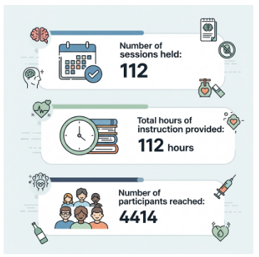
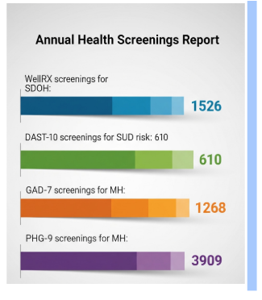
Education
Outcome
Quality Assurance Program Plan - Annual Report CY2025

Slide 53
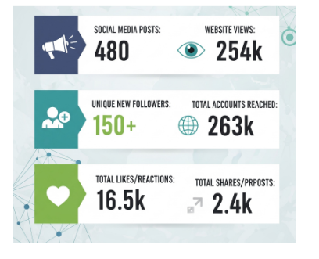
Information Dissemination
Environmental Approach
Number of prevention tips posts on EHI website
Number of community wellness events participated in
Number of materials distributed at events
Number of media campaigns on Instagram

Slide 54
Outcome Evaluation, Process Evaluation, and Recommendations
Outcome Evaluation
Process Evaluation
1,888
The information contained within this report demonstrates the extent to which EHI was in compliance with the QAPP review types: clinical, administrative, medication, and satisfaction.
Process evaluation findings confirm robust quality assurance infrastructure with systematic review processes, timely completion of required activities, and appropriate documentation across all review categories.
Total Admissions
667 Total Completions
44.8% Successful Completion
SUD (IOP, OP-SUD and Residential)
Recommendations
With each quarterly review, comprehensive feedback is provided to administrative staff for clinical, administrative, and primary care teams, including:
Recommendations for quality improvement
Corrective Action Plans for identified deficiencies
Supervisory Support and Encouragement
Personnel Staff Development Needs
Quality Assurance Program Plan - Annual Report CY2025

Slide 55
Looking Forward: Commitment to Excellence
The 2025 Quality Assurance Program Plan Annual Report demonstrates Elmhurst Home, Inc.'s unwavering commitment to delivering exceptional, evidence-based behavioral health services. Our comprehensive quality assurance framework—spanning clinical, satisfaction, administrative, and medication reviews—ensures continuous improvement and accountability.
Key accomplishments include high satisfaction rates across all consumer surveys, strong compliance in clinical documentation, exceptional staff supervision coverage, robust training compliance, and outstanding medication safety performance. Post-discharge follow-up data reveals significant year-over-year improvements in abstinence maintenance, reduced criminal justice involvement, and decreased psychiatric crises.
Opportunities for continued growth include enhancing appointment availability, strengthening functional outcome focus, expanding employment support services, and improving crisis planning education. These targeted improvement areas will guide our quality enhancement initiatives in the coming year.
As we move forward, we remain dedicated to our mission of providing "Recovery with Dignity"—delivering person-centered, stage-matched, evidence-based, and recovery-oriented systems of care for individuals addressing substance use disorders, mental health issues, and criminal conduct challenges. Our quality assurance processes ensure that this mission translates into measurable, meaningful outcomes for every individual we serve.
Quality Assurance Program Plan - Annual Report CY2025

