Slide 1
Housing Fraud and Social Services Benefits
Thomas Gravely, Assistant Special Agent in Charge
Philip Kwok, Special Agent

Slide 2
Course Agenda
Overview of HUD and HUD programs
Role and responsibilities of the OIG
Overview of HUD Low-Income Housing Assistance Programs
Social Services benefits crimes and HUD
Common housing fraud cases
Key documents to support housing fraud investigations
Successful prosecutions
OIG’s Assistance
Questions & Answers

Slide 3
U.S. Department of Housing and Urban Development (HUD)
National Housing Act of 1937
  Promoted middle-class homeownership through Federal Housing Administration (FHA) mortgage insurance program
  Creates public housing for low-income families
Became A Cabinet-Level Agency, in 1965
  Incorporated tenant-based housing assistance payment program

Slide 4

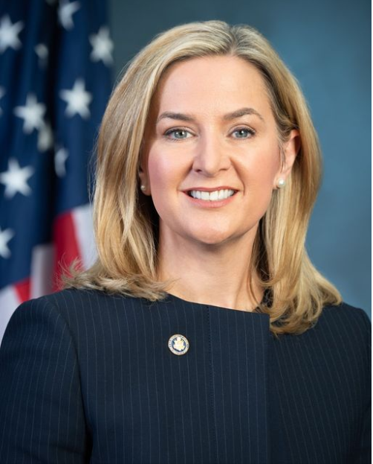
HUD Secretary and HUD Inspector General
Secretary
Marcia L. Fudge
      Inspector General
      Rae Oliver Davis

Slide 5
HUD’s Major Departments
Public and Indian Housing – Housing subsidies to local public housing authorities to provide housing and rental assistance to low-income families.
Multifamily Housing – Housing subsidies to private owner to provide housing to low-income families.
Federal Housing Administration (FHA) – Mortgage Insurance Program
Community Planning and Development (CPD) – Block grants to communities for neighborhood improvements, homeless programs, and community developments

Slide 6
Office of Inspector General (OIG)
Established by the Inspector General Act of 1978
“Congressional Watchdog”
Conduct independent and objective audits, evaluations, investigations, and other reviews
Prevent and detect fraud, waste, and abuse
  Office of Audit
  Office of Evaluation
  Office of Investigation
  Office of Special Inquiry

Slide 7
About Us
HUD OIG conducts independent audits, evaluations, investigations, and other reviews to safeguard HUD’s programs from fraud, waste, and abuse and to identify opportunities for HUD programs to progress and succeed.
Its oversight responsibilities include making timely recommendations to improve the economy and efficiency of HUD programs and operations.
The Inspector General reports directly to both the Department Secretary and Congress about the efficiency and effectiveness of HUD’s programs and operations.
Notes:
Administrations, Congress, and the public look to OIGs as a source of independent information and relies on their work in conducting Congressional oversight.
OIG has broad oversight authority and responsibilities that encompass all HUD programs and operations, including those that expend HUD funding or do business with HUD. This includes coverage across the United States.

Slide 8


OUR VISION
OUR MISSION
Influential oversight through
strategic collaboration, innovation,
and independent work.
Safeguard HUD’s programs from
fraud, waste, and abuse and identify opportunities for HUD programs to
progress and succeed.

Slide 9

Office of Investigation (OI)
Approximately 150 Special Agents Nationwide
Full Statutory Arrest and Subpoena Authority
Authorized direct access to all HUD records and information

Slide 10
Office of Investigation Regions
Notes:
Administrations, Congress, and the public look to OIGs as a source of independent information and relies on their work in conducting Congressional oversight.
OIG has broad oversight authority and responsibilities that encompass all HUD programs and operations, including those that expend HUD funding or do business with HUD. This includes coverage across the United States.

Slide 11
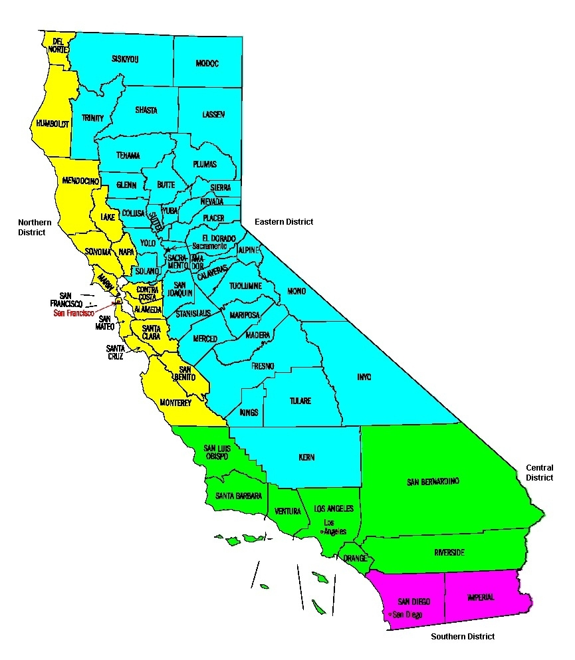
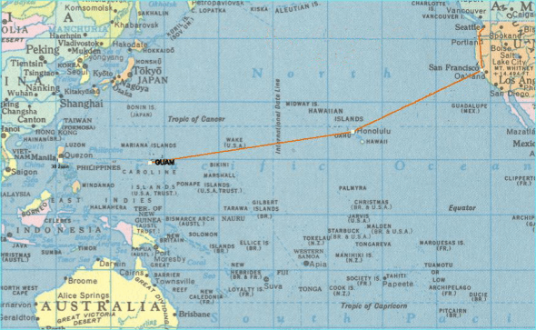
Areas of Responsibility
Los Angeles – 6 Agents (HI & Guam)
San Francisco – 2 Agents
Las Vegas – 1 Agent
Phoenix – 1Agent
Seattle – 3 Agents
Salt Lake – 1 Agent
Denver – 4 Agents

Slide 12








Where have we been for the last 5 years?

Slide 13
HUD Data - California
Program Label | Subsidized Units Available | % Occupied | # Reported | Number of People Per Unit | Household Income Per Year | % Households Where Wages Are Major Source of Income | % Households Where Welfare Is Major Source of Income | % With Disability Among All Persons In Households
Public Housing | 26,109 | 94 | 24,235 | 2.6 | $22,105 | 34 | 12 | 16
Housing Choice Voucher | 355,620 | 86 | 312,697 | 2.1 | $19,073 | 23 | 7 | 29
Project Based Section 8 | 102,293 | 95 | 98,138 | 1.7 | $16,474 | 15 | 5 | 11
Data obtained from HUD’s Office of Policy Development and Research – Picture of Subsidized Households - 2021 data based on 2010 Census
https://www.huduser.gov/portal/datasets/assthsg.html#2009-2021_query

Slide 14
Housing Assistance Budget
Data obtained from HUD’s 2023 Budget In Brief
2023 Budget In Brief Report Cover-web (hud.gov)

Slide 15
Low-Income Housing Programs
Public Housing– housing units owned and operated by local public housing authorities (PHA)
Housing Choice Voucher (HCV) –tenants can live anywhere that the private landlord accept Section 8 payments (administered by PHAs)
Multifamily Housing – multifamily housing complex owned and operated by private landlord
  Eligibility and assistance based on household composition, income, and assets.

Slide 16
The Welfare and Housing Connection
Income-based programs
Documents for eligibility (SSN)
Identical clienteles
Lies to one, lies to all (other Social Services benefits)
Programs typically do not share information; however, HUD/housing authorities can obtain welfare, supplemental security income (SSI), and employment information through Enterprise Income Verification (EIV), except self-employment.
Limited verifications due to understaffed oversight
No incentives to wean clients off program

Slide 17
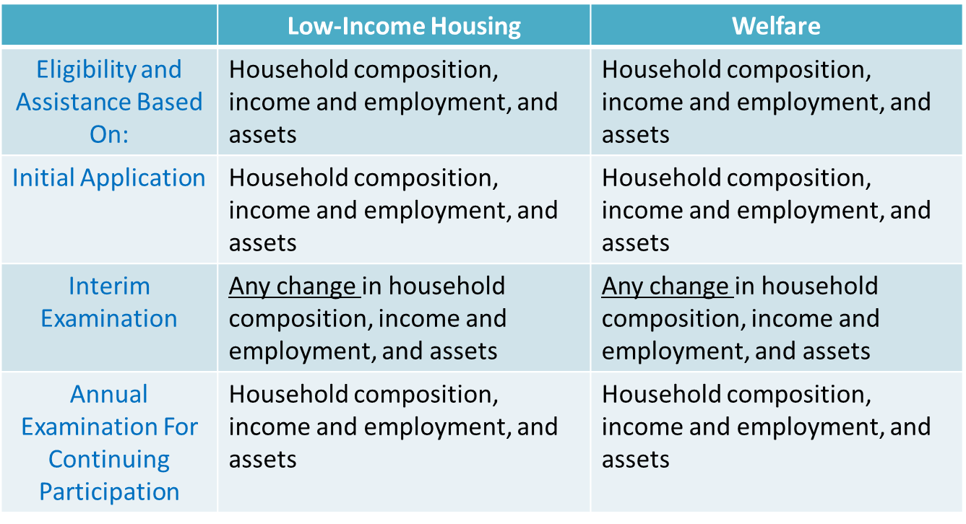
Similarities Between Low-Income Housing and Welfare

Slide 18
OIG and Public and Indian Housing (PIH)
PIH
  HCV
  Project-Based
  Public Housing
  Capital Funds
  Operating Fund
  HOPE VI
Types of Fraud
  Landlord/Tenant
  Public housing employees & contracts
  Procurement
  Public Corruption
  Kickback/Bribery (Anti-Trust)

Slide 19
Fraud Schemes in PIH (continued)
Public Housing/Office of Native American Programs
  Kickbacks / Pay to Play (redevelopment/development) (shell subcontractors)
  Tenant certification misrepresentations (income/asset/unauthorized tenant)
  Subleasing (sectioning off the apartments)
  Fugitive felon / sex offender
  Bumping individuals to top of waiting list -$
  Drug houses/human smuggling/trafficking (apartment used for illegal activity)
  Creating false documents to qualify tenants
  False landlord / Check Fraud
  Lead-Based Paint
  Contract/Grant Fraud

Slide 20

Section 8 HCV Program
Nickname “Section 8”
Golden ticket
  No term limits
  “Portability”
  Passed on
Stigma?

Slide 21
Section 8 Housing Choice Voucher Program (HCV)
Introduction
General
Rules/Procedures/Terms (Federal Government)
Key documents
Social Services fraud working groups
War stories

Slide 22
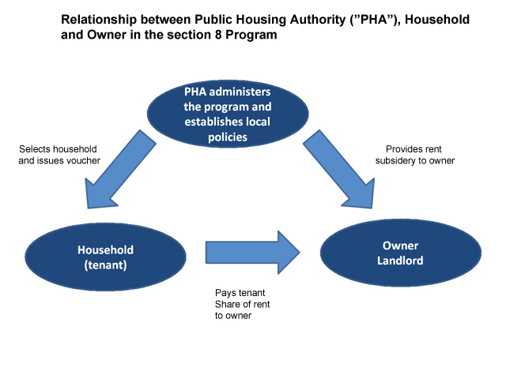
Section 8 HCV Program

Slide 23

HCV Tenant Approval Process
Initial online or in person application
“Waiting list”
  Lottery
  Preferences
  Date Stamp

Slide 24

HCV Tenant Approval Process
Eligibility
  Income /Assets
  Family composition
  Criminal history
Disability Exception

Slide 25
HCV Key Documents
Voucher
  Signed by family representative
    “Head of Household” (HOH)
  States, “The unit must be the family’s only residence.”
  States, “Commit fraud…in connection with the program.”
  HUD requires minimum 60 days
  Passed on?

Slide 26
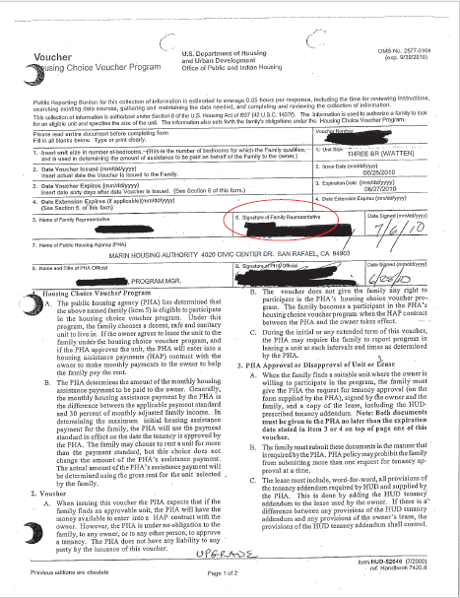
Voucher

Slide 27
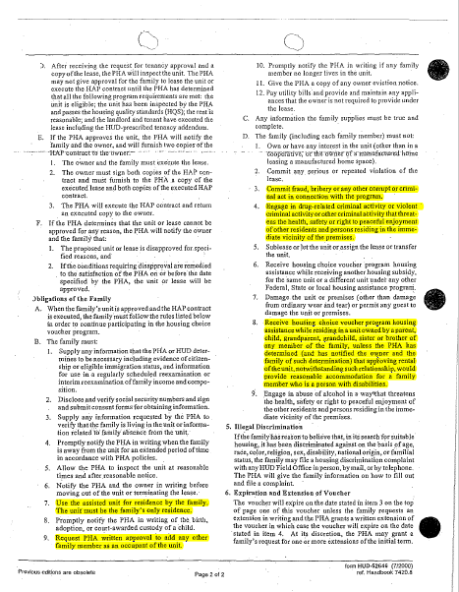
Voucher

Slide 28
HCV Key Documents
Personal Declaration
  Annual Basis
  “Annual”; “Recertification”; “Re-Examination”
  Verification of Employment
  Assets
    Property
    Bank Accounts

Slide 29
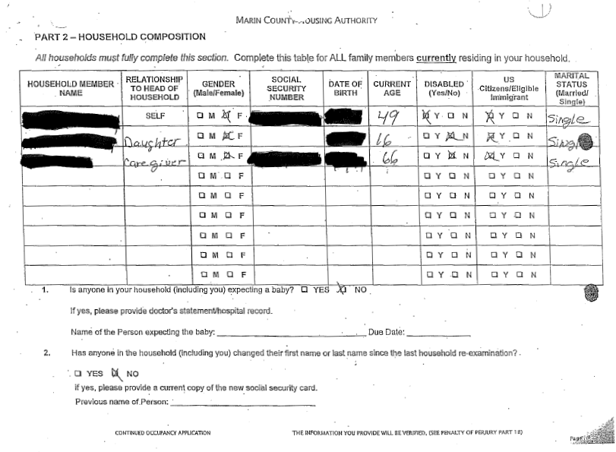
Annual
Re-examination

Slide 30
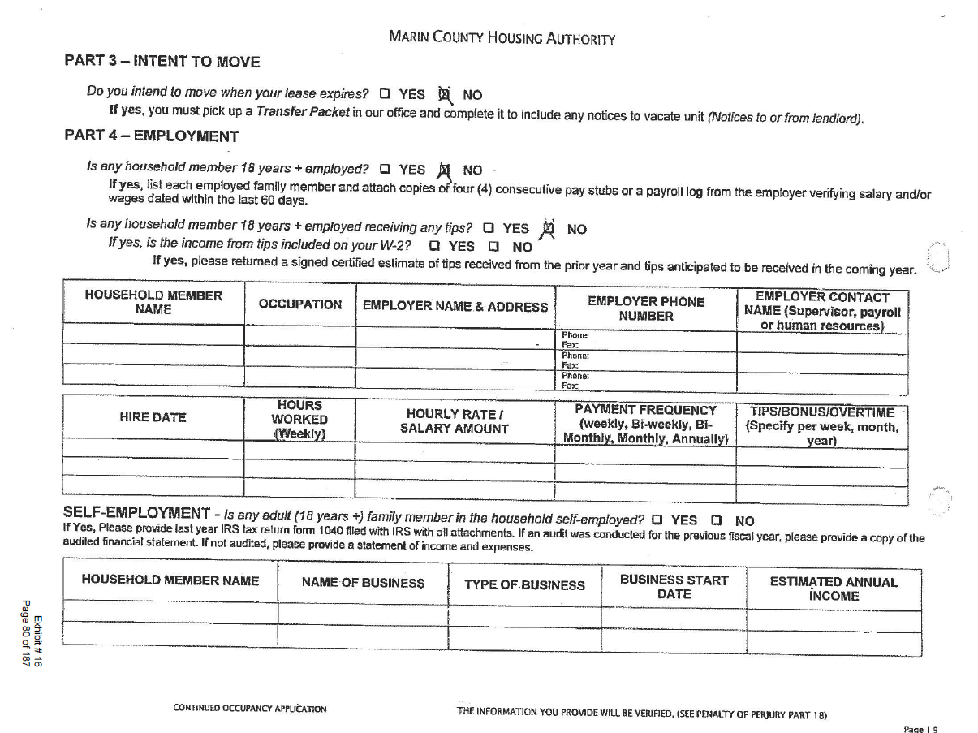
Annual
Re-examination

Slide 31
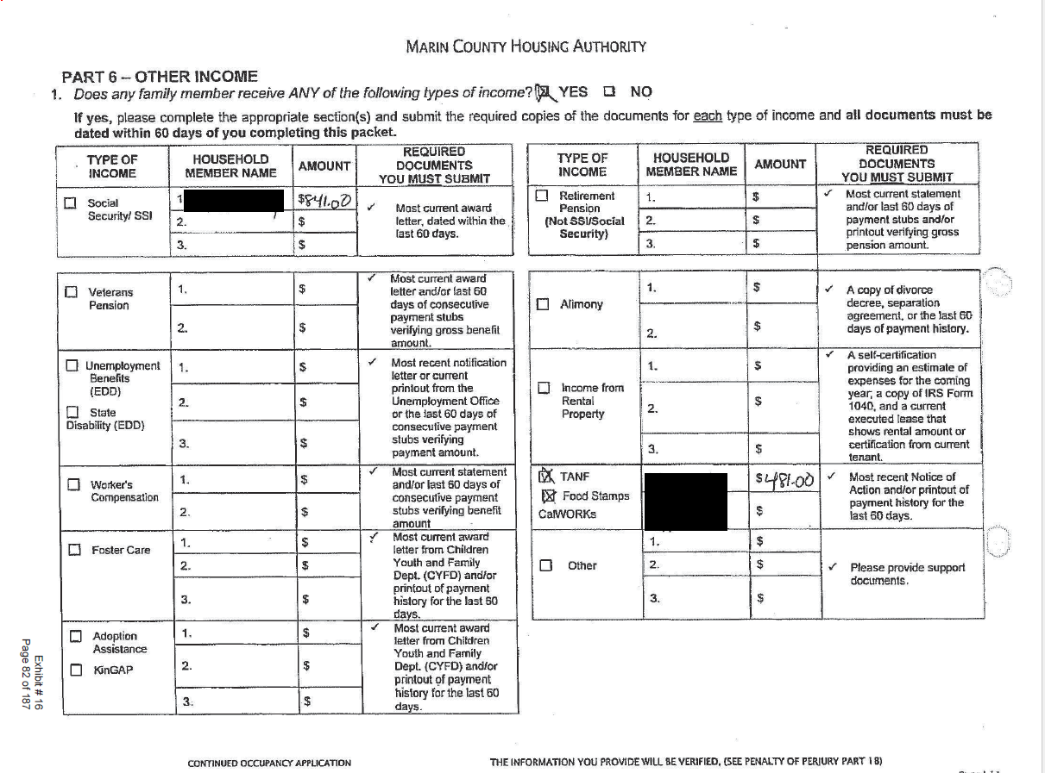
Annual
Re-examination

Slide 32
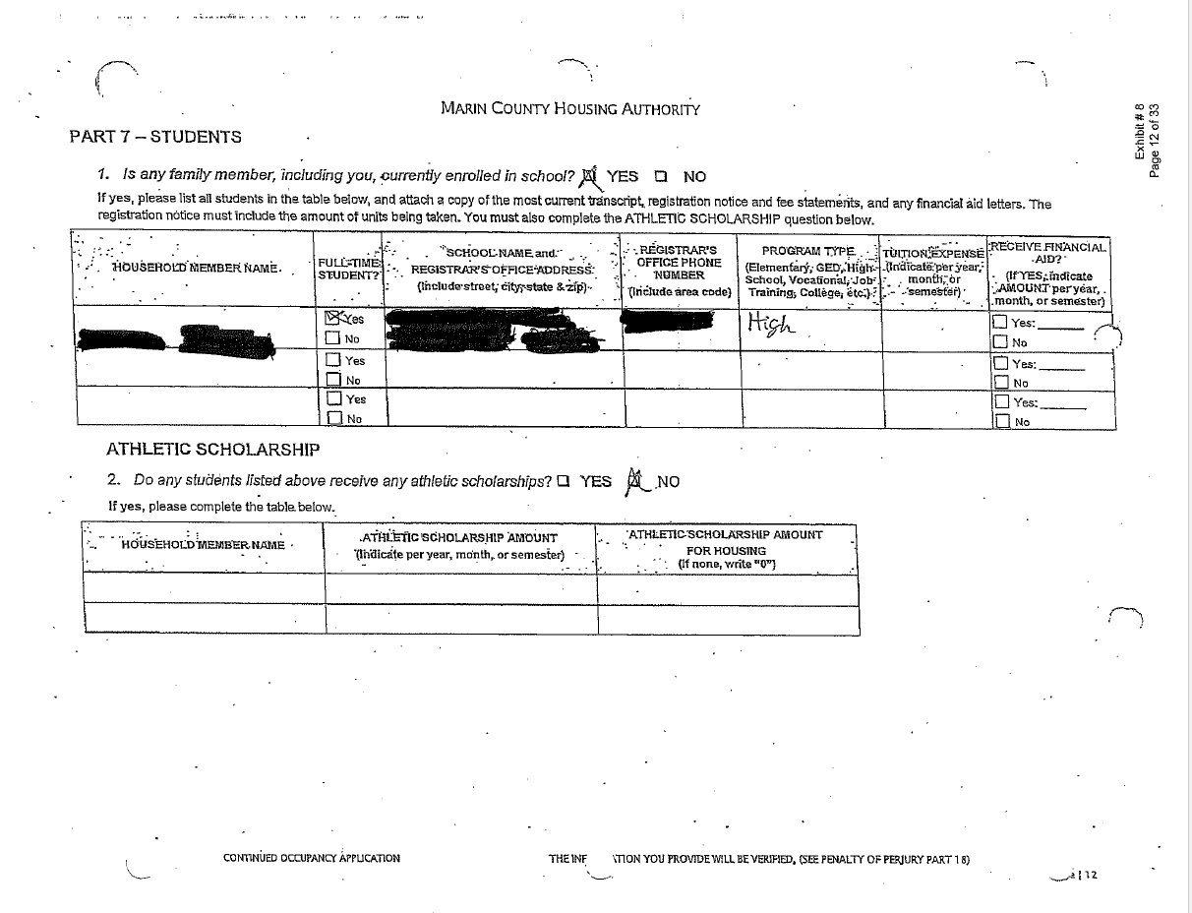
Annual
Re-examination

Slide 33
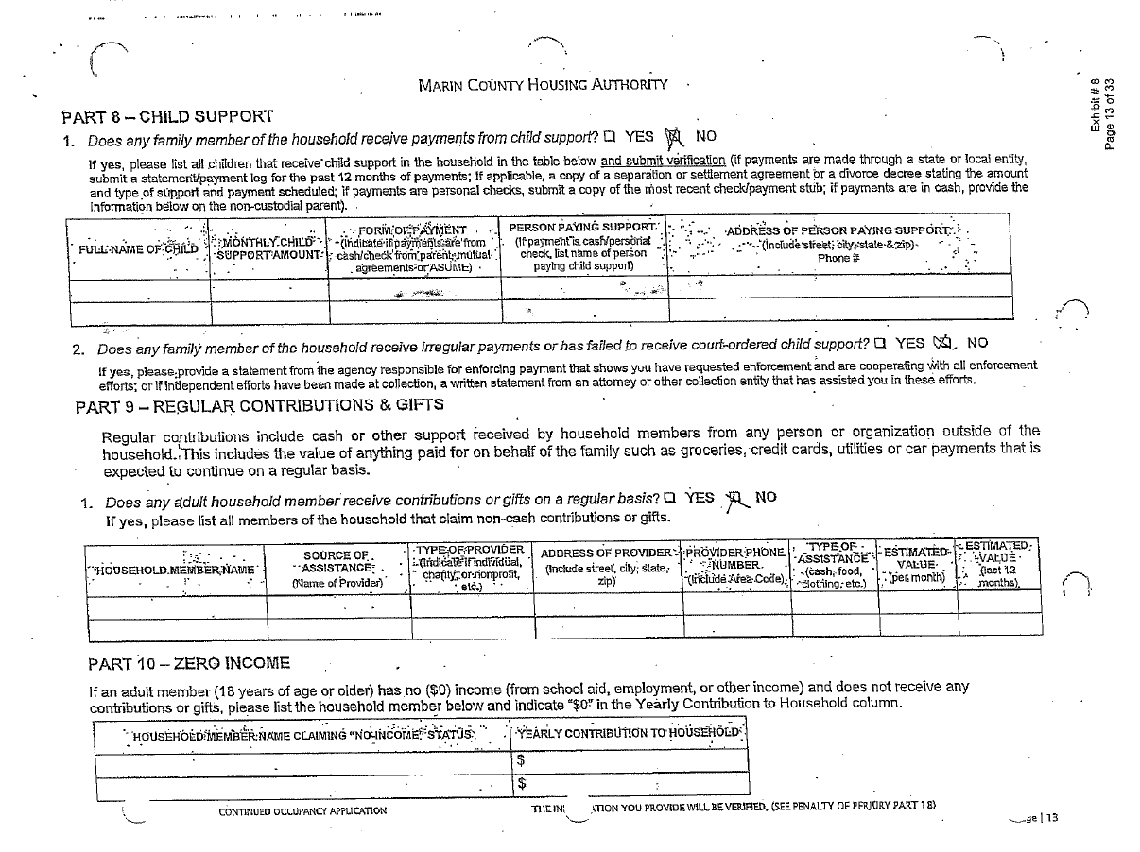
Annual
Re-examination

Slide 34
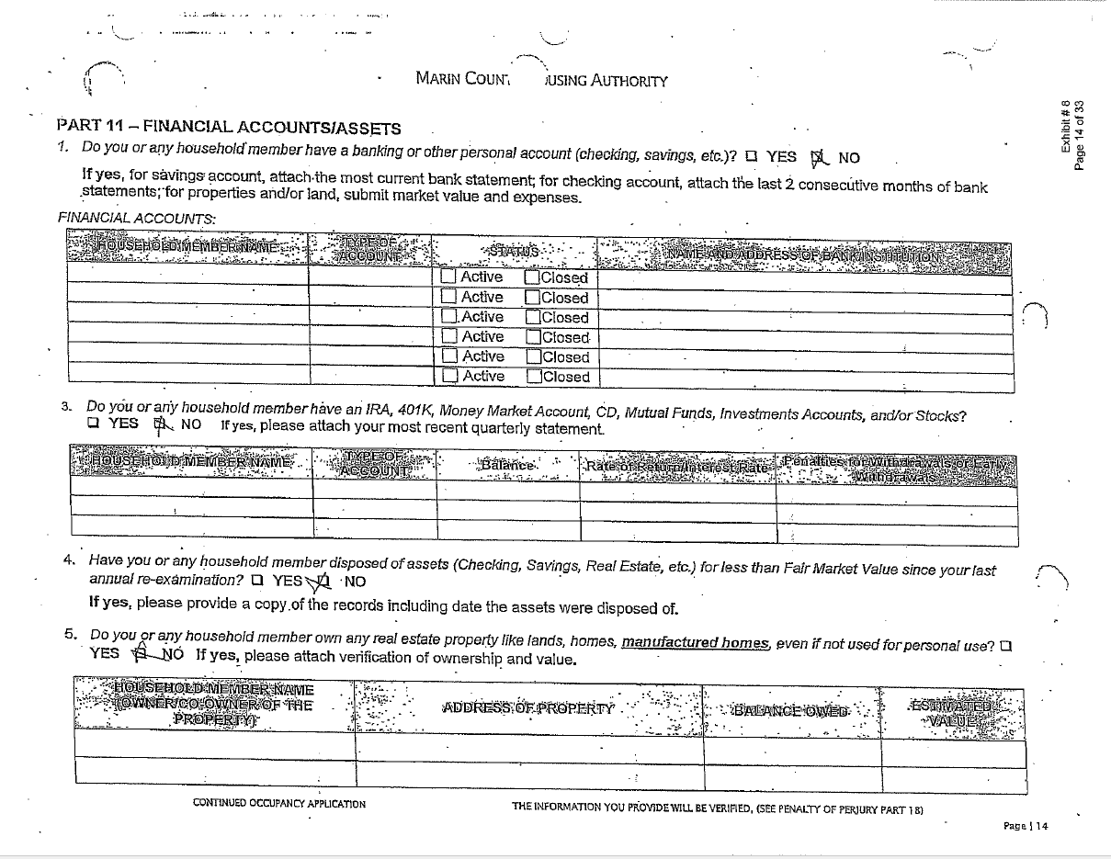
Annual
Re-examination

Slide 35
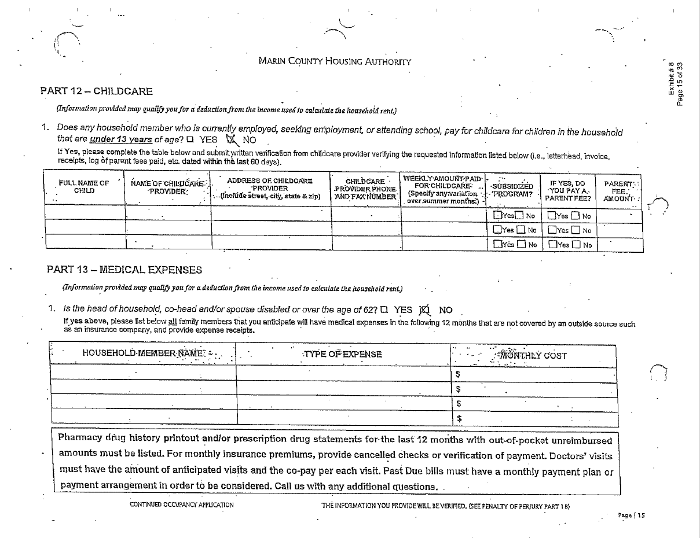
Annual
Re-examination

Slide 36
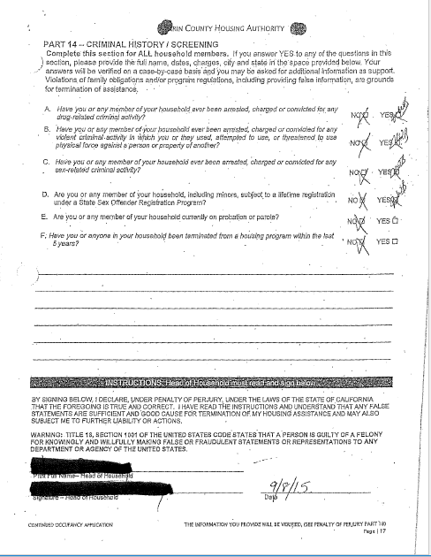



Annual
Re-examination

Slide 37
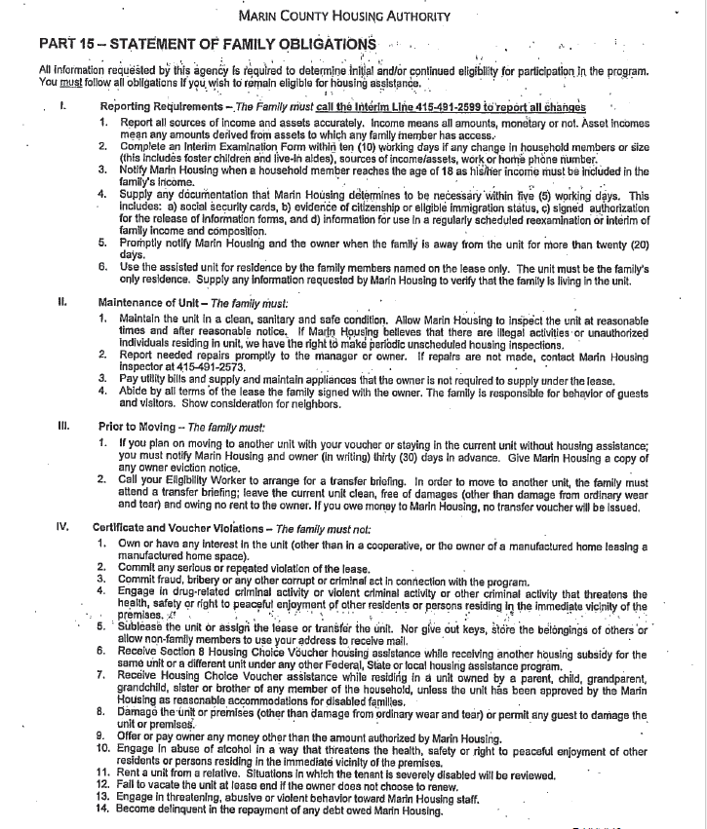
Annual
Re-examination

Slide 38
HCV Key Documents
Interim
  Required
  Change(s)
    Tenants typically advise of a loss of income or assets not a gain which would reduce their subsidy or size of their unit.

Slide 39
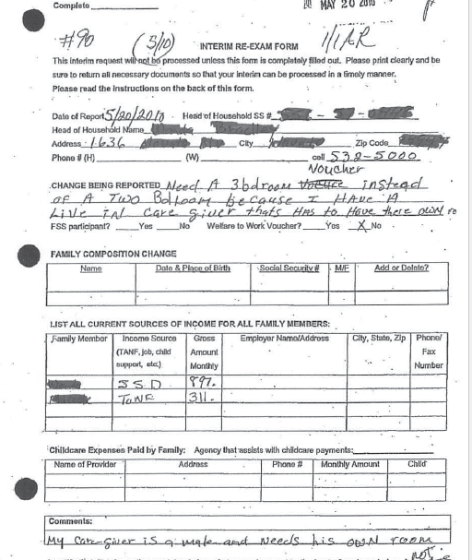
Interim
Re-examination

Slide 40
Housing Fraud
Tenant
  False Reporting; Subletting or Failure to Occupy Unit; Ownership of Section 8 Unit; ID theft
Landlord
  Conflict of Interest, Side-Payments, Failure To Report Move-Out, Extortions
Public Housing Authority Employee
  Bribery; Selling Section 8 Voucher
Fugitives
  Unauthorized, harboring
Sex Offenders
  Unauthorized, harboring

Slide 41
Housing Fraud: A Crime of Opportunity
A break-down in the Housing Authority’s detection and prevention control
A lack of Housing Authority’s oversight and follow-through
Rewards outweigh risks and punishment

Slide 42
Investigative Challenges
Missing records or poor record-keeping
Housing Authority’s key documents lacking false statements and/or perjury warning. These documents include but not limited to:
  Applications
  Personal Declarations
  Non-Assets Affidavits
  Non-Income Affidavits
  Verification of Employment
  Request for Lease Approval
  Lease Agreement
  Housing Assistance Payment (HAP) Agreement
  Non-Family Related Leasing certification

Slide 43
Investigative Challenges…Continued
PHA failed to review the submitted information
PHA failed to take action
PHA failed to adhere or did not know Section 8 protocols
Tenants were not apprised of their obligations
Inconsistent administration of PHA fraud policy

Slide 44
Privacy Act of 1974, 5 United States Code Section 552a
No agency shall disclose any record which is contained in a system of records by any means of communication to any person, or to another agency, except pursuant to a written request by, or with the prior written consent of, the individual to whom the record pertains [subject to 12 exceptions].”
Exception for Law Enforcement (USC 552a(b)(7)): Allows information to be released “(7) to another agency or to an instrumentality of any governmental jurisdiction within or under the control of the United States
1) for a civil or criminal law enforcement activity if the activity is authorized by law; and,
2) if the head of the agency or instrumentality has made a written request to the agency which maintains the record specifying the particular portion desired and the law enforcement activity for which the record is sought.”

Slide 45
Federal and State M.O.U.

Slide 46
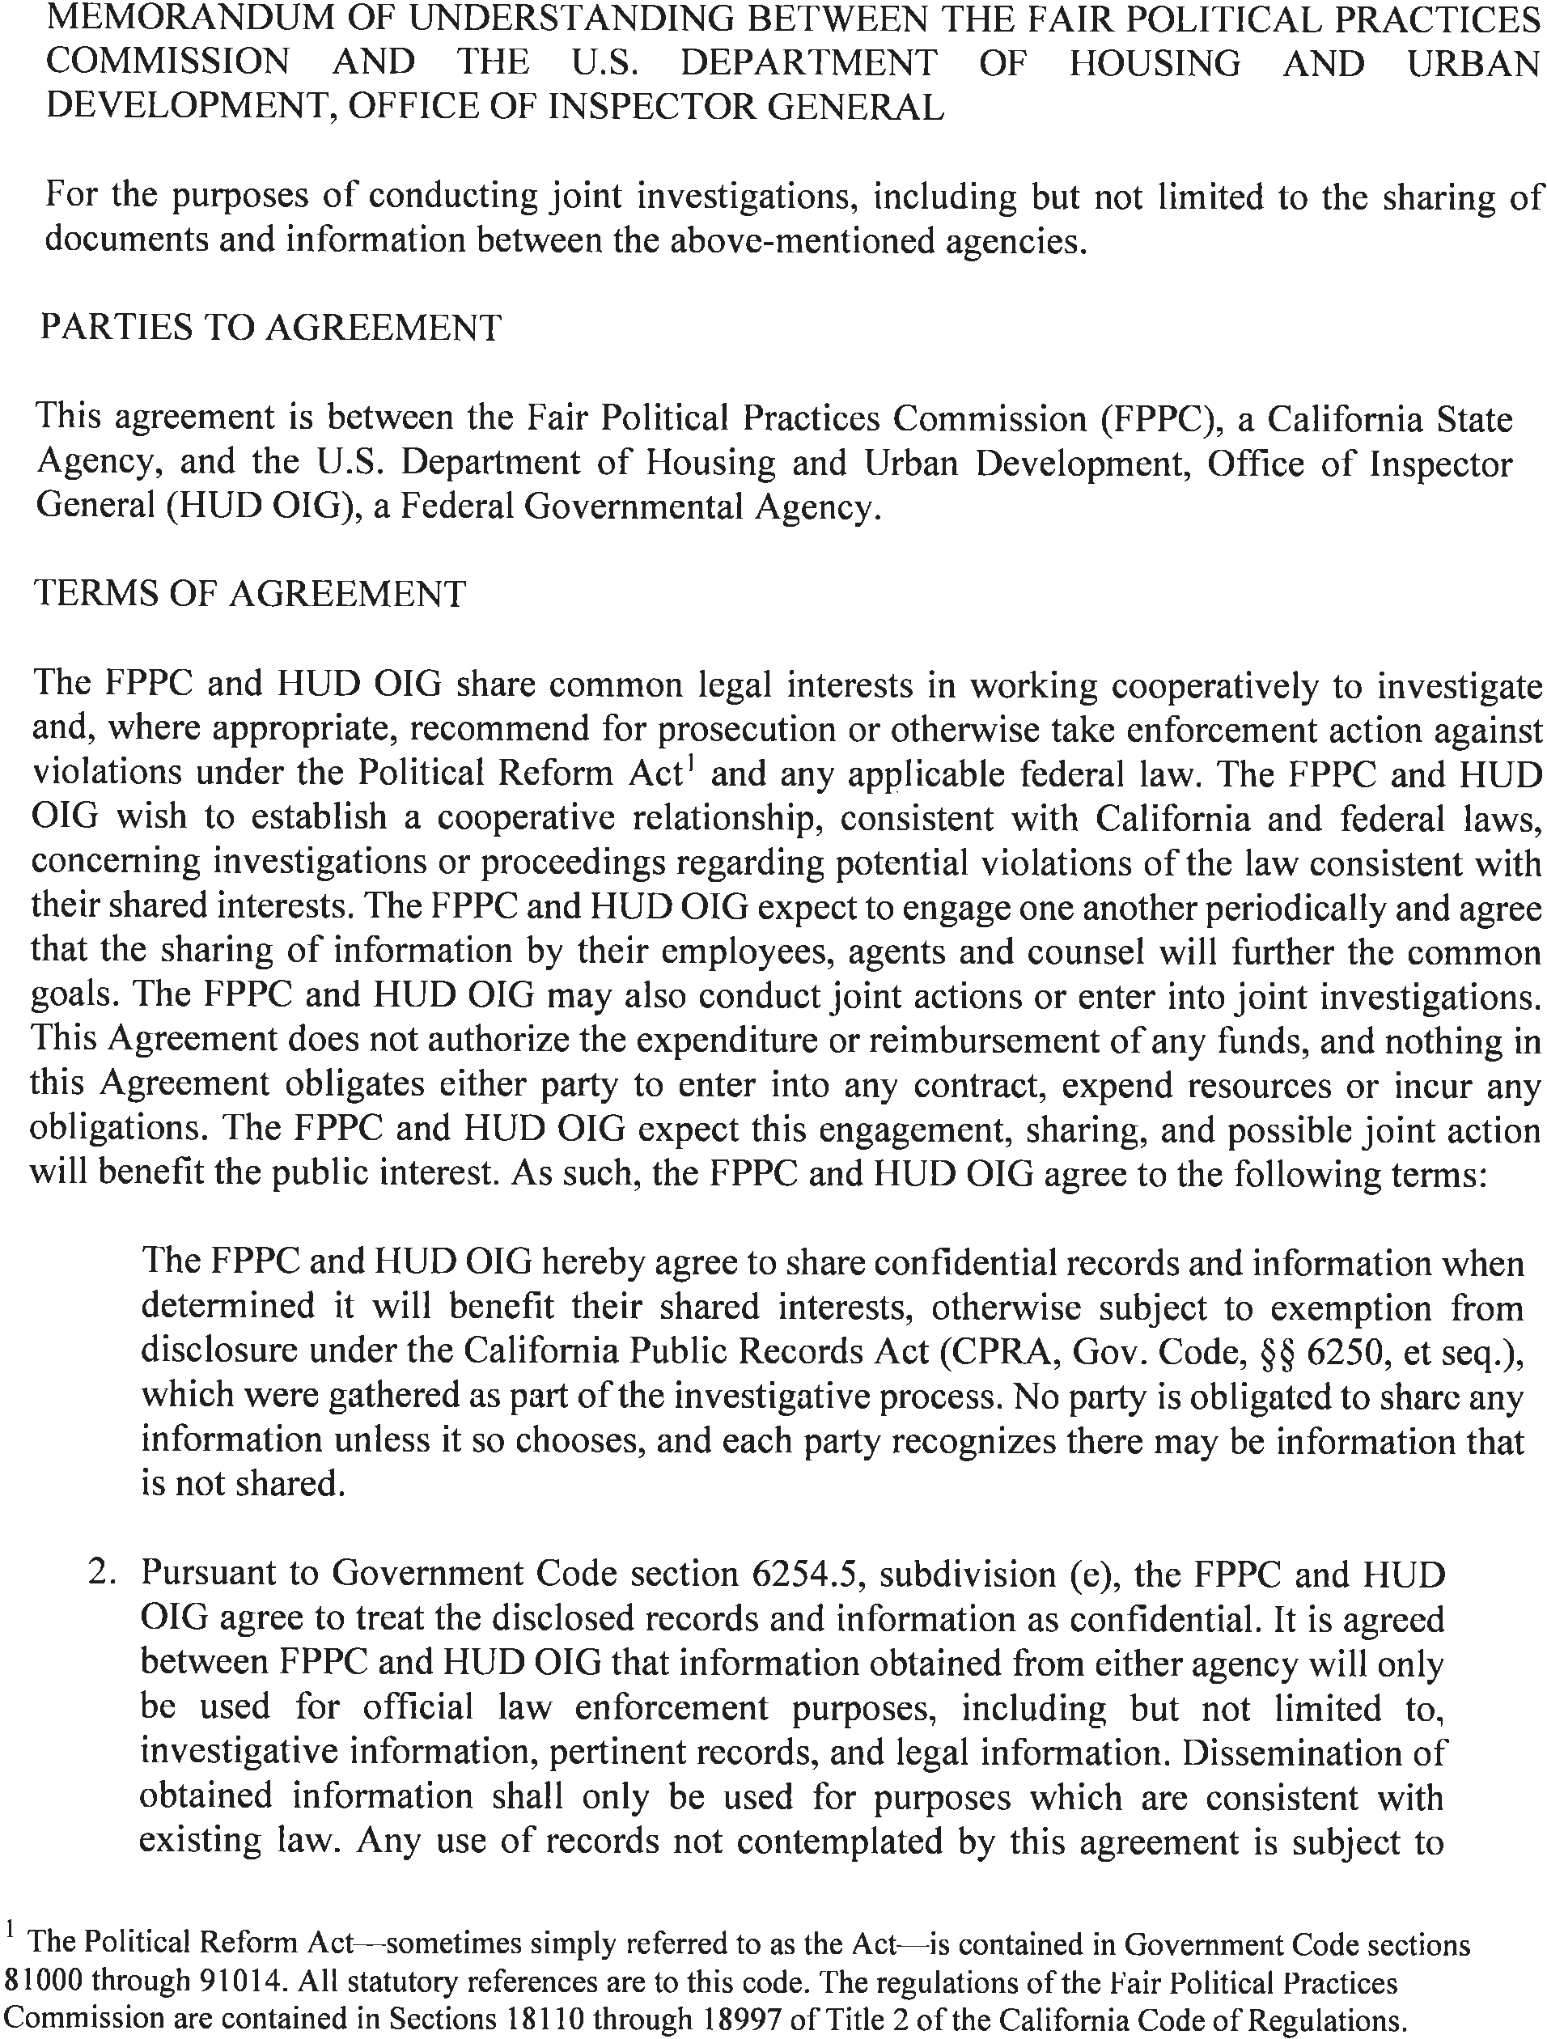

Slide 47
HOUSING FRAUD
Two forms of Housing Fraud
Profit
Housing

Slide 48
HUD/SSA/IHSS Fraud
  HOUSING SUBSIDY RECIPIENT TO SERVE 12 YEARS IN PRISON FOR FRAUD
  A Housing Choice Voucher Program participant EDWARD REED was charged with Grand Theft and Perjury.
  From 2008 to 2016, the program participant orchestrated a fraud scheme in which he failed to report his marital status and assets to the local PHA. The tenant maintained assets of over $300,000 located in various bank accounts, in addition to his wife owning property. As a result, the PHA paid over $60,000 in HAP checks on his behalf to which he was not entitled.
  During the course of the investigation, it was also determined that he was also fraudulently collecting other government subsidies to include health care services and social security benefits.
  HUD OIG; SSA OIG; and the California Department of Health Care Services, Investigations Unit conducted this investigation.

Slide 49
HUD/SSA/IHSS Fraud
Misrepresented his eligibility to receive government benefits for housing subsidies, Social Security benefits and IHSS.
13 counts of Grand Theft and Perjury
$ 275,779.06 in total restitution
    Reed was ordered to pay
      $60,380 in HUD subsidies to the Housing Authority for City of Los Angeles
      $84,374.56 to CA Department of Health Care Services
      $50,883.22 to CA Department of Public Social Services
      $80,141.28 to the Social Security Administration
Sentenced to 12 years in prison.

Slide 50
HUD/DPSS/USPS Fraud “Babysitter Club”
‘
Housing Choice Voucher Program participant, Tamara Wilson (Wilson), was charged with (1) count of Grand Theft and (11) counts of Perjury.
From 2008 to 2020, Wilson, a U.S. government employee (USPS), concealed her secondary employment and income earned as an independent contractor (Provider) for Crystal Stairs from the housing authority. HUD OIG’s investigation revealed that Wilson failed to report over $200,000 in income to the housing authority; resulting, in a governmental loss of $158,482 in housing assistance payments. Wilson was arrested at her place of employment (U.S. Post Office), and later entered into a plea agreement which she was sentenced to 24 months of formal probation and ordered to pay full restitution. Subsequently, Wilson was terminated from the USPS and is pending housing termination.

Slide 51
HUD/DPSS “Faire Belle”
Housing Choice Voucher Program participant, Shalanda Williams (Williams), was charged with (1) count of Welfare Fraud, (1) count of Grand Theft, and (2) counts of Perjury.
From 2013 to 2015, Williams deceived the County of Los Angeles Department of Public Social Services (DPSS) by underreporting her income as a self-employed hair stylist in order to qualify for larger amount of DPSS benefits. In addition, Williams intentionally deceived the housing authority by failing to disclose her true household composition, subletting a bedroom in her Section 8 unit, and not reporting her income as a hair stylist. As a result, DPSS claimed a loss of $19,428, and the housing authority claimed a loss of $19,666. Williams was sentenced to 36 months of summary probation, 200 hours of community service, and order to pay full restitution to the housing authority and DPSS.

Slide 52
Additional Fraud Cases
VICTIM: PHA, DPSS
SUBJECT: B. LOPEZ
PROGRAMS DEFRAUDED: HUD SEC 8, Welfare
COMBINED LOSS: $18,655
CHARGED: WI 10980(c)(2), WI 10980(g), PC 487(i), (3) PC 118
PLEAD NO CONTEST: WI 10980 (c)(2) and PC 487(i)
SENTENCED TO 3YRS PROBATION

Slide 53
Additional Fraud Cases…Continued
VICTIM: HECTOR, SSA, PHA, DSS
SUBJECT: RAFAEL FLORES
PROGRAMS DEFRAUDED: HUD SEC 8, SSI, DSS
COMBINED LOSS: $258,000
CHARGED: (2) PC 487, PC 118, PC 530.5(A)
PLEAD GUILTY: PC 118 and PC 530.5(A)
SENTENCED TO 2YRS and ordered to pay full restitution

Slide 54

Mortgage Fraud
Robbery without the GUN!

Slide 55
Mortgage Fraud
Frauds
  Loan Origination
  Mtg. Rescue Scams / Loan Modification / Quit Claim
  Short Sales
  Owner-occupied
  Straw buyers
  Fraudulent filing (clouding title)
  Squatters / Imminent Domain or Blight
Single Family
  FHA
  1-4 Family Mortgage Insurance (203(b))
  Rehab. Loan Insurance (203(k))
  HECM (255)
  Property Improvement Loan
  REO

Slide 56

Potential Persons of Interest
Borrower(s)
Real Estate Agent
Appraiser
Loan Officer
Loan Processor
Notary
Underwriter

Slide 57
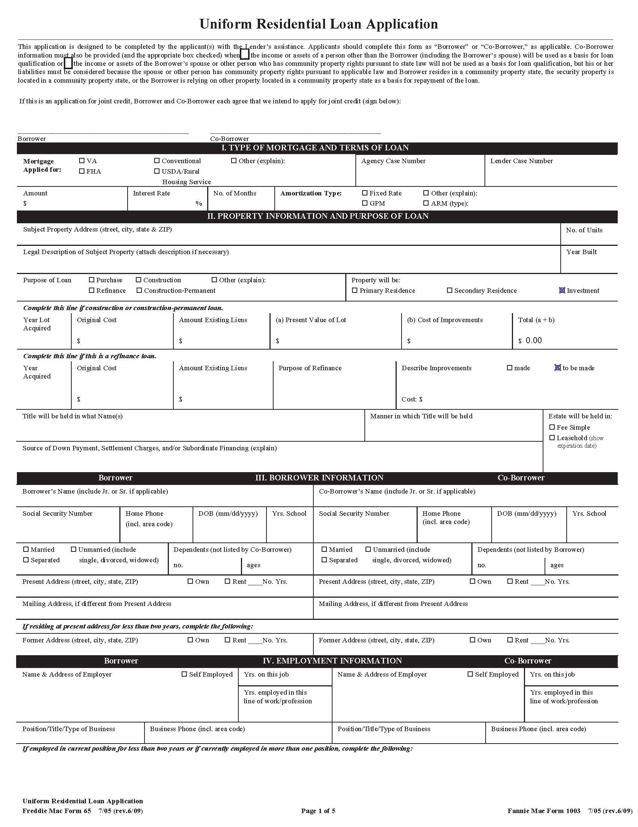
Uniform Residential Loan Application

Slide 58
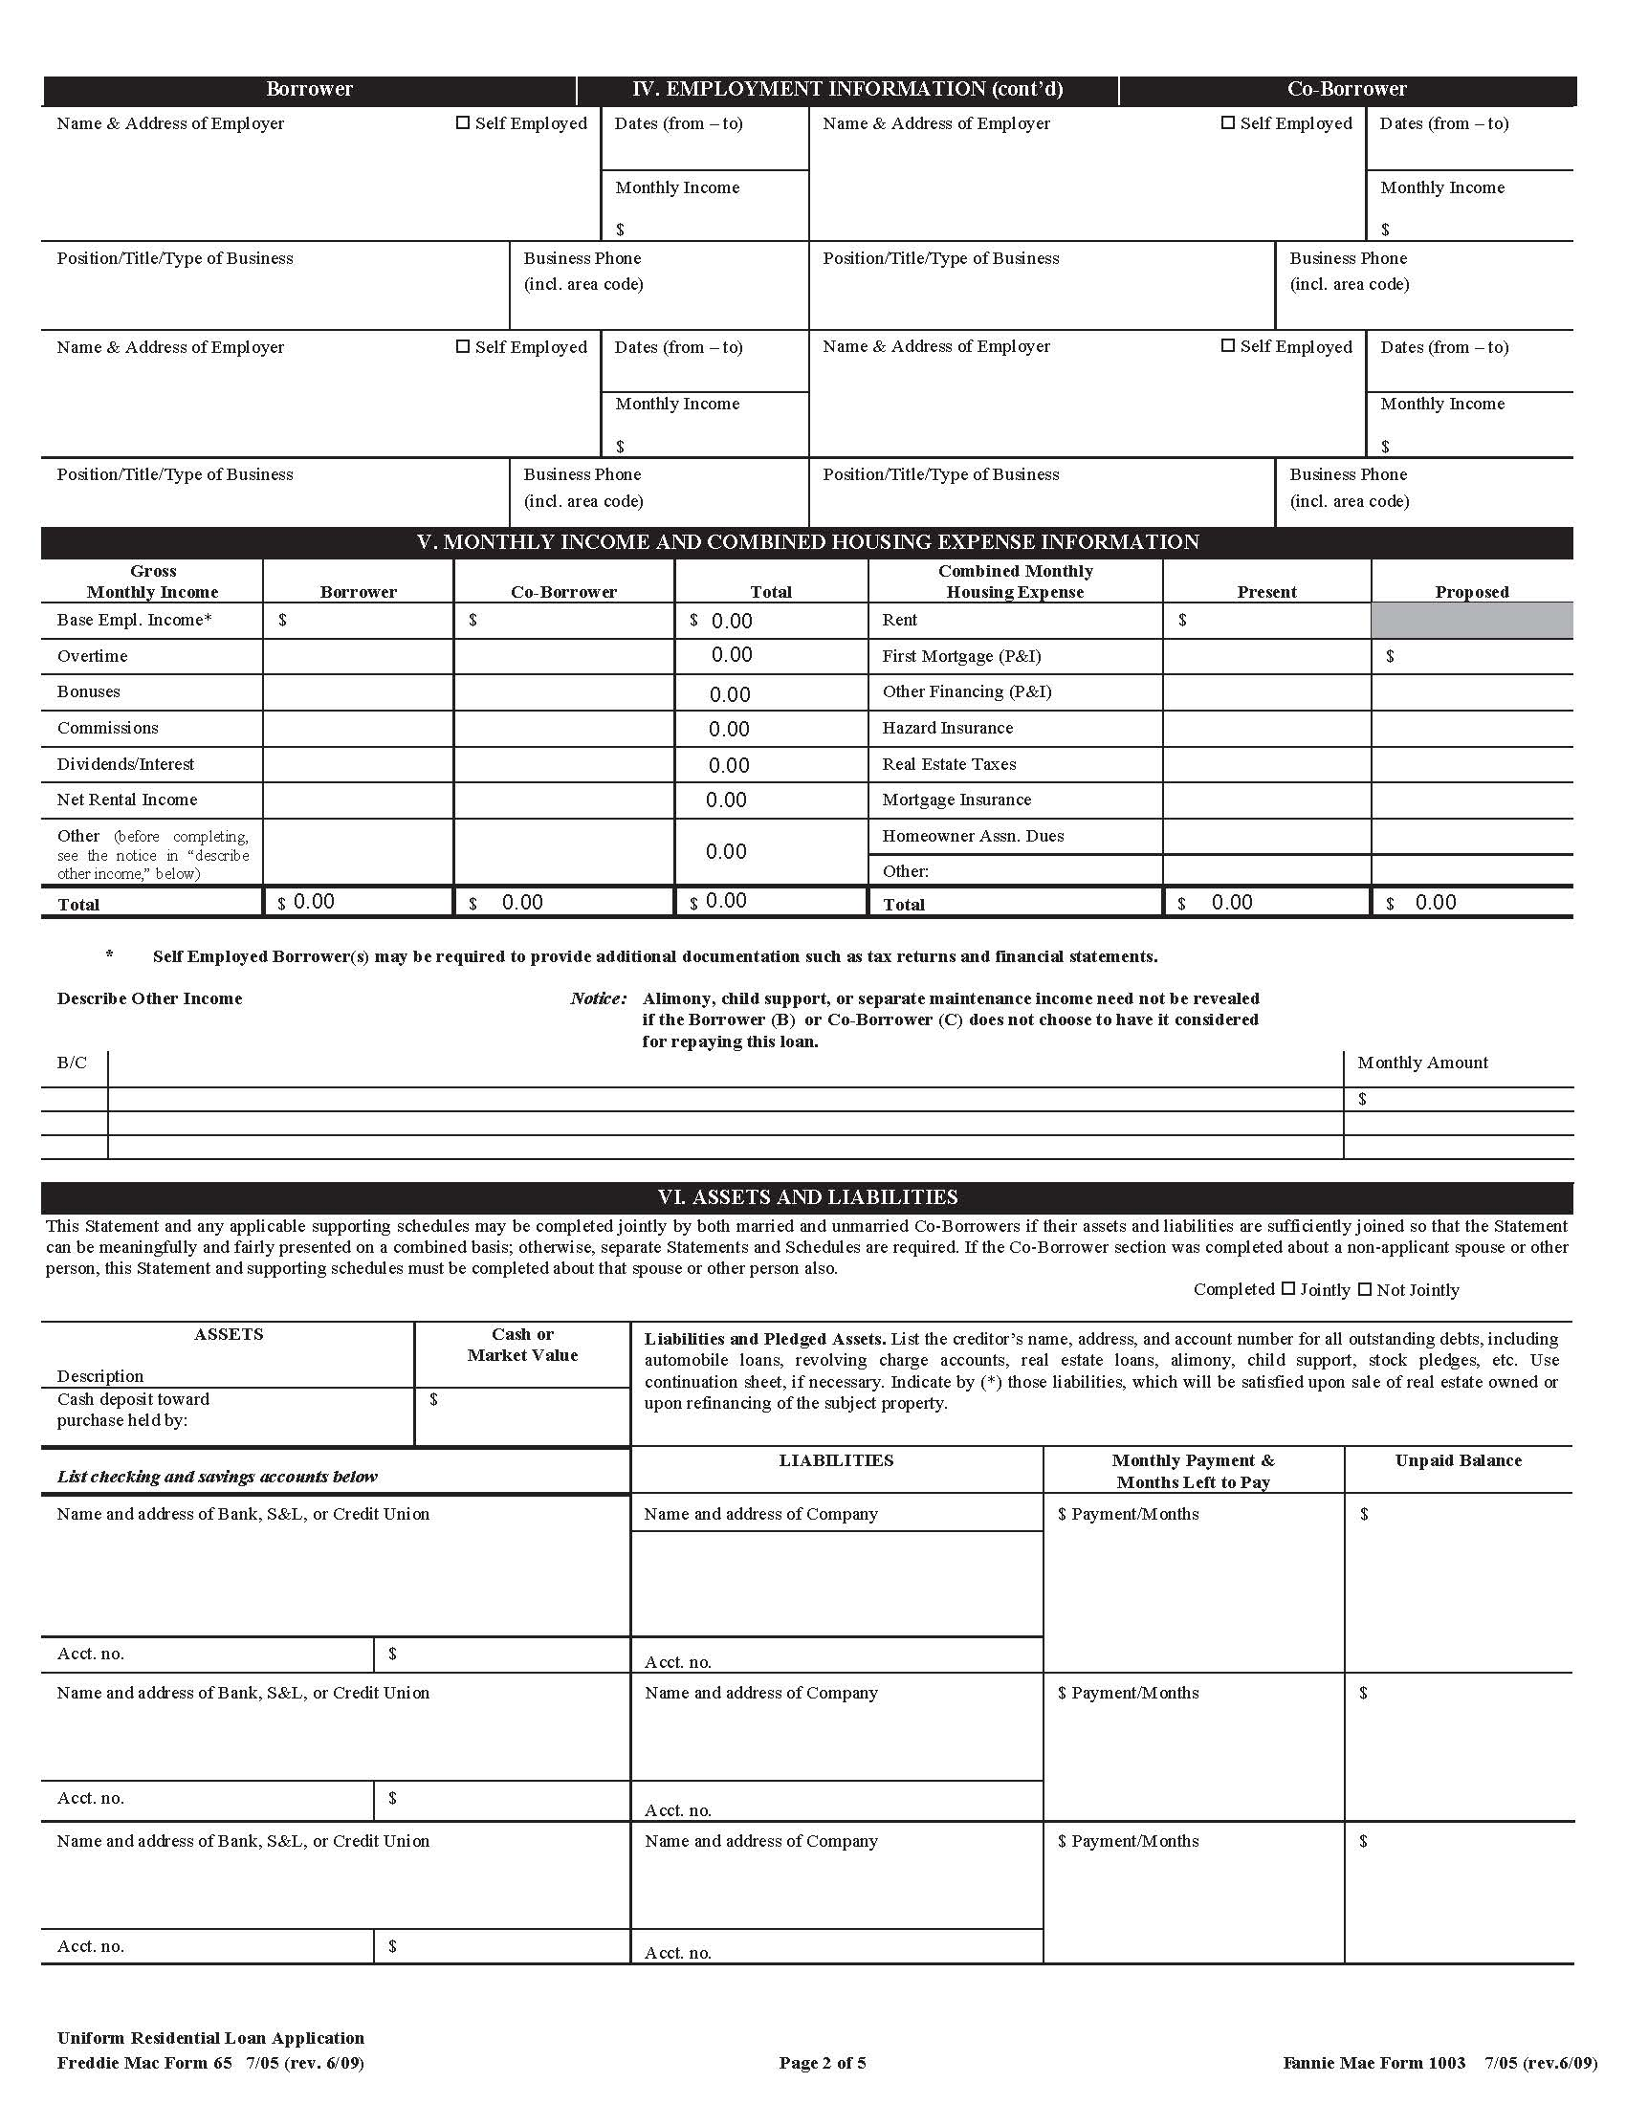
Uniform Residential Loan Application

Slide 59
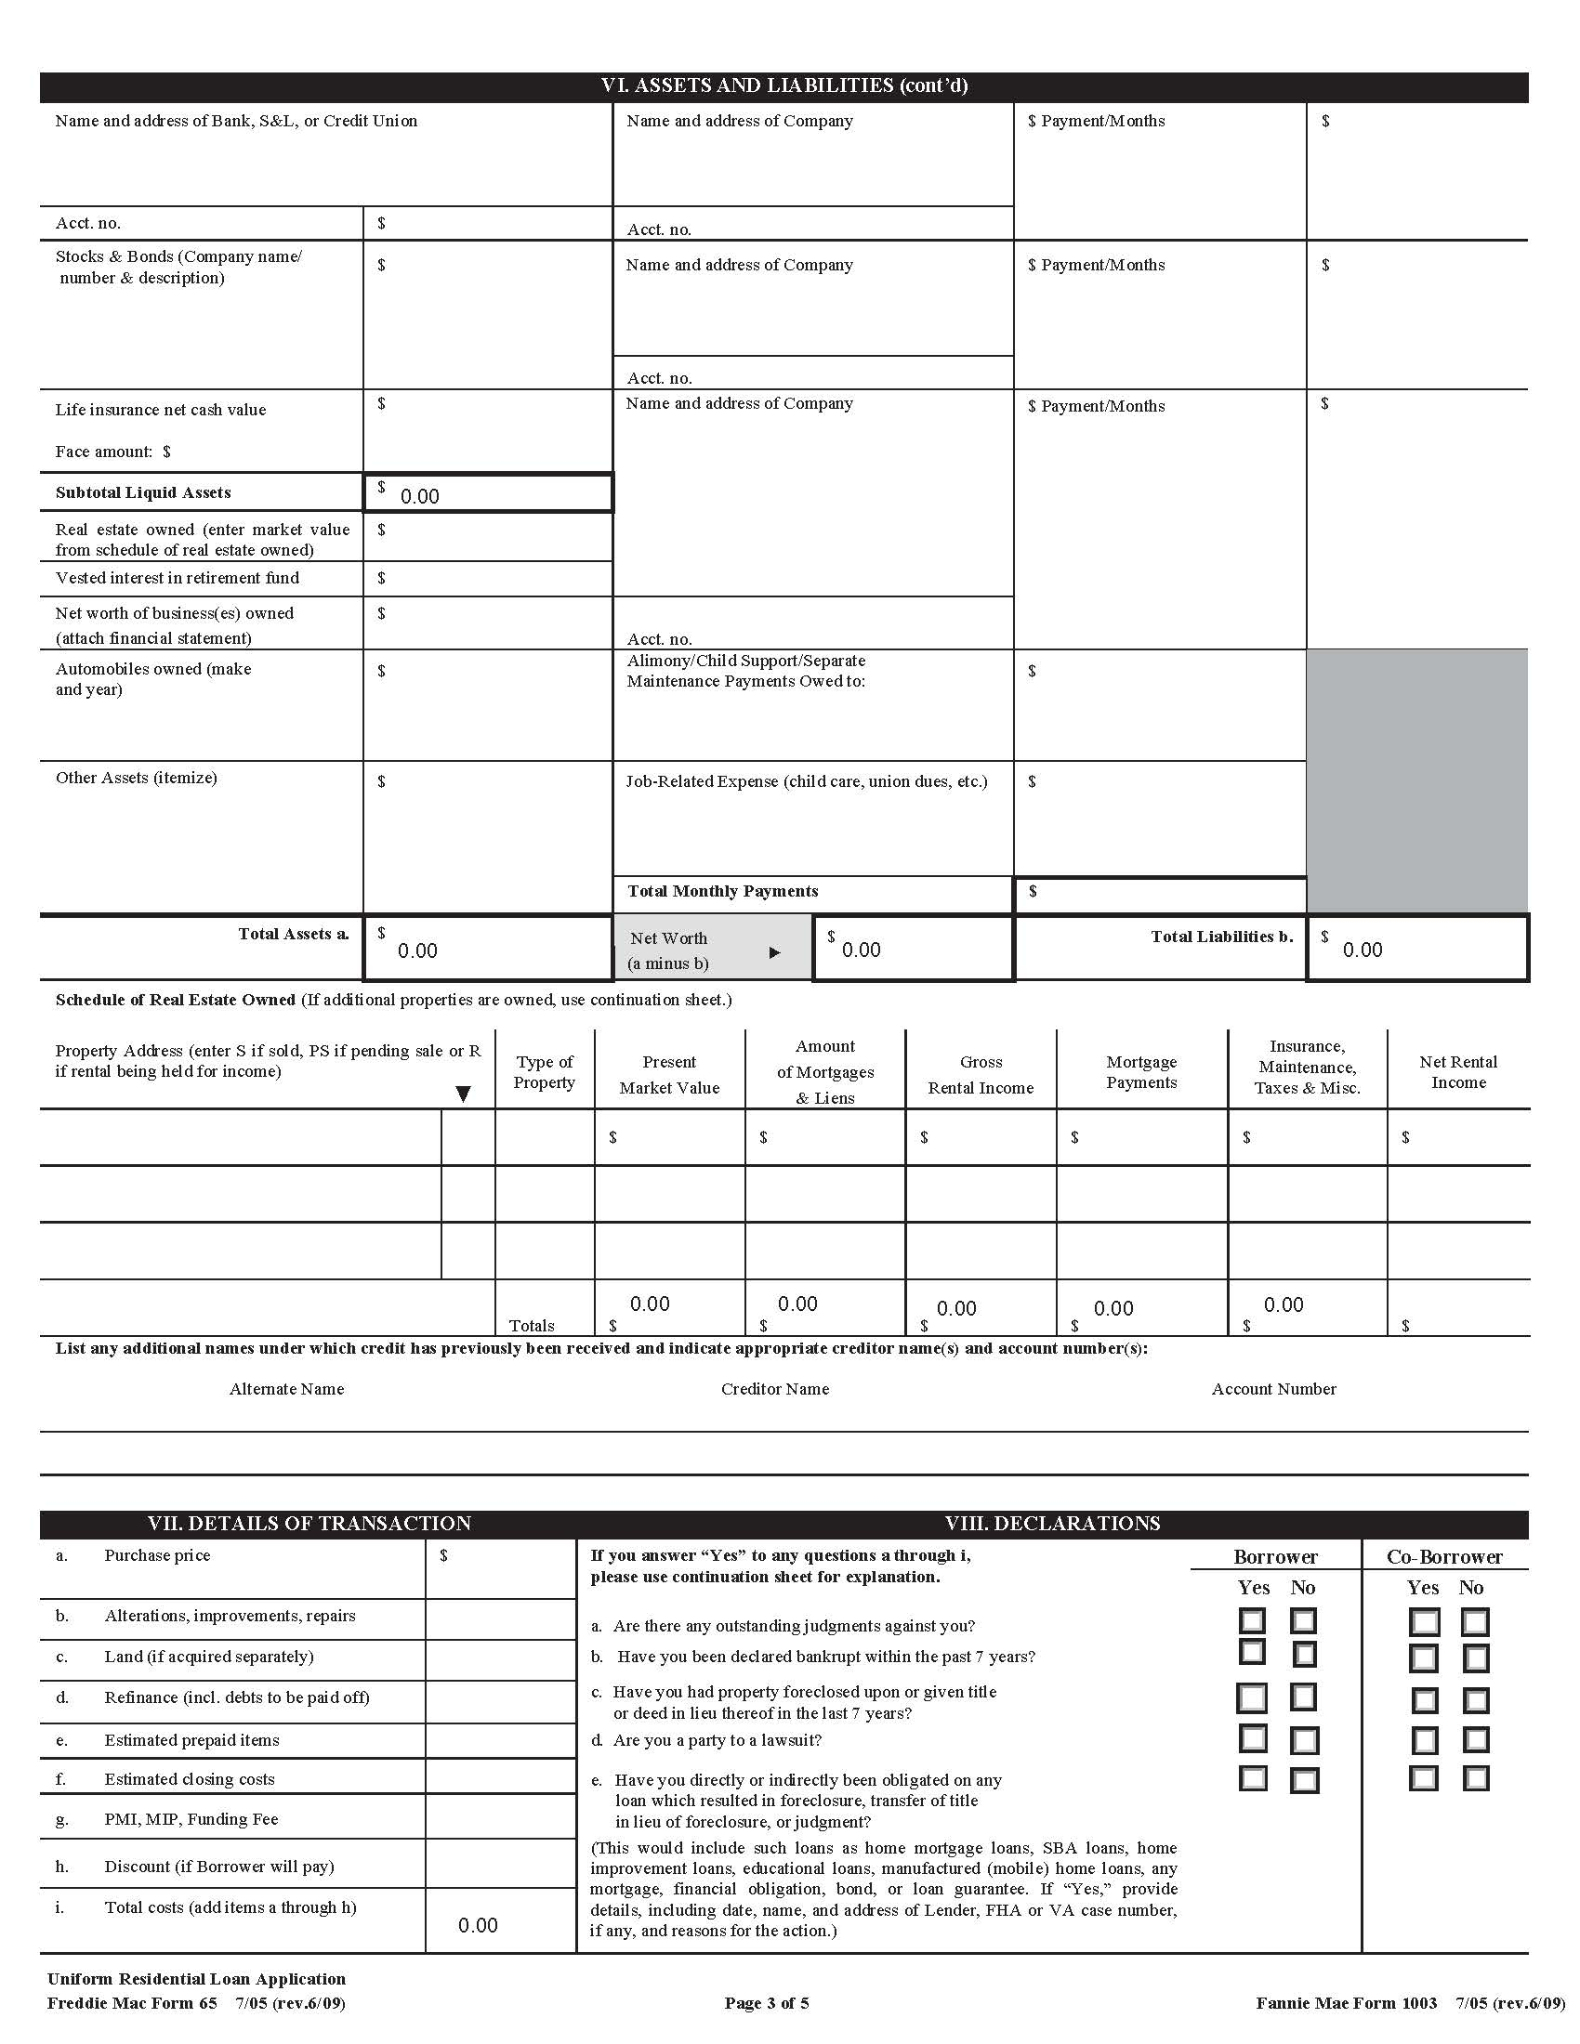
Uniform Residential Loan Application

Slide 60
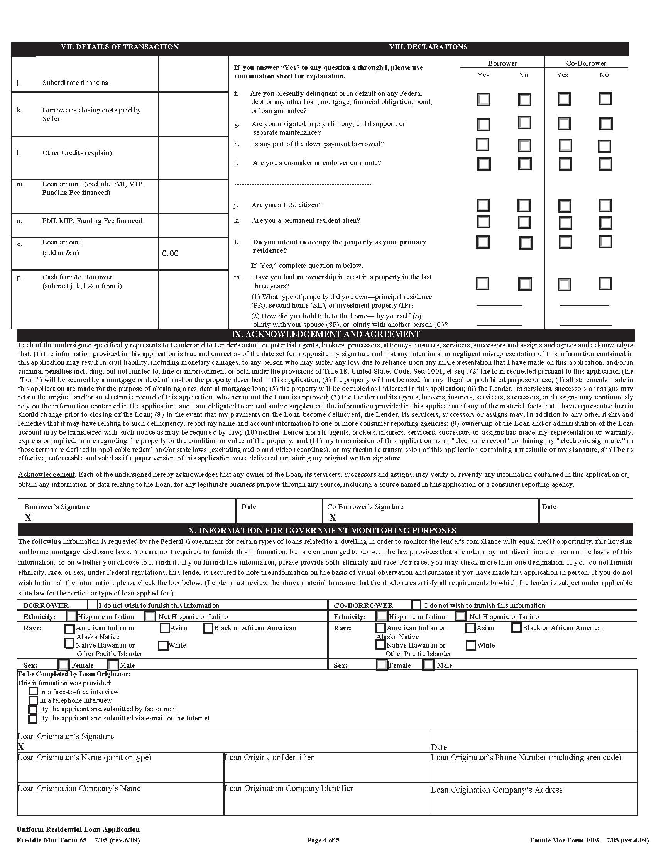






Uniform Residential Loan Application

Slide 61

Disaster Oversight Investigations
Types of Disasters
  Hurricane
  Tornado
  Fire
  Earthquake
  Erosion (AK)
    Partial/Total destruction of property
      Flood / Mold = Structural
Types of Investigations
  Public Corruption (PH/ONAP/SF/CPD)
  Block Grants
  Relocation
  Contracts (New Construction/Rehab)
Single Family
  FHA
  RESPA (Misdemeanor)
  1-4 Family Mtg. Ins (203(b))
  Rehab. Loan Ins. (203(k))
  HECM (255)
  Property Improvement Loan
  REO

Slide 62

Questions

Slide 63
Contact Us
Aaron McCullough
Special Agent
213-534-2695
amccullough@hudoig.gov
Koon Hong (Philip) Kwok
Special Agent
213-534-2510
kkwok@hudoig.gov
Thomas Gravely
Assistant Special Agent in Charge
213-434-8293
tgravely@hudoig.gov

