Slide 1

ADMINISTATIVE DISQUALIFICATION HEARINGS
How to Review, Prepare and Present a
Successful ADH

Slide 2
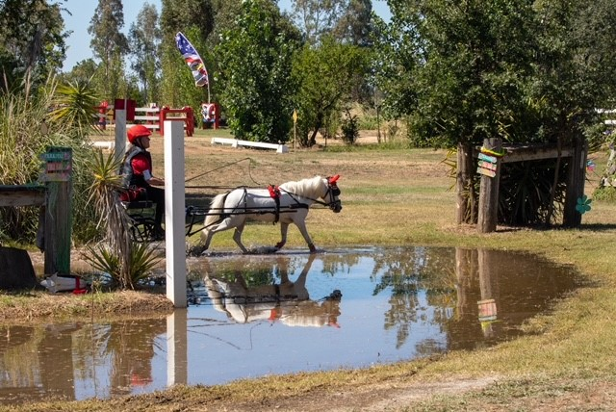
Introduction:
Kandi Griffith
Welfare Fraud Specialist, San Joaquin County
I have been with San Joaquin County since January 1989.
My first position was as a receptionist in the intake applications lobby for Human Services. I then went on to work as a dispatcher for the San Joaquin County Sheriffs, followed by a position with the Treasurer/Tax Collector. In November 1998, I was hired as an Eligibility Worker where I worked in the intake division for 13 years. In 2011, I was hired as a Welfare Fraud Investigator in a non-sworn position, now classified as Welfare Fraud Specialist.
In 2016, while attending a CWFIA Roundtable meeting in Monterey County, I gained information on the processing of Administrative Disqualification Hearings. Upon return from that Roundtable, I presented a solution to the Deputy Director for processing the backlog of ADH cases and was given the greenlight to try a pilot program for one year. That first year, I obtained 98 signed ADH waivers and collected over $250,000.00 in over-issuances and over-payments. After that, I was given the green light to continue the program. San Joaquin County currently processes more Administrative Disqualification Hearings than any other county in California. We currently hold 20 - 30 Administrative Disqualification Hearings per month with an excellent success rate. In addition to processing and presenting Administrative Disqualification Hearings, My division, currently 3 of us, investigate all of the early fraud complaints and in person employer verifications.
In my spare time, I compete in the sport of Combined Driving with my horses Kara and Jackson. I am usually cheered on by my husband Jim and remotely by my son Wyatt, who is stationed in Hawaii with the US Navy.

Slide 3


Administrative Disqualification Hearings
Counties investigate cases of alleged Intentional Program Violation (IPV).
These cases are pursued either through administrative or criminal proceedings.

Slide 4

CalWORKs
An IPV is intentionally making a false or misleading statement or misrepresenting, concealing, or withholding facts; committing any act intended to mislead, misrepresent, conceal, or withhold facts or propound a falsity; and committing these acts to establish or maintain CalWORKs eligibility or to increase or prevent a reduction in the amount of a CalWORKs grant.
The county can initiate a CalWORKs ADH when the county determines that the respondent has committed an ADH based on preponderance of the evidence.

Slide 5

CalFresh
An IPV is intentionally either making a false or misleading statement; misrepresenting, concealing, or withholding facts; or committing any act that violates the Food Stamp Act or the CalFresh program regulations.
The county can initiate a CalFresh ADH by informing CDSS State Hearings Division that it has clear and convincing documentary evidence of an IPV.

Slide 6

Rejected By DA
If the case meets the definition of an IPV, the case must be referred to the District Attorney for prosecution or to the ADH process.
If the case is not accepted by the District Attorney or the District Attorney does not act on the referral, the county must initiate ADH proceedings. (Review for appropriate ADH guidelines.)

Slide 7
This course will cover how to review, prepare, and present an Administrative Disqualification Hearing Statement of Position.
The course will also cover what makes an ADH successful as well as some of the pitfalls resulting in a denial or dismissal.

Slide 8

Administrative Disqualification Hearing Process
Benefit Recovery Unit (BRU) gathers the supporting documentation of the OP/OI. Checks for all signed forms, SAWS 2 PLUS, SAR7, SAWS 2A SAR, Case Journal.
Threshold Determination for ADH or Prosecution (Determined by your County)
Our county, Over $5,000.00 to DA for Prosecution or over $1,000.00 with prior IPV
Is it SB360 compliant? Yes – to DA. No – ADH
Sufficient evidence to determine intent
More than one failure to report.
Over IRT, then not reported at recertification or on SAR7.

Slide 9

Prior To Writing The Statement Of Position
Review case for ADH requirements.
Review all documents in OP/OI period. (I check 1-2 years prior as well)
Respondent must have signed all necessary documents.
IEVS and New Hire reports must not have been ignored by EW.

Slide 10

Case Record Must Show Clear Intent
County did not possess information that could have avoided OP/OI.
No report by respondent to WTW etc.
Review case journals. Was it reported by phone?
NOA’s informing of the OP/OI must have actually been sent.
Forms and NOA’s must be in the respondents reported primary language.
Respondent must have demonstrated knowledge of reporting.

Slide 11

Respondent Contact Information
Verify the known address/telephone # on file for the respondent. (since 2020, all ADH have been heard by telephone)
Currently on aid, or case closed within last 6 months.
Address verified by USPS.
Phone number verified.
  Call number on file to verify.
  Check journal narratives for recent phone contact.

Slide 12
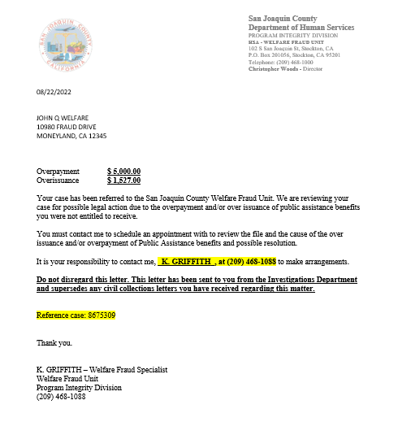
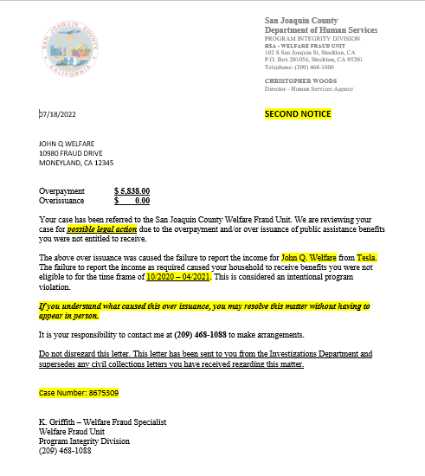
Attempt To Contact The Respondent To Review The Collector File And Cause Of The OP/OI.
1st letter
2nd letter

Slide 13
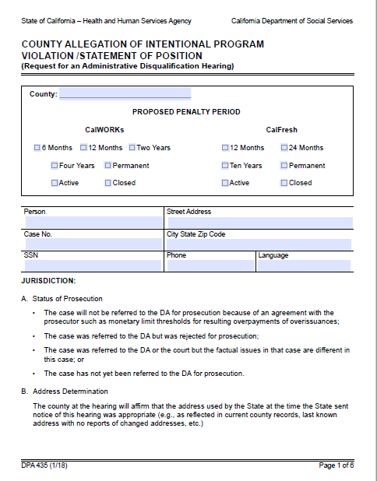
Writing The Statement Of Position
90 days from the date the RA (Recovery Account) NOA’s were mailed, write the Statement of Position.
(SOP - DPA 435)

Slide 14
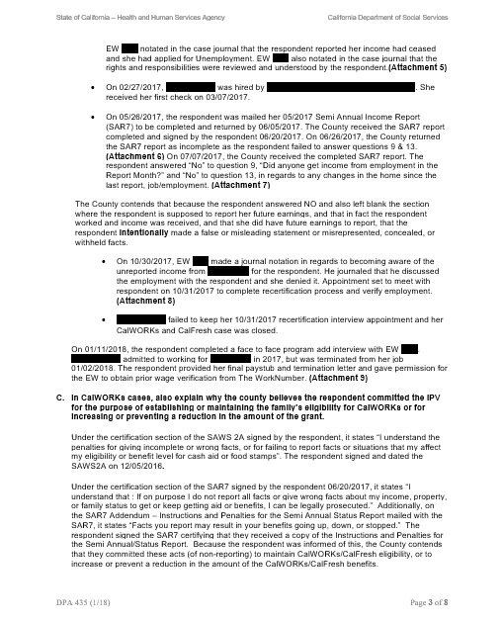
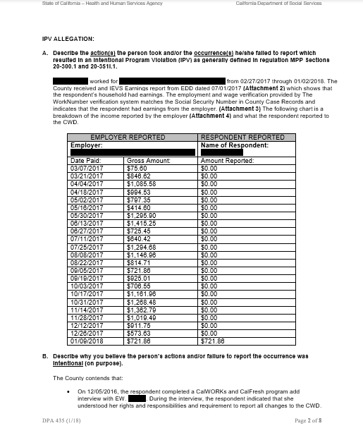
DPA 435

Slide 15
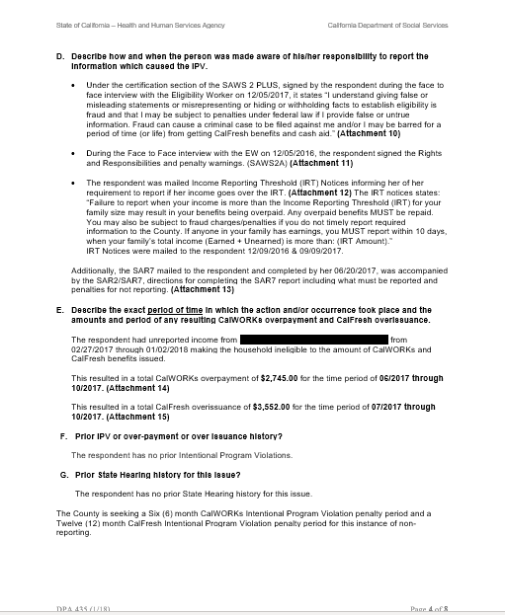
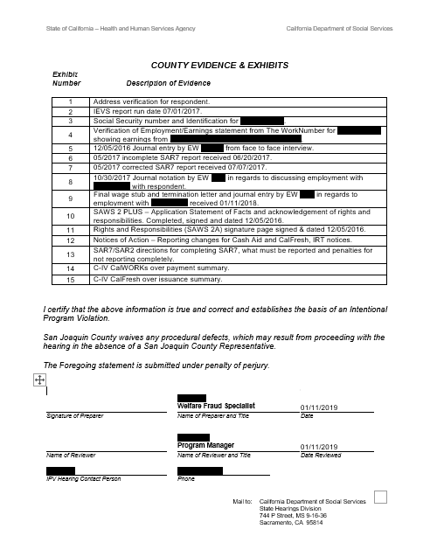
DPA 435

Slide 16

More Than One Respondent?
Prepare a separate allegation packet for each person.
Husband/Wife. Both must have signed all forms.
Unmarried couple (More on losses here later!)

Slide 17
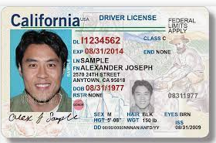
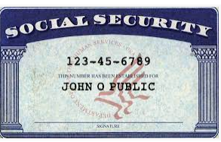
Unreported Income Cases Required Verifications
Copy of ID and SS Card provided to county at application.

Slide 18


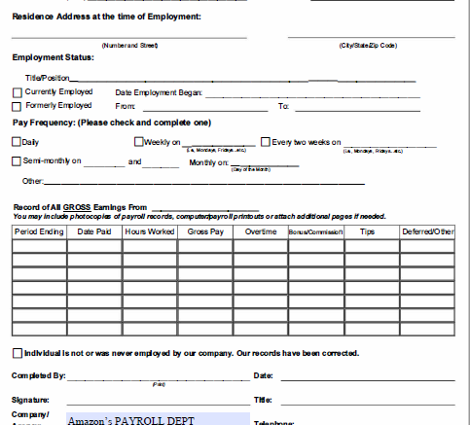
Unreported Income Cases Required Verifications Cont.
Employment verification from employer, WorkNumber, VerifyFast etc. Must have at least last 4 of SS# and name.

Slide 19
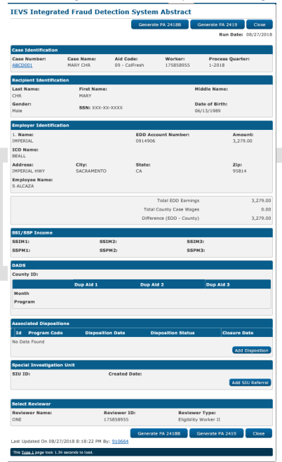
Verifs. Continued…
IEVS report or New Hire report. How did county become aware of the income not reported?

Slide 20
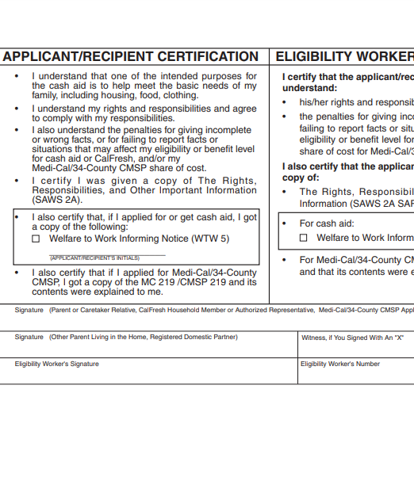
Verifs. Continued…
SAWS 2A SAR – Rights and Responsibilities signature page signed by the respondent prior to OP/OI timeframe.

Slide 21
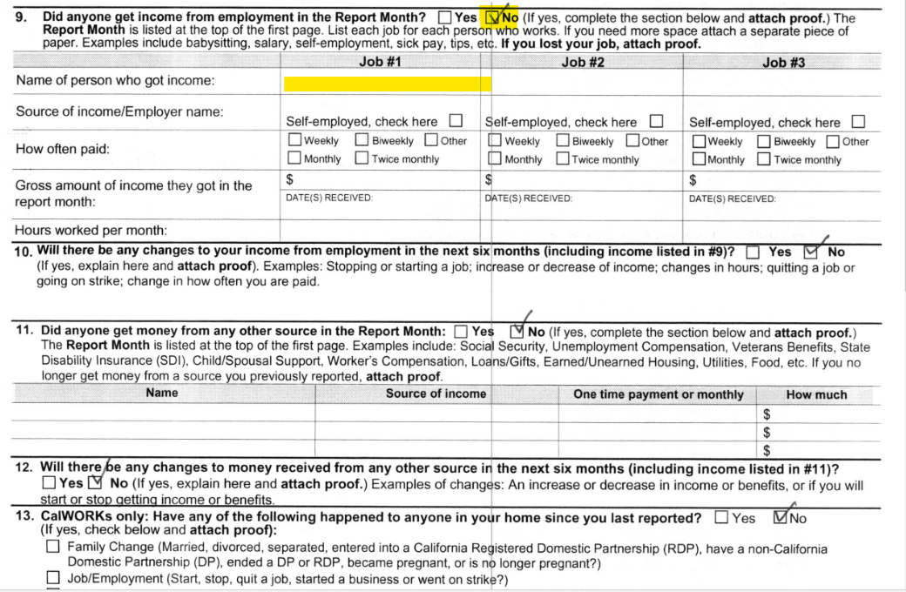
Verifs. Continued…
SAR7 failing to report income.

Slide 22
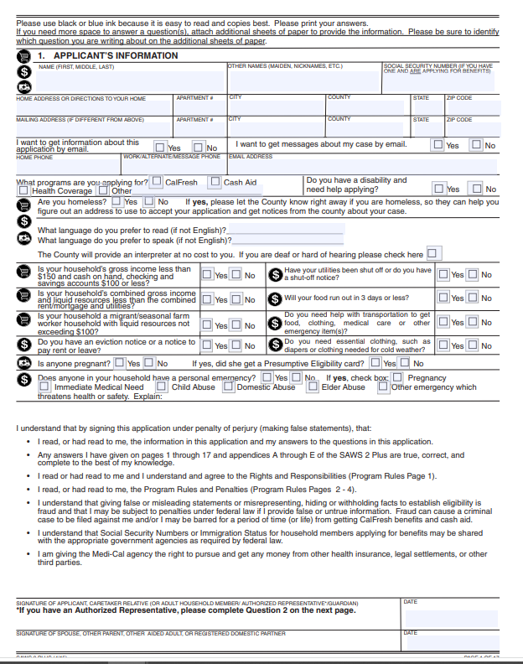
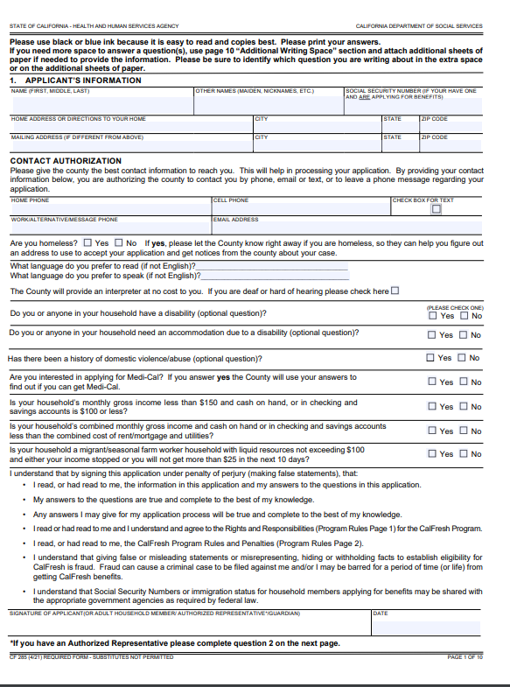
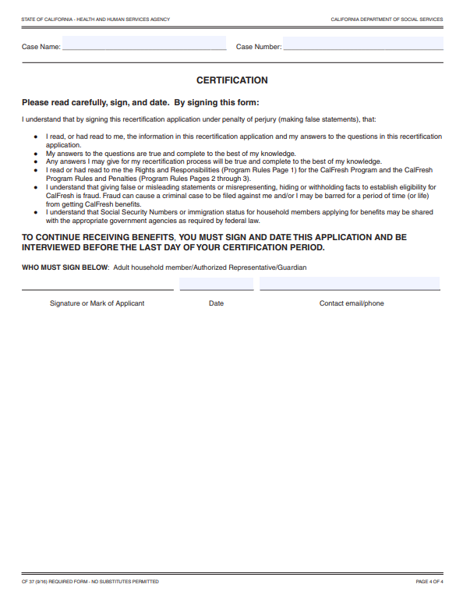
SOF – SAWS 2 PLUS, CF 37, CF 285 Failing To Report Income.
(Some ALJ’s want all pages)

Slide 23
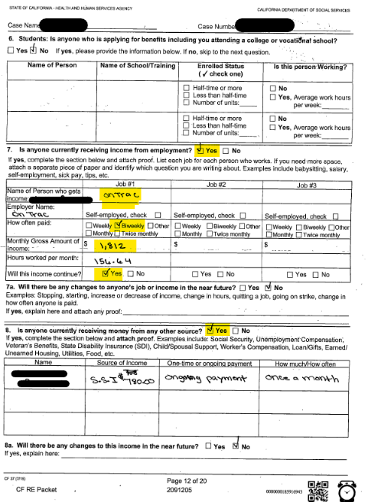
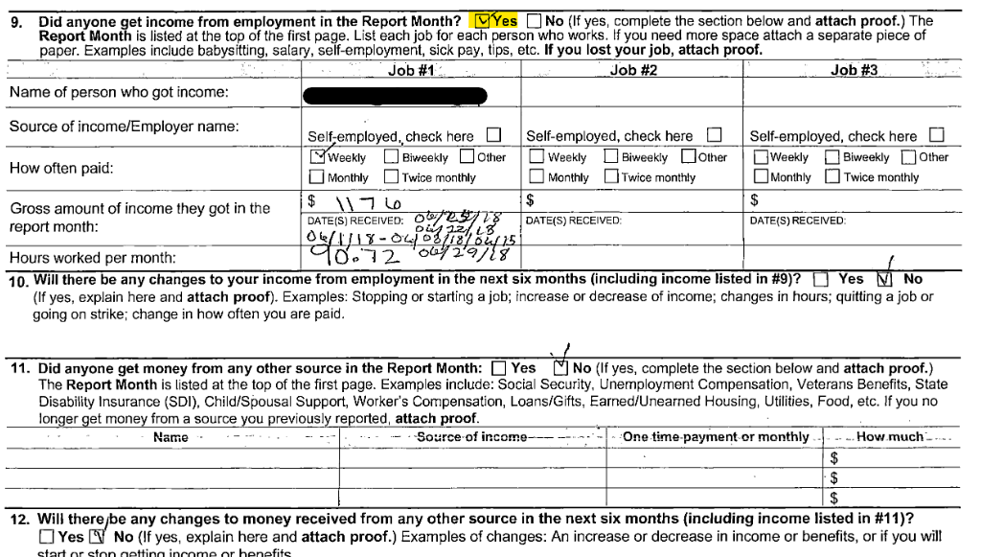
Any Prior SAR7’s Or SOF Showing Client Reported Income In The Past

Slide 24
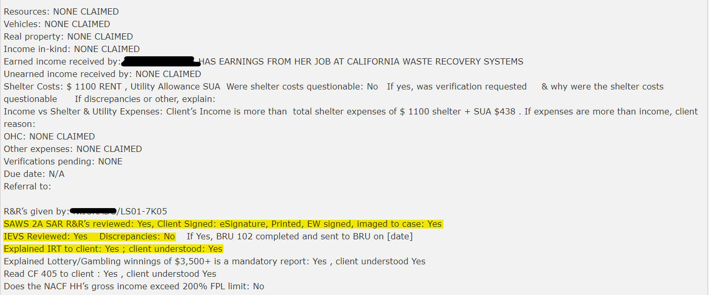
Eligibility Staff Journal Narratives

Slide 25
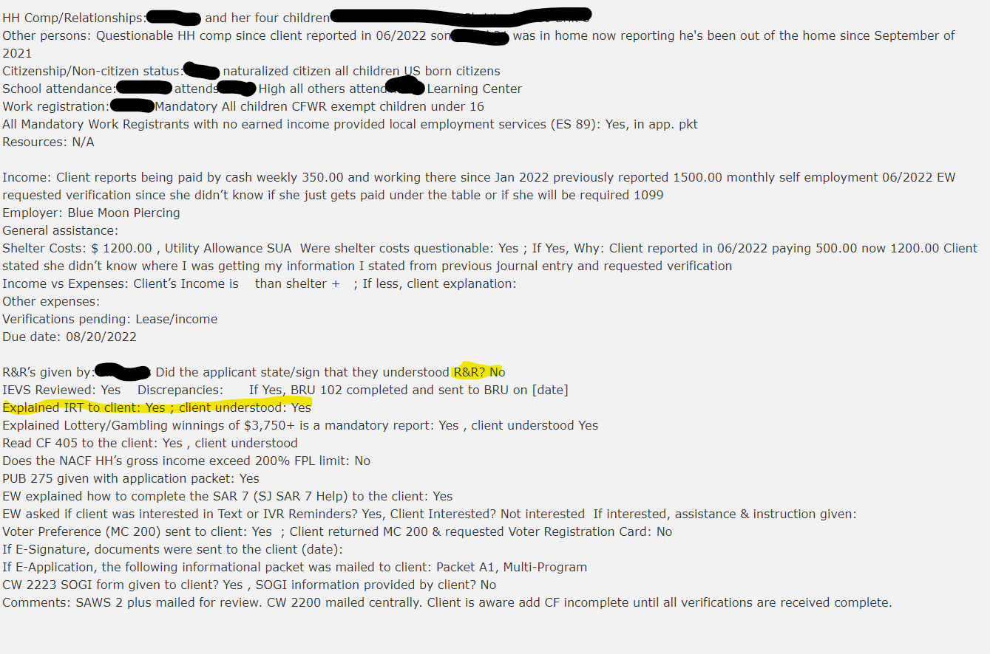
Journal Narrative Continued…

Slide 26
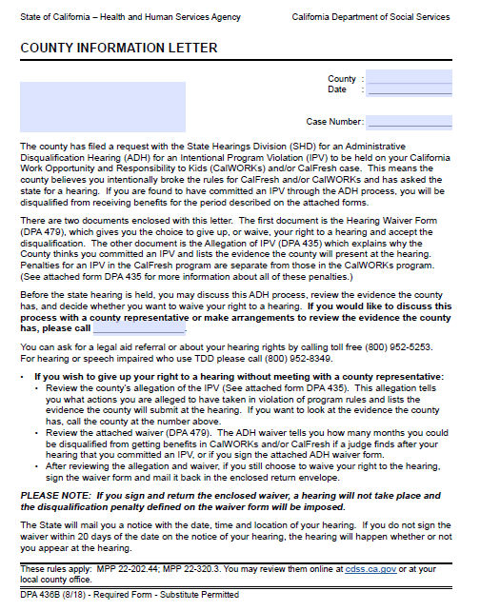
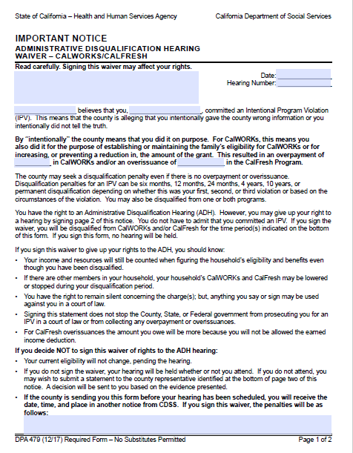
After SOP Is Typed, Mail DPA 435, DPA 436b And DPA 479 To Respondent With All Numbered Exhibits

Slide 27
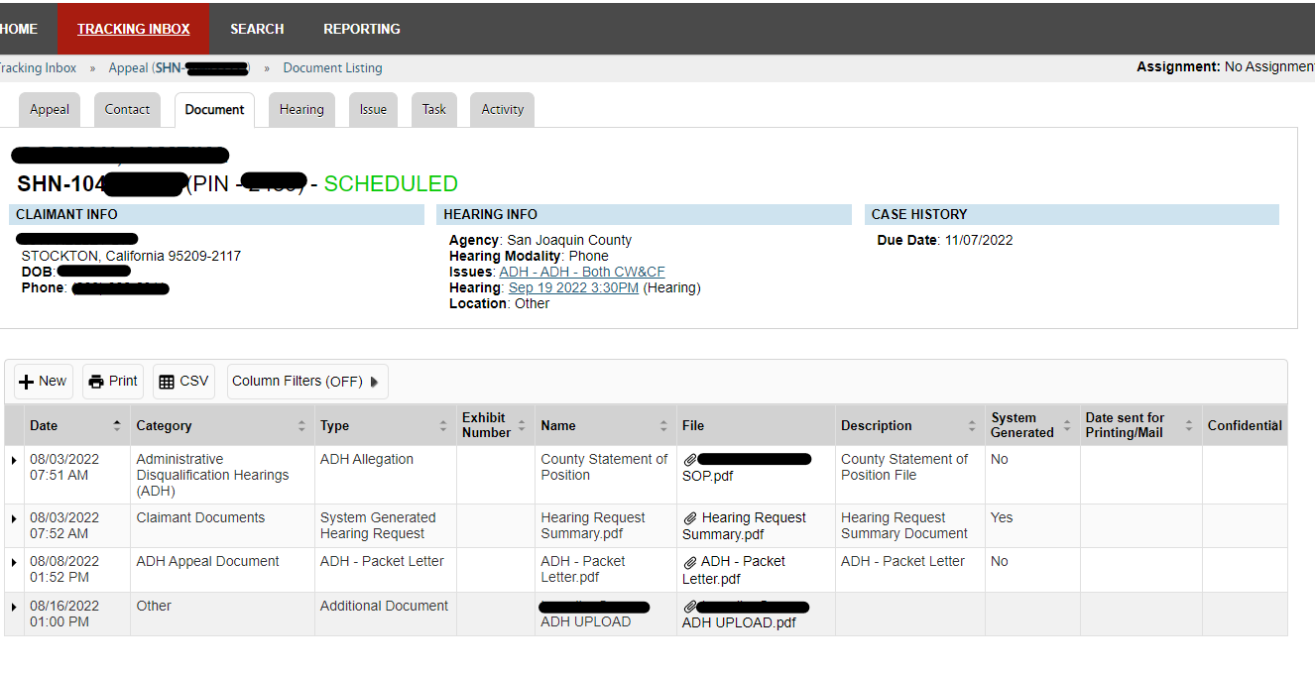
Wait 20 days, If No Waiver Received, Upload SOP To ACMS
Upload DPA 436b, DPA 479, DPA 435 and numbered evidence.
Case scheduled and hearing number assigned.
CDSS mails packet of hearing to address at least 30 days prior to the hearing date.

Slide 28
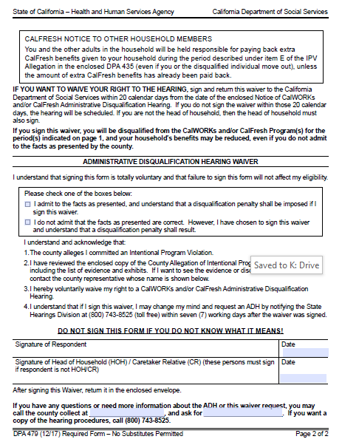
Respondent Signs The ADH Waiver, DPA 479
The respondent has 7 days to withdraw the Waiver and request a Hearing.

Slide 29
Signed Waivers
CalWORKs:
The Notice of Administrative Disqualification should be issued within 45 days of the 7th day following the date the Waiver was signed. (based on DCA per MPP 20-354.3)
References: MPP 22-320.321
When the individual waives his or her right to appear at a disqualification hearing, the period of disqualification shall begin no later than the first day of the second month which follows the date of notice. (If on aid)
References: 45 CFR 235.113(c)(3) & MPP 22-320.41
CalFresh:
The Notice of Administrative Disqualification should be issued within 45 days of the 7th day following the date the Waiver was signed. (based on DCA per MPP 20-300.43)
References: MPP 22-202.4
The period of disqualification shall begin with the first month which follows the date the household member receives written notification of the disqualification.
References: 7 CFR 273.16 (f)(2)(i) & MPP 20-300.41, and .411

Slide 30


The Hearing:

Slide 31
Beginning 2020, Due To The COVID Pandemic, All ADH’s Have Been Scheduled And Heard Telephonically.
No later than the day before the hearing, re-verify there has not been a reported change of address or telephone number which would result in a postponement of the hearing.
Check ACMS (Appeals Case Management System) that the Affidavit of mailing has been signed by the State representative.
ALJ opens the record.
Jurisdiction established
SOP presented with or without respondent present.

Slide 32
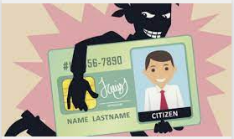



Possible Issues At The Hearing
Identity or mistaken identity.
Someone used the respondents SS# without permission.
Respondent did not sign SOF or SAR7.
Insufficient knowledge of reporting requirements.
Language Barrier.
New recipient didn’t understand.
Education or learning disability.
Mental state/depression.

Slide 33
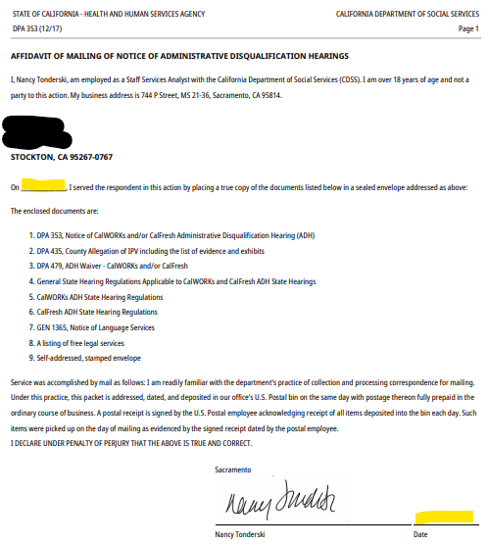

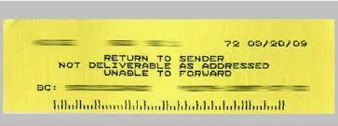
The Decision:
Dismissed without prejudice
No proof of mailing.
Disconnected Phone #.
No proof of phone # or address.

Slide 34
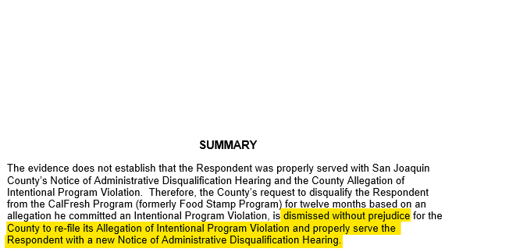
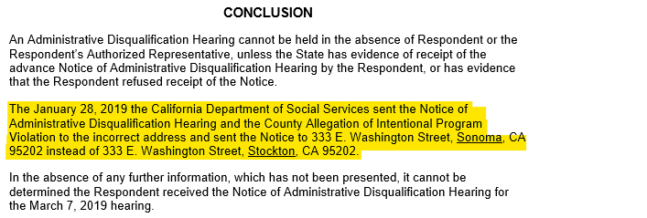
Dismissed Without Prejudice

Slide 35




Claim Granted
The Penalty:
CalFresh - Disqualification penalties vary from 12 months to permanent depending on the type of violation.
CalWORKs - Disqualification penalties vary from 6 months to permanent depending on the type of violation.

Slide 36
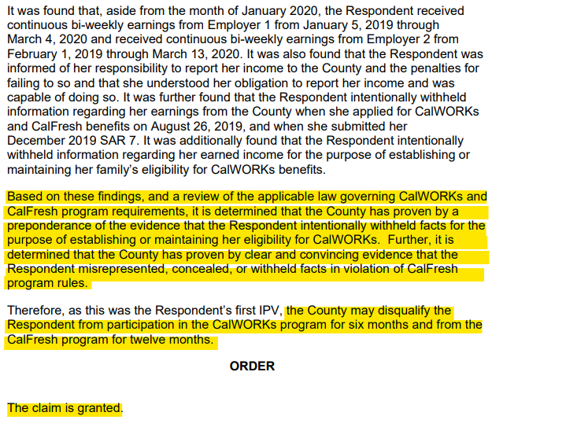
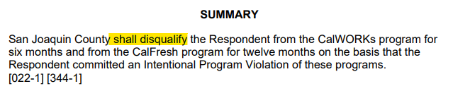
Claim Granted

Slide 37
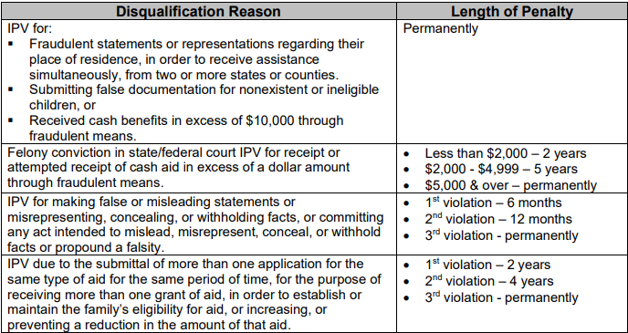
Penalties for CalWORKs:

Slide 38
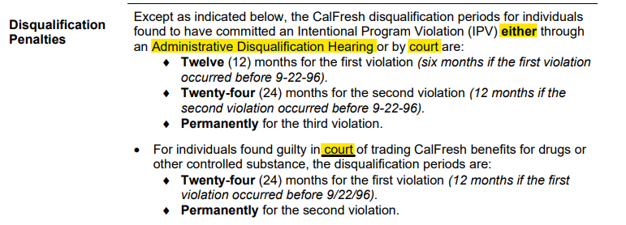
Penalties for CalFresh:

Slide 39
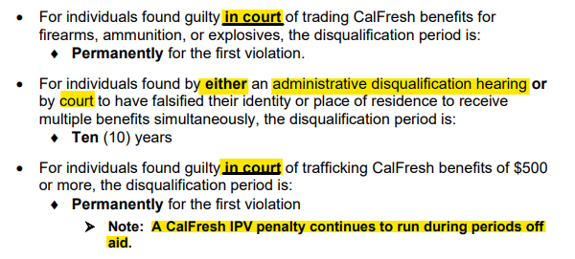
Penalties for CalFresh Cont.

Slide 40


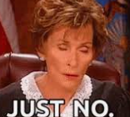
Denied
Back to issues…
Samples I have seen:
Respondent new to aid.
Significant other earnings.
ALJ having different protocol.
Learning disability.
Respondent having a stressful time in their life. (depression, divorce or separation, mental illness)

Slide 41
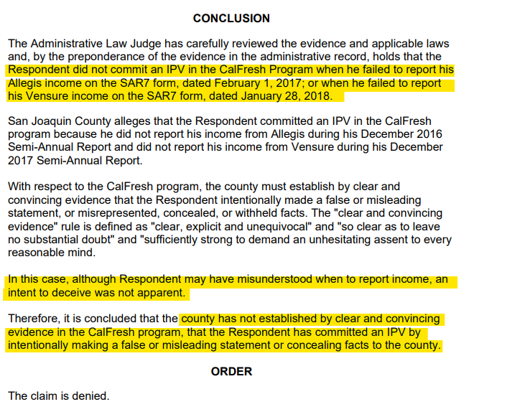
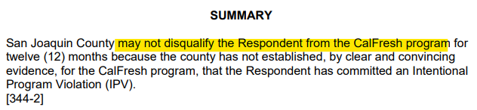
Claim Denied

Slide 42

Other Types Of Cases We Have Filed On With Success
Duplicate applications and aided in more than one State.
Forged/Falsified paychecks.
Not reporting mandatory HH member with income as in the home.

Slide 43

Questions???

Slide 44
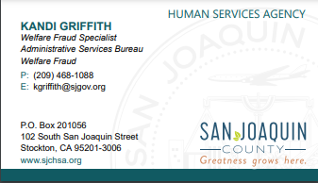
Thank You!

