Slide 1
Career Ethics and Survival
Survival Through Professionalism
Randy Fedak

Slide 2
My Background and course expectations
My Work Experience
Pronouns
Your work experience
Class Participation
Disclaimers
Free Stuff!

Slide 3
Goals and Objectives
Historical Background-why the need?
Professions versus Vocations
Management Perspective
Employee Retention
Liability
Employee Development

Slide 4
What determines Success?
Having a plan.
Attitude and Outlook
Scarcity Mentality
Mentors
Honest Self-Assessments

Slide 5
The Power of a Paradigm
Webster defines a paradigm as a model, theory, perception, assumption, or frame of reference.
It is the way that we “see” the world in terms of perceiving, understanding, and interpreting.

Slide 6
The Need for a Paradigm Shift
Our view of ourselves and how we view our environment.
How our values impact our view of our environment.
Are we on track to meet our goals?
What questions do we need to get answered?

Slide 7
Ethics and Values and how they influence our willingness to change
The basis for value formation:
Age when values are formed
What environmental factors influence values?
What can change values as we age?
Why is it important to know the values of your peers?

Slide 8
Knowing how you are wired and how others are wired.
Personality Types
Type “A” Dominant
Type “B” Calm, laid-back, non-competitive
Type “C” People Pleasers, hard time making decisions
Type “D” Stressed, hostile, job security of high importance

Slide 9
Importance of Setting Goals
Necessary Elements of Proper Goal Setting
1. Must be specific-Intrinsic versus Extrinsic
2. Must list the benefits of achieving the goal.
3. List the consequences, pros and cons
4. Beware of Roadblocks!
5. List the steps you will take to achieve the goal
6. Set a deadline
7. Identify your mentors if they have a part in accomplishing your goal.
8. Know how to measure your accomplishments.

Slide 10
The 7 Habits of Highly Effective People by Stephen Covey
There is no real excellence in all this world which can be separated from right living.
      David Star Jordan

Slide 11
The 7 Habits of Highly Effective People by Stephen Covey
Habit One:
The Power of the Paradigm

Slide 12
Habit One-The Power of the Paradigm
Proactive
Reactive
Let’s look at alternatives.
I can choose a different approach.
I control my own feelings.
I can create an effective presentation.
I will choose an appropriate response.
I choose.
I prefer.
I will.
There is nothing I can do.
That’s just the way I am.
He/She makes me so mad.
They won’t allow that.
I have to do that.
I can’t.
I must.
If only…

Slide 13
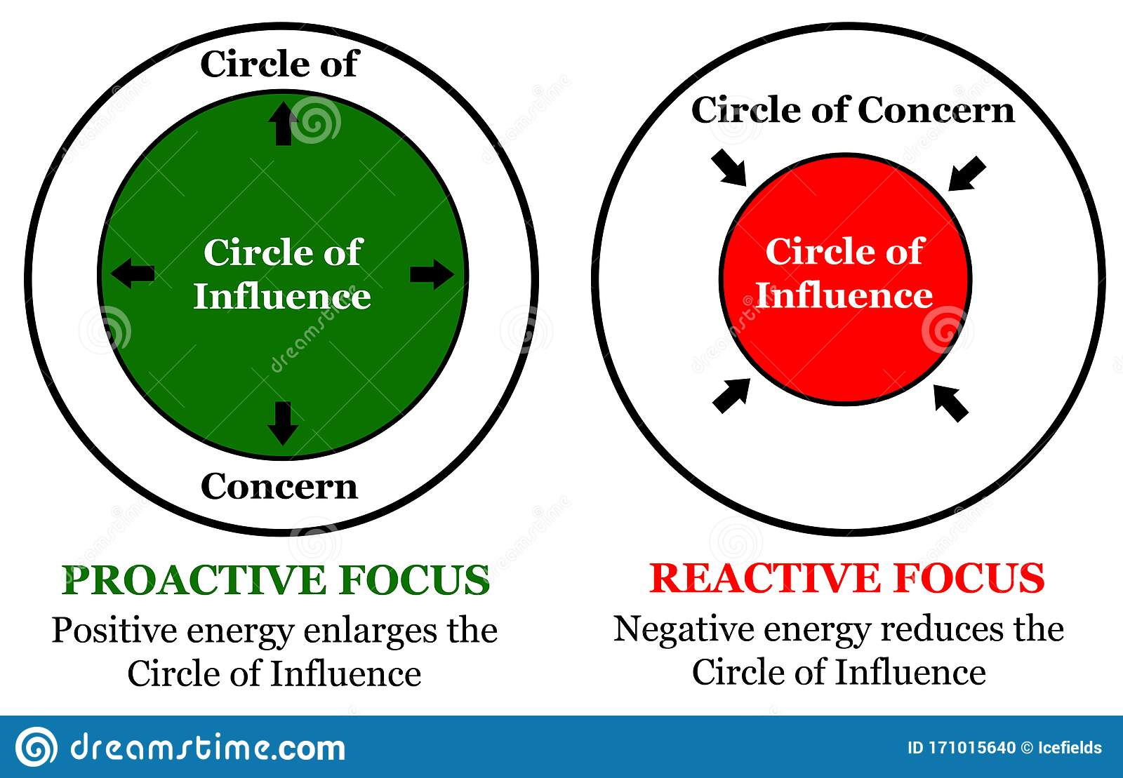
Habit#1 Be Proactive

Slide 14
Habit One
Reactive language becomes a self-fulfilling prophecy.
The Proactive approach to a mistake is to acknowledge it instantly, correct and learn from it. This literally takes a failure and turns it into a success.
It is important to immediately admit and correct our mistakes so that they have no power over that next moment and we are empowered again.
Rationalization (rational lies) puts a person on self-deceiving, self-justifying path.

Slide 15
Habit Two-Beginning with the end in mind.
What is really important to us?
Having a “Personal Mission Statement” helps in clarifying values
Once values are clarified, then goals can be set.

Slide 16
What type of “centered” person are you?
A. Spouse Centered
B. Work Centered
C. Enemy Centered
D. Family Centered
E. Possession Centered
F. Church Centered
G. Money Centered
H. Friend Centered
I. Self-Centered
Visualization-Begin with the end in mind
*Note: Almost all world class athletes and other peak performers are visualizers.

Slide 17
Habit Three-Put First Things First
Organizing and managing time and events around the personal priorities that you identified in Habit 2.

Slide 18
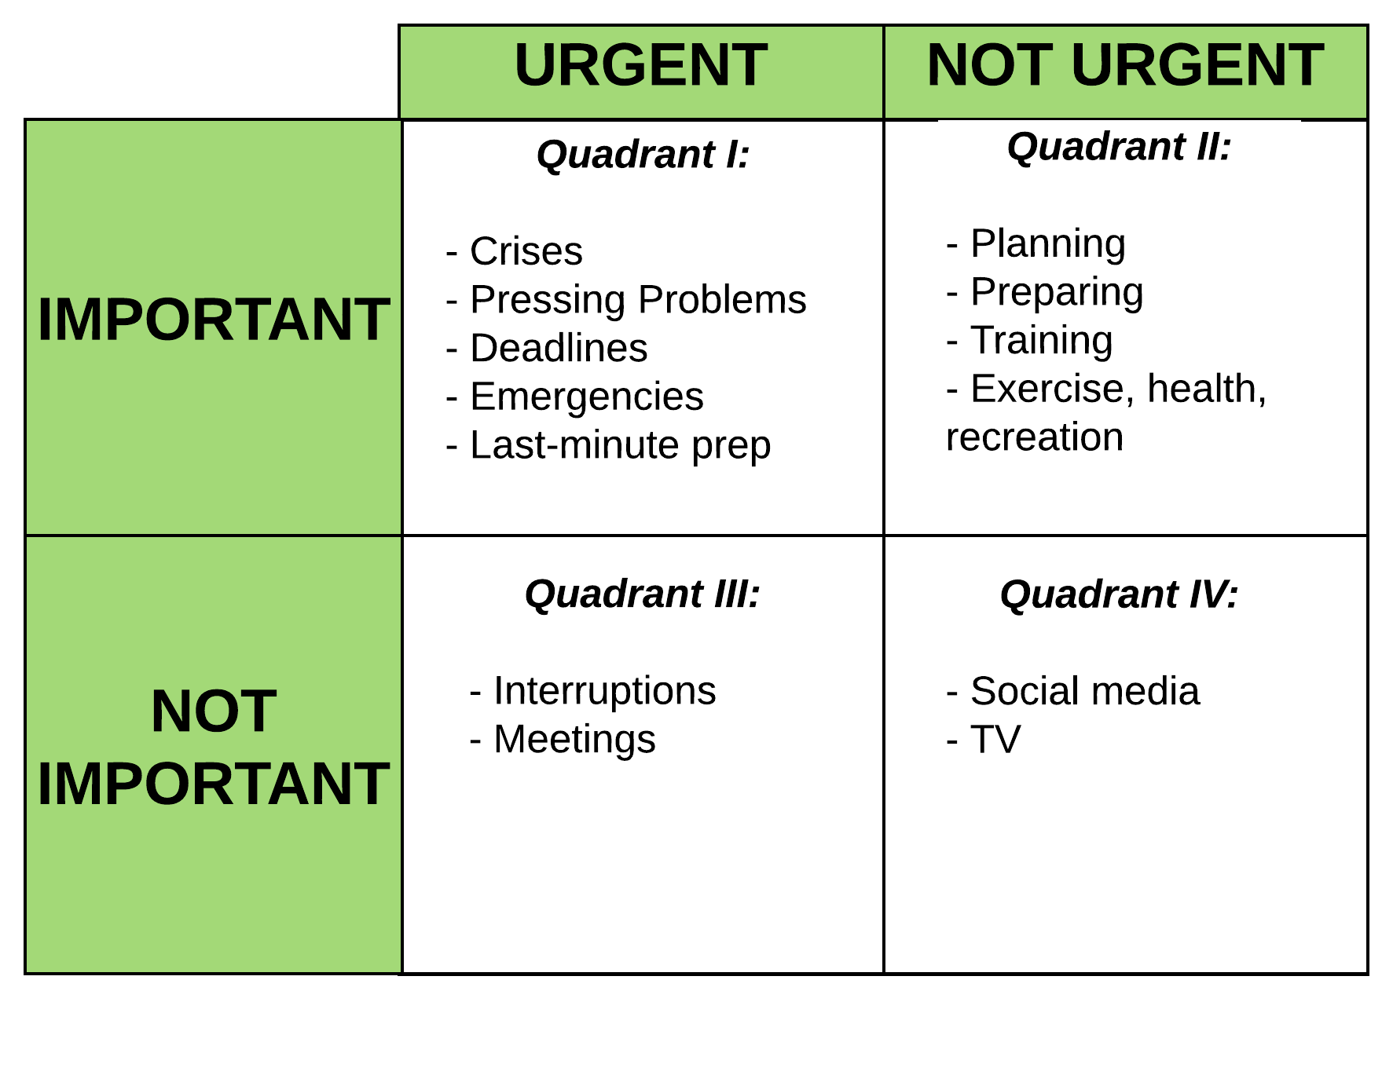
The Time Management Matrix
Habit Three

Slide 19
Time Management Take-Aways
We should devote less attention to activities that are urgent but not important.
More time to those things that are important but not necessarily urgent.
Urgent things act on us, and we usually react to them.
We must be proactive!

Slide 20
Break/Drawing Time!
10 minutes

Slide 21
TRAF System
Trash it
Refer it
Assign it
File it

Slide 22
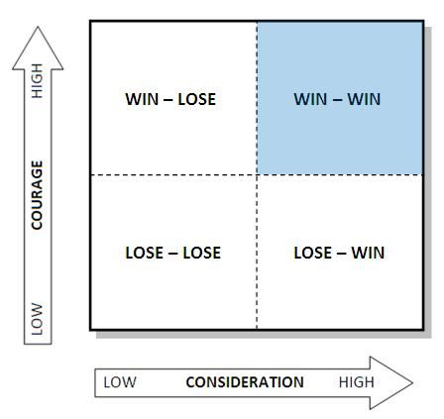
Consideration/Courage Matrix
Habit Four

Slide 23
Habit Four-Think Win-Win
This is the attitude of seeking mutual benefit.
The Abundance Mentality-synergistically increasing the pie so there is enough for everyone.
Scarcity mentalities believe there is only enough for the best. Win-Lose mentality.

Slide 24
Essential Character Traits for WIN/WIN
1. Integrity in harmony with your values.
2. Maturity-balance between courage and consideration
3. Abundance Mentality-there is plenty for everyone.

Slide 25
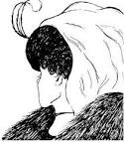
Habit #5 Communication

Slide 26
Habit Five-Seek first to understand, then to be understood.
Good communication is the essence of professionalism
We see the world as we are, not as it is.
Credibility problems begin with perception differences
We must exercise empathy
Once people are understood, they lower their defenses

Slide 27
Habit Six-Synergize
The habit of creative cooperation or teamwork.
The whole is greater than the sum of the parts.
Valuing the differences among people is the essence of synergy.
Insecure people surround themselves with like-minded people.

Slide 28
Habit Seven-Sharpen the Saw
*Question: Have you sharpened your saw lately?
The habit of self renewal.
Goose and the golden egg principle.
We must maintain our lives with balance.
Areas: Physical, Mental, Emotional-Social, and Spiritual.
We reap what we sow.

Slide 29
Do’s and Don’ts
Look for leadership opportunities and take them.
Pick a successful mentor.
Join professional organizations and get involved!
Develop your expertise and share it with others.

Slide 30
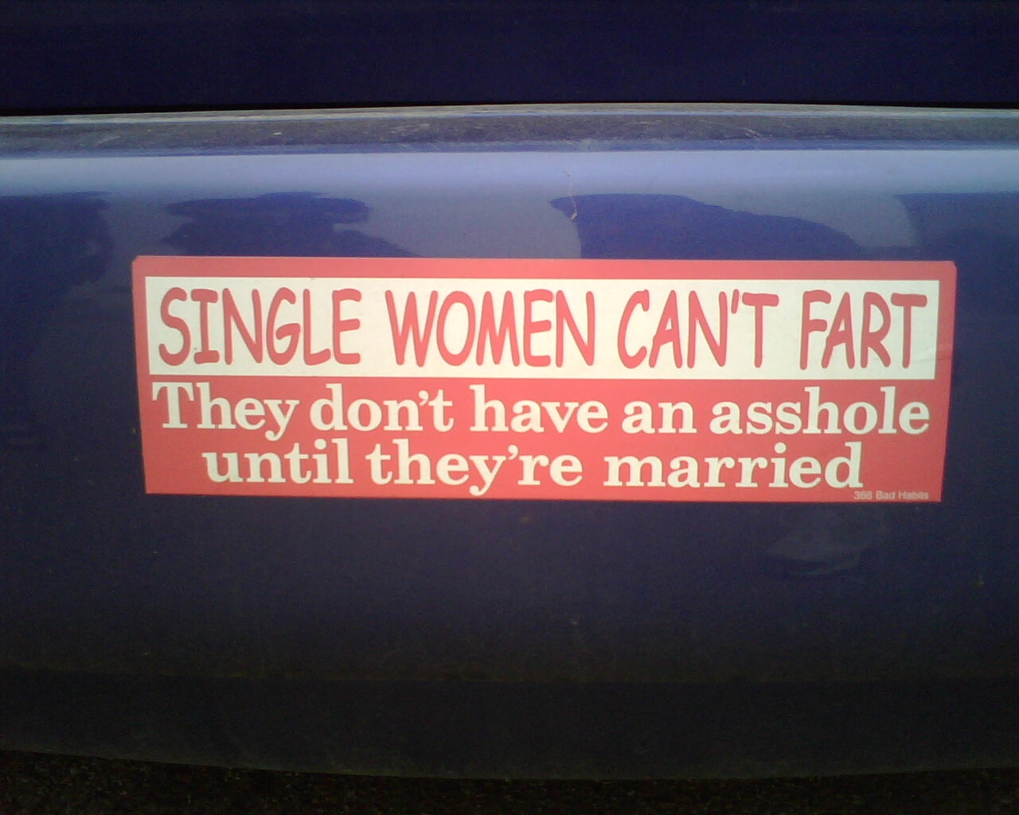
Do Not!
Advertise your views!

Slide 31
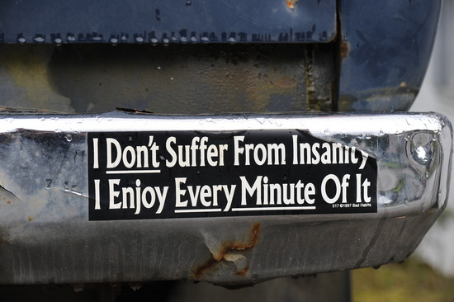

Slide 32
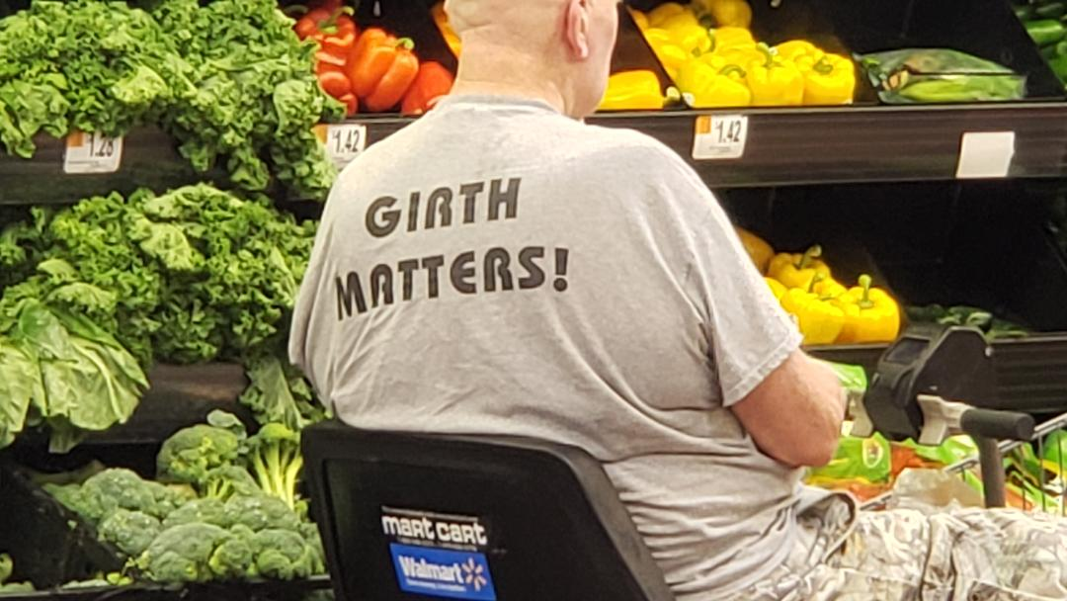

Slide 33
Do not make a statement you wouldn’t want your family to see posted anywhere.
This includes:
Emails
Texts
Blogs
Photos and any other posts

Slide 34
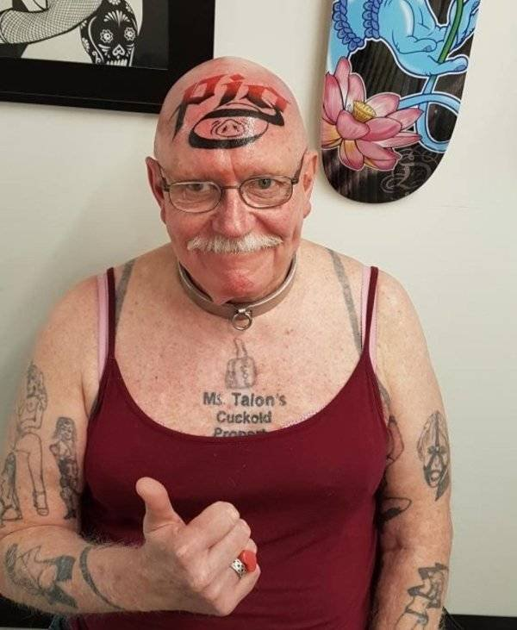
Tattoos

Slide 35
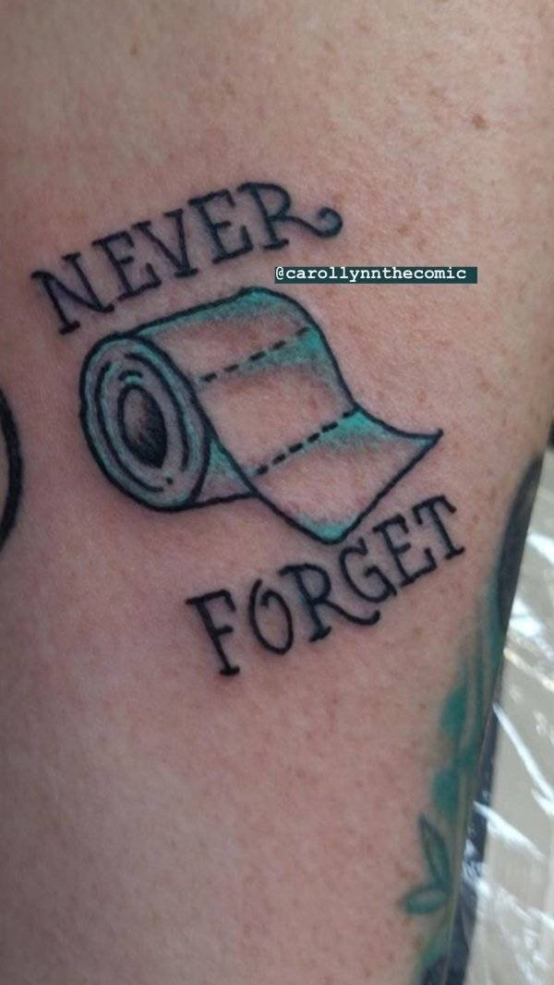

Slide 36
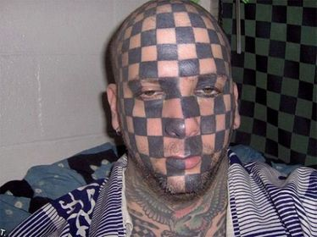

Slide 37
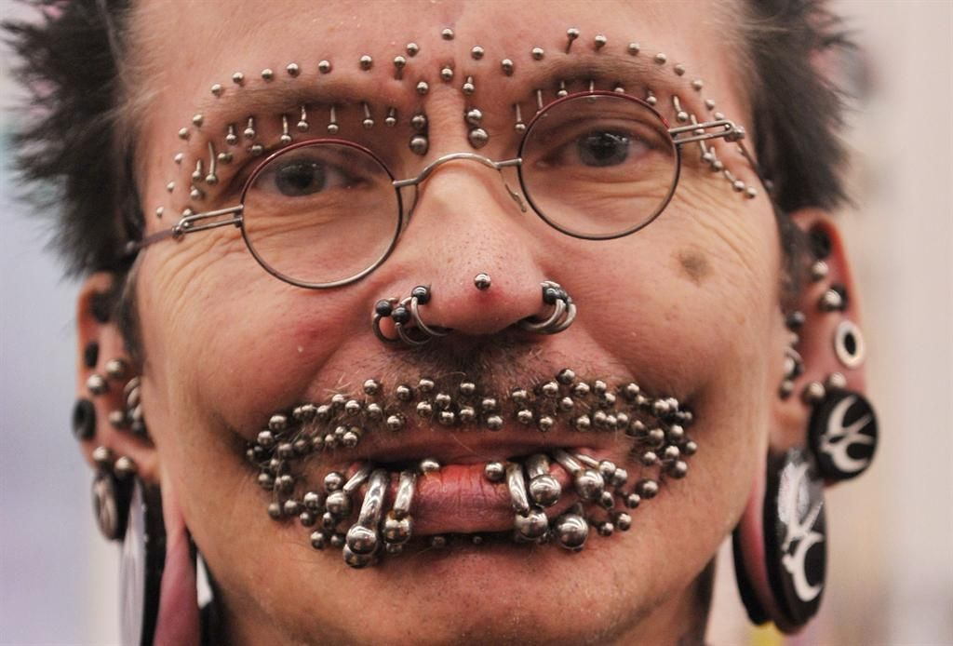
Piercings

Slide 38
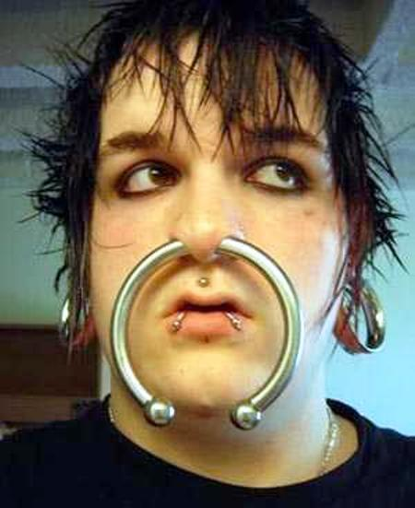

Slide 39
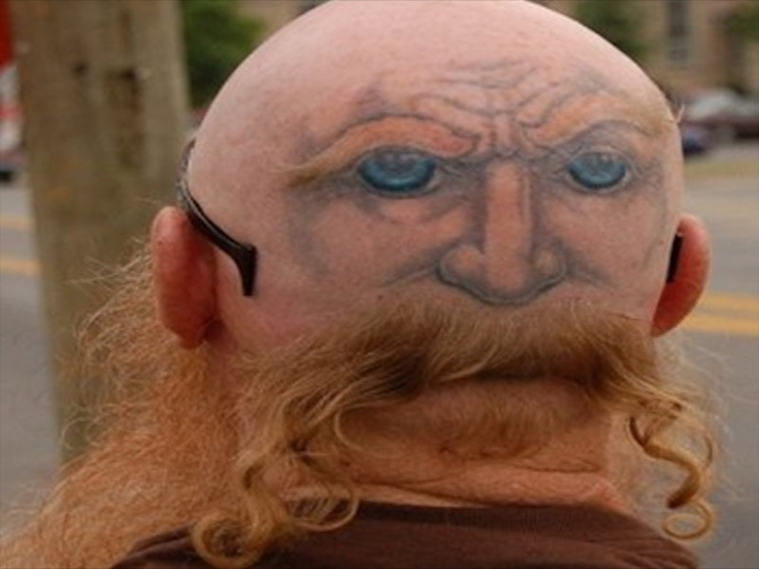
Hair me out…

Slide 40


Slide 41
Most Importantly….In closing…
Honesty and Integrity …In every facet of your life.
Treat others the way you would like to be treated.
Be enthusiastic!
Be self-motivated.
Model good communication skills.
Enjoy the ride!

Slide 42
Randy Fedak
Vice President-CWFIA/Retired SIU Chief
RandyFedak@cwfia.org
831-706-1044

