Slide 1

Cell Phone Analysis
Basic Overview

Slide 2
6 Key Points made using cell records
Device was in the general area of a location (inconclusive / only general area)
Device was not at or near a location (conclusive)
Device’s route of travel / movement
Multiple devices together or near each other
Who communicated with whom (connections)
What a device’s “normal” is (pattern of life)
  Calling pattern, top numbers called, daily usage, timelines, travel route, etc.

Slide 3
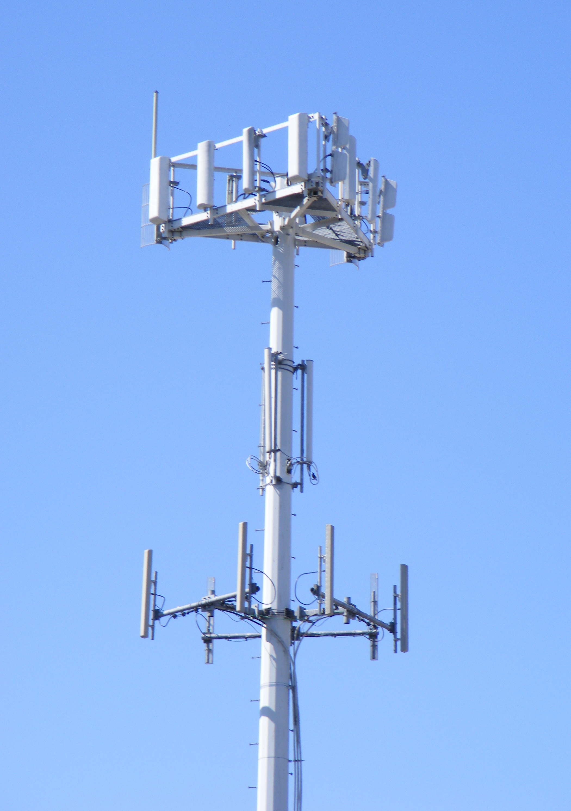
5 safe facts
Lat/Long Precise location of the tower
Direction Direction of the Sector (azimuth)
Best Signal The phone picks the tower and sector to use in a connection because it had the best signal (not because it was the closest)
General Area Use the 3 facts above to identify the “general area” of a phone
Called/Calling Who called/texted whom

Slide 4
Call Detail Records
Determine the phone number & carrier
Preserve the records (records are perishable)
  Valid for 90 days
  Cannot preserve records into the future
  Use Preservation Request template in CellHawk
Develop your probable cause
Write and submit search warrant (required for location information)
Be sure date range is adequate to establish a pattern of life

Slide 5
Call detail records
Legal Process | Threshold | Subscriber & Billing Info | Toll Records | Cell Site Location | Content
Subpoena
Court Order (Federal only) | Specific & articulable facts relevant to investigation signed by a Judge
Search Warrant | Probable cause
Exigent | Emergency involving danger of death or serious physical injury

Slide 6
Call detail records
Carpenter v US (2018) ruled that a Probable Cause based search warrant is REQUIRED for cell site location information (not just relevancy)
  FBI received CDRs with Cell Site Location information based on current law at the time
  127 days of CDR with cell site information amounted to nearly 13,000 locations
  Prior to Carpenter, a person had no legitimate expectation to privacy regarding information voluntarily turned over to third parties, therefore search warrant not required
  Carpenter v US (2018) ruled that Third-Party Doctrine does not apply here
The court did not expand its ruling on other matters related to cell phones not presented in Carpenter including real-time cell site location information (pings or cell site simulators), tower dumps [and geofences]

Slide 7
CALL DETAIL records
What information can the carriers provide?
  Subscriber information
  Call (voice) detail records
  Text (SMS / MMS) detail records
  Data / IP sessions
  Specialized location records (EXTREMELY HELPFUL BUT EXTREMELY PERISHABLE)
  Voicemail
  Text content
  Cell site lists
  Carrier keys / interpretations

Slide 8
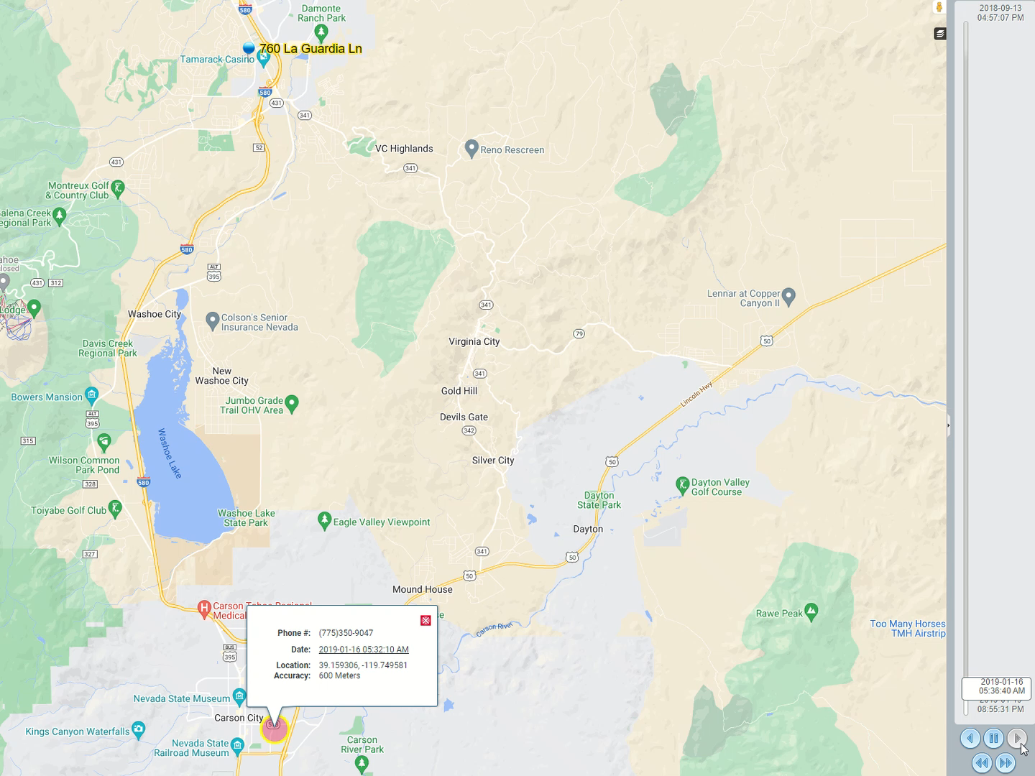

Slide 9
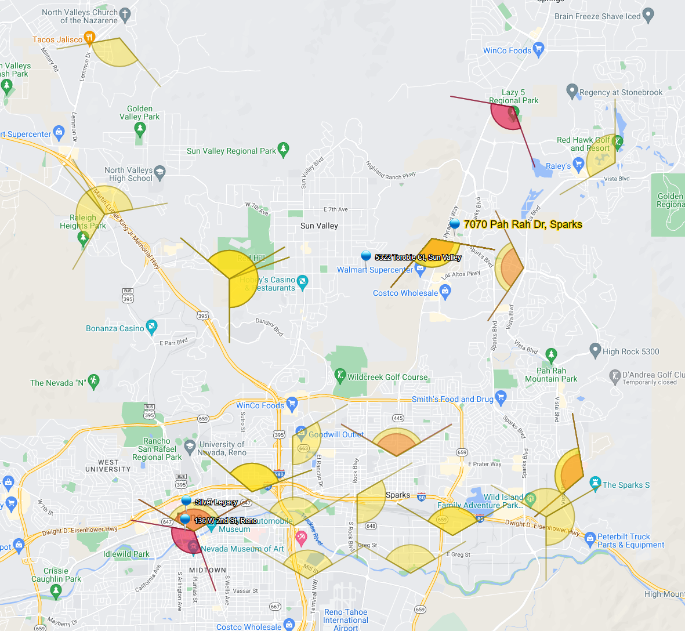
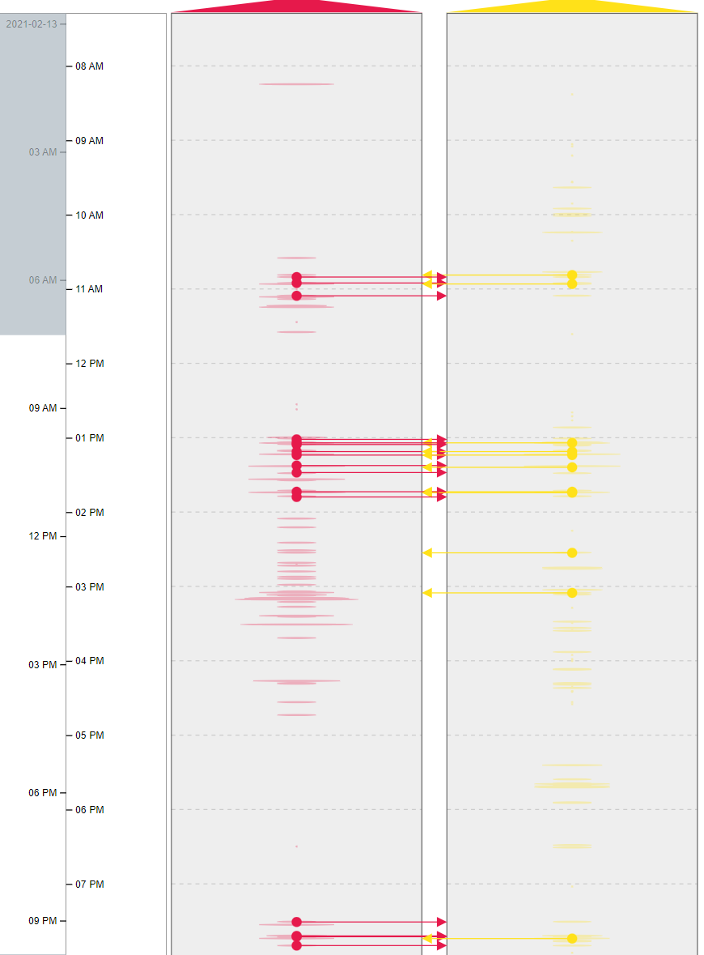
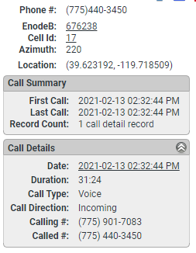
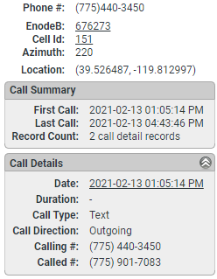

Slide 10
Question:
But what if you don’t have a suspect or phone number?
Answer:
Tower Dumps and/or Geofences

Slide 11
Cell tower dumps
Record of all usage events involving a particular tower in a specified area during a specified timeframe
The towers to be “dumped” are determined by the carrier based on the address(es) / geo-location(s) provided by YOU in your search warrant
Submit search warrant (list all carriers on one warrant)
  Ensure manageable timeframe(s)
Tower dump returns vary depending on carrier
  AT&T – voice, text, data (we wish all suspects used AT&T)
  T-Mobile – voice, text
  Sprint – voice
  Verizon – voice, text, sometimes per call measurement data

Slide 12
Cell tower dumps
It’s all about comparing / contrasting
Single location
  Have video surveillance of suspect with phone to ear
  Hoping suspect used cell phone
  Look for stand-out numbers
  Have a POI phone number
  Preserve as evidence to search later with a suspect lead
  Last resort…
Control Tower Dump – 1 dump for date/time of crime | 1 dump for same time exactly 1 week prior to crime

Slide 13
Cell tower dumps
Multiple locations
  Same location – different dates/times
    Suspect seen on video casing area days before the crime
  Different locations – one or more dates
    Serial crimes / sprees and trends
Ensure the crime scenes are separated by time and/or distance so as not to use the same towers during the same timeframes

Slide 14
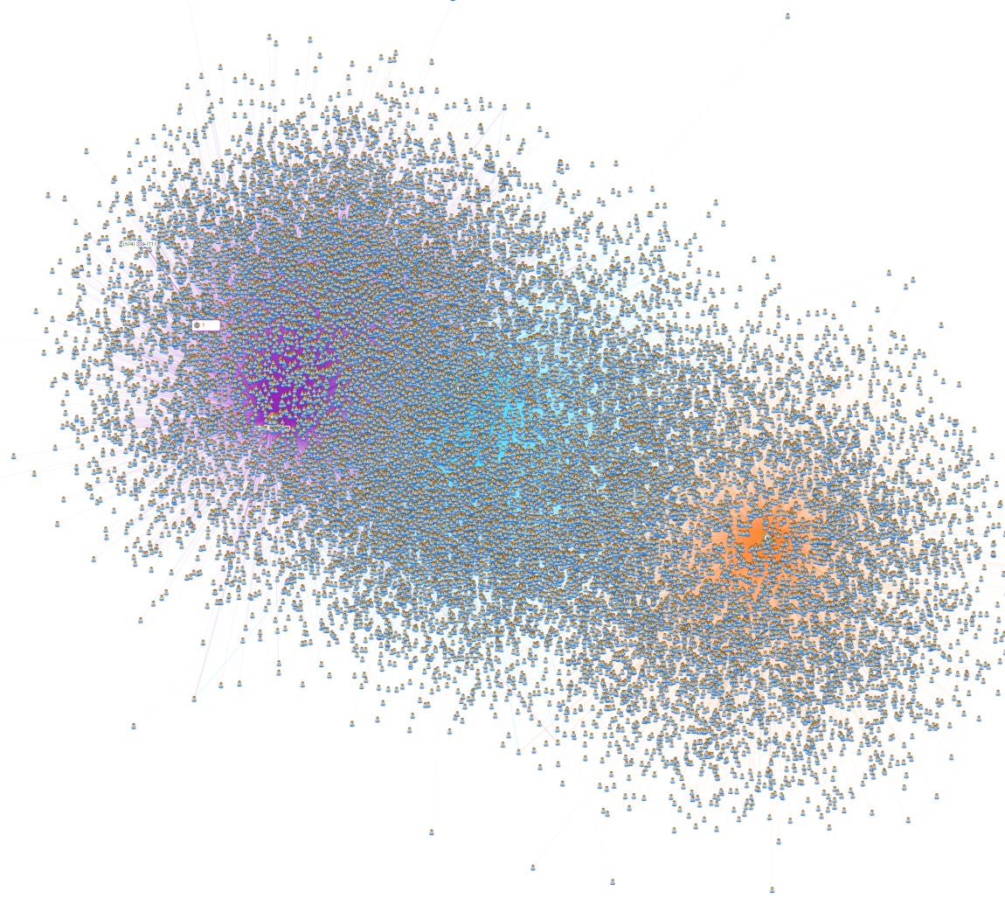
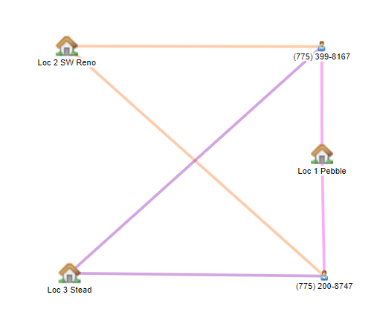
Cell tower dumps
3 distinct locations & times
Timeframe – 1 hr. each
Hundreds of thousands of numbers
Only 2 numbers hit on all three locations during the predesignated timeframes

Slide 15
Google geofence
(aka) google reverse location search
Demand Google to produce an anonymized list of device ID numbers for their subscribers based on a specified area of interest and timeframe.
Create a virtual perimeter around the area(s) of interest by drawing on a map – radius or convex polygon – based on latitudes/longitudes.
  Radius – single geo-location on the map with a radius size to create the fence.
  Polygon – At least three geo-location points creating a fenced in area.
The size and timeframe of the geofence varies by case.

Slide 16
Google geofence case law
Matter of Search of Information Stored at Premises Controlled by Google, N.D. Illinois (8/24/2020) No. 20 M 392
  Federal court ruled application was in violation of the 4th Amendment
    Two-location search warrant application
    Three separate search warrant submissions
    Two different judges
  Warrant application denied, but stated in the Conclusion:
    Simply because Google can collect this information, or because the government can obtain it from Google under a “constrained” approach “justified” by the investigation’s parameters, does not mean that the approach clears the hurdles of the Fourth Amendment probable cause and particularity. But nor does the Court intend to suggest that geofence warrants are categorically unconstitutional.

Slide 17
Google geofence case law
Matter of Search Warrant for Data Stored at Google Concerning an Arson Investigation, N.D. Illinois (10/29/2020) No. 20 M. 525
  Federal court granted search warrant application
    Multi-location search warrant application
    “…no court has held that a geofence warrant is categorically unconstitutional. Rather, the issue is whether the warrant is supported by probable cause and is particular in time, location and scope to ensure that there is a fair probability that evidence of the crime will be obtained.”

Slide 18
Google Geofence case law
Okello Chatrie Motion to Suppress the Geofence Warrant Decision (3/3/2022)
  5/20/2019 bank robbery at Call Federal Credit Union in Midlothian, VA
  Suspect had firearm and note; he forced a bank employee to open the safe
  Suspect took $195,000 and fled on foot towards an adjacent business west of the bank
  Law enforcement obtained a Google Geofence warrant to assist in identifying the suspect
  Suspect identified as Okello Chatrie
    Charged with Forced Accompaniment during Armed Credit Union Robbery and Using, Carrying, or Brandishing a Firearm during and in Relation to a Crime of Violence

Slide 19
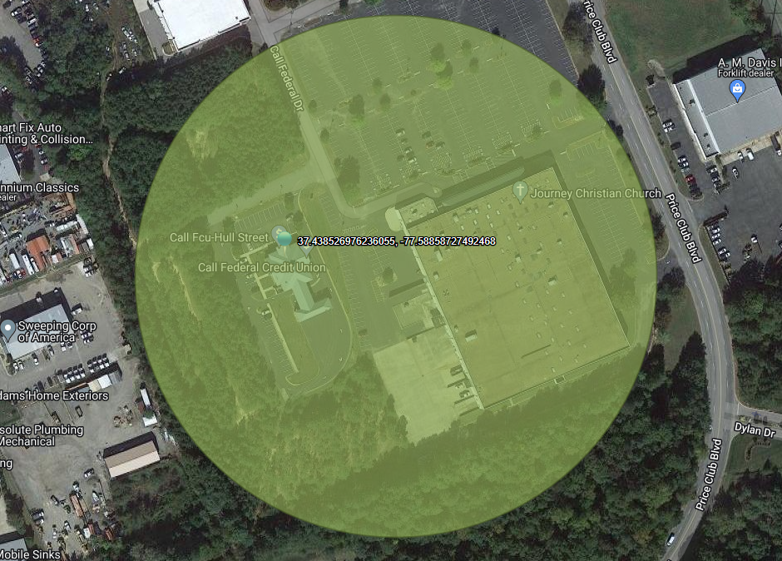
Google geofence case law
Chatrie Geofence Warrant
1 warrant – three-step process
150-meter radius (300-meter diameter)
  Encompassed 17.5 acres
  Included credit union and church
5/20/2019 – 16:20-17:20 hrs
Step 1 – Received 19 anonymized devices
Step 2 & 3 – Asked for all 19 devices
Google took issue with request
  Step 2 – 9 devices; Step 3 – 3 devices

Slide 20
Google geofence case law
Chatrie Motion to Suppress denied
  Despite the warrant failing under Fourth Amendment scrutiny, the Leon good faith exception shields the resulting evidence from suppression. The warrant lacked particularized probable cause, but was not “so lacking in indicia of probable cause as to render official belief in its existence entirely unreasonable.”

Slide 21
Google geofence
Three-step process = three search warrants
  Step 1 – Request list of anonymized devices based on area(s) of interest and timeframe(s)
    Google returns devices based on GPS / Wi-Fi hits within the geofence with a margin of error
  Step 2 – Shortlist relevant devices
    Request location data before, during, and after crime inside/outside of the geofence
    Expanded timeframe (with particularized probable cause)
  Step 3 – Shortlist relevant devices
    Request subscriber information for relevant devices (non-disclosure / delay of notice)
  Did you find your target?
    Send Google a preservation request, then ask for EVERYTHING GOOGLE (not part of geofence process)

Slide 22
Google geofence
Small geofence = greater timeframe | Large geofence = lesser timeframe
Urban area = smaller geofence | Rural area = larger geofence
Common timeframe to use in Step 1 is 1 hr before and 1 hr after the crime
If Google says your request is overly broad
  Resubmit with a smaller geofence OR lesser time (don’t do both…baby steps)
YOU HAVE 60 DAYS FROM STEP 1 – STEP 3
No preservation requests for Google Geofences

Slide 23
Google geofence
What if you don’t get anything back?
  Google Location Services has to be enabled at the account level
  Location Services has to be enabled on the device
  Location Services has to be in use at the moment
  The device has to ping within the timeframe requested
Location history is user configurable. The user can delete the location history at any time.
Beginning in May 2020, new users’ location history is auto-deleted after 18 months

Slide 24
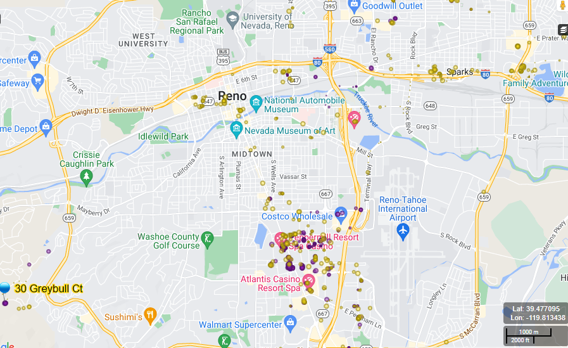
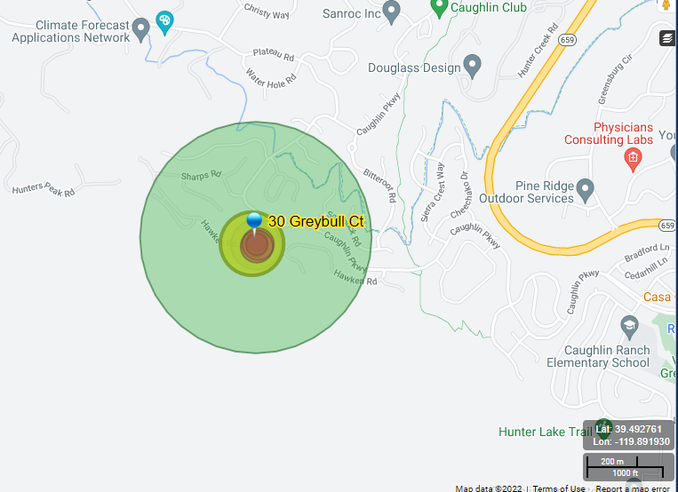
Google geofence

Slide 25
Google location history fun facts
All Android devices have Google
Location History (LH) supports Google’s advertising revenue
LH logs a device’s location, on average, every two minutes
If user ‘opts in’ to LH, Google is “always collecting” data
  LH is tied to a user’s Google account, NOT to a specific app
Approximately 1/3 of all active Google users have LH enabled
Google estimates a device’s location; aims to accurately capture 68% of users

Slide 26
What else?
Other geo-location data sources
  Cellebrite downloads
  Snapchat (any social media with location data)
  Rideshares
  Exercise apps
  Rentable scooters
  Ankle bracelets
  Personal trackers
  Connected cars
  Real Time Pings

Slide 27
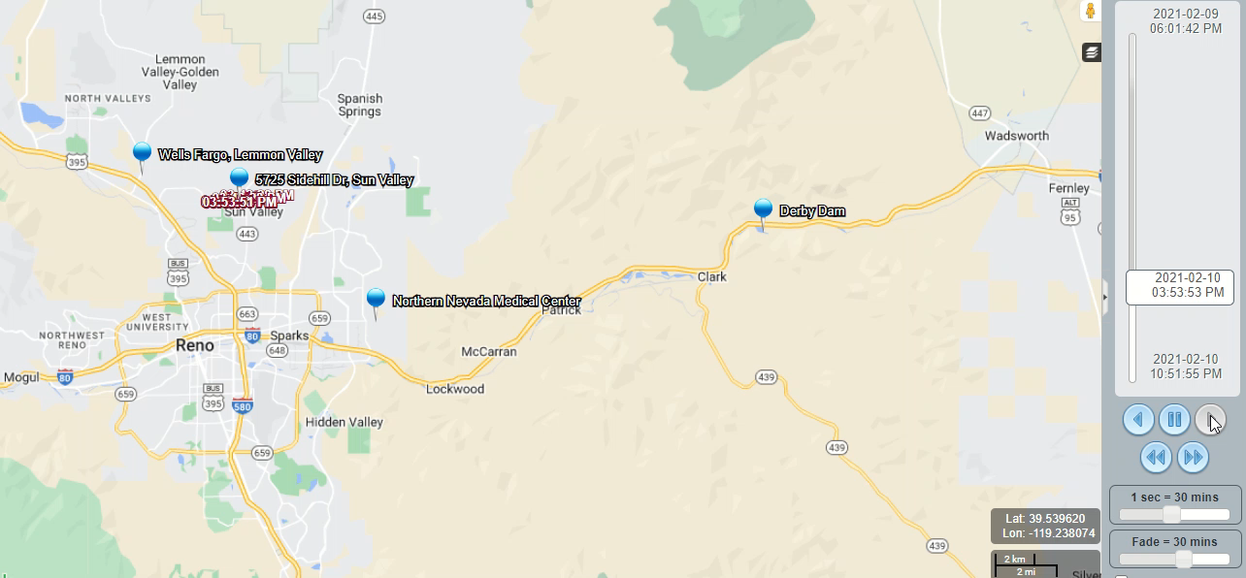

Slide 28
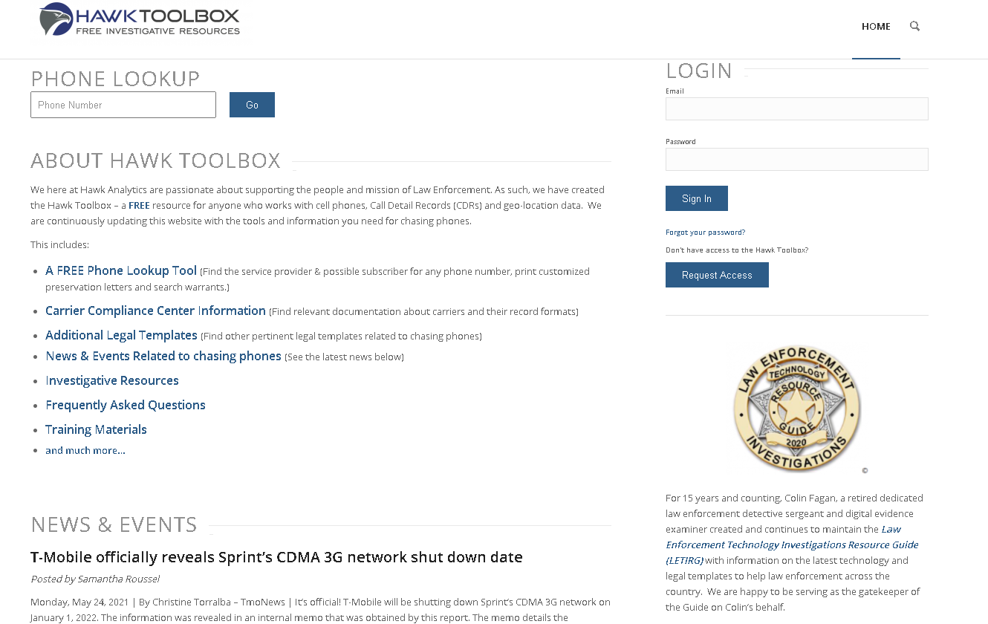
https://support.hawkanalytics.com/

