Slide 1
Fraud 101: Basics of eligibility for Investigators
S. Renee Haga

Slide 2
Eligibility Factors
CalWORKs
Deprivation
  Absent Parent
  Unemployed Parent
  Incapacitated Parent
  Deceased Parent

Slide 3
Assistant Unit/ Non Assistant Unit (AU/Non AU)
Mandatory Inclusions
Optional Persons
Excluded Persons
Ineligible Persons

Slide 4
Household Composition
(HH Comp)
Mandatory Inclusions
Separate Household
Optional Persons
Student Eligibility

Slide 5
Income
Non Exempt
Exempt
Excluded
Included
Income In-Kind (IIK)

Slide 6
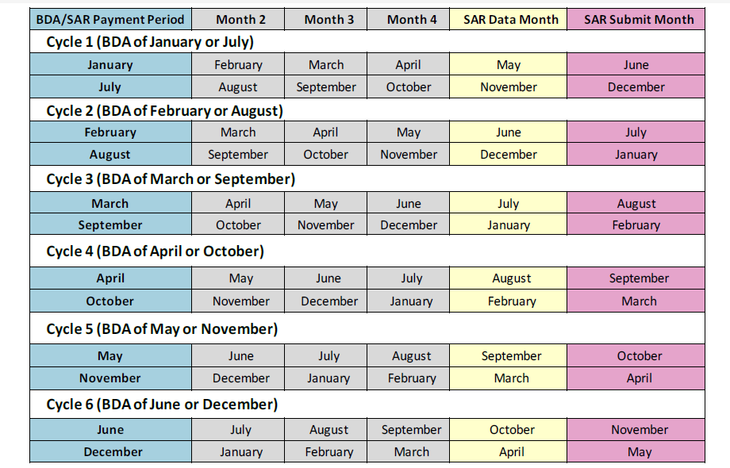
Semi Annual Reporting (SAR) Overview
Cycles
  Data Month
  Submit Month
  Payment Period
SAR2/AR2

Slide 7
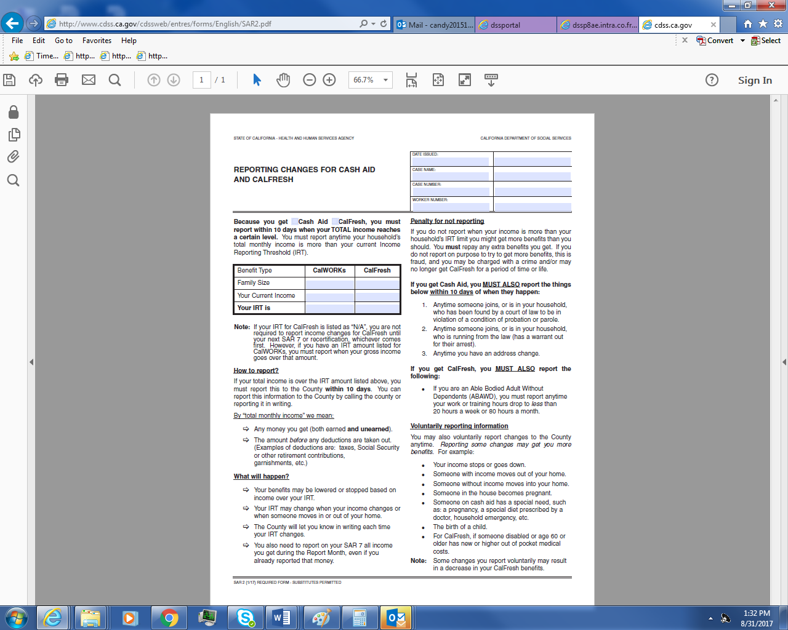
Sar2/ar2

Slide 8
Mandatory Reporting
CalWORKs Semi Annual Reporting
CalWORKs Annual Reporting
CalFresh

Slide 9
Income Reporting Threshold
(IRT)
When determining the client is over their IRT, the income must continue for two continuous months.
CalWORKs
CalFresh

Slide 10
Verified Upon Receipt (VUR)
Clients may voluntarily report changes at any time during the Semi-Annual Report period. If the report is considered Verified Upon Receipt (VUR), the EW will take action which may increase or decrease the allotment with a 10 day NOA. VUR means that the information provided is not questionable, the provider is the primary source of the information, and no further information is required to take action

Slide 11
Property/Resources
CalWORKs
All other Households
$3,250
Households with at least one member over 60
$2,250

Slide 12
Eligibility
Overpayments/Over Issuances
ACL 15-95
  Counties are required to assess the OP/OI based on the actual case circumstances
Dates
Dates are necessary to determine when ineligibility begins
Verification
Verifications are need to prove Fraud

