Slide 1
Fraud 102: IEVS & Overpayments
S. Renee Haga

Slide 2
Income and Eligibility Verification System (IEVS)
Implemented by DHCS and CDSS
  Mandated by Federal and State Law for verifying eligibility and benefit amounts for CalWORKs, CalFresh and Medi-Cal
  IEVS matches applicant name, date of birth, and Social Security Number (SSN) with
    State welfare files,
    Wage and unemployment/disability benefit files,
    Interest and dividend information from State Franchise Tax Board (FTB) files
    Social Security Administration (SSA)

Slide 3
Income and Eligibility Verification System (IEVS)
There are two components to IEVS.
  Applicant
    Reviewed at Application and Redetermination
  Recipient
    Matches are received at various times of the year
    Match (abstract) is generated when there is information in excess of the tolerance level

Slide 4
Recipient IEVS
IFD440
IRS Asset
BEER
CYA
NPM
DPM
PVS
NHR

Slide 5
Integrated Fraud Detection
(IFD 440)
Quarterly
Earnings Clearance
The wage match contains earnings that were reported to the EDD from employers
Information is 9-12 months old.
Duplicate Aid
This match finds two or more records containing the same identifiers.
Information is 7-9 months old.
SSI/SSP Match
This match compares information with the Social Security Administration

Slide 6
Internal Revenue Service (IRS) Asset Match
Annual
Unearned Income (Interest and Dividends)
  Pensions
  Lottery Winnings
  Bank Account Interest
  Stocks
  Bonds
  Retirement Accounts

Slide 7
Beneficiary Earning Exchange Record (BEER)
Quarterly
Wage Information from Tax Filings
  Self Employment
  Out of state wages
  Wages not reported to EDD that would appear on the IFD

Slide 8
Fleeing Felon Match
Monthly
File from Wanted Persons System
For CalFresh, warrant must have one of the 3 NCC codes:
  Escape (4901)
  Flight to avoid prosecution or confinement (4902)
  Flight-Escape (4999)
For CalWORKs, no eligibility

Slide 9
California youth Authority
Monthly
Information from California Youth Authority
Incarcerated Minors

Slide 10
Nationwide Prisoner Match (NPM)
Monthly
Matches records against the Social Security Administration’s Prisoner Update Program System (PUPS)
Contains data from other states jails and prisons

Slide 11
Deceased Persons Match (DPM)
Semi Annual
Match from SSA on deceased individuals

Slide 12
Payment Verification System (PVS)
Monthly
Match with the EDD
  UIB
  DIB
  Aided in 2 states at the same time

Slide 13
New Hire Registry
(NHR)
Matches with EDD
  Recently Hired
  Rehired
  Returned to Work

Slide 14
IEVS Processing Time Frames
45-Day
  Match must be reviewed and determined discrepant and pursued, or not discrepant
  Does not apply to Criminal Matches
Quarter after the Quarter
  OP/OI must be completed, and client notified

Slide 15
Criminal Prosecution of Intentional Program Violation Time Frames
ACL 18-22 (SB 360)
Stipulates a person shall not be subject to criminal prosecution if the following applies:
  The CWD was in receipt of any IEVS data match information
    The CWD has not processed the IEVS data match timely: and/or
    Has not provided a timely and adequate notice of action for the collection of the OP/OI

Slide 16
Overpayments and Overissuances
An OP/OI is based on that individuals reporting requirements
There are three reporting requirements
  Semi-Annual Reporting (SAR)
  Annual Reporting for Child Only (AR/CO
  Change Reporting

Slide 17

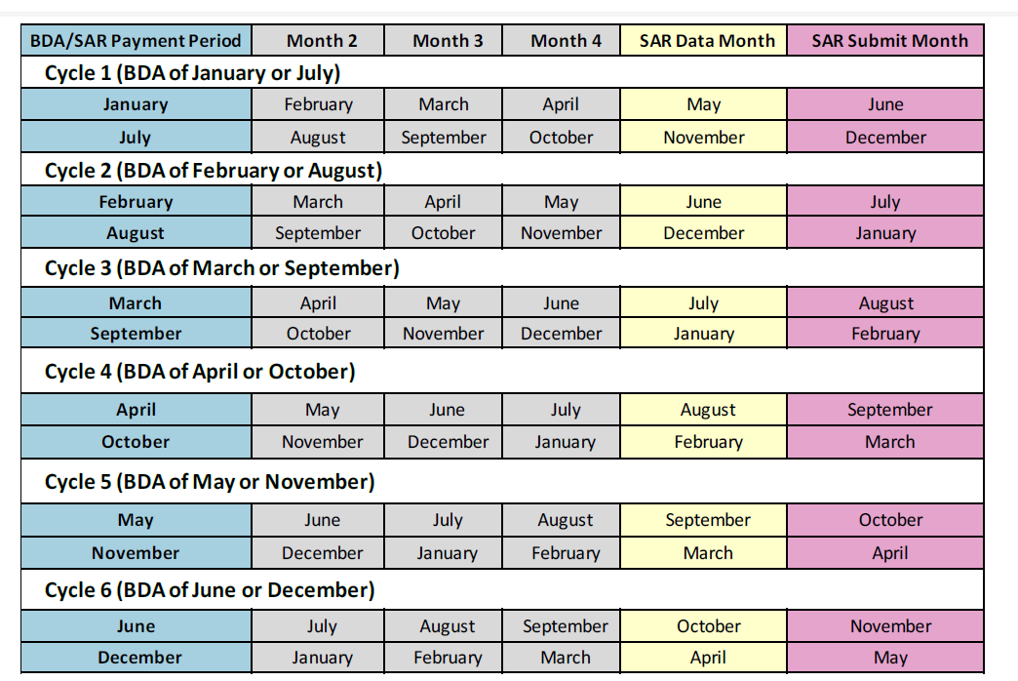
Semi-Annual Reporting (SAR)
Cases will be assigned to one of the six SAR cycles.
Each cycle consists of two Payment Periods.
In each SAR period, there is
  Data/Report Month
  Submit Month
  Payment Period

Slide 18
SAR Mandatory Mid Period Report Requirements
CalWORKS
  Income exceeds their IRT
  Drug Felony Convictions
  Fleeing Felon Status
  Parole/Probation Violations
  Address Changes
CalFresh
  Income Exceeds their IRT

Slide 19
Annual Reporting for a Child Only
(AR/CO)
No eligible Adult
Annual Renewal only-no periodic report

Slide 20
Mandatory Mid Period Report Requirements
Income exceeds their IRT
Drug Felony Convictions
Fleeing Felon Status
Parole/Probation Violations
Changes in Household Composition
Address Changes

Slide 21
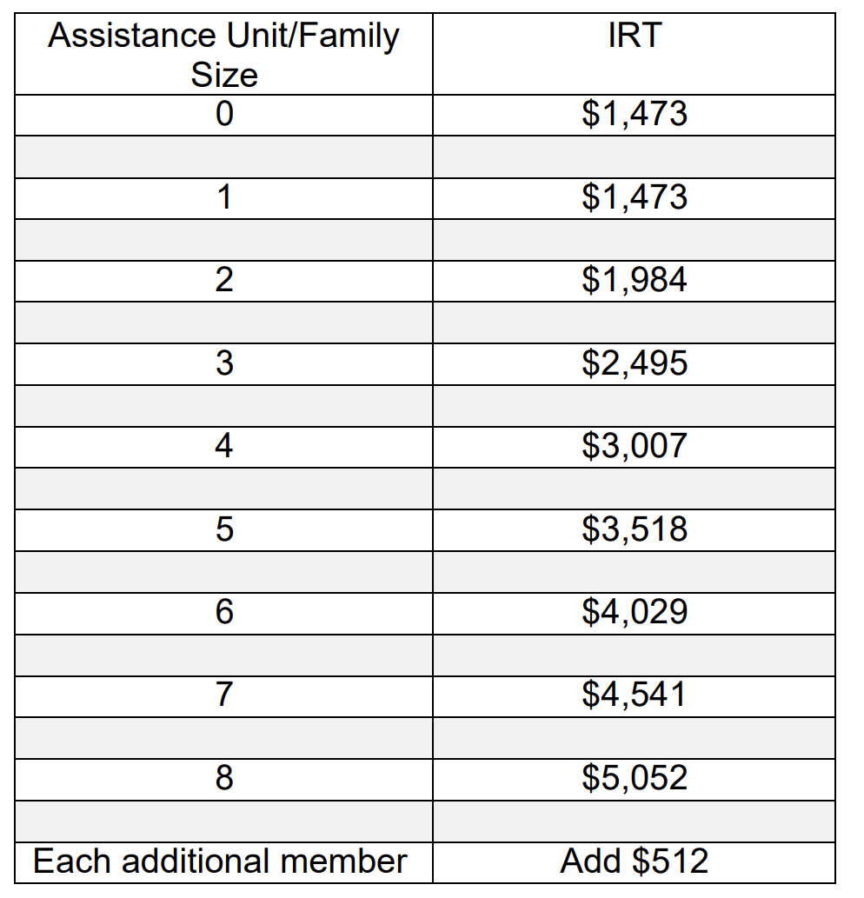
income Reporting Threshold
(IRT)
CalWORKs
  Tier 1: $996.00 plus the amount of income last used in the budget
  Tier 2: Income that would render the AU Ineligible
Must contain Earned Income

Slide 22
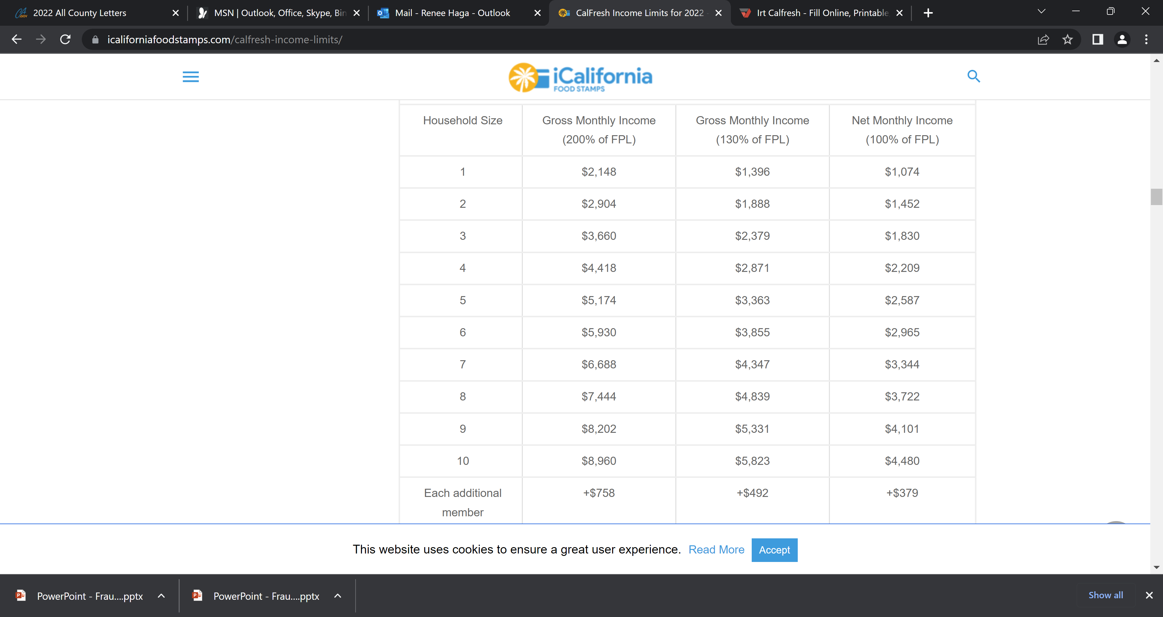
income Reporting Threshold
(IRT)
CalFresh
All income

Slide 23
OP/OI Start Dates
Dependent upon the individuals reporting requirements
CalWORKs does not require a 10-day notice
CalFresh does require a 10-day notice

Slide 24
Budgeting Methodology
ACL 15-95
  CDSS has determined that under SAR and AR/CO, CalWORKs current OP calculation methods can result in large OPs based on income that the clients did not actually have
  OP/OI shall not be assessed based on more income than the client actually received
  OP/OI must be based on the actual circumstances, taking into consideration a decrease in income

