Slide 1
California Welfare fraud investigators Association Conference
MANDATED REPORTING FOR CHILD ABUSE
DEPARTMENT OF PUBLIC SOCIAL SERVICES
CHILDREN SERVICES, REGIONAL MANAGER – APRYL AMERSON

Slide 2
Introduction and Overview
Child welfare concerns
Sobering Facts
Physical Abuse
Willful Harming
Sexual Abuse
Neglect
Emotional Abuse
In the US every year more than 3.6 million reports of child abuse are made, involving almost 6 million children. Each day 4 or 5 children are killed by child abuse or neglect.
​

Slide 3
Course Description
CHILD ABUSE IS AT AN EPIDEMIC LEVEL IN THE UNITED STATES. IN CALIFORNIA, LAW ENFORCEMENT ARE CONSIDERED MANDATED REPORTERS IN AN EFFORT TO HELP COMBAT THIS INCREASING PROBLEM. THIS REPORTING RESPONSIBILITY IS A SERIOUS ONE AND FAILURE TO ABIDE BY THE MANDATED REPORTING LAW CAN RESULT IN SEVERE PENALTIES.

Slide 4




Neglect in Child Welfare
Physical Neglect
Emotional Neglect
Medical Neglect
Educational Neglect
Failure to provide a child with basic survival needs such as nutrition, clothing, shelter, and hygiene.
Ignoring a child’s needs for attention, affection and emotional support. Permitting a child to use drugs, alcohol or engage in crime.
Not taking a child to receive appropriate medical care for serious illness or injury. Failure to follow medical recommendations for a child.
Keeping a child from special education services.

Slide 5

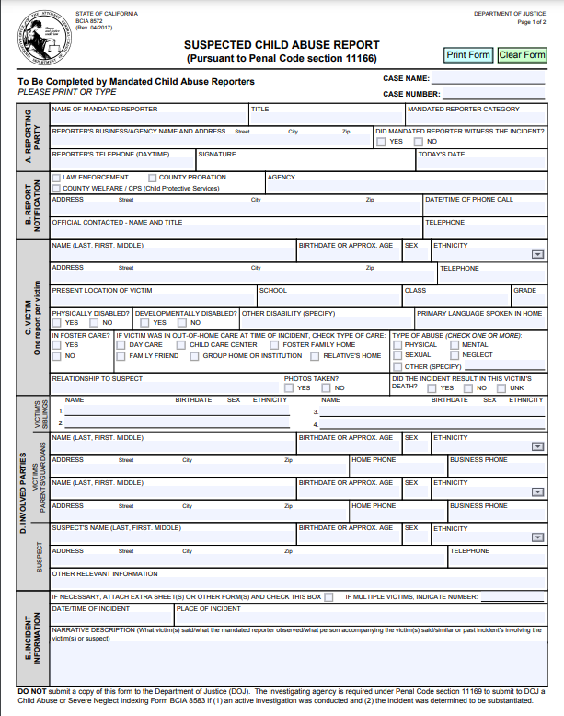
Child Abuse Mandated Reporting Responsibilities
  MANDATED REPORTER OBLIGATIONS

Slide 6
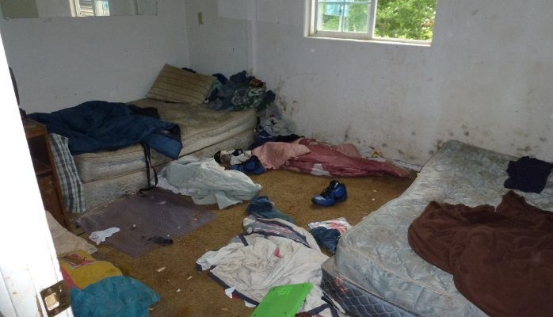
Child Abuse Mandated Reporting Responsibilities

Slide 7
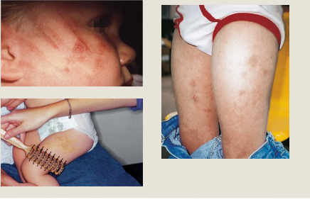
Child Abuse Mandated Reporting Responsibilities
Questionable Bruises

Slide 8
Child Abuse Mandated Reporting Responsibilities
What is your responsibility?
“What Must be Reported to CACI?” The law requires child welfare agencies to make a CACI report to the CA DOJ whenever they substantiate an allegation of 1) physical abuse, 2) sexual abuse, 3) mental abuse, or 4) severe neglect.

Slide 9
Knowledge Check
You arrive at a home to complete an investigation, when you arrive you notice the home has dead insects, animal feces, cigarette buds everywhere and excessive trash. You find a 2 year old child, frail, pale and underweight
This is medical neglect and should be reported.
This is not neglect the family lives in poverty, this should not be reported.
This is neglect and should be reported. ​

Slide 10
Knowledge Check

Slide 11
Questions?

Slide 12
Thank you
Apryl M. Amerson
951-413-5043
Child Abuse Hotline
800-442-4918​

Slide 13

Elder and Dependent Adult Abuse mandated reporting responsibilities
Julie Orozco, LCSW
Riverside County Adult Services Division

Slide 14


Definitions
Elder
Dependent Adult
Any person residing in California, 60 years of age or older
WIC 15750(b)(2)
Note: This age range changed in January 2022 due to AB-135
Any adult between the ages of 18 and 59 who has a combination of a disability and the inability to protect their own interests, or an inability to protect their own rights, including persons admitted to a 24-hour health facility
WIC 15750(b)(1)(A)(B)

Slide 15
Mandated Reporter Obligations
WIC 15610.07 and
WIC 15630
You are required to report if:
  in the course of your work, you have observed or have knowledge of elder or dependent abuse or neglect, AND
  the suspected abuse fits into the California definitions of abuse (physical, psychological abuse, abandonment, abduction, isolation, financial abuse, neglect/self-neglect).
Reminder: You do not have to KNOW the abuse occurred, you just have to have a suspicion that abuse may have occurred.

Slide 16

Legal Duty vs. Ethical Duty
If you suspect elder and dependent adult abuse outside of scope of your work:
  You are not legally required to report,
  but ethically, we hope that you will report suspected abuse

Slide 17
Legal Definitions of Abuse (Physical)
Physical Abuse (WIC 15610.63)
Sexual Abuse (WIC 15610.63)
May include:
Assault (PC 240)
Battery (PC 242)
Assault with a deadly weapon or force likely to produce great bodily injury (PC 245)
Inappropriate use of physical and chemical restraints or psychotropic medications
Confining an adult against their will (e.g., locking in room)
By law, is a form of physical abuse, and may include:
Sexual battery (PC 243.4)
Rape (PC 261)
Spousal Rape (PC 262)
Sodomy (PC 286)
Oral Copulation (PC 287)
Note: This section is also applicable with adults who are unable to give consent or comprehend the nature of these actions due to a physical or mental impairment.

Slide 18
Legal Definitions of Abuse (Non-Physical)
Caregiver Neglect
Failure to assist in personal hygiene; provision of food, clothing, and shelter; medical care; prevention of malnutrition or dehydration
Self-Neglect
Failure to exercise that degree of self-care (personal hygiene; food, clothing, or shelter; medical care, protection from safety hazards; manage own finances)
Financial Abuse
Takes, secretes, appropriates, obtains, or retains property for a wrongful use with intent to defraud or both
Isolation
Prevention from receiving phone calls or mail; false imprisonment or physical restraint from meeting visitors
WIC 15610.57
WIC 15610.57
WIC 15610.30
WIC 15610.43
Abandonment
Desertion or willful forsaking of an elder or dependent adult by a caregiver
Abduction
The removal from California or restraint from returning to California of any elder or dependent adult who does not have the capacity to consent to the removal or return
Psychological Abuse/ Mental Suffering
Actions that result in fear, agitation, confusion, severe depression, or other forms of serious emotional distress
WIC 15610.05
WIC 15610.06
WIC 15610.53

Slide 19

Investigation Jurisdictions
Law Enforcement
Adult Protective Services
Long Term Care Ombudsman
APS
Respond to emergency/crisis situations
Ensure immediate safety (e.g., EPO)
Apprehend and possibly arrest suspects
Investigate suspected criminal offenses
Cross report to appropriate agencies (e.g., APS, Long Term Care Ombudsman)
Investigate reports of elder or dependent adult abuse and neglect in private homes and public settings
Provide crisis intervention
Provide referrals to services/resources
Cross-report to appropriate agencies (e.g., law enforcement, Long Term Ombudsman, Community Care Licensing)
Investigate reports of suspected abuse of elder or dependent adults in long-term care facilities
Advocate for clients’ wishes
Cross report to appropriate agencies (e.g., APS, law enforcement, Community Care Licensing)
LTCOP
Note: Cross-reporting to APS or LTCOP is not a substitute for law enforcement taking a crime report

Slide 20
Who to Report to
Which organization do you report to?
Where is the abuse or neglect happening?
Outside of a licensed long-term care (LTC) facility, including a private home, apartment, hospital, or homeless shelter
In a facility, such as: long-term care facilities (nursing homes, residential care facilities for the elderly, assisted living/board and care homes), adult residential care facilities, intermediate care facility, and Community-Based Adult Services (CBAs)/adult day health care programs

Slide 21
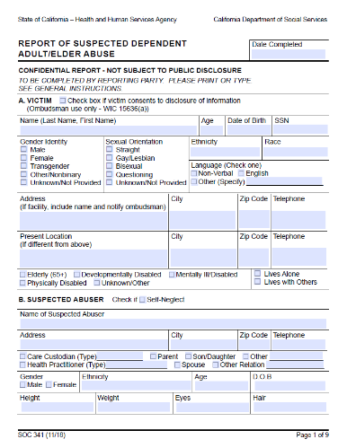



Reporting Requirements (WIC 15630)
Make a phone call immediately, or as soon as practically possible
(WIC 15630)
Some organizations have an internet reporting tool. However, if incident is time sensitive, then you should make the report by phone.
If reported by telephone, a written SOC 341 or an internet report shall be sent to Adult Protective Services/LTCOP (see Reporting Time Frames on next slide).

Slide 22
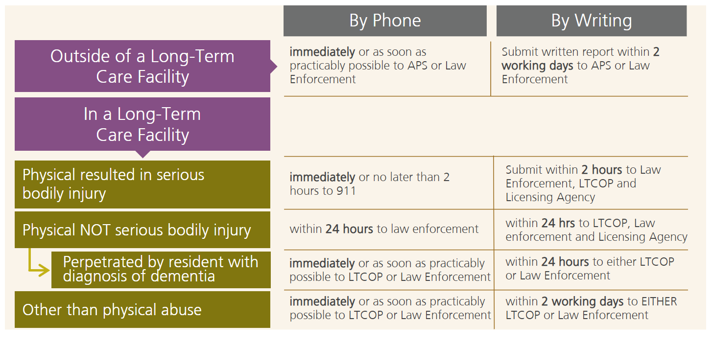
Reporting Timelines
Time frames mandated by law depend on both the type of abuse and where it occurred.

Slide 23
Failure to Report
WIC 15630(h)
There are severe penalties for failure to make a mandated report when there is knowledge of suspected abuse or neglect.
The WIC states that failure to report may result in a fine up to $1,000 , up to six months in jail, or both.
If failure to report results in “great bodily injury or death” then the penalty increases to a fine up to $5,000 and 1 year in jail or both

Slide 24
Confidentiality and Exceptions
As a mandated reporter, your identity is protected by law under Welfare and Institutions Code (WIC) section 15633.
Generally speaking, the alleged victim and perpetrator will not know that you reported, unless they are able to surmise this on their own. If the alleged victim or perpetrator asks if you made the report about them, you are NOT obligated to disclose this to them.
However, pursuant to WIC 15633.5, information relevant to the incident of elder or dependent adult abuse may be given to an investigator from an adult protective services agency, a local law enforcement agency, the office of the district attorney, the office of the public guardian, the probate court, the bureau, or an investigator of the Department of Consumer Affairs, Division of Investigation who is investigating a known or suspected case of elder or dependent adult abuse.
The following agencies are authorized to receive information regarding the Reporting Party:
  (1) An adult protective services agency.
  (2) A long-term care ombudsperson program.
  (3) A licensing agency.
  (4) A local law enforcement agency.
  (5) The office of the district attorney.
  (6) The office of the public guardian.
  (7) The probate court.
  (8) The bureau.
  (9) The Department of Consumer Affairs, Division of Investigation.
  (10) Counsel representing an adult protective services agency.

Slide 25

Record Requests from Law Enforcement
If you need Adult Protective Services (APS) investigation records, contact your local APS agency to learn how to make a request with their Custodian of Records.
Records can only be requested if it is connected to an investigation of a known or suspected incident of elder or dependent adult abuse (WIC 15633.5)

Slide 26

What Happens After You Make a Report?
Sometimes mandated reporters get frustrated because they feel it is a waste of their time as nothing ever gets done about the abuse or neglect.
Rest assured, the organizations that you have reported to will be assessing the report information. They will be evaluating the potential risk to the alleged victim, looking for prior records of abuse or neglect, and ultimately making the decision whether the law will allow an investigation.
The majority of reports will rise to the level of initiating an investigation, and even non-investigated reports are maintained on file in case other reports are received. So, each report counts every time it is made.

Slide 27
Role of Adult Protective Services (APS)
What APS Does
What APS Does Not Do
Certain reports will be prioritized and will have quicker response times based on the level of immediate danger. However, APS is required to respond to all reports within 10 days from the initial report.
An APS professional will attempt to make contact with the alleged victim and law enforcement may be brought in if the investigator is being denied access to the alleged victim.
If contact is made, alleged victims are always interviewed privately, unless they request that someone else be with them.
Collateral parties such as family members, caregivers, or neighbors may be interviewed as well.
The primary goal of APS is to promote the alleged victim’s safety, to determine if abuse and/or neglect has or is taking place, and assist with interventions to keep the client safe and to help improve the individual’s life.
It is important to remember that APS is a voluntary program, and any adult with decision-making ability can refuse or withdraw from services at any time. APS cannot force someone to speak with them or to agree to any services that might be offered.
Cross report confirmed allegations to the appropriate agencies
Disclose information to reporting parties (unless authorized by WIC 15633.5, including law enforcement)
Make someone change their lifestyle: There are many limitations on what APS professionals can do. The program is not intended to, nor does it have the power to interfere with individual lifestyle choices or the consequences of those choices. If no laws are being broken and the person in question appears to have the ability to make their own decisions, then APS cannot interfere with what they decide to do
Remove someone from their home against their will: Most importantly, APS does not have the authority to remove people from their home against the person’s will. APS does not put people in nursing homes, despite what a suspect may have told them in an act of manipulation.

Slide 28

Role of Long-Term Care Ombudsman Investigations
The Long-Term Care Ombudsman representative has a slightly different role from an APS professional.
With appropriate consent, from the client or client's representative, the Ombudsman representative will investigate the abuse or neglect allegation by talking to the resident, the resident’s family and representatives, facility staff, and others in order to verify that the abuse occurred.
They may help negotiate a solution that the resident desires, cross-report the issue to other agencies, or refer the case to law enforcement if it appears that a crime has been committed.
As with APS, the Ombudsman representative has limited authority to compel victims or alleged perpetrators to do anything. They rely on law enforcement, the licensing agencies, and the California Bureau of Medi-Cal Fraud and Elder Abuse to enforce actions to protect residents at risk.

Slide 29

Consideration: Capacity/Decision-Making Ability
When it comes to reports of abuse, it is important to remember that a person’s ability to make decisions will always be a factor.
As a witness to the abuse, you may believe that the victim cannot make these decisions for themselves, but many elders and dependent adults still have the right to self-determination, even if you think it is a bad idea.
Mental capacity can only be legally determined by a judge; however, APS, Long-Term Care Ombudsman representatives, and various mandated reporters are often faced with situations where they must make some assessment of the apparent decision-making ability for a client or resident.
In situations where the client or resident’s perceived lack of decision-making ability may place their health, safety, or property at risk, a report must be made.
Note: If APS identifies an elder or dependent adult appears to lack capacity to protect their person or assets, and another individual is not available to assist, APS may make a referral to the Public Guardian.

Slide 30
AB-135 (2021)
What Changed?
What Didn’t Change?
In 2021, Assembly Bill 135 made statutory changes to the APS Program pursuant to Chapter 13 of the Welfare and Institutions Code.
As of January 1, 2022, the elder age of eligibility decreased from 65 to 60, so APS can now serve these individuals.
AB-135 did NOT change the way that elders are defined in the Elder Abuse and Dependent Adult Civil Protection Act (Chapter 11).
Therefore, mandated reporting law did not change, and still defines an elder as 65+ and a dependent adult as 18-64 who meets all other criteria.
Penal Code 368 continues to define elder as 65+ and a dependent adult as 18-64 who meets all other criteria.
Law enforcement will continue to receive reports of abuse from APS agencies.
Law enforcement and district attorneys may follow existing protocols and procedures for investigations and prosecutions for potential penal code violations.
Persons aged 60 through 64 who are abused and neglected are still victims of a crime that may warrant a criminal investigation and prosecution.
Penal Code 368 – Elder Abuse enhancement – would not apply for older adults aged 60 through 64.

Slide 31
SB 338 (2019)
Senior and Disability Victimization
This bill made it that senior and disability victimization crimes are considered “domestic violence,” subject to the mandatory arrest requirements of Section 836, if they meet the elements described in Section 273.5, including, but not limited to, a violation by a caretaker or other person who is or was a cohabitant of the victim, regardless of whether the cohabitant is or was a relative of, or in an intimate personal relationship with, the victim.
Additionally, victim cooperation is sometimes unnecessary for prosecution, and in some cases allowing victims the option of preventing prosecution creates an opportunity for the perpetrators to obstruct justice by pressuring or threatening the victims.
Note: This may impact how APS needs to cross-report to the local law-enforcement agency (e.g., financial abuse)

Slide 32
Things to keep in mind
Whenever possible, take pictures of legal documents that a caregiver presents (e.g., Power of Attorney, conservatorship, legal guardian). Whether the documents are valid or not, if the individual is presenting as the caregiver, they are claiming they have a duty to the client, and the District Attorney can consider enhancement penalties for abuse/neglect by a caregiver.
Elders who fall victim to scams can experience serious mental and emotional trauma, including anxiety, shame, and grief, with increased suicide-risk. Please refer these individuals to APS for additional support.
The home environment is a tell-tale sign of the elder’s ability to care for themself, or the family’s/caregiver’s ability to provide proper care. At times, the family member is not intentionally neglecting their loved one, but may be in over their head, or the family member may need a higher level of care. When in doubt, make a referral to APS for additional assessment and support.
Victims are often the victim of multiple types of crime. For example, if someone is being financially exploited, they are often victims of other types of crime as well, including neglect and physical abuse.
Because APS cannot remove and place a client, they may request assistance from law enforcement to assess for a possible 5150 (e.g., danger to self, grave disability), or to consider an EPO. If this is possible, it provides APS with a little more time to develop an alternative intervention (e.g., APS Initiated-Restraining Order).
When an elder has dementia/Alzheimer’s Disease, a door locked on the outside cannot be the safety plan, as this places the elder in danger. This may be a sign that the family is overwhelmed with their care, and the elder may be being neglected. Make a referral to APS for additional assessment and support.
Many APS agencies lead or participate in Elder Abuse Forensic Centers. These are typically multidisciplinary teams that specialize in complex elder and dependent adult abuse cases. Law enforcement agencies can request to present a complex case to the EAFC for guidance/recommendations.

Slide 33
CASE PRESENTATIONS

Slide 34
Case Presentation #1
Pseudonym: Jane Doe A
Age: 88
Gender: Female
Living situation: Lives in the home with her adult daughter and adult grandson
Medical history: HBP, Pacemaker (5 years ago), HCL, overactive bladder, dementia

Slide 35
Case History
APS History:
  9 past APS Investigations
    2011 - 2018
        Majority are Financial Abuse against grandson
        2018: Self-Neglect

Slide 36
Presenting Case

Slide 37
Presenting Case
June 26, 2018
APS receives referral regarding bruising on client’s forehead and arms
Daughter/caretaker “non-chalant” about bruising and unable to provide explanation
Reports caretaker has yelled and thrown things before, and they are worried about possible physical abuse
Notes:
Referral Details:

Slide 38

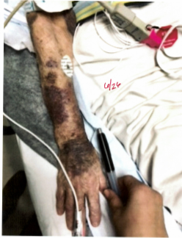
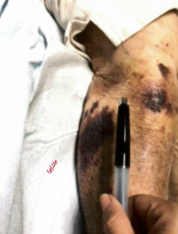
Injuries

Slide 39
Presenting Case
June 26, 2018
June 27, 2018
APS receives referral regarding bruising on client’s forehead and arms
Daughter/caretaker “non-chalant” about bruising and unable to provide explanation
Reports caretaker has yelled and thrown things before, and they are worried about possible physical abuse
Joint visit conducted (APS, law enforcement)
Client transported to hospital for evaluation
Placed on 5150 hold
Notes:
Referral Details:

Slide 40
Presenting Case
June 26, 2018
June 27, 2018
June 28, 2017 – July 16, 2018
APS receives referral regarding bruising on client’s forehead and arms
Daughter/caretaker “non-chalant” about bruising and unable to provide explanation
Reports caretaker has yelled and thrown things before, and they are worried about possible physical abuse
Joint visit conducted (APS, law enforcement)
Client transported to hospital for evaluation
Placed on 5150 hold
Investigation continues
Client is placed in out-of-home care
Bruises improve
Case presented to EAFC
Notes:
Referral Details:

Slide 41
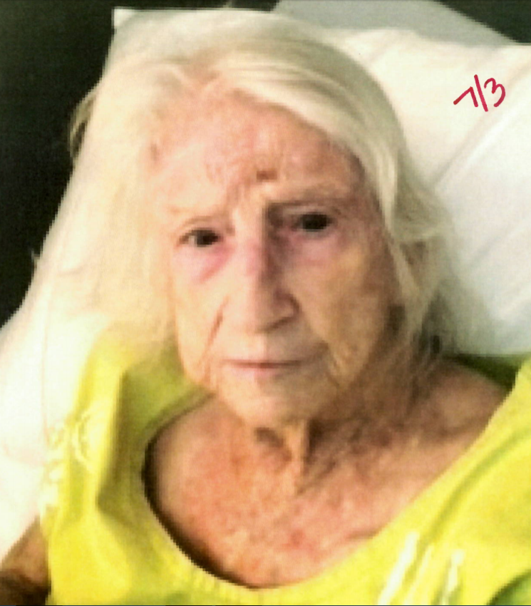
Before and After

Slide 42
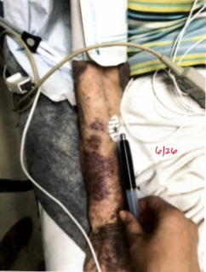
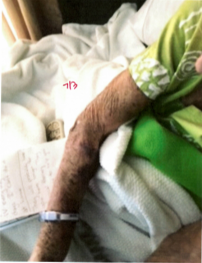
Before and After

Slide 43
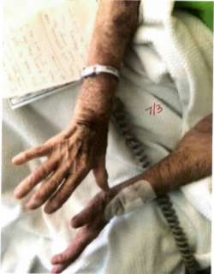
Before and After

Slide 44
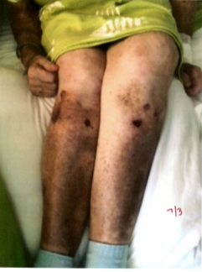
Before and After

Slide 45
Presenting Case
June 26, 2018
June 27, 2018
June 28, 2017 – July 16, 2018
July 26 – 30, 2018
APS receives referral regarding bruising on client’s forehead and arms
Daughter/caretaker “non-chalant” about bruising and unable to provide explanation
Reports caretaker has yelled and thrown things before, and they are worried about possible physical abuse
Joint visit conducted (APS, law enforcement)
Client transported to hospital for evaluation
Placed on 5150 hold
EAFC physician reviews medical records and indicates bruising is concerning, but not conclusive
AIRO Consult occurs with APS and County Counsel
Investigation continues
Investigation continues
Client is placed in out-of-home care
Bruises improve
Case presented to EAFC
Notes:
Referral Details:

Slide 46
Presenting Case
July 28 – 31, 2018
Client discharged home
Client presents with new bruising
SW conducts multiple visits to the home and observes client in her environment
Notes:
Referral Details:

Slide 47

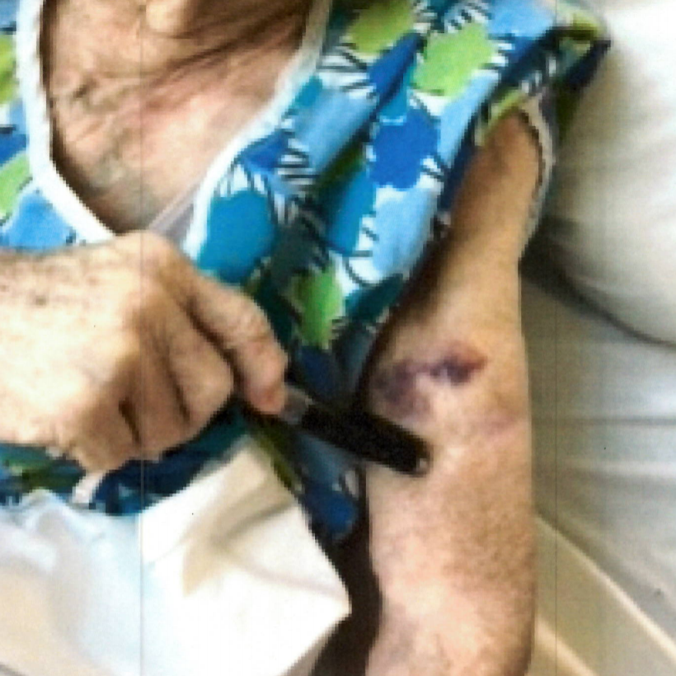
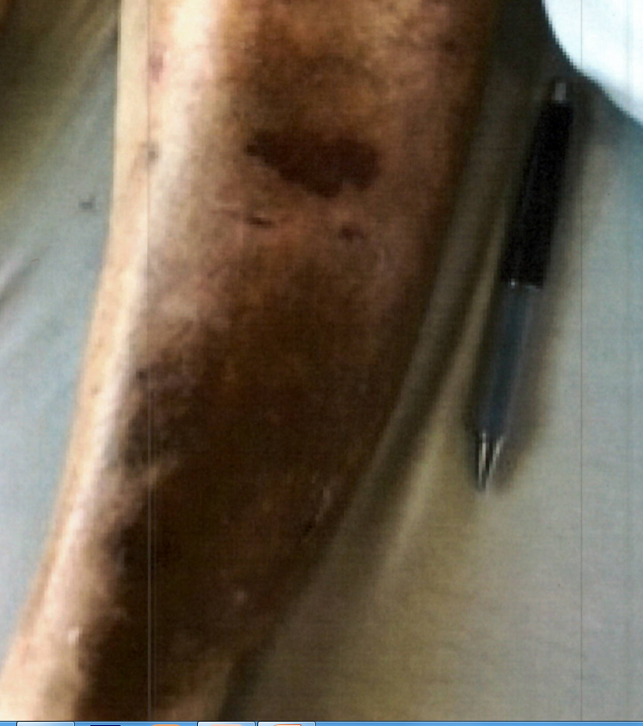
Injuries after return to home

Slide 48
Presenting Case
July 28 – 31, 2018
August 6, 2018
Throughout course of investigation, since the daughter was also Executor of the Living Trust, bank statements were evaluated and found that she failed to execute her fiduciary responsibilities and found excessive spending no used to benefit the client, allowing other family members to use her money for personal expenses, delinquent property taxes for three years.
Client discharged home
Client presents with new bruising
SW conducts multiple visits to the home and observes client in her environment
Case presented at EAFC for update
Based on APS investigation, decided to not pursue an AIRO
More home health services provided
Initiated referral to PG
Notes:
Referral Details:

Slide 49
Outcomes
Evaluation of injuries: Bruising determined to be as a result of requiring higher level of care
  EAFC Geriatrician evaluates medical history and bruising
  Social worker observes client in her environment
  Social worker photographs bruising during multiple visits
Allegation Conclusions:
  Daughter (Caregiver/Executor of Living Trust)
    Financial Exploitation: Confirmed
    Neglect: Confirmed
    Psychological/Mental Abuse: Confirmed
    Physical Abuse: Inconclusive
  Grandson:
    Financial Exploitation: Confirmed
    Psychological/Mental Abuse: Confirmed
  Self-Neglect: Unfounded
  Safety Plan:
    Home Health/Hospice services
    Son trying to become trustee/APS pursuing conservatorship as back-up

Slide 50
Case Presentation #2
Pseudonym: Jane Doe B
Age: 73
Gender: Female
Living situation: Lived at home with son (caretaker) and two other non-relative females
Medical history: Dementia, Stage 4 Kidney Disease, Hypertension, poor mobility, weakness, dizzy spells, poor balance, bladder incontinence

Slide 51
Case History
APS History
  2012: Report of client having memory issues and people residing in the home taking advantage of her
    Unfounded; client was alert, denied allegations, and allowed social worker to tour home
  2014: Report of client experiencing physical and mental decline, as well as family member trying to financially abuse client
    Undetermined; unable to contact. However, once client was made aware of questionable transactions, she declined family member access to account, requested ATM to be canceled established in-person withdrawals only
IHSS History
  Client began receiving In-Home Support Services (IHSS) in June 2015.
  Client was authorized for protective supervision.
  Suspected abuser in this case was her IHSS provider.

Slide 52
Presenting Case

Slide 53
Presenting Case
September 7, 2017
APS referral received from law enforcement
Notes:
Referral Details:
Alleged family member called law enforcement to assist with getting personal belongings from home. After assist, she called law enforcement back to the home because she heard screaming from the back of the home.
Client was found to be locked in her bedroom, confused and unable to exit room. Law enforcement intervened and removed client from room and transported client to the hospital.
Client was discharged from hospital to suspected abuser and stated client appeared to be well taken care of and investigation continued

Slide 54
Presenting Case
September 7, 2017
September 8, 2017
APS referral received from law enforcement
APS initiates investigation
Notes:
Investigation Details (9/8/17):
Contact is made with hospital and APS learns that client was discharged from hospital to suspected abuser and stated client appeared to be well taken care of
SW makes contact with SA and interviews
SW makes contact with Client. Client presents with cognitive impairment but states “I am fine at home.”
SW follows up with law enforcement officer on scene during incident

Slide 55
Presenting Case
September 7, 2017
September 8, 2017
September 11-12, 2017
APS referral received from law enforcement
APS initiates investigation
APS attempts to engage suspected abuser in removing deadbolt from client's room
Notes:
Investigation Details (9/11-12/17):
SA reports that he only uses deadbolt on occasion and for short instances when he goes outside because she wanders and it for her own safety and protection.
SA states the does not feel this is necessary and hangs up on social worker

Slide 56
Presenting Case
September 7, 2017
September 8, 2017
September 11-12, 2017
September 13, 2017
APS referral received from law enforcement
APS initiates investigation
APS attempts to engage suspected abuser in removing deadbolt from client’s room
APS follows up with the client and suspected abuser in the home
Notes:
Investigation Details (9/13/17):
SW attempted to gain entrance to the property but suspected abuser would not allow them entrance and refused to remove the deadbolt.
SW then contacted law enforcement for assistance
While waiting for law enforcement, they witnessed a vehicle parked at the client’s residence drive away
Law enforcement attempted to call out for someone to let them in, but when no one responded they jumped the fence to enter the property
They observed client through the window to be in her room. They tried to instruct her to exit the room, but she was unable to exit her room.
Client was found to be locked in her room again

Slide 57
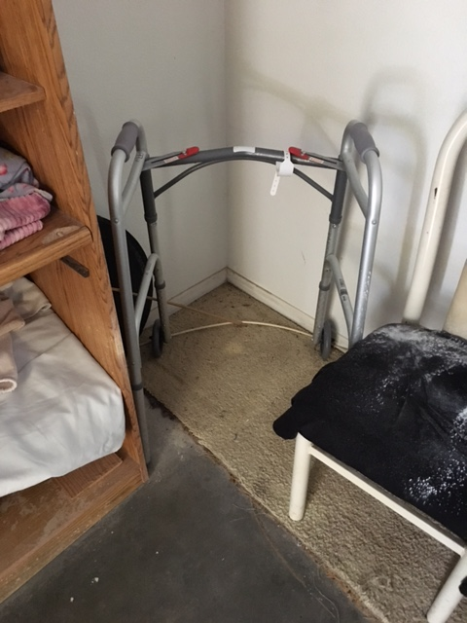
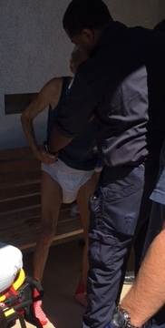
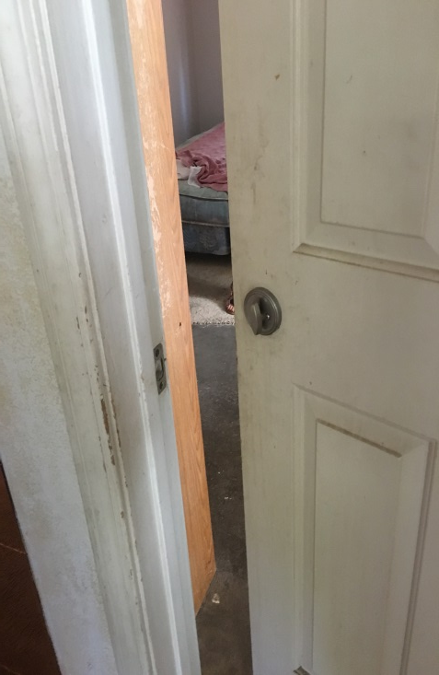
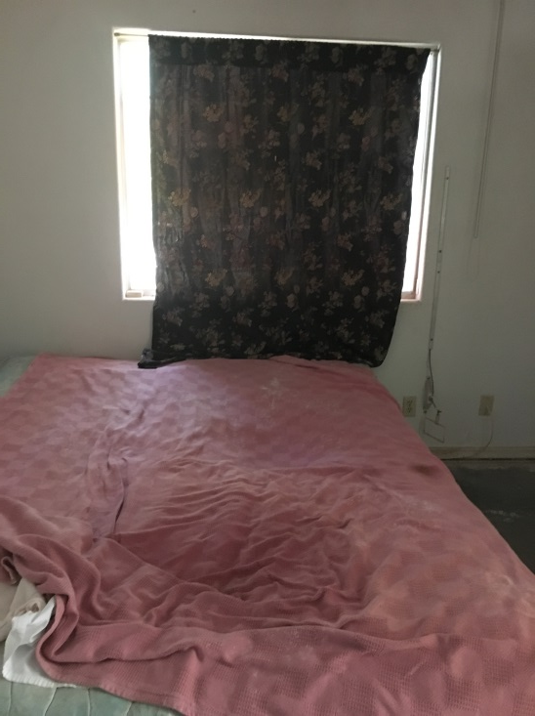
Client Presentation
Client wearing a shirt, diaper and socks
EMT estimated diaper had not been changed in several days
Client needed assistance to ambulate, walker blocked and unable to access
Client had a mattress and box spring on the floor, with a soiled blanket on top
Client did not have any clothing in her closet
Client reported she was hungry

Slide 58
Presenting Case
September 25, 2017
October 17, 2018
November 28, 2017
December 26, 2017
AIRO filed with Probate Court
TRO granted
Hearing for Permanent restraining order
Trial with social worker testimony
Restraining Order granted
Temporary conservatorship is granted for another one of client’s sons
Client was able to return to her home
Permanent conservatorship established with another son.

Slide 59

Positive Outcomes
Client removed from abusive environment
Protective orders issued (EPO, AIRO)
Conservatorship with family
Suspect arrested (bailed out)
District Attorney filed charges/Arrest Warrant Issued:
  3 Counts of PC 368(E)(1) (Embezzlement/fraud of an elder or dependent adult by caretaker)
  2 counts of PC 236 (False Imprisonment)
  PC 667(C) (Prior Felony Conviction)
  PC 667 (E)(1) (Prior Strike)
  PC 667 (C)(2) (Ineligible for Probation)

Slide 60
Case Example: Mrs. Ishikawa
You are a patrol deputy with your county's Sheriff's Department. You are dispatched to a home after a complaint has been received that someone there may be in distress.
27 years old
Severe autism
Limited verbal skills
She appears to be wearing soiled clothing and is extremely thin.
Knowledge Check:
1. Is Mrs. Ishikawa an elder, dependent adult, or neither?
Answer:
2. Are you mandated to make a report?
Answer:
3. Who would you make the report to – Adult Protective Services (APS) or Long-Term Care Ombudsman?
Answer:

Slide 61

Knowledge Check
The failure by individuals to support the physical, emotional, and social needs of adults dependent on others for their primary care is defined as:
Abandonment
Self-Neglect
Physical Abuse
Caregiver Neglect

Slide 62
Knowledge Check
An elder adult being neglected at home by their caregiver should be reported to:
The California Attorney General
The Long-Term Care Ombudsman Program
California State Licensing
Adult Protective Services

Slide 63
Knowledge Check
Adult Protective Services (APS) cannot do which of the following?
Contact law enforcement to obtain access to a suspected victim
Place a client into a nursing home against their will
Interview a client without their caregiver present
Make an abuse or neglect report without the client’s consent

Slide 64
Knowledge Check
The two populations that mandated reporters must file reports on if they suspect abuse or neglect are elders and ________________________.
Frail adults
Depressed adults
Dependent adults
Diminished adults

Slide 65
Knowledge Check
Which of the following requires a mandated reporter to file a report?
Reporter has knowledge of suspected abuse or neglect of an elder or dependent adult
Reporter has observed suspected abuse or neglect of an elder or dependent adult
Reporter is told about suspected abuse or neglect of an elder or dependent adult
All of the above

Slide 66
Knowledge Check
In the case of abuse that results in serious bodily injury that takes place in a Long-Term Care Facility, the written SOC 341 is due within how many hours after reporting to law enforcement?
72 hours
2 hours
24 hours
48 hours

Slide 67
Knowledge Check
The Long-Term Care Ombudsman Program cannot make an abuse or neglect report unless the victim consents.
True
False

Slide 68
Q&A

