Slide 1

California Department of Health Care Services
Investigations Division
California’s Medicaid Fraud Investigations
CWFIA 2022 Conference

Slide 2
Presenters
Sally Montoya, Assistant Chief of Investigations
Robert Musso, Investigator
Notes:
Sally to start through slide 8.
Introductions and background information about ourselves.

Slide 3
Course Objectives
Structure & Implementation of Medicaid
Medi-Cal Fraud Investigations
Innovation in Medi-Cal Fraud Investigations
Joint Investigations with Outside Agencies
Legal Considerations
Case Examples

Slide 4
Structure & Implementation of Medicaid

Slide 5
About DHCS and Medicaid
Medicaid known in CA as “Medi-Cal”
Medi-Cal is government funded healthcare intended for eligible low-income individuals & families
Welfare in the form of health coverage
Affiliated with Medicare, claims often paid by both
Notes:
Crossover claims
State and federal funding sources (discuss CA FMAP percentage compared to other states)

Slide 6
Beneficiaries of Medi-Cal
Total Medi-Cal beneficiaries as of March 2022
  14,678,374
Percentage of beneficiaries on managed care plans
  84.7% as of June 2022
Medi-Cal Rx
  Pharmacy claims are carved out of managed care services
California Advancing and Innovating Medi-Cal (CalAIM)
  99% Managed Care enrollment by 2024
Notes:
Medi-Cal Monthly Enrollment Fast Facts
Cal AIM initiatives:
https://www.dhcs.ca.gov/calaim#initiatives
Enhanced Care Management
Enhanced Care Management is person-centered care management provided to the highest-need Medi-Cal enrollees, primarily through in-person engagement where enrollees live, seek care, and choose to access services.
Community Supports (also known as “In Lieu of Services”)
Medi-Cal managed care plan partners will begin offering “Community Supports,” such as housing supports and medically tailored meals, which will play a fundamental role in meeting enrollees’ needs for heath and health-related services that address social drivers of health.
New Dental Benefits
CalAIM will expand key dental benefits statewide, including a tool to identify risk factors of dental decay, and silver diamine fluoride for children and certain high-risk populations.
Behavioral Health Delivery System Transformation
DHCS will strengthen the state’s behavioral health continuum of care for all Californians and promote better integration with physical health care.
Services and Supports for Justice-Involved Adults and Youth
These initiatives help California address poor health outcomes and disproportionate risk of illness and accidental death among justice-involved Medi-Cal eligible adults and youth as they re-enter their communities.
Standard Enrollment with Consistent Managed Care Benefits
To improve each enrollee’s experience, CalAIM will expand the use of managed care plans and standardize benefits so that each enrollee will have access to a consistent set of services, no matter where they live.

Slide 7
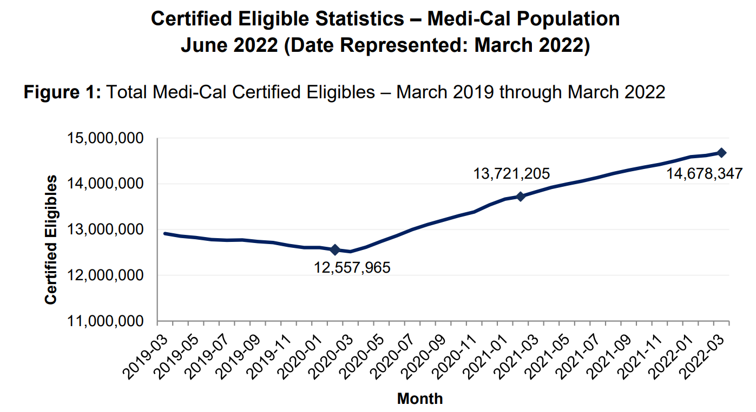
Notes:
https://www.dhcs.ca.gov/dataandstats/statistics/Documents/FastFacts-March2022.pdf

Slide 8



U.S. Department of Health & Human Services (HHS)
Centers for Medicare & Medicaid Services
Designated Single State Agency
Designated Medicaid Fraud Control Unit (MFCU)
CA Department of Justice
CA Department of Health & Human Services
Department of Health Care Services
Division of Medi-Cal Fraud & Elder Abuse (DMFEA)
County Social Service Departments
Notes:
Discuss our position in the Medicaid landscape.
Medi-Cal is administered at the county level through social service departments.
Healthcare provider fraud referrals to DOJ.
In 2021, 1 in 6 Californians receive Medicare.

Slide 9
How we partner with counties
Discuss your concerns with an investigator
Exchange of information
  household composition/residency/employment/income/contact information/marriage status
Joint investigations with county SIUs
Notes:
ROBERT to cover slide 9 and slide 10, should be just under 10 minutes in.
Even if something doesn’t rise to the level of a referral, we may be able to help answer questions.

Slide 10
What we will ask from counties
Enrollment and renewal documents
  Establishing a fraud timeline, scrutinizing details
Identity documents
Perjury statements & signatures
Recorded telephone calls
Journal entries/case notes
Notes:
Certain things we need to conduct comprehensive investigations and identify maximum exposure.
1. Applications & renewals submitted in chronological order without any missing pages.
Declared vehicles/assets, financial accounts, signatures under penalty of perjury.
Although assets may not be needed for MAGI eligibility, needed to develop PROBABLE CAUSE as proof of expenses may exceed reported income.
2. Advisements and copies of rights and responsibilities forms sent to beneficiaries and methods used to send.
3. We need to know the initial dates each beneficiary began receiving Medi-Cal coverage as well as when their next redetermination is due if ongoing.
4. How were the documents submitted? CalHEERS yes/no applications can lack information to successfully investigate.
5. Early on we establish a timeline of events, we use this information to calculate the dollars at risk which can dictate the course of the investigation.
Statutes of limitation for fraud
A) 3 year clock begins at date of initial discovery, if ongoing fraud. we can investigate all the way to the beginning of enrollment
to further develop probable cause
B) Talk about what we do why its important (counties) to stay motivated and continue to submit referrals (MC-609) to us
lack of resources, limited amount of investigators

Slide 11

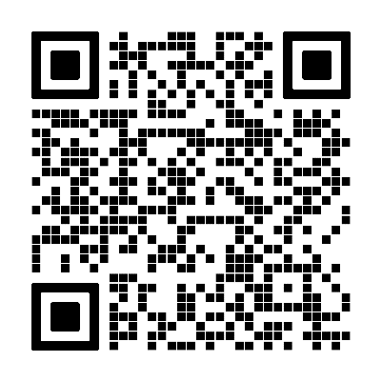
How to submit fraud complaints to DHCS
Via email to: Fraud@dhcs.ca.gov
Call our 24-hour hotline: 800-822-6222
Complete online referral form:
  https://www.dhcs.ca.gov/individuals/Pages/StopMedi-CalFraud.aspx
Mail a complaint:
  Medi-Cal Fraud Complaint – Intake Unit
  Audits and Investigations
  PO Box 997413, MS 2500
  Sacramento, CA 95899-7413​
Notes:
Sally to Cover: 11:30-12:00 minutes.
Not all complaints/referrals will be investigated
Intake screening process
Educational letters
Administrative remedies
Other referral mechanisms (crime stoppers, local hotlines)

Slide 12
Medi-Cal Fraud Investigations

Slide 13
Medi-Cal Fraud Takes Many Forms
Fraud committed by beneficiaries/recipients
Fraud committed by DHCS enrolled healthcare providers
Medi-Cal fraud as a result of third parties outside the control of DHCS
Organized crime involving the loss of Medi-Cal funds
Notes:
Sally to cover first two bullets – Robert the second two:
1. Beneficiary fraud – Failing to accurately report employment/income, household composition, businesses, financial accounts.
2. Provider fraud – Billing for services not rendered, manufacturing false medical records, theft and sale of sensitive patient information.
Robert
3. Non-enrolled healthcare providers that see Medi-Cal beneficiaries for cash, beneficiary then receives a prescription upon the non-enrolled provider's orders that Medi-Cal ultimately pays for. Cash for prescription to outside Provider and fill with Medi-cal pharmacy benefits at an enrolled pharmacy (e.g. CVS).
4. Criminal enterprise of Medicare and Medi-Cal fraud schemes, taking advantage of enrolled Medi-Cal providers and stealing identities to bill for services. ID theft rings that involve beneficiaries of Medi-Cal and other sources of PHI, PII.

Slide 14
What can DHCS Investigators Do?
Take administrative action
Conduct full scope criminal investigations
  Achieve court ordered restitution upon conviction
Submit provider fraud referrals to our designated MFCU
Assist other law enforcement agencies with their respective healthcare fraud investigations
Identify program deficiencies that can be addressed to prevent fraud
Notes:
Sally to cover slide 14 and 15:
Administrative actions
Terminations from the IHSS program, reporting information back to eligibility workers to add case notes or make adjustments as needed.
Temporary or permanent payment suspensions for enrolled healthcare providers (e.g. General Practice, Pharmacies, Hospitals).
Criminal – criminal complaint filing at local, state, or federal level, court ordered restitution upon conviction, incarceration.
Cal DOJ will receive our referral and conduct full scope criminal investigations into healthcare providers.

Slide 15
What Tools do DHCS Investigators Have?
Authority to obtain HIPPA protected information
Sworn peace officer status PC 830.3(h)
The ability to author and execute search warrants and affect arrests
Notes:
As they pertain to an investigation.
Ability to obtain information non-sworn staff members may not be able to obtain.

Slide 16
How Cases are Generally Worked
Scrutinize information received
Request additional information if not received
Use law enforcement tools to provide leads & answer questions
Serve search warrants to obtain incriminating evidence
Deploy interview tactics to obtain admissions/confessions
Notes:
Robert to cover: around 17:00 minutes
With a fine tooth comb go through all case documents
5. Surveillance techniques

Slide 17
Innovation in Medi-Cal Fraud Investigations

Slide 18
Self-Initiating Fraud Through Data Analytics
Obtain eligibility level data for example:
  Self-employed beneficiaries with household members receiving zero cost Medi-Cal
  Beneficiaries who submit no documents to support income
  Addresses shared among high numbers of beneficiaries
  High amounts of healthcare claims paid far distances from patient residence or in other states
  Beneficiaries with residence addresses of social service buildings
    P.O. boxes used as residence addresses
Notes:
Sally to cover slide 17 – slide 20: Approximately 20:00 minutes in
It is easier for a self-employed beneficiary to commit fraud as they can easily manufacture their own proof of income documents.
Counties that have access to their eligibility data can collaborate with investigators to provide reports used to self-initiate fraud investigations.
Managed care plans also submit referrals based on their own program integrity data mining efforts. Non-medical transportation trips without corresponding claims for services rendered

Slide 19
Public Assistance Reporting Information System
(PARIS)
U.S. HHS created Information Sharing Project
Information sharing among other states’ Medicaid programs
Notes:
U.S. HHS created benefits information Sharing Project.
Used to address residency problems, duplicate coverage.
Counties send letters to beneficiaries that come back as undeliverable. These names go to the database and we can look for interstate data matches – verify if active in another state. Once verified, terminate them as absent from the state – cost savings in capitation rates for us.

Slide 20
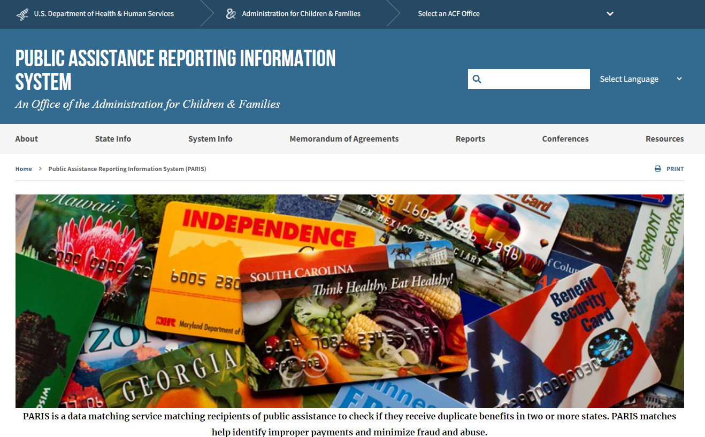
Notes:
PARIS Project, information sharing among the states’ Medicaid programs.
Residency discrepancies, duplicate coverages and payments issued.
Fraud schemes that continue/extend outside California.

Slide 21
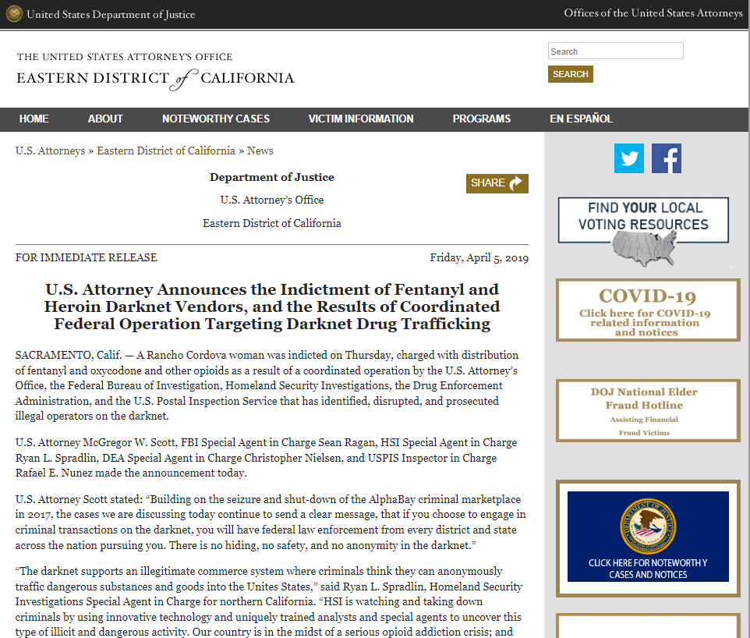
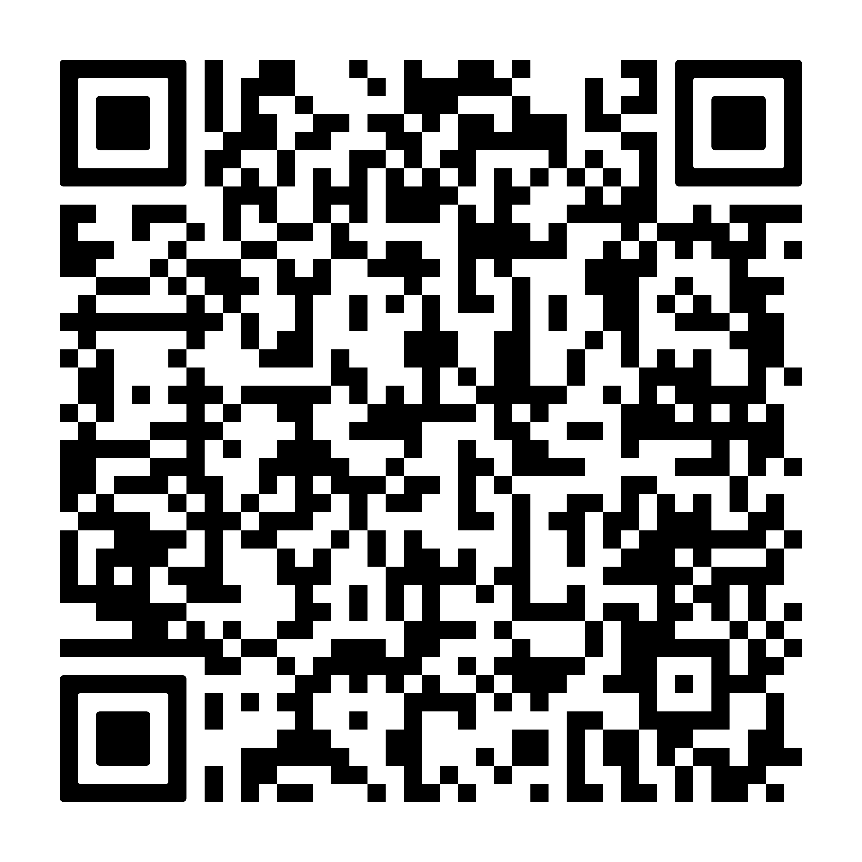
Notes:
We work closely with the FBI and HHS-OIG and have dual-sworn task force officers that work with special agents in some of the federal field offices.

Slide 22
Investigations using cellular & computer technologies
Call detail record analysis
Geolocation data
CMIPS ESP - IP address data & TTS call logs
  IHSS timesheet fraud
Electronic Visit Verification System (EVV)
Field deployable cameras
Notes:
(communications evidence) Records of communications, often contains GPS coordinates that can be mapped and presented as evidence. (historical time & place evidence)
Sally EVV:
Section 12006 of the 21st Century Cures Act requires all state Medicaid agencies implement an EVV solution for Personal Care and Home Health services. States that do not implement EVV will incur a reduction of Federal funding.
EVV was separated into 2 phases
1. IHSS
2. all other HH
federal rule is CURES act
all HH services verified electronically start time end time and location

Slide 23
Joint Investigations with Outside Agencies

Slide 24
Information Sharing
Establishing a joint case (nexus)
DHCS possesses fairly reliable sources of contact information for suspects and their relatives/household members.
Medical records
Notes:
Case numbers exchanged.
Common goals of criminal charges or administrative sanctions.
Can be shared during a joint investigation given a legitimate nexus.

Slide 25
Finding a Nexus to Medi-Cal Fraud
Unreported proceeds from criminal activity/enterprise
  Money laundering
CalWORKS, CalFRESH, Cash Aid, EBT fraud
1 in 3 Californians are receiving Medi-Cal
Notes:
Marijuana cultivation case in San Luis Obispo County.
Fraud in Medi-Cal, likely fraud is occurring in other welfare programs.
Private health insurance fraud may involve public insurance.
Elder or dependent adult abuse/neglect, DHCS has mutual interest.

Slide 26
What DHCS Investigators Need
Ongoing cooperation with social workers
  Timely responses to information requests
  Responsive and ongoing communications
Case notes/journal entries
Recorded telephone calls with beneficiaries
Notes:
Ongoing cooperation with social workers.
retrieve documents and discuss case specific eligibility details
currently DHCS investigators do not have access to CalSAWS and CalWIN or eligibility level data sources and heavily rely on our county partners.
As a general rule, any documents submitted that if proven false could result in fraud
penalty of perjury
specific intent
Timeline of events
renewals auto/or attested
letters requests for information
establishing repeated propensity to commit fraud
building probable cause for SW

Slide 27
Legal Considerations
Notes:
Sally to cover slide 28 – slide 30.

