Slide 1
Legal Considerations
Notes:
Sally to cover slide 28 – slide 30.

Slide 2
Foundational Authorities
Medicare and Medicaid Act of 1965 – President Lyndon B. Johnson
Title 19, Social Security Act -Grants to States for Medical Assistance Programs
  Section 1936 - Medicaid Integrity Program
Title 42, Code of Federal Regulations Part 455 - Program Integrity: Medicaid
  42 CFR 455 Subpart A – Medicaid Agency Fraud Detection & Investigation Program
  42 CFR 455.15 – Full investigation
Title 22, California Code of Regulations
  22 CCR 50004 – DHCS is designated single state agency
Notes:
19 SSA § 1936 - established the Medicaid Integrity Program
45 CFR § 164.512 - a health care provider is allowed to make disclosures, without the patient’s permission, that are required by law, so long as the disclosure complies with and is limited to the relevant requirements of the law. Health care providers are also permitted to make disclosures, without the patient permission, to health oversight agency for oversight activities authorized by law, including audits, civil, administrative, or criminal proceedings or actions.
45 CFR Section 164.512 (d). Under either provision of the regulation, providers are allowed, and are indeed, required to disclose individually identifiable information to health oversight agencies (DHCS)
W&I §14123(a), Participation in the Medi-Cal program by a provider of service is subject to suspension in order to protect the health of the recipients and the funds appropriated to carry out this chapter.

Slide 3
Common Crimes Investigated
WIC 14107(a) – Defrauding the Medi-Cal Program (Felony)
WIC 14014(a) – Receiving healthcare not eligible for based on false declarations of eligibility. (Wobbler)
PC 72 & PC 550(a)(6) – Submitting fraudulent claims (Wobblers)
BPC 4324(a) – Prescription Forgery (Felony)
PC 530.5(a) – Identity Theft (Felony)
PC 118(a) – Perjury
Over $950 = Felony
Notes:
BREAK after slide. Should be 45:00-50:00 minutes in to presentation.

Slide 4
Case Examples
Notes:
Robert to cover slide 31 – slide 50. You have 45 to 50 minutes total for case examples if we resume no later than the hour.

Slide 5
IHSS Fraud Case
Recipient misusing designated provider’s information
All mail correspondence went to the recipient’s residence
  As a result, recipient was able to enroll herself and her provider into TTS, allegedly without provider’s knowledge.
Recipient submitted and approved her own time sheets from 8/2014 to 4/2021, stealing $195,691.29 she was not entitled to. Forging dozens of written signatures on paper timesheets prior to TTS.
Cell tower and Google location evidence
Social Security Administration initiated tag-along case
Notes:
The RP (IHSS provider) became aware of income paid by the State, allegedly without her knowledge, as a result of rendering IHSS services to her designated IHSS recipient.
RP stated she applied for EDD disability benefits as a result of a pregnancy and noticed her qualified benefit amount was much higher than anticipated. IHSS income was listed that she claims she didn’t earn.
RP stated she used to work for the recipient, however stopped working for her in December 2016 after a verbal falling out and claims to have only worked for 4 months in total.
Income was direct deposited into a joint checking that both Provider and Recipient have access to. RP claims to have not accessed or used these funds except for a select few times.
RP was cooperative, consented to search of phone for identifying info, (number, carrier, IMEI).
RP went with me into bank branch and provided recorded verbal consent. Spoke to teller and obtained bank statements that corroborated RP’s claims of not using funds (only $389.02, there were other small cash withdrawls)
Majority of purchases were made in Los Osos area
Distance: recipient lives in Los Osos (SLO), Provider in Bakersfield (KERN).
Search warrants: Chase Bank, T-Mobile, AT&T, and Google.
Recipient failed to report IHSS income to SSA which made her ineligible for SSI/SSP benefits.

Slide 6
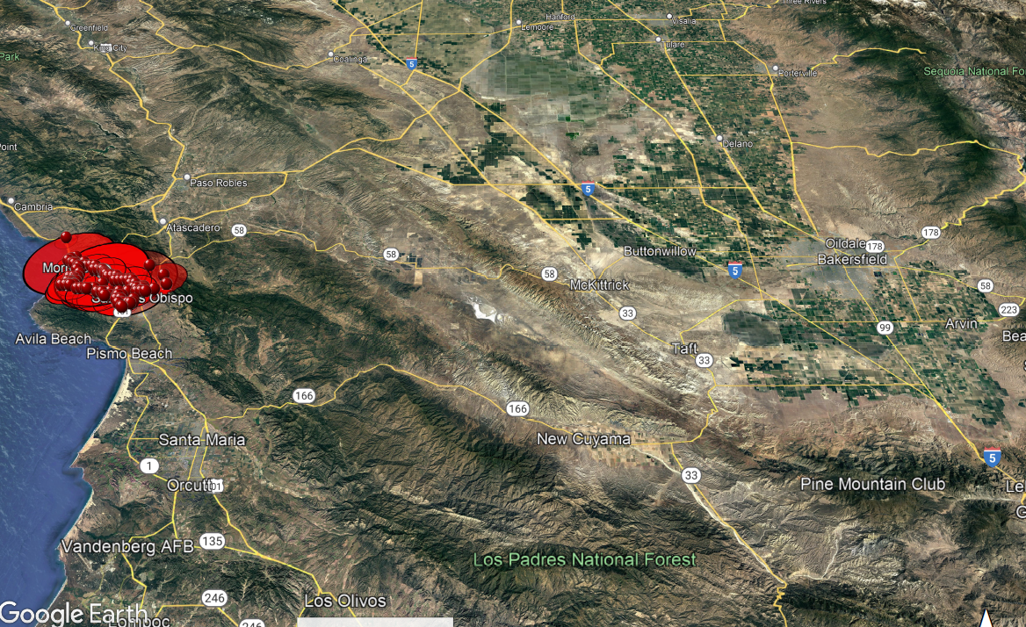
Suspect’s Location History
Notes:
Only a small segment of cell site data.
Cell site pin markers can be expanded to show many more cell, text, and data sessions.

Slide 7
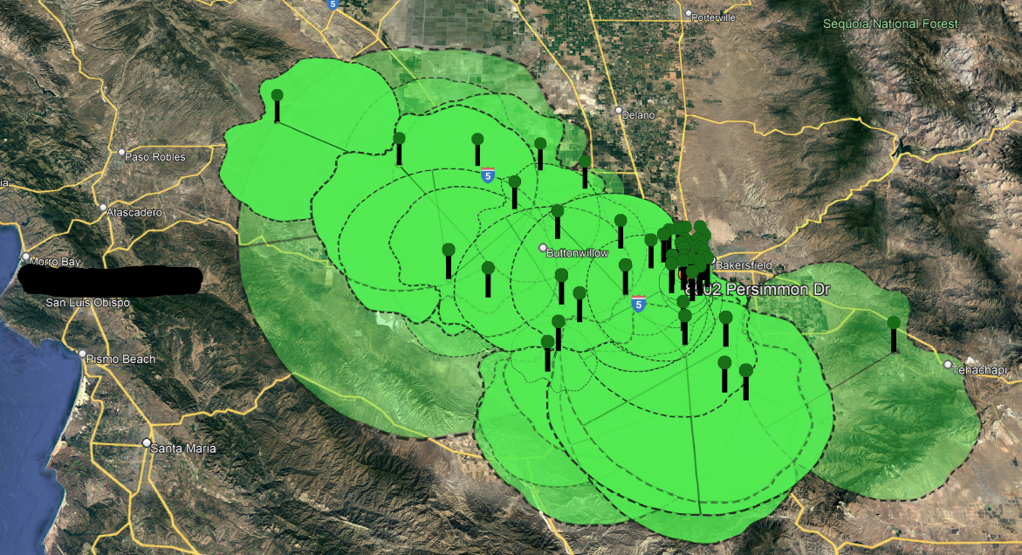
Provider’s Location History
Notes:
Only a small segment of entire cell site data retrieved.
Data reports were also obtained (cell site frequency reports).
Ability to geo-fence data and see times of device entry/exit.

Slide 8
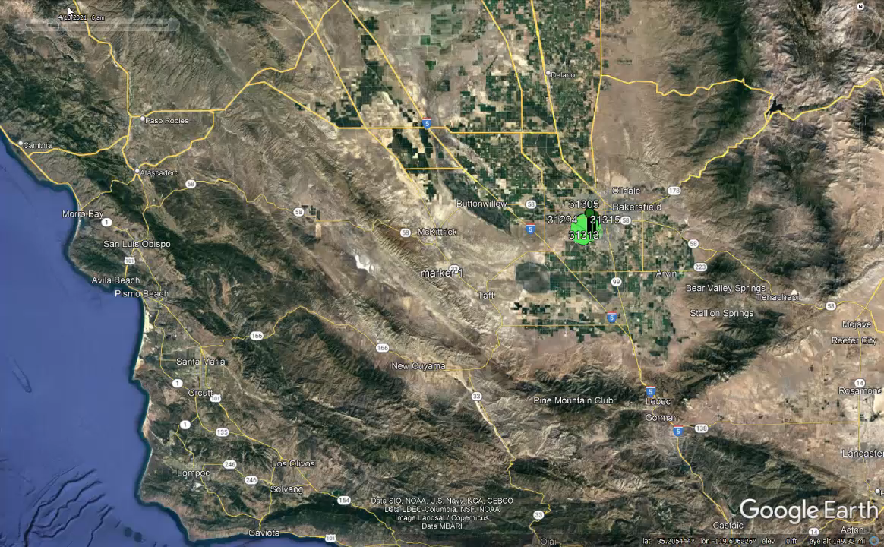
Notes:
Example of a small sample of the data moving through time.
This can be used to determine routes of travel and other behaviors that can be corroborated with other forms of evidence.

Slide 9
IHSS Fraud Case
Initial estimated dollars at risk = $143,522.37
  County estimated based on verbal statements of RP
Final fraud loss calculation = $195,691.29
  Not including loss sustained by SSA (approx. $17,000)
Additional loss of $52,168.92 confirmed using location-based evidence of both provider and recipient.
Notes:
Suspect confessed to forging timecards for the entire IHSS case period.
When presented with the geolocation evidence, she didn’t even want to look at it.
Suspect stated she needed the money because her other unearned income sources were not enough.

Slide 10
Managed Care Referral Case
Managed care plan program integrity staff located a data anomaly upon receiving a verbal report
High utilization of non-medical transportation by beneficiary seen in paid claims data without corresponding claims for office visits
Contractor of plan provided detailed trip data and recorded telephone calls of suspect requesting fraudulent transportation rides.
Notes:
Kern Family Health referral.
3. At the time, Kern Family Health contracted with Lyft to perform the NMT services to beneficiaries via contractor American Logistics Company (ALC) for hotline and coordination of rides with Lyft.

Slide 11
Managed Care Referral Case
From 9/1/17 to 11/25/18, suspect’s transportation claims were cross referenced with her medical and pharmacy claims.
Suspect received 162 fraudulent rides paid for by the plan resulting in an approximate loss of $3,138.94.
Suspect would call a hotline requesting medical transport, provide an address of a medical facility or pharmacy near her intended destination in order for the trip to be approved. The majority of requested trips made were illegitimate.
Notes:
1. Providers the suspect reported as destinations were contacted who verified the suspect was not a patient.
Recommendations were made to the plan to make changes to their NMT program to prevent future fraud.
Suspect was interviewed while in custody at Kern County Jail on other charges. Admitted to the fraudulent rides in part because she gets tired of walking.
Felony arrest warrant issued, failed to appear, bench warrant issued.

