Slide 1
Eligibility Case
Anonymous reporting party alleging husband & wife falsely reporting income
Suspect later found to be self-employed as a truck driver
Household of 6, claiming 138% FPL = $51,322 annually in 2022
Notes:
Kern County Case (active investigation)
1. HH is receiving Medi-Cal, food stamps, and other benefits per RP.
2. Owner operator of a trucking company, one truck only.
3. RP stated they are earning 300k annually and suggested Investigators search bank accounts and tax return documents.

Slide 2
Eligibility Case
Application/renewal documents chronologically examined since case beginning
Head of household provided copies of checks as inaccurate proof of income
  Multiple checks in the amount of $1,500 from payers in trucking industry
Sold CA home in 10/2020, moved out of state, applied for Medicaid on 11/2020
Notes:
1. False statements identified, establishing probable cause
Checks from multiple logistics companies for delivering loads
Suspect believed to have requested pay advances to get the $1500 amounts, advances are common in the trucking industry
False reporting of income, appears to be fabricated profit and loss statements using QuickBooks, $5000 gross monthly sales and only $200 monthly operating expenses (fuel alone exceeds that).
EDD records of wages also used to bolster probable cause.
Contacted logistics companies (payers), some reported income information that well exceeded what was reported to Kern DHS.
Joint criminal investigation with destination state (Indiana FSSA)
PARIS can facilitate these relationships, DHCS now shares all our statewide contacts to enhance our relationship building efforts
Husband now reporting to be unemployed in new state, but purchased a home worth about 700k
Never notified Kern County of move, had to terminate household during investigation

Slide 3
Eligibility Case
Search warrants served at multiple financial institutions & the CA Franchise Tax Board for tax returns
Over MAGI income limits as determined by county
  County provided a case redetermination on letterhead to be used as evidence in court
Notes:
Search warrants: Bank of America, Chase, Wells Fargo
Income identified much higher than reported, other check images were located in amounts much higher than $1,500 from payers (multiple $10,000 checks)
About $142,000 adjusted gross income on 2020 individual income tax for head of household, unknown what mechanisms county use to electronically verify income tax records, appears to not be effective.
Total income for business claimed in 2020 was about $304,000.

Slide 4
Eligibility Case
5 of the 6 household members were determined to be ineligible during specified periods
  Intermittently from 11/2013 to 12/2020
Conducted web-based suspect interview with approval from prosecutor
Notes:
Husband admits to signing apps/renewals but claims to not understand and someone filled them out for him. Claims a friend but refused to provide contact info for the “friend.”
Also admits that tax records obtained are accurate however pretends to not understand what happened.
Pending interview with wife who will also be charged since case created in her name and false documents submitted as well.

Slide 5
Eligibility Case
Total calculated dollar loss $130,902.09
  Capitation, FFS, Dental, Managed Care Claims
Potential for in-flight extradition
  DHCS Investigators are trained to conduct these
  Authority to fly armed
Notes:
Kern County DA’s office will potentially seek an arrest warrant with out of state extradition. DHCS Investigators can fly to Indiana and take custody of the suspect(s) and return them to California for court.

Slide 6
IHSS & Beneficiary Eligibility Case
IHSS provider subcontracting others to care for disabled mother
Provider is giving subcontractors free housing and/or money in exchange for care services
Provider fraudulently profiting from IHSS program
Joint case with county DA and HHS-OIG
Notes:
Monterey County DSS Referral (active case).
Subcontractors are enrolled and non enrolled, multiple people subcontracting over several years.
Email located of a fabricated job offer (titled personal care contract) was obtained, concerning statements suggestive of fiduciary elder abuse.
Suspect provider created a job offer and gets subcontractors to agree to her terms
One provider was supposed to receive $500 a month and free housing in exchange, reports was never paid, relationship went sour, mother was taken away, concerns for her welfare.
Established Nexus and formed Joint case with MCDA and HHS OIG (recipient is also a Medicare beneficiary). HHS-OIG has similar interests, protecting their beneficiaries.

Slide 7
IHSS & Beneficiary Eligibility Case
Suspect provider moved out and lived alone away from recipient (mother)
Provider is also a Medi-Cal recipient
Received full scope benefits, no share of cost for income at or below 109% FPL = $14,813 annually for HH of 1
Notes:
Reports were provider wanted a life of her own, husband is ill, strain on suspects marriage.
Provider failed to accurately report residence and current employment for Medi-Cal eligibility.

Slide 8
IHSS & Beneficiary Eligibility Case
Quick social media search showed suspect is employed as a manager at a private company
Recipient and subcontractors lived in low income housing they did not qualify for intended for students and faculty
All IHSS correspondence went to recipient’s address, provider’s real address could not be determined behind desk
Notes:
Social media searches are very fruitful and we encourage EWs to perform searches when screening applications for aid.
EDD showed unreported records of wages over MAGI limits. These data sets don’t seem to be connected to IEVS.
Estranged husband was ex-faculty, updated information was not provided to property management.
Current subcontractors were 18 year old nieces of the suspect provider.

Slide 9
IHSS & Beneficiary Eligibility Case
Undercover surveillance operation
  Live cell phone ping
  GPS tracking device installed
  Physical surveillance by investigators
Corroborate possession of phone and vehicle by suspect
  Geofences established, tracker ran for 24 days
  Suspect went to recipient's house for a total of ~5 hours spanning three separate occasions
Notes:
Suspect consistently claims 5 service hours almost daily.

Slide 10
IHSS & Beneficiary Eligibility Case
Search warrants served at providers actual unreported residence and recipient’s residence
  Evidence of income
  Cell phones seized, later searched
  Suspects detained & interviewed
During service of warrant at recipient’s home, recipient suffered injuries from a fall the prior night, no medical care received
  EMS transported recipient from scene, initiated by investigators
Notes:
Provider dissuaded recipient from seeking care.
Incriminating text messages located.
Suffered femoral fracture, requiring surgery, dependent adult neglect being charged.
Wi-Fi cameras were in the home during the scene, unfortunately was live feed only otherwise evidence could have been obtained from the cloud provider.
Preservation request sent and that was response from the company.
Historical google geolocation data to identify maximum IHSS exposure, total fraud loss.
Talk about phone evidence.
Photos to corroborate location data of being out of the state (vacations) or otherwise away from recipient. Flight confirmations.
Text messages indicating a disregard for the recipient’s condition (she's faking it).
Special Agent with HHS-OIG served a federal subpoena to current employer for attendance and payroll records.

Slide 11
IHSS & Beneficiary Eligibility Case
Provider submitted and approved her own timesheets within the same minute using online ESP portal
  ESP IP address data
Total amount of gross IHSS payments made to suspect = $78,802.70
Total amount of monthly capitation payments issued = approx. $56,736.37
Total estimated dollars at risk = approx. $138,784.83
Notes:
ESP IP address data suggests she used employer’s internet service to submit fraudulent timesheets.

Slide 12
Cases Opened from Data Analysis
IHSS inpatient overlaps
  DHCS data query identifies beneficiaries with concurrent inpatient and IHSS service hours claimed
Cannot provide services outside the home unless approved ny county
  Common case type easily identified

Slide 13
How to Contact the Investigations Division
Investigations Division Mainline
  916-750-1169
Division Email
  IBInquiry@dhcs.ca.gov
Division Website
  https://www.dhcs.ca.gov/individuals/Pages/AIInvestigationsBranch.aspx
Notes:
Sally to cover.

Slide 14
Q&A

Slide 15
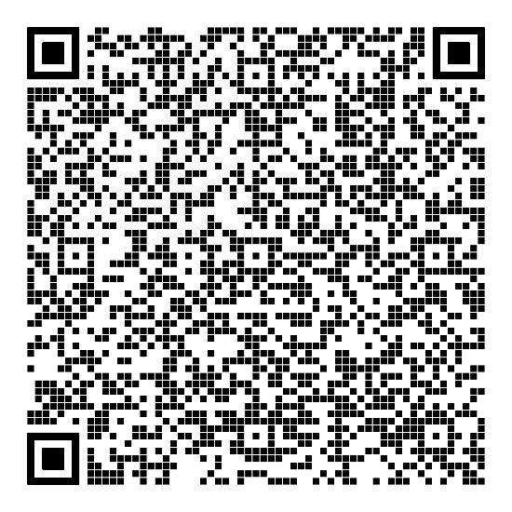


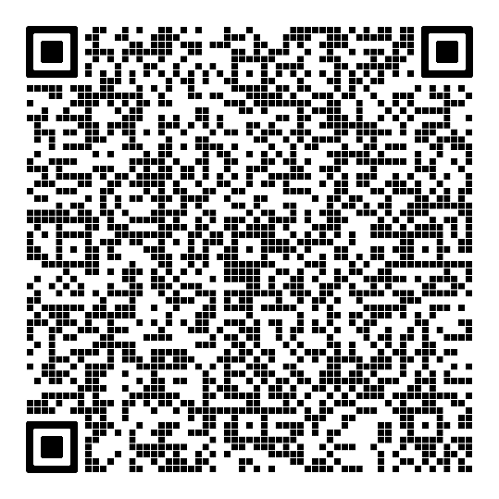
Sally Montoya
Robert Musso

