Slide 1
Threat AssessmentS
Sergeant Nate Grgich

Slide 2
Introduction
the Secret Service National Threat Assessment Center (NTAC) is tasked with delivering research, training, consultation, and information sharing on threat assessment and the prevention of targeted violence, including targeted attacks directed at workplaces, houses of worship, schools, and other public spaces.
Mass Attacks in Public Spaces – 2018 (MAPS-2018), NTAC’s second analysis of mass attacks that were carried out in public spaces, builds upon Mass Attacks in Public Spaces – 2017 (MAPS- 2017). In MAPS-2017, NTAC found that attackers from that year were most frequently motivated by grievances related to their workplace or a domestic issue. All of the attackers had recently experienced at least one significant stressor, and most had experienced financial instability. Over three-quarters of the attackers had made threatening or concerning communications, and a similar number had elicited concern from others. Further, most had histories of criminal charges, mental health symptoms, and/or illicit substance use or abuse.

Slide 3
Introduction, Continued
With this latest report, Mass Attacks in Public Spaces – 2018 (MAPS-2018), the Secret Service offers further analysis and operational considerations to our partners in public safety.2 Between January and December 2018, 27 incidents of mass attacks – in which three or more persons were harmed – were carried out in public spaces within the United States.3 In total, 91 people were killed and 107 more were injured in locations where people should feel safe, including workplaces, schools, and other public areas.4 The loss of life and traumatic nature of these attacks had a devastating impact on the victims and their families, local communities, and the entire nation.

Slide 4
Introduction, Continued
Regardless of whether these attacks were acts of workplace violence, domestic violence, school-based violence, or inspired by an ideology, similar themes were observed in the behaviors and circumstances of the perpetrators,5 including:
• Most of the attackers utilized firearms, and half departed the site on their own or committed suicide.
• Half were motivated by a grievance related to a domestic situation, workplace, or other personal issue.
• Two-thirds had histories of mental health symptoms, including depressive, suicidal, and psychotic symptoms.
• Nearly all had at least one significant stressor within the last five years, and over half had indications of financial instability in that timeframe.
• Nearly all made threatening or concerning communications and more than three-quarters elicited concern from
others prior to carrying out their attacks.
The violence described in this report is not the result of a single cause or motive. The findings emphasize, however, that we can identify warning signs prior to an act of violence. While not every act of violence will be prevented, this report indicates that targeted violence may be preventable, if appropriate systems are in place to identify concerning behaviors, gather information to assess the risk of violence, and utilize community resources to mitigate the risk.

Slide 5
Introduction, Continued
The typical Active Shooter will display 4 to 5 behavioral indicators, and the majority will have had 3 or more recent stressors. There is no demographic or psychological “profile” of an active shooter. They can be of any age, race, or religion, although they are predominantly male.
Less than ½ of all behavioral threat indicators displayed by ever get reported to Law Enforcement. Many people do not want to get their coworker, friend or family member into trouble if they are wrong. This makes it very important to take the time and conduct a threat assessment when these behaviors are reported.
No active shooter will present with all of these behaviors. When conducting an analysis, having three or more indicators should cause you to take a serious look at the subject and conduct a more thorough and deeper assessment of the individual.

Slide 6
Warning Behaviors
Pathway
Fixation
Identification
Novel aggression
Energy burst
Leakage
Directly communicated threat
Last resort behavior

Slide 7
Pathway Warning behavior
Research and planning activities:
Surveillance.
probing (looking for a response or reaction).
using internet search engines to obtain personal information, researching methods to attack (weapons, bombs, etc.).
Research is any attempt to gain information about the target or location.

Slide 8
Pathway Warning behavior
On June 5, 1968, on the first anniversary of the Six Day War, Sirhan Sirhan carried out the meticulously planned assassination of Senator Robert F. Kennedy. After months of preparation, he conducted the attack following Kennedy’s vote to sell 50 Phantom jet fighter-bombers to Israel in January 1968.
In the 5 months leading up to the date, he secured a .22-caliber revolver, practiced at a shooting range, made at least four approaches—perhaps failed attempts or efforts to see how close he could get—to Kennedy in a public venue and, finally, shot him multiple times while hiding in the pantry at the Ambassador Hotel in Los Angeles, California

Slide 9
Fixation Warning Behavior
Increasingly pathological preoccupation with a person or cause.
“It’s all he ever talks about or thinks about.”
The rest of his life is falling apart or is being damaged by the obsession.
Devoting a lot of time and energy to the object of the obsession.

Slide 10
Fixation Warning Behavior
Malik Hasan, the U.S. Army major who conducted a mass murder at Ft. Hood, Texas, on November 5, 2009, became increasingly fixated by his belief that the United States was at war with Islam. During his residency and fellowship at Walter Reed Army Medical Center in Washington, D.C., he openly articulated his beliefs to other psychiatric residents, fellows, and supervisors. Hasan gave two presentations entitled “The Koranic Worldview as It Relates to Muslims in the Military” and “Why the War on Terror Is a War on Islam.”

Slide 11
Fixation Warning Behavior
In the months preceding the killings, the fixation continued with efforts to avoid deployment to Iraq or Afghanistan by retaining an attorney; he also communicated via e-mail with Anwar al-Awlaki, an American spiritual sanctioner and recruiter for al Qaeda in the Arabian Peninsula (AQAP) in Yemen. He inquired whether killing American soldiers and officers was a religiously legitimate act. The arguing and preaching stopped during this period, but clandestine operational planning likely continued. His fixation was a cause, but also was deeply personal because his grievance against the wars in the Middle East went unheeded.

Slide 12
Identification warning behavior
The warrior or pseudo commando.
May include idolization of or identification with past mass killers.
Costuming is a manifestation of this mindset.
Mirroring aspects and mannerisms of past active shooters.

Slide 13
Identification warning behavior
Anders Breivik, the Norwegian mass murderer who killed 77 in July, 2011, aspired to be the contemporary incarnation of the Knights Templar, the Christian Crusade “special forces” of the 12th century.
Timothy McVeigh, the 1995 Oklahoma City bomber, believed he was the “ultimate warrior,” and wanted to be “the first hero of the second American Revolution.”
Dr. Malik Hasan, the 2009 Ft. Hood mass murderer, had SoA printed on his business card, a reference to “Soldier of Allah.”

Slide 14
Novel Aggression Warning Behavior
An act of violence that appears unrelated to the target. This may be a “test of ability” to act violently.
Killing of pets or small animals.
May also include desensitizing his/herself through online media (“snuff-films”) or ultra violent video games.

Slide 15
Novel Aggression Warning Behavior
On the evening of May 23, 2014, in Isla Vista, California, 22-year-old Elliot Rodger killed six people and injured fourteen others near the campus of University of California, Santa Barbara, before killing himself inside his vehicle.
he drove to a sorority house, but failed to gain access. He then shot three women outside; two of them died. He next drove past a nearby deli and shot to death a male student who was inside. He then began to speed through Isla Vista, shooting and wounding several pedestrians and striking several others with his car. Rodger exchanged gunfire with police twice during the attack, receiving a non-fatal gunshot to the hip. The rampage ended when his car crashed into a parked vehicle and came to a stop. Police found him dead inside his car with a self-inflicted gunshot wound to the head.
Prior to the sorority attack, Rodger stabbed his two roommates and a visitor to death in his apartment, for no apparent reason. This appears to have been a test of his resolve to see if he could actually kill.

Slide 16
Energy burst warning behavior
Increase of frequency or variety of warning behaviors
Accelerated rate of training or practicing with weapons.
Acquisition of weapons, etc.
large ammunition purchase.
stalking is intensified, etc.
Sudden unexplained change in mood or demeanor. The subject may have made the final decision to act and has a sense of relief.

Slide 17
Energy burst warning behavior
On January 8, 2011, Jared Loughner attempted to assassinate U.S. Congresswoman Gabriele Giffords, wounded 12 others, and killed Chief District Federal Judge John Rolland five others in a shopping mall outside Tucson, Arizona.
In the 12 hours prior to the shooting, Loughner dropped off a 35mm roll of film at a Walgreen’s drugstore to be developed, and then checked into Motel 6 shortly after midnight. At 0219 he picked up the photos and made another purchase at Walgreen’s. He then left a telephone message with a friend. At 0412 he posted to his MySpace page a photo of a Glock 19 and the words, “Goodbye friends. . ..” He also conducted web searches intermittently through the night on “assassins” and “lethal injection.” Just after 0600, he visited a Walmart and a Circle K store. He left the first Walmart where he did not complete a purchase because the clerk was concerned about his behavior, went to a second, and purchased 9mm full metal jacket ammunition and a black diaper bag at 0727. Shortly thereafter he was stopped by an officer for running a red light. He went home where his father confronted him about the contents of the bag, and Loughner ran away from him. He returned to the Circle K where a cab picked him up and took him to a Safeway supermarket where he insisted on obtaining change so he did not overtip the driver.
Sixteen minutes later he began his rampage at 1010.

Slide 18
Leakage warning behavior
Communication of intent to commit violence to a third party.
Leakage can occur through social media, school work or projects, casual conversations.
May not be direct—the violence might be inferred. Might take the form of a warning to avoid the attack.

Slide 19
Leakage warning behavior
Eric Harris and Dylan Klebold, Columbine High School (April 20, 1999)
Eric Harris and Dylan Klebold killed 12 students and one faculty member and injured 24 others at Columbine High School in Colorado. The homicide investigation indicated that Harris and Klebold engaged in extensive planning and preparation for this attack. Associated with their planning was significant “leakage” prior to the event. This leakage included writings on Harris’ website, saying, for example, “Kill ’em all!!!” Some were explicitly threatening in nature, and others portrayed themes of homicide and suicide.

Slide 20
Leakage warning behavior
They also filmed a video in a wooded area featuring both Harris and Klebold and several of their friends practicing with firearms which they would ultimately use against their classmates: both a “pathway” and an “identification” warning behavior. Other examples of significant leakage were not discovered until after the shooting. During the search of Harris’ bedroom additional videotapes and writings were found which provided detailed information about the planning of the shooting and the mental states of the shooters (Columbine Review, 2001; Cullen, 2009).

Slide 21
Last resort warning behavior
The feeling that options have run out, their back is against the wall, and they have no choice but to resort to violence.
May include a time imperative (e.g. I have to do this before I get sentenced to prison).
Deadlines associated with legal proceedings like divorce or custody decrees.
All other non-violent remedies have failed.
Acceptance of “end of life” consequences, i.e. life in prison, suicide etc.

Slide 22
Last resort warning behavior
On June 17, 2015, 21yearold Dylann Storm Roof committed mass murder at Emanuel African Methodist Episcopal Church in Charleston, South Carolina. He killed nine people during a Bible study meeting, including the senior pastor and Senator Clementa Pinckney, and wounded several others. Days after the shooting, his website, The Last Rhodesian, was discovered, including a manifesto. Roof had written, “I have no choice. I am not in the position to, alone, go into the ghetto and fight. I chose Charleston because it is most historic city in my state, and at one time had the highest ratio of blacks to Whites in the country. We have no skinheads, no real KKK, no one doing anything but talking on the Internet. Well, someone has to have the bravery to take it to the real world, and I guess that has to be me.”

Slide 23
Directly communicated threats
Might include warning others to avoid the time and location of the planned attack.
Not all attacks are preceded by direct threats.
Intimacy effect.
May include some type of “legacy token” such as a manifesto or video blog.

Slide 24
Directly communicated threats
At approximately 8:30 a.m. on October 28, 2002, Robert Stewart Flores, Jr., entered the College of Nursing at the University of Arizona armed with a Norinco .45-caliber semi-automatic pistol, a Glock .40-caliber semi-automatic pistol, a Smith and Wesson .357-caliber revolver, a Colt .357 semi-automatic revolver, a Czech 9-mm semi-automatic pistol, and approximately 250 rounds of ammunition. Flores then shot to death three nursing professors before taking his own life.
Flores had sent a “communication from the dead” to the Arizona Star prior to the events of October 28, 2002. This document explained the events in his life that precipitated the shootings. In his missive, Flores described himself as depressed. He indicated that he was falling behind in his bills, his child support, and his student loan responsibilities, and he was failing in his studies. Flores blamed the failures in his recent adult life on the faculty and staff of the College of Nursing at the University of Arizona.

Slide 25
Assessment
Look at the subject’s motivation/ideation
Look for recent stressors/triggers
Look for recent lifestyle changes
Does the subject appear fixated on a target to the detriment of everything else?
Look at the subject’s motivation and actions from his perspective not your own. It doesn’t have to make sense to you if it does to him.

Slide 26
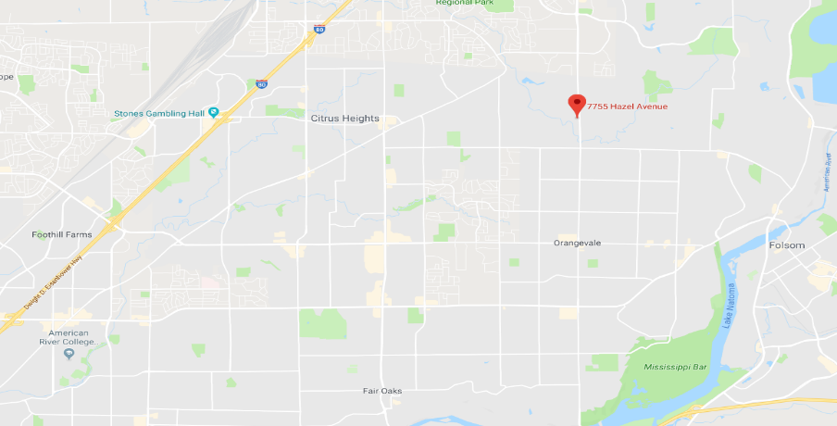
Temple Or Rishon

Slide 27
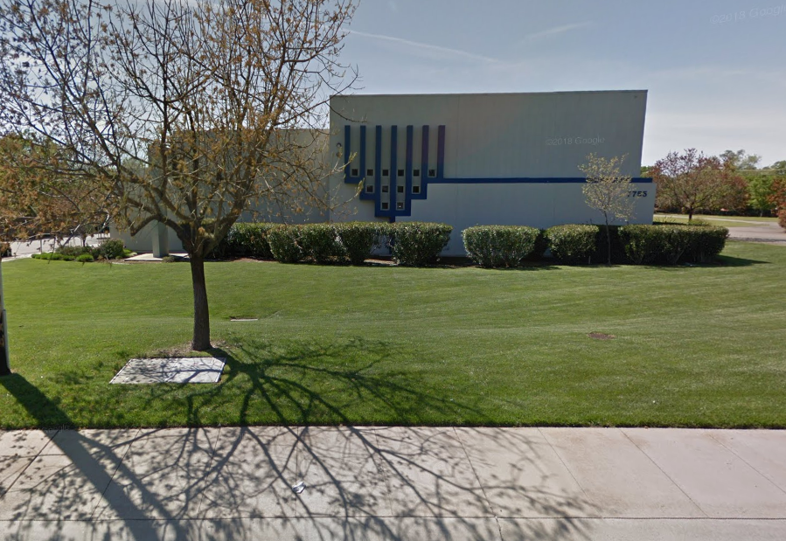

Slide 28
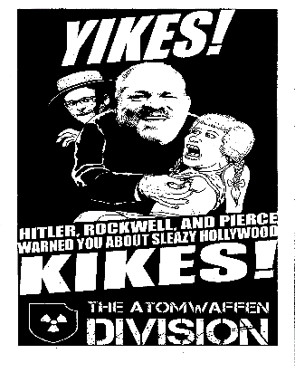
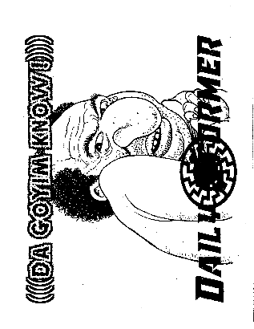

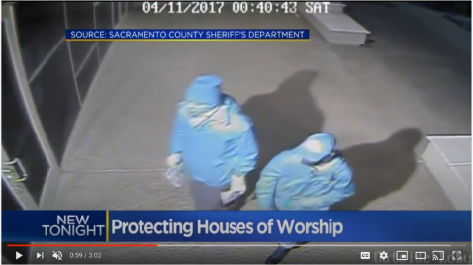
Making themselves known-
November 3-4, 2017 late night early morning two subjects placed posters on the windows with glue in Orangevale, California.

Slide 29
The shot across the bow-
The first call the Synagogue made was to the media then the Sheriff’s Office was notified.
After the original papering of the building the synagogue placed more cameras all over the building, some in plan view and others hidden.
On December 4, 2018 the building was papered again. This time with new posters stating almost the exact same message.
This time the Synagogue called the Sheriff’s Office first because we had a relationship built in.
Video surveillance revealed two subjects were seen placing the posters on the front windows of the building then saluting the posters before walking away, their faces were covered and hidden from camera view the entire time.
Just before they left they performed a hale Hitler salute and left the area.
No cars were seen in the area

Slide 30
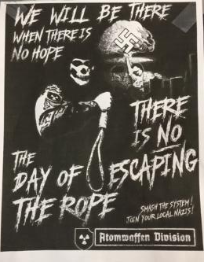
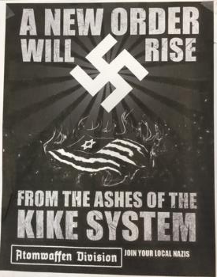
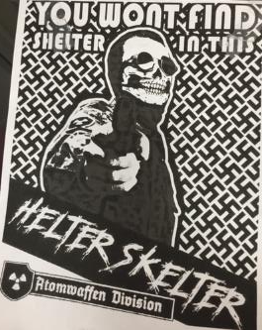
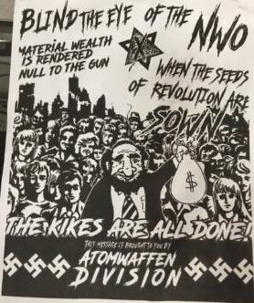
Rise in Atomwaffen

Slide 31
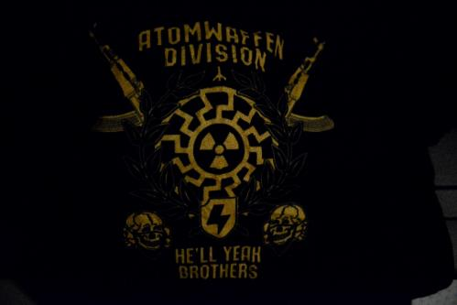
Who is Atomwaffen Division
Coming from the German “Atomwaffen” means Atomic Weapon
They primarily hold online meetings and chat groups and have thousands of underground followers who hide under fake names and anonymous profiles throughout the world.
Atomwaffen members rarely meet in public and if the do, they will wear face coverings as to not be identified.
They meet in chatrooms
They rejoice at the killing of innocent people
  Especially those of Jewish decent
They conduct training camps
Youngest age 14 years old

Slide 32
The Bowl Patrol

Slide 33
Bowl Patrol
The "Bowl Patrol" is an informal group of neo-Nazi agitators who convene in online chats and sometimes record podcasts to promote Dylann Roof imagery. Roof and his haircut have become a rallying point for white supremacists eager to partake in, or encourage, 'lone wolf' style murder attacks. Roof has become a martyr like symbol for the more hardcore neo-Nazi elements of the alt-right. Bowl Patrol invokes an elaborate symbolism of support for Roof's action, and also serves to encourage copycat attacks based on the Charleston shooting.
While presenting itself as dark humor, Bowl Patrol serves as a platform to unite enthusiasts and encourage similar massacres. In the years since Roof's attack, other deadly attacks have been carried out, and would-be killers have been arrested for hatching murder plans in Roof's name.
A person with the screen name of “Vic Mackey” was the founder of the “Bowl Patrol” and takes his name from the main character of The Shield, a fictional, corrupt police officer named Vic Mackey played by Michael Chiklas
The Bowl Patrol encourages copycat killings like Roof’s targeted murder of 9 African Americans in June 2015 at a Charleston, SC church.

Slide 34
Warning
Warning this following video is concerning and vulgar, but it shows the subjects mindset

Slide 35
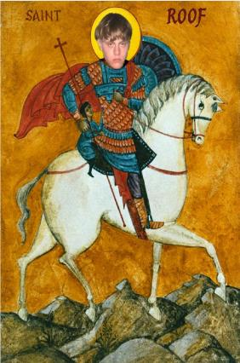

Bowl Patrol
The group hosted many online Podcasts which promoted harassing and terrorizing neighborhoods
The group had 5 major contributing members lead and organized by Vic Mackey
The group has harassed reporters
This seemed to spur the group and at one point members from adjoining groups began to target the Podcaster/Reporter
At one point the group posted an address to the Podcaster’s/Reporters home, which in fact was not his home and instead they terrorized an innocent family.

Slide 36
What we knew
The Sheriff’s Office had intelligence after the second placement of the flyers that it could be someone local.
Rumors in the area began to circulate about an online group identified at the Bowl Patrol
There was a lack of evidence to point to one subject and the trail started to turn cold
The Sheriff’s Office worked with the Synagogue on Security for the facility and conducted random spot checks with no contact with any subjects onsite.
Until……

Slide 37
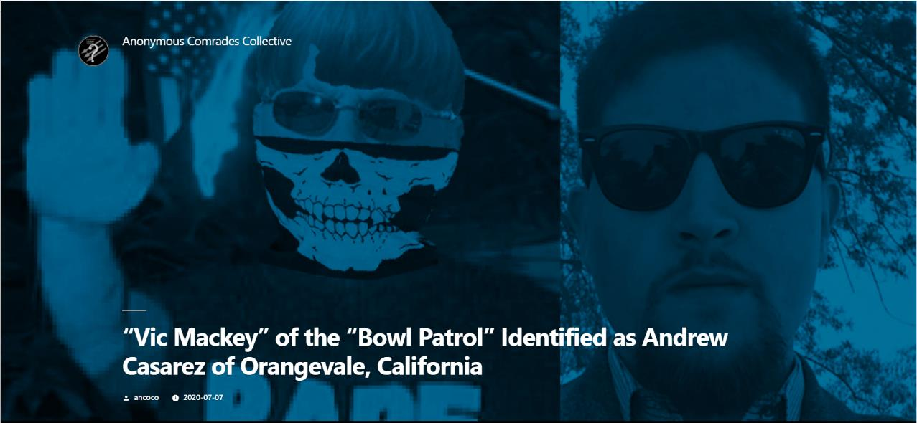

Slide 38
DOXING
What is Doxing?
  Search for and publish private or identifying information about (a particular individual) on the internet, typically with malicious intent.
    This works both ways for extremist on both sides
    Examples of Doxing
      Flyers posted around the subjects home
      Social media
      At the job of the subject
      Being followed and chanting and or yelling your name in public
      Attending the subjects work and advising the manager of the subjects involvement in behavior which counters the public image of the company.
  Not bound by traditional methods of investigations
    No procedural justice
    Lack of concern for family and or friends associated to the subject
    No expectation of restraint

Slide 39
Andrew Casarez (“Vic Mackey”)
    Andrew Richard Casarez DOB 1/9/1993
    Resides in Orangevale, CA
    Attended University of the Pacific and ARC
    DUI arrest in 2012
    No serious criminal offenses in his past
    No real social media presence under his given name
    Lived at his family home with his mother and father and elderly grandmother
    His father was a retired firefighter for the Sacramento City Fire Department
    Worked a pizza place
    No records of being married and no evidence of being in a romantic relationship
    His family is incredibly left leaning as

Slide 40
After we knew
The Doxing officially hit in the evening
Even though we believed we knew he was the suspect from the Synagogue there was no evidence to tie him to the crime
We were able to find that he had a firearm and we became concerned
  Our thought process was Casarez had talked a big game
  He was viewed as this leader of likeminded people who wanted to see destruction of the Jewish heritage
  Fearing he would have to act or be looked at like a coward we authored a Gun Violence Restraining order
  It was first of its kind

Slide 41
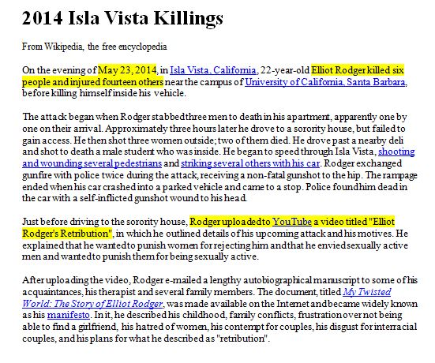
WHY GUN VIOLENCE RESTRAINING ORDERS?

Slide 42
ASSEMBLY BILL (AB) 1014
EFFECTIVE JAN. 1, 2016
COMMENCE WITH PENAL CODES
  18100 - 18205
RIGHT TO PETITION
  LAW ENFORCEMENT
  FAMILY
PERSON PROHIBITED FROM OWNING, PURCHASING, POSSESSING, RECEIVING OR HAVING ACCESS TO
    FIREARMS, MAGAZINES OR AMMUNITION FOR UP TO 21 DAYS

Slide 43
TEMPORARY EMERGENCY
GVRO (LE ONLY)
THE COURT MUST FIND THE SUBJECT POSES:
  AN IMMEDIATE AND PRESENT DANGER OF CAUSING INJURY TO SELF OR OTHERS BY HAVING, OWNING, PURCHASING, POSSESSING, OR RECEIVING A FIREARM
  AND
  TO PREVENT INJURY TO SELF OR OTHERS BECAUSE LESS RESTRICTIVE ALTERNATIVES EITHER HAVE BEEN TRIED, AND FOUND TO BE INEFFECTIVE, INADEQUATE OR INAPPROPRIATE.

Slide 44
EX PARTE GVRO
(LE OR FAMILY)
THE COURT MUST FIND THE SUBJECT POSES:
  A SIGNIFICANT DANGER, IN THE NEAR FUTURE OF CAUSING INJURY TO SELF OR OTHERS BY HAVING, OWNING, PURCHASING, POSSESSING, OR RECEIVING A FIREARM
  AND
  TO PREVENT INJURY TO SELF OR OTHERS BECAUSE LESS RESTRICTIVE ALTERNATIVES EITHER HAVE BEEN TRIED, AND FOUND TO BE INEFFECTIVE, INADEQUATE OR INAPPROPRIATE.

Slide 45
GVRO HEARINGS
OFFICER WHO ISSUED THE TEMPORARY EMERGENCY GVRO OR EX PARTE GVRO SHALL APPEAR AT THE HEARING
CASES ARE CALENDARED WITHIN 21 DAYS OF ISSUANCE

Slide 46
GVRO NOTIFICATIONS
    AFTER A TEMPORARY EMERGENCY GVRO OR EX PARTE GVRO IS ISSUED, THE ISSUING OFFICER SHALL EMAIL THE GVRO & PROOF OF SERVICE
    NO LATER THAN END OF SHIFT
    THIS WILL NOTIFY:
      COMMUNICATIONS CENTER
      COURT LIAISON
      PROFESSIONAL STANDARDS
      SUPERIOR COURT

Slide 47
GVRO CONSIDERATIONS
    SURRENDERING FIREARMS & AMMO
      IF SERVED, IMMEDIATELY SURRENDER TO LE. IF NO IMMEDIATE REQUEST IS MADE, THEY HAVE 24 HOURS TO SURRENDER TO LE, OR SELL/TRANSFER TO A LICENSED FIREARM DEALER
      IF A DEALER IS CHOSEN, THEY HAVE 48 HOURS TO PROVIDE PROOF TO THE COURT

Slide 48
GVRO CONSIDERATIONS
    SURRENDERING FIREARMS & AMMO CONT.
      IF ANY FIREARMS, AMMO OR MAGAZINES ARE CONFISCATED, LE MUST PROVIDE A RECEIPT (FIREARMS AND PROP BOOKING RECEIPT) AND COMPLETE & INCIDENT RPT.
      THE PROPERTY DIVISION MUST RETAIN SURRENDERED ITEMS WHILE THE GVRO IS IN EFFECT

Slide 49
GVRO CONSIDERATIONS
    SEARCH WARRANT REQUIREMENTS
      IF THE PERSON REFUSES TO COMPLY WITH THE ORDER, YOU MUST OBTAIN A SEARCH WARRANT
      EVEN THOUGH THE REFUSAL TO COMPLY WITH THE ORDER MIGHT QUALIFY AS A MISDEMEANOR VIOLATION, THE GVRO DOES NOT PERMIT ACCESS IN THE ABSENCE OF CONSENT OR A SEARCH WARRANT

Slide 50
GVRO CONSIDERATIONS
    RELATION TO W&I CODE 8102
      IF AN INDIVIDUAL SATIFIES THE REQUIREMENTS FOR W&I 5150, THE PROVISIONS OF W&I 8102 CAN BE USED
      THE GVRO IS A MEANS TO PROVIDE LE WITH A TOOL TO ENHANCE AUTHORITY IN THE FIELD WITH REGARD TO SAFEGUARDING THE COMMUNITY

Slide 52
The Court Date
Casarez case took many strange turns and the court case was no exception
  The father was a former interpreter for the court and the Judge remembered him
  The attorney for Casarez attempted to state many times the Sheriff’s Office overreached and harassed his client
  At one point the attorney stated there should be a lower level of enforcement
    The judge stopped the attorney and said this was the lowest possible enforcement
Casarez never showed his face and never spoke
The attorney even stated at the end that whatever might have been said by his client was a joke and never was meant to be taken seriously.
We were granted a one year order
The gun is now ground up in tiny pieces because Casarez never picked up the firearm

