Slide 1
CPW Working Group Members
CO Wolf Reintroduction
Meritt Linke, Grand County Commissioner & TWG member
Francie Jacober, Pitkin County Commissioner & SAG member
Lenny Klinglesmith, cattle rancher & SAG member
Renee Deal, sheep rancher & SAG member

Slide 2
Points of Discussion
Introduction area (TWG)
Livestock loss compensation (SAG)
Management controls (lethal and non-lethal) (SAG & TWG)
Monitoring (SAG & TWG)

Slide 3
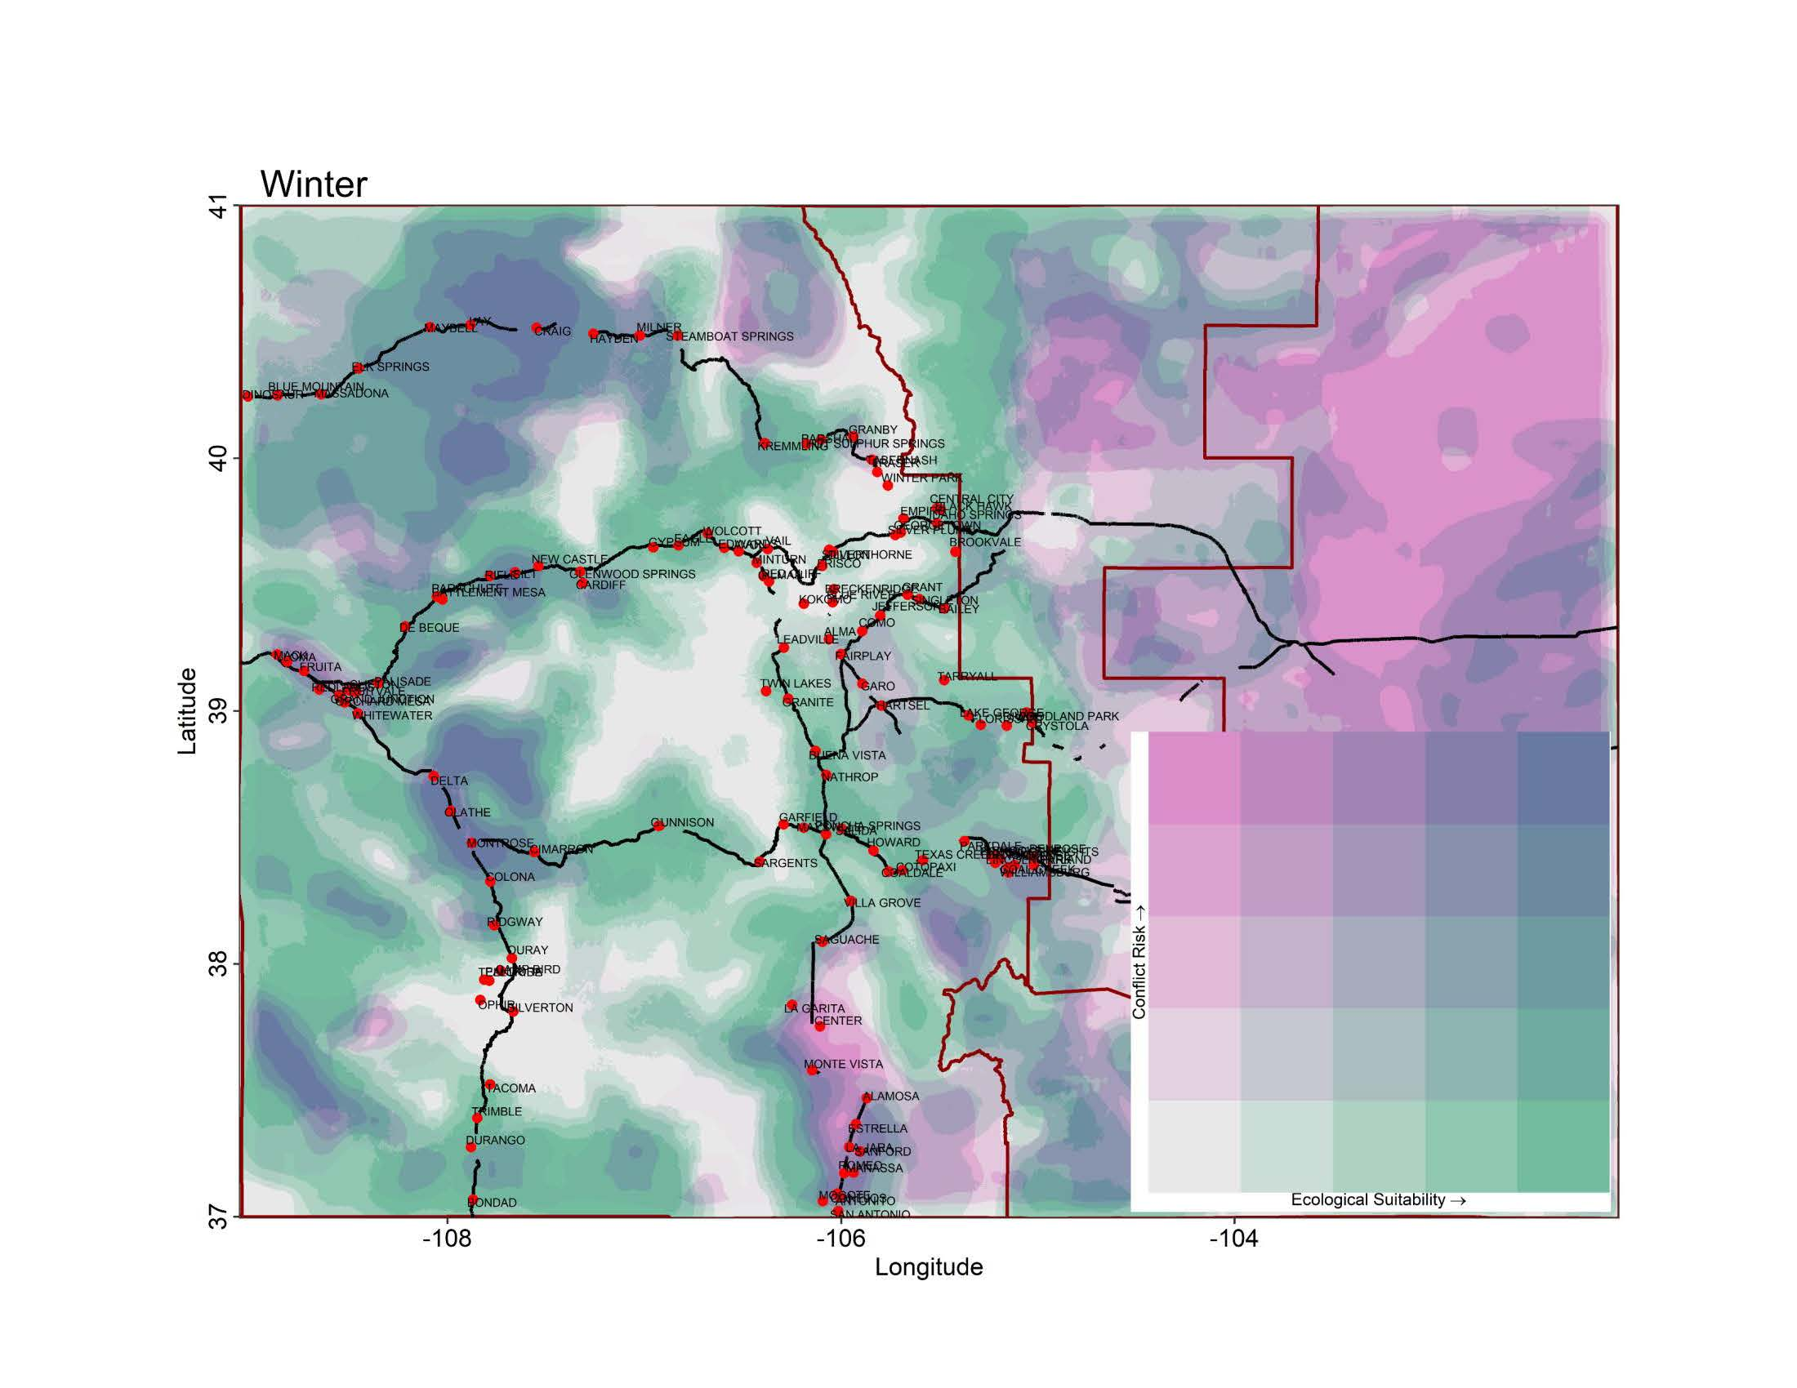
Proposed suitability map Ditmer, et al 2022
Pink areas indicate high conflict risk
Green indicates high ecological suitability
Blue/Purple indicates an overlap of high conflict and ecological suitability
https://www.sciencedirect.com/science/article/pii/S2351989422001949

Slide 4
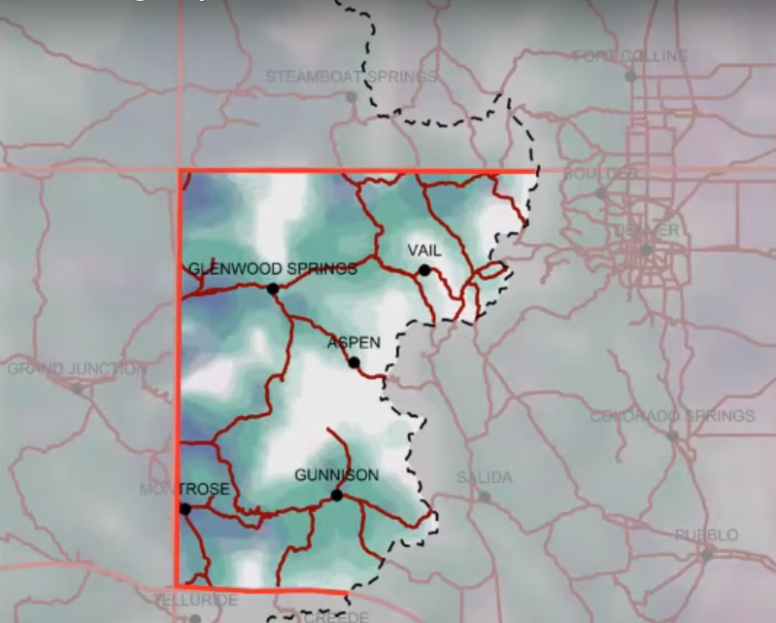
Map was shown at our final SAG meeting & published by CPR.ORG:
https://www.cpr.org/2022/09/09/where-colorado-will-reintroduce-wolves/
CPW Proposed Introduction Area:
Boundary is overlaid on Ditmer map (previous slide)
Red lines indicate borders that are 60 miles from neighboring states and Tribal lands
Dotted line is the continental divide denoting the Western Slope
*There has been no reported decision on specifically where introductions will occur*

Slide 5
Livestock Loss Compensation
From SAG compensation report (see website below for full reports)
Proposed alternatives and levels of support from the SAG
“Alternative 4: Itemization for compensation of production losses and missing livestock (15/17 SAG members supporting/not objecting)”
“Alternative 3: Simple compensation ratio for missing livestock (14/17 SAG members supporting/not objecting)”
“Alternative 5: Producer chooses between simple ratio (Alternative 3) or itemization (Alternative 4) (13/17 members supporting/not objecting)”
”Alternative 5 had the highest number of SAG members selecting it as their preferred alternative (11/17 members preferred it over all other options; no other option was preferred by more than 2 SAG members).”
https://www.wolfengagementco.org/advisory-groups

Slide 6
Alternative 3: Compensation Ratio for Losses
Confirmed kills are paid at 100% FMV (similar to bear/lion claims)
  Contracts or receipts showing a different valuation can be used
Compensation Ratio: (sometimes referred to as a ”multiplier”)
  SAG recommended a ratio between 5&7
  This ratio can cover up to 5-7 missing calves or sheep for each confirmed wolf kill. The animals claimed must be confirmed missing (production counts) and in the same area as the confirmed kill. Yearlings were also considered.
  Example using a 5:1 ratio:
  2 confirmed kills – 1 cow & 1 calf
  Determined 8 missing calves, 2 missing cows
  Since only calves can be claimed with the full ratio, the 8 missing calves would also be paid (up to 10 calves would have been covered)

Slide 7
Alternative 4: Itemized Production Losses
If there is a confirmed wolf depredation, the producer can itemize their losses
Examples of losses considered:
  Missing animals
  Decreased weaning weights
  Decreased conception rates
Producer must use baseline production numbers to establish losses
**Start organizing and keeping DETAILED production records NOW!

Slide 8
Alternative 5: Choose between 3 & 4
Producer can choose to take the compensation ratio
  This is beneficial for CPW & the producer as a more simplistic approach
  This is beneficial for producers who don’t have adequate baseline data
Producer can choose to itemize their losses
  This is beneficial for a particular producer who is getting especially hard-hit and notices significant indirect losses
  This option will be more complicated for both CPW & the producer but allows for those losses to be considered

Slide 9
Non-Lethal Conflict Minimization
SAG recommended robust funding for non-lethal management efforts
SAG recommended that CPW & USDA/APHIS WS provide financial and logistical support to encourage producers to use non-lethal measures, BUT…recommended it should NOT be required for compensation
Non-Lethal examples:
  Fladry and electric fencing
  Range-riders
  Guard animals
  Scare devices

Slide 10
Lethal Control Measures
From SAG compensation report (see website below for full reports)
SAG had full consensus on the following lethal measures:
  “Allowance of lethal control by state and federal agents and by producers or their agents (with a permit) for wolves caught in the act of biting, wounding, grasping, or killing livestock or working dogs.”
  “Allowance of lethal control of chronically depredating wolves following depredation event(s), after evaluation of circumstances, by state and federal agents across all Phases and by producers with limited duration permits in Phase 3”
  “Discretion to CPW to make determination as to whether a situation is characterized as chronic depredation…”
https://www.wolfengagementco.org/advisory-groups

Slide 11
Lethal Control Measures (cont.)
From SAG compensation report (see website below for full reports)
SAG was one vote short of consensus on the following lethal controls:
  “Allowance of lethal take of chronically depredating wolves by a producer or agent with a limited duration permit in Phases 1 and 2 (state endangered and threatened).”
  “Allowance of lethal control by state/federal agents for wolves caught in the act of chasing in all Phases, and by producers or their agents, with permit and prior depredation in area required in Phases 1 and 2.”
https://www.wolfengagementco.org/advisory-groups

Slide 12
Monitoring for Impact-Based Management
The SAG and TWG discussed at length the need for proper monitoring
CPW has stated that any wolves that are reintroduced will be collared
BUT…they are very hesitant to commit to keeping collars operational and/or deploying collars on animals who naturally migrate or are born here

Slide 13
Talking points for comments at the upcoming commission meetings:
Don’t relitigate! Utilize your time for discussing productive issues
Compensation – Support for giving the producer options to claim direct AND indirect losses. Unified support for Alternative 5 would be very helpful.
Lethal Control – Support for recommendations that got full consensus AND those that were one vote shy of full consensus from the SAG.
  Catching a wolf chasing or attacking are VERY RARE circumstances but the allowance eases tensions and increases support for a healthy wolf population.
  Managing chronic depredators is CRITICAL!
Overall, expressing support for the SAG recommendations shows that we (producers) value our partnership with CPW.

Slide 14
CPW Upcoming Meeting Timeline
November 17-18 Gateway meeting – wolf update & discussions on public engagement strategies for 2023
December 9 Virtual meeting – presentation of wolf plan
NO comments will be taken during this meeting
2023 Tentative meetings/locations
January 19 in Colorado Springs
January 25 in Gunnison
February 7 in Rifle
February 16 Virtual
February 22 in Denver

