Slide 1
DIAMOND INTERNATONAL SPORTS ACADEMY
Presentation and identity
2021-2022

Slide 2
Academy /Club Statement
Our club is striving to be the best service provider for players not just looking to progress into the semi professional / professional game but also for the ones who just want to improve their game, develop professionally and socially and follow a path in the private or public sector of the football industry.
The professional background of our staff and the desire to succeed in a competitive market helps us to make everyone feel part of the club and provide the best opportunities available.

Slide 3
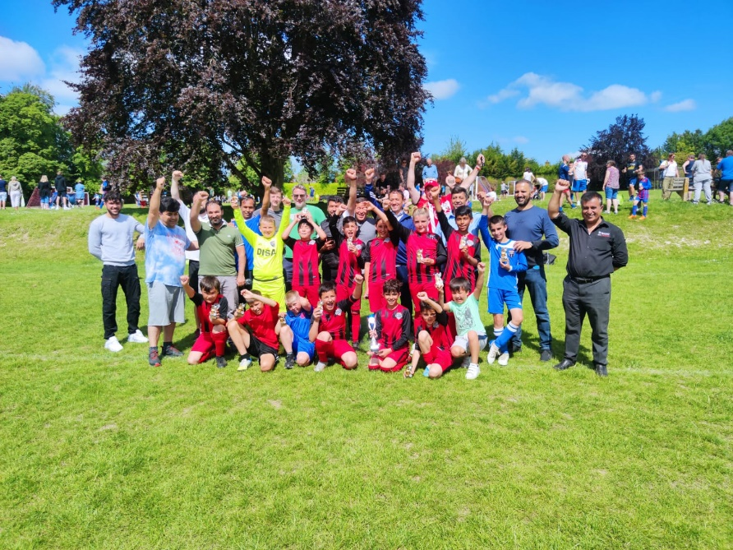
Club History
3+ years Hampshire County Leagues experience
Multiple trophies won at academy success under 12s
35+ years experience and qualified Management
10+ years Cavendish School of English soccer camps
3+ years connection with F.C. Wilhelmus ( Holland )
Sports Leaders UK accreditation in 2017
Charter Standard accreditation in 2019
Links with local colleges and Universities
Member of the UK Providers of Learning Register

Slide 4
Organizational Structure
Chris PARRY
CEO
Kristine Richards
Head of administration
Club Managers
Club Coaches
Academy Head of Operations
Admin
(Support Staff)
IT
(Support Staff)
Coaching
(Support Staff)
Diamond Youth FC
Development officer
Academy Managers
Academy coaches
www.diamondsportsac.com

Slide 5
Academy / Club Operations
Teams | Activities | Location | Days | Times
Under 7s/8s/9s/10s Under 11s – 16 Sunday League Under 11s – 16s academy Saturday leagues | Training Matches Training Matches Training Gym / Match Preparation | Southampton Outdoor Sports Centre, Thornhill Road. Bassett Hampshire. SO16 7AY Gym / Classroom | Monday /Thursday Saturday Mondays / Thursday Sunday Mondays / Thursdays Thursdays every other week | 5pm – 6pm 10am – 11.30am 5pm – 7.30pm TBA 5.45pm – 7.15pm 5.45pm – 6.30pm
U18s | TBA |  | TBA | TBA
Reserve Team 1st Team | Training Matches Training Matches | TBA Southampton Outdoor Sports Centre. Wellow ? | Monday / Thursday Saturdays Monday / Thursday Or Possibly Monday / Friday from July 2022 | 7pm – 8.30pm 2.15pm – 5.15pm 7pm – 8.30pm 2.15pm – 5.00pm
www.diamondsportsac.com

Slide 6
Squad / Team Introduction
The FA identification uses the Four Corners system which identifies the four attributes a player requires to study and learn through structured coaching, The Four Corners are Tactical , Technical , Physical , and Social and within a Professional Academy there are certain phases a player goes through which are Foundation , Development and Academy.
Foundation Phase : Under 9s – 11s , Youth Development Phase : Under 12s – 16s, Professional Development Phase : Under 17s – 21s , Professional contract .
We as a club and wishing to follow the FA Talent Identification process we also understand that all players have different abilities and learn slower than others and as coaches we need to identify that . As a club we feel we need to adapt by giving the most talented to go forward as well as the players that require further development , This is where our academy structure is very important to us to further develop the players who show that talent to go forward into the semi or pro game still Following the Four Corners of the FA.
The Player your Son / Daughter : We want your son / daughter to enjoy their football as much as possible on their pathway which ever direction it takes them . Through our dedicated staff their role is to encourage your son / daughter to learn the four corners of their development, as part of their development could involve Practical coaching session , Match Play and Technical and tactical sessions.
The Academy : As above we need to cater for the more advanced player of which we identify from our development squads under 12s – 16s , these players has the opportunity to develop to a high standard with our more advanced coaching staff which is to UEFA B or A Level . The player will also train etc hours and increased match play and a sports education program (14s – 18s ) . The parent has a very vital role in this pathway as the player needs their 100% commitment . We feel the commitment is split 3 ways , 1 . The club to insure that the structure and the development available at all times as a academy player. 2. The player to give 100% in his development at all times on and off the pitch . 3 the parent to support the player 100% to insure he /she attends all training and other activities within the program , each academy player will be assessed every 8 weeks which feedback will be given to player and parent which must be attended with the Coach and welfare officer .
Social activities : We believe this is just as important to a players development to learn , leadership , Communication and social skills and also for the parent to be involved with the club. From time to time we will run activities for the teams , such as tournaments , over sea`s tours (14s – 16s ) . We also wish the parents to get to know our club and its staff by attending any functions that we arrange on our social calendar.

Slide 7
Key staff
Administration
Chris Parry / Chairman Diamond Youth FC / CEO Chris has experience that spans over 42 years as a pro and semi pro player and has held posts within a academy environment.
Kirstein Richards : Academy / Club Secretary / Welfare officer. Kirstein has joined us very recently , Kirstein has had many years experience as a secretary with large firms locally and brings her expertise to us.
Lisa Holgate : Course Verifier and Tutor Assessor Lisa has been with us from day one , Lisa has a lot of experience within the education and social care for youth , Lisa also advise us on Welfare and safeguarding issues
Education Enrolment and Social Secretary (vacant Position )
Community Support co-ordinater (vacant Position )
Head of Youth Development (vacant position)
Coaching Staff
Chris Parry : UEFA A diploma , FA Talent ID Level 1 PFSA level 2 , Sports Leaders uk Tutor and assessor, Sports Leaders Accredited Centre Manager : Chris has experience that spans over 38yrs as a Pro and semi pro player , has coaching experience with PSV Eindoven , FC Bruges experience as a junior coach at AFC Bournemouth (foundation Level ) been club chairman and other positions of grassroots football.
Nikolay Trenschev : UEFA A , Bulgaria National Licence ; Nickolay has recently joined us but with his experience that has also spanned over 20 yrs. as a pro player and time at academy coach with some of the clubs of his home country.
Colin Plumhoff : FA Level 2 coach : Colin has extensive experience of local football that spans over 20 – 25 yrs. as local junior player going onto county level and semi pro level . Colin has been a successful manager for local club and seen players reach a excellent level.
Craig Mallett , Thomas Simpkins ; These young coaches are the future of the club and academy and their development to Level 2 is very much part of our plans.
Support coaches : we have 4 support coaches which are with us for work experience and development , these young people are from local universities and the Kickstart scheme (run by Hampshire county council and DWP )

Slide 8
OUR VISION WHAT WE WANT TO ACHIEVE We want to produce more and better home-grown players. We want our players to be technically excellent and tactically astute independent decision-makers on and of the field, equipped for a successful career as professional footballers. We want to develop the world’s leading youth coaches, provide inspirational facilities and world-class support services
Technical
Professional
Social
Developing players
Providing educational programes for young people aged 14-21
Provide community support
Provide a high standard of welfare support
Provide jobs
Developing players on the pitch and off the pitch
Providing trial and scholarship opportunities
Provide opportunities for black and ethnic minorities and people at risk
Providing a pathway to semi-professional / professional level
Provide exchange programes for students with overseas clubs
www.diamondsportsac.com

Slide 9
Academy Partners
www.diamondsportsac.com

Slide 10
Club Contact
CEO/Chairman
Email : chris@diamondsportsac.com
Player Recruitment Diamond Youth FC
General Secretary : Kristine Richards
Email : krichards@diamondyouthfc.com
Academy and Sports Education
Chris Parry
Email : disacademy01@gmail.com
Address:
Outdoor Sport Centre
Thornhill Road
Southampton
SO16 7AY
www.diamondsportsac.com

