Slide 1
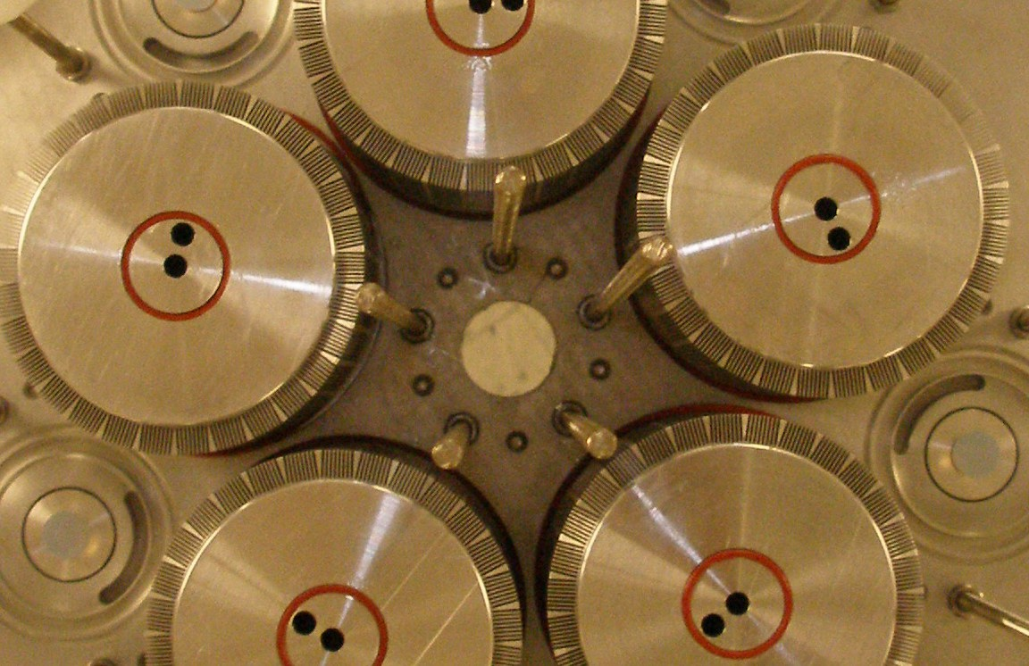

A F T E R MOR E
T H A N 1 0 Y E AR S ,
A N D 9 P A T E NT S ,
E NG I N E I S NO W
T H E T H E R M O H E A R T ®
S C A L I N G G L O B A L L Y
W I T H
E F F I C I E NT E L E C T R I C A L
P O W E R E D B Y C A P T U R E D
G E N E R A T I O N
W A S T E H E A T .
2 5 K W .
H I G H
E F F I C I E N C Y .
R A P I D
R O I .

Slide 2
T H E W A S T E
H E A T
R E C O V E R Y
M A R K E T
W I L L
E C L I P S E
$ 5 3 B B Y
2 0 1 8
6 5 % O F F U E L
E N E R G Y
I S W A S T E D
T H R O U G H E X H A U S T
A N D C O O L I N G
R A D I A T O R S
I N R E M O T E G E N E R A T O R S

Slide 3
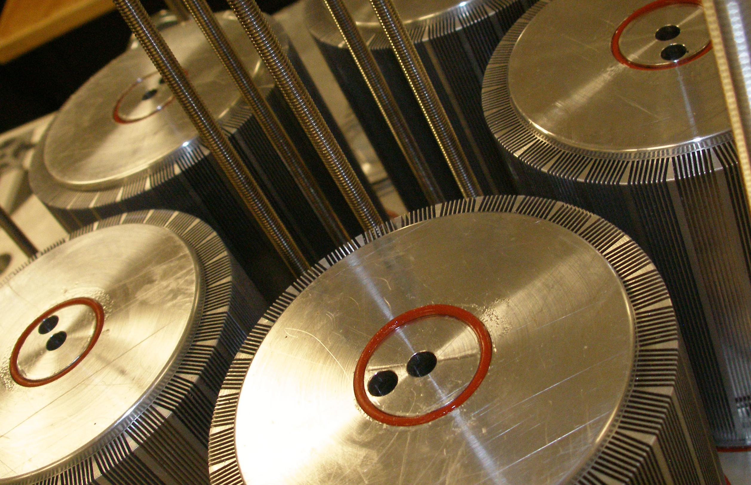
I N T R O D U C I N G T HE
T H E R M O H E A R T
®
E NG I NE
B Y C O O L E NE R G Y
I N D U S T R Y - L E A D I N G
L O W T E M P E R A T U R E E F F I C I E N C I E S ,
1 5 0 - 4 0 0
D E G R E E C E L S I U S
W O R L D ’ S M O S T A D V A N C E D W A S T E H E A T
R E C O V E R Y
S Y S T E M ,
9 P A T E N T S , 2 5 K W O F E L E C T R I C A L P O W E R
M A R K E T - R E A D Y A F T E R 1 0 Y E A R S A N D $ 1 1 M O F I N V E S T M E N T

Slide 4
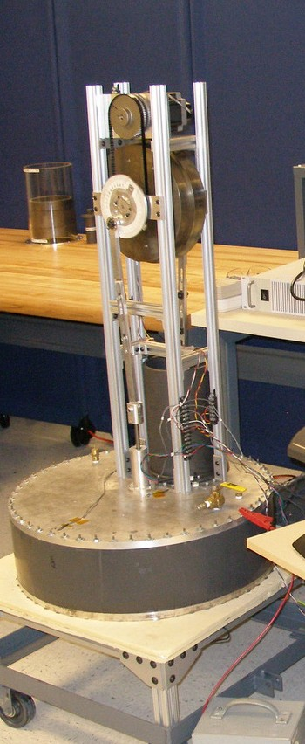
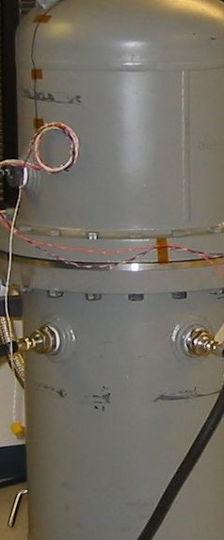
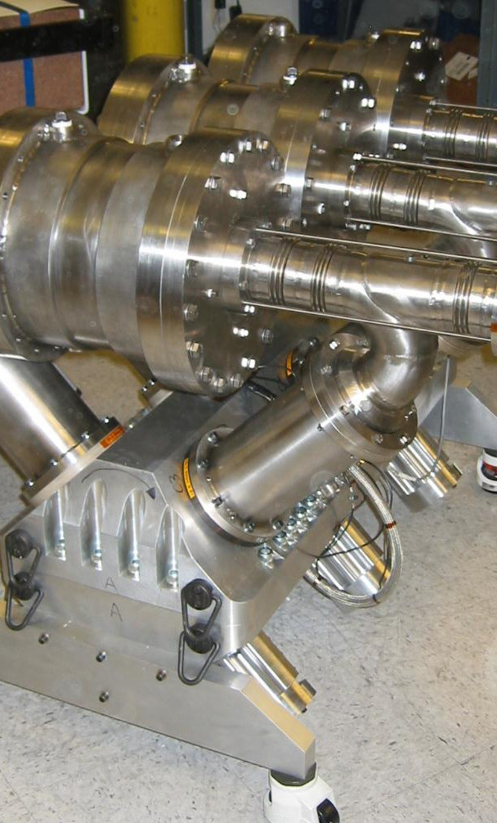
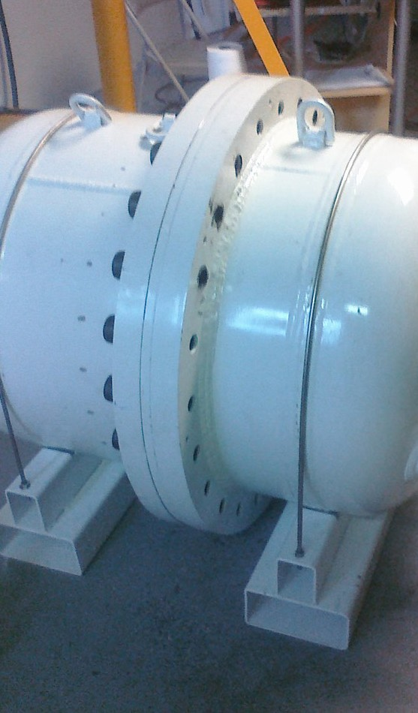
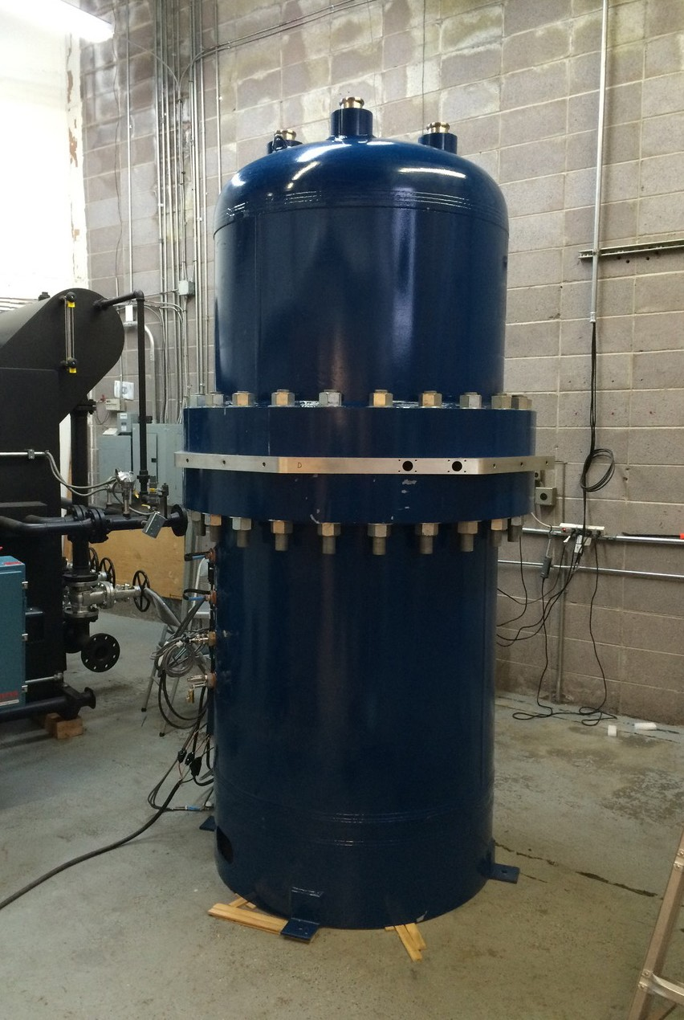
T E C H N O L O G Y
& D E V E L O P M E N T
‘ S T I R L I N G ’
P0 - 50W
<5% EF F.
‘ S I E M E N S ’ P1 - 350W 10% EF F.
‘ R I D E R ’
P2 - 2,000 W A TTS
R I D E R ’
3X P3 - 3000W
22% EFF @ 315°C
‘ S U P E R
‘ T H E R M O H E A R T
25KW
2 5 K W ’
16.5% EF F. @ 230°C
31% EFF @ 340°C
›
2 0 0 7
2 0 0 8
2 0 0 9
2 0 1 0
2 0 1 1
2 0 1 2
2 0 1 3
2 0 1 4
2 0 1 5
2 0 1 6

Slide 5
P O W E R I N G A
C L E AN
T OMOR R OW
W A S T E H E A T I S
N O L O N G E R
W A S T E D .

Slide 6
C U S T O M E R
V A L U E
- 2 5 K W W H R
P A Y B A C K
V S . A N N U A L
O P E R A T I N G
H O U R S
P A Y B A C K ( Y R S )
@ $ 0 . 1 5 / K W H
15.0
10.0
5.0
0.0
1752
2628
3504
4380
5256
6132
7008
7884
8760
A N N U A L O P E R A T I N G H O U R S
S I M P L E | P A Y B A C K | E L E C R A T E | P A | Y B A C | K | I R R
7 0 0 0 H R S / Y R , | 7 % L O A N | $0.10/KWH | 4.0 | YEARS | (US) | 25%
NO SUBSIDIES OR | INCENTIVES | $0.15/KWH | 2.5 | YEARS | (CALIF) | 40%
 |  | $0.25/KWH | 1.5 | YEARS | (I TA LY) | 67%
 |  | $0.35/KWH | 1.0 | YEARS | (GENSET | 100%

Slide 7
M U L T I P L E M A R K E T
A P P L I C A T I O N S
C O N C E N T R A T E D S O L A R P O W E R
W A S T E C O L D R E C O V E R Y
DISH
TROUGH
POWER TOWER
LIQUIFIED NATURAL GAS
I N T E R N A L C O M B U S T I O N W A S T E H E A T R E C O V E R Y
LOCOMOTIVES
NATURAL GAS GENERATORS
DIESEL
GENERATORS
SHIP
ENGINES
I N D U S T R I A L W A S T E H E A T R E C O V E R Y
THERMAL POLLUTION CONTROLS
KILNS
STEEL MILLS
‘ETC’
PAPER MILLS
FOOD PROCESSING
-OIL & GAS

Slide 8
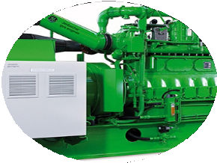
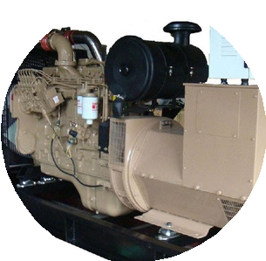
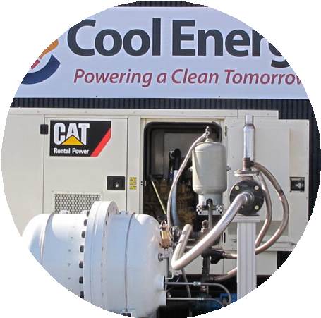
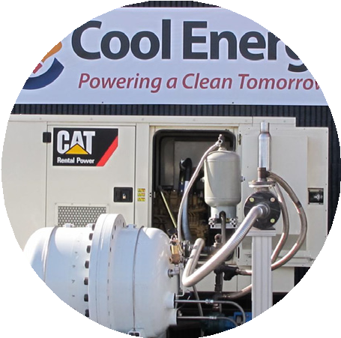
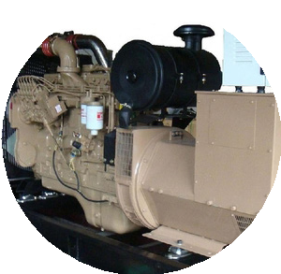
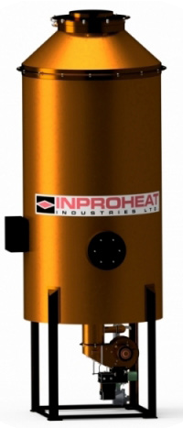



M A R K E T F O C U S
C O N C E N T R A T E D S O L A R P O W E R
W A S T E C O L D R E C O V E R Y
DISH
TROUGH
POWER TOWER
LIQUIFIED NATURAL GAS
I N T E R N A L C O M B U S T I O N W A S T E H E A T R E C O V E R Y
LOCOMOTIVES
N ATURAL GAS GENER ATORS
DIESEL
GENER ATORS
SHIP
ENGINES
I N D U S T R I A L W A S T E H E A T R E C O V E R Y
THERMAL POLLUTION CONTROLS
KILNS
STEEL MILLS
‘ETC’
PAPER MILLS
FOOD PROCESSING
-OIL & GAS

Slide 9
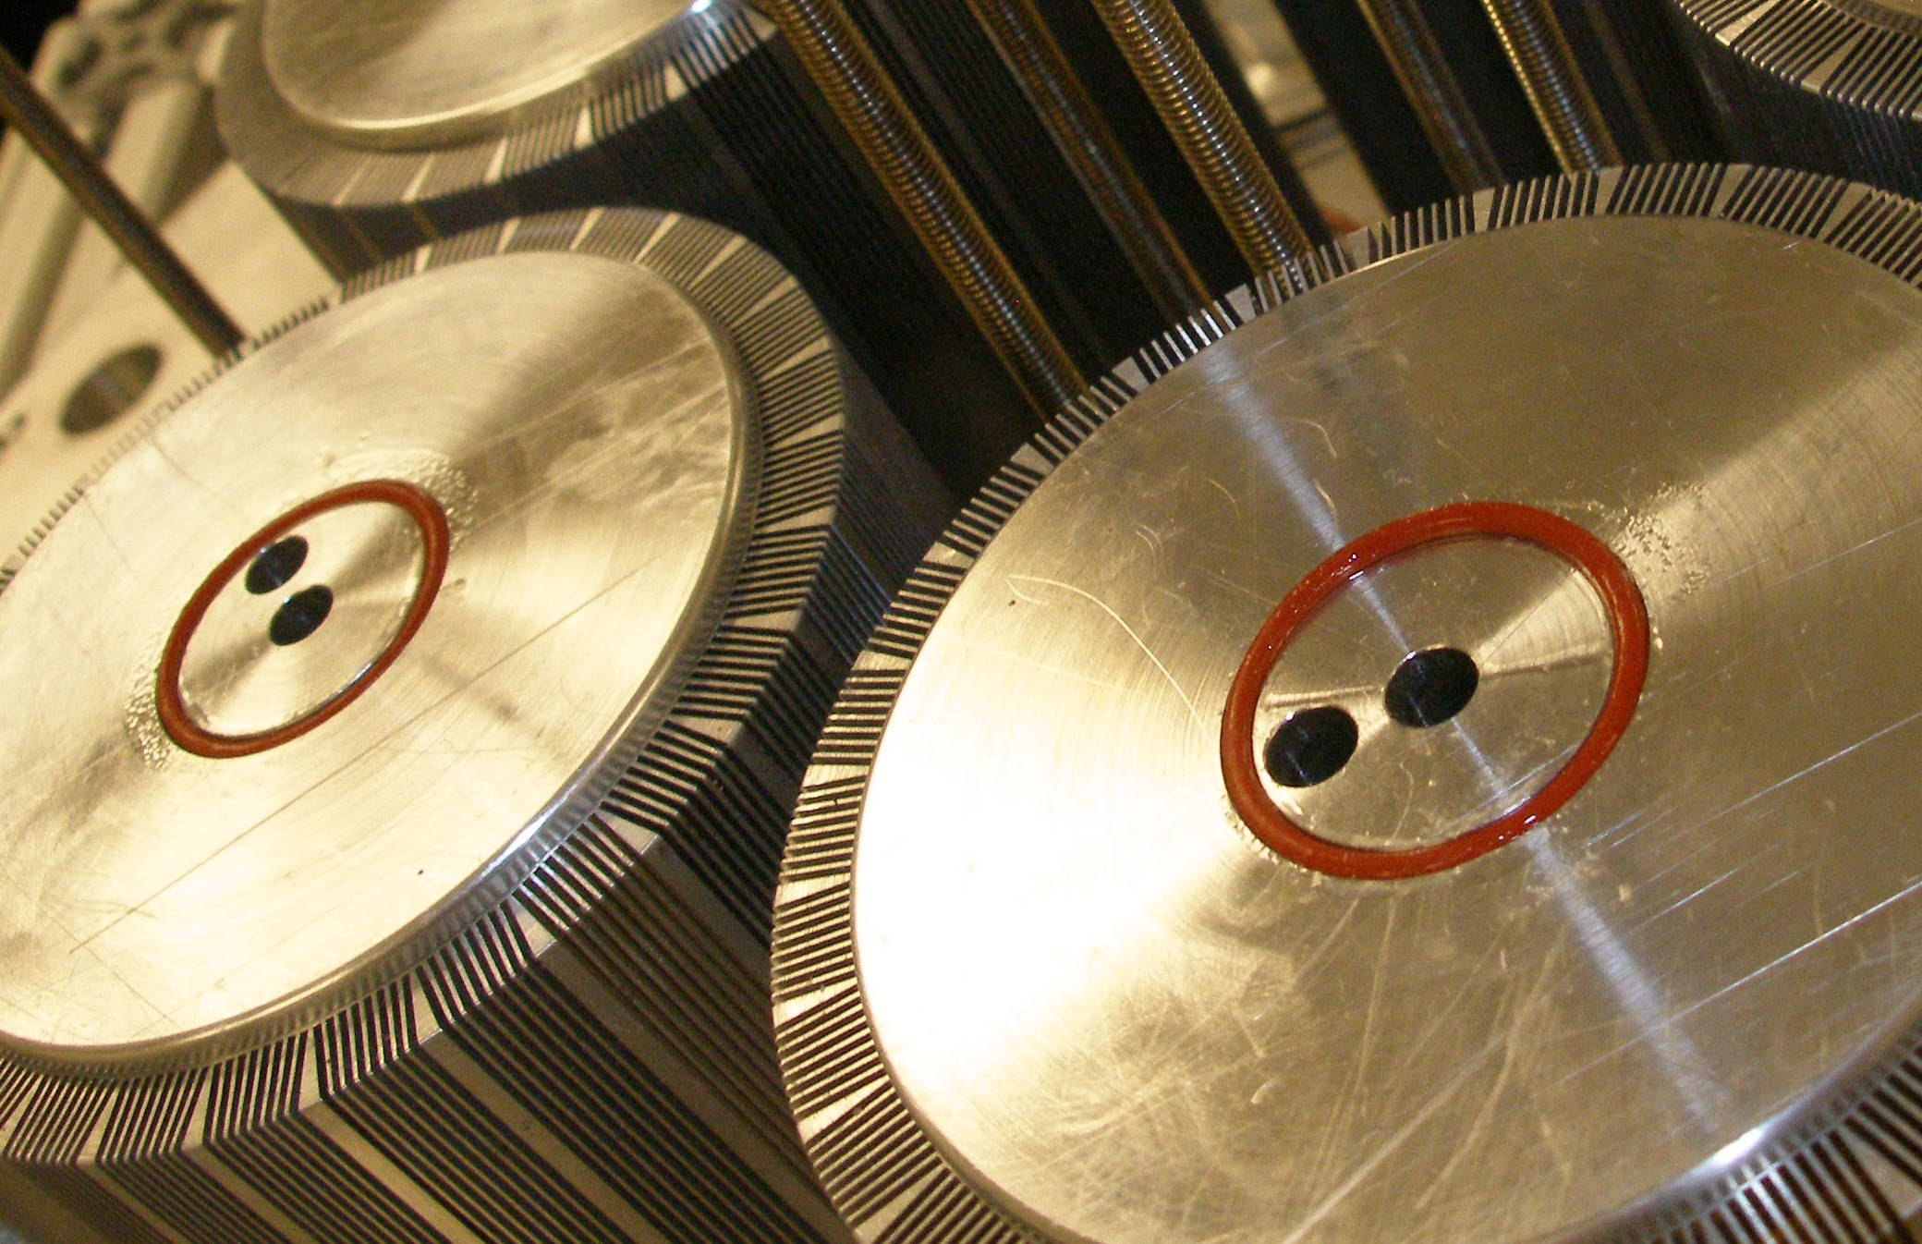
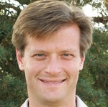
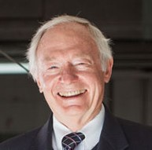
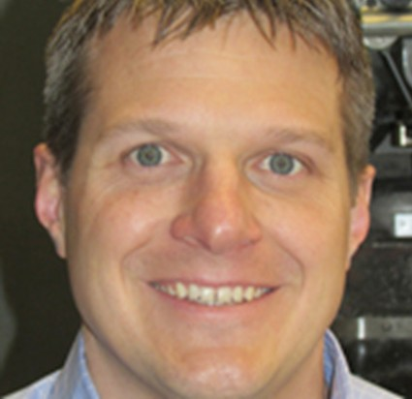
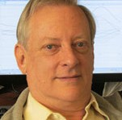
W H O W E A R E
HAS P ASSIONS FOR CLEAN ENERGY AND PRODUCT DEVELOPMEN T, AND HIS ROLE AT COOL ENERGY ALLOWS HIM TO NOURISH BOTH. BEGINNING HIS
EXPLOR ATION OF CARBON-FREE POWER GENER ATION AS A BOY
BRAINSTORMING WITH HIS F ATHER, HIMSELF A NUCLEAR ENGINEER AND
ENTREPRENEUR, SAM HAS CONTINUED ON THE CLEAN-ENERGY P ATH WITH COOL ENERG Y, AS WELL AS BEING A BOARD MEMBER OF PROTON POWER.
S A M P . W E A V E R
C E O P R E S I D E N T & F O U N D E R
HAS WORKED IN THE ADV ANCED M ATERIALS INDUSTR Y FOR OVER 40 YEARS AND HOLDS NINE ISSUED P ATENTS IN THE AREA OF ADV ANCED M ATERIALS.
HE HAS COMPLETED THE SALE OF MILLENNIUM M ATERIALS TO DYSON GROUP PLC, AND THE CORPOR ATE SALE OF US NUCLEAR TO EAGLE-PITCHER.
S A M C . W E A V E R
C H A I R M A N , F O U N D E R
BEGAN WITH COOL ENERGY IN JU LY 2006. SINCE THEN, HE HAS LEAD THE DESIGN, BUILD, AND TEST OF ALL CEI ENGINES. PRIOR TO CEI, HE WORKED AT BOTH LARGE AND SMALL COMPANIES, FOCUSING ON PRODUCT AND
PROCESS DEVELOPMEN T, PRODUCT TESTING, AND MANUF ACTURING.
B R I A N N U E L
D I R E C T O R O F E N G I N E E R I N G
JOINED COOL ENERGY IN 2006. HE CAME TO COOL ENERGY WITH OVER 30
YEARS OF THERMAL ANA LYSIS AND ENGINEERING EXPERIENCE IN A V ARIETY OF SECTORS. LEE IS RESPONSIBLE FOR DEVELOPING CUSTOMIZED SIMUL ATION
MODELS AND ANA LYSIS PROGRAMS FOR OPTIMIZING AND IMPROVING THE SOLARHEAR T ENGINE DESIGN AND COMPONENTS.
L E E S M I T H S E N I O R T H E R M A L S Y S T E M S A N A L Y S T

Slide 10
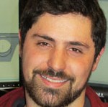
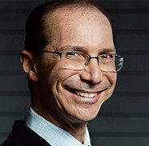
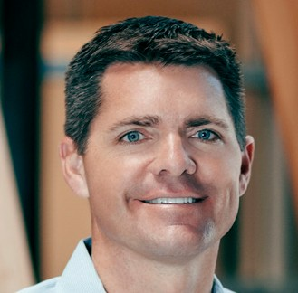
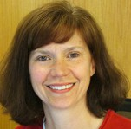
W H O W E A R E
HAS A BACKGROUND WHICH INCLUDES FINITE ELEMENT ANA LYSIS, MECHANICAL DESIGN, TEST DEVELOPMENT AND SYSTEM TESTING. HE GRADU ATED FROM THE UNIVERSITY OF COLORADO WITH A B.S. IN MECHANICAL ENGINEERING AND A
M.S IN MECHANICS OF M ATERIALS. STEF AN IS A BOULDER N ATIVE AND STRIVES TO ENJOY THE MANY ACTIVITIES THIS TOWN HAS TO OFFER.
S T E F A N B E R K O W E R :
M E C H A N I C A L E N G I N E E R
FOUNDER IDEALAB, LIFELONG ENTREPRENEUR, S TAR TING HIS FIRST SOLAR BUSINESS IN HIGH SCHOOL. AFTER GRADU ATING FROM CALIFORNIA INSTI -
TUTE OF TECHNOLOG Y, MR. GROSS S TAR TED GNP DEVELOPMEN T, INC., WHICH MADE A N ATURAL LANGUAGE PRODUCT FOR LOTUS 1-2-3 CALLED HAL.
B I L L G R O S S
D I R E C T O R
R Y AN HAS WORN THE H AT OF FOUNDER AND CEO OF SUCCESSFUL COMPANIES FOR NEAR LY 30 YEARS, AS WELL AS HELPING EAR LY S TAGE ENTREPRENEURS
NA VIG ATE THE BUSINESS LANDSCAPE. HE W AS THE LONG-TIME ENTREPRENEUR IN RESIDENCE AT ICONIC AD AGENCY CRISPIN POR TER + BOGUSKY AND
A W ARDED EMERGING ENTREPRENEUR OF THE YEAR BY OFFICE OF ECONOMIC DEVELOPMENT IN 2013.
R Y A N F E R R E R O
B R A N D M A N A G E R , F O U N D E R / C E O I G N Y T E
SHE JOINED THE TEAM IN 2008. TRACY’S BUSINESS, HEA LTH AND ENVIRON - MENT EXPERIENCE W AS A GRE AT FIT FOR THE V ARIETY OF ROLES SHE FILLS. SHE EARNED HER SUS TAINABILITY MANAGER CER TIFIC ATE IN 2010 FROM THE UNIVERSITY OF COLORADO. TRACY TAKES ON MANY SPECIAL PROJECTS ON TOP OF MANAGING THE OFFICE.
T R A C Y S C H O L L
A D M I N I S T R A T I O N M A N A G E R

Slide 11









S T R A T E G I C
P A R T NE R S H I P S
T H R O U G H
P R O T O T Y P I N G
A N D N O W
S C A L A B I L I T Y

Slide 12
G O T O M A R K E T
A S A S O P H I S T I C A T E D E N G I N E E R I N G A N D D E S I G N C O M P A N Y , C O O L E N E R G Y I S A C T I V E L Y E N G A G E D W I T H E X P E R T C H A N N E L
P A R T N E R S , N E G O T I A T I N G L I C E N S I N G A G R E E M E N T S I N M U L T I P L E G E O G R A P H I E S A N D S P E C I F I C C A T E G O R Y U S E S .

Slide 13
2 0 1 6
FIRST THERMOHEAR T REVENUE,
POR TLAND ROASTING PURCHASE ORDER,
WHR
2 0 1 7
LONGWIN JOINT VENTURE,
ASIAN LICENSING P AR TNER/THERMOHEART MANUFACTURER, $750K+ REVENUE
2 0 1 8
SECTOR LICENSING, TARGET GE AND GLOBAL INDUSTRIAL
INFRASTRUCTURE
2 0 1 9
ADD 4 GEOGRAPHIC MARKETS, TPC AND WHR
(AUSTRALIA, I TALY, INDIA, JAP AN)

Slide 14
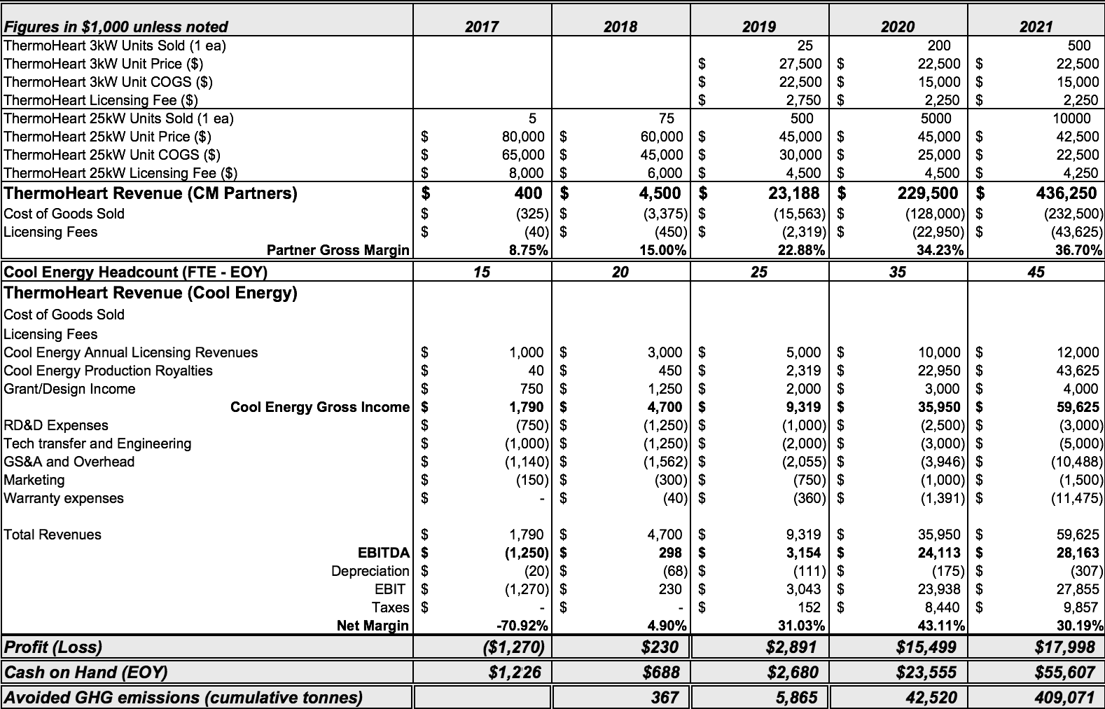
P R O F OR MA
F I N A NC I A L S
L I C E N S I N G M O D E L =
G R E A T
M A R G I N S , I N V E S T O R R E T U R N S
PILOTS
LICENSING

Slide 15
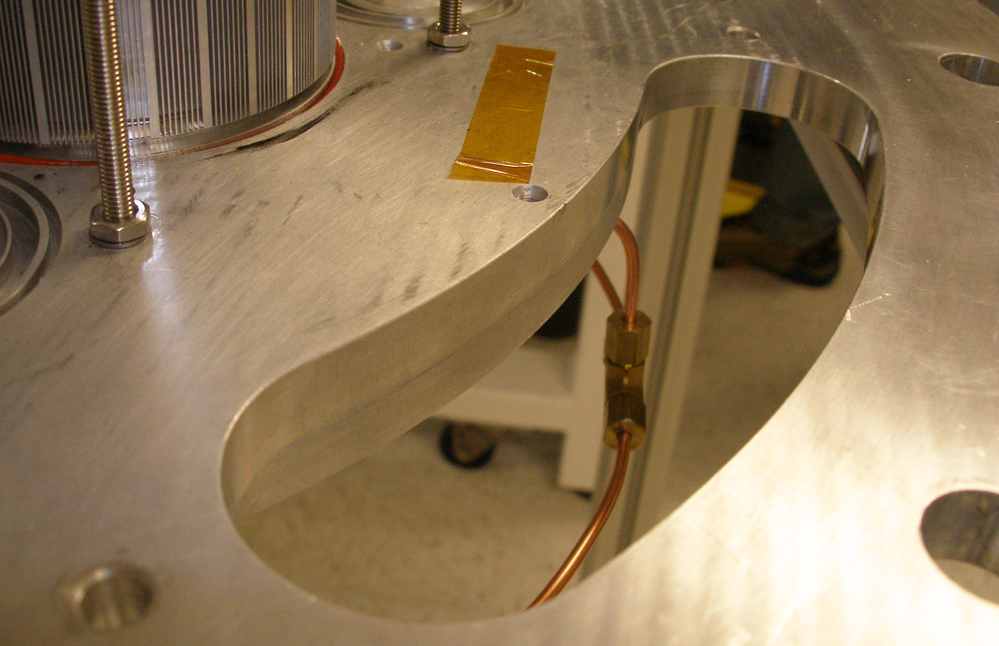
S U M M A R Y

Slide 16
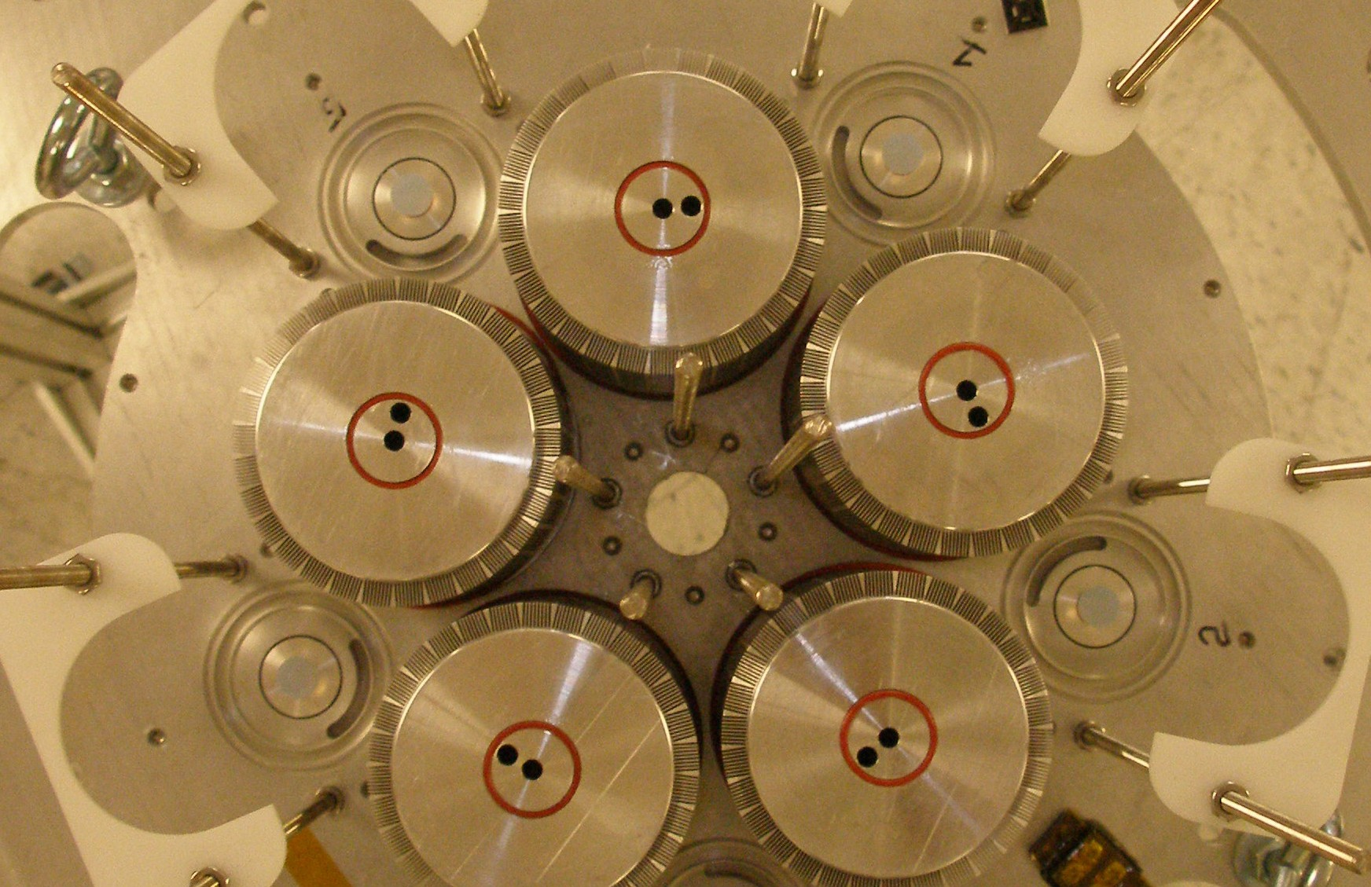

R A P I D R O I . T O M O R R O W
2 5 K W .
H I G H
E F F I C I E N C Y .
A N D P O W E R I N G A C L E A N
F o r m o r e i n f o r m a t i o n , P l e a s e
c o n t a c t
S A M W E A V E R
s p w e a v e r @ c o o l e n e r g y . c o m o r 3 0 3 - 4 4 2 - 2 1 2 1

