Slide 1

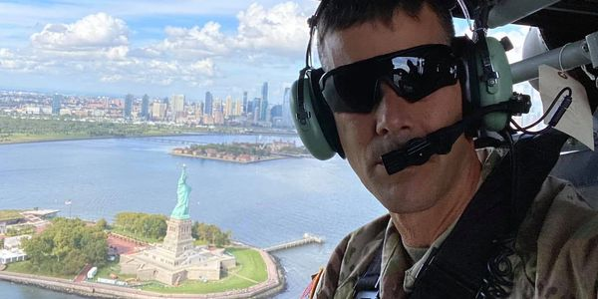
Leadership and Risk Management in Combat
Major General (Ret) Bob Whittle
robert.whittle.com
Whittle & Associates, LLC

Slide 2
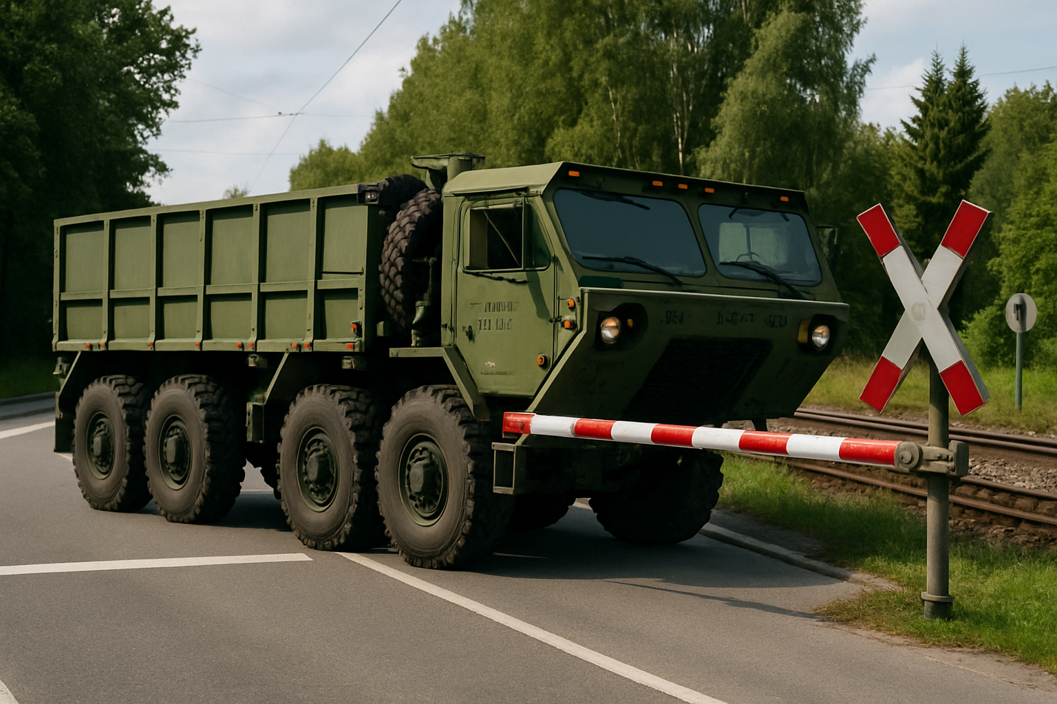
Probability and Severity
Collided Together in 1995 in Mannheim, Germany

Slide 3

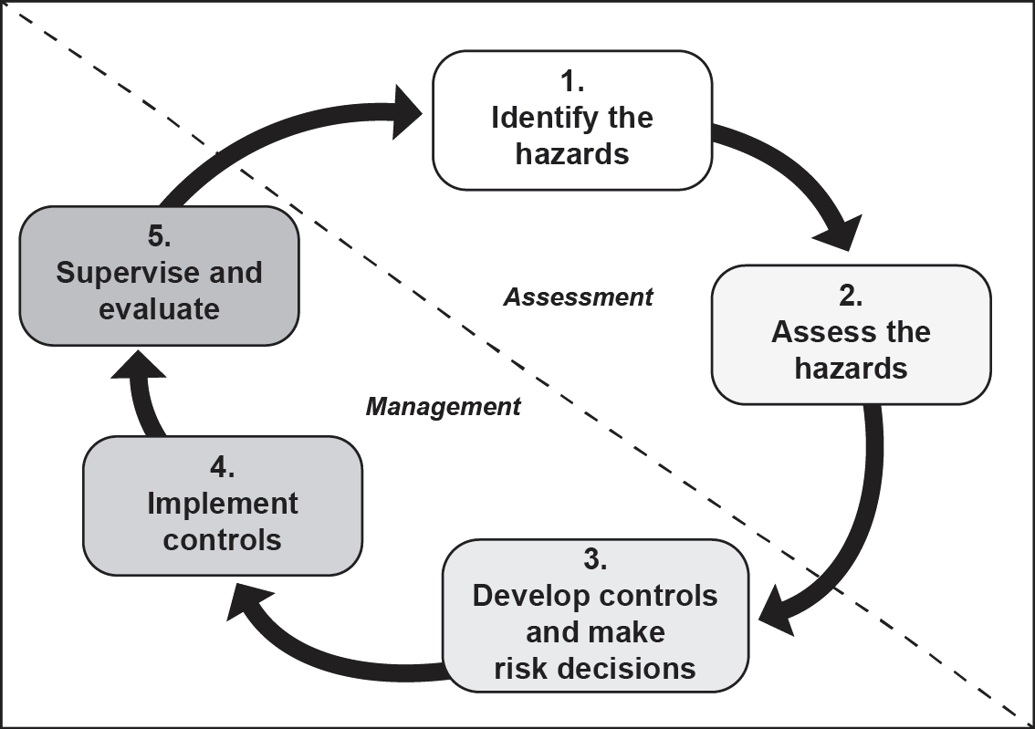
Army Risk Assessment / Management Steps
QR Code- Army
Risk Management Book

Slide 4
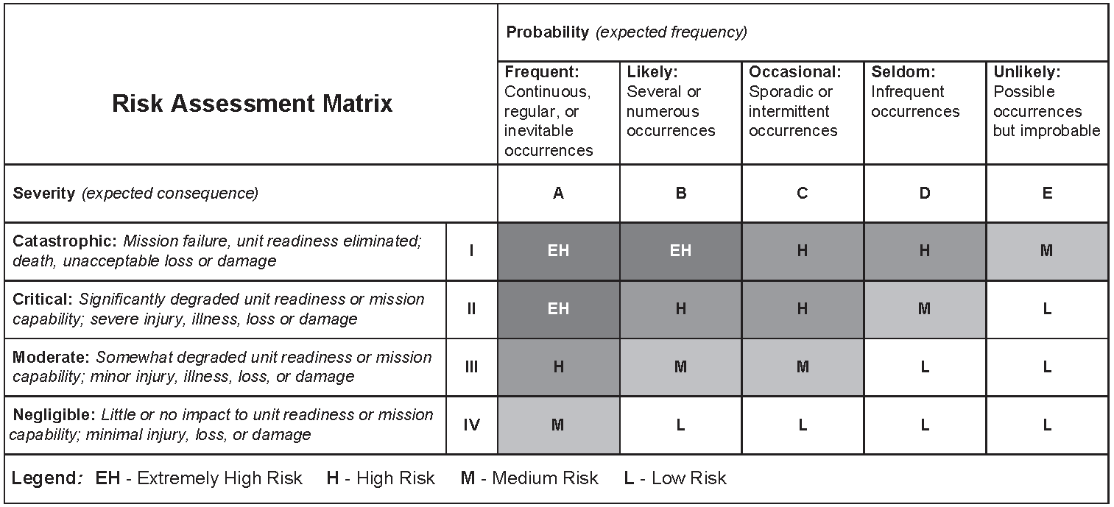
“A hazard is a condition with the potential to cause injury, illness, or death of personnel; damage to or loss of equipment or property; or mission degradation “(Joint Pub 3-33)

Slide 5
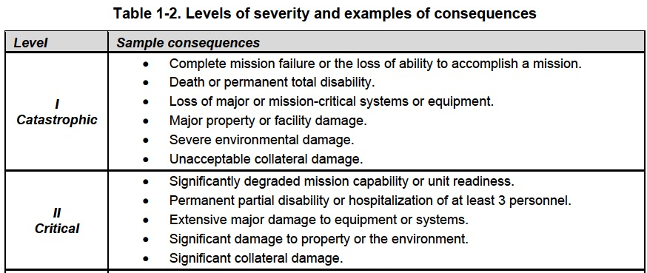

Slide 6
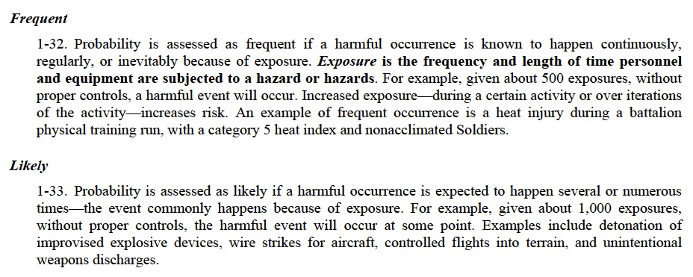

Slide 7
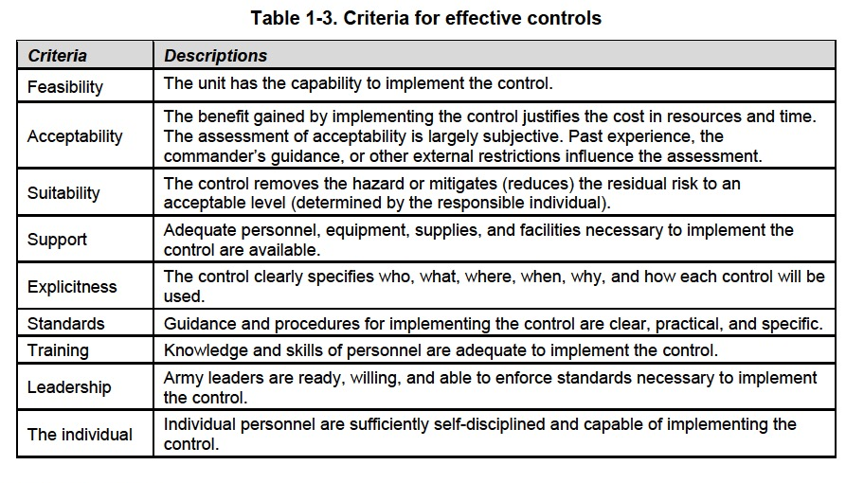

Slide 8
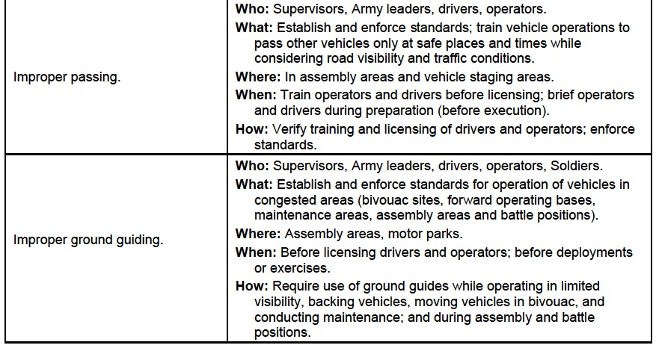

Slide 9
Return to Risk Assessment Matrix and Determine Residual Risk

Slide 10
Army Risk Assessment / Management Steps
QR Code- Army
Risk Management Book

Slide 11
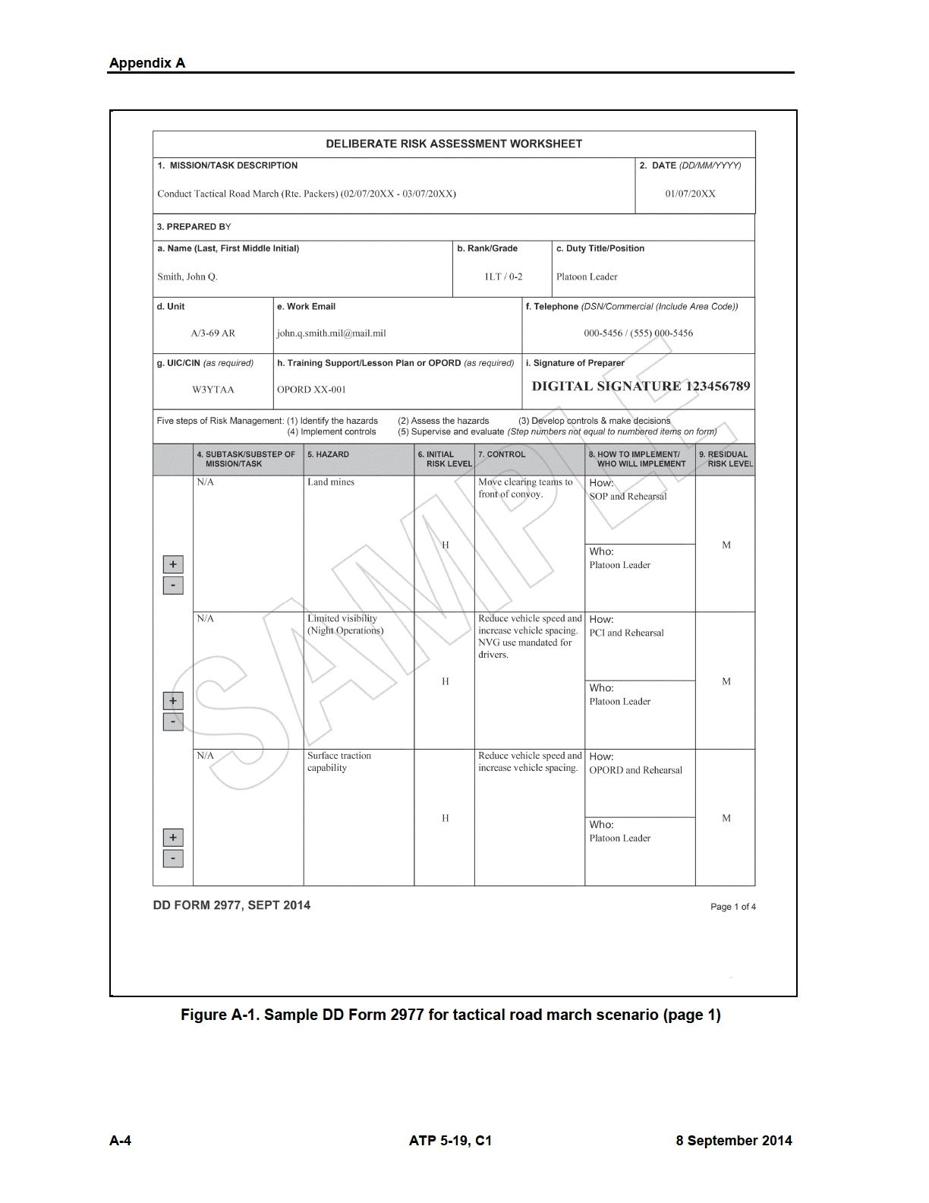
Dept of Defense Form 2977 – Putting it all together

Slide 12

Dept of Defense Form 2977 – Putting it all together
QR Code for Form 2977

Slide 13
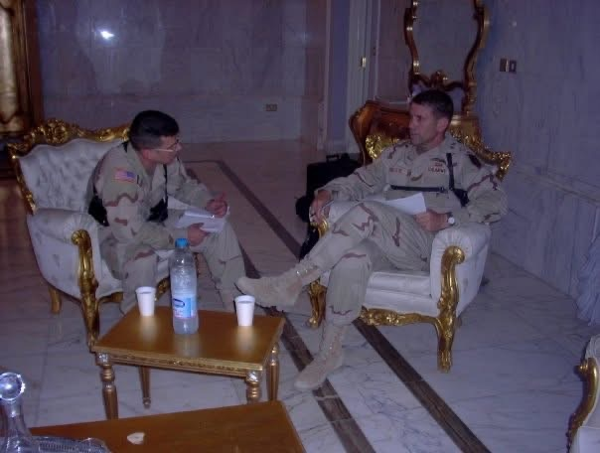
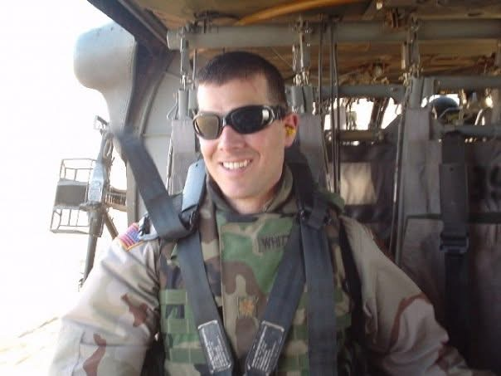
Reconnaissance to Iraq in August 2023
Major Bob Whittle and Major General John Batiste

Slide 14
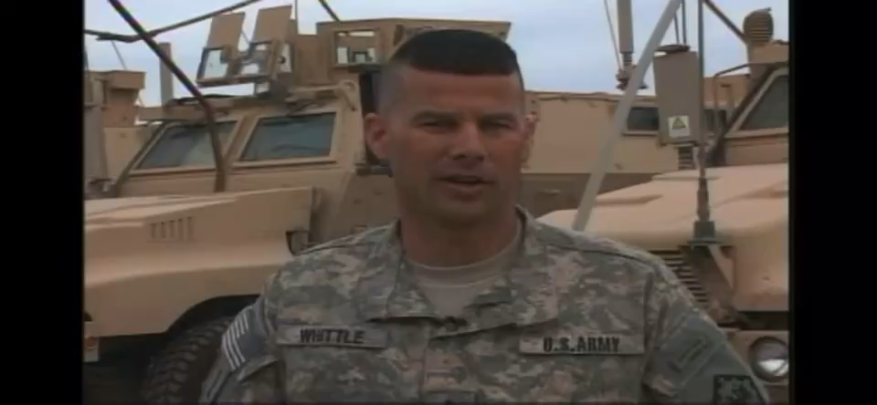
Clearing Routes of IEDs, 2009-2010
400+ Soldiers Deployed in this Route Clearance Battalion
There were no deaths or severe injuries

Slide 15
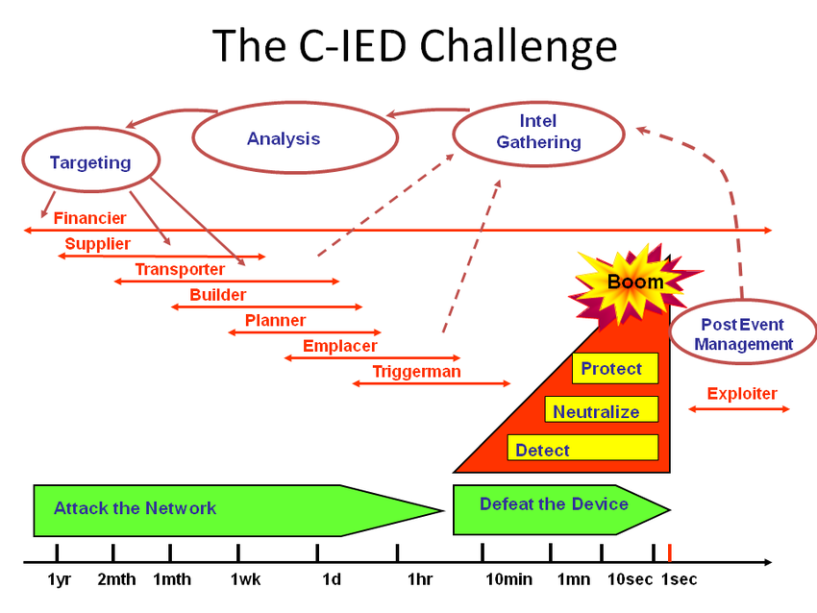
Avoiding / Mitigating the Boom with Controls
Faust, Anthony & de Ruiter, Cornelis & Ehlerding, Anneli & Mcfee, John & Svinsås, Eirik & Rheenen, Arthur. (2011). Observations on Military Exploitation of Explosives Detection Technologies. Proceedings of SPIE - The International Society for Optical Engineering. 8017. 10.1117/12.886391. SMC.

Slide 16
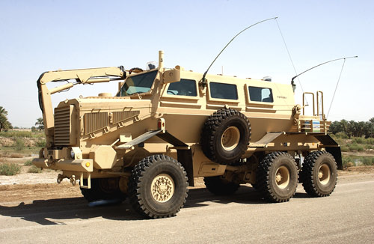
The Buffalo MRAP in Iraq arrives in Fall 2003
USA Photo/Master Sergeant Lek Mateo.

Slide 17
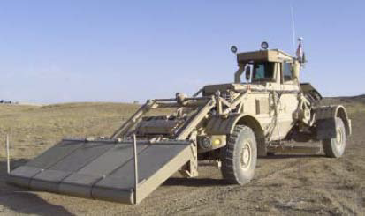
The Husky
Photo from The Joint IED Defeat Organization, DoD’s Fight Against IEDs Today and Tomorrow, Armed Services Subcommittee on Oversight and Investigations, November 2008

Slide 18
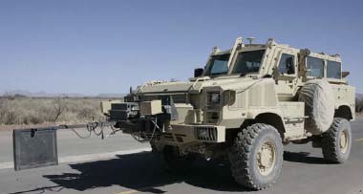
The Rhino
Photo from The Joint IED Defeat Organization, DoD’s Fight Against IEDs Today and Tomorrow, Armed Services Subcommittee on Oversight and Investigations, November 2008

Slide 19
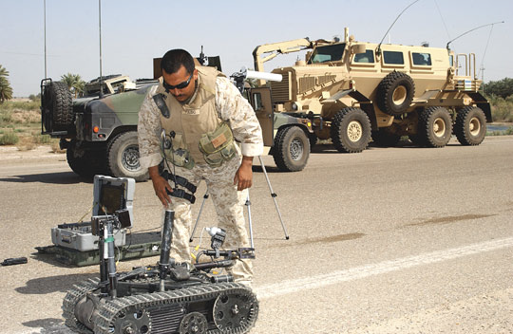
The Talon Robot
USA Photo/Master Sergeant Lek Mateo.

Slide 20
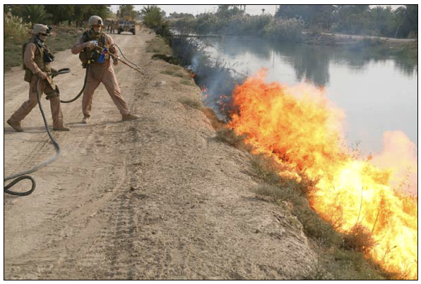
Flamethrower Burning Vegetation
DOD Photo/Lance Corporal Joseph A. Lambach, USMC.

Slide 21
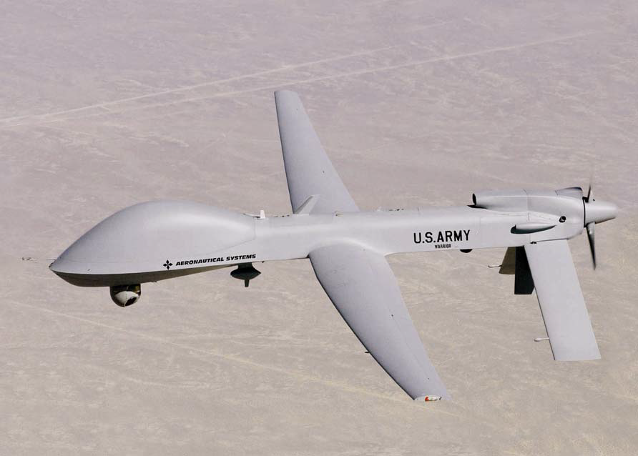
Warrior Alpha UAV with Persistent Surveillance
Photo from The Joint IED Defeat Organization, DoD’s Fight Against IEDs Today and Tomorrow, Armed Services Subcommittee on Oversight and Investigations, November 2008

Slide 22

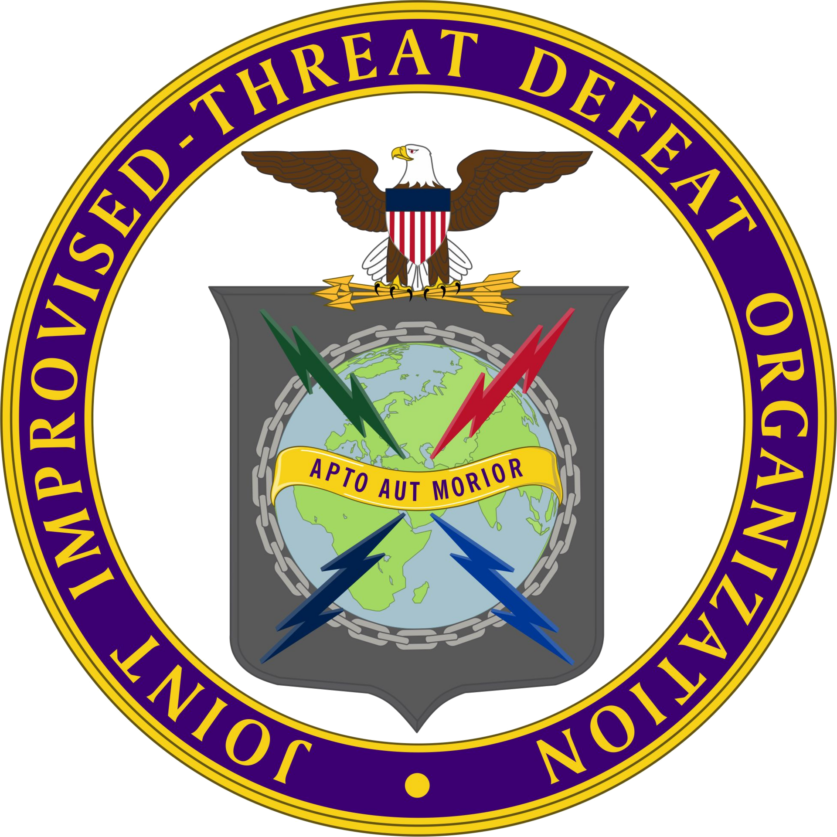
The Pentagon’s Joint IED Defeat Organization (JIEDDO)
JIEDDO studied the End-to-End process that the enemy uses to employ Improvised Explosive Devices (IEDs). In
Three Lines of Effort to Mitigate Risk to Mission
  Defeat the Network
  Defeat the Device
  Train the Force
AUT INVENIAM AUT FACIAM means "I shall either find a way or make one,” attributed to Hannibal when he crossed the Alps
JIEDDO became JIDO in 2016, motto changed to APTO AUT MORIOR , “I must adapt or I will die”
Notes:
This slide summarizes the critical situation regarding IED threats faced by American troops. It highlights the initial delay in recognizing the threat, the urgent plea by Gen. Abizaid for help, the devastating impact of IEDs on soldiers, and the call for a large-scale, dedicated response comparable to the Manhattan Project's intensity during WWII.
JIEDDO becomes JIDA in April 2015(an agency), later changed to JIDO in 2016 and moved to DTRA

Slide 23
Getting Left of the Boom by Applying the Risk Management Cycle
To the Full End-To-End Process
APTO AUT MORIOR
Faust, Anthony & de Ruiter, Cornelis & Ehlerding, Anneli & Mcfee, John & Svinsås, Eirik & Rheenen, Arthur. (2011). Observations on Military Exploitation of Explosives Detection Technologies. Proceedings of SPIE - The International Society for Optical Engineering. 8017. 10.1117/12.886391. SMC.

Slide 24
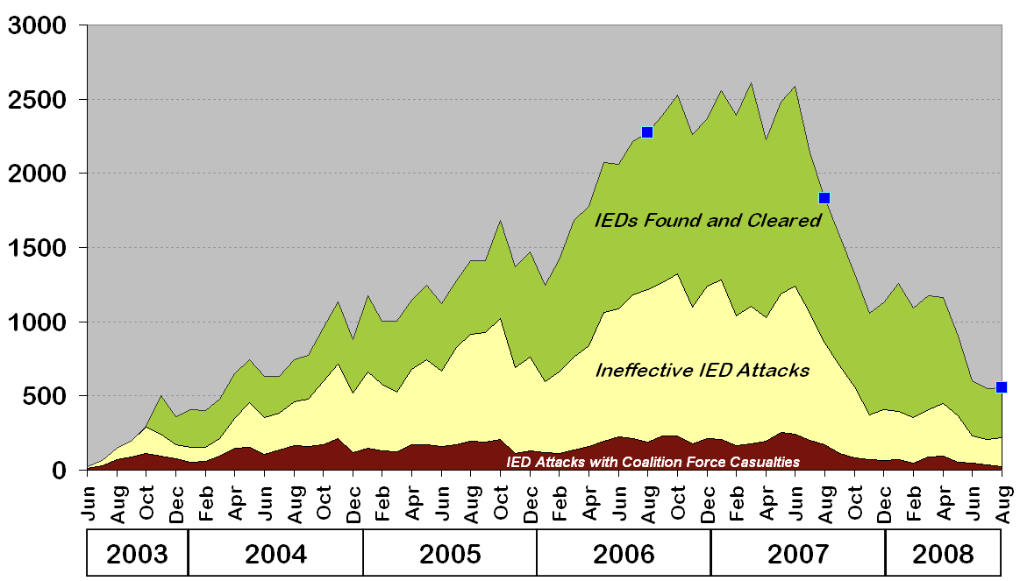
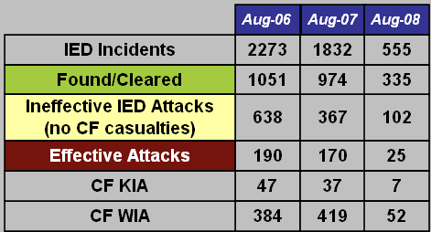
Effective IED attacks per incident in Iraq dropped from 8.3% to 4.5% in 24 months due to Risk Management of a fully developed End to End Process
Data and chart from The Joint IED Defeat Organization, DoD’s Fight Against IEDs Today and Tomorrow, Armed Services Subcommittee on Oversight and Investigations, November 2008

Slide 25
How We Created a Risk Management Culture
Leadership Emphasis
Set the Example
Educate
Train, Train, and Train
APTO AUT MORIOR
Accountability

Slide 26
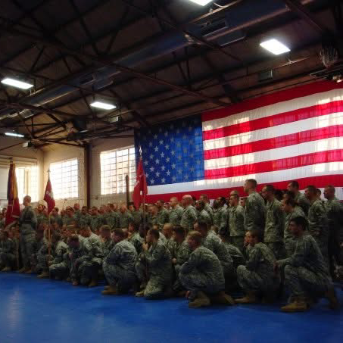
1st Engineer Battalion Command Philosophy
Deploy, Fight, and Win
Take Care of Soldiers and Families
Greatest Engineer Battalion Ever Formed

Slide 27

Win
Care
Teamwork
Notes:
This slide outlines the core tenets of the Command Philosophy. It emphasizes successful deployment and combat readiness, the importance of supporting soldiers and their families to maintain morale, and the ambition to be recognized as the greatest engineer battalion, reflecting dedication, excellence, and commitment.

Slide 28
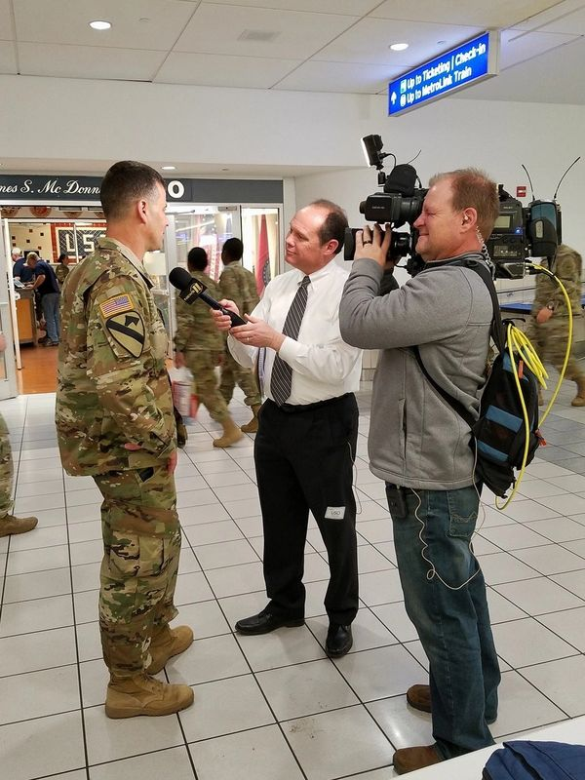
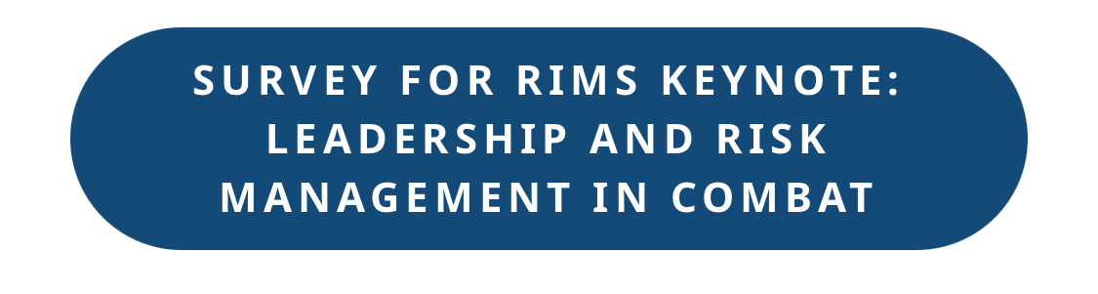

Questions/ Website/Survey
Discussion Look for this button:

