Slide 1
The Impact of Early Trauma on Perpetuation of Migraine
David Kernick. Exeterheadachecare.co.uk

Slide 2
Outline of talk
Poetical
Epidemiological
Theoretical
Practical

Slide 3
What is a Trauma?
Stressor that promotes an inappropriate or prolonged inflammatory response.
Stressor can be Physical, Psychological, Social.
Here considering trauma arising from interaction with others

Slide 4
Types of Trauma.
Generational Trauma
Childhood trauma - Significant adverse childhood events
Adult trauma

Slide 5
Key questions
Does trauma exacerbate or perpetuate migraine?
To what extent is the trauma agenda culturally (our conditioned and filtered world view) pulled?
To what extent is the trauma agenda professionally pushed?
How does our own trauma impact on our patient relationship and clinical approach?
Should we explore a trauma background in our consultations?
How should we proceed when we do?

Slide 6
Outline of talk
Poetical
Epidemiological
Theoretical
Practical

Slide 7
Migraine and Trauma
Association between trauma and migraine
ACEs are most important (Relative risk 1.5 for people with migraine)
Dose dependent relationship (? One off)
Khanna P, Clinical Practice and Research. 2025.
Association carried with chronic migraine

Slide 8
Significant adverse childhood events
Abuse
Physical abuse
Emotional abuse
Sexual abuse
2. Neglect
Physical neglect
Emotional neglect
3. Household Dysfunction
Witnessing domestic violence
Living with someone who has substance use disorder
Living with someone with mental illness
Parental separation or divorce
Having an incarcerated household member

Slide 9
Frequency
UK 48% at least one
17% two or more
Bellis, M.A., Hughes, K., Leckenby, N. et al. National household survey of adverse childhood experiences and their relationship with resilience to health-harming behaviors in England. BMC Med 12, 72 (2014). https://doi.org/10.1186/1741-7015-12-72

Slide 10
Outline of talk
Poetical
Theoretical
Practical

Slide 11
Simple explanation
“Trauma can trigger prolonged inflammation which can impact on
how the body and brain function including increasing migraine
sensitivity.”

Slide 12
Resolves
Inflammatory response
Nervous system
Hormonal system
Cytokine system
Stressor
Persists
Trauma

Slide 13
1. The body needs to optimise energy expenditure
Friston, K. The free-energy principle: a unified brain theory? Nature reviews neuroscience. 2010:11(2):127-138.

Slide 14
2. Deficiencies in energy production in the migraine brain
Sun W, Chen T, Song M, Gao Y and Xu S (2025) Energy metabolism disorders in migraine: triggers, pathways, and therapeutic repurposing. Front. Neurol. 16:1561000. doi: 10.3389/fneur.2025.1561000

Slide 15
3. Brain and other levels of scale minimise energy expenditure by operating in a predictive mode

Slide 16


Allostatic control – feedforward c.f. Homeostatic control
Causes of sensory information inferred based on experience
The aim is to minimise predictive error Friston 2011
Predictive Model
Predictive error
Sensory input = 0 t

Slide 17

The brain in reactive mode
“The car is not in the right direction for this curve.
I need to make an immediate correction to my steering”
The brain in predictive mode
“I have an idea how I need to steer around this corner
ahead. I’ll steer based on my prediction and update
it if my idea if it is not correct”

Slide 18
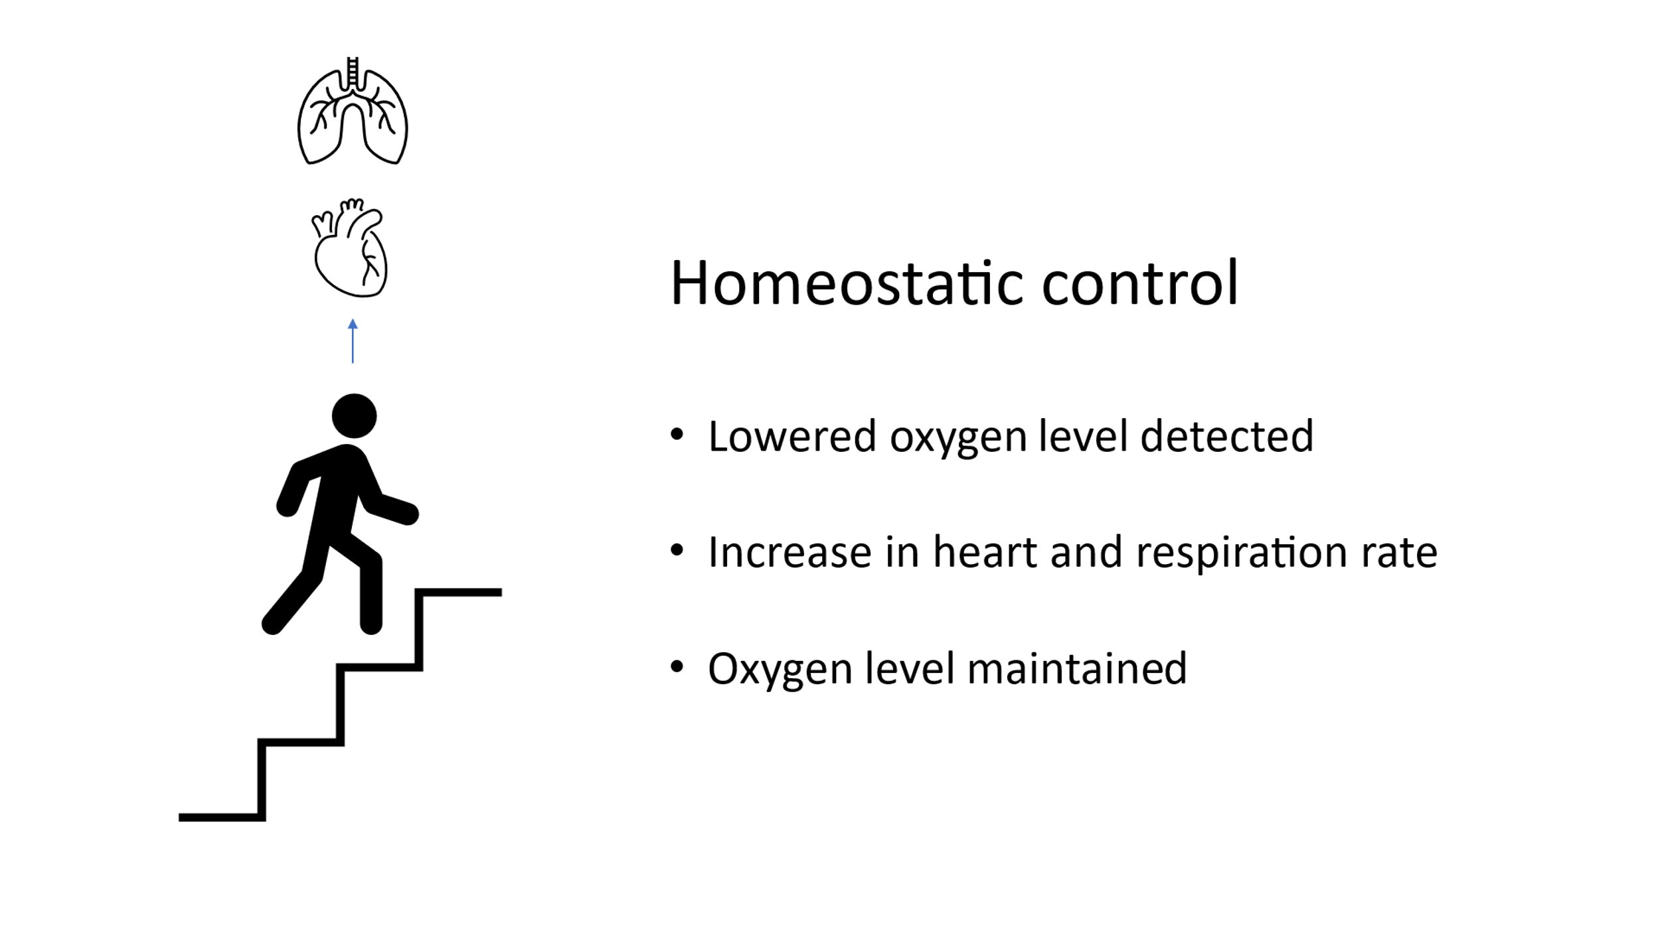

Slide 19
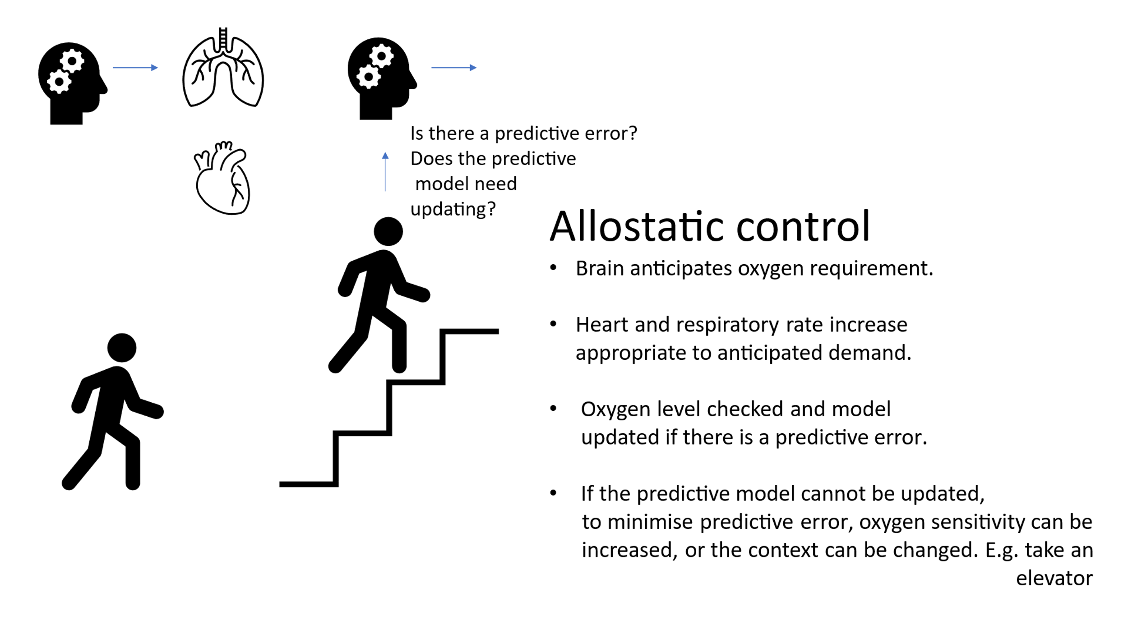

Slide 20
Free energy principle Friston 2011
Disorder is minimised with minimisation of prediction error.
This is facilitated by maximising information exchange between interacting systems.
This occurs when interacting systems are coherent i.e. their complexity is matched.
Predictive Model
Predictive error
Sensory input = 0 t

Slide 21
4. The migraine brain (hypersensitive) can have difficulty resolving predictive errors which is an energy demanding process
Sensory signals amplified in attempt to resolve error
Leads to overload and shut down
Sedley, W., Kumar, S., Jones, S., Levy, A., Friston, K., Griffiths, T., & Goldsmith, P. (2024). Migraine as an allostatic reset triggered by unresolved interoceptive prediction errors. Neuroscience & Biobehavioral Reviews, 157, 105536.

Slide 22
5. Energy demands and predictive processing are further compromised by chronic inflammation
David Borsook, Nasim Maleki, Lino Becerra, Bruce McEwen, Understanding Migraine through the Lens of Maladaptive Stress Responses: A Model Disease of Allostatic Load, Neuron, Volume 73, Issue 2, 2012, Pages 219-234, https://doi.org/10.1016/j.neuron.2012.01.001.

Slide 23
Impact chronic inflammatory load
Held across the body. Inappropriate interpretation of physiological change. Distorts body signals. (positive feedback).
Increased energy consumption.
Impact on cognitive functioning - reduced model flexibility, updates model inappropriately (“I feel bad all the time, the world must be bad”).
Overweighs certain predictive errors (Those linked to threat or discomfort)

Slide 24
The impact of childhood trauma
Difficulty in constructing consistent models
Dependence on unreliable predictive errors
High chronic inflammatory load
McLaughlin KA, Sheridan MA, Lambert HK. Childhood adversity and neural development: Deprivation and threat as distinct dimensions of early experience. Neuroscience & Biobehavioral Reviews. 2014 Nov 1;47:578-91.

Slide 25
Outline of talk
Poetical
Epidemiological
Theoretical
Practical

Slide 26
Key questions
Does trauma exacerbate or perpetuate migraine?
To what extent is the trauma agenda culturally (our conditioned and filtered world view) driven?
How does our own trauma impact on our patient relationship and clinical approach?
Should we explore a trauma background in our consultations?
How should we proceed when we do?

Slide 27
Key questions - Does trauma exacerbate or perpetuate migraine?
Clear association, dose response but is it causal?
Theoretical support

Slide 28
Key questions
To what extent is the trauma agenda culturally (our conditioned and filtered world view) pulled?
To what extent is the trauma agenda professionally pushed?

Slide 29
Key questions
How does our own trauma impact on our patient relationship and clinical approach?

Slide 30
Self reflection on our own “stress buckets.”
“We are masters at hiding from ourselves that with which we don't know how to cope”
We unconsciously manufacture reactions and projections to alleviate our inner discomfort

Slide 31
Key questions
Should we explore a trauma background in our consultations?

Slide 32
What is suppressed causes us to be distressed and needs to be expressed.
“But if in consciousness there is no willingness to admit unconscious contents, then the energy of these contents is diverted to the sphere of affectivity, namely to the sphere of the instincts. From there arise emotional outbursts, and irritability, of which consciousness usually suffers a profound disorientation.
Jung

Slide 33
Always Vigilant
“Often, we find that difficult experiences even going back to childhood can impact upon physical illnesses like migraine.”
“I don’t want to go into any details, but I wonder if there is anything that may be troubling that could be arising from previous difficult experiences?”

Slide 34
Should you address unresolved trauma?
Is it harming you?
Is it harming others?
Are you at peace with yourself?

Slide 35
Key questions
How should we proceed when we do?

Slide 36
3. Where do you go for help?
NHS mental health services or GP
Psychotherapist or psychologist (registered)
Trauma focussed holistic practitioner (proceed with caution)

Slide 37
The Impact of Early Trauma on Perpetuation of Migraine

