Slide 1
Diagnosis slides part 1

Slide 2
Migraine Diagnosis

Slide 3
So, What is Migraine?
Migraine is a neurological condition which features amplification of a number of sensory pathways¹. Some studies suggest that genetic components contribute to susceptibility to the condition⁵
May be lifelong but varies in impact, severity and frequency throughout life (epigenetics)²
Is a spectrum condition; attacks may be mild, moderate or severe¹
Can lead to attacks which may start at any age; usually in early adulthood³
Has a natural history, often eventually improving with age²
Migraine is NOT just a bad headache⁴
1. Brennan K., Pietrobon D. A systems neuroscience approach to migraine. Neuron. 2018;97(5):1004-1021. 2. Kelman L. Migraine Changes with Age: IMPACT on Migraine Classification. Headache. 2006;46(7):1161-71. 3. Migraine Trust. What is Migraine? Available at: https://migrainetrust.org/wp-content/uploads/2023/05/What-is-migraine-factsheet.pdf . Accessed October 2023. 4. Lai C. Flashing lights and poor funding: more than a headache. Lancet. 2017 (Radio). 5. Bron et al. Exploring the Hereditary Nature of Migraine. Neuropsychiatric Disease and Treatment. 2021;17. 1183-1194.
Notes:
NOTE TO MLR REVIEWER: not a new slide (Tech Check not required)

Slide 4
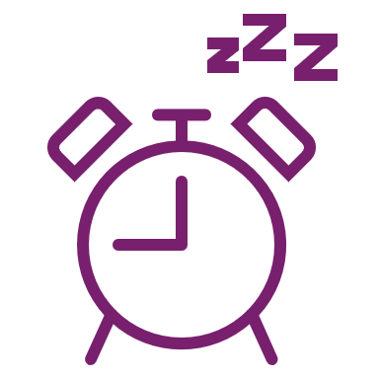
There are several common characteristics and triggers for migraine
Alterations to homeostatic functions (e.g., sleep) are common in migraine⁶
Common features:
Genetics – Estimates indicate that about 42% of migraine is because of an individual’s genes¹
Age – Prevalence is highest in people between 18–44 years*²
Gender – Migraine is more prevalent in women than in men³
Triggers⁴
Stress
Hormones
Lack of food
Weather
Sleep disturbances
Smells (i.e., perfumes)
Neck pain
Lights
Alcohol
Smoke
Sleeping late
Heat
Food
Exercise
Sexual activity
Many migraine attacks can be spontaneous. Sometimes apparent triggers can be premonitory symptoms⁵
*This research is based on United States of America population²
1. Grangeon et al. The Journal of Headache and Pain 2023; 24:12; 2. Peters GL. Am J Manag Care 2019;25(Suppl. 2):S23–S34.; 3. Global Burden of Disease (GBD) 2016 Headache Collaborators. Lancet Neurol 2018;17:954–976; 4. Kelman L. Cephalalgia 2007;27:394–402; 5. Karsan N, et al. J Neurol. 2021; 268:1885–1893; 6. Goadsby P, et al. Physiol Rev 2017;97:553–622.

Slide 5

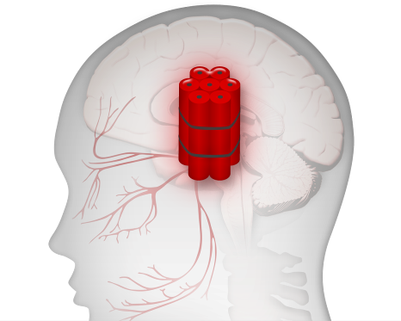
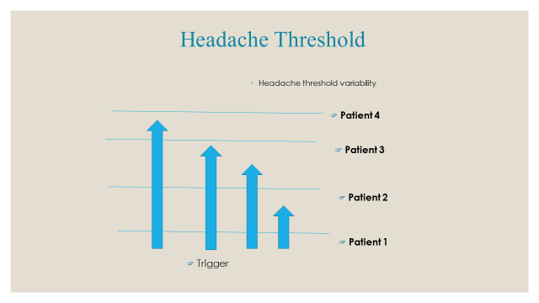

Consider the migraine brain to be sensitive to normal life events
Dehydration
Sleep disturbance
Diet
Environmental stimuli
Hunger
Stress
Changes in oestrogen level in women
Coppola G et al. Cephalalgia. 2007;27:1429–1439; Kelman L. Cephalalgia. 2007; 27:394–402; Pietrobon D et al. Nat Rev Neurosci. 2003;4:386–398.
Notes:
The triggers (with their frequencies) in this study were stress (79.7%), hormones (eg, estrogen levels in women) (65.1%), hunger (57.3%), sleep disturbance (49.8%),
References:
1. Coppola G, Pierelli F, Schoenen J. Is the cerebral cortex hyperexcitable or hyperresponsive in migraine? Cephalalgia. 2007;27(12):1429–1439.
2. Pietrobon D, Striessnig J. Neurobiology of migraine. Nat Rev Neurosci. 2003;4(5):386–398.
3. Kelman L. The triggers or precipitants of the acute migraine attack. Cephalalgia. 2007;27(5):394–402.
R1, p 1434, C2,
Par 2, L 1-4
R1, p 1434, C2,
Par 3, L 1-2, 14-16
R1, p 1434, C2,
Par 3, L 4-13
R3, p 1, Abs,
Par 1, L 1-2
R3, p 1, Abs,
Par 1, L 7-8
R3, p 1, Abs,
Par 1, L 8-12
R2, p 391, C1,
Par 2, L 6-9
R2, p 390,
Legend to Fig. 3
Kelman, p 394, C1,
Par 1, L 1-15
Kelman, p 396, Fig 2

Slide 6
The International Classification of Headache disorders criteria for migraine: ICHD 3
A. At least five attacks fulfilling criteria B-D
B. Headache attacks lasting 4-72 hrs (untreated or unsuccessfully treated)
C. Headache has at least two of the following four characteristics:
unilateral location
pulsating quality
moderate or severe pain intensity
aggravation by or causing avoidance of routine physical activity (e.g, walking or climbing stairs)
D. During headache at least one of the following:
nausea and/or vomiting
photophobia and phonophobia
E. Not better accounted for by another ICHD-3 diagnosis
ICHD-3, International Classification of Headache disorders criteria for migraine
1. IHS Classification ICHD-3 Available at: https://ichd-3.org/1-migraine/1-1-migraine-without-aura/. Last accessed: January 2024.

Slide 7
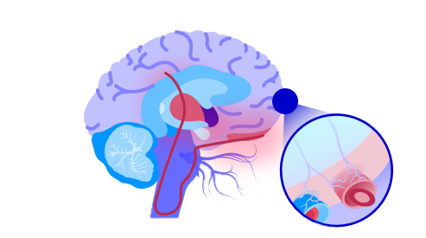
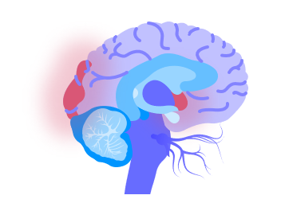

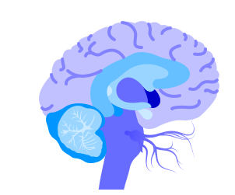

What do people experience during a migraine attack?
Activation of hypothalamic region
Cortical spreading depression
Activation of trigeminovascular system
Altered brain-blood flow*
Neck pain Fatigue
Poor concentration
Mood change
Food craving
Reversible
Neurological changes – visual, sensory, motor, speech
Headache
Nausea
Photophobia
Phonophobia
Osmophobia
Fatigue
Cognitive changes
Muscle pain
Triggers
Triggers
Multifactorial predisposition
Multifactorial predisposition
Interictal phase
Prodrome¹
Aura¹
Headache¹
Postdrome¹
Interictal phase
Few hours–days
5–60 minutes
4–72 hours
24–48 hours
Adapted from Ferrari et al. 2022.1
*Postdrome is the least studied and understood phase. 1. Ferrari MD, et al. Nat Rev Dis Primers 2022;8:2.

Slide 8
Common misconceptions about migraine
1. Visual auras occur in every migraine attack
2. Migraine head pain must be pulsating
3. Migraine head pain is always one sided
4. Migraine attacks only last 4-72 hours
ICHD-3 a migraine headache must have at least two of the following characteristics^{1:}
Unilateral location
Pulsating quality
Moderate or severe pain intensity
Aggravation by or causing avoidance of routine physical activity (e.g, walking or climbing stairs)
ICHD-3, International Classification of Headache disorders criteria for migraine
IHS Classification ICHD-3 Available at: https://ichd-3.org/1-migraine/1-1-migraine-without-aura/.[last accessed Jan 2024]

Slide 9
The Landmark Study found that most primary headache presenting to primary care is migraine
The Landmark study (2004)
Study design:
Prospective open-label study
128 practices, in 15 countries
1203 patients
At screening, patients self-reported a headache diagnosis
Assigned initial headache diagnosis by their physician
Nonmigraine primary headache
Migraine
Inclusion criteria:
Age 18–65 years
Consulted their physician with a headache as a primary or secondary complaint
Diary records of headache symptoms for up to 3 months or 6 attacks
Expert panel, unaware of the clinic diagnosis used diary data to assign a headache diagnosis to each attack and to each patient
A new clinic diagnosis of migraine was almost always correct : 98% of patients with a clinic diagnosis of migraine had IHS-defined migraine
Of patients with nonmigraine diagnosis of primary headache, diary evidence showed 82% had IHS-defined migraine
Conclusion: “Consider all disabling episodic primary headache with a normal physical examination to be migraine”
IHS, International Headache Society.
1. Tepper SJ, et al. Headache 2004;44:856–64.

Slide 10
Keeping it simple: diagnosing migraine
‘PIN’ the diagnosis (three-item Migraine ID Screener):¹
PIN:
Questions to ask patient:
P
Photophobia
1. Does light bother you when you have a headache?
In the absence of any contradictory evidence, episodic, disabling primary headache are more likely to be migraine than any other headache (primary care setting)²
I
Impaired function
2. Has a headache limited your activities for a day or more in the last three months?
N
Nausea
3. Are you nauseated or sick to your stomach when you have a headache?
If your patient answers yes to ≥2 of the questions, this suggests that they may have migraine*
CI, confidence interval.
*Sensitivity of 0.81 (95% CI, 0.77 to 0.85), a specificity of 0.75 (95% CI, 0.64 to 0.84), and positive predictive value of 0.93 (95% CI, 89.9 to 95.8).¹
1. Lipton RB, et al. Neurology 2003;61:375–82; 2. Tepper SJ, et al. Headache 2004;44:856–64.
Notes:
Speaker notes:
For Dr. Walker…
After presenting this slide, please hand over to Dr. Watson for his presentation on ‘Migraine diagnosis: Remembering the pieces’

Slide 11
Diagnosis slides part 2

Slide 12
Migraine diagnosis, myths and thinking errors

Slide 13
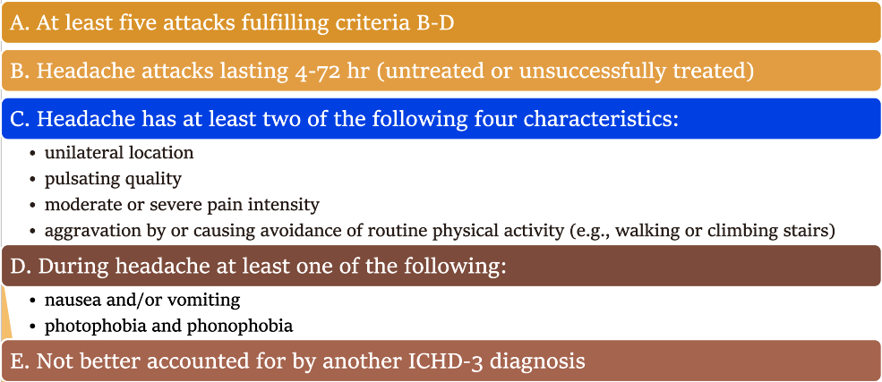
International Classification of Headache disorders
The International Classification of Headache disorders criteria for migraine, ICHD 3​ ​

Slide 14
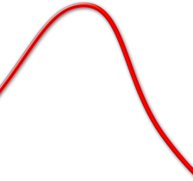











Migraine: A Continuum of Symptoms
Premonitory
Aura
Early Headache
Advanced Headache
Postdrome
Fully reversible
Neurological changes: Visual somatosensory
Mood changes
Fatigue
Cognitive changes
Muscle pain
Food craving
Dull headache
Nasal congestion
Muscle pain
Unilateral
Throbbing
Nausea
Photophobia
Phonophobia
Osmophobia
Fatigue
Cognitive changes
Muscle pain
Preheadache
Mild
Moderate
Severe
Post headache
Time
Headache
Notes:
Key point: Migraine is manifested clinically as a constellation of symptoms that evolve through the
various phases of a migraine attack; clinical experience indicates that symptoms typically associated
with each phase of an attack often recur during other phases of the attack, resulting in a continuum of
symptoms, rather than a succession of distinct phases.
CLINICAL PHASES OF MIGRAINE¹
A migraine attack can take days to develop and resolve; headache is only 1 of several symptoms associated with migraine.¹
Although the symptoms of migraine often overlap, the classic view is to separate an attack into phases.¹
The Premonitory Phase¹
Seventy percent of patients suffering from migraine with or without aura experience premonitory symptoms.¹
Premonitory symptoms are often seen as predictors of the headache attack. ¹
Mood alterations, muscle pain, food cravings, cognitive changes, fluid retention, and yawning are common premonitory symptoms.¹
Eighty-three percent of subjects with premonitory symptoms could predict over 50% of their attacks.¹
The Aura Phase ¹
An aura involves focal, reversible neurologic symptoms that often precede the headache.¹
Aura symptoms are believed to arise from an electrical disturbance called cortical spreading depression (CSD); it occurs in approximately was 15-32% of migraine attacks.^{1,2,3}
Auras are not always followed by headache pain; such auras are called acephalgic migraine or migraine aura without headache.¹
The Headache Phase¹
The headache phase is subdivided according to headache pain intensity into an early phase and an advanced phase.¹
Early headache: mild pain without the associated symptoms of migraine¹
Advanced headache: moderate to severe pain with the associated symptoms of nausea, photophobia, phonophobia, or disability; used to confirm a migraine diagnosis¹
Postdrome¹
Phase of migraine-associated symptoms beyond the resolution of the headache; often entails significant disability that can last for 1 or 2 days.¹
Cady R et al. Headache. 2002;42:204–216.
Linde M. Acta Neurol Scand. 2006;114:71–83.
Linde M. Cephalgia. 2006; 26; 712–721.
References:
Cady R, Schreiber C, Farmer K, Sheftell F. Primary headaches: a convergence hypothesis. Headache. 2002;42(3):204–216
Launer LJ, Terwindt GM, Ferrari MD. The prevalence and characteristics of migraine in a population-based cohort: the GEM study.
Neurology. 1999; 53(3): 537—542.
3. Rasmussen BK, Olesen J. Migraine with aura and migraine without aura: an epidemiological study. Cephalalgia.1992;12(4):221-228
.
.
R1, p 206, C1,
Par 1, L 1-14
R1, p 206, C1,
Par 2, L 1-12
and C2, Par 1,
L 1-9
R1, p 206, C2,
Par 2, L 1-13
R2, p5, para3, L1-2
R3, p222-3, last para-cont, L11-12
R1, p 206, C2,
Par 3, L 1-7
and p 207, C1,
Par 1 and Par 2
R1, p 207, C1,
Par 3, L 1-4
Cady, p 206, C1 Par 2 L 1-12
Cady, p 206, C2 Par 2 L 1-4
Cady, p 206, C2 Par 3 L 4-6
Linde, p 71, C2 Par 1 L 4-9
Cady, p 207, C1 Par 1 L 1-11
Linde, p 74, C1 Par 3 L 1-15

Slide 15


Migraine: Headache Not Always Gradual
Advanced Headache
Unilateral
Throbbing
Nausea
Photophobia
Phonophobia
Preheadache
Severe
Postheadache
Time
Headache Phase
Notes:
Key point: Even though the pain intensity usually increases gradually, in some
Patients the debut is more rapid.¹
Cady R et al. Headache. 2002;42:204–216. Linde M. Acta Neurol Scand. 2006;114:71–83.
Linde M. Cephalgia. 2006; 26; 712–721.
R1, p 73, C2,
Par 3, L 7-12
Reference:
1. Linde M. Migraine: a review and future directions for treatment. Acta Neurol Scand. 2006;114(2):71–83.
Linde, p 73, C2 Par 2 L 7-12

Slide 16
Myth : Visual auras occur in every migraine attack
Common misconceptions about migraine
Reality
Aura is a spreading electrochemical event in the brain surface within the brain’s cortex
30% of people with migraine experience aura and typically last 5-60 minutes, in some cases even longer
Aura can also be sensory, verbal, or motor including vertigo, numbness, slurred speech and unsteady gait.
Notes:
Migraine World Summit David Dodick MD

Slide 17
Reality
The character of head pain, if present at all, can vary between qualities such as stabbing, throbbing or crushing due to pressure
Throbbing pain is the most common descriptor of the headache involved in migraine, but symptoms are individualised
The head pain may also be stabbing, pulsating, or crushing due to enormous pressure
Some migraine attacks may not even include headache
Myth: Migraine head pain must be pulsating

Slide 18
Reality
Among people with migraine, only 15% of attacks are “side-locked”, meaning they always occur on the same side.
60% of attacks have head pain on one side
40% of attacks have head pain on both sides
Some attacks have no head pain but may have aura and other migraine symptoms such as dizziness
Randolph W. Evans; Practical Neurology
Myth: Migraine head pain is always one sided

Slide 19
Reality
Some individuals may experience status migrainosus, an attack lasting over 72 hours
ICHD-3 criteria limits an attack to 4-72 hours, but this does not reflect everyone’s experience
The benchmark for adequate relief following acute/abortive medication for migraine is 50% reduction in symptoms within 2 hours
Status migrainosus is a diagnosis for an attack lasting over 72 hours, which may become a debilitating, chronic condition
Myth: Migraine attacks only last 4-72 hours

Slide 20
Patients presenting to primary care mostly have migraine
Landmark study
Conclusion is “consider all disabling episodic headache with a normal physical examination to be migraine” : 94%
If patients were given a diagnosis of migraine by the assessing primary care physician, 98% met ICHD criteria for migraine
Of patients with non migraine diagnosis of primary headache, diary evidence showed 82% had migraine, most common misdiagnosis is tension type headache or sinus headache
Notes:
Landmark Study, Tepper et al ,Headache 2004 Oct,44(9):856-64

Slide 21
Diagnostic Thinking Errors
Tension Type Headache
Patient presenting with neck pain and pain at the back of the head who is currently stressed diagnosed as tension headache
70% of migraineurs get neck pain during a migraine attack
40% of migraine pain affects both sides
Migraine pain can be anywhere on the head
Stress is a common trigger for migraine
Anchoring on first diagnosis and premature closure

Slide 22
Sinus Headache
Diagnostic Thinking Errors
Bilateral Facial pain with a blocked nose
An observational study¹ showed (N = 2991) 88% of people with a self-diagnosis or medical diagnosis of sinus headache were classified with migraine based on ICHD criteria.
Migraineurs get cranial autonomic symptoms, pain can be bilateral
Diagnostic momentum: once a diagnostic label has been assigned to an individual or by an individual it is difficult to remove that label.
Ascertainment bias:
thinking is shaped by what we expect to see: the patient with recurrent “sinus headache”
Notes:
1. Foroughipot M et Al, Causes of Headaches in Patients with a Primary Diagnosis of Sinus Headache. Eur.Arch.Oto-Rhino-Larhngol.2011;268: 1593-1596

Slide 23
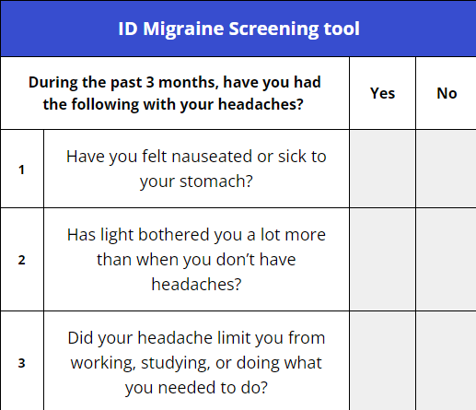
ID Migraine: 3 screening questions
Two or more positive responses suggests the patient has migraine.
The positive predictive value is high at 0.93%. In other words, for 100 patients diagnosed as having migraine by the ID Migraine screener 93 will have migraine.

