Slide 1
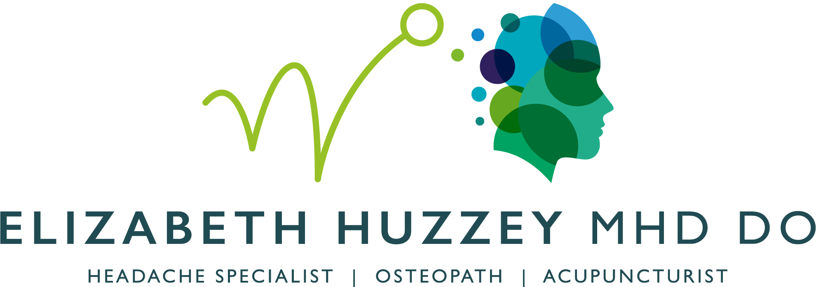
The Osteopathic Approach to Headaches
20th March 2026
Notes:
Good afternoon.
Thank you to Racheal for inviting me to talk to you about the osteopathic approach to the headache patient.
overview
What is osteopathy.
What is it osteopaths actually do.
Which headache patients could benefit from osteopathic ttt.
Practicalities where can we find them, how do we know they are registered, professional and safe.
How does that differ from physios and chiros.
May I get an idea of what you already know about osteopaths.
Raise your hand if you know an osteopath, if you have worked with an osteopath and if you have been treated by an osteopath.

Slide 2
Notes:
Where do you find an osteopath, what do they do and who do they see.
There are around 5000 osteopaths practising in the UK providing 30,000 consultations every year. The title is protected in law, 4/5 year training and graduate qualified to be first contact practitoners, to know when and how to treat and just as importantly when not to treat. We are strictly regulated by our governing body GOsC ensuring professional standards, fitness to practice, ethics, CPD, compliance and consent.
According to the most recent NCOR data, You will find most in the community, on your high street, or in GP and dental practices. They operate as sole practitioners or small groups practices. A small number are employed within the NHS on the same contracts as physios.
Most patients self refer through word of mouth or a private health care provider. Sadly the NHS stopped funding osteopathy in 2016. Conditions treated are LBP 36%, upper back 27% neck pain 15% and most relevant for today 9% for head and facial pain.
Equal numbers are male and female can range from babies to geriatrics but the largest cohort are tween ages of 35-55.

Slide 3
What does an Osteopathic Consultation look like?
30-45 minutes
Cost: £65-90.00 (£45 - £160.00) /treatment
A case history
Examination
Diagnosis
Discussion of findings and treatment plan
Consent
Manual therapy
Health care advice
Self-management support
Listening and talking

Slide 4
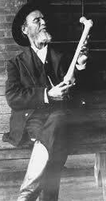
Principles of osteopathic medicine
The human body is a unit, an integrated organism in which no part functions independently.
It has the capacity to self-regulate and self heal.
Focus on the relationship between structure and function.
A Rational Treatment Approach
Notes:
story of osteopathy and principles.
Before we concentrate on osteopathic approach to the headache patient it may be helpful to understand the principles of Osteopathy. It all started with this handsome man.
A dr in the mid 19th century in the mid states of America had 4 sons die of meningitis and the medicines available in the day were unable to help.
He had been bought up on a farm butchering his own animals. He not only saw the aniamls as cuts of meat and offal but also the neurovascular bundles, fascia and lymphatics. He noticed a correlation tween structural and functional changes and the idea of osteopathic medicine was born. There is big branding problem as most think osteopaths only treat bones , However it comes form the way Still used bones as levers to move the body , pumping fluids, creating space and releasing areas of restctiona and tension in an attempt optimise body function. This classic osteopathic approach was used to treat diseases and gained popularity in the US. With the huge advances of moderm medicines this approach became irrelevant. Osteopathy then became used mostly for MSK disorders but the underlying principles are still taught and to a greater or lesser extent do form the basis of how osteopaths approach care
The 4 princpiles of osteopathy are...

Slide 5
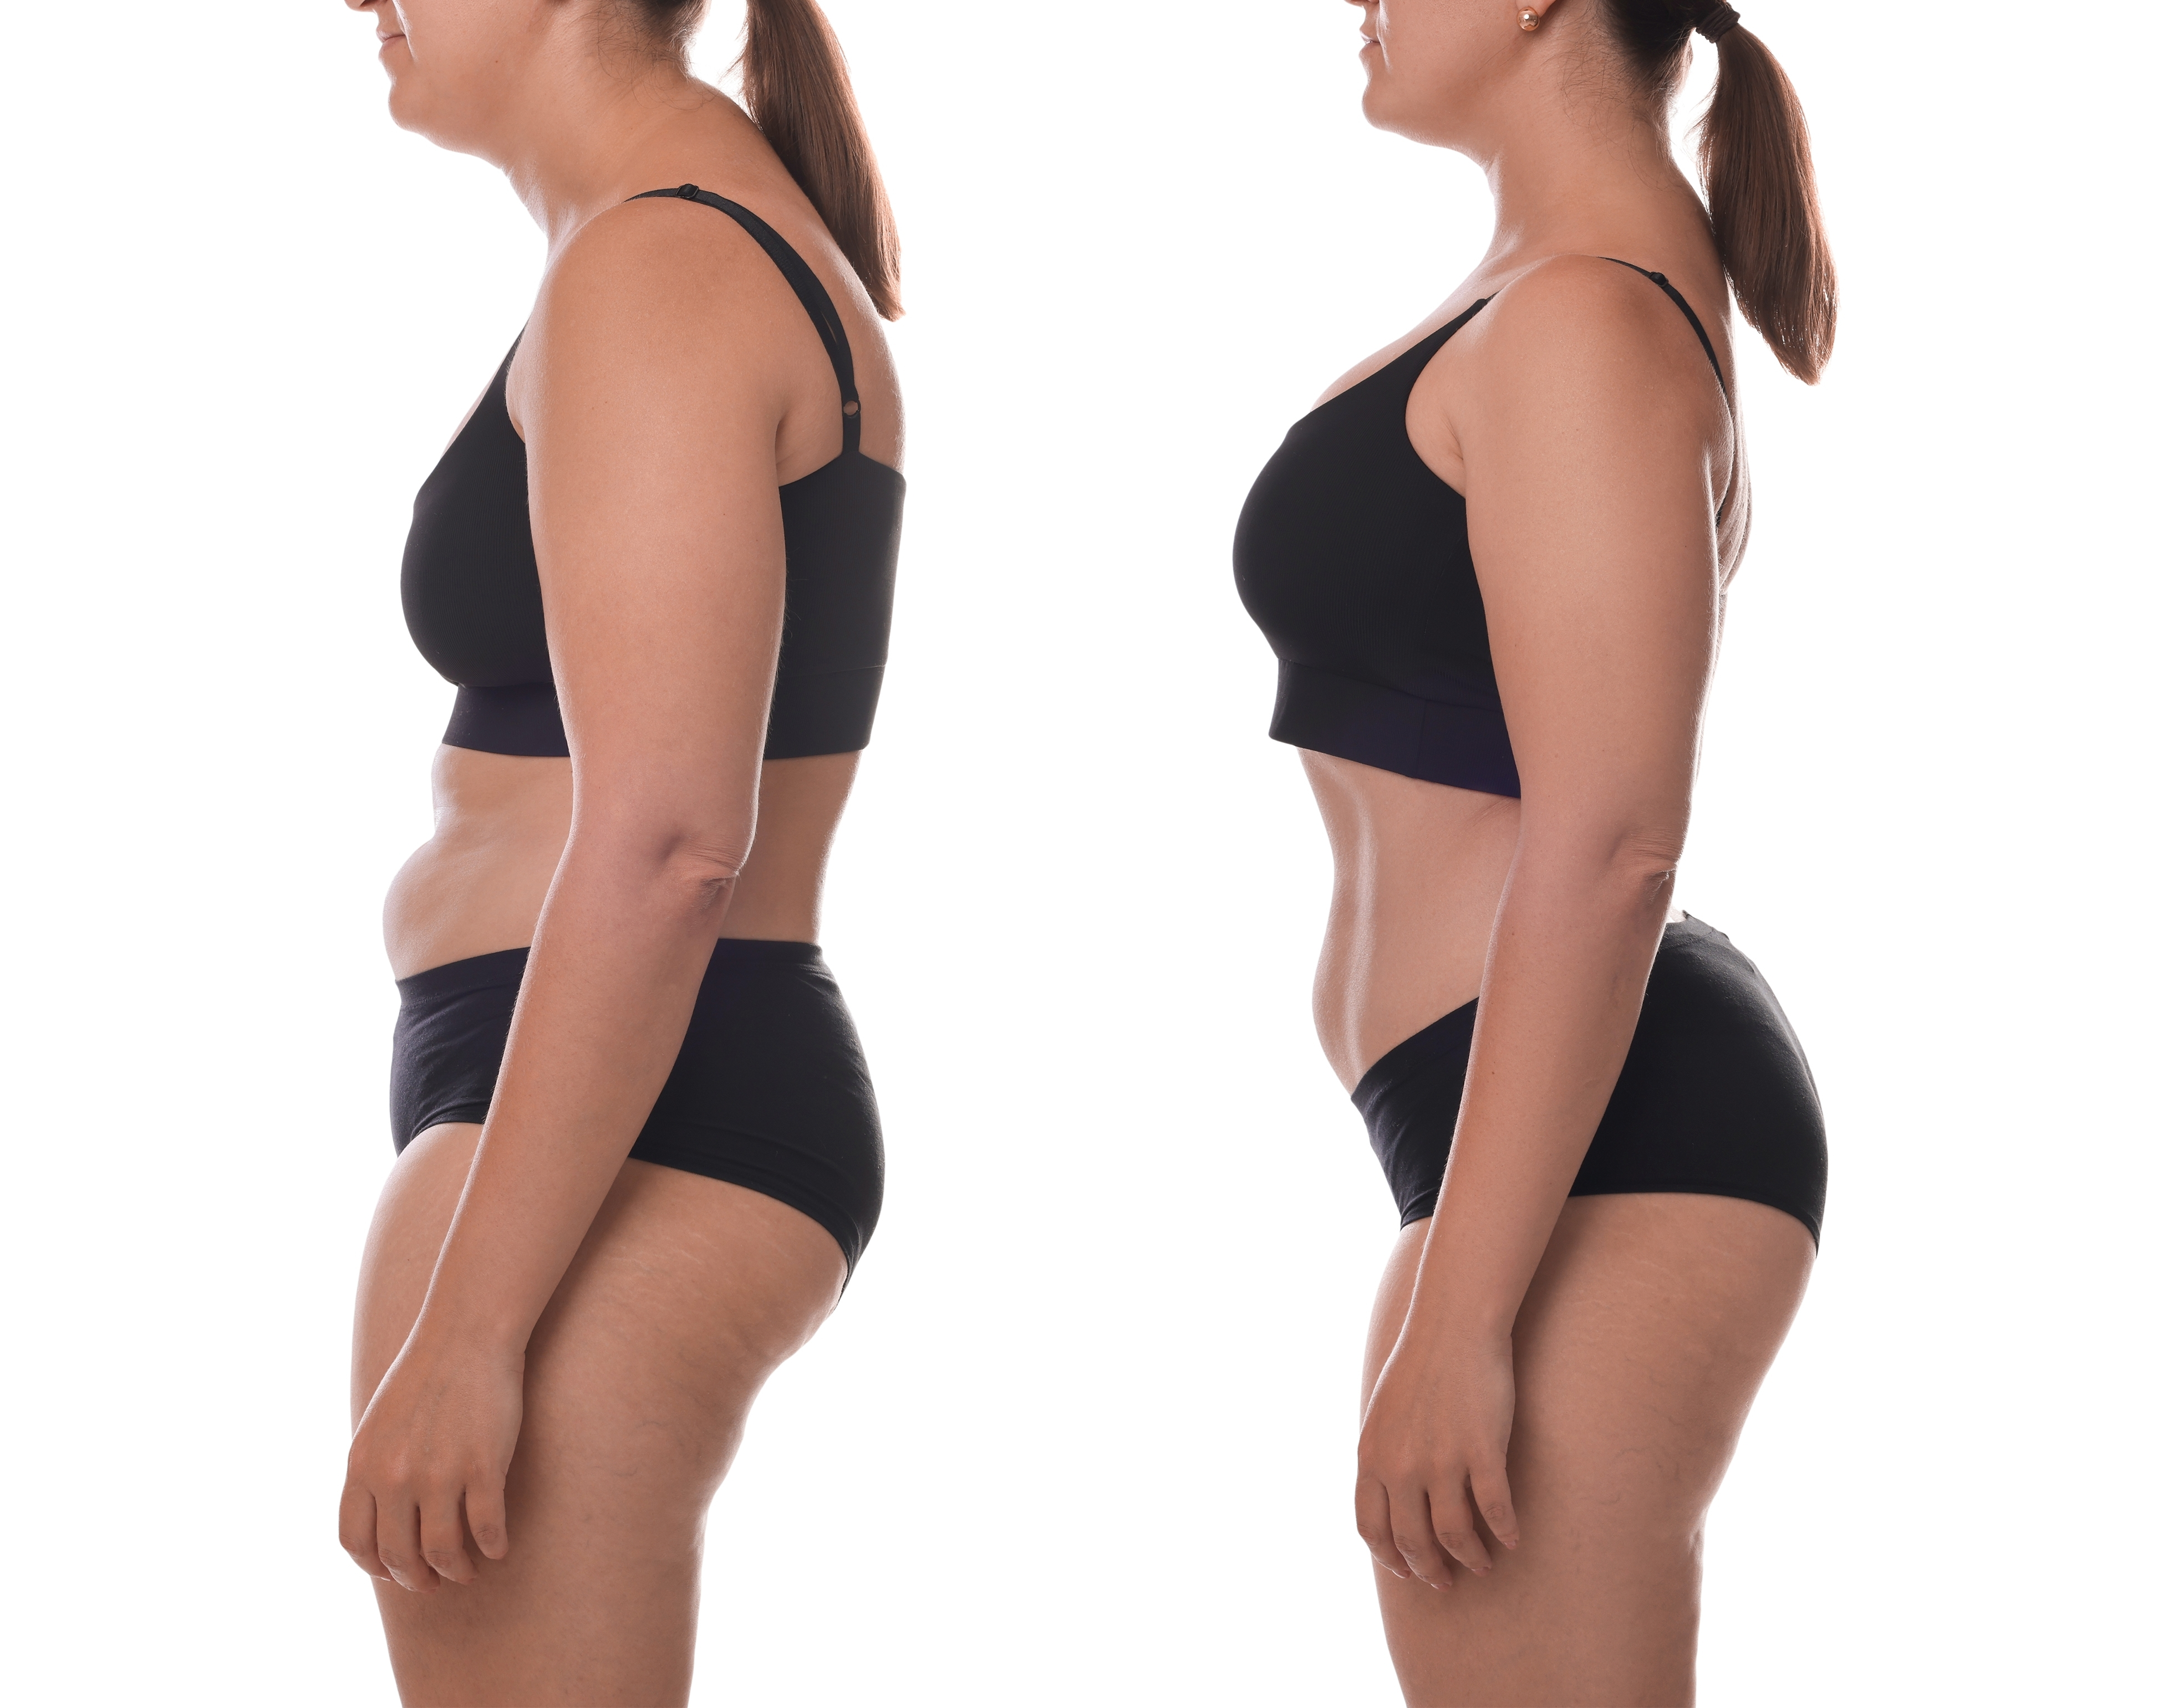
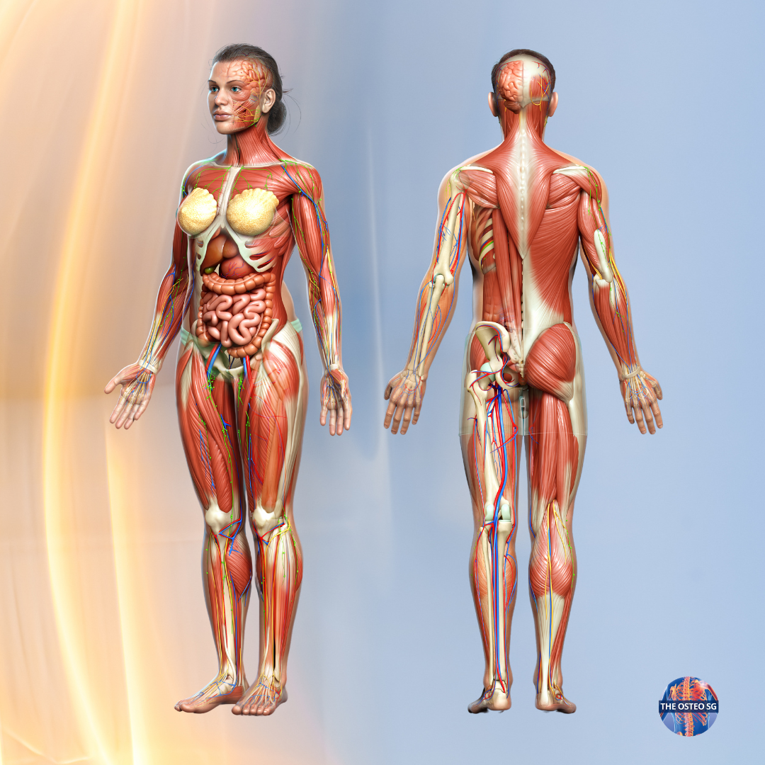
Notes:
Slide 3
When an osteopath look at the patient they are looking at it with the eyes of a body engineer.
Looking for points of loading, points of stress, postural patterns, emotional or physical. How different areas interrelate.
In the headache patient:
Pelvic tilts, exaggerated spinal curves, a slumped shoulder girdle, the effect on the t inlet, the overuse and underuse of muscle groups, fascial drag thorugh the throat and loading at the pivots and keystone.
Then consider these structural changes and what p[otential influence they could have on blood flow, venous and lymphatic drainage, the peripheral and autonomic nerve pathways serving the the head and neck

Slide 6
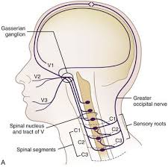
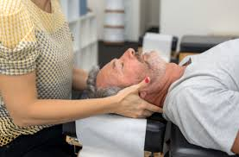
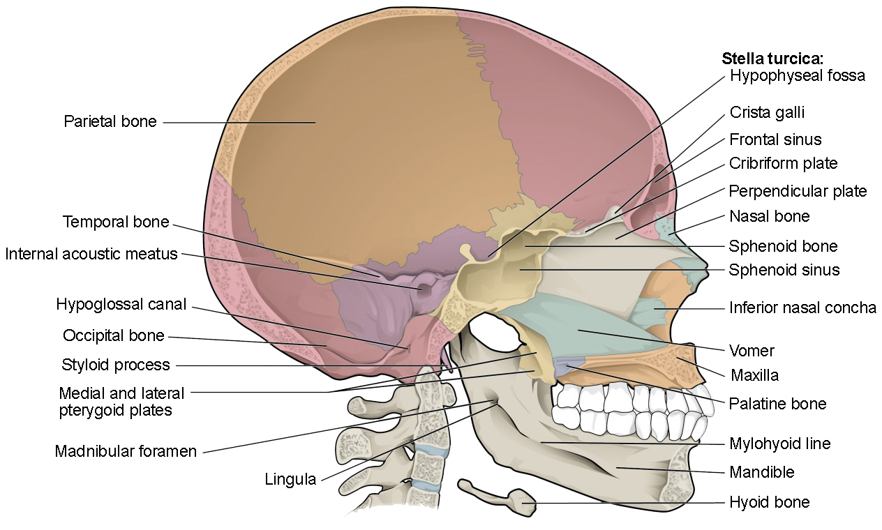
What does treatment look like?
Notes:
So when it comes to treatment of the headache patient one important area of direct importance is the upper c spine and the cranial base.
We know the C1-3 share the same neurology as headache disorders
Convergence of sensory input from the upper cervical spine at the TCC main junction box for headache disordes
Evidence suggests Noxiuos afferent input from Upper cervical facets, Upper cervical muscles,C2-3 intervertebral disc are thought to be potential drivers for all headache disorders not just CGH. This science supports many ttts from WATSON, ACUPUNCTURE and supports what osteopaths have to be effective in practice.
Osteopathic Treatments include gentle techniques to create space, relieve pressure and length the spine, relax the subocioatl muscles and reduce neural tension.
But. Not in isolationa as wethe osteopath will look address the other curves thoracic lumbar and pelvis that indirectly influence how the head balances on the neck with a combination mobilization, soft tissue, myofascial, HVT to open the t outlet, to encourage mvt in the thoracic kyphosis, to release the lower lumbars and balance the pelvis.

Slide 7
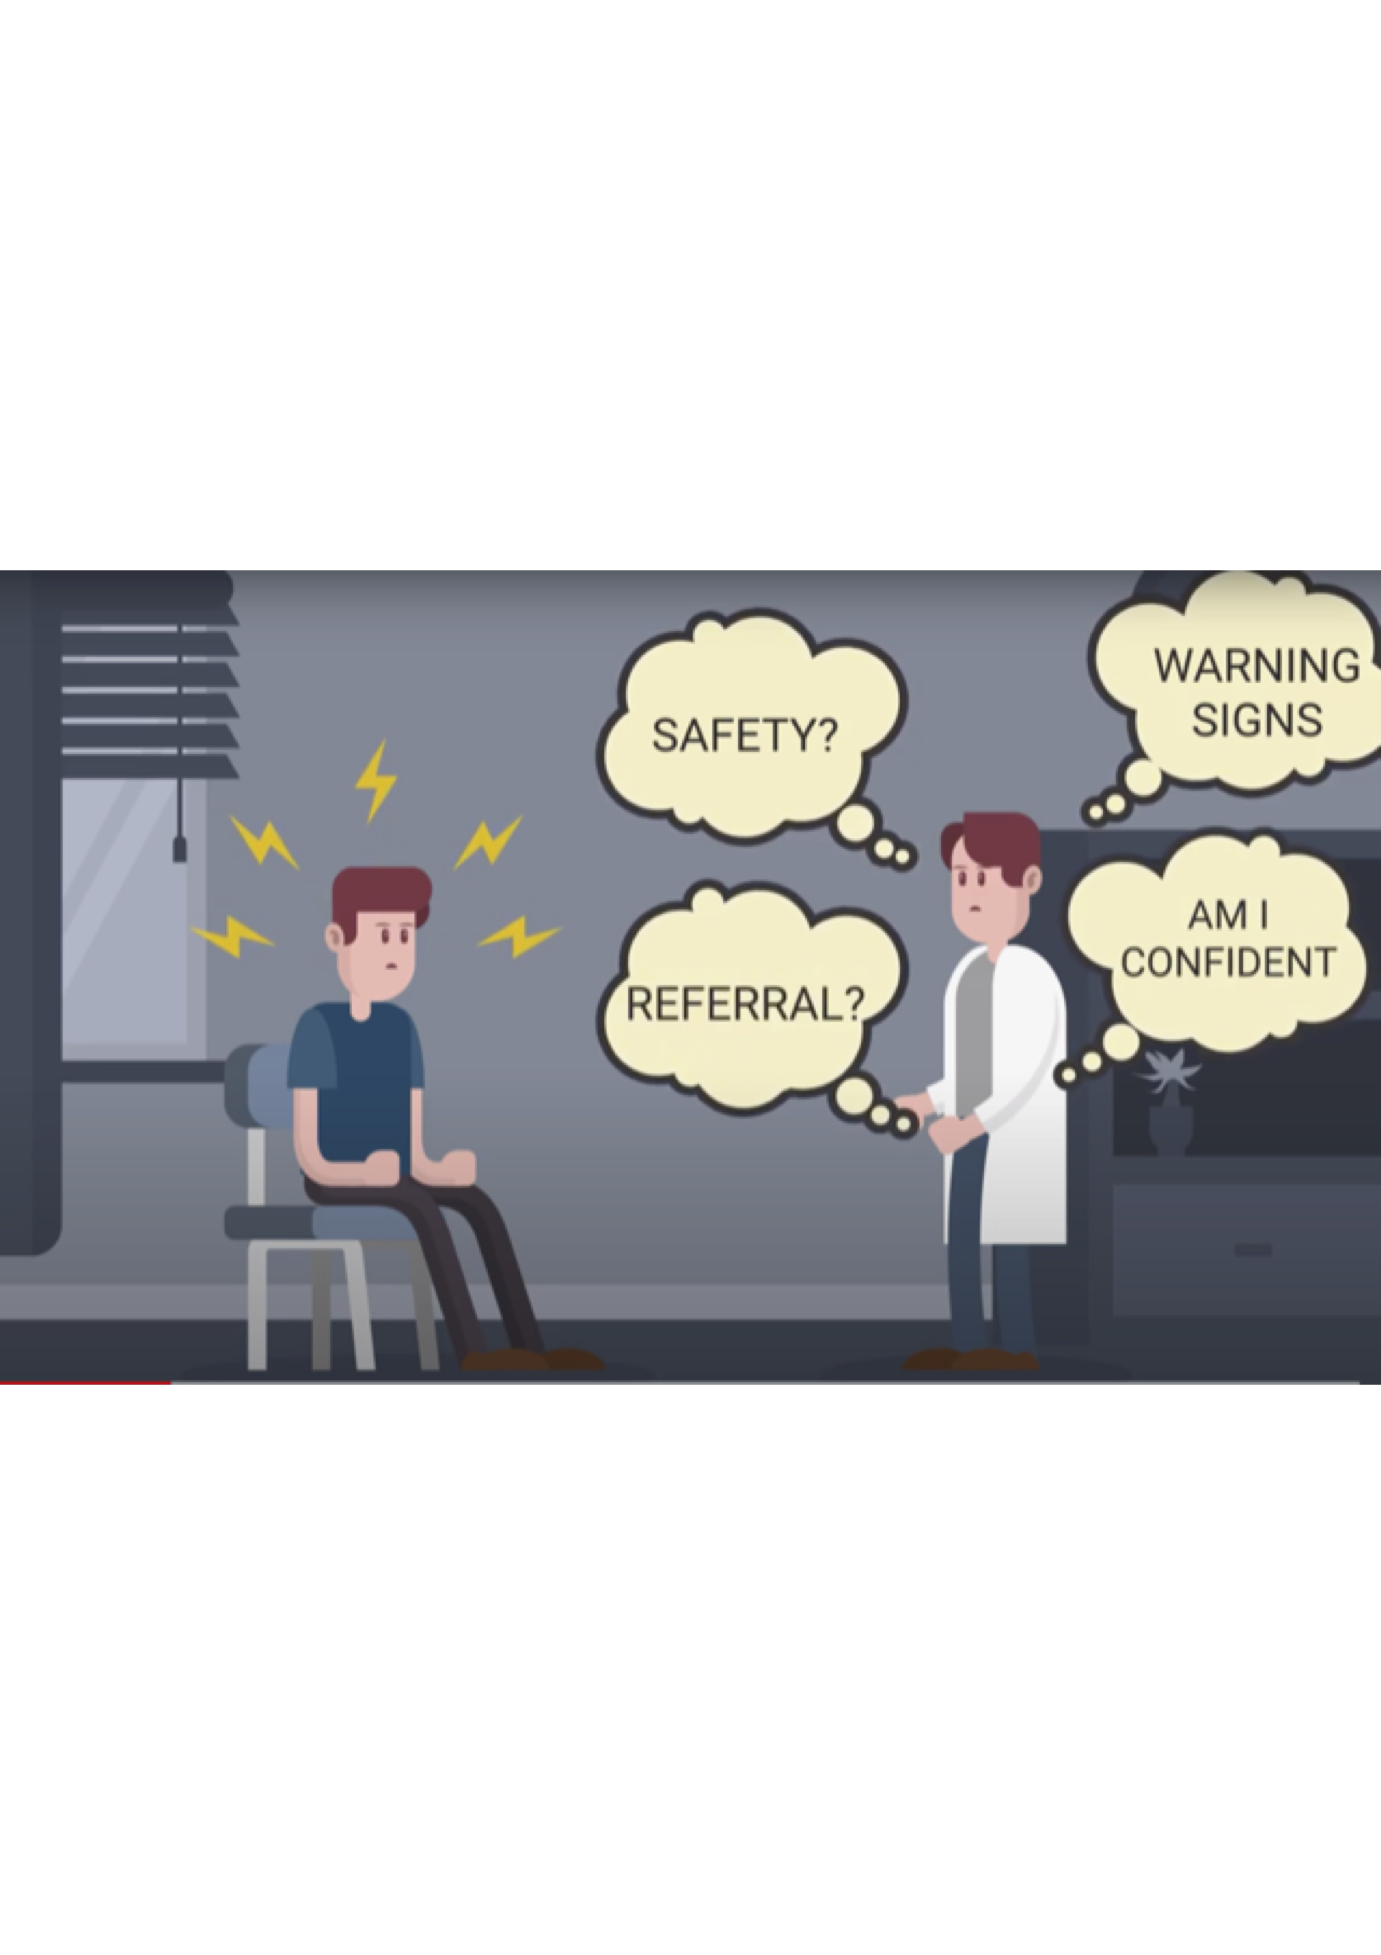
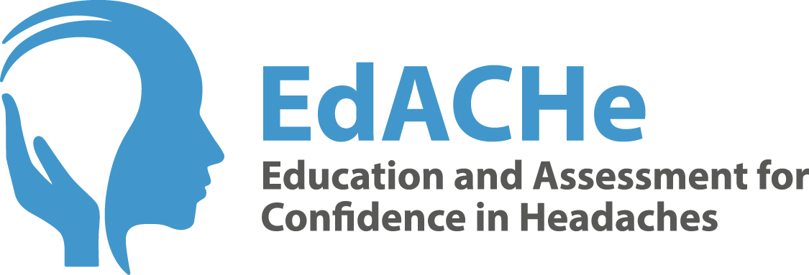
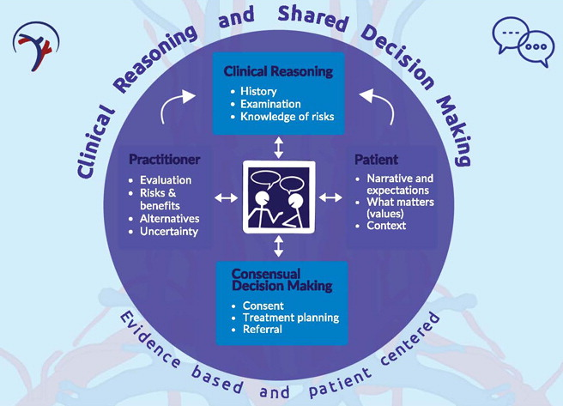
International Framework for Examination of the Cervical
Region for Potential of Vascular Pathologies of the Neck
Prior to Musculoskeletal Intervention IFOMPT
Notes:
This is how osteopaths have been treating headaches for 180 years.
Although effective for some It does over-simplify what we all know are very complex disorders. Over the last 15 years OPHM have had a mission to improve education, collaboration and rersearch I did MHD in Copenhagen Helena Edinburgh the result was the EdACHe project. Aninymous survey. , Online e learning and face to face to educate osteopaths to better understand the headache patient, recignise phenotypes underatnd the underlying mechanisms and the advances in ttt options.
What should a headache patient expect from their osteopath:
Website: should signpost for the main red flags and/or 6 month rule
Full headache Case history. Ask the right questions
Most likely Diagnosis ICHD-3
Refer?
Examination could include BP 3 min neuro screening
Contraindications: upper c ligament instability, potential vascualar pathologies IFOMPT, risk v benefit developed based upon the best contemporary evidence and experts using rigorous consensus methods.
Evidence based assessment CFRT, R&R,
Comorbidities,
All Treatment options
Treat osteopathically where demonstrable mechanical dysfucntion
Manage patient expectations
Initial 3-4 treatments and review
Maintenance ttt
Self management/LIFESTYLE ADVICE

Slide 8
Benefits
Professional standards
Patient Centered
Time
Experts in hands on diagnosis and treatments
Therapeutic touch
Accessible, affordable
Continuity of care
Drug free option
Safe
High patient satisfaction
Limitations
Hypothosis v science
Is not a cure
No effect on centrally driven headache disorders
MA MO TAC PTHD IIH SIH
No effect in absence of related mechanical dysfunction
Not all Osteopaths understand headache disorders YET
Passive treatment but can not build strength

Slide 9
Notes:
Now for The question every one wants answered What the difference? I asked AI
Physiotherapy, osteopathy, and chiropractic are all regulated healthcare professions that focus on restoring movement and reducing pain, but do differ in their core philosophies and treatment methods.
Which one should you choose?
Choose Physiotherapy: available on NHS. In the mainstream medical framework so more suppprt and funding for better research and science which all 3 benefit from. Less hands on more structured, exercise-led plan for long-term management.
Choose Osteopathy: If you prefer a whole-body, hands-on approach that looks at how and your overall lifestyle affect your pain.
Choose Chiropractic: If your pain is centered in your spine or neck and you prefer immediate, focused manual adjustments.
In reality there can be a lot of overlap. I have worked and learned from colleugues, strength in collaboration so I tell my patients find someone you feel comfortable with , whose diagnosis makes sense and in. whose hands you feel safe and whose treatment feels effective .

Slide 10
Useful links
Risk v benefits for manual treatment in cervical spine
IFOMPT https://www.jospt.org/doi/epdf/10.2519/jospt.2022.11147
EdACHe Headache online course for osteos/physios/chiros
https://www.cpdcourses.hsu.ac.uk/edache_education_and_assessment_for_confidence_in_headaches
To Find an Osteopath. https://www.iosteopathy.org/
General Osteopathic Council https://www.osteopathy.org.uk/home/
NCOR https://ncor.org.uk/
Training clinics in London and Kent:
BCNO Headache Clinic https://www.bcom.ac.uk/bcom-clinic/our-clinics/headache-clinic/ (£28-16.00)
ESO Headache Clinic https://www.eso.ac.uk/eso-clinic/our-clinics/headache-clinic/
Elizabeth Huzzey DO MHD Central London W1 and Hertfordshire Clinics (£68—140.00)
admin@elizabethhuzzey.co.uk
www.elizabethhuzzey.co.uk

Slide 11
Osteopathy is a regulated profession.
All Osteopaths study for 4-5 years and are trained to be first contact practitioners
Not all osteopaths understand headache disorders YET
BUT we are working hard for progress for headache patients
An accessible, affordable and a safe option.
Potentially helpful for a lot patients with headache disorders where there a significant biomechanical dysfunction
Headaches most likely to respond are side dominant, demonstrate CFRT, Reproduction and Resolution
Consider in non classic presentations
Notes:
Take home messages

Slide 12
THANK YOU
admin@elizabethhuzzey.co.uk
www.elizabethhuzzey.co.uk
Notes:
I firmly believe that Headache patients are best served when disciplines collaborate
invitation

