Slide 1

MTIS – GLASGOW 2026
Cluster headache
Trigeminal neuralgia
Exertion
Dr Pete Miller Specialty Dr Royal Devon University Hospital Trust
Previously GPwSI headache

Slide 2
Cluster headache

Slide 3
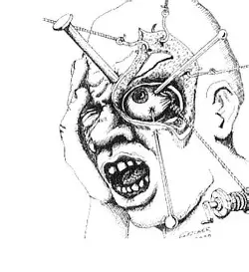
Cluster headache
Why is it important
Making a positive diagnosis
Being aware of differentials
Treat pro-actively
Oxygen
Preventatives and future treatments
Ar.inspiredpencil.com

Slide 4
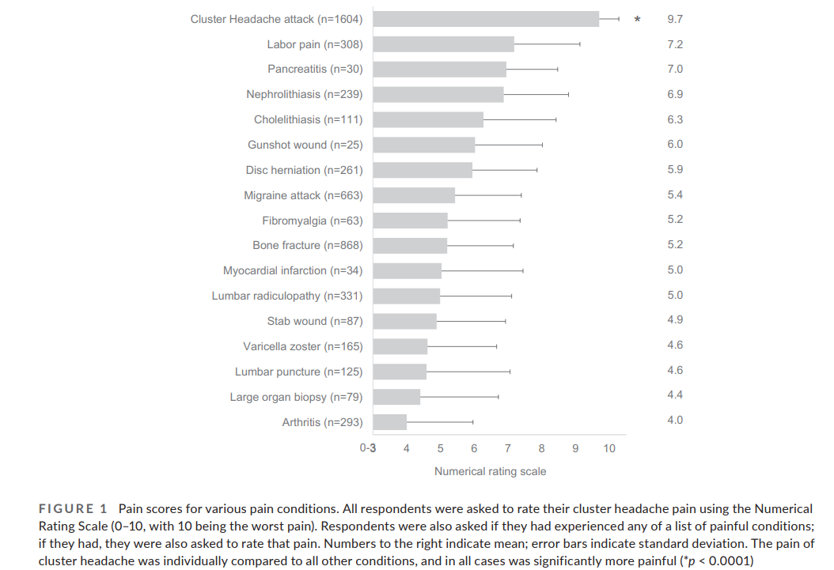
Why is it important – intensely painful
Burish MJ, Pearson SM, Shapiro RE, Zhang W, Schor LI. Cluster headache
is one of the most intensely painful human conditions: Results from the International Cluster
Headache Questionnaire. Headache. 2021;61:117–124. https://doi.org/10.1111/head.14021

Slide 5
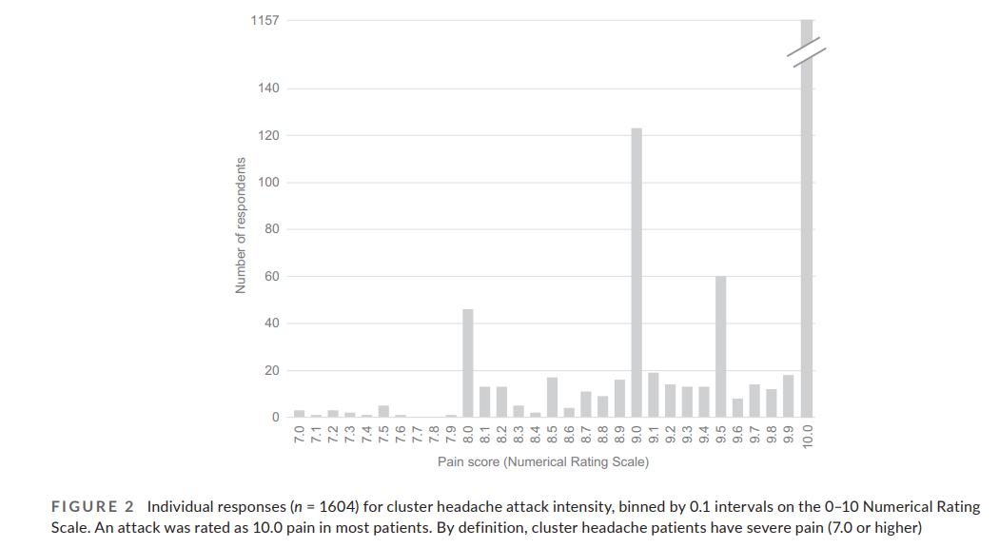
Why is it important - intensely painful
Burish MJ, Pearson SM, Shapiro RE, Zhang W, Schor LI. Cluster headache
is one of the most intensely painful human conditions: Results from the International Cluster
Headache Questionnaire. Headache. 2021;61:117–124. https://doi.org/10.1111/head.14021

Slide 6
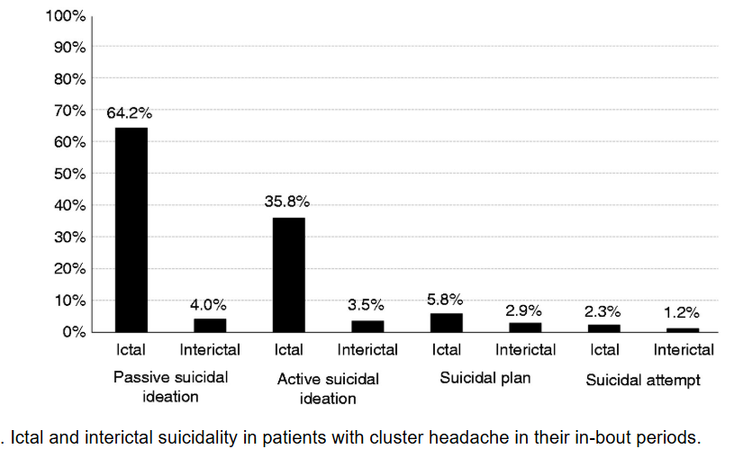
Why is it important – suicide risk
Lee et al Increased suicidality in patients with
Cluster headache. Cephalalgia 39(1249-1256) 2019

Slide 7
Simple headache paradigm
What type of headache
Secondary
Primary
Migraine
Cluster
Other

Slide 8
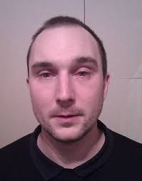
Proactively diagnose Cluster headache

Slide 9
4 key features
Unilateral
Up to 3 hours
Autonomic
Agitation

Slide 10
Proactively diagnose Cluster headache
AUTONOMIC SYMPTOMS
  Unilateral to pain
  Often extent related to pain level
  Disinhibition of trigeminal autonomic reflex by hypothalamus
PARASYMPATHETIC ++++
  VII nerve
Lacrimation, conjunctival injection, nasal symptoms, aural fullness, periorbital swelling
SYMPATHETIC --
Miosis, ptosis

Slide 11
Diagnosing Cluster headache
Supporting
Core

Slide 12
Cluster headache
Other features 1
Symptoms
Pattern
Usually V1 ( can affect V2,teeth, neck)
Can have persistent autonomic features eg Horners
Can have aura (14%)
Can have premonitory symptoms like migraine eg irritable
Can have migrainous symptoms
Can have shadows beforehand
Tends to build up in frequency before reducing
Triggers within bout and quickly eg alcohol, heat, exertion, smell
FH 6-8%
Male predominance
Usually stops in 60s

Slide 13
Cluster headache
Other features 2
Usually alternate day to three daily but can be up to 8 a day
Can have circadian rhythm , similar time each day
Usually a link to sleep eg 90 minutes after sleeping or 2am
Can be seasonal – spring , autumn
Episodic vs chronic

Slide 14
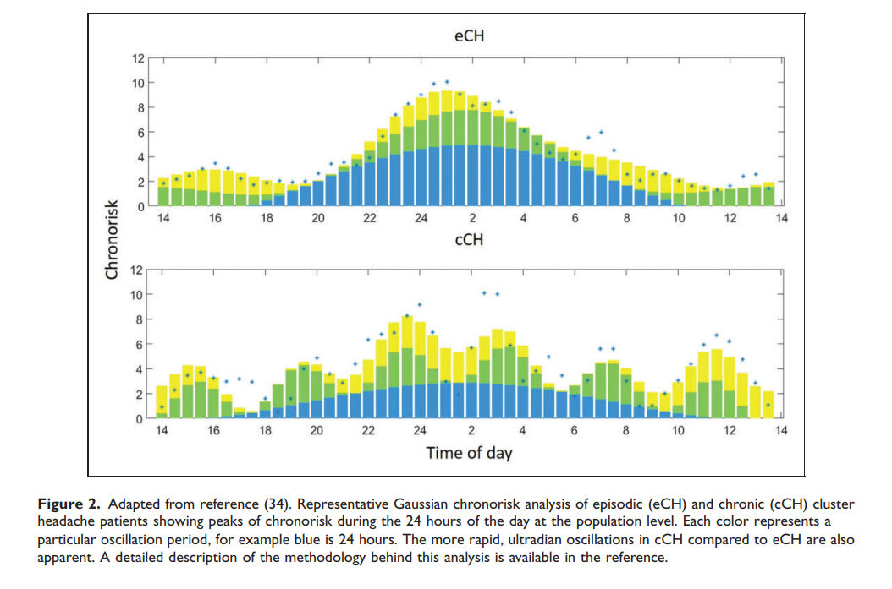
Circadian variation
Belin and Barloese The genetics and chronobiology of
Cluster headache Cephalalgia 2023

Slide 15
Make positive diagnosis, be careful and be pro-active
It is NOT any really painful headache or any headache with eye watering
Or any headache that wakes you up
Think do I need to image ?
could this be migraine ?
could this be a different cephalalgia ?
how can I treat acutely – o2 , triptans
ECG + consider verapamil
Oxygen
OUCH

Slide 16
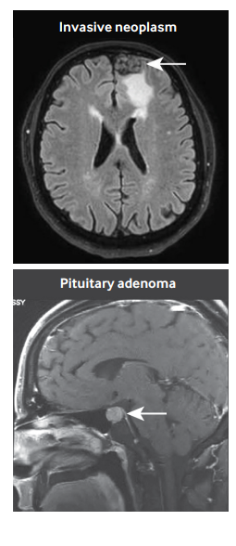
Do I need to Image?
Yes
No need for pituitary imaging
Schindler and Burish BMJ 2022; 376

Slide 17
Could this be migraine?
Migraine
Cluster
Reduced energy
Lasts 4 hours or more
Unilateral or bilateral
Migraine triggers
Sensitivity ++
Restless
Lasts less than 3 hours
Unilateral
Daily, annual pattern
Autonomic ++
Women more likely to have sensitivity than men

Slide 18
Could this be a different cephalalgia?
Think of these if :
Very short episodes
Very frequent episodes
Indomethacin
TN is TRIGGERED
TN is usually V2,3
Usually older person gets TN
TN
Cluster
Hemicrania continua
Paroxysmal hemicrania
SUNHA

Slide 19
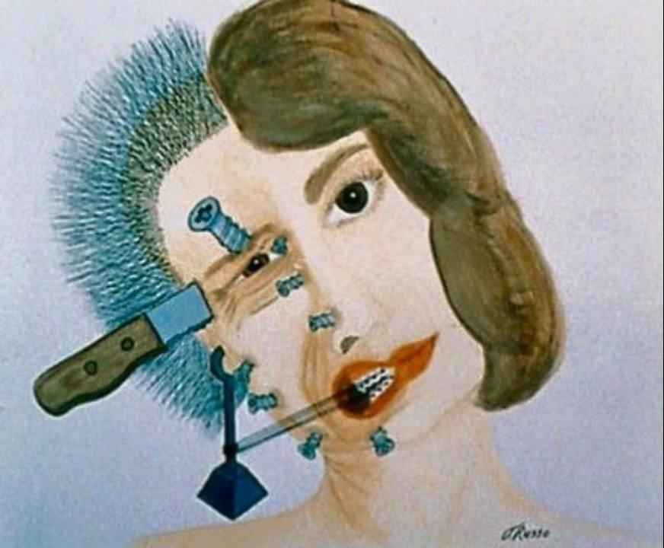
Trigeminal neuralgia
TRIGGERED
    Lightly tactile
    + spontaneous
Usually V2, V3
Right > left
Up to 2 minutes shocks
Electric, severe
Mean age of onset 53-57
Doesn’t wake
Refractory period
Frequency vary variable , at least 40% > 10 a day
2/3 relapsing remitting
Up to 50% concomitant pain ?
Assoc anxiety and suicide
Ar.inspiredpencil.com

Slide 20
Trigeminal neuralgia 2
Think about :
Carbamazepine
Does this need investigation ( young , constant, at night, spontaneous, not responding.. )
    Compromise and secondary
Is it migraine ?
Is it another cephalalgia?
Is it something else eg teeth?
Meaningful control in 90%
Start 100-200mg daily
Up to 1200 mg daily
Quick release; liquid forms
Dizziness, ataxia, drowsy
Na +
DRESS , rash
50 % failure 5 to 10 years?
Less tolerated in women

Slide 21
Trigeminal neuralgia 3
Other treatments
Oxcarbazepine - no if rash with CMZ
Lamotrigine - interacts with CMZ, slower, rash
Gabapentin – similar doses to pain
Pregabalin
Baclofen
(Botox)
Lacosamide
Acutely lidocaine
sumatriptan injection
SURGERY
  Stereotactic radiosurgery (SRS)
    If secondary eg MS
    Takes a long time to improve
    Day case
  Decompression
    If classic better than SRS
    Best less than 3 years from symptoms
    60 – 90 % response

Slide 22
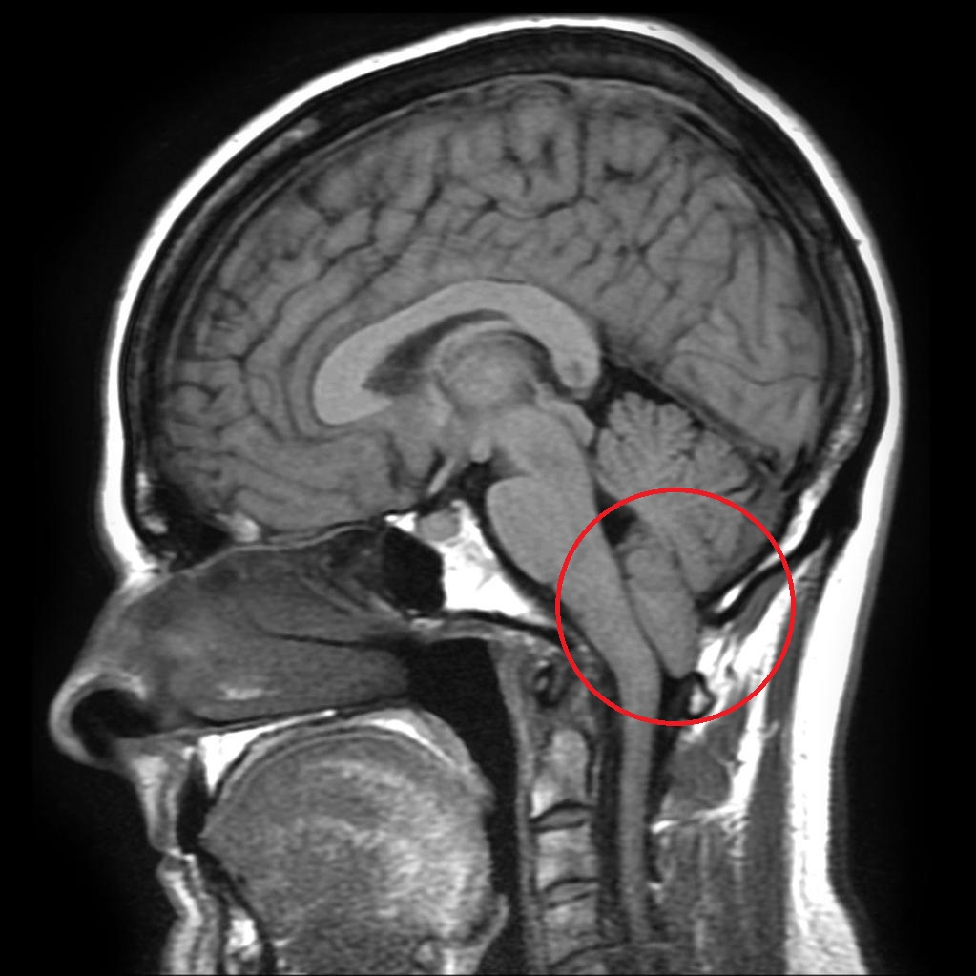
Other triggered headaches –exertional headaches , sudden onset
COUGH
Valsalva ( cough, sneeze, laugh, stoop, strain )
Up to 30mins but may be dull for hours
Ave age 50s
40% have secondary cause eg chiari
Geekymedics.com

Slide 23
Headache associated with sexual activity and exertion
Pre-orgasmic and orgasmic
4 -12 % orgasmic have SAH
One study suggests majority had RCVS ( reversible cerebral vasoconstrictor syndrome )
Need MRA
Post coital might be low csf pressure
SSRI, stimulants might trigger
Rx beta blockers, indomet
Most resolve
Exertional headache
Will worsen migraine usually
Purely triggered by exertion needs imaging although usually normal
Treat beta blockers, indomethacin, as migraine

Slide 24
Make positive diagnosis, be careful and be pro-active –cluster headache
Think do I need to image ?
could this be migraine ?
could this be a different cephalalgia ?
how can I treat acutely – o2 , triptans
ECG + consider verapamil
Oxygen
OUCH

Slide 25
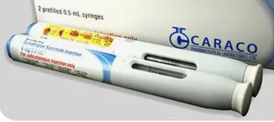
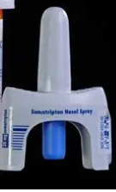
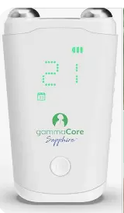
Cluster headache treatment eg European academy neurology 2023
ACUTE
TRIPTANS
Subcut triptan 6mg ( 3mg) .
Maximum 12mg a day
Nasal sumatriptan 20mg , zolmitriptan 5-10mg
Oral zolmitriptan 10mg
High flow Oxygen ( 7 – 12 l). Non re-breather or demand valve mask
Gammacore
Lidocaine nasal spray
In nostril or cheek
Octreotide
Coffee or energy drink ( caffeine, taurine)

Slide 26
Oxygen
Useful questions for Hoof
High flow 12 litres
Non rebreathe mask
Demand valve
15 minutes + 5 minutes after resolved
HOOF
In Scotland refer to secondary care
Can get rebound and agitation makes it difficult to sit still
Do you smoke?
Does anyone smoke?
Smoke alarm?
Multi occupancy?
Any falls
Consent to share info and email
Share hoof terms and conditions

Slide 27
Triptans
Zomig tablet licensed but only one
Nasal/ sc quicker : ¾ 6mg suma at 15 mins ; 6/10 nasal zomi 10 and suma 20 at 30 mins
Some risk MOH if history or FH of migraine
Side effects: nausea, lethargy, tight feeling
CI in IHD
Oral triptan night before can help
 | Dose (mg) | Maximum daily
Sumatriptan nasal | 10-20 | 40
Zolmitriptan nasal | 5-10 | 10
Sumatriptan injection | 6 ( 3) | 12

Slide 28
Cluster headache treatment
Preventatives
Verapamil
Prednisolone : 100mg reducing by 20 every 3 days
Melatonin : 12mg . ½ hour before bed
Lithium
Topiramate. Higher doses eg 50-800
Other tablets : baclofen, (valproate)
ONI ( occipital nerve injection )
Gammacore
CRGP - galcanezumab
Think :
How quickly do I need to treat?
Pred 35 % cessation at day 7
Verap 7% “ “ “ “
Similar day 28 65% / 67%
How long am I going to treat for ?
Interactions and side effects

Slide 29
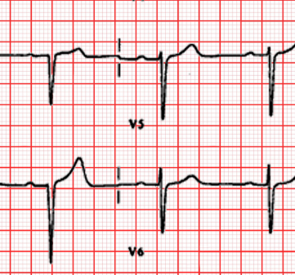
Verapamil
Patient Information Sheets – The Exeter Headache Clinic
Wide variety of receptors , may affect circadian rhythm
Start 80 mg tds. Ordinary release not SR
Increase by 80 mg every 2 weeks with ECG monitoring until treated
Then ECG monthly until 6 months . Then 6/12
Heart block, constipation, oedema, TEETH – dentist
80% respond at 360mg a day
Go straight back to helpful dose

Slide 30
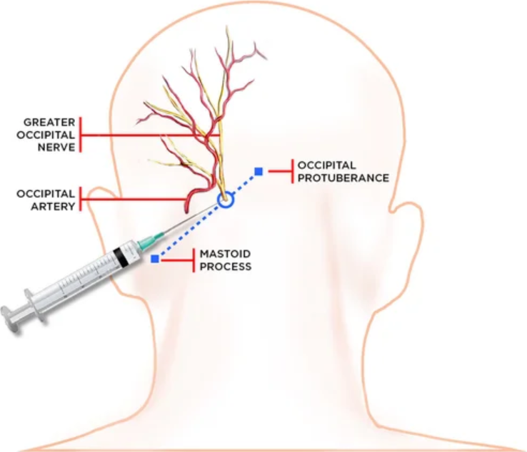
Occipital nerve injection

Slide 31
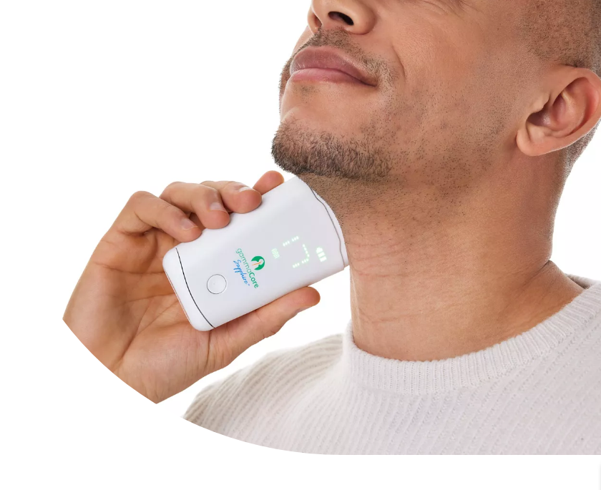
Gammacore
Ipsilateral
6 minutes ( 3 x 2mins) twice a day
2 bursts of 6 minutes as needed
Gammacore.co.uk

Slide 32
Cluster headache emerging areas
More investigation on CGRP treatments
Psychedelics
    5HT2a rec ag . Long lasting . Limited doses. Eg LSD, psilocybin . Mostly surveys
High dose vitamin D
    Anecdotal . Ongoing trial
Occipital nerve stimulation
Deep brain stimulation
SPG ( sphenopalatine ganglion ) stimulation
Intracutaneous zolmitriptan
PACAP -38
Inflammatory biomarkers

Slide 33
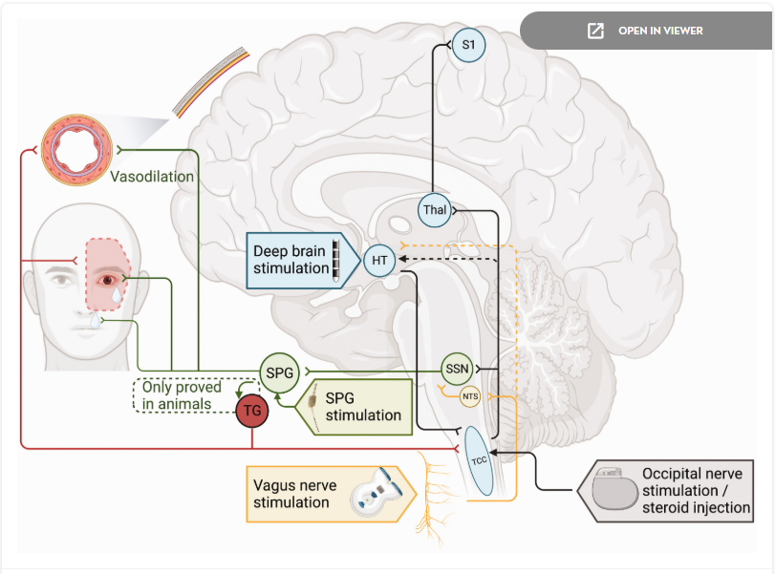
Neuromodulation in cluster headache
Management of cluster headache : treatments and their mechanisms Peng and Burish Cephalalgia 2023

Slide 34
Cluster headache
Why is it important
Making a positive diagnosis
Being aware of differentials
Treat pro-actively
Oxygen
Preventatives and future treatments
Ar.inspiredpencil.com

