Slide 1
Surviving the ten-minute headache presentation
David Kernick.
Exeter Headache Care.

Slide 2

www.exeterheadachecare.co.uk

Slide 3
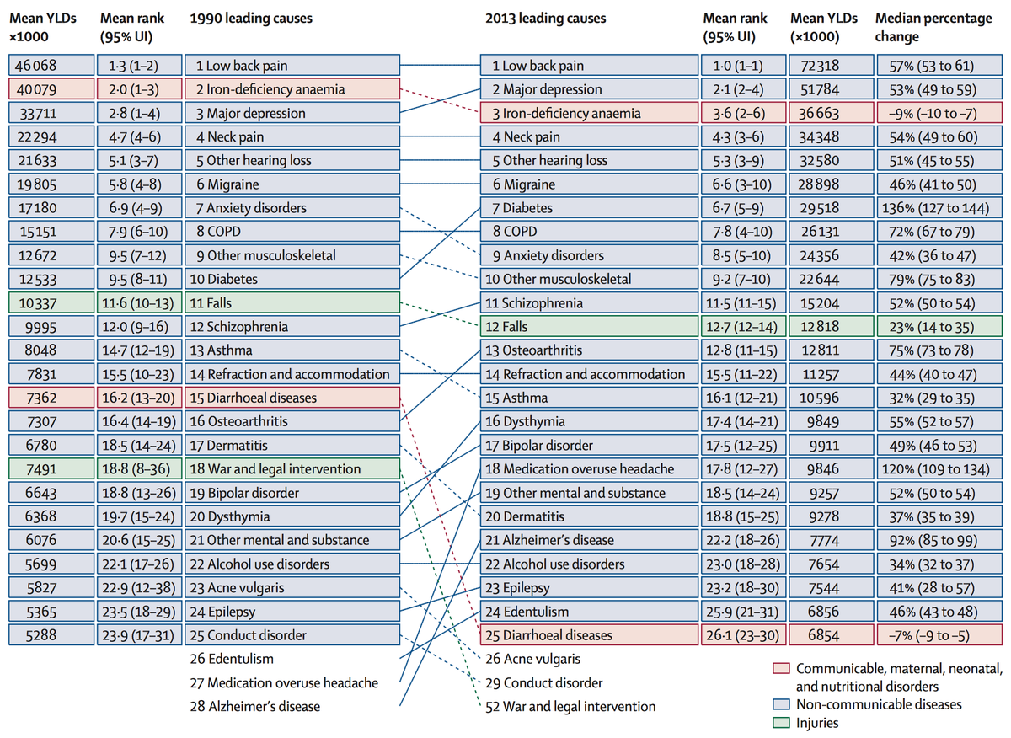
WHO 2016

Slide 4
Rule of thumb
Under 50 – Why is this not migraine
Over 50 – Why is this not temporal arteritis

Slide 5
Case 1 Short history New headache | Case 2 Complex headache
First ever headache Well | Constant headache past 24 months Not sleeping No clear features Abdominal pain Pains all over body On SSRI for anxiety and depression Worried as friend has brain tumour.
Two approaches very different
Perspective from primary care
Context of 1-3 ten-minute consultations

Slide 6
Make a diagnosis.
Offer simple explanation.
Treat.
Case 1

Slide 7
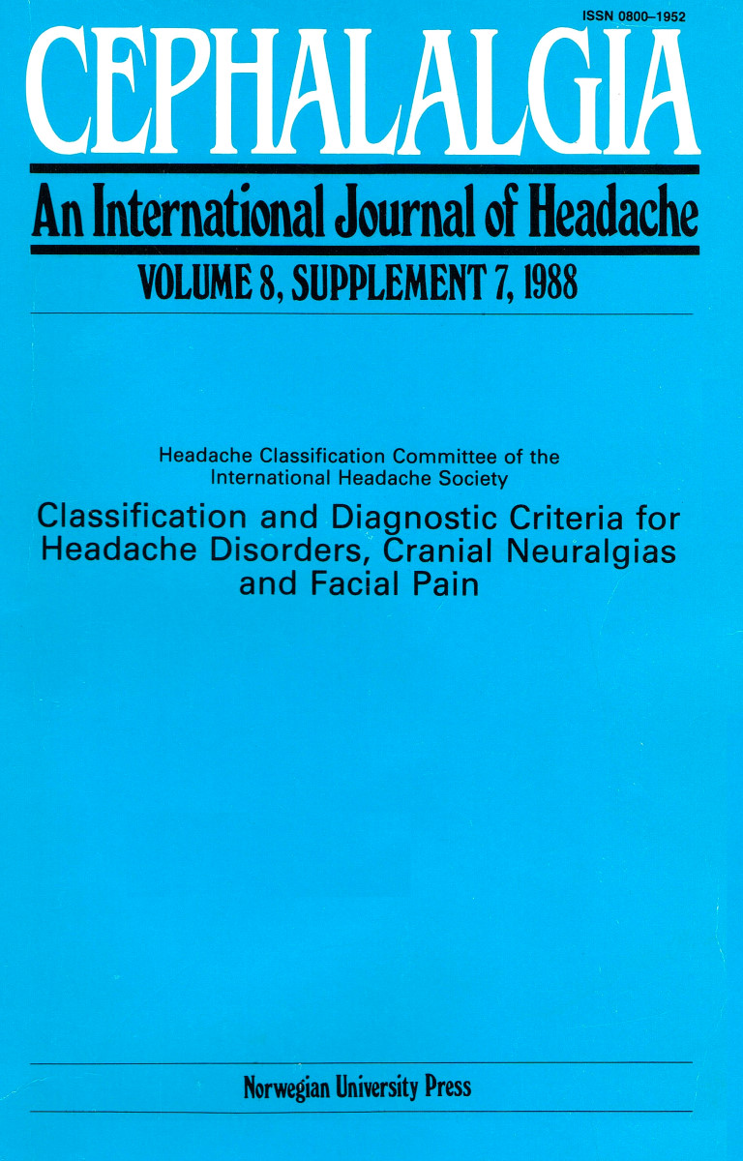
Primary Secondary
Migraine
Tension type
Autonomic cephalalgias (Cluster)
Traumatic
Vascular
Non-vascular (SOL)
Substance induced
Infection
Disturbed homeostasis
Facial structures
International headache society classification 2018

Slide 8
Step 1
Don’t panic

Slide 9
Step 2
Apply Bayesian statistics

Slide 10
Probability in primary care
Kernick 2008
Tepper 2004
Probability
94%
0.9%
0.7
%
0.1%
0.1%
Migraine Cluster Temporal arteritis Sub-arach Tumour

Slide 11
Step 3
Take a history - Its all in the history

Slide 12
The History
Family history?
Pain length and associated features?
What do you do?

Slide 13
Step 4
Basic examination
Inflammatory marker if >50 years

Slide 14
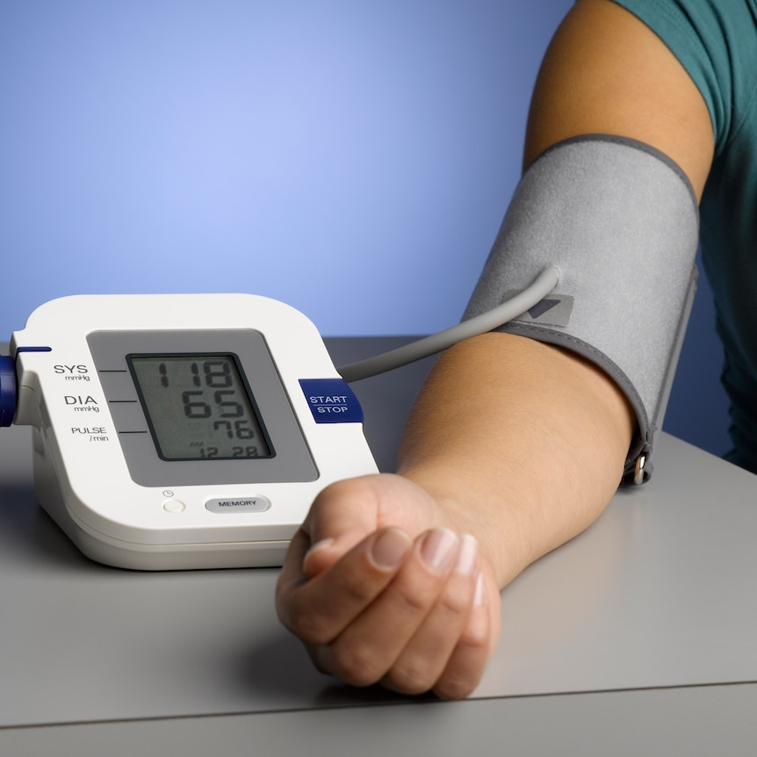
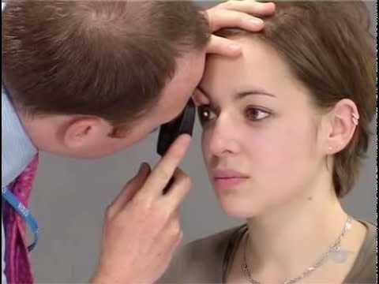
Examination first appointment

Slide 15


Step 5
Press a red or orange button?

Slide 16
Act right now
Papilloedema
Thunderclap headache
(New headache over 50)

Slide 17
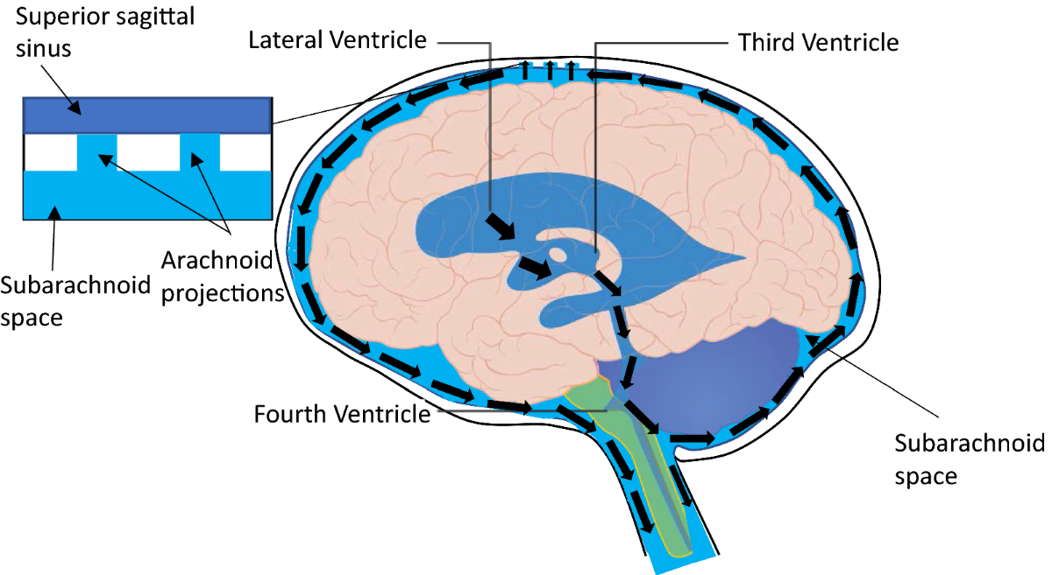
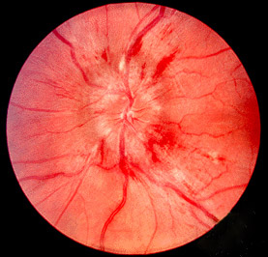
Obstructive pathology

Slide 18
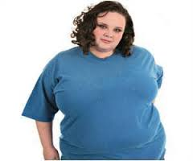
Headache
Pulsatile tinnitus
Visual disturbances
Idiopathic intracranial hypertension

Slide 19
Act right now
Papilloedema
Thunderclap headache
New headache over 50

Slide 20
Step 5a (Thunderclap presentations)
Address the inadequate management of A and E

Slide 21
Thunderclap Headache (Max one minute)
Subarachnoid Haemorrhage
Stroke
Third ventricle colloid cyst
Pituitary apoplexy
Venous sinus thrombosis
Carotid artery dissection
Spontaneous intracranial hypotension
Acute cervical instability
Reversable cerebral vasoconstriction syndrome
A and E excludes these
Hopefully A and E excludes these
A and E may not think of these
“Do you have lax joints?”
A and E will not think of this
“Have you had sex headache?
Are you on SSRI or recreational drugs?”

Slide 22
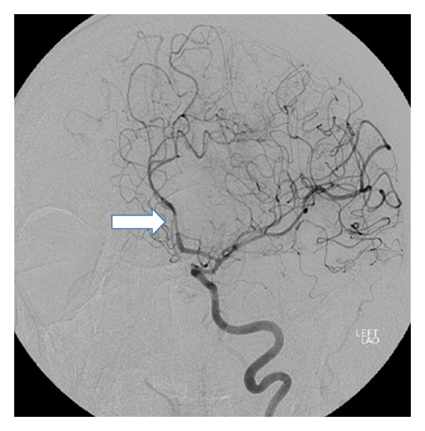
Need angiogram for diagnosis
Constriction is not immediate
Pain lasts up to three months
Reversible vasoconstriction syndrome

Slide 23
Act right now
Papilloedema
Thunderclap headache
New headache over 50

Slide 24
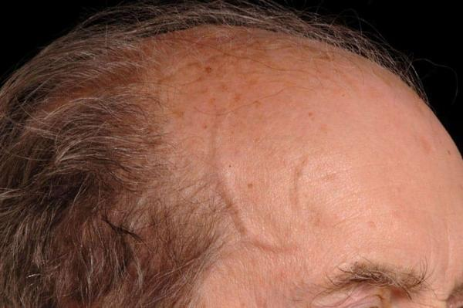
Follow local protocols

Slide 25
Act right now
Other red buttons

Slide 26
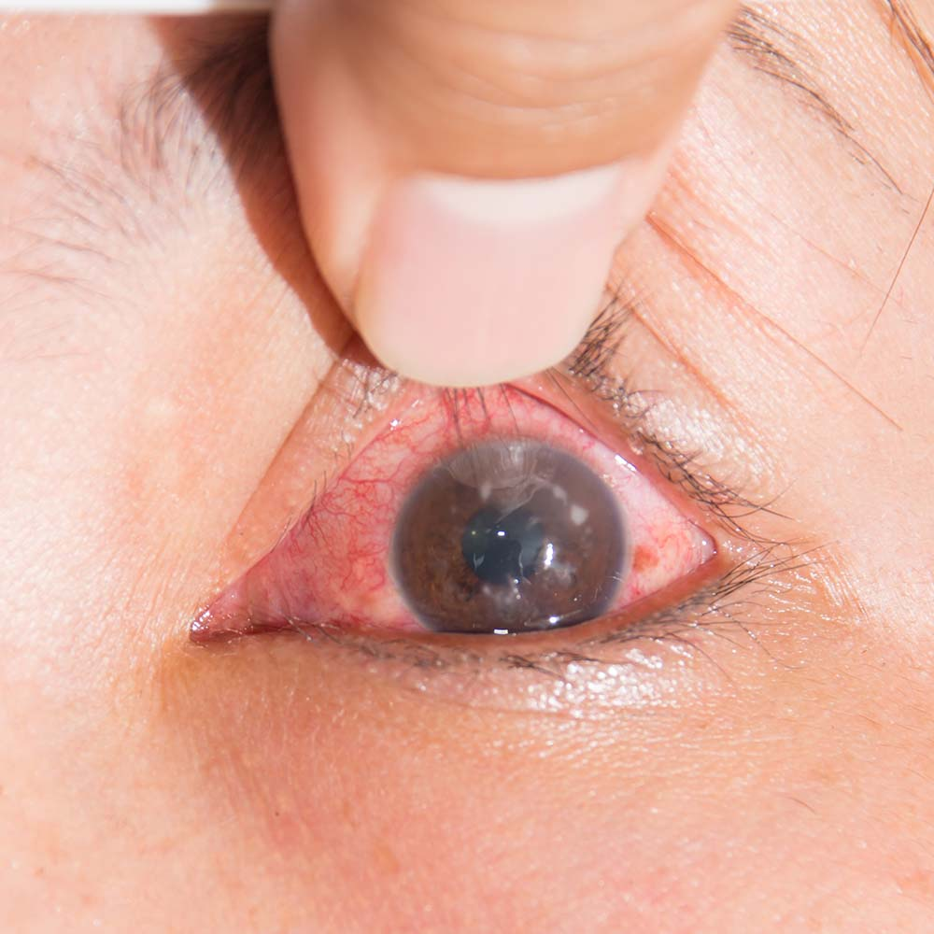

Slide 27
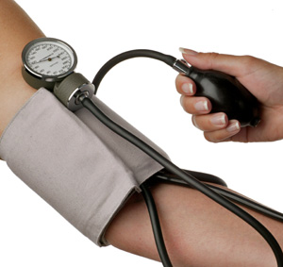
Malignant hypertension

Slide 28
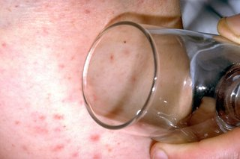

Slide 29
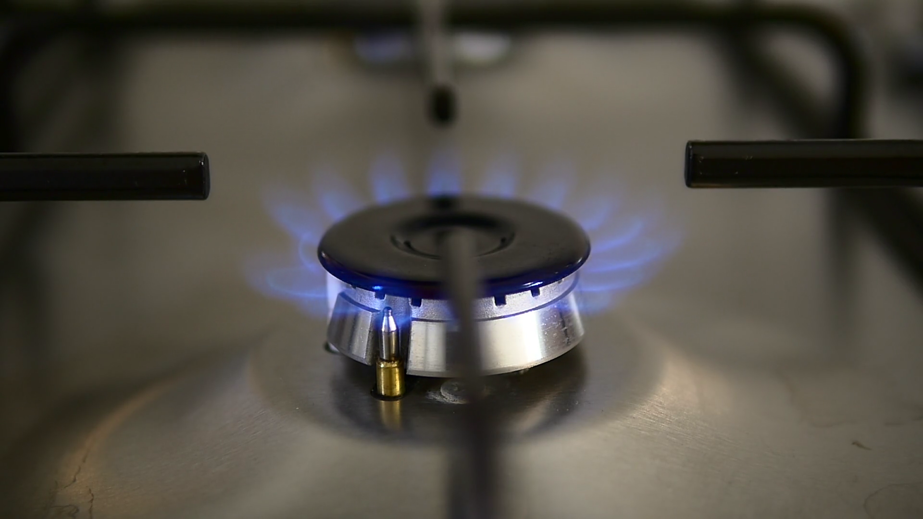

Slide 30
Act soon
Tumour
Cluster headache

Slide 31
Risk 1% +. Image
Headache with:
Red Flags
Only 10 % of tumour presentations
will be with isolated headache
Abnormal neurological symptoms or signs
New seizure
Headache triggered by exercise
History of cancer elsewhere, HIV

Slide 32
Orange Flags
Risk 0.1-1%. Image or watch closely.
Headache:
Aggregated by Valsalva manoeuvre
Headache with significant change in character (E.g. progressive, change in aura)
Awakes from sleep
New headache over 50 years
Memory loss
Personality change

Slide 33
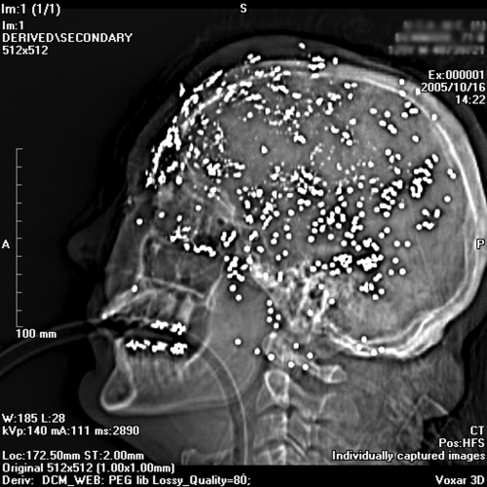

Slide 34




Step 6 – I’m not sure
Delaying tactic 1
Looking for a pattern to emerge

Slide 35
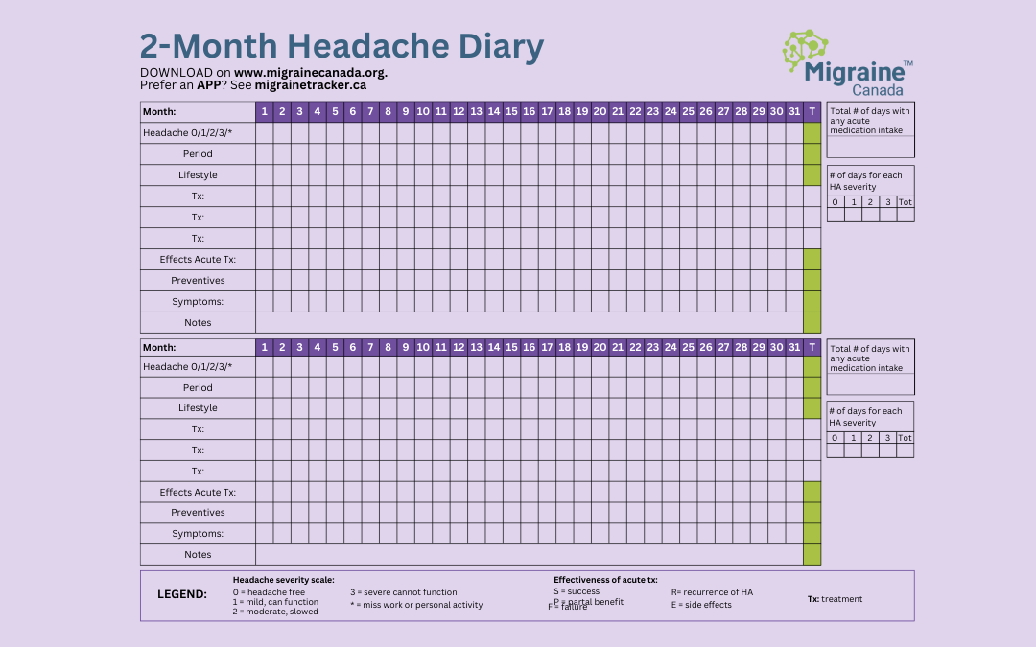
Reassure
Keep a diary
Safety net
See 4 weeks

Slide 36
Step 7 (Four weeks later) – I’m still not sure
Delaying tactic 2

Slide 37
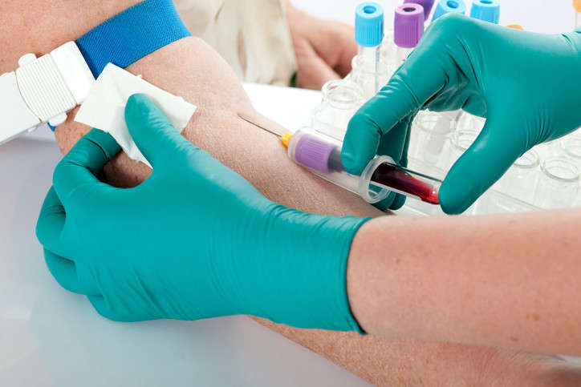
Basic neurological examination
Basic blood tests
FBC, Biochem, CRP, T4.
No other blood tests unless clinically indicated
Continue diary
Reassure
See 4 weeks

Slide 38

Giles Elrington
Three minute examination
YouTube
https://www.youtube.com/watch?v=c9-yUvZoZnQ

Slide 39
Step 8 (8 weeks) – I’m still not sure?
Repeat neurological examination.
Discuss imaging.
Do not image for reassurance. (Advise incidental abnormalities – 15%)
Consider advice or referral.

Slide 40
More about migraine
A story that makes sense

Slide 43
Hyperactive and hypervigilant brain
Impact of chronic
inflammation
Compromised
energy production
Migraine – what is the problem?

Slide 45
More about migraine
Treatment

Slide 46
Acute Treatment
Analgesic, NSAI, Antiemetic
Triptan. Failure to respond not a class effect, Not in CVD, different preparations
Rimegepant if two triptan failures

Slide 47
Migraine Prevention
When and what?

Slide 48
Preventive treatment not specific to migraine¹
Class | Drug | Dose recommendations
Beta-blockers | Propranolol | 10–160 mg daily
Angiotensin II receptor blocker | Candesartan* | 2–32 mg daily
Tricyclic antidepressants | Amitriptyline | 10-100 mg nocte
Anticonvulsants | Topiramate** | 25-100 mg daily
*Unlicensed
** Contraindicated in women of childbearing age without a pregnancy prevention plan in place and highly effective contraception
https://cks.nice.org.uk/topics/migraine/management/adults/ (last accessed February 2025)
https://www.nice.org.uk/advice/esuom33/chapter/Key-points-from-the-evidence (last accessed February 2025)

Slide 49

CGRP-blocking medications
 | Rimegepant¹ | Atogepant² | Erenumab³ | Galcanezumab⁴ | Fremanezumab⁵ | Eptinezumab⁶
Indication | Acute treatment of migraine with or without aura and preventive treatment of EM in adults | Preventive treatment of migraine in adults (EM and CM) | Preventive treatment of migraine in adults (EM and CM) | Preventive treatment of migraine in adults (EM and CM) | Preventive treatment of migraine in adults (EM and CM) | Preventive treatment of migraine in adults (EM and CM)
Standard recommended dose | 75 mg EOD | 60 mg QD | 70 mg (or 140 mg) monthly | 120 mg monthly (240 mg loading dose) | 225 mg monthly or 675 mg quarterly | 100 mg (or 300 mg) quarterly
4 or more migraine days a month
Stopping rules
Please see individual SmPCs for full prescribing information.
CGRP, calcitonin gene-related peptide; CM, chronic migraine; EM, episodic migraine;; MoA, mechanism of action; QD, once daily; SC, subcutaneous; SmPC, Summary of Product Characteristics.
1. MHRA. Vydura (rimegepant) SmPC. July 2023. [Last accessed: September 2024]; 2. MHRA. Aquipta (atogepant) SmPC. August 2023. [Last accessed: September 2024]; 3. MHRA. Aimovig (erenumab) SmPC. February 2024. [Last accessed: September 2024]; 4. MHRA. Emgality (galcanezumab) SmPC. September 2023. [Last accessed: September 2024]; 5. MHRA. Ajovy (fremanezumab) SmPC. April 2024. [Last accessed: September 2024]; 6. MHRA. Vyepti (eptinezumab) SmPC. October 2023. [Last accessed: September 2024].

Slide 50
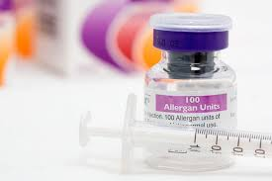
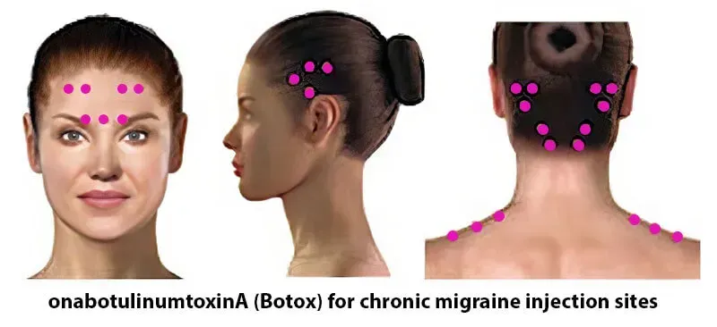
Botulinum toxin for migraine¹
1. Dodick DW, et al., Headache. 2010 Jun;50(6):921-36.

Slide 51
Non-pharmacological options

Slide 52
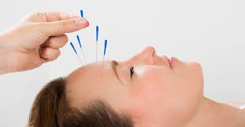
Acupuncture
NICE 2021
‘If both topiramate and propranolol are unsuitable or ineffective, consider a course of up to 10 sessions of acupuncture over 5–8 weeks’
Not available on NHS
Ou MQ, et al., Front Neurol. 2020 Jun 30;11:596
https://cks.nice.org.uk/topics/migraine/management/adults/

Slide 53
Supplements that may help with migraine
Magnesium 400mg daily (glycinate, citrate)¹ | Vitamin B2 Riboflavin 400mg daily¹
Omega-3 <150mg daily³ | Co-enzyme Q10 150mg daily⁴
Disclaimer: these products are not licensed for migraine and are food supplements in the UK
Patel P, Minen MT. Complementary and Integrative Health Treatments for Migraine. J Neuroophthalmol. 2019;39 (3):360-369).
Nowaczewska M, et al. The Role of Vitamin D in Primary Headache–from Potential Mechanism to Treatment. Nutrients. 2020;12(1):243.
Ramsden C, et al. Dietary alteration of n-3 and n-6 fatty acids for headache reduction in adults with migraine: randomized controlled trial. BMJ. 2021;374:n1448.
The Migraine Trust. Supplements for treating migraine. Available at https://migrainetrust.org/live-with-migraine/healthcare/treatments/supplements/ (accessed July 2024))

Slide 54
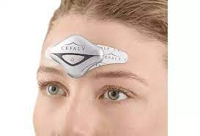
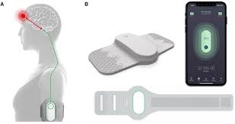
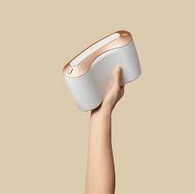
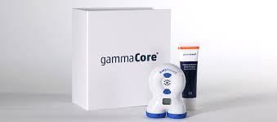
Neuromodulation
Cefaly Dual
(supraorbital nerve stimulator)
Nerivio
(remote electrical neuromodulation)
sTMS
(single pulse transcranial magnetic stimulator)
Gammacore TVNS
(transvagus nerve stimulator)
Notes:
Neuromodulation for migraine involves the use of electrical or magnetic stimulation to modulate neural activity and alleviate migraine symptoms. Various neuromodulation techniques have been explored, both non-invasive and invasive.
Non-invasive methods include transcutaneous supraorbital nerve stimulation (tSNS), transcranial magnetic stimulation (TMS), and non-invasive vagal nerve stimulation (nVNS). These techniques have shown promise in reducing headache intensity and frequency. For instance, tSNS has been effective in episodic migraine prevention, while nVNS has demonstrated efficacy in acute migraine therapy.^{[1-2]}
Invasive methods, such as occipital nerve stimulation (ONS), are typically reserved for chronic migraine patients who are refractory to other treatments. ONS has shown some effectiveness in migraine prevention, although the results are modest and the procedure carries surgical risks.^{[3-4]}
The mechanisms by which neuromodulation exerts its effects include altering brainstem activity and connectivity, as seen with respiratory-gated auricular vagal afferent nerve stimulation (RAVANS), which modulates brainstem nuclei involved in pain regulation.^{[5]} Additionally, neuromodulation can induce plastic changes in the brain, potentially correcting maladaptive plasticity associated with chronic migraine.^{[6]}

Slide 55
Case 2 Complex
Constant headache past 24 months Not sleeping No clear features Abdominal pain Pains all over body On SSRI for anxiety and depression Worried as friend has brain tumour.

Slide 56
Make a diagnosis.
Offer simple explanation.
Treat.
Case 1
Unpack a complex problem.
Offer a coherent story that makes sense.
Manage the problem holistically with
appropriate medical interventions
and utilising
the body’s intrinsic ability to heal itself.
Within context of a
therapeutic consultation
Ideally from headache specialist care
Case 2

Slide 57
Be aware of other causes of chronic headache
Chronic tension type
Low pressure
High pressure
Chronic infection

Slide 58
Make a diagnosis.
Offer simple explanation.
Treat.
Case 1
Chronic migraine (transformed migraine)
Headache > 15 days month of which 8 migraine
With medication overuse headache
Case 2

Slide 59
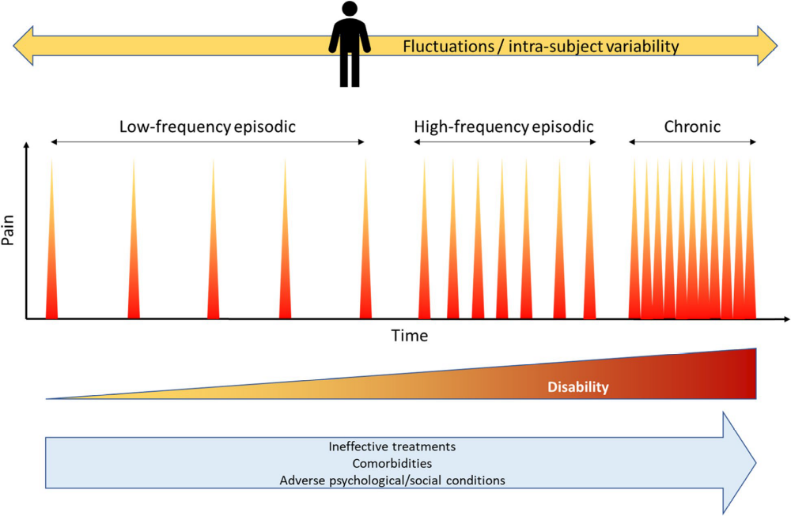
Physical, psychological, social stressors
Treatment resistant
Medication overuse headache
Multimorbidity

Slide 60
Step 1 Approach context of minimum three 10-minute consultations
Listen to their story and take them seriously.
Witness their suffering.

Slide 61
Step 2
Get the basics done

Slide 62
Getting the basics done
History.
How many types of headache?
What pain killers taking?
Neurological examination
Reassure serious pathology and reassure re scan
Basic bloods

Slide 63
Step 3
Establish realistic expectations

Slide 64
Expectations – this is the deal
Understanding what is going on – coherent story
Control not cure
Going to take time to sort out
Going to need commitment on their part

Slide 65
Step 4
Start appropriate medical management
Address medication overuse component of headache

Slide 66
Step 5
Get multimorbidities on the table

Slide 67
Migraine co-morbidities.
Probably aware of relationship
May not be aware of relationship
And need to ask
Will be previously diagnosed
Ubiquitous
May not want to go there!
Anxiety
Depression
Fibromyalgia
IBS
Insomnia
Restless leg syndrome
Asthma
Epilepsy
Life trauma and in particularly childhood SAEs.
Neurodiversity

Slide 68
Step 6
A story that makes sense

Slide 69
Resolves
Inflammatory response
Nervous system
Hormonal system
Cytokine system
Stressor
Persists
Trauma
Stressor – physical, psychological, social event that provokes an inflammatory response
Trauma – persistent inflammatory response

Slide 70

The inflammatory problem
A normal inflammatory
response
An abnormal inflammatory
response to a single stressor
An abnormal inflammatory
response that builds up from
Persistent stressors over time

Slide 71

Stressors
Migraine
Physical
Psychological
Social
Poor diet
Lack exercise
Obesity
Previous trauma
Chronic inflammatory load
Activation autonomic nervous system
Hormone pathways
Cytokine system
Welcome to my stress bucket

Slide 72

Step 7
Start thinking holistically

Slide 73
Holistic medicine
Guiding principle
To negotiate the interface between medical science and
the body’s intrinsic ability to heal itself.

Slide 74
Gepants against placebo at week 12.
50% response rates
Drug | Population | (Active) | Rate (Placebo)
Atogepant | Episodic migraine | 71.3% | 43.9%
Atogepant | Chronic migraine | 41% | 26%
Rimegepant | Episodic migraine | 49% | 41%
Croup 2021
Lipton 2022
Pozo-Rosich 2023
Tassorelli 2024

Slide 75
Outline of the handbook “Manage your Migraine Holistically.” www.holisticmigraine.org
i). A comprehensive handbook “Manage your Migraine Holistically.”

Slide 76
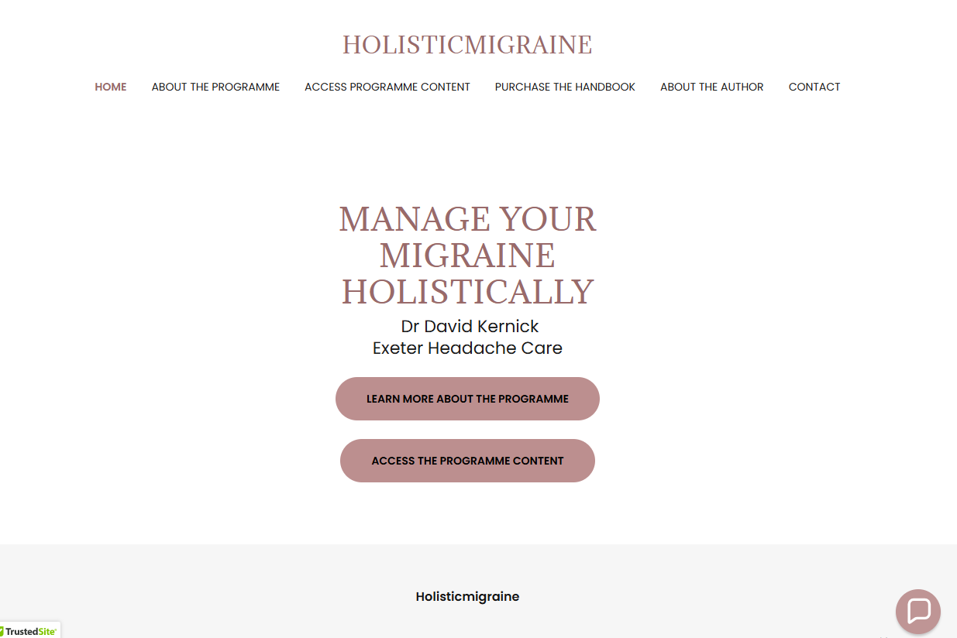
www.holisticmigraine.org.uk

