Slide 1




Sleep & Headache
Dr Tom Chambers MBBS iBSc MSc (Sleep Med)
ESRS-certified Somnologist
Anaesthetic and Sleep Medicine Doctor
Chief Medical Officer, Theta Sleep
Notes:
Tom – anaesthetic registrar and sleep medicine doctor
Am also the CMO of Theta Sleep - a tech-enabled clinical sleep service delivering sleep medicine care out of hospitals and in patients’ homes in the NHS and private sector
My research areas of interest have always been around how to deliver scalable sleep medicine care
Also just had baby – so living the patient experience of sleep deprivation and apologize in advance for any sleep-deprivation related errors

Slide 2
Intro to Sleep and Sleep Disorders
Sleep and Headaches
Practicalities and screening for sleep issues
Take home messages

Slide 3
What is sleep?
‘Sleep is a period of physical inactivity during which time an individual avoids movement within and environment which it is poorly adapted, using this time to undertake a range of essential biological activities that allow optimum performance during time of activity’ (Foster, 2022)
‘Sleep is the cement that glues our days together’(Rob Auton, poet)
Notes:
Foster, R. 2022. Life Time: The New Science of the Body Clock, and How It Can Revolutionize Your Sleep and Health. Penguin UK.
It is not just a period of inactivity, it’s a dynamic process necessary for everything we do! Poor sleep impacts ever aspect of physical health mental health performance etc
Sleep impacts every single aspect of our physical and mental health.
So for all aspects of physical and mental health disorders it is a target for intervention.

Slide 4
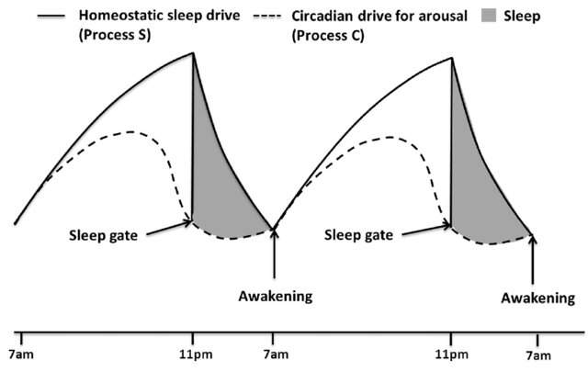
Sleep & Circadian Rhythms
The 2-process model of sleep.
Light is the significant zeitgeber for circadian rhythms. (Borbely, 1982, 2016, 2022)
Everyone is different!
Circadian preference
Sleep duration
Response to light
Response to other zeitgebers
Response to sleep disturbance
No one-size fits all solutions
Notes:
https://pubmed.ncbi.nlm.nih.gov/35502706/ - Borbely 2022
2 process model describes two competing/complementary factors at play during sleep
Sleep pressure builds up over the course of the day from when you wake up to when you sleep
What keeps you awake is the alerting signal that builds up over the course of the day before dropping off around 2100 or so
When these are in sync everything works perfectly – when they’re out of sync is when it causes a problem
From a medical perspective the best way to understand this is thinking about sleeping between night shifts, the reason you sleep terribly is because your circadian alerting system tells you to be awake at 1400 in the afternoon.
Also why the ‘sleep when the baby sleeps’ advice is pretty terrible
Even in the absence of disease, everyone is different…

Slide 5
Sleep disorders
Daytime drugs, nighttime impact
59 classified sleep disorders! (ICSD-3, 2023)
Uppers
Downers
Insomnia disorders
~10%-30%
Beta-agonists
Opioids
Sleep-related Breathing Disorders
~20%-25%
Steroids
Sleep-related Movement Disorders
Gabapentin / Pregablin
~5%-10%
Beta-blockers
Parasomnias
Last year ~1.5%, Lifetime ~7%-18%
Amitriptyline
Anti-depressants
Circadian Rhythm Disorders
~1%-3%
Sedative anti-histamines
Decongestants
Central Disorders of Hypersomnolence
~0.02%-0.03%
Notes:
Incredibly common to see patients with sleep disorders in general practice and secondary care, most are hidden and undiagnosed
Prevalence data has to be taken with a bit of a pinch of salt as the methodologies and underdiagnosis and defintions change the whole time but this is to say that disorders are common, you will see lots of patients with sleep disorders, and in may cases this has a huge impact on their lives
Also want to touch on the medications that we give patients that interact with sleep

Slide 6
Sleep and Headache

Slide 7
Trigger
Symptom
Sleep & Headache Interactions
Direct cause
Comorbidity
Notes:
Complex part of this relationship is it’s difficult to know whether things are symptoms or causes and the two are so interlinked that pulling them apart can be tough
Sleep disturbance as a trigger
Irregular sleep, sleep deprivation, oversleep, and circadian disruption can precipitate migraine attacks in susceptible patients. Reviews consistently identify sleep disruption as a common trigger domain.
B. Sleep disturbance as part of the migraine phenotype
Sleep symptoms can appear across the attack cycle - prodrome, during or after - and poor sleep quality correlates with greater migraine severity/disability.
Cause of headache directly – particularly OSA, sleep disordered breathing – it’s own specific category in the ICHD-3 (Sleep apnoea headache)
C. Sleep disorders as comorbidities that worsen burden
Insomnia, restless legs syndrome, and OSA commonly co-occur with migraine and may contribute to refractoriness and chronification. A recent meta-analysis reported pooled RLS prevalence in migraine around 20%. (d’Onofrio et al. 2025) - https://pubmed.ncbi.nlm.nih.gov/40968706/
This all makes assessing sleep issues in the context of a headache clinic very challenging!

Slide 8
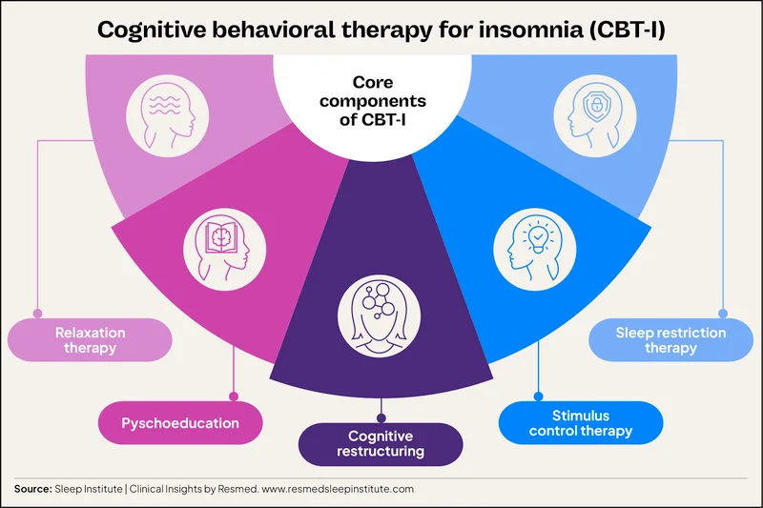
Insomnia & Headache
Insomnia and migraine links are probably the best studied
There is a strong link between migraine and multiple sleep disorders, insomnia in particular
Worse sleep quality is associated with worse migraine severity (Almansour et al. 2025)
Those with insomnia are more likely to develop migraines 10+ years down the line (Odegard et al. 2011)
CBTi is a highly effective therapy that may also improve migraine frequency and severity (small studies) (Tiseo et al. 2025)
Access to therapy is the biggest challenge.
Notes:
https://pubmed.ncbi.nlm.nih.gov/21457241/
https://pmc.ncbi.nlm.nih.gov/articles/PMC7590682/#Sec5
There is a bidirectional relationship between the two disorders – they should be identified in both sleep and headache clinics and treated at the same time
Want to touch on CBTi
Different to ‘normal’ CBT
Highly structured set of cognitive, behavioral, and relaxation therapeutics to directly target insomnia
2 biggest elements are SRT and SCT which aim to improve the bed/sleep connection
SCT is common and in sleep hygiene – 15 minute rule etc, basic and non-personalized
SRT is more interesting and effective – can be delivered as a single intervention, HABIT trial
Access may be changing in the NHS to digital tools

Slide 9
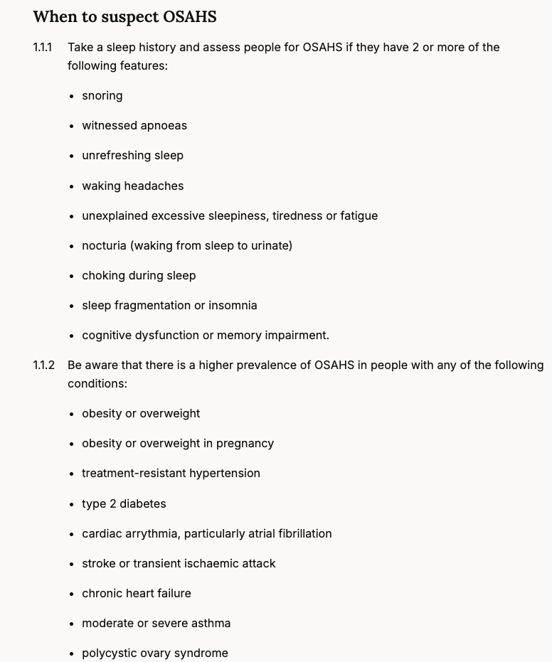
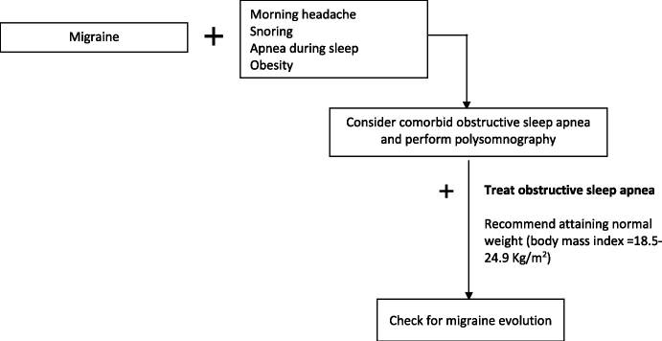
Sleep apnoea & headache
Sleep-apnoea related headache is a standalone disorder in the ICHD-3 (morning headache, <4 hrs, gets better or worse with OSA)
Trial data on the relationship between headaches and OSA are inconsistent – RR 1.43 (95% CI 0.92-2.25) (Blaszcysk et al. 2024)
Headache clinics are an opportunity to identify those at risk of OSA to get them on treatment and reduce long term negative health outcomes.
Tiseo et al. 2020 (Migraine and sleep disorders: a systematic review)
Notes:
OSA-related headache diagnostic criteria are slightly tricky – technically the diagnosis can only be made after diagnosis and treatment
One key criteria involves ‘headache worsening in parallel with worsening sleep apnoea’ OR
Significantly improved or remitted with improvement in sleep apnoea
Trial data – this is an SR on prevalence data in OSA and headaches
RR for headache was 1.43 in those with OSA
This data, like all OSA data is hampered by massive underdiagnosis.
10m + people in the UK with OSA. 85% of these individuals are undiagnosed.
Most prevalence studies DO NOT look at severity or undertake a diagnostic test and follow people up, it massively skews all data – so much so that it’s almost impossible to draw meaningful conclusions
Access to diagnosis is hard in the NHS as sleep studies are now the fastest growing diagnostic test the NHS undertakes – have increased by 140% in the past 4 years and many NHS services are really struggling – RTT times can be 2y +
Take the suggested flowchart with a pinch of salt - very textbook symptoms. NICE guidance on OSA symptoms is much better.

Slide 10
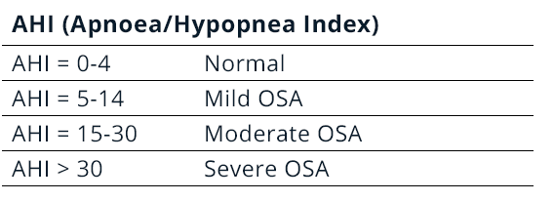
Not all ‘AHIs’ are created equally
Inter-scorer variability (Yagi 2018)
The first-night effect (Harrison et al. 2021)
Night-to-night variability (Punjabi et al. 2020, Stoeberl et al. 2017)
The AHI is a flawed metric (Malholtra et al. 2021, et al. 2016, Saaresranata et al. 2015) Arnardottir)
Defining hypopneas with 3% or 4% makes for huge variation in disease severity (Hirtosu et al. 2019)
Notes:
The AHI as a the apnoea hypopnoae index – that we describe as number of times per hour someone stops breathing (apnoea) or has significantly reduced breathing (hypopnea)
AHI does not correlate with symptom burden and it's not good in women - a history is really important. Cases where people say 'if the AHI isn't >15 then they don't get treatment' are madness.
AASM criterai changed 9 times in 25 years. Most recent is 3% which is important for slim/women/skin of colour

Slide 11
A word on RLS and headache
https://www.rls-uk.org/medications-avoid
AASM Clinical Practice Guideline on RLS and PLMS (2025)
Notes:
Other than insomnia and OSA, the evidence for relationships and modification of disease are limited
Similarly, other than for migraine, the evidence in rarer headache subtypes is small and theoretical
2025 SR and MA suggested the prevalence of RLS in those with migraine is 20% (2x as high as baseline)
- RLS is much easier to identify
- Single question – when you relax in the evening, do you get unpleasant, restless feelings in your legs that can be relieved by walking or movement?
Important things with RLS are:
1. Medications – many patients with chronic headache disorders are on multiple different medications. Big culprits are
- Antidepressants – SSRIs, SNRIs, Tricyclics – amitriptyline
- Antihistamines for people who are taking them for sleep issues – can make this worse
2. Guidelines on RLS treatment have changed in the past year – significantly
- Dopamine agonists are not first line and should be stopped – Ropinerole/Pramipexole – augementation and impulse control
- First line is iron supplementation – check a ferritin to guide oral or IV but we know that IV iron works much better
- a2d ligand medications are first line – pregabalin and gabapentin
- Gabapentin = 300 OD, 300 BD, 300 TDS – uptitrate
- Pregablin = 150mg in divided doses, e.g. 50mg / 75 mg BD

Slide 12
Practicalities and identifying sleep problems in clinic
Notes:
What are the key things to identify an undiagnosed sleep disorder – they are so prevalent that every opportunity to identify a sleep disorder is a good one!

Slide 13
Sleep histories are long and sleep clinicians love a questionnaire.
High yield
Sleep Condition Indicator
Insomnia Severity Index
Pittsburgh Sleep Quality Index
SCI for insomnia
Restless Legs Syndrome Scale
Stanford Sleepiness Scale
Single question for RLS
RBD Screening Questionnaire
StopBANG*
Swiss Narcolepsy Scale
Idiopathic Hypersomnia Severity Scale
Is your sleep refreshing?
Horn-Ostberg MEQ
Munich Chronotype Questionnaire
Consider medication impacts
StopBANG
Epworth Sleepiness Scale
Notes:
Taking a full sleep history is very long and not worth trying to do so. 90 min plus for behavioural psychologists
What is high yield – 1st is using it as an opportunity to ask about sleep and identify sleep as a contributing / causative factor. That’s step one! Signposting for Dx and Rx comes afterwards.
The Sleep Condition Indicator has a 2 question stripped back version
- Item 1 (Trouble): "Thinking about the past month, to what extent has poor sleep troubled you in general?" (Options: Not at all, A little, Somewhat, Much, Very much).
Item 2 (Frequency): "Thinking about a typical night in the last month, how many nights a week do you have a problem with your sleep?" (Options: 0–1, 2, 3, 4, 5–7)
when you relax in the evening, do you get unpleasant, restless feelings in your legs that can be relieved by walking or movement?
When it comes to OSA, ESS and SB are the classics
The Epworth Sleepiness Score is not standalone a useful questionnaire in sleep apnoea
It was not designed as a sleep apnoea screener, it was to look at sleepiness in those with OSA and with narcolepsy
It’s great for monitoring treatment response to CPAP and also to flag high risk patients who are very sleepy who may be at occupational/driving risk
SB is good, it’s quick, it’s easy, it’s very well studied and is sensitive
It is not good in women – cutoffs should be lower and index of suspicion has to be higher
In women, the NICE symptom list is better – have a high index of suspicion in someone who is peri/post-menopausal

Slide 14
Bidirectional & complex relationship
Trigger, symptom, cause, or co-morbidity
Take home messages
Treating sleep can improve headache burden
An opportunity to identify undiagnosed disorders and refer on for Dx/Rx
Tiseo et al. 2020 – ‘Migraine and Sleep Disorders: a systematic review’
Notes:
1. Sleep and headache are bidirectional, not incidental.
Trigger
Symptom
Cause
Comorbidity
When it comes to epidemiological studies – underdiagnosis ruins good conclusions. We are lacking large scale RCTs as we are in so many places in medicine.
2. Sleep can impact headaches in many different ways and the relationship between one patients sleep and headache for the same complaints may be very different
3. Treating sleep disorders is likely to improve headache burden – particularly migraine. Highly effective treatments are available.
4. I will always wax lyrical about the benefits of identifying sleep disorders as treating them can be transformational – ‘this has changed my life’ – step 1 = identify poor sleep, step 2 = try and find out what this means and how to manage it

Slide 15
Thank you!
Any questions?
Tom.chambers@thetasleep.com

