Slide 1
Facial Pain
Dr Jessica Briscoe
GP with Extended Role in headache and facial pain, GSTT

Slide 2
Aims
To describe common facial pain disorders in context of ICHD-3 criteria
Explore interaction between facial pain and headache disorders
Explore the differences (and similarities) between SUNA and Trigeminal neuralgia
Explore management of common facial pain syndromes

Slide 3
Classifications of facial pain
Various classifications exist:
ICHD-3¹ has a sub-category: ”Painful lesions of the cranial nerves and other facial pain”
IHS have a second publication: International Classification of Orofacial Pain, 1st edition from 2020²
British journal of Anaesthesia published a guideline in 2013³
1. https://ichd-3.org/13-painful-cranial-neuropathies-and-other-facial-pains/
2. International Classification of Orofacial Pain, 1st edition (ICOP). Cephalalgia. 2020;40(2):129-221. doi:10.1177/0333102419893823
3. Differential diagnosis of facial pain and guidelines for management. Zakrzewska, J.M. British Journal of Anaesthesia, Volume 111, Issue 1, 95 - 104

Slide 4
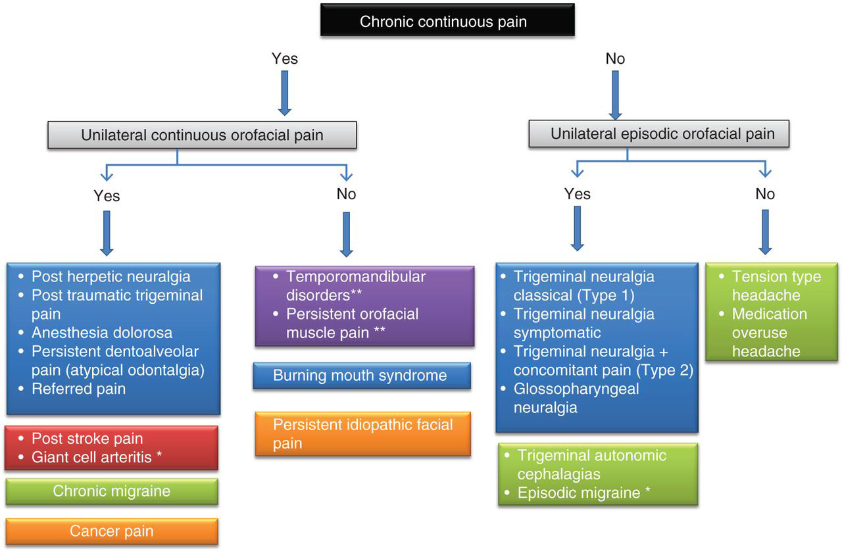
Differential diagnosis of facial pain and guidelines for management. Zakrzewska, J.M. British Journal of Anaesthesia, Volume 111, Issue 1, 95 - 104

Slide 5
Case: Jill 52 year old lady with facial pain
Duration around 1 year
Unilateral pain in left side of face
Intermittent
Starts in cheek around maxilla radiating up to temple
Severe pain
Short duration and seems to occur in bouts
Sharp intensely painful, lasting for a few seconds
Finding it difficult to chew on that side and can’t brush her teeth

Slide 6
Initially saw her dentist who felt it was related to a filling which may have worn down
Had this re-filled, and symptoms improved immediately after but became worse after a few weeks
Dentist gave antibiotics for possible infection
Had an X-ray, nothing obvious found
Tried second line antibiotics
Patient wanted tooth removed but dentist refused
Had second opinion and second dentist agreed with the first
Suggested she see her GP

Slide 7
Past medical history:
Borderline diabetes
Previous migraine when adolescent and into 20s but not particularly bothersome now
Otherwise well
Has tried ibuprofen, codeine, tramadol (had left over from back injury) but no regular medications and no allergies
Works in a nursery. Is really affecting her ability to work: she’s run out of sick leave. She needs to be able to concentrate during her work as she looks after toddlers.
This is really affecting her mood: she feels isolated and low. She doesn’t have a history of anxiety or depression.
Her sleep is r poor: she finds it difficult to get into the right position and she’s worried about the pain.
She often wakes early in the morning and is unable to get back to sleep.

Slide 8
Differentials?

Slide 9
GP noticed unilateral and short lasting so wondered if this might be trigeminal neuralgia

Slide 10
ICHD-3 criteria for Trigeminal neuralgia
International Classification of Headache Disorders edition 3 (ICHD-3) diagnostic criteria for trigeminal neuralgia
Recurrent paroxysms of unilateral facial pain in the distribution(s) of one or more divisions of the trigeminal nerve, with no radiation beyond, and fulfilling criteria B and C.
Pain has all of the following characteristics:
Lasting from a fraction of a second to 2 min.
Severe intensity.
Electric shock-like shooting, stabbing or sharp in quality.
Precipitated by innocuous stimuli within the affected trigeminal distribution.
Not better accounted for by another ICHD-3 diagnosis.

Slide 11
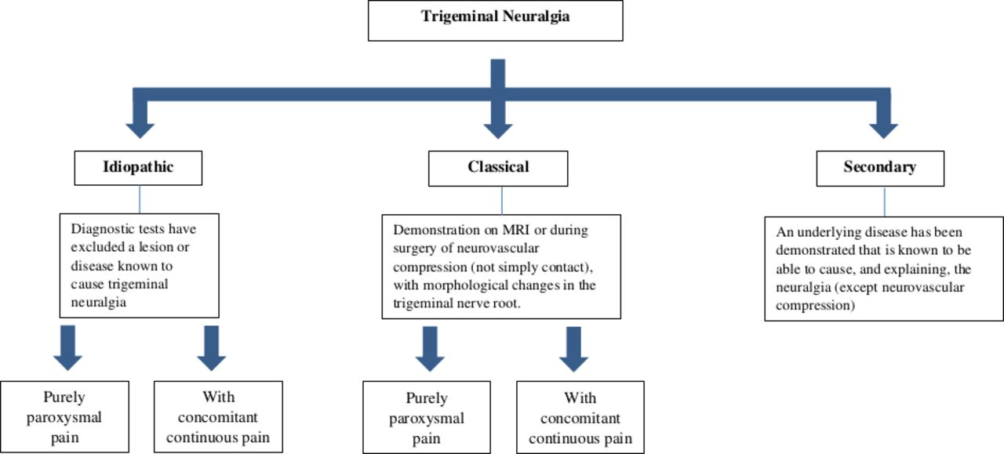
Trigeminal neuralgia classificarions
Lambru G, Zakrzewska J, Matharu M, Trigeminal neuralgia: a practical guide, Practical Neurology 2021;21:392-402

Slide 12

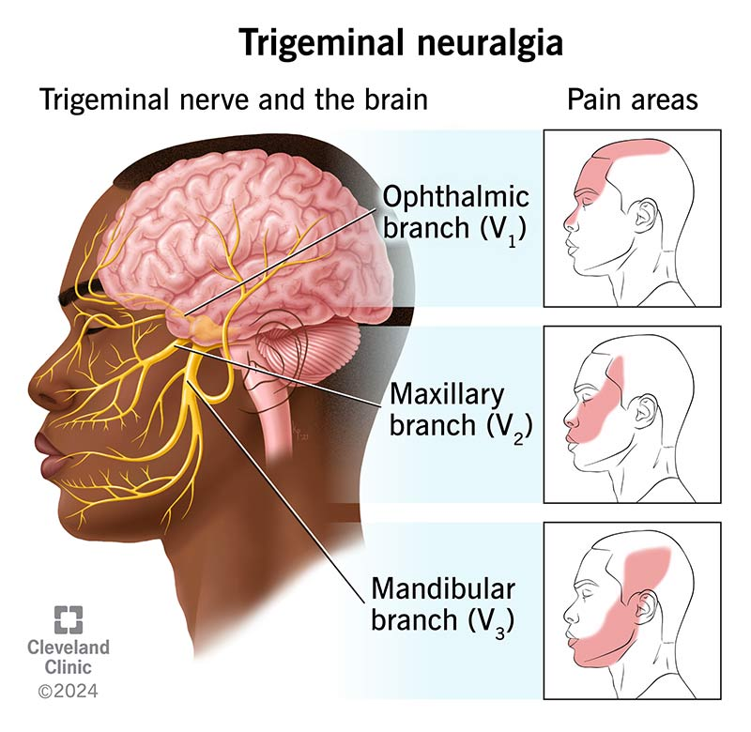
Type 1 TN: Classical trigeminal neuralgia without persistent background facial pain.
Type 2 TN: Classical trigeminal neuralgia with persistent background facial pain.
Bilateral pain is rare BUT it can be side-alternating
Presence of either of these should raise suspicion of secondary TN
Site of pain
commonly in V2 or V3
can affect V1 (approximately ¼ of cases)
Cleveland clinic trigeminal neuralgia leaflet

Slide 13
Frequency and duration are variable:
Typical duration <1min – 2mins (74% cases)
Can last up to 10 minutes
Paroxysms can last up to an hour
Frequency ranges from a few to hundreds per day
Typically a relapsing-remitting pattern
Usually a mixture of triggered and spontaneous attacks

Slide 14
Triggers
Hallmark feature of TN with 91-99% of patients reporting triggers
Often mixture of triggered and spontaneous attacks
Common triggers include:
Light touch
Talking
Chewing
Brushing teeth
Washing or drying
Drinking
Shaving.
Most patients have several trigger factors
Triggered attacks typically followed by refractory period

Slide 15
Continuous pain
Presence of continuous pain is diagnostically confusing
Reportedly occurs in 14-50% patients
Typically described as persistent pain with triggerable paroxysms
More common in women
Often starts as type 1 (purely paroxysmal) then develops into continuous pain
It is important to ask patients about paroxysms if they describe continuous facial pain

Slide 16
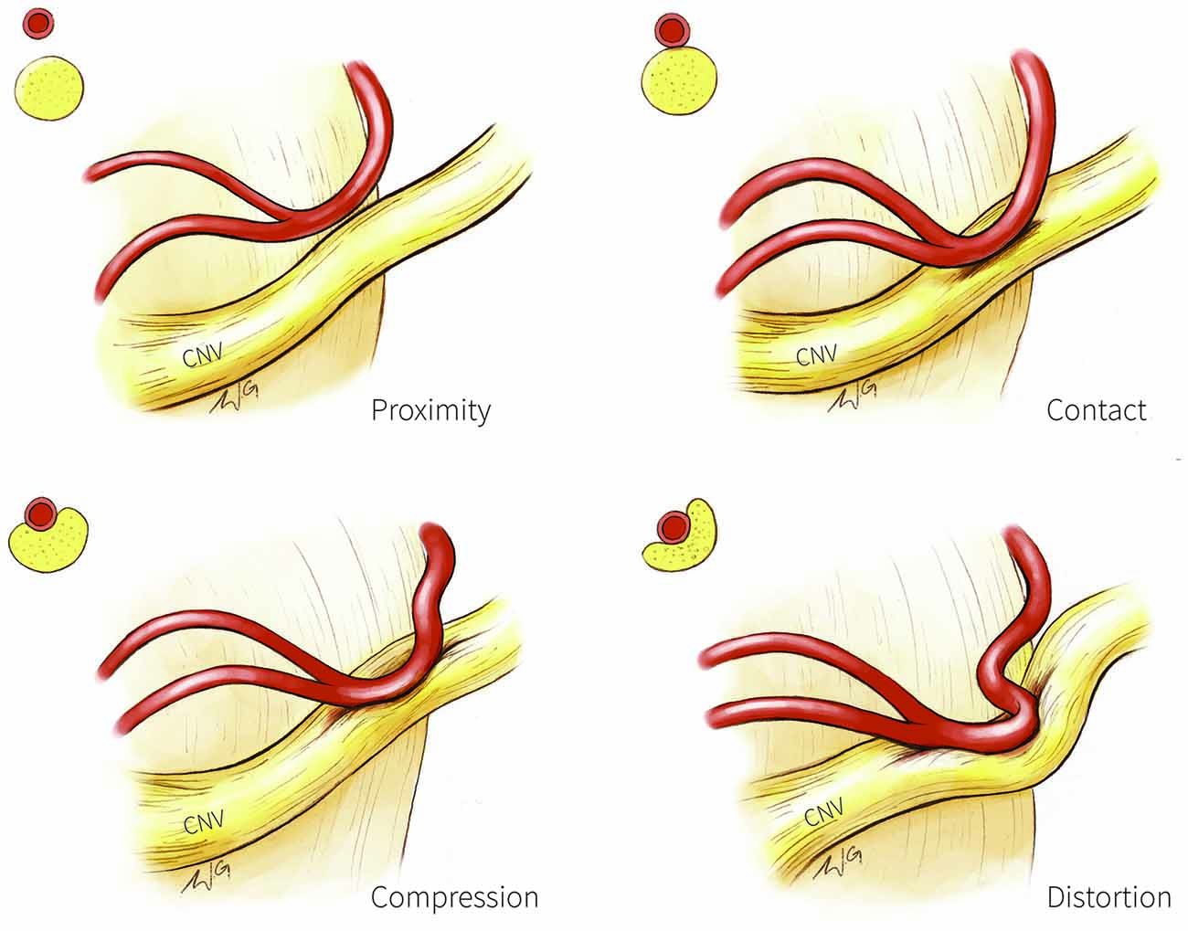
Pathophysiology
Pain precipitated by proximal compression of trigeminal sensory root by brainstem by blood vessel
Root entry zone also vulnerable to demyelination
Classical (Type 1) TN is associated with neurovascular compression(NVC)
Presence of NVC is not diagnostic!
Front. Neuroanat., 19 October 2016 Volume 10 2016 https://doi.org/10.3389/fnana.2016.00095

Slide 17
Case continued
GP started patient on carbamazepine 100mg BD but she felt drowsy when she tried to increase the dose up to 200mg BD. She stayed on this for about a week.
She then tried amitriptyline to see if her sleep could be improved.
She tolerates this fairly well up to 50mg ON but the pain is no better.
GP considers oxcarbazepine but decides to refer to neurology

Slide 18
NICE guidance
If no red flag symptoms start treatment
Carbamazepine only licensed treatment for TN
Maximum dose 1600mg/day
Gradually reduce dose when in remission
If carbamazepine is contraindicated, ineffective, or not tolerated:
seek specialist advice.
Do not offer any other drug treatment unless advised to do so by a specialist.
Red flag symptoms
Sensory changes
Deafness or other ear problems
History of skin or oral lesions that could spread perineurally
Pain only in the ophthalmic division of the trigeminal nerve (eye socket, forehead, and nose), or bilaterally
Optic neuritis
Family history of multiple sclerosis
Age of onset before 40 years

Slide 19
Carbamazepine
Often poorly tolerated BUT works well
Side effects are dose-dependent and often resolve after a couple of weeks
Nausea and vomiting
Sedation
Dizziness
Ataxia
FBC and U&E monitored every month until dose stabilised then every 6 months whist on treatment
Hyponatraemia is common (20%)
Leucopenia, thrombocytopenia, agranulosis and aplastic anaemia can occur

Slide 20
Case continued
After another 8 months I meet Jill in clinic.
Updated history:
She’s now had the pain for 2 years.
Almost always has the pain but it can be unpredictable.
Features not discussed before:
Nasal obstruction
Conjunctival tearing
Conjunctival injection
Triggers:
Brushing teeth
Chewing
Touching the face
Cold
Menopausal features also present + she’s having headache too

Slide 21
Differentials?

Slide 22
CAF with facial pain
More common in patients with V1 distribution TN
42% experience lacrimation
16% lacrimation
11% rhinorrhoea
In most cases, TN with cranioautonomic features (CAF) is likely to be misdiagnosed SUNA
If only one CAF and sporadic, likely to be TN

Slide 23
Features | Trigeminal neuralgia | SUNCT/SUNA
Predominant pain distribution | V2/V3>V1 | V1>V2/V3
Severity of pain | Very severe | Very severe
Duration (seconds) | <1–120 | 1–600
Autonomic features | None or sparse | Prominent
Spontaneous attacks only | None or rare | 40%
Refractory period | Present | Absent
Periodicity | Mostly episodic | Mostly chronic
Preventive treatment of choice | Carbamazepine or oxcarbazepine | Lamotrigine
Lambru G, Zakrzewska J, Matharu M, Trigeminal neuralgia: a practical guide, Practical Neurology 2021;21:392-402

Slide 24
Similarities between SUNA and TN
Clinical similarities
Ipsilateral trigeminal neurovascular compression
Studies show more vascular contact with the symptomatic trigeminal nerve than with the non-symptomatic side
Therapeutic overlap: Carbamazepine, Oxcarbazepine and Lamotrigine can successfully treat both
Are SUNA and TN a continuation of the same disorder?

Slide 25
Pathophysiology of SUNA
Complex interplay between the central and peripheral mechanisms involving the posterior hypothalamus and potential trigeminal sensory root demyelination
CAF of SUNA arise from
activation of the trigeminal nucleus caudalis by the contacted trigeminal nerve,
followed by stimulation of the superior salivatory nucleus and sphenopalatine ganglion
ultimately triggering the trigemino-parasympathetic reflex

Slide 26
Case continued
Organised imaging
MRI brain with trigeminal views (+/- pituitary)
Started lamotrigine 25mg OM,
increasing after 2 weeks to 25mg BD (max dose 200mg BD)
Watch for Steven-Johnston syndrome
Weaned off amitriptyline
Other options for treatment?

Slide 27
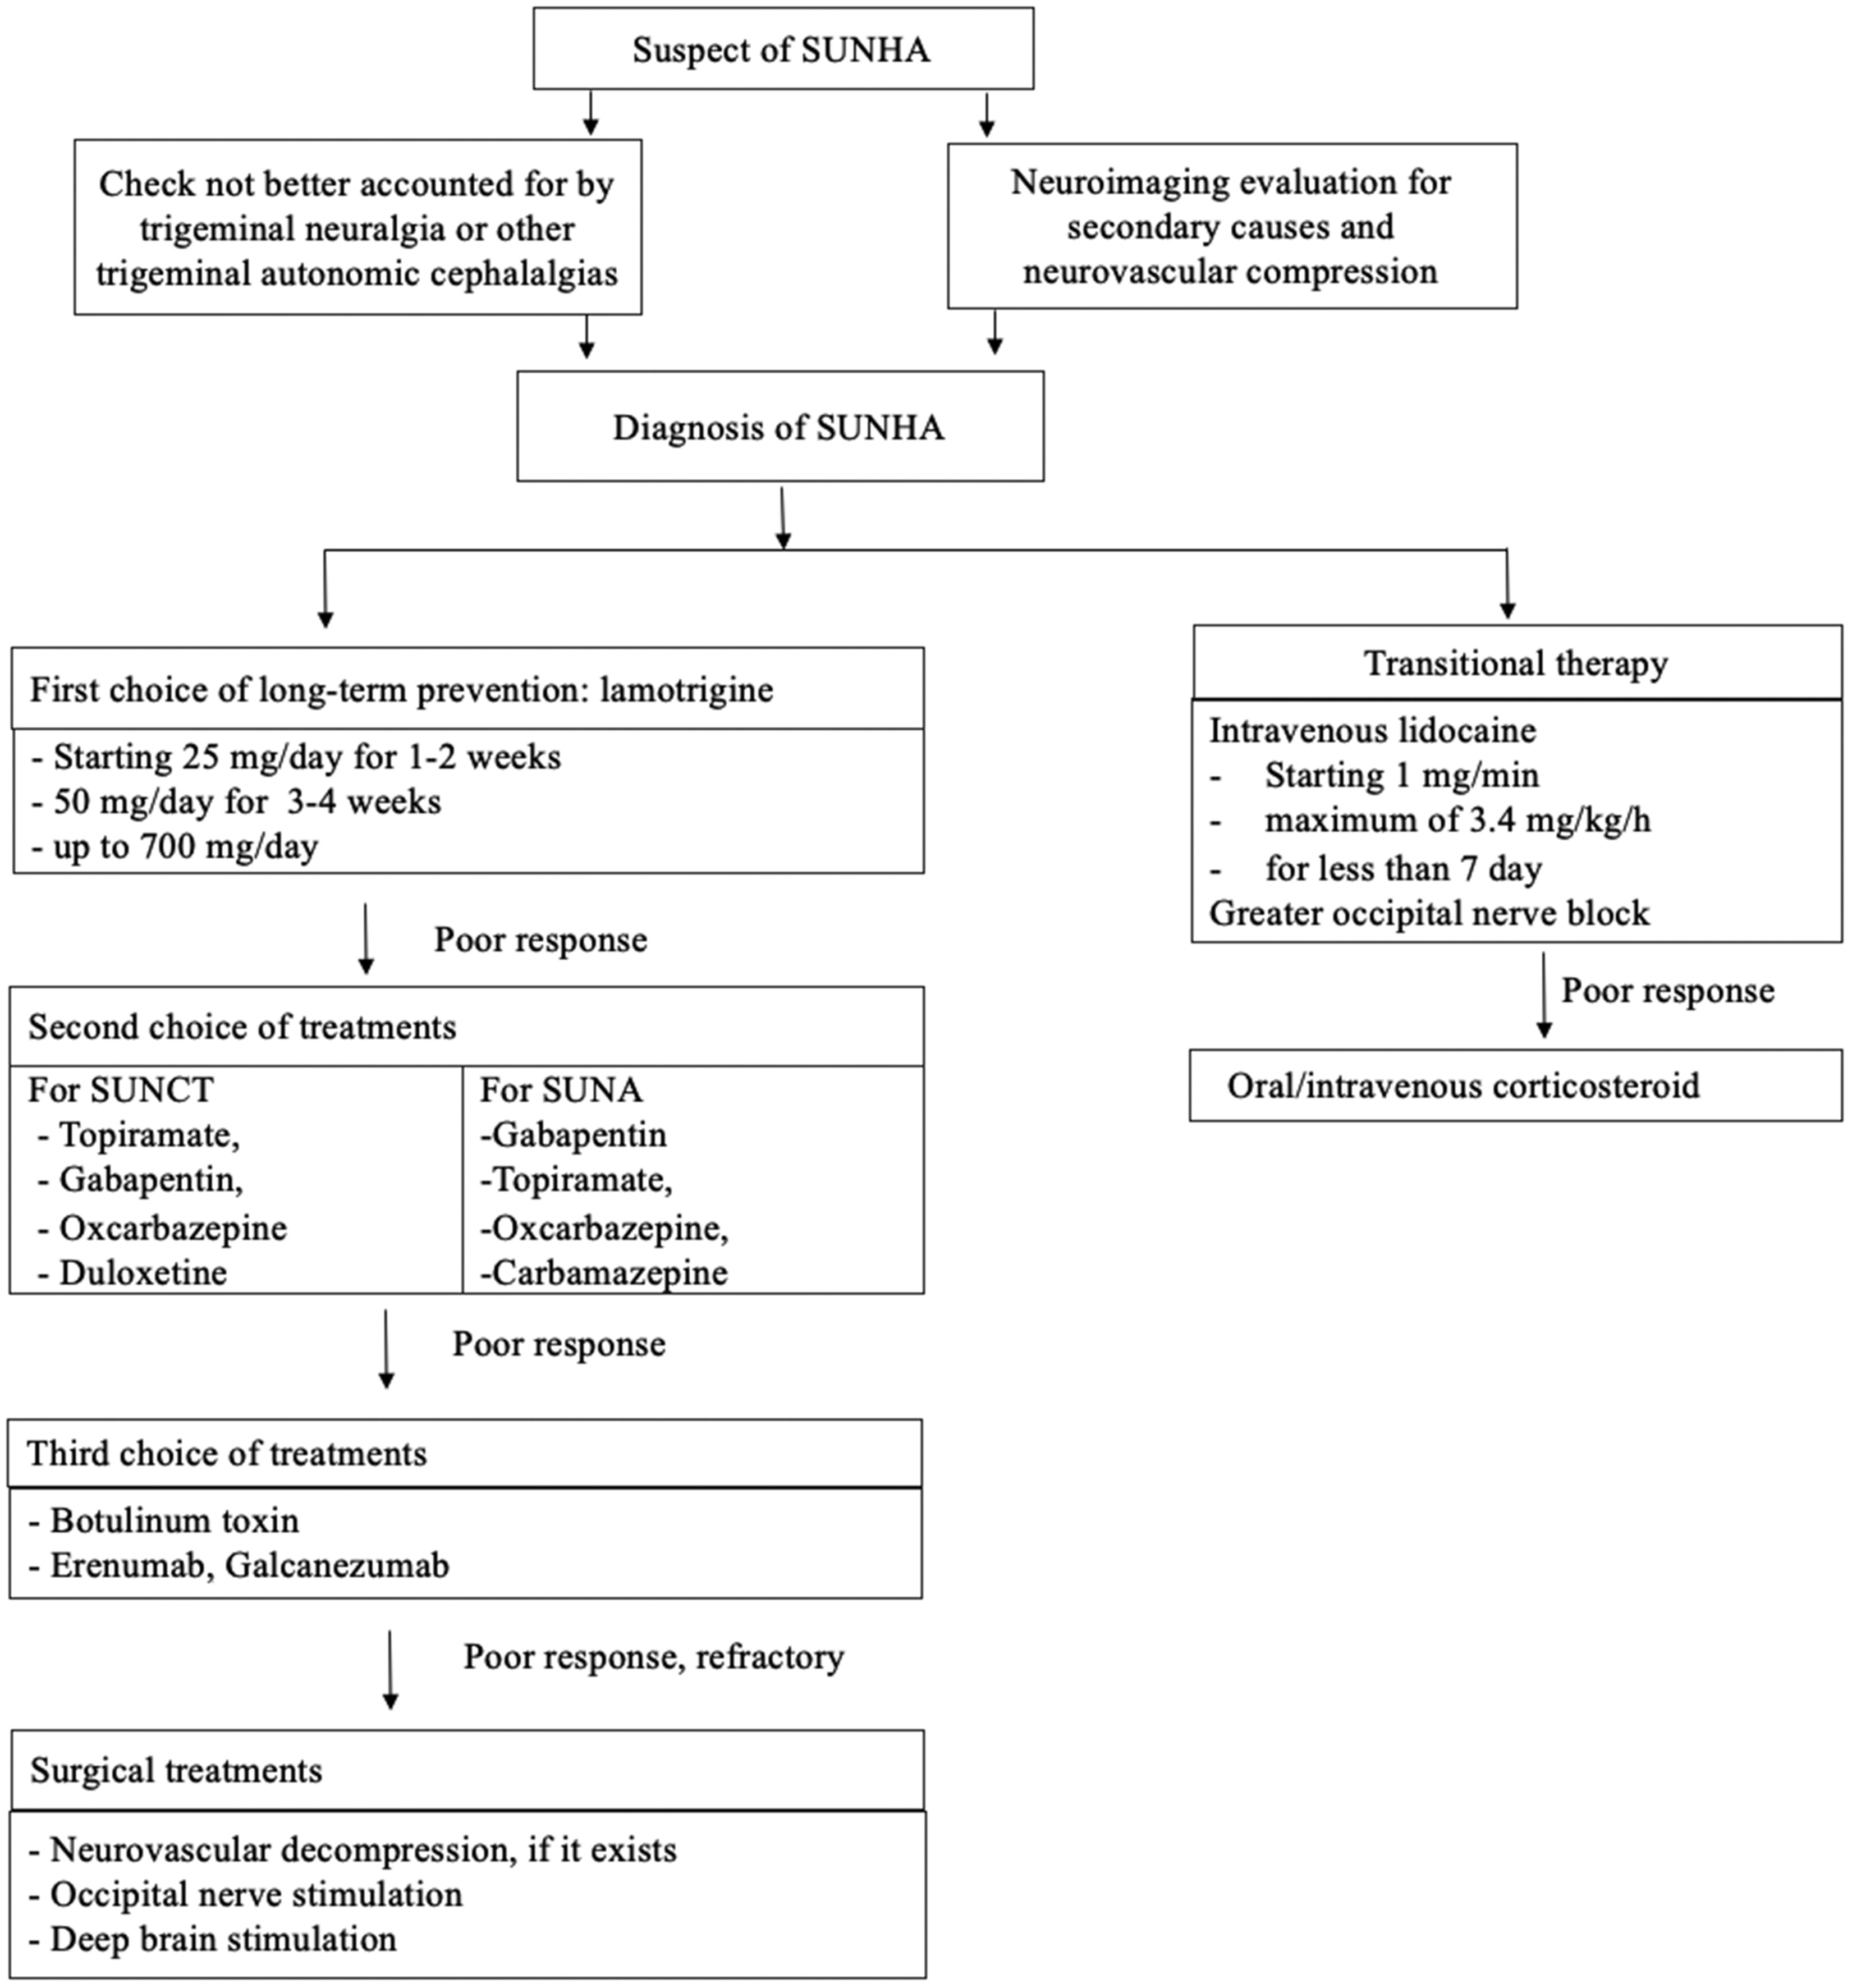
Kang M-K, Cho S-J. SUNCT, SUNA and short-lasting unilateral neuralgiform headache attacks: Debates and an update. Cephalalgia. 2024;44(2). doi:10.1177/03331024241232256

Slide 28
Other treatments: Botox
RCTs show Botox helpful for managing TN:
Subcutaneously
Intraorally
Response after 3 months ranged between 68% and 86% compared with 15%–32% of placebo
SE: facial weakness (mild-moderate and transient)
Few trials which show benefit in SUNA

Slide 29
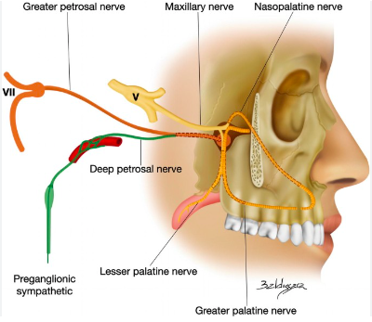
Other treatments: Neuromodulation
Mechanism: in SUNA, stimulation of sphenopalatine ganglion triggers trigemino-parasympathetic reflex
Sphenopalatine pulsed radio frequency (SPG PRF):
Small study¹ (9 patients) with chronic refractory SUNA
77.8% responded for 6 months
1 patient had 2 month 40% improvement
Repeated reproducible response in 2 of the 4 responders
1. Ornello R, Palmisani S, Murphy M, Sacco S, Al-Kaisy A, Lambru G. Sphenopalatine Ganglion Pulsed Radiofrequency for the Treatment of Refractory Chronic SUNCT and SUNA: A Prospective Case Series. Headache. 2020 May;60(5):938-945. doi: 10.1111/head.13788. Epub 2020 Mar 23. PMID: 32202666.

Slide 30
Other treatments: Surgery
3 Surgical approaches:
Invasive and non-ablative methods:
Microvascular decompression
Invasive and ablative methods:
controlled lesioning of the trigeminal ganglion or root by
mechanical (balloon compression)
thermal (radiofrequency thermocoagulation)
chemical(glycerol rhizolysis)
separation of trigeminal nerve fascicles in the posterior fossa (internal neurolysis)
non-invasive ablative
stereotactic radiosurgery which focuses radiation at the trigeminal root entry zone
Also invasive neurostimulation
Occipital nerve stimulation
Deep brain stimulation

Slide 31
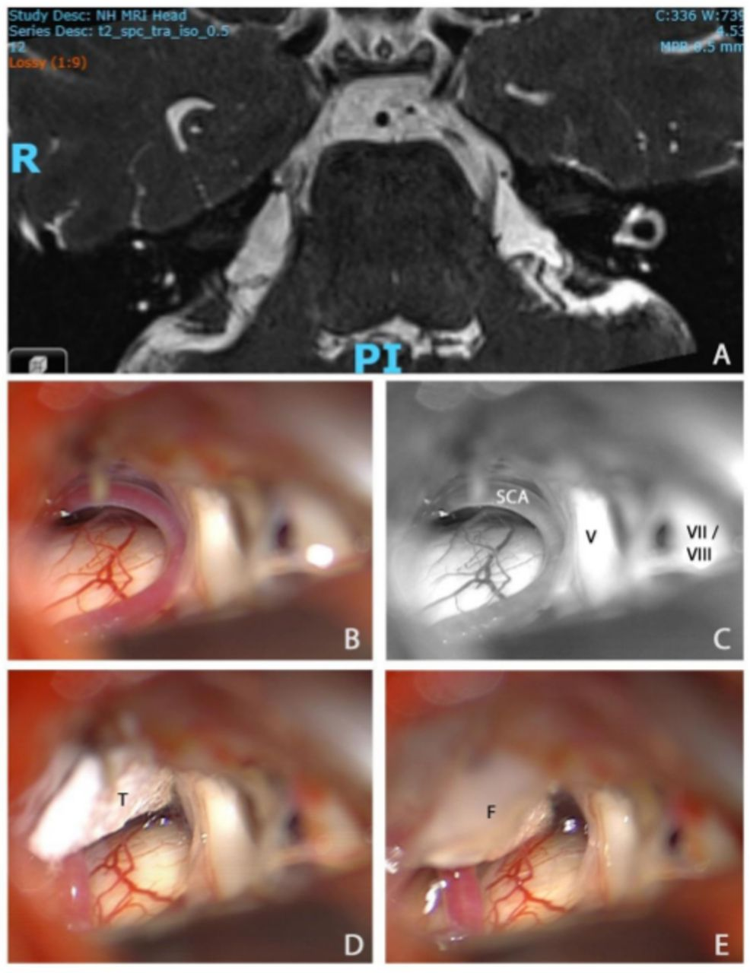
Microvascular decompression (MVD)
MVD considered if significant NVC on MRI shows and in absence of a plaque in the pons
evidence suggested that a brainstem lesion related to the TN on MR is a negative prognostic factor for microvascular decompression
MVD is a major procedure that can be carried out successfully in the elderly provided they have no significant comorbidities
results are poorer <25 years
Severe complications are rare
There is small risk of mortality (0.3%)
Lambru G, Zakrzewska J, Matharu M, Trigeminal neuralgia: a practical guide, Practical Neurology 2021;21:392-402

Slide 32
Case: conclusion
Jill tolerated lamotrigine well and only required 100mg BD to settle her symptoms
She had a flare when the weather got cold and increased her lamotrigine to 125mg BD but developed fatigue
She was started on botox:
PREEMPT facial and L temporal injections
Preauricular, upper and lower V3 injections
Significant improvement after 2 weeks so repeated every 3-4 months
Able to wean off injections and went back to work

Slide 33
Things to consider
Concurrent migraine
Possibility of co-treating
Effect of hormones/perimenopause

Slide 34
Questions?

