Slide 1

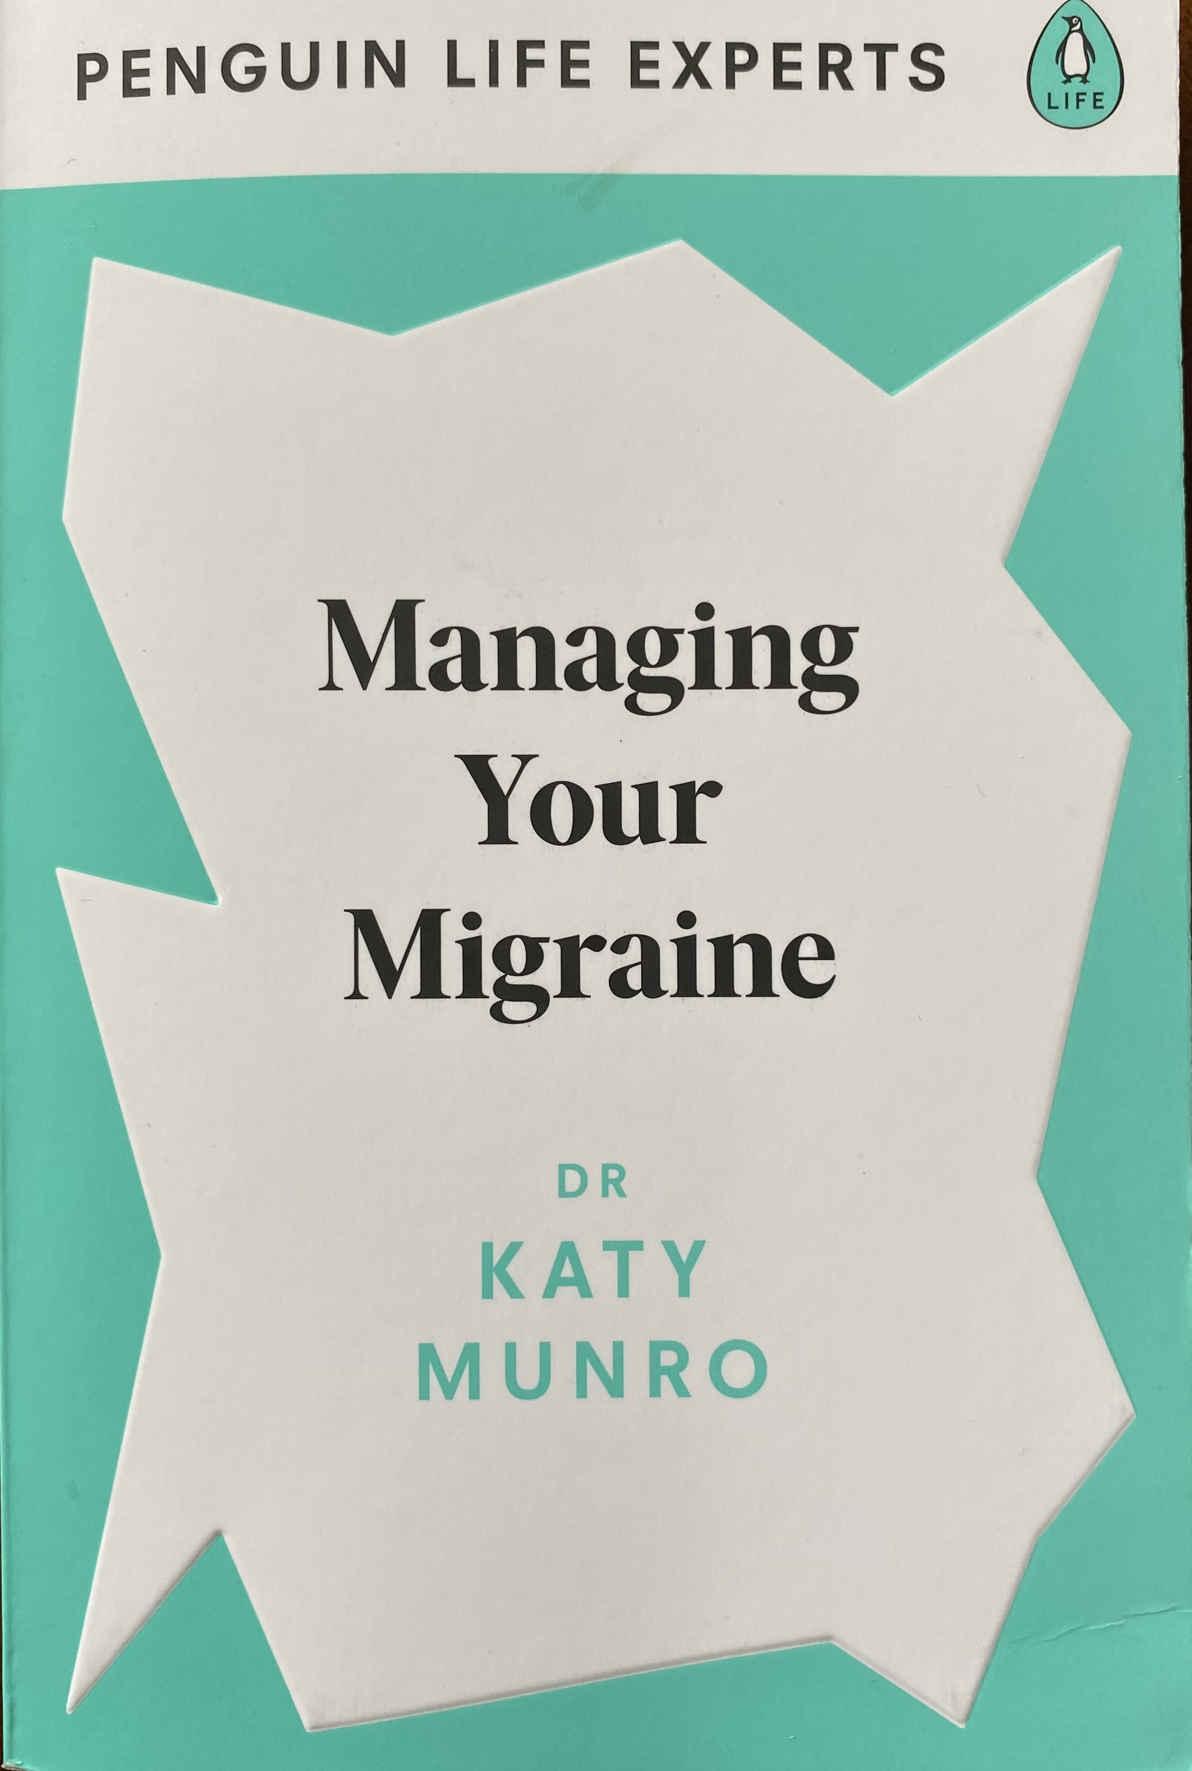

Headache in Children & Adolescents Diagnosis, management & communication with young patients & families
Dr Katy Munro
Senior GP Headache Specialist, NMC
Host of ‘Heads Up’ podcast
Author: ‘Managing Your Migraine’ book
Instagram @migrainedoc

Slide 2
Disclosures
Speaker fees, travel and grants: Pfizer, Teva, Abbvie, Reckitt, Lundbeck
Consultation on devices: Chordate, Cefaly (Theranica), Nerivio (Dr Reddy)
Radio phone in fee: BBC Radio Wales
Expert support for poster presentation: Haleon
Royalties: Penguin Random House, ”Managing Your Migraine” book
Advisory Board member:
British Pain Society – Refractory Migraine treatment statement
Royal Pharmaceutical Journal
National Audit of Headache working group
Pfizer -various
Voluntary roles:
Secretary of International Headache Society GP Special Interest Group
Host of Heads Up podcast
Contributor to various articles for journalists

Slide 3
Headache in Children: the size of the problem
  Very common & disabling problem for children & adolescents
Negatively impacts education, social development, & mental health
Long-term losses across many life areas and impact on families
According to GBD data, headache disorders (especially migraine) affect up to 60% of children & adolescents. Of these, 8% to 11% have migraine (at least)
Frequency & disability increase in adolescence
more pronounced in females aged >10 years old
risk of chronicity increases
  Studies show adverse experiences in childhood (ACEs) predispose to headache
  financial stress; physical, emotional, or sexual abuse; parental divorce, bereavement, mental illness
Better awareness with strategies to assess & help in primary health care & with school-based programmes - critically important
Migraine and headache in children and adolescents: A 2026 evidence-based factsheet Cephalagia 2026 Uluduz et al https://doi.org/10.1177/03331024261463173
Headache in Children and Adolescents Christina Szperka, 2021 doi: 10.1212/CON.0000000000000993
Kernick D, et al Cephalalgia 2009;29(12):1311–1316. doi:10.1111/j.1468-2982.2009.01872.x

Slide 4
Headache in Children under 12: NICE referral guidelines
(updated 2023)
Refer immediately children aged <12 years with headache for same-day assessment, according to local pathways, if they have any 1 of the following headaches:
with fever and features of meningism
associated with change in conscious level or pervasive lethargy
associated with ataxia
occurring within 5 days of a head injury
associated with squint or failure of upward gaze ('sunsetting’)
triggered or aggravated by coughing, sneezing or bending down
associated with vomiting
wakes them at night
present on awakening in the morning
progressively worsens
Refer urgently all children aged under 4 years with headache for neurological assessment
www.nice.org.uk/guidance/ng127/chapter/Recommendations-for-children-aged-under-16#headaches-in-children

Slide 5
Headache in Children: Red Flags
Acute onset (started <3 months ago)
Severe vomiting
High-risk underlying comorbidities
Fever
Focal motor abnormality
Changes in mood or personality over days or weeks
Altered conscious state
Seizures
Abnormal ocular movements, squint, pathological pupillary responses
Increase in severity or characteristics of the headache
Pain that wakes the child from sleep or occurs on waking
Ataxia, gait abnormalities, impaired coordination
Meningism
Occipital headache
J Yeungnam Med Sci 2022 Sep 14;39(4):278–284. doi: 10.12701/jyms.2022.00528 Pediatric headache: a narrative review Saeyoon Kim

Slide 6
Headache in Children under 12: NICE referral guidelines
(updated 2023)
Recurrent headaches and migraine attacks
Perform or request fundoscopy for all children with recurrent headache & refer urgently for neuro assessment if abnormalities
For all children with recurrent headache:
be aware hypertension might be the cause
measure BP & check measurement against BP reference ranges adjusted for age & height
refer if headaches consistently worsened by upright posture & relieved by lying down.
Do not routinely refer children with migraine unless affecting school life, social life or family activities, or they have features as per previous slides
Be aware that emotional stress is a strong trigger of migraine & chronic, daily headache in children.
Ask child, + parent or carer about specific learning problems, bullying at school & family stress
Ask about analgesic use in children with recurrent headache to ensure that medicine use is not excessive and to assess the likelihood of medication overuse headache.
NICE guideline on headaches in over 12s for more info on medication overuse headache.
www.nice.org.uk/guidance/ng127/chapter/Recommendations-for-children-aged-under-16#headaches-in-children

Slide 7
Headache in Children: What if I miss a Brain Tumour?
Brain tumours: secondary headache may be presenting symptom but
only 41% of kids with brain tumours had headache as the presenting symptom
Neurological signs were present in 88% at the time of diagnosis
make up 25% of all childhood cancers
affect 1 in 2400 children, younger than 16 years old, annually in UK
Life-threatening causes of headache such as brain tumours occur in
approx 2- 3% of children presenting with headache to ED/A&E
approx 1% of children with headache seen in Primary Care
Migraine & primary headache – much more common - 1 in 10 children
Wilne et al 2010 DOI: 10.1136/adc.2009.162057 (Guideline to assist assessment
Schobitz E, Qureshi F, Lewis D; Pediatric headaches in the emergency department. 2006 DOI: 10.1007/s11916-006-0066-3
Brain Tumour Charity https://bettersafethantumour.com/

Slide 8
Headache in Children: To Scan or not to scan?
Intracranial tumour symptoms? Think Headache Plus…
      nausea and vomiting, abnormalities of gait and co-ordination, and papilloedema
usually recurrent, frequent and gradually worsening
may be worse on waking, indicating raised intracranial pressure
Most worrisome features :
abnormal neurologic examination, significant systemic illness, and new or worsening pattern of headaches
Neuroimaging unnecessary for children with
stable frequency of headaches
absence of concerning features
normal neurologic examination
Headache in Children and Adolescents Christina Szperka, 2021 doi: 10.1212/CON.0000000000000993

Slide 9
Headache in Children: Common Comorbidities
Anxiety disorders and depressive symptoms
Sleep problems – insomnia, insufficient sleep, irregular sleep, parasomnias and, in some children, restless legs or sleep-disordered breathing.
ADHD and learning/behavioural difficulties – especially with migraine
Atopic disease – asthma, allergic rhinitis and eczema have been associated in some studies
Hypermobility – incl Ehlers Danlos and linked with POTS, MCAS
Coeliac disease
Other pain and somatic symptoms – recurrent abdominal pain, functional abdominal pain, back pain and other functional gastrointestinal symptoms
Medication-overuse headache – relevant in children with frequent headache who regularly use analgesics or triptans; anxiety and depression are common in this subgroup also
Epilepsy and other neurological disorders – an association is reported, although epilepsy remains uncommon among children with migraine
Tic disorders/Tourette syndrome – reported particularly in neurodevelopmental or psychiatric comorbidity studies
Headache and comorbidity in children and adolescents
Benedetta Bellini, Marco A. Arruda, et al. The Journal of Headache and Pain 2013-09-24 doi.org › 10.1186 › 1129-2377-14-79
Notes:
https://headachejournal.onlinelibrary.wiley.com/doi/10.1111/head.13032
Results
Children with migraine were more likely to have persistent asthma compared to absence of asthma (odds ratio [OR]: 4.57, 95% confidence interval [CI]: 2.04-10.24) and less likely to have been treated by inhaled or nasal corticosteroid (OR: 0.34, 95% CI: 0.15-0.76) or antihistamine therapy (OR: 0.33, 95% CI: 0.18-0.60). The median number of monthly migraine episodes was higher in children with persistent asthma (3; interquartile [IQR]: 1-4; range: 0.5-10) compared to children with intermittent asthma (2; IQR: 1-3; range: 0.1-4) or non-asthmatic children (2; IQR: 1-3; range: 0.1-12) (P < .01).
Persistent childhood asthma was associated with increased risk of migraine and higher frequency of migraine attacks. History of anti-asthmatic or anti-allergic therapies was associated with decreased risk of migraine in children and adolescents. The role of these therapies on the pathogenesis and occurrence of migraine needs to be further elucidated because of the huge potential impact in terms of public health.

Slide 10
Migraine common condition, commonly missed, commonly misunderstood
Genetic, multi-symptom neurological condition with environmental factors (epigenetics)
42 or more genes identified to date
Lifelong predisposition to migraine attacks
In children, presenting symptoms may differ from adult presentation
Patterns of symptoms differ - >80% have bilateral pain
Headache may be absent
Attacks tend to be shorter and less frequent
Nearly 50% of children who experience headache never get a diagnosis
(Lipton et al 2007)
Headache was considered unclassified in 67.6% of children & adolescents in recent retrospective Primary Care study (6-17 yo) (unclassified in children > adolescents)
Migraine accounted for 31.3% of headache presentations
Watson et al June 2026 Migraine diag & managemt in children & adolescents BJGP Open www.bjgpopen.org/content/early/2026/06/24/BJGPO.2026.0021
(this is an improvement from findings by Kernick et al – 80% were unclassified)
Kernick D, et al Cephalalgia 2009;29(12):1311–1316. doi:10.1111/j.1468-2982.2009.01872.x

Slide 11
Migraine
Proposed diagnostic criteria for children
A. At least five headache attacks fulfilling the criteria from B to D
B. The headache lasts for 30 minutes or longer (untreated or treated)
C. The headache has at least one of the following characteristics:
1. Pain of at least moderate severity
2. Unilateral or bilateral headache
3. Throbbing or pounding nature of pain
4. Exertion intolerance; avoidance of walking or playing
D. The headache is associated with at least one of the following:
1. Loss of appetite, stomach discomfort, or dizziness
2. Sensitivity to light and sounds as indicated by inability to watch TV or play on the computer or on electronic games
3. Having one cranial autonomic symptom associated with headache attacks
Not better accounted for by other diagnoses J Yeungnam Med Sci 2022 Sep 14;39(4):278–284. doi: 10.12701/jyms.2022.00528 Pediatric headache: a narrative review Saeyoon Kim

Slide 12

Migraine Prevalence in childhood
Prevalence & features vary from childhood (3.4% age 5) to late adolescence (19.1%) & from boys to girls
Boys tend to develop migraine younger
Youngest patient at NMC aged 4 with migraine with aura
Before puberty, prevalence is equal in boys & girls
After puberty, girls > boys
65% of youth with migraine continue to have symptoms in adulthood
30–50% may progress to chronic daily headache, particularly females
Watson et al June 2026 Migraine diag & managemt in children & adolescents BJGP Open www.bjgpopen.org/content/early/2026/06/24/BJGPO.2026.0021
Notes:
1 year prevalence in one US study estimated prevalence
in 12-19 year olds to be 6.3%

Slide 13


The importance of making a diagnosis in children
Delay in diagnosis results in harms to the child:
  poor management of symptoms – risk of transition from episodic to chronic
  risk of medication overuse headache
  loss of confidence and low self esteem
  depression and anxiety - anticipatory anxiety of future attacks
  poor school attendance and/or school refusal –absenteeism & presenteeism
  reduction in academic performance – affecting career choices?
  incorrect labelling as malingerer
  Can lead to parental anxiety driving investigations
  Parental catastrophising and protective parenting style may worsen
Migraine and headache in children and adolescents: A 2026 evidence-based factsheet Cephalagia 2026 Uluduz et al https://doi.org/10.1177/03331024261463173

Slide 14
Diagnosing Headache/Migraine in children
  History is KEY (from child or caregiver or both)
  ask them to keep a headache diary
  ask them to describe a typical attack, and about impact
  PedMidas : Pediatric Migraine Disability Assessment
  https://media.gosh.nhs.uk/documents/pedi_midas_questionnaire.pdf
  Pediatric Quality of Life Inventory (PedsQL) www.pedsql.org/about_pedsql.html
  Examination
  BP, full neurological examination & fundoscopy, urinalysis
  Tests?
  Tests are done to exclude other causes not to diagnose migraine
  Bloods to exclude anaemia, thyroid issues, Coeliac disease, low Vit D
  Scans if indicated –CT, MRI

Slide 15
Always ask about Family History
Family History of migraine means higher risk of child developing migraine at a young age
No Family History?
  Family members may not have been asked!
  Diagnosis may not be clear or mild attacks
  Mislabelled – ‘sick headaches’, ‘the normal headaches everybody gets’
  Unrecognised
If both parents have migraine, risk of child having migraine is increased by 75%
1st degree relatives of Migraine with aura - child has 4 x risk of having MA
Other Clues in the history:
Migraine is linked with
  Travel sickness
  Cyclical vomiting
  Episodic dizziness
  Infantile colic
  Benign torticollis of childhood

Slide 16
Could it be Cluster Headache?
Cluster headache onset has been documented at every paediatric age.
Pain in all typical locations
full range of durations (15–180 minutes)
But lower attack frequency - between every other day and 6 per day (official criteria is between every other day & 8 per day)
All the autonomic and restlessness features described
lacrimation in 81%
restlessness in 63%
conjunctival injection in 61%
nasal congestion in 57%
ptosis in 52%
rhinorrhea in 45%
facial sweating in 16%
miosis in 14% ,
eyelid edema in 3%

Slide 17
Could it be Cluster Headache?
Cluster headache patients often display migrainous symptoms
paediatric onset patients most commonly display photophobia in 58% , nausea in 37% , & phonophobia in 29%
Sex Ratio in paediatric-onset cluster headache patients was 1.8 (79 male, 43 female)
No significant differences before and after puberty
Both male and female patients displayed a wide range of ages but data too limited to comment on a particular at risk age
Attack duration quite useful diagnostically
when less than 2 h (more consistent with cluster headache)
more than 3 h (more consistent with migraine)
BUT when the attack duration is 2–3 h, detailed assessment of other features critical
Other features include
No of attacks per day (1–8 per day for cluster headache, one per day for migraine),
restlessness (present for cluster headache, often absent for migraine where motion aggravates the headache)
location of pain (strictly unilateral for cluster headache, unilateral or bilateral for migraine)
Pediatric-onset trigeminal autonomic cephalalgias: A systematic review and meta-analysis 2021 Cephalalgia Ghosh et al.
https://journals.sagepub.com/doi/10.1177/03331024211027560

Slide 18
Migraine Attack Phases in Children: Phase 1
Phase 1 : Prodromal phase - premonitory symptoms
  Reported less frequently by children
  May be 24-72 hours before headache appears
  Commonest – fatigue, mood changes, neck stiffness
  Also yawning, light-headedness, polyuria, visual blurring, cravings, light sensitivity
  Poor concentration also common – this has implications at school

Slide 19
Migraine Attack Phases: Phase 2 Aura
Visual & non-visual neurological symptoms
developing over 5-20 minutes & resolving within an hour, before the onset of headache
more common in older children & if FH of aura
93% of affected children get visual symptoms but may struggle to describe aura
  head banging in younger children
Non- visual symptoms include
  Tingling, numbness of face, hands or other areas
  Word-finding difficulties, slurring of speech
  Clumsiness, dizziness/vertigo
  Attention loss, confusion, agitation
  Rarely hemiparesis – Hemiplegic Migraine
NB Contraception in girls : Migraine with aura – avoid oestrogen containing methods, increased risk of stroke. UKMEC4

Slide 20
Phase 3 –The Headache (impact) phase
Head Pain
  one-sided or bilateral or peri-orbitally, commonly frontotemporal or not localized
  severity may be variable
  often described as throbbing or constrictive pressure
Nausea & vomiting
  Common, gastric stasis – vagus nerve affected
  Some present with only abdominal pains or cyclical vomiting
Autonomic symptoms
stuffy, runny nose, red eyes, body temp changes, facial skin changes etc
Heightened Sensory symptoms : Increased sensitivity to light, sound, smells, allodynia
  Dizziness and motion sensitivity
  Glare, flashing lights, flicker, computer screens, spots & stripes

Slide 21
Phase 4 –The postdromal phase
May last hours or days
Child or young person is not back to normal but may be back to school
Non-pain symptoms e.g. fatigue, cognitive difficulties, & nausea often persist for hours after pain has resolved
More than 80% of children develop new symptoms, including thirst, somnolence, visual disturbances, and food cravings, after the pain has resolved
Headache in Children and Adolescents Christina Szperka, Continuum (Minneap Minn). 2021 Jun 1; 27(3): 703–731.

Slide 22
Recognising Abdominal Migraine *
  Episodic central abdo pain
    usually lasting >1 hour
    occurs with other features of migraine
    sensory disturbance, anorexia, nausea, vomiting, pallor
    associated with other episodic syndromes eg Cyclical vomiting, Migraine limb pain
    well between attacks – normal physical & neuro exam
  Peaks at age 12
  Predictive of adult migraine & can persist to adulthood
  Family history of migraine common
  Avoid assuming that abdo pain with no demonstrable pathology is psychogenic in origin!
  Missing the diagnosis led to 4-5% having inappropriate surgery (appendectomy)
  *Abdominal Migraine BMJ 2018;360:k179 Heather Angus-Leppan et al

Slide 23
Managing Migraine in children
  Treatment Goal - effective control as quickly as possible so that child can return to normal activities
  Education of child and care givers reduces fear & restores hope:
  What is migraine? Four phases
  Age-appropriate information for the child
  Information for care givers and school re migraine as a condition & as a disability
  PedMigraineActionPlan (PedMAP) https://headachejournal.onlinelibrary.wiley.com/doi/pdf/10.1111/head.13255

Slide 24
Managing Migraine in children
  Lifestyle Considerations: Be SMART (Sleep, Meals, Activity, Relaxation, Triggers)
  Sleep – sleep hygiene, bedtime sleep and wake routines important
  Meals –never skip, bedtime snack, low GI foods, lots of plants!
  Activity – can help, can trigger
  Relaxation - Stress management
  Triggers & Other factors
Attacks may be triggered by changes accumulating
    exercise and sports, weather changes, hormonal fluctuations esp oestrogen levels falling pre-menstrually, growth spurts
    (Caffeine – best avoided in children)
    Routine is important!

Slide 25
Managing Acute Migraine attacks in children
  Simple measures – rest, dark room, eat something, simple analgesics
    Ibuprofen, Naproxen, Paracetamol
  Consider pro-kinetic, anti-emetic
    e.g Prochlorperazine, Domperidone, Cyclizine
    (Ondansetron if severe vomiting)
  Triptans can be useful
    Sumatriptan & Zolmitriptan are in the BFNC; Rizatriptan FDA approved from age 6.
    Different formulations available
    Nasal sprays can be rapidly effective but taste bad
    Side effects – drowsiness, tightness in the chest, spaced out feeling
    Use on maximum 8-10 days per month to avoid MOUH
  NEVER use Codeine or other opioids for migraine in children or adults
  Avoid Aspirin under 16 because of risk of Reye’s syndrome

Slide 26
Managing Migraine in children: Prevention
  Realistic Goal – reduce impact by 50% - frequency, severity and duration
  Unrealistic goal – cure
  Think about starting a daily preventer if
    Attacks are occurring > 4 times per month for >3 months
    PedMIDAS score >30
    Acute medications are ineffective or being overused (> 10 days/m)
    Aura is troublesome
    Intermittent prevention for high risk situations?
BUT poor medication palatability, parents’ concerns about long-term safety & side effects, & difficulties integrating treatment regimens into daily routines (e.g., school schedules & extracurricular activities) may reduce adherence & limit treatment effectiveness
https://doi.org/10.1177/0333102426146 2026 Cephalagia Migraine and headache in children and adolescents: A 2026 evidence-based factsheet
Kacperski et al Opt management of headaches in children & adolescents Ther Adv Neurol Disord 2016 9(1) 53-68

Slide 27
Starting and Stopping Preventative Medications
Start
share decision making with the child and caregiver
tailor choice of drug to the young person’s life & other relevant medical conditions
warn about common side effects & likely delay in onset of benefit
trial of maximum tolerated dose for 3 months is necessary before assessing efficacy
placebo effect is high but…help and no harm?
start low & increase dose slowly
no evidence support using two preventative medications together
Stop
Medication should not be given without being reviewed & planning when & how to stop it :
once effective dose reached & migraine impact reduced, maintain dose for further 6-12 months & then wean off
if improvement is <30-50% after three months on maximum tolerated dose
if side effects are intolerable
Meta-analysis of 40 studies (2742 patients) found that 30% experienced adverse effects, mainly drowsiness, anorexia, fatigue and paraesthesia.
Notes:
https://journals.sagepub.com/doi/10.1177/03331024261441586#core-bibr9-03331024261441586-1

Slide 28
Prevention: Medication Options
Type | Examples | Useful if co-existing | Common side effects & cautions
Beta- blockers | Propranolol | Anxiety | Avoid if h.o. asthma. May cause fatigue, wheezing, poor exercise tolerance, cold extremities
Anti-depressants TCAs | Amitriptyline, Nortriptyline | Sleep problems possibly | Dry mouth, daytime somnolence, weight gain. Risk of suicidality in teens. Caution if h.o. eating disorder
ARBs | Candesartan |  | BP & U&E monitoring with dose changes
Serotonin antagonists | Pizotifen | Histamine issues | Often causes weight gain, sleepiness, dizziness, dry mouth, nausea, increased appetite. Used much less commonly by headache specialists.

Slide 29
Topiramate : Medication to use with caution!
Previously recommended as a preventer in various guidelines, recent MHRA advice issued
Common side effects and risk of harm
Cognitive dysfunction, glaucoma, depression, paraesthesia, kidney stones HARM to baby if taken in pregnancy: higher risk of congenital malformations, high prevalence of babies born small for dates approx 2-3 times increased risk of intellectual disability, autistic spectrum disorders & ADHD Avoid if at all possible Pregnancy Prevention Programme now recommended Ensure that all women (including girls) of childbearing potential: are using highly effective contraception have a pregnancy test to exclude pregnancy before starting topiramate are aware of the risks from use of topiramate sign the Risk Awareness Form

Slide 30
Other options to consider
  Greater Occipital nerve blocks: combination of local anaesthetic & steroid in the occipital region
  Onabotulinum toxin (Botox) :
  several recent studies confirm safe & effective. 11-18 years old. https://www.ncbi.nlm.nih.gov/pmc/articles/PMC7887883/
  Anti-CGRP medications – mAbs & Gepants – coming soon?
  anti-CGRP monoclonal antibody injections (mAbs)
  not licensed in children yet in UK
  Fremanezumab currently FDA & Health Canada approved for children & adolescents with episodic migraine, aged 6–17 years old, & weighing >45 kg
  https://ir.tevapharm.com/news-and-events/press-releases/press-release-details/2025/FDA-Approves-Expanded-Indication-for-AJOVY-fremanezumab-vfrm-The-First-Anti-CGRP-Preventive-Treatment-for-Pediatric-Episodic-Migraine/default.aspx
  Recent study of Fremanezumab (Ajovy) use in 6-17 yr olds https://pubmed.ncbi.nlm.nih.gov/41534042/ NEJM 2026
  Gepants- Oral CGRP blockers - small study 13 patients, 2023 https://doi.org/10.1212/WNL.0000000000202606

Slide 31
Nutriceuticals as preventers
    Magnesium – citrate, glycinate, malate
    no strong study evidence but safe to try
    citrate may cause diarrhoea
    Riboflavin (Vitamin B2)
    dose of 200-400mg daily for three months has been studied/tried
    no strong evidence
    turns the urine yellow/orange
    Coenzyme Q10
    some study evidence of deficiency in children with migraine (Hershey 2007)
    supplementation seemed to help some
    Vitamin D optimization – deficiency risk esp if photophobia
    Omega 3 in diet
    (Feverfew and Butterbur not recommended in children)

Slide 32
Non-medication interventions
  Neuromodulation devices:
  Very unlikely to get these on the NHS
  Cefaly Dual/Enhanced (Lloyd’s TENS machine for migraine): Transcutaneous electrical stimulation (£400 + electrodes)
  Nerivio device: Remote Electrical Neuromodulation:– placed on the upper arm, 18 doses and then dispose of device (£ Check with company)
  sTMS mini: Transcranial Magnetic Stimulation safe & well tolerated, small study, 21 pts, 12-17 year olds. 2018. (£450 per quarter)
  Behavioural techniques, Psychologist support, CBT, relaxation & giving written instructions about treatment plans can be helpful
  Acupuncture, Mindfulness techniques, Massage, Biofeedback all lack good evidence

Slide 33

Managing high risk times: Intermittent/Situational Prevention
High risk times may include:
School exams, public exams – GCSE, A-level etc,
School trips
Interviews for college, university or jobs
Family holidays especially long-haul travel
Parties and weddings

Slide 34
Strategies for high risk times
Reasonable adjustments put in place in school or college in advance
Naproxen 250mg three times a day for up to 2 weeks
Greater Occipital nerve block
In future: ? Gepants

Slide 35
Medication Overuse Headache
Common cause of chronic headache especially with opioids but also with simple analgesics and triptans
Prevent by early education when starting acute, rescue treatments
Advise to keep rescue treatments use to maximum 8-10 days per month
Detox from acute analgesics & triptans essential
Start effective prevention and arrange follow up – high risk of recurrence

Slide 36
Managing Migraine in children: Three challenges
First challenge:
Get them to consult a healthcare provider
despite significant disability from their headaches, only 5% to 40% of adolescents with chronic migraine had visited a health care provider for headaches within the preceding year
Second challenge:
For the child to receive a migraine diagnosis
large UK study found only 1 in 5 children presenting to their GP for headache were given a diagnosis of migraine
Third challenge:
For the child to have & use appropriately prescribed treatment
even when a diagnosis of migraine made, prescription of appropriate therapies by primary care providers is low
Acute meds only prescribed to 37.8% children & 50.1% adolescents in 12 m after diagnosis
Preventives only prescribed to 27.5%
Gender, racial and socioeconomic differences too
Kernick D, Stapley S, Campbell J, Hamilton W. What happens to new-onset headache in children that present to primary care? A case-cohort study using electronic primary care records. Cephalalgia 2009;29(12):1311–1316. doi: 10.1111/j.1468-2982.2009.01872.x
Watson et al June 2026 Migraine diag & managemt in children & adolescents BJGP Open www.bjgpopen.org/content/early/2026/06/24/BJGPO.2026.0021

Slide 37
Proposed Action plan for Clinicians: Part 1
Think ‘Could this be migraine?’ in any child with recurring abdominal pain or headache
Make and CODE the diagnosis. Headache is NOT a diagnosis.
‘Probable migraine’ can be useful if in doubt
Ask adults with diagnosed migraine about their children.
Family History should include descendants, not just ancestors
Create a plan with the child and carers to cover all aspects as you would make an asthma plan. Involve school or college too with information leaflets if necessary.
Plan typically formalized through an Individual Healthcare Plan (IHP) in the UK
(504 Plan or an Individual Educational Program (IEP) in the USA)
Make sure the child or teenager is on board with the plan! SO important

Slide 38
Proposed Action plan for Clinicians: Part 2
Discuss lifestyle, acute treatments, prevention
Also management of high-risk times ‘intermittent prevention’ e.g. exams
Don’t be scared of giving triptans to children but be aware of common side effects
Offer a different one if they don’t like the first one.
Ask about migraine symptoms specifically when prescribing contraception to girls
Describe to them clearly what migraine is and what aura is.
Give HOPE
Explain to the child and care givers that the propensity to have migraine is lifelong but lots of strategies can help and new medications are on the way.
Please also be aware that CLUSTER HEADACHE is different & rare but can occur in children as young as 2 & needs a very different treatment plan
(Heads Up podcast Series 7 features children with CH)

Slide 39
Things to try hard to avoid
Attributing headaches in children to Tension type headache
Suggesting the child is just anxious about school or that they need to wear their glasses more, instead of making the diagnosis
Suggesting their headaches are all down to mobile phone or screen use, gaming etc
Prescribing them anything containing Codeine or opioids
Leaving them with no follow up plan – migraine may change as children change and grow
Telling them they will grow out of it – instead empower them with good information sources for this lifelong condition

Slide 40
Resources for Clinics
PedMidas : Pediatric Migraine Disability Assessment
https://media.gosh.nhs.uk/documents/pedi_midas_questionnaire.pdf
Pediatric Quality of Life Inventory (PedsQL)
www.pedsql.org/about_pedsql.html
PedMigraineActionPlan (PedMAP)
https://headachejournal.onlinelibrary.wiley.com/doi/pdf/10.1111/head.13255

Slide 41
Further Resources
Heads Up podcast (on all the usual podcast places) Episode 10, Series 1 is about kids
www.nationalmigrainecentre.org.uk/understanding-migraine/heads-up-podcast/
Dr David Kernick : resources for schools and students
www.tedwraggtrust.co.uk/heads-up-resources
NHS Scotland Guidelines
https://www.clinicalguidelines.scot.nhs.uk/rhc-for-health-professionals/guidelines/primary-care-referral-guidelines/medical-paediatric-pre-referral-guidance/headache-in-children-advice-for-referrers/
NICE Guidance 12-17s
https://cks.nice.org.uk/topics/migraine/management/young-people-aged-12-17-years/
The Migraine Trust
https://migrainetrust.org/migraine-in-children-and-young-people/
’Managing your Migraine’ book, Penguin Life Experts series : Dr Katy Munro
Brain Tumour Charity
https://bettersafethantumour.com/
OUCH UK (Organisation for the Understanding of Cluster Headache)
https://ouchuk.org/get-informed

Slide 42
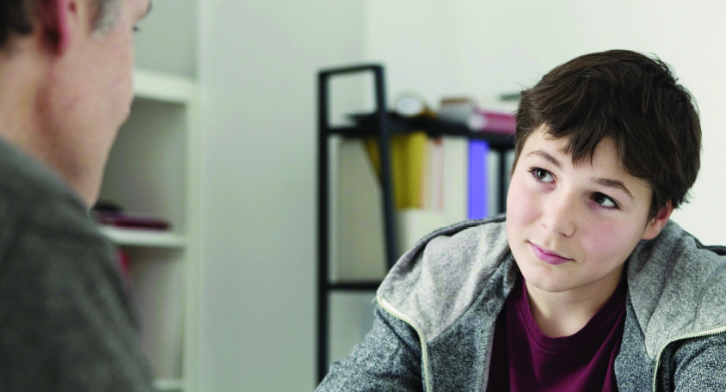
About the National Migraine Centre
Charity established over 40 years ago - no NHS support
Video or telephone consultations
People with migraine can refer themselves or their children
Pre-pay or donation basis – not-for-profit
Mainly GPs with specialist training in managing Migraine & other primary headaches
Our podcast, Heads Up, has had over 395,000 downloads

