Slide 1
Cervicogenic Mechanisms in Headache – The Case For…
Dr Alex Valori
Norfolk & Norwich Hospital
BASH GP meeting, Wolfson SPaRC 20/3/2026

Slide 2
Proposals
Cervical signs are present in most headache cases.
Trigeminal and Occipital pain may be provoked from Suboccipital Vectors.
Acute and ongoing headache may be relieved by cervical treatment.
Cervical nociception is a major contributor to headache.

Slide 3
Dilemma
Explain Cervical generation of Headache,
OR: to illustrate limitations of the Brain Disease model.
Notes:
2nd is too easy so I thought I should focus on the upper neck…

Slide 4
Background
Cervicogenic Headache is an accepted phenotype of Secondary Headache, - but diagnostic criteria are challenging.
Most ‘Primary’ migraine phenotype patients express neck symptoms in the early stages of attack onset.
NDI raised in 77% of Migraine, 87% of Chronic Migraine Pts. -1st order vectors give tightness, 2nd order, below C2, give pain.
- Yet this is dismissed as being generated by an initiating cerebral, suprathalamic, stimulus. Not from Cervicogenic origin. (Except in rheumatology clinic!)
Notes:
Polarity of politics & principles between Jes Olsen & Ottar. HIS high specificity/ low sensitivity.

Slide 5
Obvious Cervicogenic circumstances:
Post-traumatic Headache (Sport, Whiplash & ‘TBI’, & E-DS)
- mainly characterized as Migraine.
Many cannot sleep on one side without provocation of headache.

Slide 6
‘Brain Disease’ Anomalies
Why do intracerebral catastrophes occur without pain. e.g. Fits/CVA. - If there is pain, it’s not migraine.
Why does Whiplash & TBI produce Migraine?
Why matutinal Headache, after stress-free sleep.
Why do suboccipital injections provoke Migraine 7-10/7 before relief.
Notes:
Sea side / Grouse butt

Slide 7
Brain Anatomy – problems
The Decussation Enigma:
Cranial nerves do not Decussate.
PET scan activity is ipsilateral to Migraine pain.
- Hemiplegic symptoms are also ipsilateral.
? How
- Cervical signs are ipsilateral to dominant headache, and hemiplegic symptoms.
Notes:
MISS

Slide 8
Problems with cerebral genesis theory
Most Migraine medications, acute/prophylactic, don’t cross BBB.
CGRP prevalent in peripheral sensory pathways and in Spinal cord.
Why can patients not sleep on one side?
Why does V1 pain predominate?
What central mechanism accounts for pain provocation/abolition from Suboccipital Vectors like Scalenus Medius/Levator Scapulae?
Decussation anatomy: PET scan activity is Ipsilateral to dominant headache pain.
BUT peripheral neurosymptoms/Hemiplegic episodes are Ipsilateral to dominant headache.
- A Cervical Origin of pain accounts for these anomalies.
Notes:
Thinking Neck pain is caused by Migraine is like thinking the wind is caused by the trees waving their branches.

Slide 9
Cervical Anatomy
C0/1/2 is the critical region of neck-related Headache.
2nd order neurones of afferent Occipital Nerve & Trigeminal Nerve fibres occupy these spinal levels. -> As far as C3/4. (Inheritance - variable).
Disposition of Trigeminal Nuclei (V1 is Caudal). This accounts for predominant symptom profiles.
Spinal Trigeminal Nuclear chain variation is inherited.

Slide 10
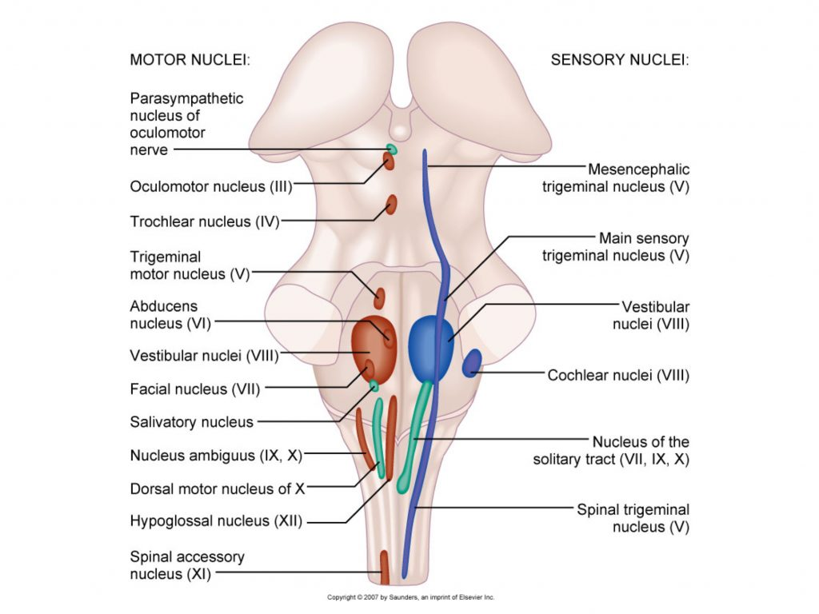

Slide 11
CEH Mechanism
No stabilising intervertebral discs at C0/1/2
This gives high mobility - at expense of vulnerability.
C0/1/2 intervertebral relationships are dependent on the forces of Suboccipital Vector Muscles.
Spinal cord stress results from influence of intervertebral relationships.
Trigeminal and Occipital neurones are affected.
Referred regional and holocranial pain are experienced.

Slide 12
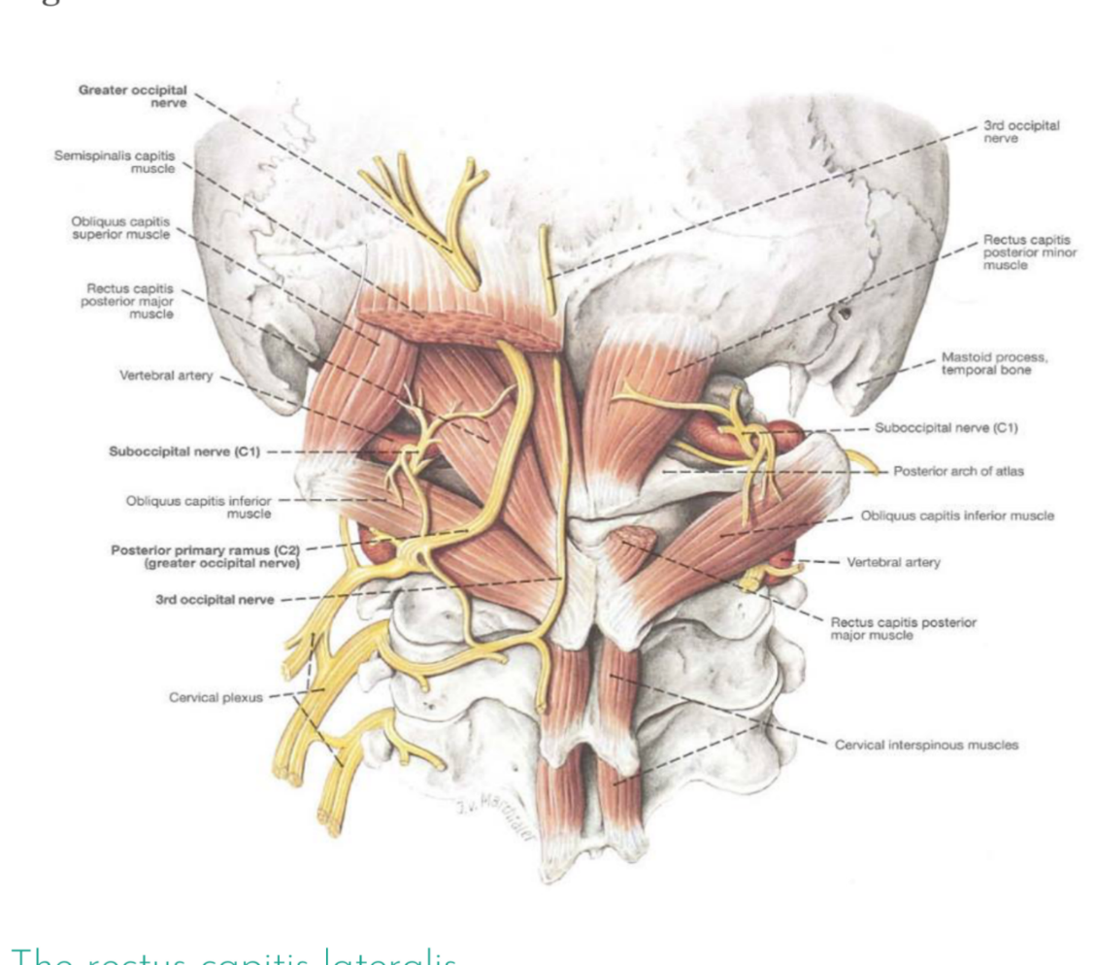
Suboccipital Triangle
Notes:
Interest in muscle dynamics…

Slide 13
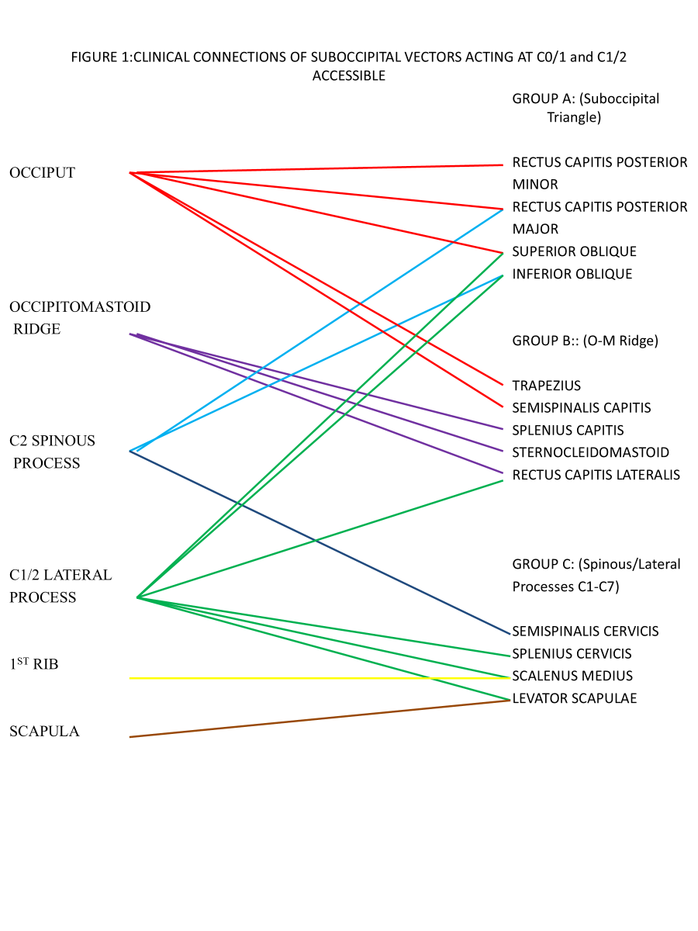
Notes:
My interest in muscle dynamics….

Slide 14
PAIN PROVOCATION
Systematic palpation of Suboccipital Vector aponeuroses may provoke only a regional pain that is characteristic of the patient’s habitual headache.
Provoked pain is almost invariably ipsilateral to the major suboccipital dysfunction.
All regional headache pains and facial pain have been provoked cervically.

Slide 15
Provocation: Migraine (1 of 2)
No. | Occiput | C1 | C2 | Splen | Scal M | Levator | MISC | EYE | V1 | V2 | V3 | Occiput | Parietal | EAR | Temple | MISC
12 | X |  |  |  |  |  |  | X
119 | XL |  |  |  |  |  |  | XR
27 | X |  |  |  |  |  |  | X
31 | X |  |  |  |  |  |  |  | X
32 | X |  |  |  |  |  |  |  | X
41 | X |  |  |  |  |  |  |  | X
56 | X |  |  |  |  |  |  |  | X
82 | XX |  |  |  |  |  |  |  | X
85 | X |  |  |  |  |  |  |  | X
118 | XL |  |  |  |  |  |  |  | XR
122 | X |  |  |  |  |  |  |  | X |  |  |  |  |  |  | Aura
78 | X |  |  |  |  |  |  |  | X |  |  | X
21 | X |  |  |  |  |  |  |  |  |  |  |  |  |  | X
96 | X | X |  |  |  |  |  |  | X
15 | X | X | X |  |  |  |  |  |  |  |  |  |  |  |  | Snow X
16 | Xt | Xt | Xt |  |  |  |  |  |  |  |  |  |  |  |  | Aura X
24 | X |  |  | X |  |  |  |  | X
111 | X |  |  | X |  |  |  |  | X
7 |  | X |  |  |  |  |  | X
61 |  | X |  |  |  |  |  | X
100 |  | X |  |  |  |  |  | X
120 |  | X |  |  |  |  |  | X
79 |  | X |  |  |  |  |  |  |  | X
101 |  | X |  |  |  |  |  |  |  | X
73 |  | X |  |  |  |  |  |  |  |  | X
75 |  | X |  |  |  |  |  |  |  |  | X

Slide 16
Provocation: Migraine (2 of 2)
No. | Occiput | C1 | C2 | Splen | Scal M | Levator | MISC | EYE | V1 | V2 | V3 | Occiput | Parietal | EAR | Temple | MISC
37 |  |  | X |  |  |  |  | X
125 |  |  | X |  |  |  |  |  | X | X | X
57 |  |  | X |  |  |  |  |  |  |  |  | X
74 |  |  | X |  |  |  |  |  |  |  |  | X
36 |  |  | X |  |  |  |  |  |  |  |  |  |  |  | X
2 |  |  |  | X |  |  |  | X
44 |  |  |  | X |  |  |  |  |  |  |  |  | X
114 |  |  |  | X |  |  |  |  |  |  |  |  |  | X
51 |  |  |  | X |  |  |  |  |  |  |  |  |  |  | X
76 |  |  |  | X |  |  |  |  |  |  |  |  |  |  | X
60 |  |  |  |  | X |  |  | X
28 |  |  |  |  | X |  |  | X |  |  |  |  |  |  | X
3 |  |  |  |  | X |  |  |  | X
6 |  |  |  |  | X |  |  |  | X
11 |  |  |  |  | X |  |  |  |  | X
4 |  |  |  |  | X |  |  |  |  |  | X
72 |  |  |  |  | X |  |  |  |  |  |  | X
117 |  |  |  |  | X |  |  |  |  |  |  | X
29 |  |  |  |  | X |  |  |  |  |  |  |  | X
8 |  |  |  |  | X |  |  |  |  |  |  |  |  |  | X
53 |  |  |  |  | X |  |  |  |  |  |  |  |  |  |  | Crown
19 |  |  |  |  | X |  |  |  |  |  |  |  |  |  |  | Eye Aut X
63 |  |  |  |  |  | X |  | X
84 |  |  |  |  |  | X |  |  |  |  |  | X
87 |  |  |  |  |  | X |  |  |  |  |  |  | X
93 |  |  |  |  |  |  | Aura |  |  |  |  |  |  |  |  | OnRt offLt
99 |  |  |  |  |  |  | RL shift |  |  |  |  |  |  |  |  | 2nd Aura changing sides

Slide 17
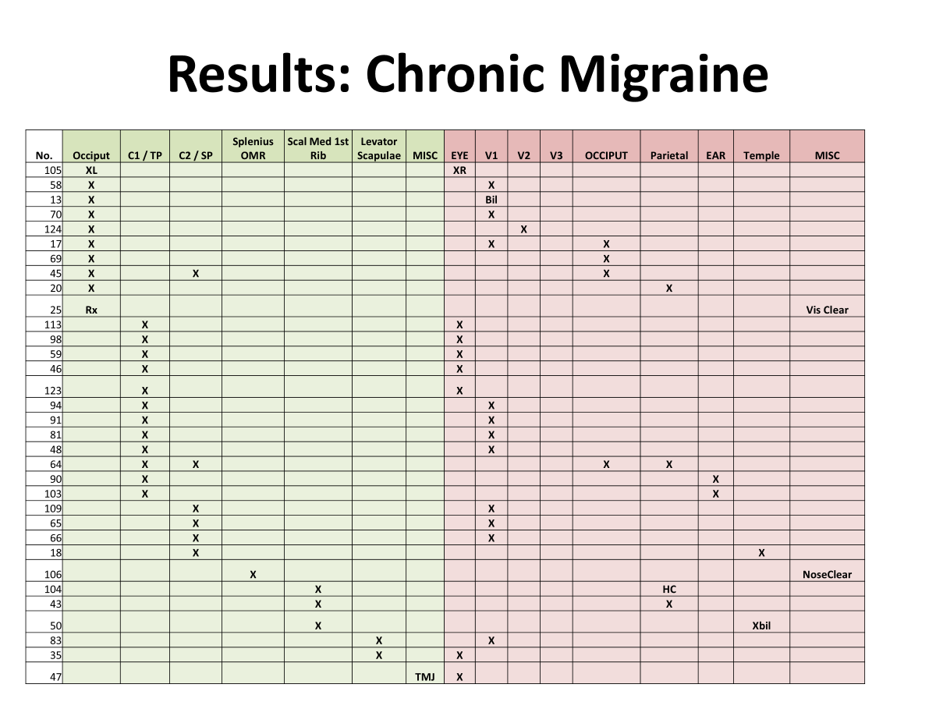
Notes:
Similar charts for Cluster Headache, Hemicrania, Sunct & Suna.

Slide 18
Provocation: CEH
No. | Occiput | C1 / TP | C2 / TP | Splenius | Scal Med | Levator | MISC | EYE | V1 | V2 | V3 | Occiput | Parietal | Ear | Temple | MISC
38 | X |  |  |  |  |  |  | X
92 | X |  |  |  |  |  |  |  |  |  |  |  |  |  | X
126 |  | X |  |  |  |  |  | X
115 |  | X |  |  |  |  |  |  |  |  |  |  |  |  | X
62 |  | X |  | X |  |  |  |  |  |  |  |  |  |  |  | Facial Pain
40 |  |  | X |  |  |  |  |  |  |  |  | X
71 |  |  | X |  |  |  |  |  |  |  |  | X
116 |  |  |  | X |  |  |  |  | X
80 |  |  |  |  | XX |  |  |  | XX
33 |  |  |  |  | X |  |  |  |  |  | X
34 |  |  |  |  | X |  |  |  |  |  | X
97 |  |  |  |  | X |  |  |  |  |  |  | X
112 |  |  |  |  | X |  |  |  |  |  |  | X
9 |  |  |  |  | X |  |  |  |  |  |  | X
68 |  |  |  |  | X |  |  |  |  |  |  | X
89 |  |  |  |  | X |  |  |  |  |  |  |  |  | X
54 |  |  |  |  | X |  |  |  |  |  |  |  |  |  | X
121 |  |  |  |  |  |  | ACJ | X

Slide 19
Provocation: SUNCT
No. | Occiput | C1 | C2 | Splenius | Scal Med | Levator | MISC | EYE | V1 | V2 | V3 | OCCIPUT | Parietal | Ear | Temple | MISC
127 | X |  |  |  |  |  |  |  | X
23 | X | X | X | X | X | X |  |  |  |  |  |  |  |  | X
110 |  | X |  |  |  |  |  |  |  | X
42 |  |  | X |  |  |  |  |  | X
39 |  |  |  | X |  |  |  |  | X
55 |  |  |  | X |  |  |  |  | X
Provocation: Hemicrania
No. | Occiput | C1 | C2 | Splenius | Scal Med | Levator | MISC | EYE | V1 | V2 | V3 | Occiput | Parietal | Ear | Temple | MISC
127 | X |  |  |  |  |  |  |  | X
23 | X | X | X | X | X | X |  |  |  |  |  |  |  |  | X
110 |  | X |  |  |  |  |  |  |  | X
42 |  |  | X |  |  |  |  |  | X
39 |  |  |  | X |  |  |  |  | X
55 |  |  |  | X |  |  |  |  | X

Slide 20
Treatment
Conventional steroid/LA Injection to dysfunctional Suboccipital Vector aponeuroses:
Objective => To break cycle of pain and promote Rehabilitation.
(+ Neck stretch exercises to restore function).
The GON does not need to be treated except in cases of Occipital Neuralgia.

Slide 21
Relief
A proportion of relief of active headache may arise from simple counter-tension.
Injection =>75-80% benefit in relief of current headache, also Aura & autonomics, breaking cycles of pain, and giving significant relief for 2-4 months.
Subsequent injxs give progressive benefit of frequency/severity/duration and treatment response.

Slide 22
Phenotypic Spectrum of Response
1. Cervicogenic headache responds.
2. All ‘Primary’ phenotypes have responded positively.
3. Most treated is Chronic Migraine.
4. Episodic Cluster can be aborted, & figures suggest remission extension. (CCH resistant)

Slide 23
Conclusion
Cervical signs are present in most headache cases.
Trigeminal and Occipital pain may be provoked from Suboccipital Vectors.
Acute and ongoing headache may be relieved by cervical treatment.
Cervical nociception is a major contributor to headache across the spectrum of phenotype.

Slide 24
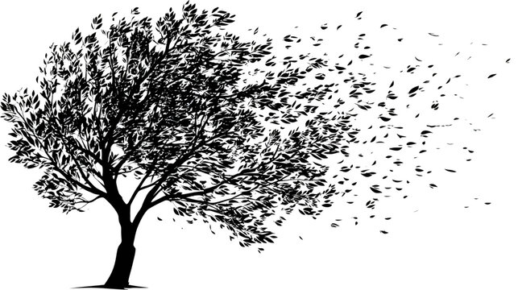
Finally…
If migraine is a ‘Brain Disease’,
- then the wind is caused by the trees waving their branches.

