Slide 1
Migraine Management
From Science to Practice

Slide 2
Introduction and Content
Dr Lauren Wellburn
GP in Leeds and GPwER Headache for Bradford Community Neurology Service
Education Fellow – National Migraine Centre
Disclosures: Honoraria for speaking AbbVie and Pfizer. Consulting/Steering Group Honoraria AbbVie and Pfizer
Aims:
1. Explain core migraine neurophysiology in clinically useful terms
2. Understand and use acute treatments more effectively
3. Recognise and manage medication overuse headache
4. Choose and escalate preventive strategies appropriately

Slide 3
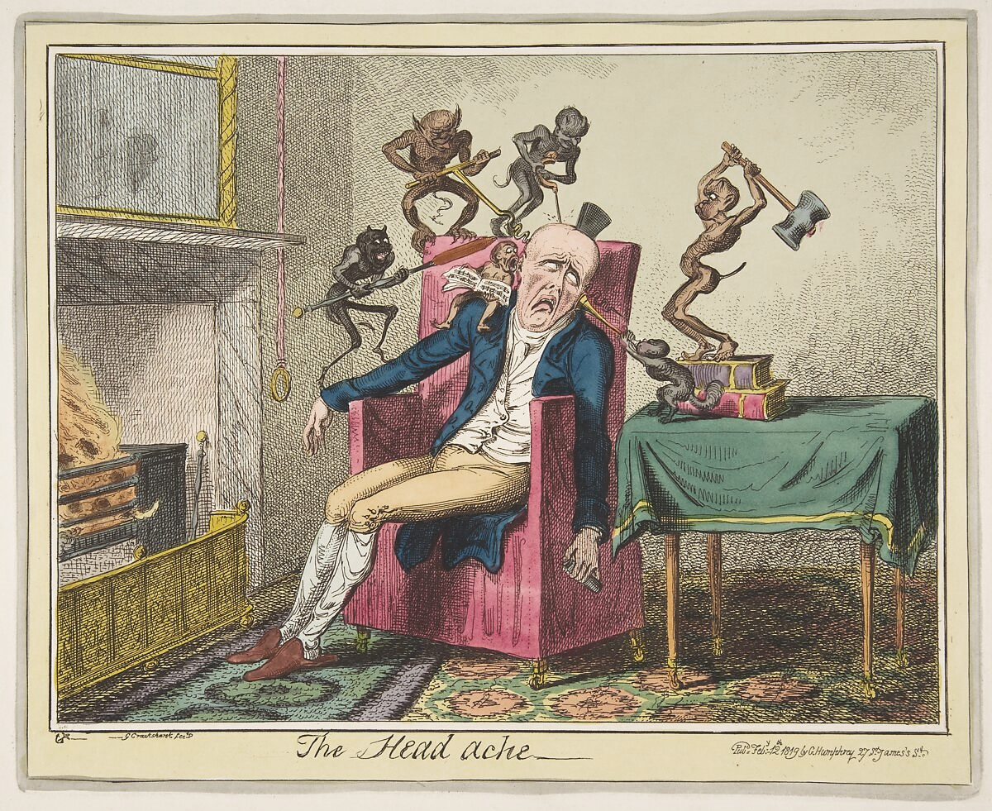
Migraine in History
It is said that the earliest description of migraine as a periodic syndrome appeared 3,000 B.C. in Mesopotamian poems.
Hippocrates (c.460-c.370 B.C.) provided an account of severe pain in one half of the head associated with disturbance of sight. "he seemed to see something shining before him like a light, usually in part of the right eye...a violent pain supervened in the right temple, then in all the head and neck.... vomiting, when it became possible, was able to divert the pain and render it more moderate.”
Notes:
By George Cruikshank 1800s

Slide 4


Migraine in the modern world

Slide 5
The Science

Slide 6
Migraine is a disorder of brain network excitability and sensory processing
Notes:
Migraine starts as altered brain excitability and sensory processing. The hypothalamus/brainstem lower the attack threshold, the trigeminovascular system then generates the headache, CGRP amplifies the signal, aura is usually a cortical spreading depolarisation phenomenon, and repeated attacks can ‘turn up the volume’ in the CNS so touch starts to hurt and attacks become more frequent.”
Breaking down each point
Premonitory phase = hypothalamus/brainstem activation
Think of this as the brain’s homeostasis and arousal network starting to misfire before pain begins. That fits the yawning, thirst, food craving, mood change, fatigue, neck stiffness, and light/sound sensitivity people report hours to days before headache.
Trigeminovascular activation = the pain phase
This is the pain-generating circuit. Nociceptors in the meninges and large cranial vessels send signals via the trigeminal system to the brainstem and thalamus, producing the headache and associated nausea, photophobia and phonophobia.
CGRP = the key amplifier
CGRP is best described as a chemical messenger that boosts trigeminal pain signalling and contributes to neurogenic inflammation/sensitisation. It is not “the whole disease”, but it is a very important part of the cascade — which is why CGRP-targeted treatments work. 1
Aura = cortical spreading depolarisation
Aura is most plausibly a slow wave of neuronal/glial depolarisation across the cortex. If it involves visual cortex you get visual aura; if sensory/language cortex, sensory or speech symptoms. NICE describes aura as fully reversible neurological symptoms developing gradually and lasting 5–60 minutes.
Central sensitisation = the nervous system turns up the gain
Summary:
Migraine is a reversible brain-state disorder:
hypothalamus/brainstem trigger → trigeminovascular pain pathway activates → CGRP amplifies signalling

Slide 7
Activation
Hypothalamus/brainstem generators become dysfunctional — increased activity/misfiring reduces normal inhibitory control
This triggers the cascade of amplification within the trigeminal nucleus and thalamus
Activation of trigeminal nerve fibres innervating the meningeal vessels causes release of neuropeptides (CGRP, substance P, PACAP)
Neuropeptide release → vessel dilation + neurogenic inflammation → sensitises nerve endings → fire more readily to normal stimuli
Amplification
Trigeminal nucleus acts as an amplifier. It gathers input from face, forehead, neck, shoulders, and meninges, but is poor at localising signal origin
Relays amplified signal to the thalamus (pain modulator) → pain can be felt anywhere across this network
Explains why >40% of attacks start in the neck, and why pain can occur in face, sinuses, teeth, or beyond (e.g. stomach)
CGRP released at trigeminal nucleus synapse sensitises second-order neurons → turns up the "gain," so the amplifier fires more readily and strongly
Amplified thalamic activity spills into shared visual/auditory circuits → normal light/sound levels perceived as amplified (photophobia/phonophobia
Autonomic neuronal activity is also heightened during amplification, causing symptoms such as nausea, vomiting, flushing, sweating, a fast heart rate, and cranial autonomic features like a runny/stuffy nose, watery eyes, and ear fullness

Slide 8
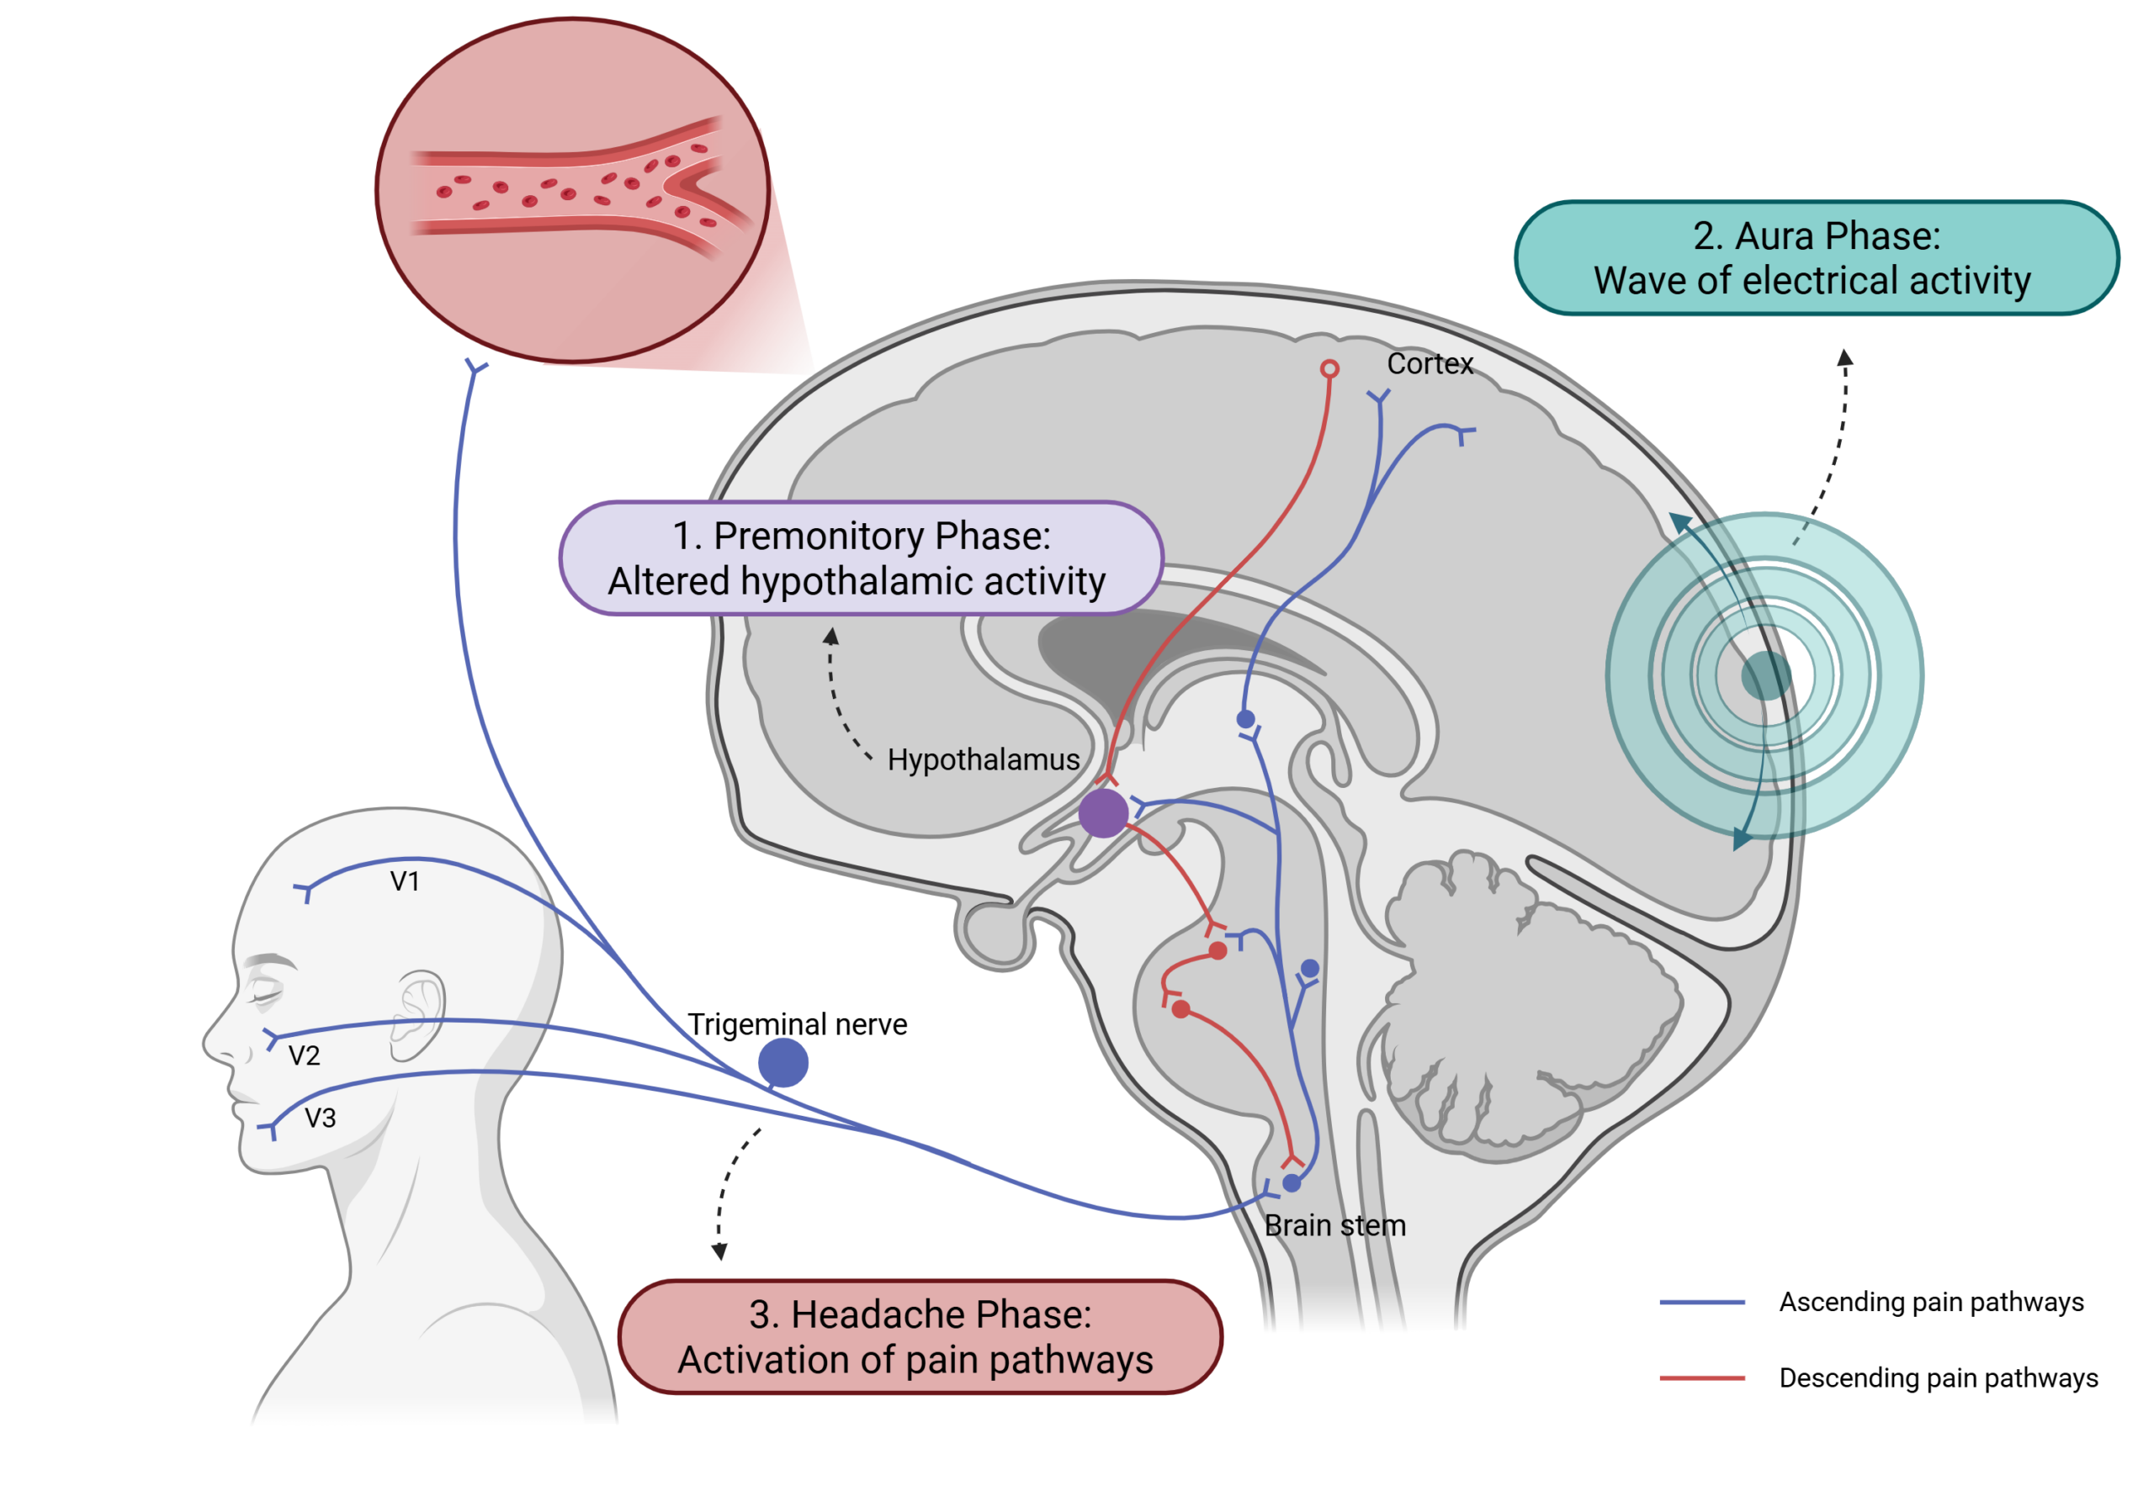
The hypothalamus is recognised as an early trigger structure because it regulates circadian rhythms, sleep, arousal, feeding and homeostasis which map onto common premonitory symptoms such as yawning, fatigue, thirst and food craving.
There is also strong evidence for cortical hyperexcitability, particularly in the occipital cortex, which helps explain the visual phenomena of aura.

Slide 9
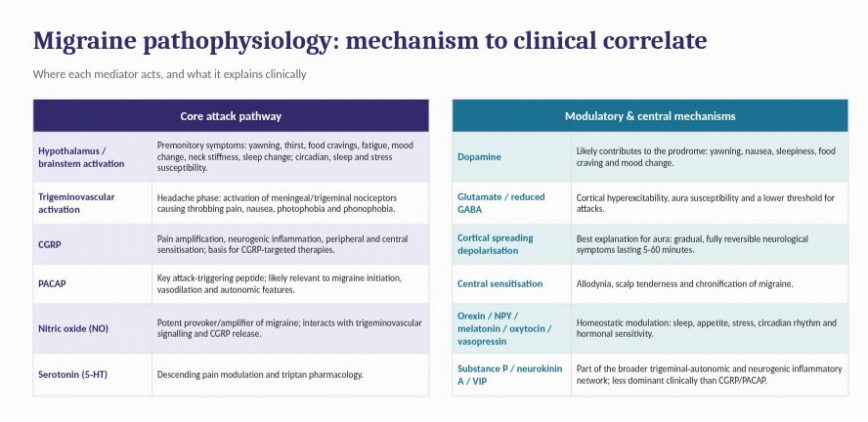

Slide 10
Cortical Spreading Depression
Migraine aura is a fully reversible focal neurological syndrome, most often visual, sensory or speech/language, which develops gradually over at least 5 minutes and lasts 5–60 minutes
Cortical spreading depression is a slow wave of neuronal and glial depolarisation across cortex, followed by transient suppression of activity
It typically starts in occipital cortex and spreads at about 2–6 mm/min, producing the stereotyped “march” of symptoms
It may also activate trigeminovascular pain pathways
Notes:
The proposed link to pain is that this cortical event is not confined to the cortex: it generates local biochemical changes, including extracellular potassium, glutamate, ATP, hydrogen ions and nitric oxide, which may diffuse towards the pia and meninges and activate meningeal nociceptors. That provides a route into the trigeminovascular system.

Slide 11
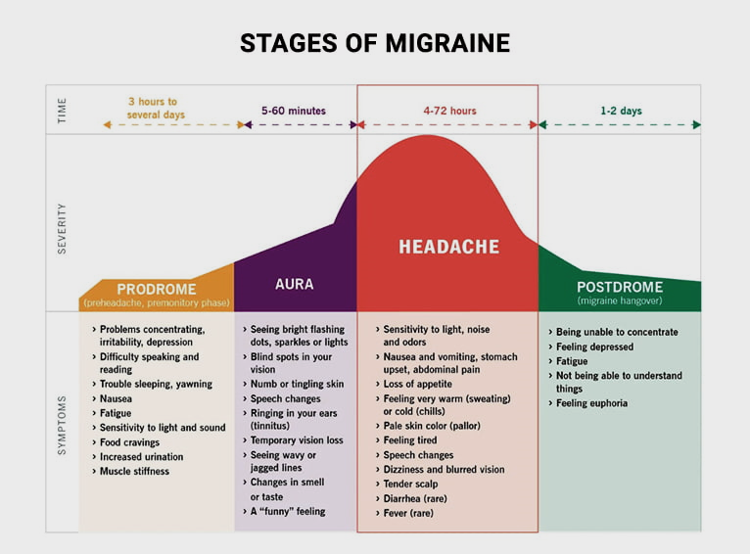

Slide 12
Aims of
Acute Medication

Slide 13
Stop the attack early
Relieve pain and associated symptoms (MBS)
Restore function
Reduce repeat dosing and risk of medication-overuse headache

Slide 14
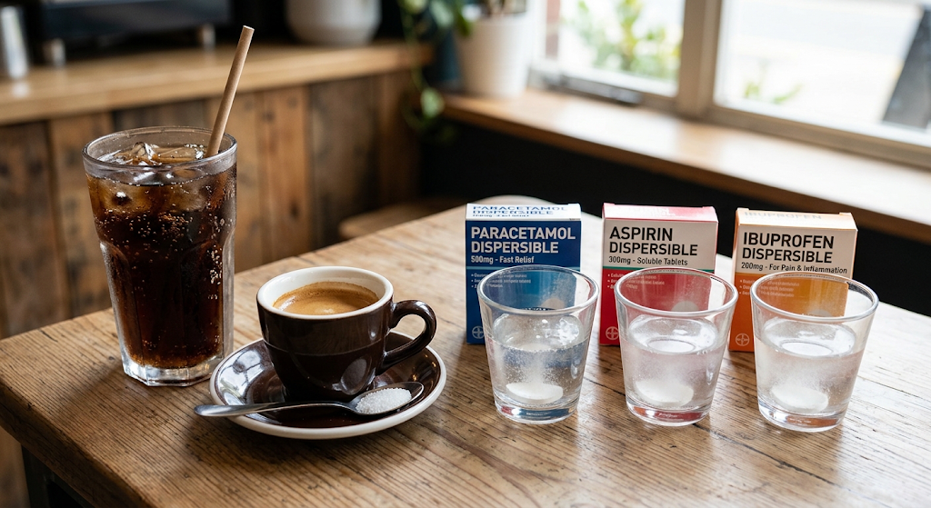


Opioids
OR
1000mg
900mg
400-600mg
+/- PPI and +/- Prokinetic Anti-Emetic e.g. Metoclopramide 10mg and potentially in combination with a Triptan medication

Slide 15
Triptans
There are 7 – Sumatriptan, Zolmitriptan, Eletriptan, Almotriptan, Rizatriptan, Naratriptan and Frovatriptan
Some have faster onset of action; some have longer half lives
Can tailor to your patient e.g. early vomiting – nasal Zolmitriptan
How to take: Take at onset of migraine (post aura if there is one)
    If no effect by two hours don't repeat
    If some effect but some symptoms remain or rebound then can take second in 24hrs
Max 8 days use per month
May not work every attack and may need to increase dose
Lack of response to one triptan doesn't mean lack of response to others

Slide 16
Effective acute management looks like...
Pain freedom (or near enough) by 2 hours
No rebound or responds to 2nd dose
Not having to avoid taking e.g. at work due to side effects
Not having to use further acute analgesia within 24 hours
Feels like can function again
If not achieving this in good proportion of attacks
Switch
Increase the dose
If two or more triptans tried – CCRP eligible

Slide 17
When to consider a Gepant
Triptan Contraindication e.g. MI/CVA/IHD or uncontrolled blood pressure
Intolerable side effects e.g. throat tightness, somnolence, dizziness, paraesthesia
Lack of efficacy – pain freedom, MBS freedom, can they take freely e.g. at work

Slide 18
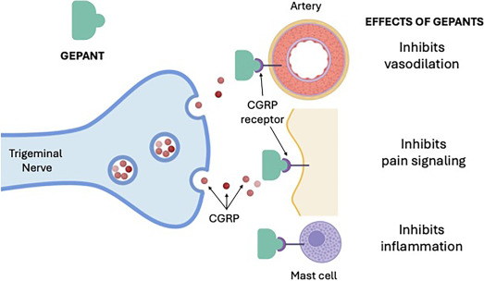
Gepants for acute management
Where simple analgesia ineffective/CI and two or more triptans have (i) not been tolerated (ii) are ineffective or (iii) are contraindicated
They are small molecule oral calcitonin gene related peptide receptor antagonists – "Anti-CGRPs"
What is CGRP release doing in migraine:
Vasodilation of meningeal blood vessels
Neurogenic inflammation — a local sterile inflammatory response around the meninges
Peripheral sensitisation of trigeminal nerve endings, making them fire more readily to normal stimuli (e.g. vascular pulsation → throbbing pain)
Central sensitisation — CGRP acts at the trigeminal nucleus synapse, sensitising second-order neurons and amplifying signals relayed to the thalamus
Notes:
Rimegepant: 2-hour pain freedom about 19–21% vs 11–14% placebo; pain relief about 56–59% vs 43–46% placebo
Atogepant: 2-hour pain freedom 24.3% vs 13.1% placebo; pain relief 72.1% vs 54.4% placebo

Slide 19
Gepants for acute management
In some areas of the country prescribable as per NICE/SIGN eligibility – others require A&G to neuro or specialist recommendation, some referral.
Two options for ACUTE use.
Atogepant
60mg oral tablet. Max 60mg daily
Side effects: nausea, constipation, somnolence, weight loss, hypersensitivity
Interactions: CYP3A4/OATP
Avoid: Severe hepatic, pregnancy, paediatric population. Caution: Raynauds.
Reduce dose: End stage renal failure, CYP3A4 meds
Also has a preventative indication (episodic or chronic)
Rimegepant
75mg oral lyophilisate. Max 75mg daily
Side effects: Nausea, hypersensitivity
Interactions: CYP3A4/Pg-P
Avoid: Severe hepatic or end stage renal failure, pregnancy, paediatric population. Caution: Raynauds
Also has a preventative indication (episodic)
Although CVA/Recent MI etc not listed in SmPC for gepants explicitly as CI/Caution - patients with a recent MI, stroke, or transient ischemic attack (TIA) within the prior 6 months were strictly excluded from all phase 3 clinical trials and most clinical units restrict too <6 months from event or with ongoing instability/high vascular risk factors
Notes:
Rimegepant: 2-hour pain freedom about 19–21% vs 11–14% placebo; pain relief about 56–59% vs 43–46% placebo
Atogepant: 2-hour pain freedom 24.3% vs 13.1% placebo; pain relief 72.1% vs 54.4% placebo

Slide 20
Medication Overuse Headache

Slide 21
MOH is a secondary headache occurring in a patient with a pre-existing headache disorder, with headache on 15 or more days per month and regular overuse for more than 3 months of acute/symptomatic headache medication.
Usual overuse thresholds are:
Triptans, Opioids, Ergots, combination analgesics: 10 or more days/month (8-10)
Paracetamol, Aspirin, NSAIDs, alone or in any combination: 15 or more days/month (10-14)

Slide 22
Who might you suspect MOH in
High headache frequency (or increasing frequency over several months from a previously manageable baseline)
Frequent acute medication use (days not doses)
Triptans, opioids, combination analgesics, or multiple acute drugs on records or diaries
Psychiatric comorbidity, especially anxiety and depression
Other chronic pain conditions
Notes:
The best-supported mechanisms are central sensitisation, reduced descending pain inhibition, and increased excitability of the trigeminal/cortical pain system.
In practical terms, frequent use of triptans, opioids, combination analgesics, and related agents may:
sensitise trigeminal pathways and promote allodynia,
facilitate cortical spreading depression / cortical hyperexcitability,
alter serotonergic and endocannabinoid modulation,
increase CGRP-related pronociceptive signalling,
for some drugs, produce dependence-like behaviour that perpetuates overuse

Slide 23
Managing MOH
Explain the diagnosis clearly and non-judgementally (diaries objective)
Reassure that MOH is treatable – over various studies roughly half to three quarters had improvement in their headache frequency
Withdraw all overused acute headache medications
Advise abrupt stop rather than gradual reduction for typical MOH unless drugs which require titration to avoid withdrawal
Include alcohol and caffeine where applicable
Expect short-term worsening before improvement (~2 weeks)
Provide close follow-up and support (think med3s, anti-emetics)
Consider preventive treatment for the underlying headache disorder

Slide 24
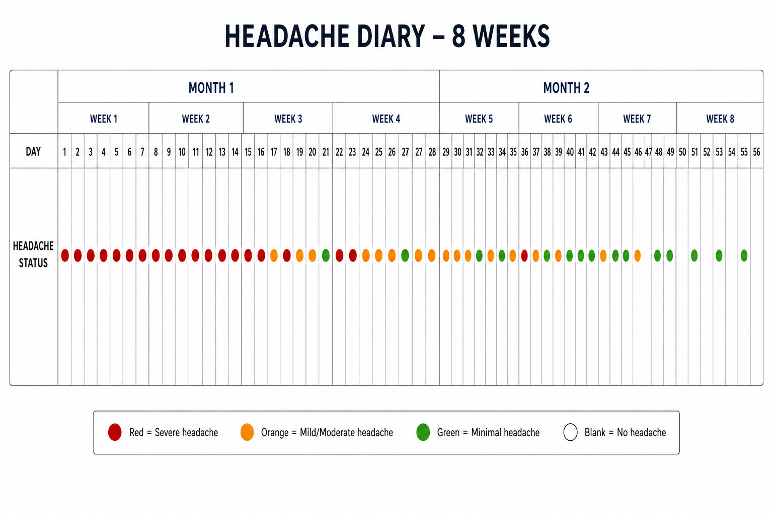

Slide 25
Aims of Preventative Medication

Slide 26
Reduce attack frequency, severity and duration
Improve disability, function and quality of life
Reduce need for acute medication and, in turn, lower risk of medication-overuse headache

Slide 27
​Targeted CGRP treatments / BOTOX can be considered and prescribed if three or more standard preventatives (usually from Amitriptyline/Nortriptyline, Candesartan, Propranolol or Topiramate) have been considered/tried and resulted in treatment failure, aren't tolerated or aren't suitable.
Start a dose and come up with a titration plan e.g. 10mg every 2 weeks until X dose then review at X months
Consider your patient – low and slow or able to move quicker
Utilise texts, pharmacist etc to keep the ball rolling
Use diaries to see progress
Counsel what to do if SE

Slide 28
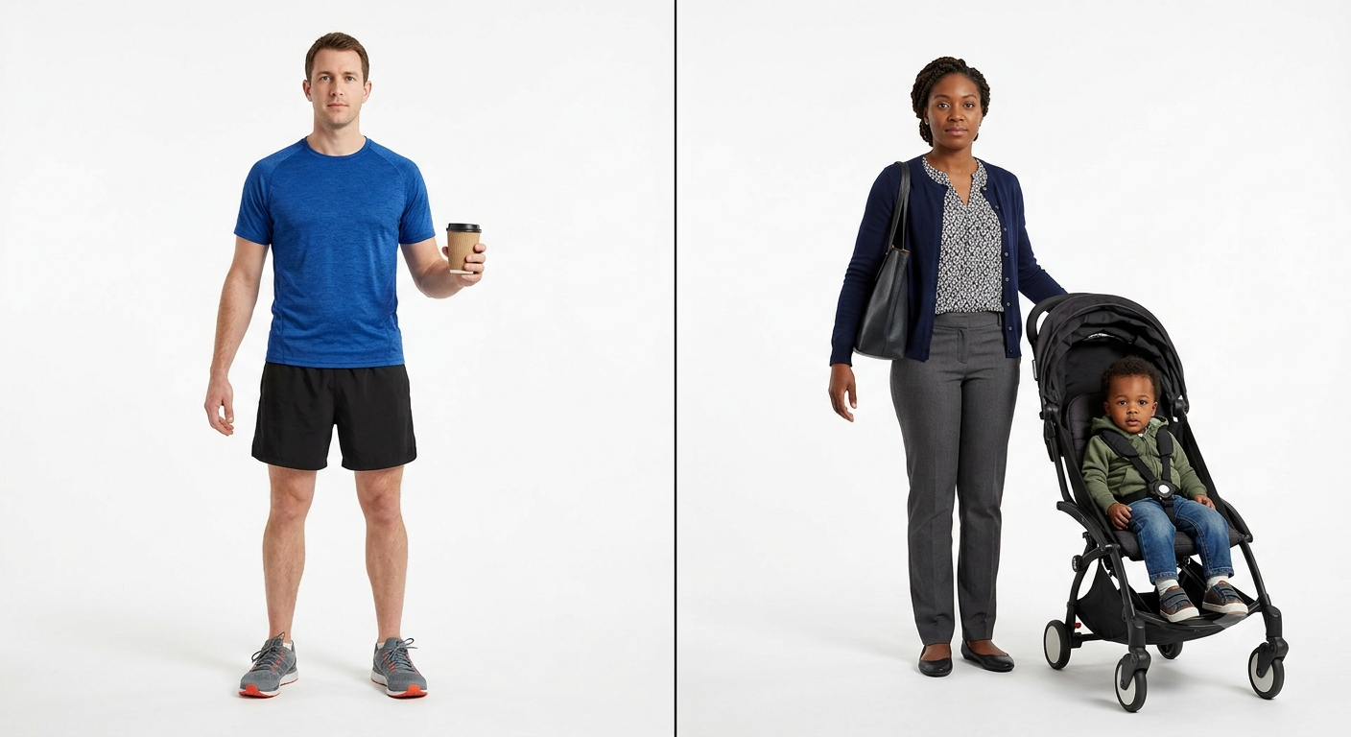

Slide 29
​
Main principle to follow: Trial at MAX tolerated or therapeutic dose for 3 months before reviewing to judge efficacy (use diaries)​
​
Episodic: Want to see ≥50% reduction in frequency and/or severity ​
Chronic: Want to see ≥30% reduction in frequency and/or severity​
At 12 weeks, if no improvement, stop the medication +/- switch
If successful, review the continuing need at 6 months. Can consider a trial weaning down or off to see if benefit sustained.

Slide 30
Prevention escalation
NICE/SIGN recommend further escalation for adults with ≥4 migraine days/month, only if ≥3 preventive medicines have failed (not worked, not tolerated) or not been deemed suitable or safe.
If episodic migraine:
Rimegepant 75mg Alternate Days or Atogepant 60mg OD
If chronic migraine:
Atogepant 60mg OD
Rimegepant: ≥50% responder rate (12 week) 49.1% vs 41.5%
Atogepant: ≥50% responder rate (12 week)
  Episodic: 60% vs 29%
  Chronic 41% vs 26%
Important additional considerations (but not official guidance/universal practice):
Manage vascular risk factors e.g. smoking, optimise blood pressure (check BP first three months)
If not effective referral to neurology to discuss Anti-CGRP injectables (monoclonal antibodies) or BOTOX
Notes:
gepants do not cause classic direct vasoconstriction like triptans, but they block CGRP, which is a key endogenous vasodilator. In people who already have Raynaud’s or other microvascular vulnerability, removing that CGRP-mediated “protection” may let vasospasm become more likely or more symptomatic

Slide 31
