Slide 1
A Framework for taking a Headache History: Some Tips

Slide 2
New or Existing Headache
New presentation with Headache
Secondary
Headache
Syndromes
Due to
History
Examination
Primary
headache
syndrome
other
Diagnostic question
management questions
CNS infection
Systemic
illness/GCA
Need to understand the purpose of the questions we ask
intracranial
haemorrage
Raised or lowered ICP
headache

Slide 3
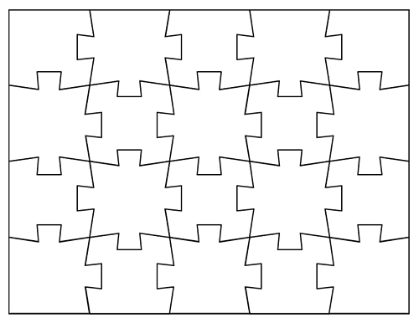
Headache Diagnosis: piecing the jigsaw together
?
?
?
?
?
?
?
?
?
?
?
?
?
?
?
?
?
?
?
?

Slide 4
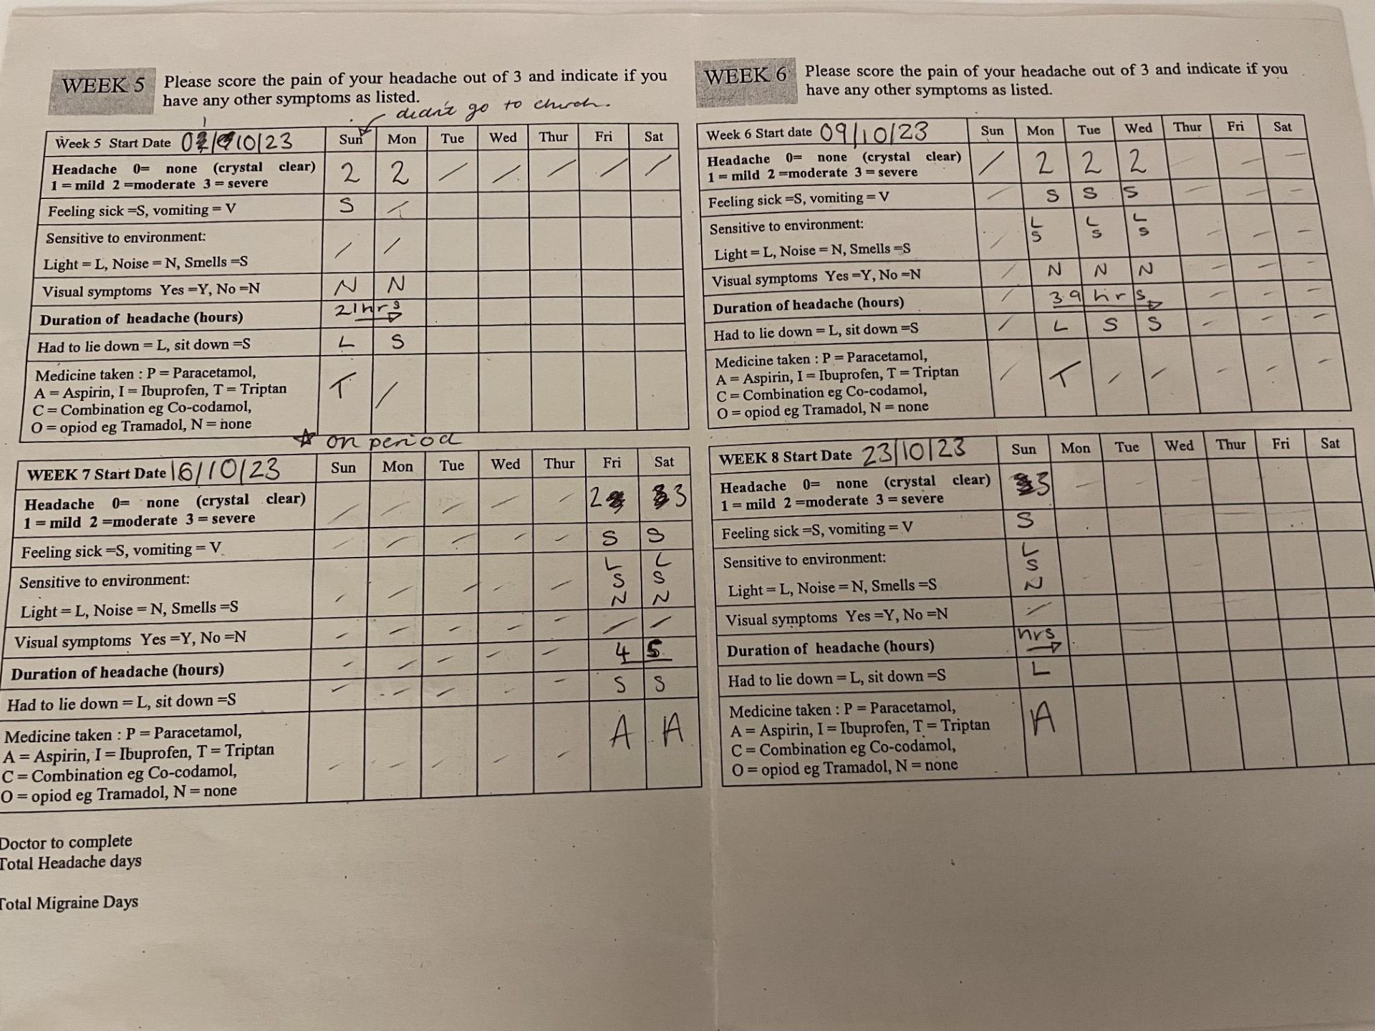
Starting point: Is this a new headache or transformation or worsening of an existing headache?
Is the patient a headache prone person or is headache new for them?
First ever and previous headache, include menstrual headache and undeserved hangovers, expand “normal” headache
Assess frequency, ask about crystal clear days
How many bad headache days a month?
Family history of headache
Based on 1. SIGN. SIGN 107. Diagnosis and Management of Headache in adults. Published November 2008. 2. Schytz HW, et al. J Headache Pain. 2021; 22(1):22.

Slide 5
New Headache
Headache onset, what was happening the day the headache started or before it? What were you doing when the headache started? eg infection, vaccination, trauma, surgery, new medication, carbon monoxide exposure
How quickly it started? Thunderclap?
Positional , worse lying/standing
Valsalva triggers?
Risk factors for secondary headache: previous cancer, HIV, hypermobility, recent pregnancy, age, obesity, analgesia use
Systemic symptoms: fever, rash, shoulder stiffness, new eye symptoms

Slide 6
Mnemonic for Red Flags
SNOOP
Systemic symptoms and secondary risk factors
Neurological signs and symptoms
Onset
Older (>50)
Progression or change post headache

Slide 7
The headache
Long or short headache, < or >4 hours , untreated duration
Site ? Strictly unilateral ?V1,2,3, ? C2 ? neck
What would you want to do when you have a headache?
Character of pain though not always helpful
Associated symptoms, may have to tease them out
Nausea, vomiting, sensitivity noise/ light/smell/movement, dizziness, cognitive impairment, word finding difficulty, cranial autonomic symptoms, neck stiffness, allodynia,
Neurological symptoms: visual, sensory, motor ? Aura
Prodrome/ postdrome/interictal symptoms
Triggers: stress/hormones/disrupted routine/ weather
Co-morbidities

Slide 8

Hidden Clues
Aura
Yawning
Cranial
Autonomic
symptoms
Tinnitus
Hormones
Fatigue
Allodynia
Cognitive
Weather

Slide 9
Management
Patients ideas, concerns, expectations
Contraception/ pregnancy plans
Previous Treatment/self management
Vomiting, late or early?
Timing of acute treatment
Route of acute treatment
Preventer treatments, dose, duration, tolerability
Co-morbidities

Slide 10
Acronyms as Mnemonics for those that like them
SOCRATES
Site
Onset
Character
Radiation
Associations
Time course
Exacerbating/relieving/ precipitating factors
Severity
OLD CAART
Onset
Location
Duration
Characteristics
Associated Factors
Aggravating factors
Relieving factors
Treatments

