Slide 1
Headache Diagnosis and Management in Primary Care

Slide 2
New or Existing Headache
New presentation with Headache
Secondary
Headache
Syndromes
Due to
History
Examination
Primary
headache
syndrome
other
Diagnostic question
management questions
CNS infection
Systemic
illness/GCA
Need to understand the purpose of the questions we ask
intracranial
haemorrage
Raised or lowered ICP
headache

Slide 3
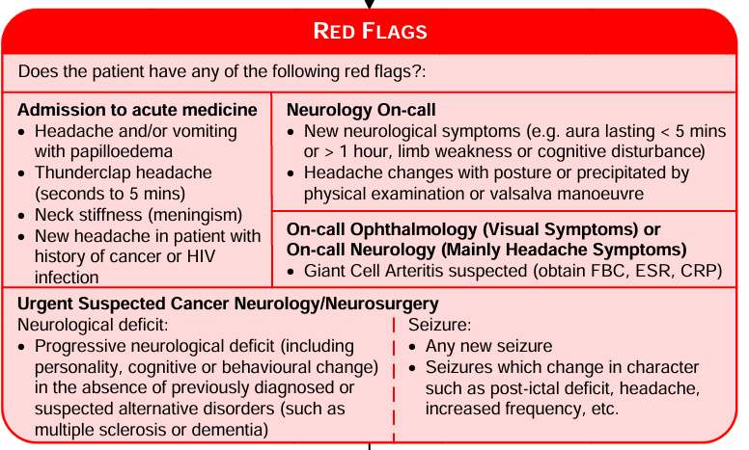
Notes:
My examples: cerebral sinus thrombosis pt. pt with headache, history of previous cancer.

Slide 4

Mnemonic for Red Flags
SNOOP
  Systemic symptoms and secondary risk factors
  Neurological signs and symptoms
  Onset
  Older (>50)
  Progression or change in headaches

Slide 5

Brain Tumours and Headache
positive predictive value (PPV) of isolated headache for brain tumour in general practice is well under 0.1% (i.e., <1 in 1,000 consultations).
In large primary‑care datasets, migraine‑like headaches have a positive predictive value (PPV) for brain tumour of <0.01% (less than 1 in 10,000).
If a patient presents with classic migraine symptoms and a normal neurological exam, the probability of a brain tumour is vanishingly small

Slide 6
Previous Cancer History
In patients with a previous cancer diagnosis who present with new headache, the likelihood of a brain tumour (usually a metastasis) is around 3–10% in published studies.
So, arrange an MRI !!

Slide 7
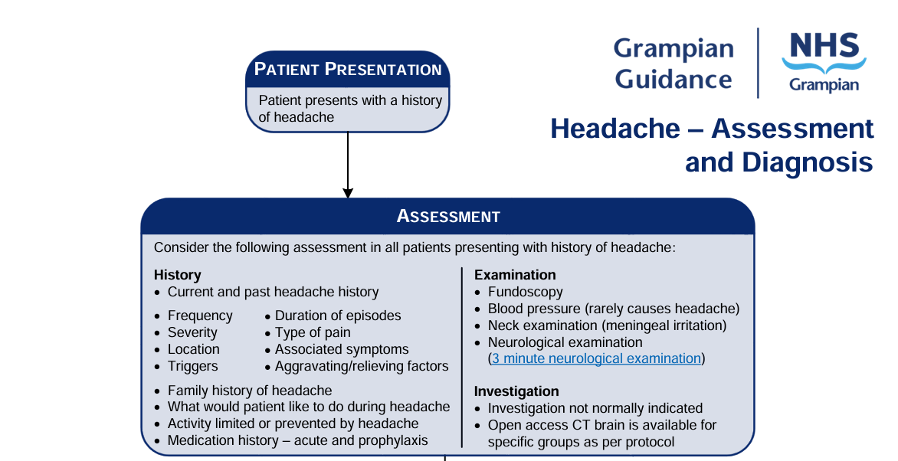

Slide 8

Neurological Examination

Slide 9
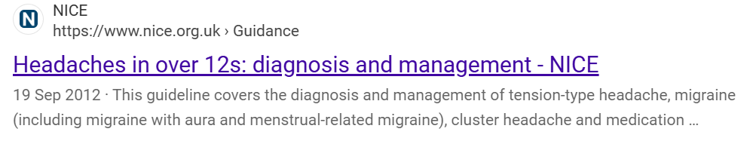

Slide 10
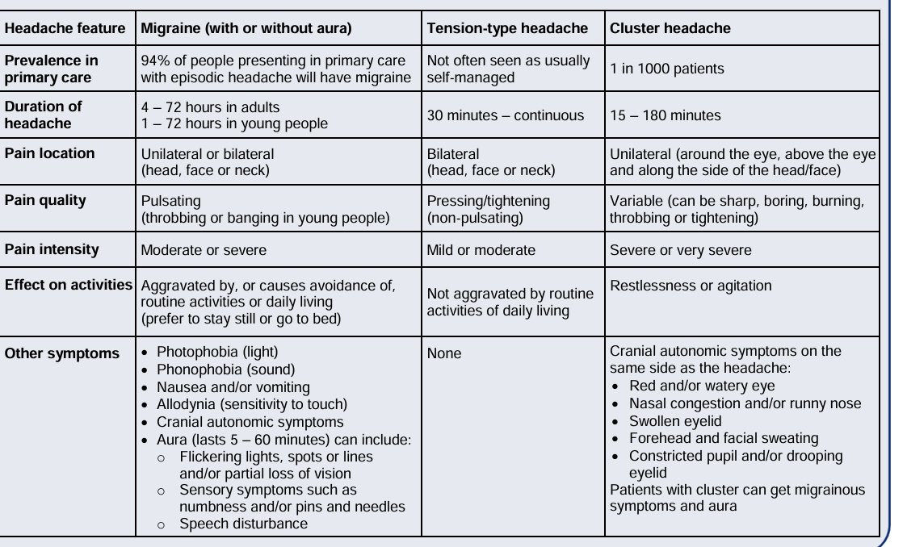
Notes:
See NICE 2012 Headaches > 12 years old

Slide 11
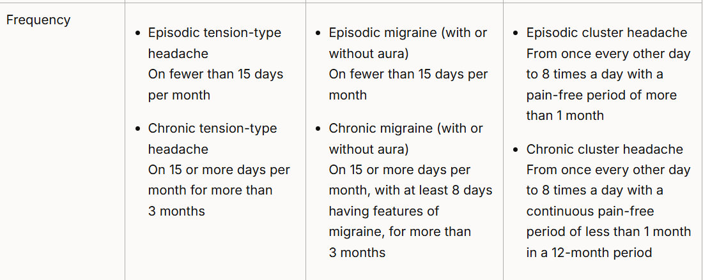

Slide 12
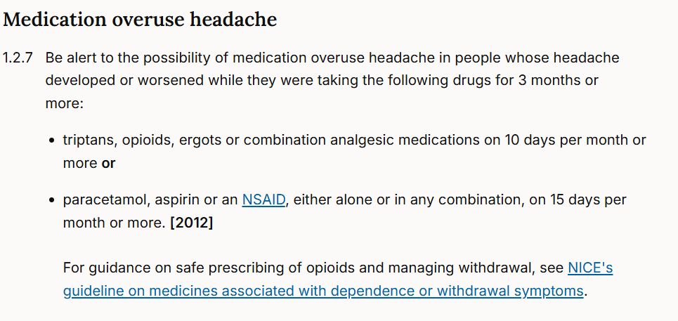


Slide 13
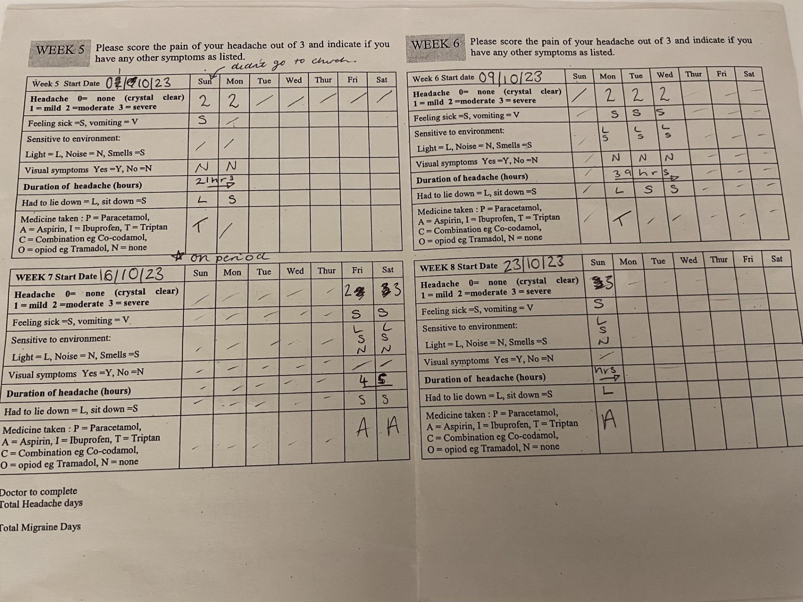
Starting point: Is this a new headache or transformation or worsening of an existing headache?
Assess frequency, ask about crystal clear days
How many bad headache days a month
More than one headache type ?
Based on 1. SIGN. SIGN 107. Diagnosis and Management of Headache in adults. Published November 2008. 2. Schytz HW, et al. J Headache Pain. 2021; 22(1):22.

Slide 14
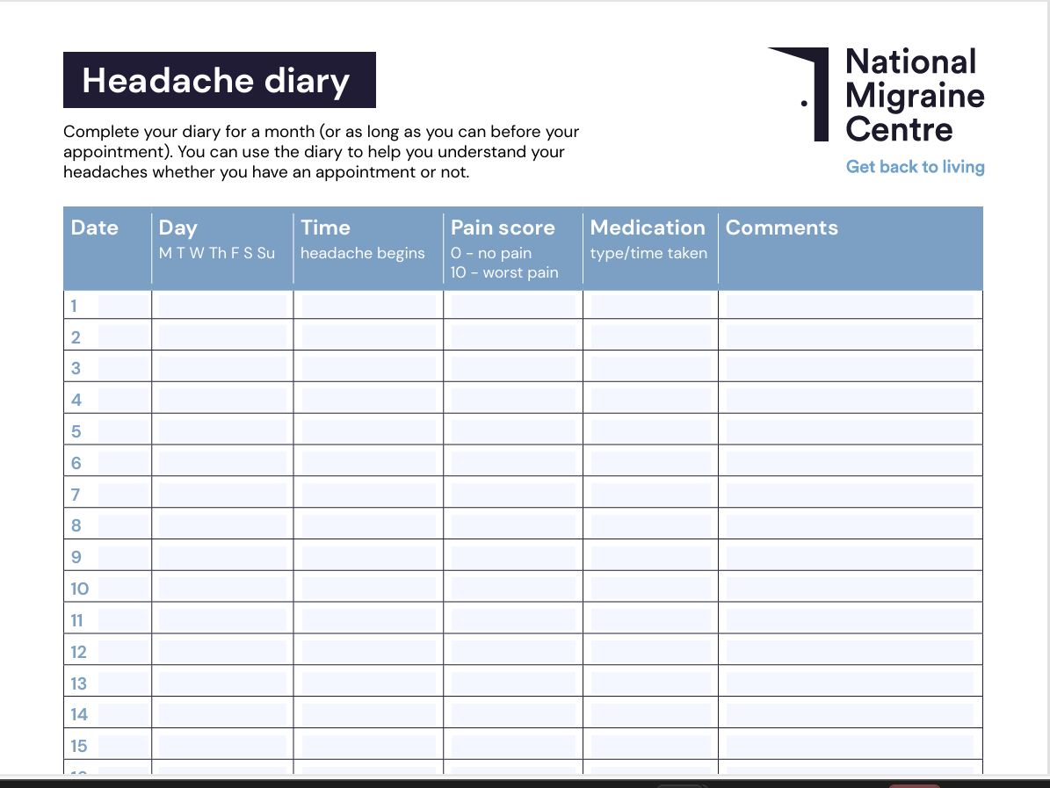
Notes:
Why are headache diaries important: diagnosis, acute/chronic. Medication overuse. Treatment monitoring.

Slide 15

Migraine Epidemiology
Migraine is the most common disabling headache disorder, ranked as 7th highest among specific causes of disability globally and is responsible for 2.9% of all years of life lost to disability.
The global lifetime prevalence is 10% in men and 22% in women
Peak prevalence increases to the age of 40 years and declines thereafter in both women and men, though can present de novo later in life.

Slide 16

Migraine Epidemiology
Chronic migraine is a highly disabling primary headache disorder that affects 2% of the population with reduced quality of life
increased risk of anxiety, depression and chronic pain and greater use of healthcare resource.
Around two-thirds of patient with chronic migraine have medication overuse.

Slide 17
Migraine Diagnosis
Headache Features
Unilateral (bilateral)
Moderate to severe pain
Throbbing or Pulsating
Made worse by activity
Non-Headache Features
Aura (25%)
Nausea and or vomiting
Photophobia (80%)
Osmophobia
Notes:
Vestibular migraine: vertigo, imbalance, motion sensitivity, nausea, headache (can occur without headache)

Slide 18
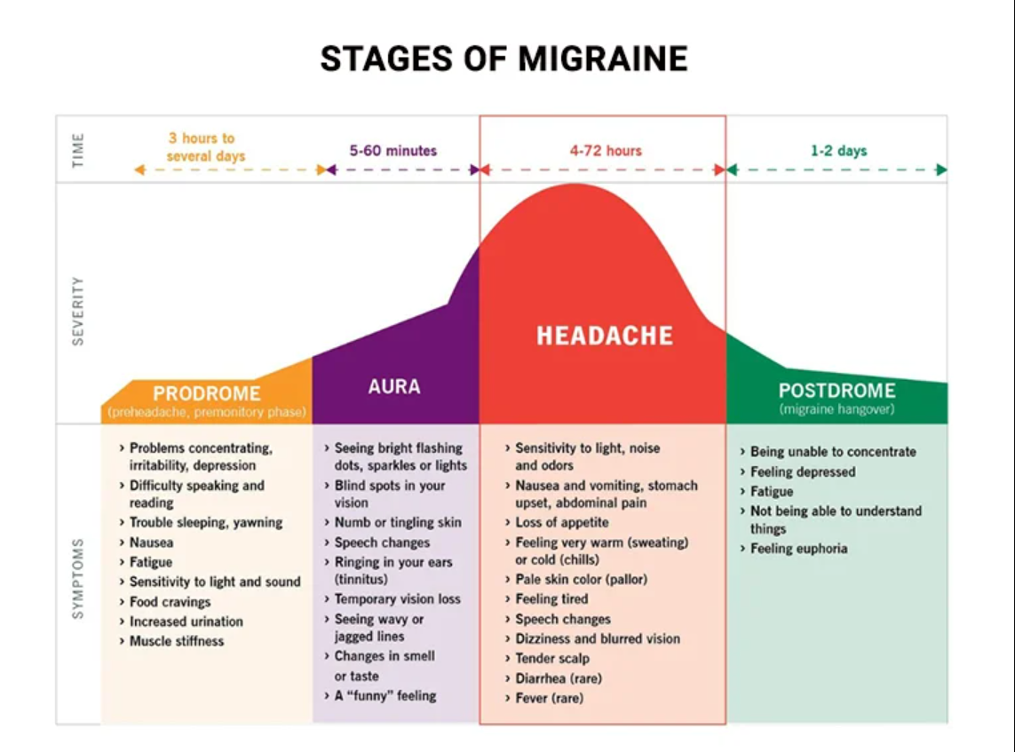

Slide 19

Notes:
We here present the IHS Visual Aura Table, where, for the first time, headache researchers show the full spectrum of aura visual disturbances in a standardised way.
The aura table has been tested in a large, multicentre international population among 215 migraine with aura patients – the article is published in Cephalalgia.

Slide 20


Slide 21
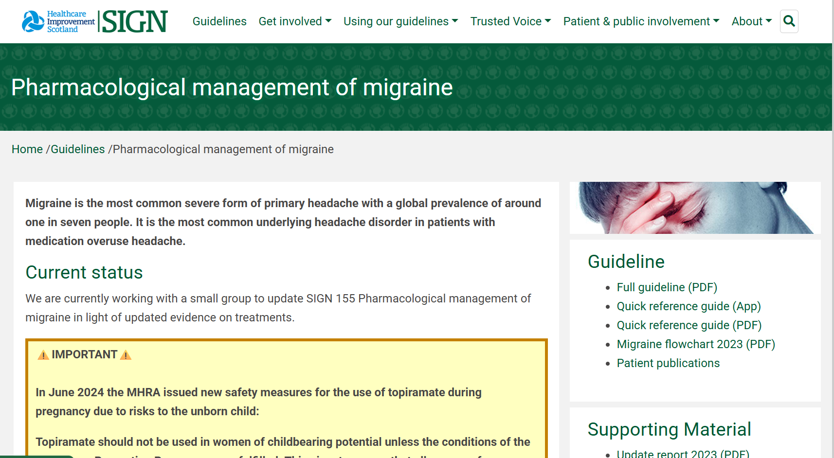

Slide 22
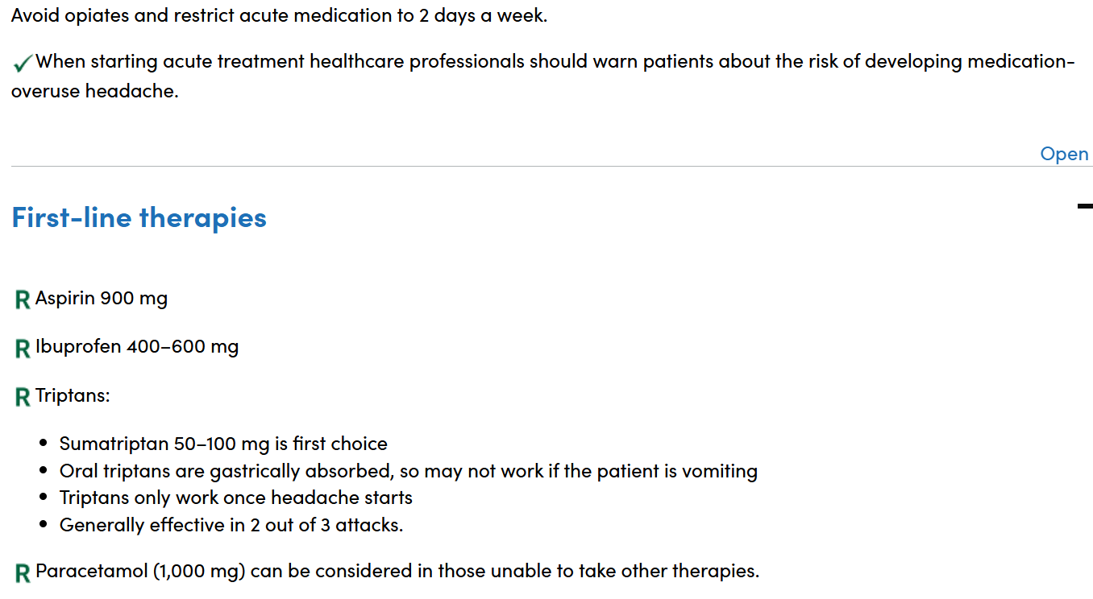
Notes:
Aspirin 4000mg/day. Ibuprofen 2400mg/day. Stepped approach vs stratified approach, stratified best outcomes. Triptans: take after the aura phase. CI IHD,CVD uncontrolled hypertension. Max 8 days use per month, write it on the prescription !!

Slide 23
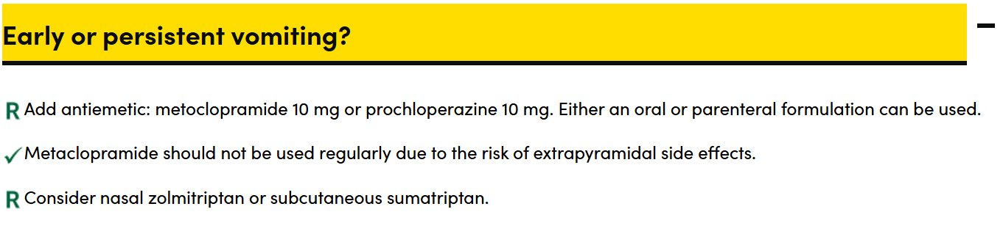
Notes:
Always consider antiemetic

Slide 24
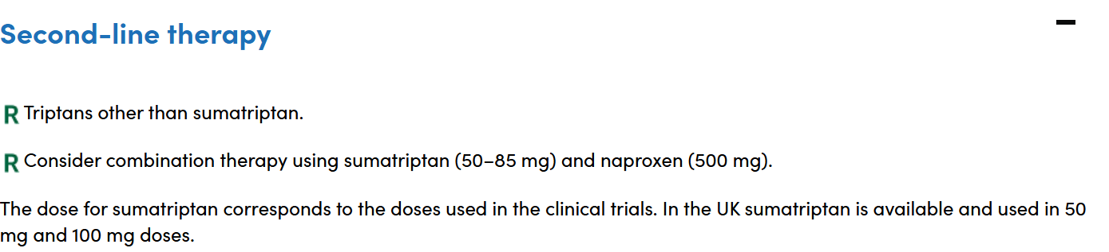

Slide 25
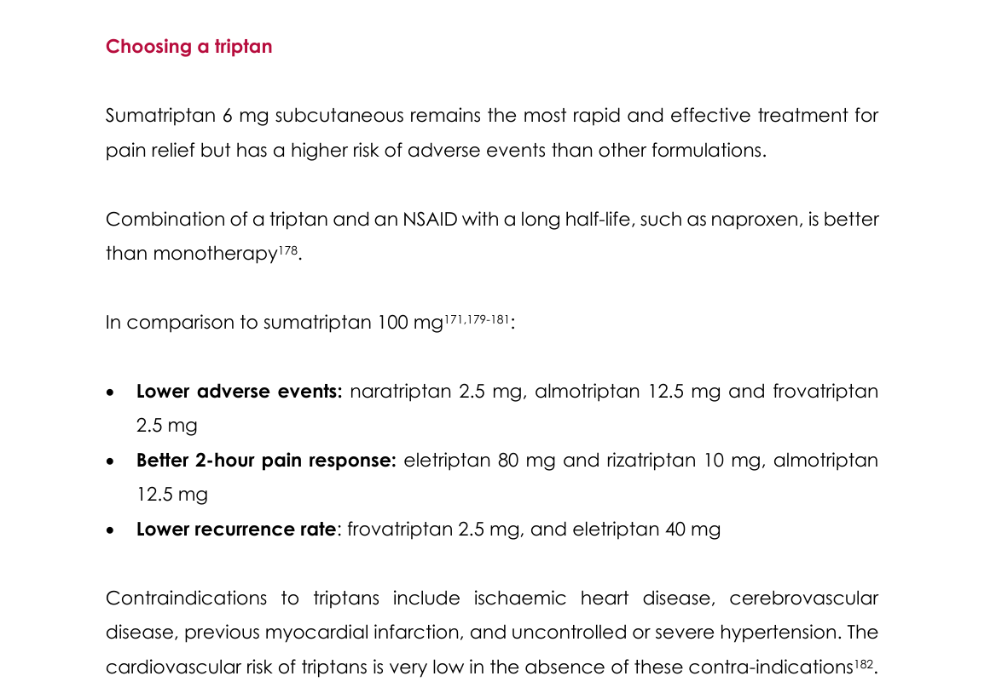
Notes:
BASH Guidelines. 30% patients do not respond to any triptan. Successful treatment is headache resolution in 2 hours.

Slide 26
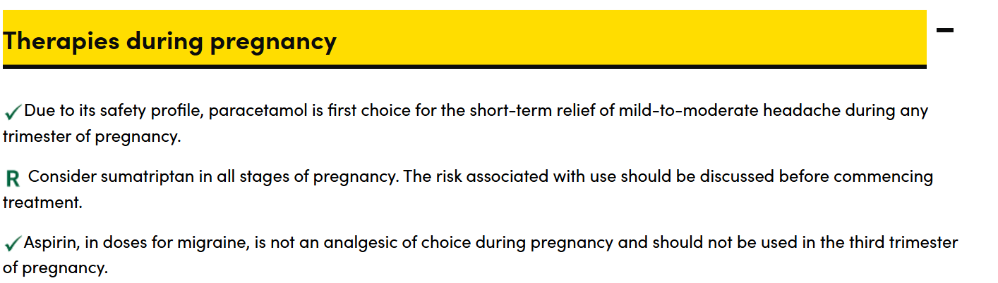
Notes:
SIGN

Slide 27
Preventative Therapy (SIGN)
Consider if migraine is disabling and reducing quality of life, e.g. frequent attacks (>1 per week on average) or prolonged severe attacks.
Which medication to try first depends on patient comorbidities, other health issues, drug interactions and patient preference.
Anticonvulsants should be avoided in women who may become pregnant.
Start at low dose and gradually increase according to efficacy and tolerability.
Good response is a 50% reduction in severity and frequency of attacks.
Treatment failure is a lack of response to the highest tolerated dose used for 3 months.

Slide 28
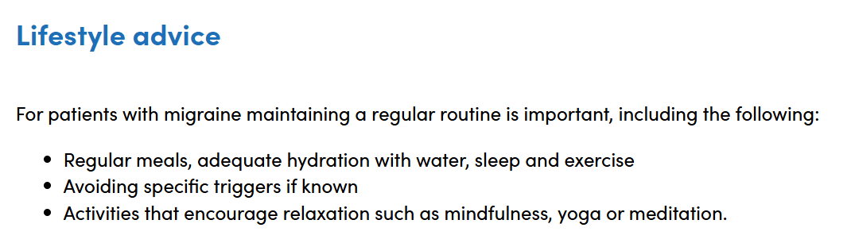

Slide 29
Supplements for Prevention
Co-enzyme Q10 150 mg/day
Magnesium 400 mg/day can titre to 600mg.
Riboflavin 400 mg/day

Slide 30
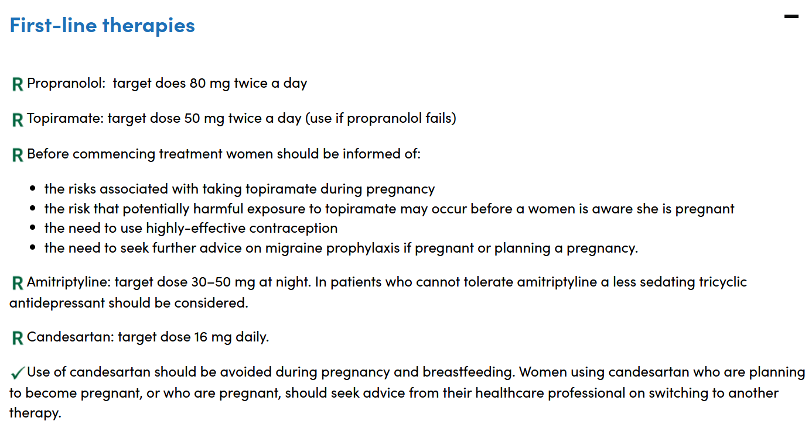

Slide 31
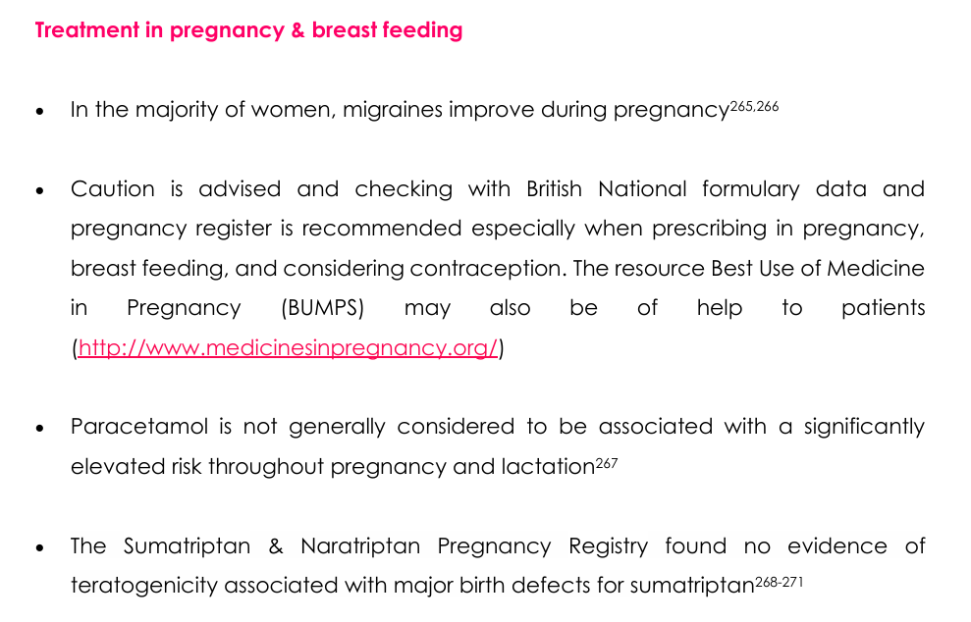

Slide 32


Slide 33
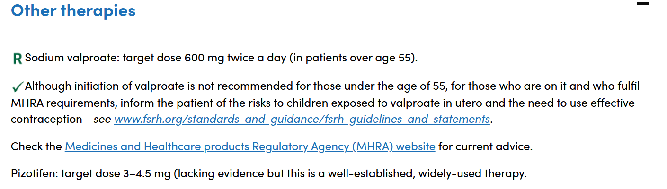
Notes:
Pregnancy prevention programme. IUS, copper coil or implant.

Slide 34
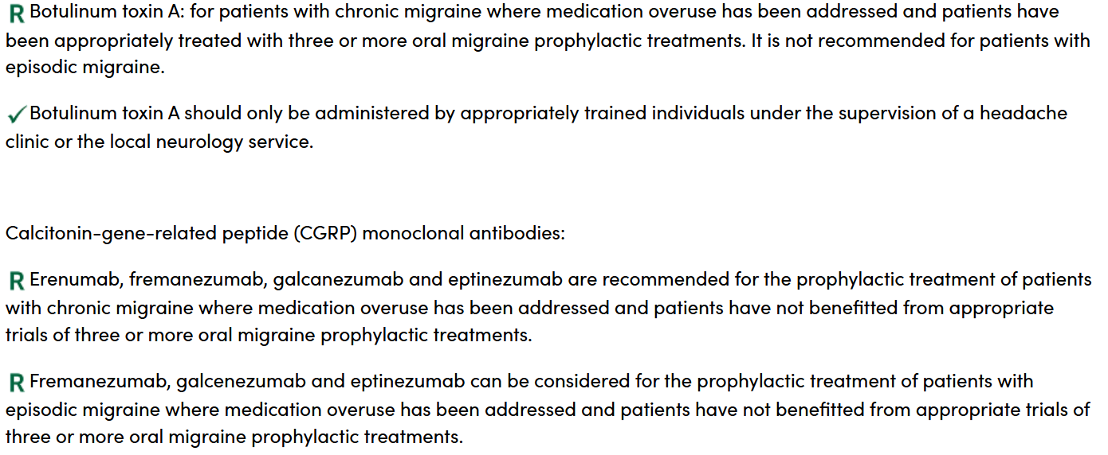

Slide 35
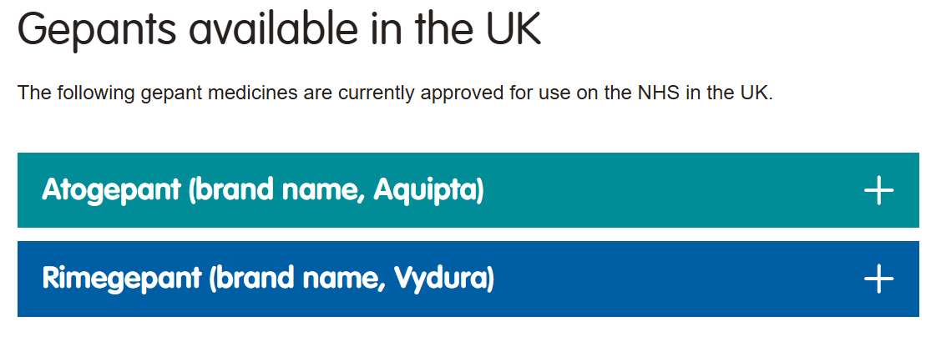

Slide 36
For acute intervention:
One wafer is taken at onset of pain, up to once a day.
It can be prescribed after two triptans have not worked or caused intolerable side effects. In practice, trying three triptans is more appropriate with consideration of nasal or injectable preparations if severe nausea or vomiting is present.
Maximum 15 tablets a month. There is currently no evidence of medication overuse headache.
Exeter Headache Clinic July 2024

Slide 37
Prevention:
One 75mg wafter is taken daily, every other day.
For initiation, patients must have between 4 and 15 migraine attacks a month and have tried and not found effective three other tablet preventers.
The effectiveness of Rimegepant should be reviewed at three months to determine if the frequency of migraine days has reduced by at least 50%. If the response to treatment meets these criteria, it can be continued*

Slide 38
Menstrual Migraine
The acute treatment of menstrual related attacks is no different to non-menstrual attacks.
Preventative options:
FROVATRIPTAN 2.5 mg twice daily on the days migraine is expected (generally from two days before until three days after bleeding starts).
ZOLMITRIPTAN 2.5 mg twice or three times a day on the days migraine is expected.
COCP (Contraindicated if aura)
Notes:
Women with MRM will also have attacks at other times. Less than 10% of women report migraine exclusively with menstruation and at no other time (‘pure’ menstrual migraine)

Slide 39
Tension Type Headache
Tension-Type Headache (TTH) is the most common primary headache disorder with a mean global lifetime prevalence of 42% (Range 19-83%)
Chronic tension-type headache affects 0.5 - 4.8 % of the worldwide population.

Slide 40
TTH Treatment
Acute treatments: paracetamol, NSAIDs
Preventative:
Amitriptyline 10mg starting dose, max 150mg
Acupuncture 6 sessions

Slide 41
Trigeminal Autonomic Cephalagias
Cluster Headache
Paroxysmal hemicrania
SUNCT/SUNA (Short-lasting neuralgiform attacks with conjunctival injection and tearing/Short-lasting neuralgiform attacks with cranial autonomic features)
Hemicrania continua

Slide 42
Cluster Headache
Severe/very severe unilateral orbital, supraorbital and/or temporal pain lasting 15–180 minutes (untreated)
Either or both of the following: 1. At least one of the following symptoms or signs, ipsilateral to the headache:
a. Conjunctival injection and/or lacrimation
b. Nasal congestion and/or rhinorrhoea
c. Eyelid oedema
d. Forehead and facial sweating
e. Forehead and facial flushing
f. Sensation of fullness in the ear
g. Miosis and/or ptosis
2. A sense of restlessness or agitation
C. Attack frequency between one every other day up to 8/day for > half the time the disorder is active
Notes:
Refer all suspected cluster headache patients for urgent specialist assessment. MRI indicated.

Slide 43

Cluster Headache Attack…

Slide 44
Cluster Headache Acute Treatments
The most effective acute treatment is the sumatriptan 6mg subcutaneous injection with significant relief within 15 minutes.
The maximum limit is two 6mg injections a day.
Nasal Sumatriptan or Zolmitriptan can be effect.
High flow oxygen 100% at 7-15 litres/minute for 15-20 minutes, using a non-rebreathable mask, is effective in aborting acute attacks of cluster headache.

Slide 45
Cluster preventative treatments
Greater Occipital Nerve Blocks
Verapamil (with ECG Monitoring)
Prednisolone 40mg for 10 to 14 days then taper.
Lithium
Melatonin 10mg

Slide 46
