Slide 1
Holistic management of migraine
Patient self management
Shared decision making
What does a holistic approach look like?
The Primary Care Team
Dr David Kernick
Exeter Headache Care

Slide 2
Disclosures
Education support and advisory income from Lilley, Pfizer, Abbvie, Teva

Slide 3
1. What do we mean by holistic?
Definitions and implications

Slide 4
Holistic Gr Holos - whole
Holistic Approach - range of disciplines to manage migraine
Holistic Practices - approaches drawing upon a holistic perspective. Focus
on the body's intrinsic ability to heal itself.
Holistic Perspective - different way of looking at the world - Interconnected

Slide 5
 | Rimegepant¹ | Atogepant² | Erenumab³ | Galcanezumab⁴ | Fremanezumab⁵ | Eptinezumab⁶
 | Acute treatment of migraine with or without aura and preventive treatment of EM in adults | Preventive treatment of migraine in adults (EM and CM) | Preventive treatment of migraine in adults (EM and CM) | Preventive treatment of migraine in adults (EM and CM) | Preventive treatment of migraine in adults (EM and CM) | Preventive treatment of migraine in adults (EM and CM)
Standard recommended dose | 75 mg EOD | 60 mg QD | 70 mg (or 140 mg) monthly | 120 mg monthly (240 mg loading dose) | 225 mg monthly or 675 mg quarterly | 100 mg (or 300 mg) quarterly
“Sixty-six percent of the benefit is from contextual effects.”
These merit further scrutiny as a means of improving migraine headache.”
Forbes RB, McCarron M, Cardwell CR. Efficacy and contextual (placebo) effects of CGRP antibodies for migraine: systematic review and meta‐analysis. Headache: The Journal of Head and Face Pain. 2020 Sep;60(8):1542-57.
Healing in Action

Slide 6
What is a holistic perspective?

Slide 7

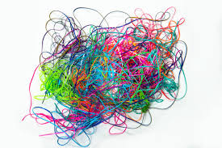
Complicated
Latin Com – with
Plica – folds
Complex
Latin Com – with
Plexus – braided together

Slide 8
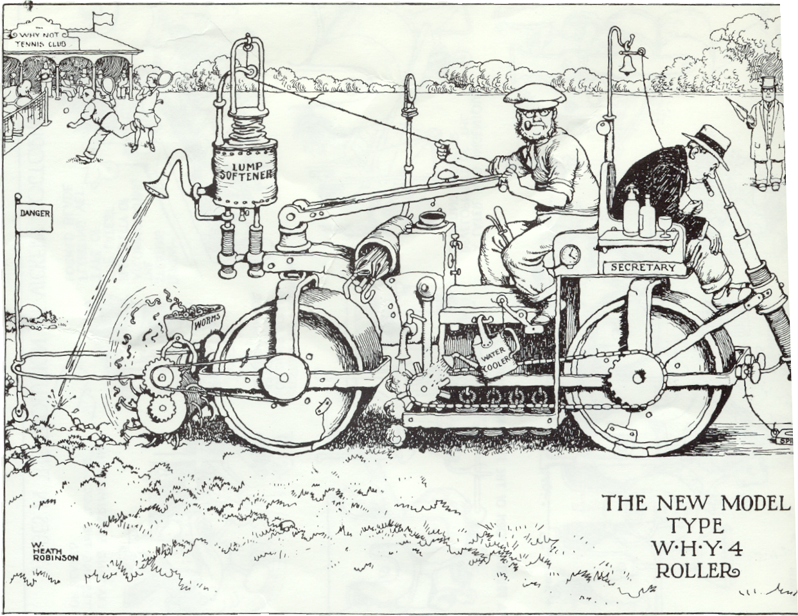
THE SCIENTIFIC APPROACH
Structures, levers, control, measurement, checking
The traditional approach of science and medical science. Linear or reductionist

Slide 9
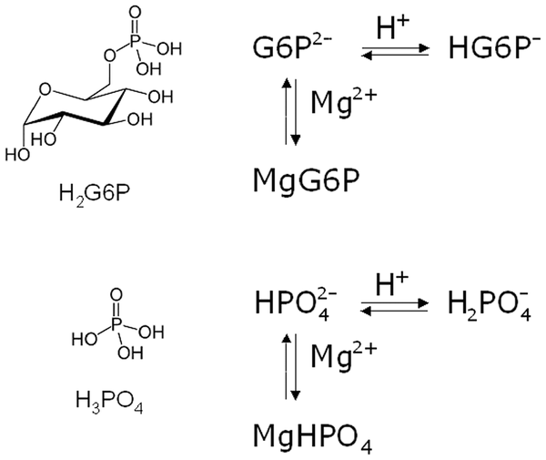
THE SCIENTIFIC APPROACH
Which is the bit that
needs to be fixed?

Slide 10
Where is the system out of harmony?
THE HOLISTIC PERSPECTIVE
Organ cross-talk
Che, H., Gao, Y., Xu, Y. et al.
Organ cross-talk: molecular mechanisms, biological functions,
and therapeutic interventions for diseases.
Sig Transduct Target Ther 11, 8 (2026).
https://doi.org/10.1038/s41392-025-02329-1

Slide 11
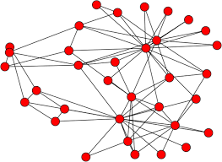
A broader holistic perspective

Slide 12
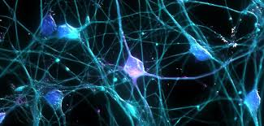
https://www.youtube.com/watch?v=8saDn3SIfP8&t=2s
Complexity science
Dynamic
Reiterative interactions
with positive and negative
feedback loops
Non-linear
Patterns emerge
due to local interaction.
Notes:
This is due to recursive nature of interactions. Outputs are fed back in a step wise manner rather tahan continuos

Slide 13
Characteristics of Holistic Practice
Medical Practice | Holistic Practice
Focus on lowest level of analysis | Stand back. Take a broader view.
Focus on generalisability. Statistical inferences from groups of people. | Focus on the individual. What works for the individual?
Focus restoration of function – fix it | Focus is on harmony and the body's intrinsic ability to heal itself

Slide 14
A holistic practice for understanding and managing migraine:
Stand back
Broader view of pathophysiology
Broader view of treatment
Shift in theoretical frameworks from complicated to complex

Slide 15
Some thoughts on shared decision making from holistic perspective
The Disease
The Illness
The sickness

Slide 16
Some thoughts on shared decision making
From migraine patient to person with migraine
From not just accurate scientific diagnosis to witnessing and interpreting the person’s story
From clinical outcomes to meaningful outcomes
From direct language to curiosity and non-judgement
From proscription to shared exploration
An awareness that both parties sit in a complex web of influences
Negotiating the interface between the predicament of the individual and the potential of medical science

Slide 17


GUIDELINES
O O O O O O O O O O O O O O O
O O O O O O O O O O O O O O O
A holistic perspective on
shared decision making
TOOLBOX

Slide 18
Migraine Self-Help
Soluble aspirin, soluble paracetamol, sumatriptan 50 mg .
Buccastem. (Prochlorperazine )
Vitamin B2, magnesium, coenzyme Q10
Electrical devices. E.g. Cephaly
Holistic Practices
https://www.tedwraggtrust.co.uk/_site/data/files/who-we-are/heads-up-resources/82679A4656C66E951C032DA0121B2B02.pdf

Slide 19
Managing migraine holistically

Slide 20

Understanding what's going on - Standing back
Developing a coherent story
Brains, Batteries, and Buckets
A Hypervigilant, Hypersensitive brain.

Slide 21


Slide 22
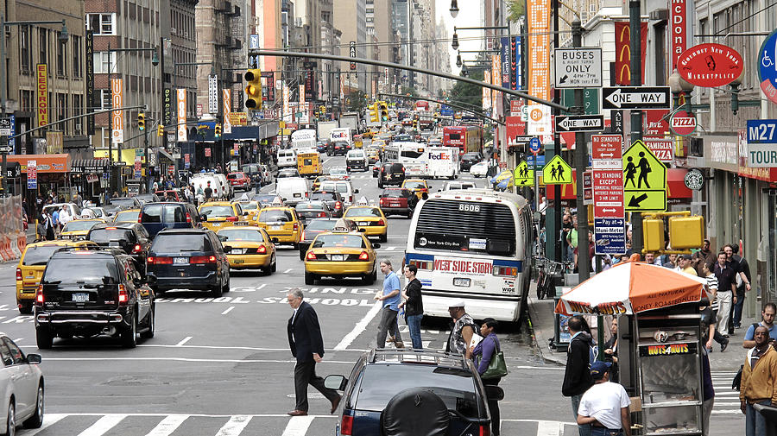

Slide 23
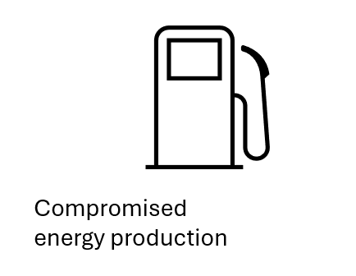
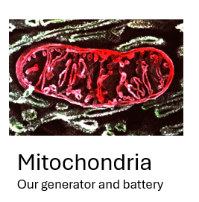
Wang Y, Wang Y, Yue G, Zhao Y. Energy metabolism disturbance in migraine:
From a mitochondrial point of view.
Frontiers in physiology. 2023 Apr 13;14:1133528.

Slide 24
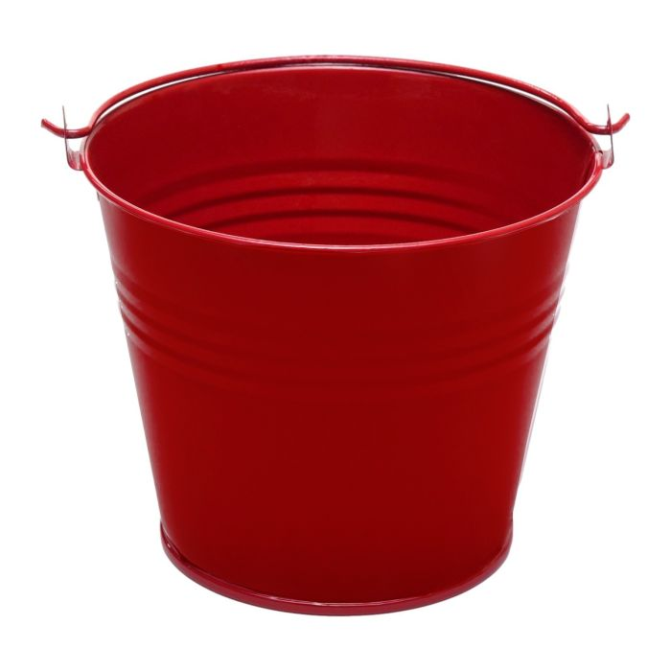
Stressors
Physical, Psychological or Social
Inflammation Defence, Repair and Recovery
Activation of:
Autonomic nervous system
Hormone pathways
Cytokine system – complex system of cellular and
biochemical pathways

Slide 25

Stressors
Migraine. The end result of migraine is an inflammatory process.
Physical. E.g. Co-existing physical illness.
Psychological. E.g. Anxiety, depression.
Social. E.g. Poor social circumstances, bereavement.
Poor diet. Ultra processed food is a powerful inflammatory stimulant.
Lack exercise.
Obesity.
Trauma, previous or existing. Childhood trauma is important.
Inflammatory load
Energy demanding and places brain in a state of alert
What's in my stress bucket?
Borsook D, Maleki N, Becerra L, McEwen B.
Understanding migraine through the lens of maladaptive stress responses:
a model disease of allostatic load. Neuron. 2012 Jan 26;73(2):219-34.

Slide 26


FOOD
Glucose
Battery
Alarm level
ATP
STRESS BUCKET

Slide 27
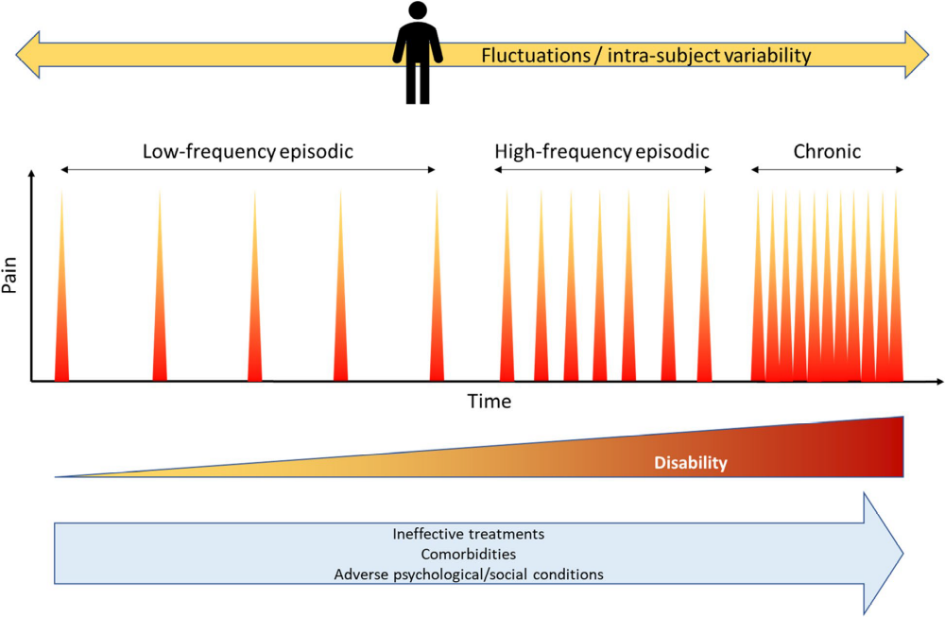


Precipitating factors
Genetic disposition
What does this look like in practice?

Slide 28
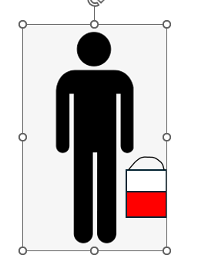
Perpetuating factors

Slide 29
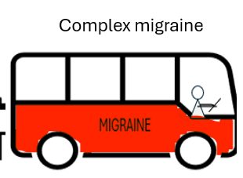
What's on the bus?
Other headache phenotypes
Medication Overuse Headache
Anxiety
Depression
Trauma history
Insomnia
Irritable Bowel Syndrome
Fibromyalgia
Autonomic instability
Mast cell activation
Restless leg syndrome

Slide 30
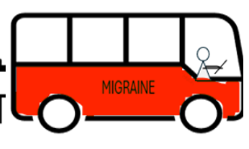


A Holistic approach to migraine

Slide 31
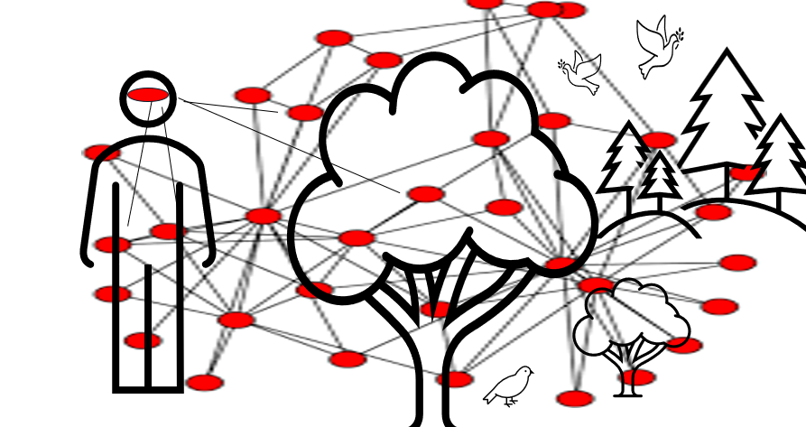
Medical science Holistic practices

Slide 32
The Medical Approach
Do I Have the best evidence-based medical treatment?
E.g. Drugs, other medical devises.

Slide 33
The psychological approach
How can I address unhelpful thoughts and emotions?
Psychological distancing
CBT
Managing Comorbid Mental Health.
(Anxiety and depression)
Trauma therapy

Slide 34
Trauma?
An event or events that are overwhelming to our psychological protective mechanisms
Are not adequately processed by brain and body
70% of people with migraine will have at least one significant childhood event

Slide 35
‘We sometimes find that unprocessed emotions
can be making some people's migraine worse
and this can be caused by difficult events that may have occurred in the past.
I don't want to go into this in any detail, but I wondered if this may be something that could be relevant?’

Slide 36
Managing the external environment
Do I have a lifestyle that is beneficial to my migraine health?
Triggers and constant environment
Exercise
Gut biome
Unhelpful social environments
Healthy diet: Avoid Ultra processed foods
Sleep
Migraine diets
Supplements

Slide 37
Improving energy production
Carbohydrates Glucose + Oxygen Energy
Fats Ketones + Oxygen Energy
Keto diet, Ketone supplements
Magnesium (600mg elemental magnesium)
Vitamin B2, 400mg a day7
Co Q 10, 50-100 mg three times a day

Slide 38
Managing the internal environment
“Interoceptive healing”
Am I supporting my body to heal itself?
Getting out of the brain.
Addressing the brain on high alert status
Listening to the body using body awareness techniques – yoga, body scanning
Meditative techniques to cultivate stillness of mind and non-judgemental awareness
Visualisation techniques
Breathing techniques to regulate body/emotional mechanisms
Emotional freedom technique (EFT) to re-wire inappropriate pathways
Trauma release exercises (TRE)

Slide 39
Managing the interaction between internal and external environment
“Exteroceptive healing Approach”
How can I improve the harmony between my inner and outer worlds?
Nature immersion
Social engagement
Art therapy, journaling
Meditative techniques

Slide 40
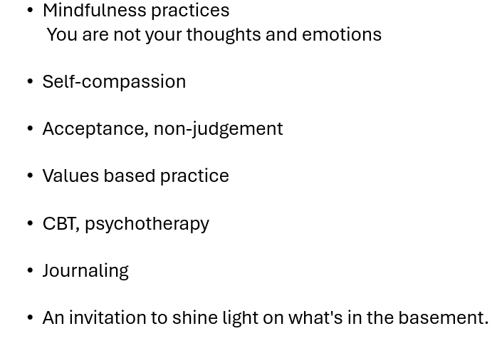
The migraine world
Frustration, shame, guilt, despondency
Unhelpful coping strategies
Taking back sense of self
Is my problem influencing how I see myself and can I change this?

Slide 41
Thinking about migraine in a different way
Anger, failure, frustration, despondency resignation, withdrawal……
?

Slide 42
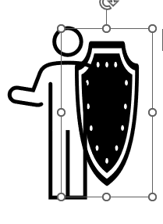




The body in protective mode

Slide 43
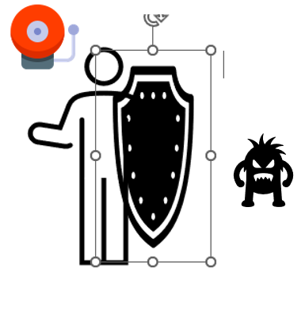
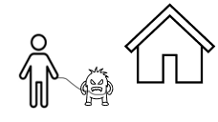

Taking back control

Slide 44
What would a holistic focus Look like?
The body is trying to keep you safe
Notice with curiosity and without judgement protection or guarding
Not forcing to fight back but softening
What small steps can I take and explore how my body responds?

Slide 45
Migraine is my friend trying to keep me safe.
My friend is over enthusiastic, but I understand why that is.
I wonder if my migraine is Trying to tell me
something that I don't want to hear.

Slide 46
The Primary Health Care Team

Slide 47
Community Optician (Community physio and dentist) Identification of a headache problem and signposting.
The Community Pharmacist. Accessible First Contact. Early recognition, advice on acute treatment and medication overuse, signposting.
The Practice Pharmacist. Medication review, adherence, identifying overuse, practical advice about acute and preventative medications. Signposting.
The practise nurse education. Monitoring and follow-up, self-management support, lifestyle support, Signposting. Continuity of care.
The GP. Formal diagnosis, identify red flags, explanation of migraine and the options for management, comorbidities, medical management.

Slide 48
A shift from which drugs should we use in this patient?
To:
1. How as a team can we help this person navigate their whole system with a story that makes sense to them ?
2. How can we negotiate the interface between the potential of medical science and the ability of the patient to heal themselves?
3. How can we maintain continuity of care and mobilise the importance of the therapeutic relationship?

Slide 49
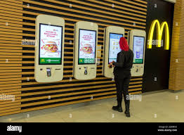
The MacDonaldisation of medicine

Slide 50
?

Slide 51

www.holisticmigraine.org.uk

Slide 52
Resources
Holistic migraine.org.uk
Headache GP.org.uk
Complexity https://www.youtube.com/watch?v=8saDn3SIfP8&t=2s
Exeterheadachecare.co.uk

