Slide 1
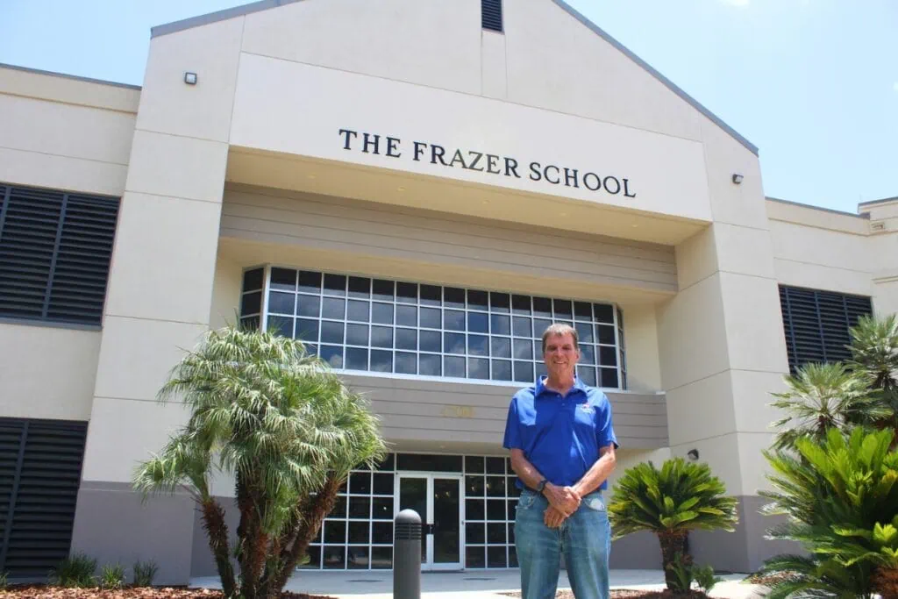

Slide 2

The Frazer School
Frazer School Elementary Grades K-5
Frazer Middle School Grades 6-8
Frazer High School Grades 9-12

Slide 3

Accolades
Math:
2025 State Champions-MATHCOUNTS
2025 Florida State Math Champions
2025 National Champions Mu Alpha Theta
Science:
Science Bowl 2025 Middle School Regional Champions
Science Bowl 2025 High School Regional Champions
Science Bowl 2025 Middle School Top 12 nationally - Highest Finishing Florida School
Science Bowl 2025 High School Top 12 nationally- Highest Finishing Florida School
Physics Bowl 2025 National Champions Division 2
Chess
2025 11th Grade National Champions
2025 High School State Champions
2024 10th Grade National Champions
2025 4th Place SuperNationals High School - Top School South and West of Virginia
Quiz Bowl:
2025 Florida State Champions
2025 National Championship Top Florida Middle School
2025 National Championship Top Florida High School
Robotics:
2025 Middle School State Champions
2025 VEX Middle School World Championship Top 20 out of 15,000+ Teams

Slide 4
The Winning Continues
9 National Merit Semifinalists 2025
7 National merit semifinalists 2026 (50% of senior class)
Frazer School Seniors SAT (vs. National): Math 795 (505), ERW 765 (519)
Katie He takes first place at Prestigious MIT for Girls competition
Aadya Guduru and Chloe Zhang win congressional APP challenge in Florida’s 3rd congressional district

Slide 5

Individual Competitions:
Speech and Debate
FBLA-Future Business Leaders of America
Foreign Language
ACL Mythology Exam
US Olympiads:
  Physics
  Chemistry
  Biology
  Earth Science
  Astronomy/Astrophysics
  Computing

Slide 6








Matriculation: Seniors from the class of 2025 are attending:

Slide 7
What We Are:
Phone Free
Reduced Screen time
Exclusivity
A school for competitive academics
Teamwork
Community

Slide 8
Who we are looking for:
Community Service and Summer
This year’s academic calendar: 187 days not 180
Likely first day of school August 3, 2026 (one week prior to everyone else)
Students that want to learn and compete

Slide 9
Our Tuition $$
Frazer School Tuition is all inclusive at $4,000 (compare at $16,000+)
Frazer School Mandatory Fees:
+ Application Fee $0 (compare at $75)
+ Registration Fee $0 (compare at $100)
+ Textbooks Fee $0 (compare at $400)
+ Technology Fee $0 (compare at $325)
+ Program Fee $0 (compare at $150)
+ Uniforms Fee $0
= $0 (compare at $1,050 + uniforms)

Slide 10
Bell Schedule
 | Start | End
Period 1 | 7:50 AM | 8:40 AM
Period 2 | 8:44 AM | 9:34 AM
Period 3 | 9:38 AM | 10:28 AM
Period 4 | 10:32 AM | 11:22 AM
Lunch | 11:22 AM | 11:52 AM
Period 5 | 11:56 AM | 12:46 PM
Period 6 | 12:50 PM | 1:40 PM
Period 7 | 1:44 PM | 2:35 PM

Slide 11
Frazer Middle School
Math Offerings
Honors Pre-Algebra
Competitive Pre-Algebra
Algebra 1 Honors
Geometry Honors
Competitive Math 1
Competitive Math 2
Competitive Math 3

Slide 12
Frazer Middle School
Science Offerings
Social Studies Offerings
Physical Science
Life Science
Earth Science
Honors Biology (may be offered depending on course requests)
World History
American History-Great Figures
Civics and Government
American History-Wars
AP Human Geography (middle or high school)

Slide 13
Middle school sequence of courses:
6th grade | 7th grade | 8th grade | 9th grade
World History | Government & Civics | American History-Wars | Social studies
English | English | English | Pre-AP English 1
Honors Pre-Algebra | Math | Math | Math
Science | Science | Science | Science
American History- Great figures | AP Computer Principles | AP Human Geography** | Elective
Elective | Elective | Foreign Language | Foreign Language
Elective | Elective | Elective | Elective
Electives
Speech and Debate
Robotics
Foreign Languages
Spanish 1 (adding 2 and 3)
Latin 1, 2, and 3
Chinese
Physical Education
Science Team
** Students interested in a 2nd elective may take this class in high school instead

Slide 14
Frazer High School
Math Offerings (6 out of 6 Math and Computer Science AP’s):
Competitive Math 1
Competitive Math 2
Competitive Math 3
Algebra 2 Honors
AP Statistics/AP Statistics Team
AP Pre-Calculus
AP Pre-Calculus Team
AP Calculus BC/Team
Discrete Math: every other year next up 2026-2027
Science Offerings
(7 out of 7 Science AP’s):
AP Environmental Science
AP Biology
Chemistry – Honors and AP
AP Physics – 1, 2 and C: E&M and Mechanics

Slide 15
Frazer High School
Social Studies Offerings
(9 out of 10 History and Social Science AP’s):
AP Government and AP Comparative Politics
AP American History
AP European History
AP World History
AP Macroeconomics & AP Microeconomics
AP Psychology
AP Human Geography
Sequence for students NOT competing in social studies based on competitions
Sequence for students WHO PLAN to compete in social studies based on competitions
9th Grade | 10th Grade | 11th Grade | 12th Grade
AP American History | AP Government/ Comparative Politics | AP European History | AP World History
9th Grade | 10th Grade | 11th Grade | 12th Grade
AP World History | AP American History | AP Government/ Comparative Politics | AP European History

Slide 16
Frazer High School
Required but flexible timing:
**AP Macroeconomics & AP Microeconomics
**AP Finance/Financial literacy
Recommended but flexible timing:
AP Statistics
Suggested Electives:
Spanish 2, 3, and AP Spanish Language
Latin 1, 2, 3, and AP Latin
Chinese
AP Computer Principles
AP Computer Science A
AP Psychology
AP Human Geography
Robotics
Speech and Debate
**Physical Education
Dual Enrollment @UF
**Graduation requirement

Slide 17
Frazer High School
9th Grade | 10th Grade | 11th Grade | 12th Grade
Pre-AP English 1 | Pre-AP English 2 | AP English Language | AP English Literature
Science | AP Government and AP Comparative Politics | Math | AP World History
AP American History | Science | Science | Math
Math | Math | AP European History | Science
Foreign Language | Foreign Language | Foreign Language | Elective
Elective | Elective | Elective | Elective
Elective | Elective | Elective | Elective

Slide 18
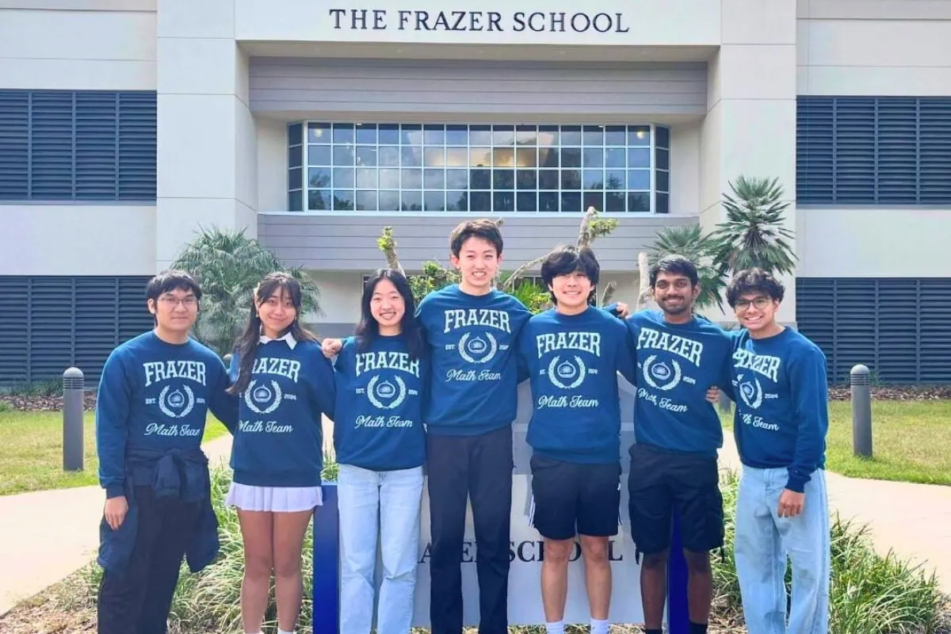
Questions?

