Slide 1
Disability Justice and Mental Health Intersectionality Panel
November 15, 2022

Slide 2
Why We’re Here

Slide 3
What is Disability?
“A disability is any condition of the body or mind that makes it more difficult for the person with the condition to do certain activities (activity limitation) and interact with the world around them (participation restrictions).”
Source: CDC, “Disability and Health Overview”

Slide 4
What is Mental Health?
“Mental health includes our emotional, psychological, and social well-being. It affects how we think, feel, and act. It also helps determine how we handle stress, relate to others, and make healthy choices…[but] poor mental health and mental illness are not the same.”
Source: CDC, “Mental Health”

Slide 5
The Medical Model of Disability
“The Medical Model views disability as resulting from an individual person's physical or mental limitations, and is not connected to the social or geographical environments. The Medical Model focuses on finding a ‘cure’ or making a person more ‘normal.’”
Source: University of Oregon Accessible Education Center, “Medical and Social Models of Disability”

Slide 6
The Social Model of Disability
“The Social Model views disability as a consequence of environmental, social and attitudinal barriers that may prevent people from fully participating in society.”
Source: University of Oregon Accessible Education Center, “Medical and Social Models of Disability”

Slide 7
Identity and Expertise
“Social identities are neither pre-existent in individual minds nor static entities in the social world; they are dynamic historical and cultural constructs that are creators of and responsive to collective action.”
Source: APA, Thomas P. Dirth and Nyla R. Branscombe, “The Social Identity Approach to Disability”

Slide 8
Remarks from Emily McClintock
Mental Health Access and Referral Counselor
Affiliations:
Counseling & Psychological Services (CAPS)
Mental Health Access and Referral team
Source: Cornell Health, “Emily McClintock”

Slide 9
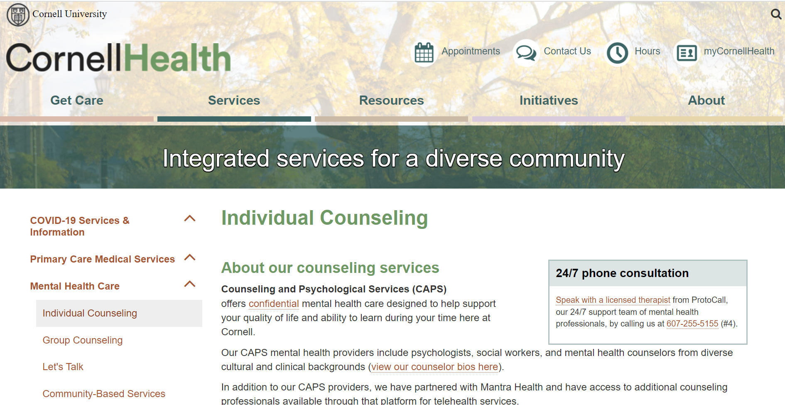
CAPS Appointment Process
Step 1: Log in to MyCornellHealth through the Cornell Health website
Source: Cornell Health, “Appointments”

Slide 10
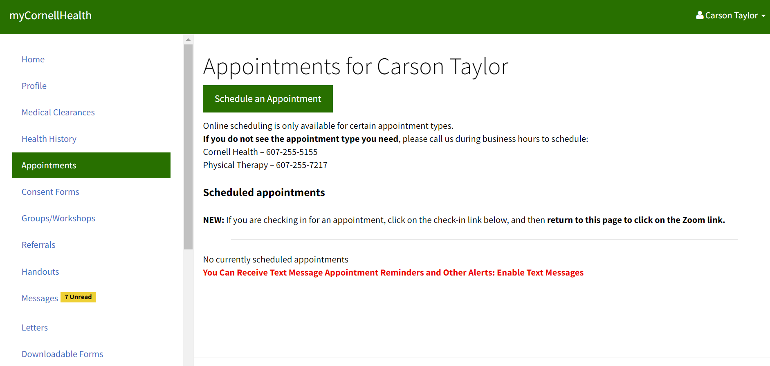
CAPS Appointment Process
Step 2: Click on “Schedule an Appointment”
Source: Cornell Health, “Appointments”

Slide 11
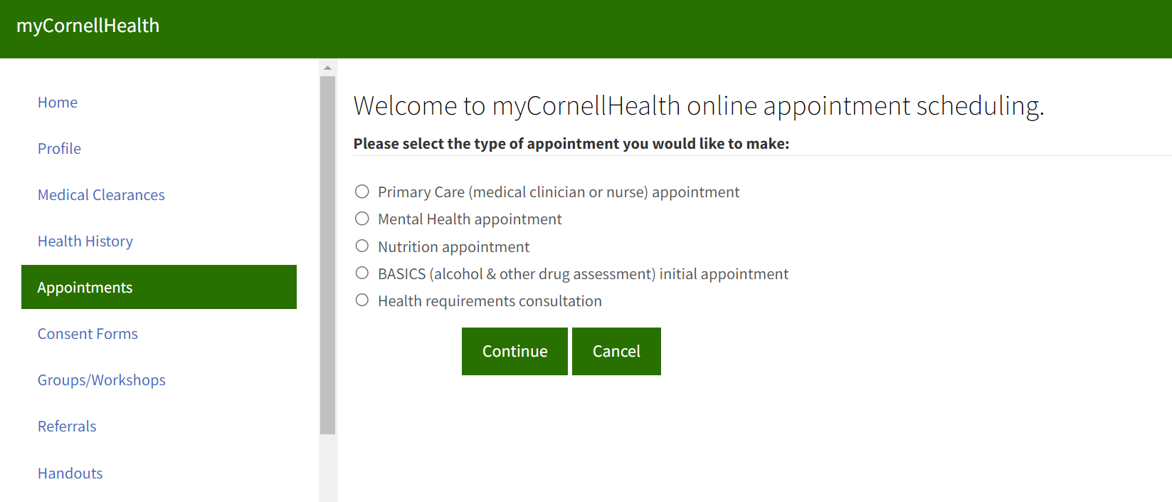
CAPS Appointment Process
Step 3: Select the type of appointment
Source: Cornell Health, “Appointments”

Slide 12
CAPS Appointment Process
Step 4: Confirm your location
Source: Cornell Health, “Appointments”

Slide 13
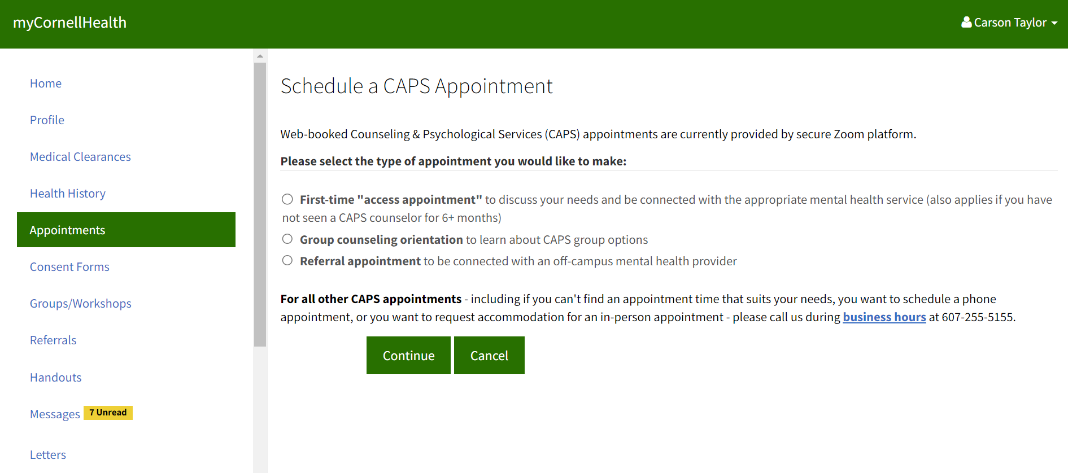
CAPS Appointment Process
Step 5: Select the type of CAPS appointment and leave a callback number
Source: Cornell Health, “Appointments”

Slide 14
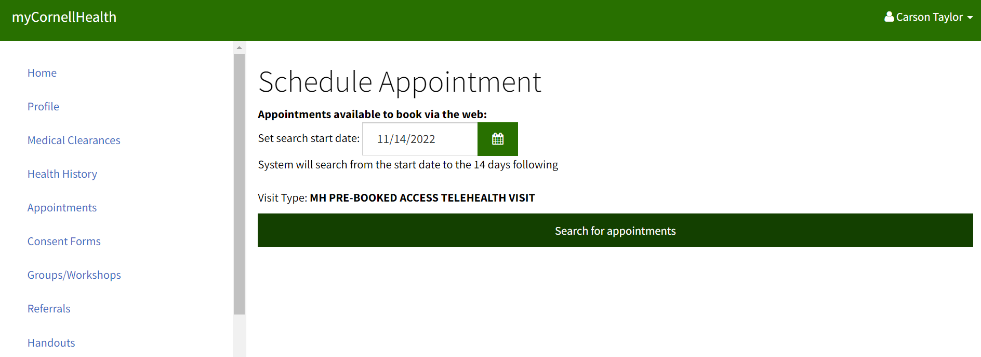
CAPS Appointment Process
Step 6: Find a time that works for you!
Source: Cornell Health, “Appointments”

Slide 15
What Do We Have Access To?
Resources at Cornell:
Cornell Health
CAPS, SDS, etc.
Peer Resources
EARS, community/affinity groups, etc.
Tompkins County/Ithaca Resources
County/Local Mental Health Services, etc.
What works for us!
Source: Cornell Health, EARS, CampusGroups (Various Pages)

Slide 16
Welcome to:
EARS at Disability Justice & Mental Health Intersectionality Panel
Date: November 15, 2022 Time: 4:30-5:30 PM
Workshop Facilitator: Aerin

Slide 17
Founded nearly 50 years ago, EARS (Empathy Assistance & Referral Service) is an organization dedicated to empowering peers to foster a more empathetic and connected Cornell community.
We’re currently undergoing a massive overhaul of our programs - look out for our peer mentoring, empathy chair, liaison and training programs, available to the entire Cornell community!
Email: ears@cornell.edu
Instagram: @cornell_ears
Facebook: @cornellears

Slide 18
Founded nearly 50 years ago, EARS (Empathy Assistance & Referral Service) is an organization dedicated to empowering peers to foster a more empathetic and connected Cornell community.
Email: ears@cornell.edu
Instagram: @cornell_ears
Facebook: @cornellears
Website: https://www.earscornell.org

Slide 19
Services we offer
Peer Mentoring
Training
Workshops
Empathy Chairs

Slide 20
Peer Mentoring
Private peer-to-peer conversations with trained EARS staff
Offer active listening, empathy, and mental health referrals
Hours & location on the website!
Updated staff bios available on website soon!
https://www.earscornell.org/team

Slide 21
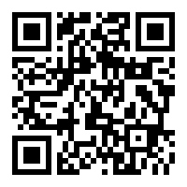
Training
Benefits
Learn to be a better listener, friend, family member, and leader, part of the move towards more empathy on campus
Professional development
Supportive community and social events
Gain confidence
Improve communication skills
Commitment
2h/week, 1h in large group and 1h with a small group
https://www.earscornell.org/training

Slide 22
Workshops
Workshops of different lengths (30 min, 60 min, 120 min)
1-off or 2-part
Topics covered: intro to EARS, empathy, active listening, Empathy Chair training, case studies, additional EARS skills
Organizations can select which topic(s) they would like to hear about
Fill in Workshop Request Survey to coordinate
Past collaborators: Human Ecology Peer Partnership Program, Cornell Speech and Debate, Learning Strategies Center

Slide 23
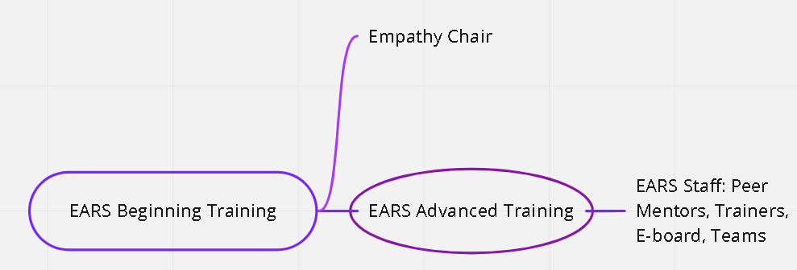
How do I join staff?

Slide 24
Closing
We’re offering peer mentoring as a place to chat this semester! If you’d like to learn more about EARS, participate in training, or arrange a workshop for your group or organization:
Email: ears@cornell.edu
Instagram: @cornell_ears
Facebook: @cornellears

Slide 25
Q&A Session
Feel free to grab some pizza!
Our panelists and speakers will answer any questions you have, on Zoom or in person!
Feel free to speak up or type in our chat!

Slide 26
Thank you for coming!
We appreciate you spending your time with us today!
All materials will be posted online at disabilityawarenessunion.org!
Follow us on social media @disabilityawarenessunion!

