Slide 1
Agenda
Defining Intersectionality and Ableism
Our Higher Educational Experiences
Hyperproductive Academic Culture
Disability Justice
Our Teaching
Additional Resources

Slide 2
Framing Disability Intersectionally
“[An] intersectional framework enables the acknowledgment of our multiple identities as well as the ways in which various social injustices are intertwined and interactively affect our daily lives.”
—disability justice scholar and activist Akemi Nishida

Slide 3
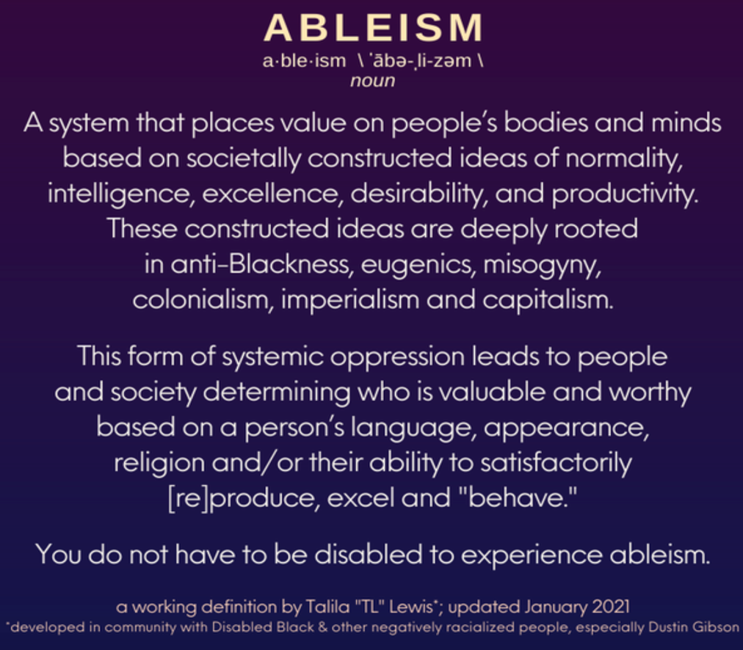
Ableism

Slide 4
On Hyperproductive, Ableist Academic Culture
“We describe this academic culture as ableist because the level of productivity expected always assumes normative or non-disabled bodies and minds. While accessibility is often framed as a ‘disability’ issue, workplace cultures that place excessive emphasis on (hyper)productivity uphold standards that privilege those most ‘able,’ without considering other factors like gender, race, and class that shape our opportunities to create, produce, and succeed. These practices exclude people with diverse lived experiences, hindering the quality of — and range of perspectives represented in — scholarship produced within our institutions. They also compromise the health and well-being of all involved.”
—critical disability scholars Susan Mahipaul
and Erika Katzman

Slide 5
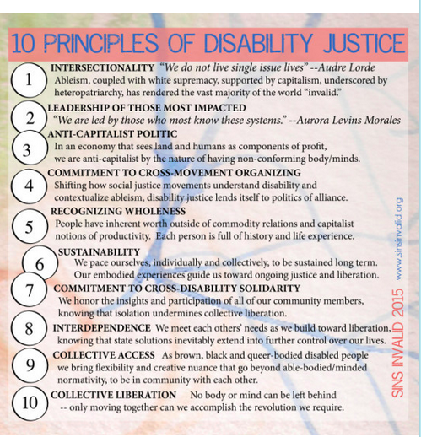

Slide 6
Some Resources for Intersectional Disability Justice
--Autistic Hoya: https://www.autistichoya.com/
--Disability Solidarity: https://twitter.com/dissolidarity
--Disability Visibility Project: https://disabilityvisibilityproject.com/
--Harriet Tubman Collective: https://harriettubmancollective.tumblr.com/
--Leaving Evidence: https://leavingevidence.wordpress.com/
--Ramp Your Voice: http://www.rampyourvoice.com/
--Rooted in Rights: https://rootedinrights.org/
--Sins Invalid: https://www.facebook.com/sinsinvalid/
--T.L. Lewis: https://www.talilalewis.com/

Slide 7
Questions?
Please feel free to get in touch with us:
Dr. Cook
lhc62@cornell.edu
Professor Weiner Heinemann
aaw43@cornell.edu

