Slide 1


FAST.
RELIABLE.
AFFORDABLE.
FIBER OPTIC INTERNET
DRUM POINT
APRIL 1, 2025

Slide 2
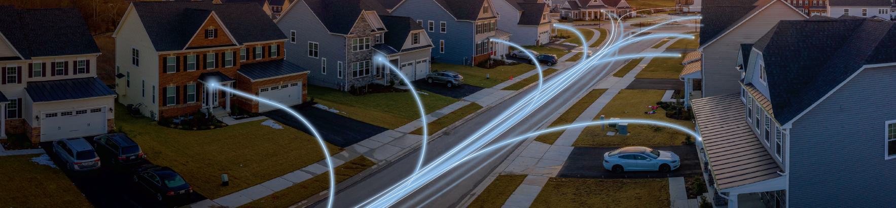

THINKBIG NETWORKS
Bringing Highspeed Fiber Optic Internet to the Residents of Calvert County, MD

Slide 3


We deliver fiber-optic internet directly to the home.
DSL was built to deliver telephone service.
Cable was built to deliver television service.
FIBER IS BUILT TO DELIVER ALL DATA.

Slide 4



Fiber is the future of internet connectivity.
Faster
Data is transmitted using pulses of light through a thin glass strand. Speeds are symmetrical, meaning upload equals download speed with very little lag or the time it takes the data to transfer across a network.
More Reliable
Dedicated bandwidth to each home, so there isn’t a service drop during peak hours. Little reliance on power and almost no interference from other electronic devices.
Sustainable
Because fiber-optic networks rely on light to transmit data, there is less reliance on electricity, greatly reducing the carbon footprint over long distances compared to a cable network.

Slide 5


We believe in choice.
Most of the communities like Drum Point in Maryland have a choice of broadband providers. We believe in competition, and we believe in our mission to provide affordable world class broadband services to communities like yours!

Slide 6
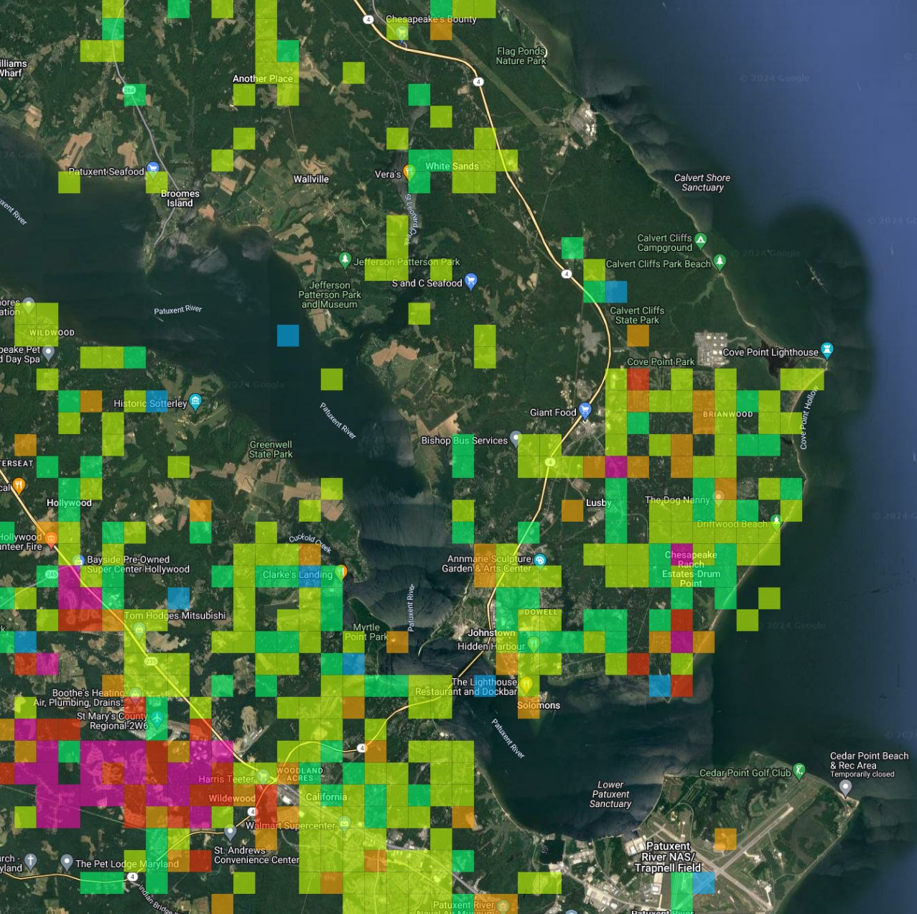
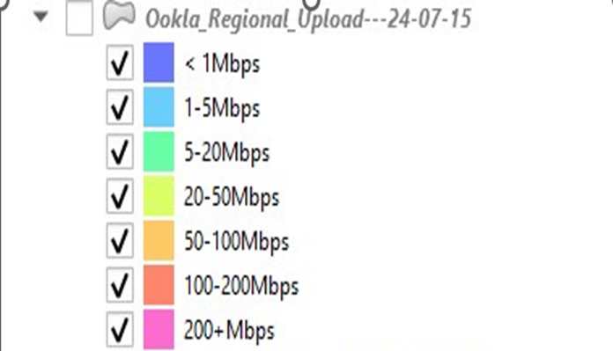

Slide 7
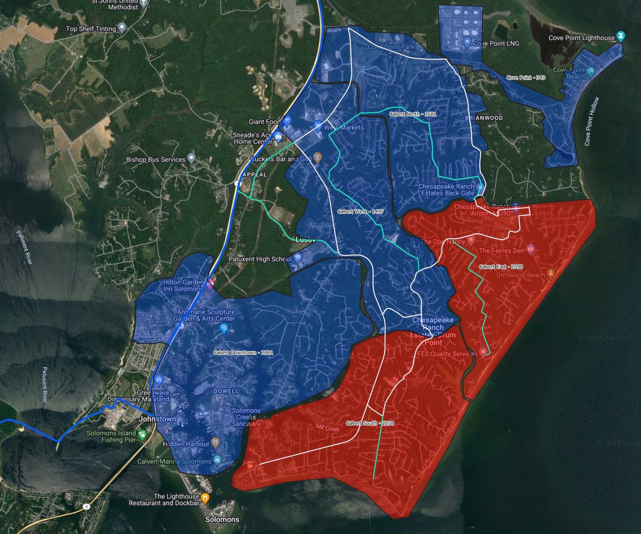
Calvert FIBER OPTIC BUILD INITIAL PHASES
Majority buried cable
Ability to service 100% passed homes
One area POP (Point of Presence)
Will compete for all customers
Local staff & supported
Community partnership
Best practices – State of the Art Network

Slide 8



Calvert NOTIFICATION OF PRE-CONSTRUCTION
Engage with the Community
Pre-Construction Door Hangers
ThinkBig Team in Neighborhood
Construction is the first impression – we make it a great one!

Slide 9
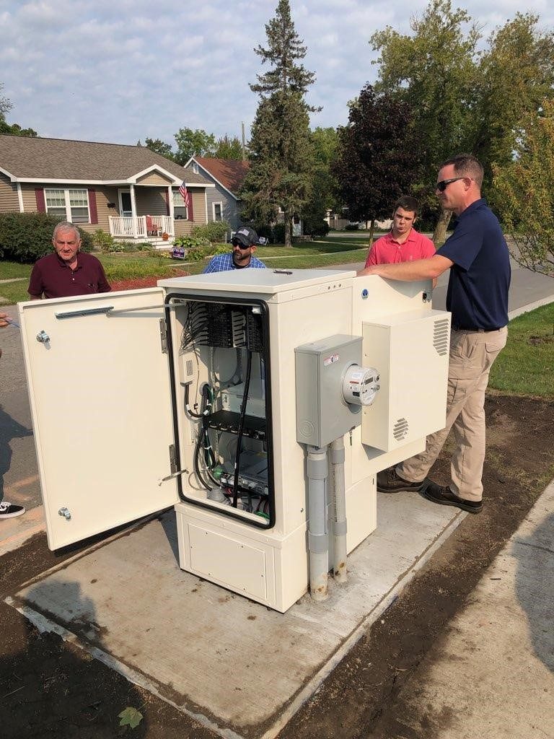
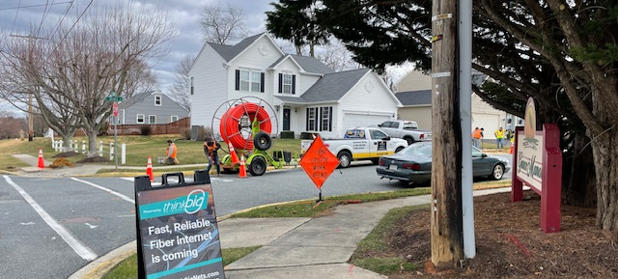
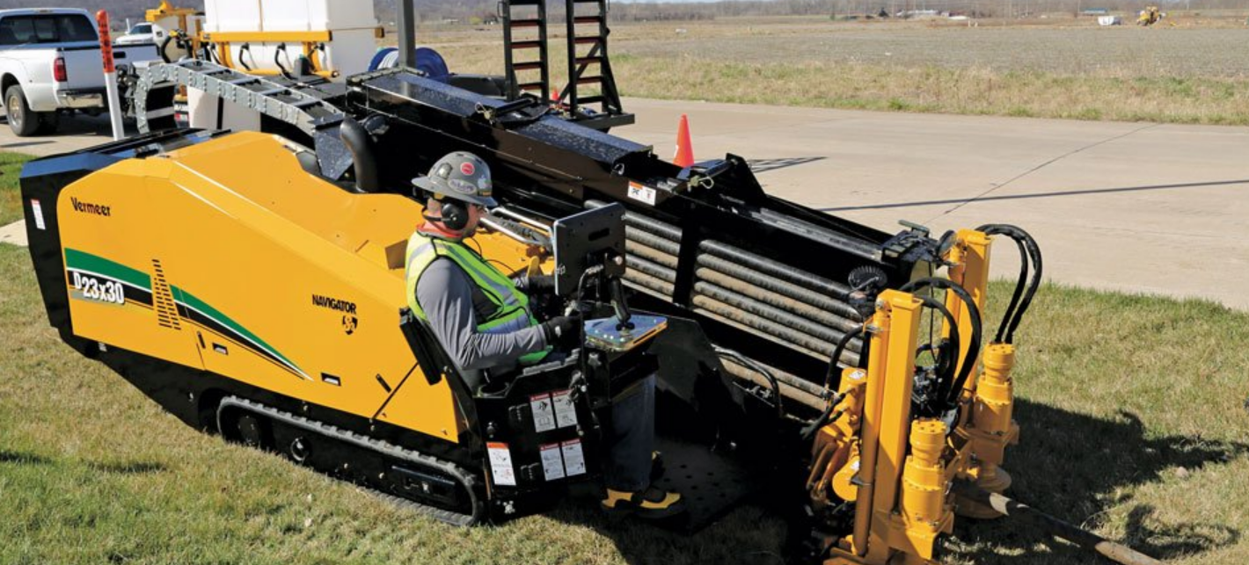
VIEW INTO OUR CONSTRUCTION

Slide 10

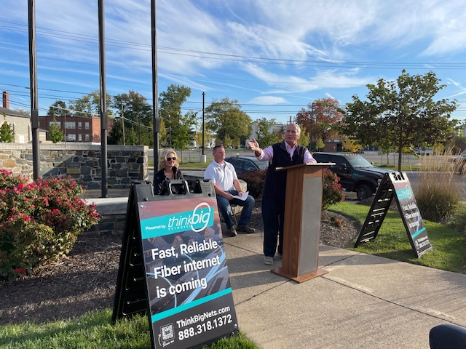
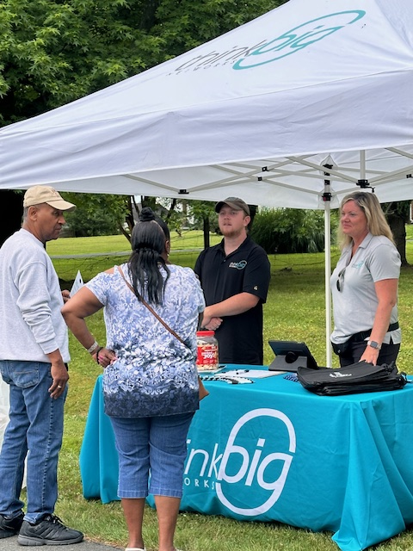

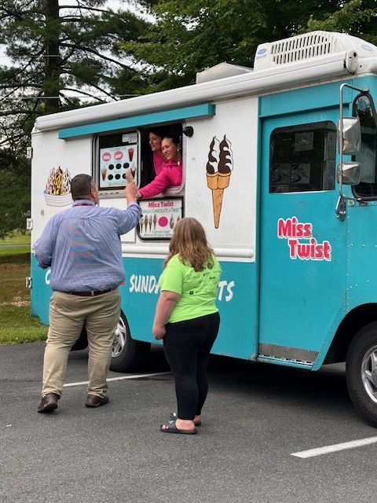
VIEW INTO OUR COMMUNITY ENGAGEMENT

Slide 11




THINKBIG NETWORKS SERVICE OFFERINGS
Live. Work. Play. Stream. Upgrade.

Slide 12
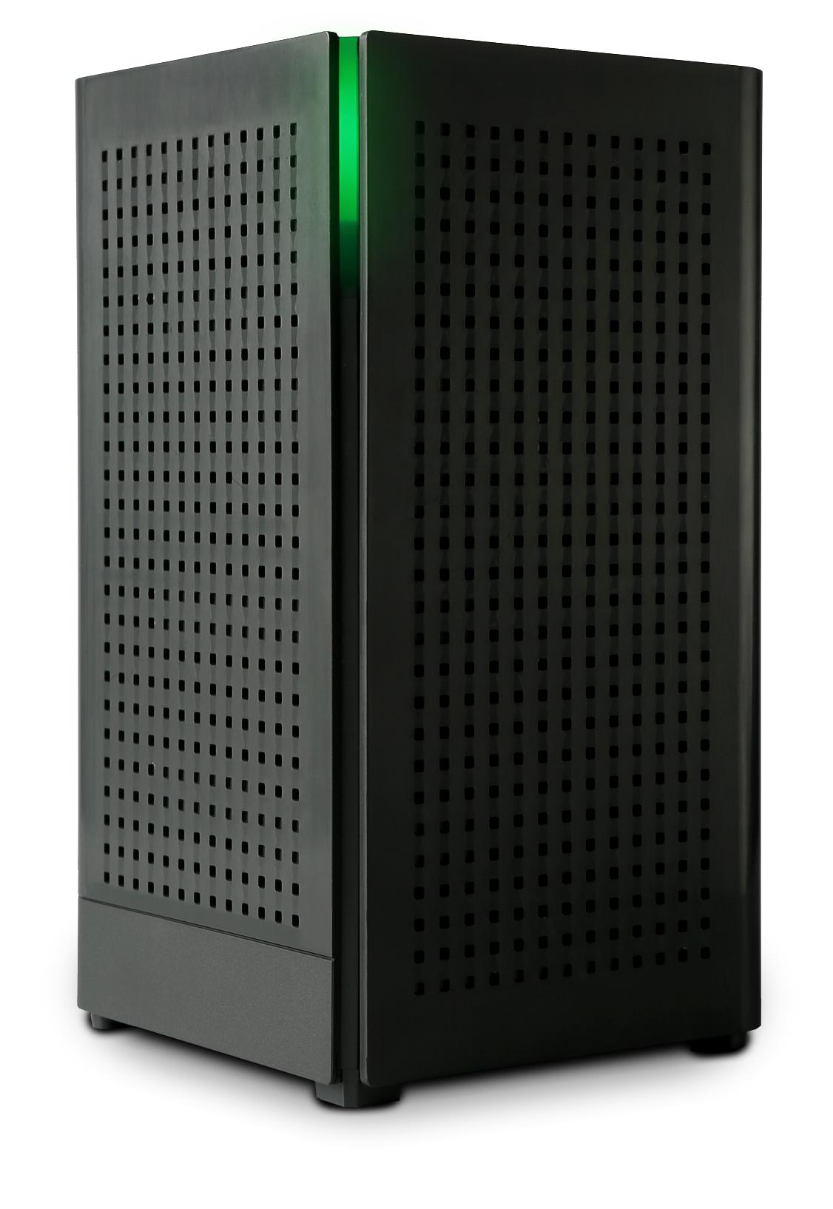

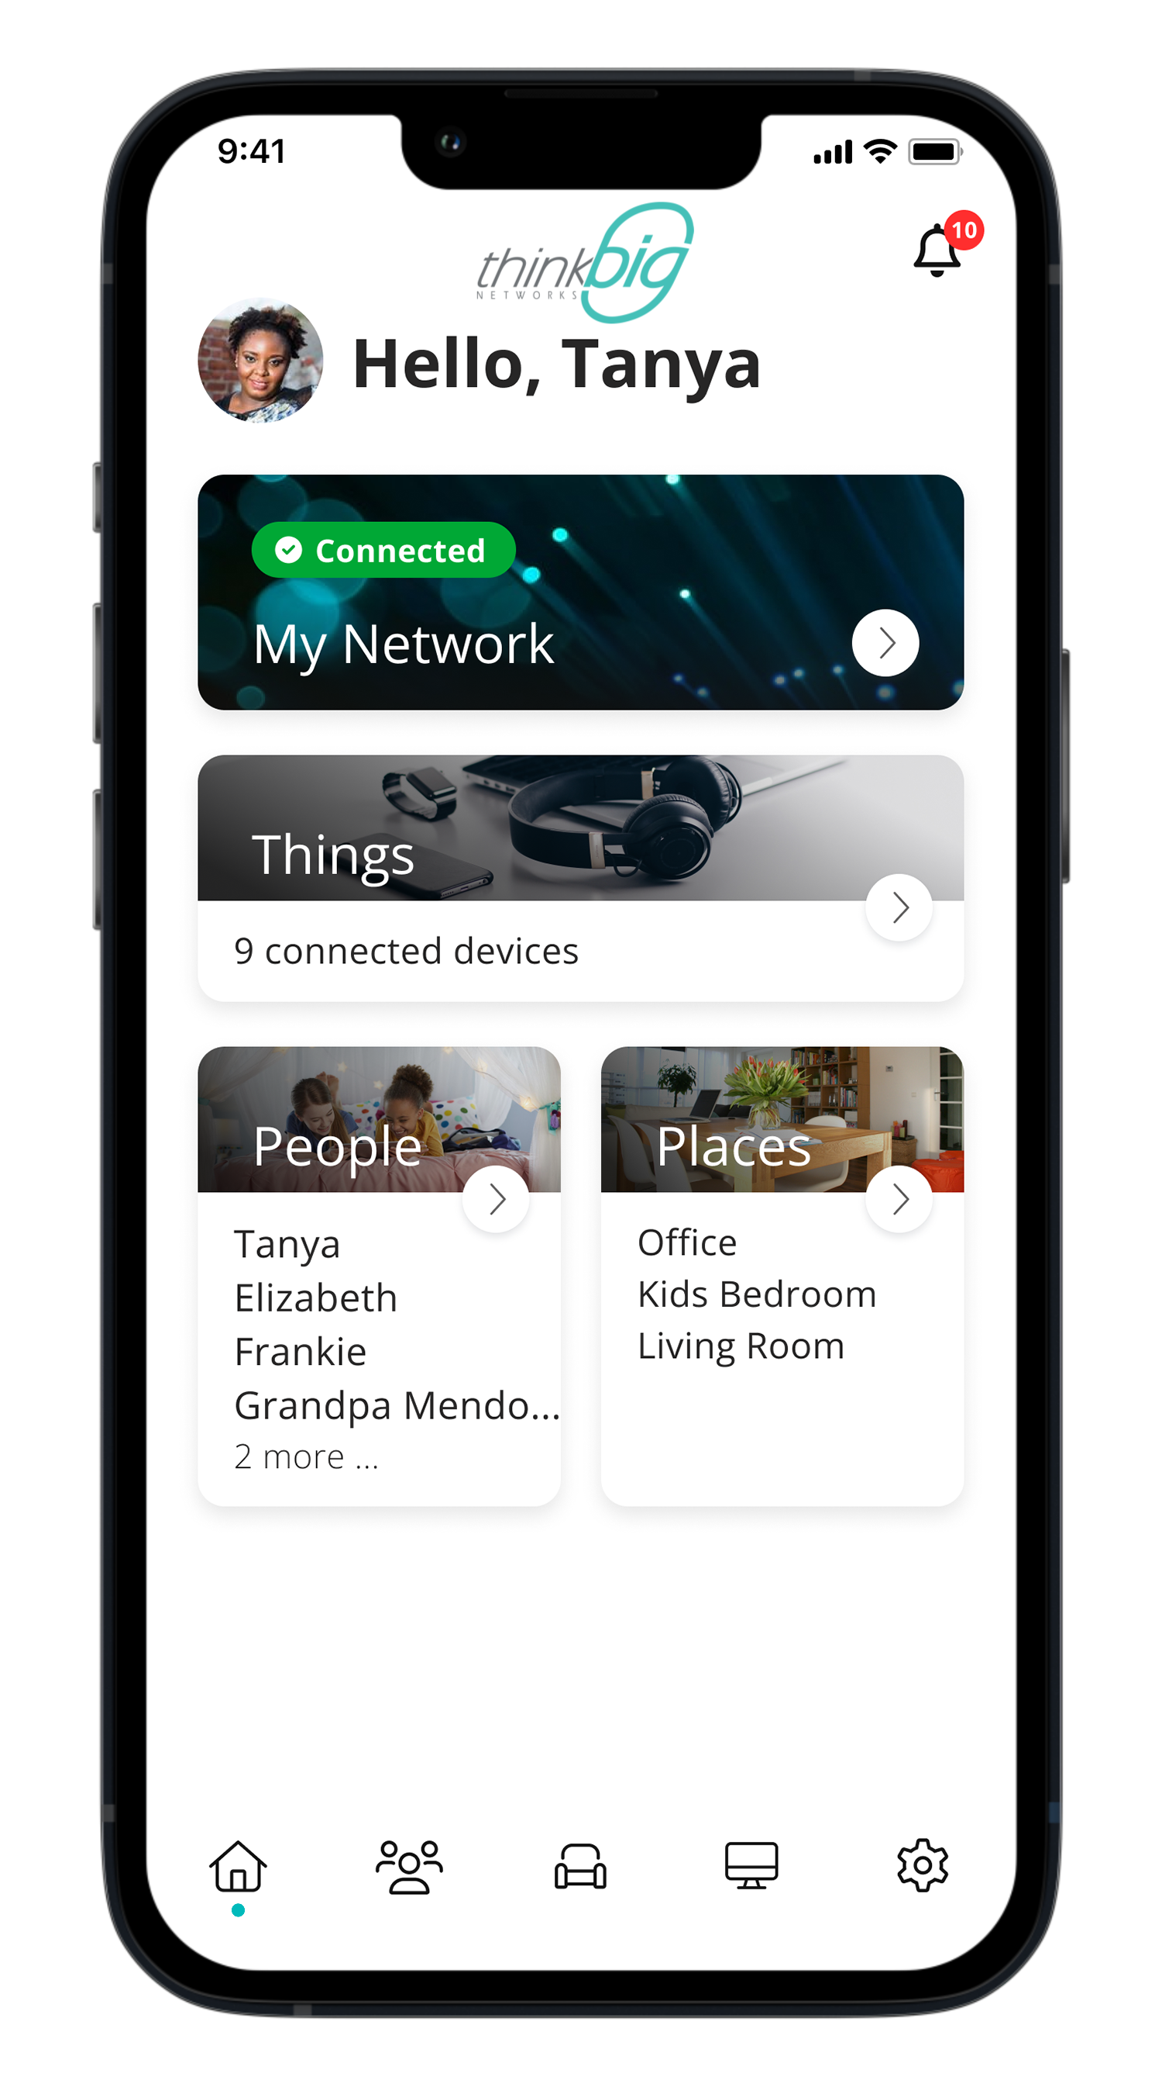

THINKBIG NETWORKS HOME EQUIPMENT
Voice. Power. Control.

Slide 13
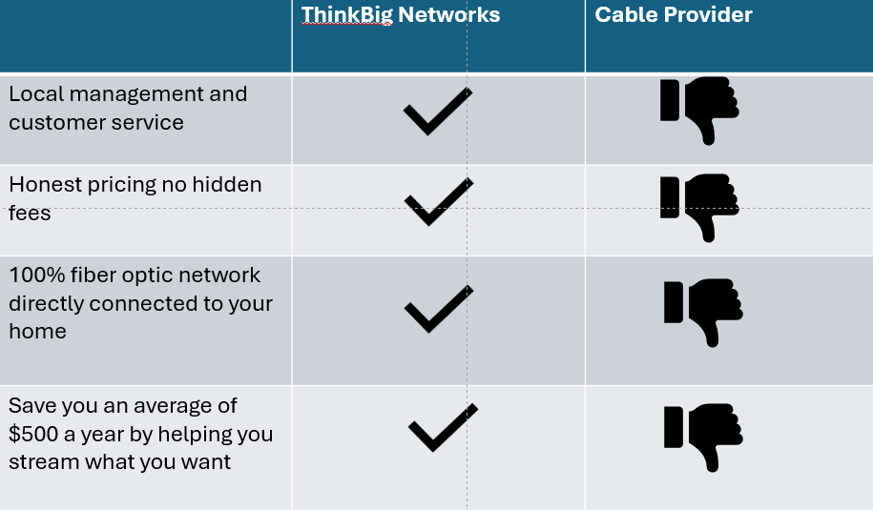

Slide 14





Slide 15
CALVERT COUNTY’S LOCAL FIBER INTERNET PROVIDER
www.ThinkBigNets.com

