Slide 1
The Temple Mount
By Sefir Olevsky

Slide 2
The history of the Temple Mount
The Temple Mount is a very old Monument that holds many stories to the Israelites past. The Temple Mount was built over the very same spot where Solomon's temple used to stand, some of Solomon’s temple is still there, but just built in with some of the new structures. In the middle of the Temple Mount there is a structure, called the Dome of Rock, which is holy to many religions including, Muslamic, Palestinian, and Judaism. The reason the Dome of Rock is Called the “Dome of Rock” is because there is a rock inside of it, which is holy to both Muslims and Jews. The rock is said to be where all creation of the earth began and it is where Abraham poised to sacrifice his son, Isaac.

Slide 3
Sizes and Dates of the Temple Mount
In 957 BCE Solomon’s Temple was built, but a few hundred years later it was then destroyed by the Babylonians in 586 BCE. However, the jews weren't ready to let go of the past, so in 19 BCE Herod the Great decided to rebuild the temple and make it bigger than ever. So, he set out on an ambitious project that involved over 10,000 workers, but all the hard work paid of and they nearly doubled the original size. Now the temple had even more relics and structures than before, which included the Dome of Rock, which held the rock that started it all. The Temple mount is approximately 488 m along the west, 470 m along the east, 315 m along the north and 280 m along the south, giving a total area of approximately 150,000 m2 (37 acres).

Slide 4
Work Cited
https://www.myjewishlearning.com/article/what-is-the-temple-mount/
https://www.haaretz.com/archaeology/.premium-the-history-of-the-temple-mount-1.5331578
https://www.smithsonianmag.com/history/what-is-beneath-the-temple-mount-920764/
https://www.historynet.com/what-is-the-history-of-temple-mount.htm

Slide 5
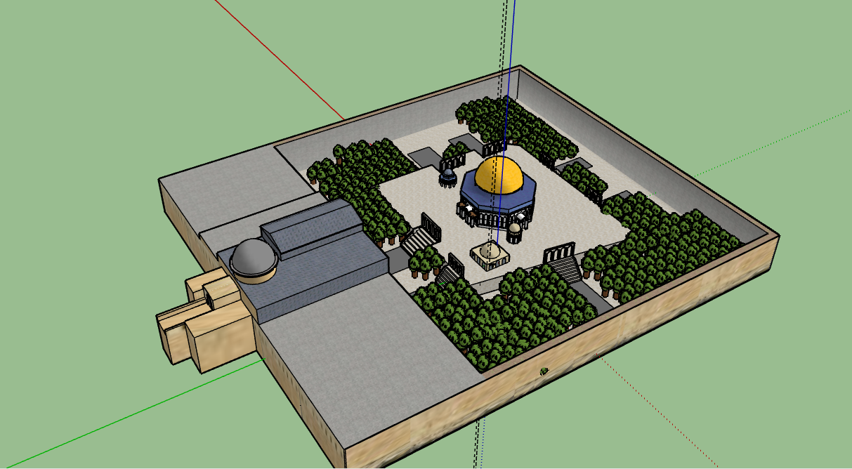
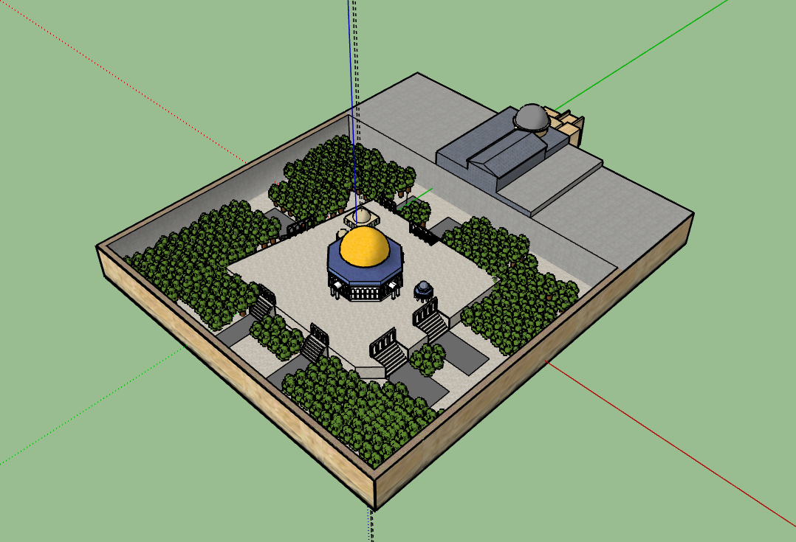
Top Views of the Temple Mount

Slide 6
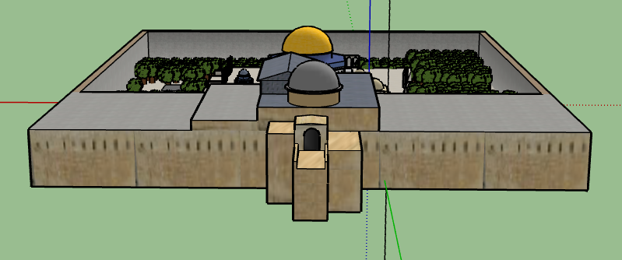
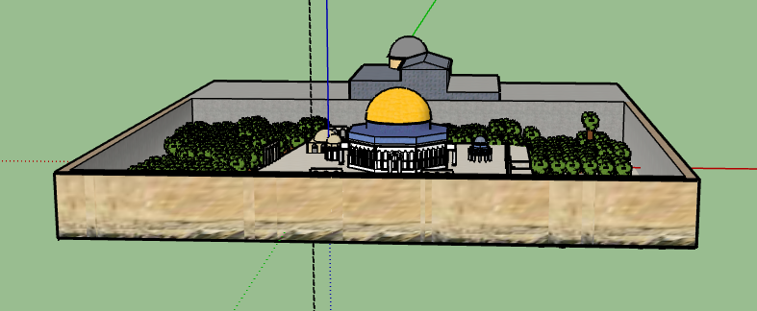
Front and Back view of the Temple Mount

Slide 7
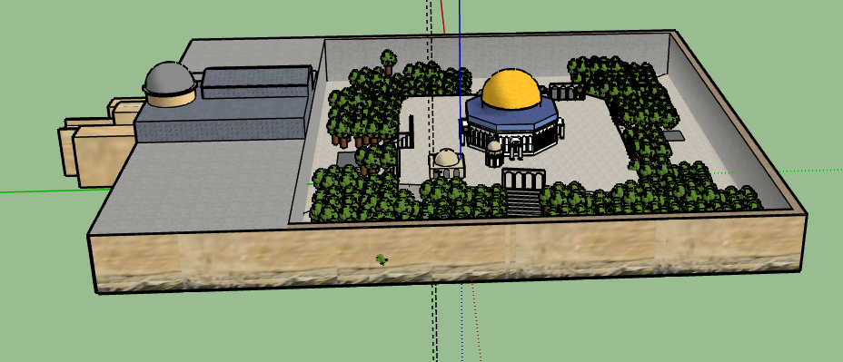
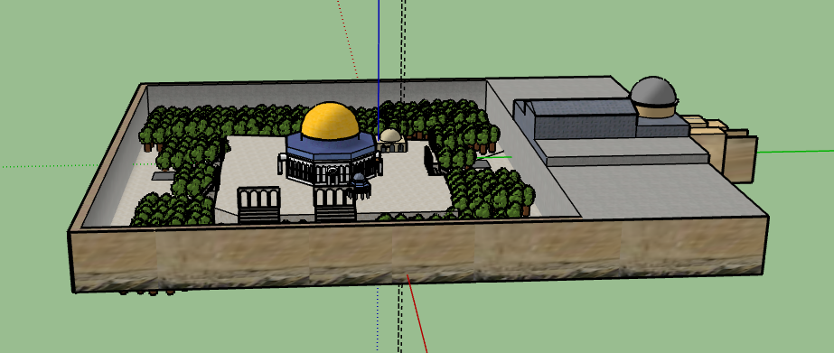
Side Views of the Temple Mount

Slide 8
Positive/Negative Experiences creating the Temple Mount
One positive thing I went through creating my structure was that there were many times when I could duplicate different things, for example when I made the stairs I was able to duplicate some of them. Another time was when I created the tree’s and I only had to create one version, then I duplicated it and scattered it around the inside of the Temple Mount.
One negative time I had creating my structure was that, when I went to color the outside part of the structure I used the actual picture to color it, so it became very annoying to try to line up the exact parts of the picture to that exact part on the structure.
Another positive time I had when creating my structure, was when I was making the domes on top of almost any structure. This was because, it was very easy to make a half circle and cut it in half, then you just had to use a follow me tool to connect one side of the half circle to the other, and then you would create a dome.

