Slide 1
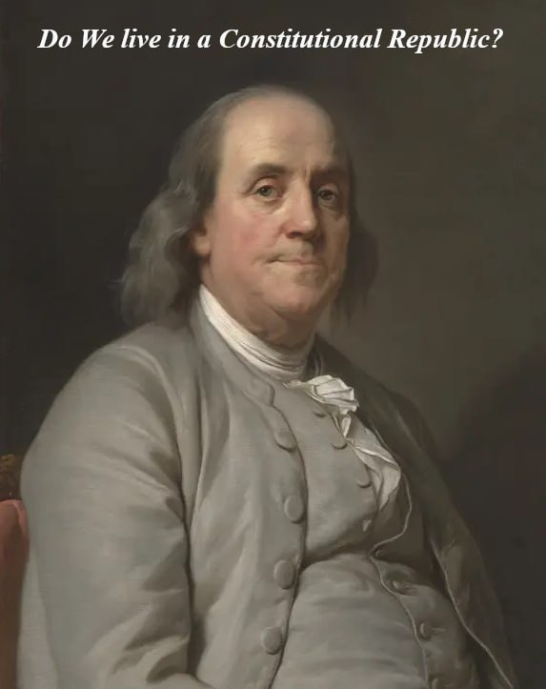
Part 1
The State Constitutions

Slide 2
Summary Review of: Dave Jose’s “The People’s Power & Duty To Stop Unlawful Prosecution of President Trump” Part 1: Streamed June 20, 2023 https://rumble.com/v2vdr7e-the-peoples-power-and-duty-to-stop-unlawful-prosecution-of-president-trump.html
This tutorial is taken from Dave Jose’s recent video linked above. Here, WTPN breaks Dave’s presentation into three PowerPoints showing the People their power to fix what is wrong in government-- peaceably, lawfully, and BY RIGHT.
Part 1 is presented herein: The Fifty State Constitutions
Part 2: presents The Fundamental Principles of Law that allowed creation of the American constitutional republics
Part 3: shows how the People are to preserve the republic and find remedy using logical steps documented in Historical Law by John Locke

Slide 3
What are Freemen? Example? Americans!
In a republic no man is a slave. In the British Monarchy the King was the sovereign and political ruler over the land; citizens were merely subjects.
When the American colonists decided to declare independence from the monarchy, they looked to the wisdom of the ages to formulate a new system pursuant to Christian teachings, customs and usage (the common law) and constituted their new states as republics, whereby the powers of the British Throne were transferred to God’s People.
The new states were by design republican in form, as the People reserved rights inherent from God to themselves and enacted their creation: a voluntary political association (body politic) with a sole purpose to preserve the People’s life, liberty and property.

Slide 4
Kentucky Bill of Rights Section 2: “Absolute and arbitrary power over the lives, liberty and property of freemen exists nowhere in a republic, not even in the largest majority.”
Largest Majority Rules? That would be a democracy-- one step from tyranny.
In our republic legislators may use a limited majority procedure to set policy, but shall not rule over the People’s life, liberty or property
Lately there have been ongoing attacks on the People’s life, liberty, and property. Some examples: Covid mandates, indoctrinating schoolchildren, gun control efforts, limiting the People’s freedoms to speak and protest
In our republic We, the People have the inherent right to control our state.

Slide 5
Kentucky Bill of Rights Section 1: “All men are, by nature, free and equal, and have certain inherent and inalienable rights, among which may be reckoned:
First: The right of enjoying and defending their lives and liberties.
Second: The right of worshipping Almighty God according to the dictates of their consciences.
Third: The right of seeking and pursuing their safety and happiness.
Fourth: The right of freely communicating their thoughts and opinions.
Fifth: The right of acquiring and protecting property.
Sixth: The right of assembling together in a peaceable manner for their common good, and of applying to those invested with the power of government for redress of grievances or other proper purposes, by petition, address or remonstrance.
Seventh: The right to bear arms in defense of themselves and of the State, subject to the power of the General Assembly to enact laws to prevent persons from carrying concealed weapons.”
See Sixth: “other proper purposes” not enumerated b/c these matters are up to the People to decide
The People have the right & duty to give petition or remonstrance to servants as to state of our nation

Slide 6
Georgia Constitution Bill of Rights Paragraph 1: Origin and Structure of Government “The people of this state have the inherent right of regulating their internal government. Government is instituted for the protection, security, and benefit of the people; and at all times they have the right to alter or reform the same whenever the public good may require it.”
We do not hire leaders into government. We, the People are to govern our servants
How often do you tell your will to your government servants?

Slide 7
Missouri Constitution Article 1 Section 2: Promotion of General Welfare--Natural Rights of Persons-Equality Under the Law--Purpose of Government “That all constitutional government is intended to promote the general welfare of the people; that all persons have a natural right to life, liberty, the pursuit of happiness and the enjoyment of the gains of their own industry; that all persons are created equal and are entitled to equal rights and opportunity under the law; that to give security to these things is the principal office of government, and that when government does not confer this security, it fails in its chief design.”
“to give security to these things is the principal office of government”
“when government does not confer this security, it fails in its chief design”
We are supposed to be fixing this. How is 5$ per gallon gas and shutting down pipelines benefitting you?
The People, as trust protector, are to change government ‘as required’ to keep it responsive
Government servants do not understand how government is supposed to work. For starters, focus on stopping your servants from doing wrong.

Slide 8
Missouri Constitution Article 1 Section 3: Powers of the People over Internal Affairs, Constitution and Form of Government “That the people of this state have the inherent, sole and exclusive right to regulate the internal government and police thereof, and to alter and abolish their constitution and form of government whenever they may deem it necessary to their safety and happiness, provided such change be not repugnant to the Constitution of the United States.”
We should not look to trappings of authority or big names to save us
Inherent = comes from God
The word “Policy” is the root of the terms politics, political & police … We, the People hold all power over our public policy and our body politic (society)!
We have the right to change the constitution whenever we deem it necessary. Wherever or however we deem it necessary, we have power to change government (individual persons, offices, and/or form or structure)
The People have a right to say to trustees, “you have failed in your chief design”. Do we have to… keep paying them? … keep contracting with them? … wait until the next election? … wait until we get permission? NO
Government should be changed any time We, the People deem it necessary for our happiness and safety

Slide 9
Christian Principles Exist in the Highest Law: Psalms 118
Verse 8: It is better to trust in the LORD than to put confidence in man.
Verse 9: It is better to trust in the LORD than to put confidence in princes.
Verse 10: All nations compassed me about: but in the name of the LORD will I destroy them.
Verse 13: Thou hast thrust sore at me that I might fall: but the LORD helped me.
Verse 14: The LORD is my strength and song, and is become my salvation.

Slide 10
Christian Principles Exist in the Highest Law: (pt.2)
The Psalmists understood that following the Lord and believing in Him was necessary in order to destroy all the nations that were encompassed round about him. He could look out and see armies attacking from every direction; but he knew that in the name of the Lord he would win.
Our forefathers constituted a nation that God allowed us to create, with contract terms / a covenant that our servants will follow whatever it is that the people have required and, as evidence of their indenture, are paid to enact our business.
We must get back to the fundamental principle that Good Faith must be observed.
We need to seek what is right in the Maxims of Law: Fairness, virtue, righteousness, protecting the People, standing by your oath. All these are fundamental, yet no one has taught us.
Conservatives don’t know or feel that they can lawfully correct these things, so they don’t take action. Don’t be distracted by the confusion around you. We all need to do that which is right.

Slide 11
Key Information on our State Constitutions
Each state constitution consists of a Preamble and two sections:
The Preamble, a spiritual statement
The Declaration or Bill of Rights, which no trustee/servant shall transgress
The Frame of Government, a general grant of powers to agent trustees
The state constitutions are whereby We, the People stand on our God-given rights, regulate our government, and work towards a more perfect union
All state constitutions must remain republican in form (People hold all power)
The People’s constitutions are express trusts in form, indenturing each gov’t servant into a role of trustee; under obligation of contract to perform adequately

Slide 12
End of Part 1: The Fifty State Constitutions
This presentation is compiled from original webcast content by Dave Jose on June 20, 2023
Dave Jose’s webcasts can be found on his Rumble channel Davecaresforyou
IMPORTANT! Please follow Dave on X (Twitter) @RealDaveCares4u
Please feel free to follow up with WTPN via email to: admin@WeThePeopleNotices.org
We, the American People are learning our power in the state constitutions and as a movement are growing exponentially as we reform government at Grassroots level
Get out there: Assemble, Consult, and Reform government peaceably, lawfully, And BY RIGHT!

