Slide 1
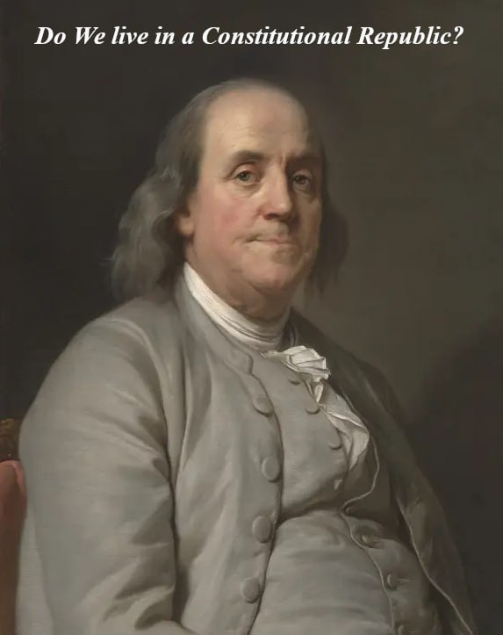
Part 2
Fundamental Principles of Law

Slide 2
Summary Review of: Dave Jose’s “The People’s Power & Duty To Stop Unlawful Prosecution of President Trump” Part 2: Streamed June 20, 2023 https://rumble.com/v2vdr7e-the-peoples-power-and-duty-to-stop-unlawful-prosecution-of-president-trump.html
These tutorials are taken from Dave Jose’s recent video linked above. Here, WTPN breaks Dave’s presentation into Three PowerPoints showing the People their power to fix what is wrong in government-- peaceably, lawfully, and BY RIGHT.
Part 1: presents the Fifty State Constitutions
Part 2 is presented herein: The Fundamental Principles of Law that allowed creation of the American constitutional republics
Part 3: shows how the People are to preserve the republic and find remedy using logical steps documented in Historical Law by John Locke

Slide 3
The Fundamental Principles of Law: A Selection of Maxims of Law by Charles A. Weisman Chapter 50: Good Faith
50c. Good faith demands that what is agreed upon shall be done
Are our trustees following election laws? Was there government authority for Covid lockdowns?
50d. Good faith must be observed.
Good Faith is a biblical principle that one must do what he agrees to do

Slide 4
The Fundamental Principles of Law: A Selection of Maxims of Law by Charles A. Weisman Chapter 51: Government
51b. The government is to be subject to the law, for the law makes the government.
What the People put into their constitution, is what all government servants have to follow. They must be able to see that only statutes in pursuance of their constitutional authority are what they agree to do and must do.
51c. Obedience makes government, not the name by which it is called.
They are supposed to follow what the People want and the laws say. They often don’t want do the job they agreed to do
51d. The laws themselves desire that they should be governed by right.
The persons that get into government positions have to follow the law. What they swear to do in good faith, they must follow.

Slide 5
The Fundamental Principles of Law: A Selection of Maxims of Law by Charles A. Weisman Chapter 51: Government
51k. The law is not to be violated by those in government.
People complain about having their rights taken away. But most people tend to think of collective rights, not individual rights which are of equal importance
51i. Individual liberties are antecedent to all government.
Individual liberties… not collective. Some believe you can vote every two years to have your collective rights protected. No. We are to alter, reform or abolish government at will any time we see that our happiness and safety are not secured … and that means individual rights too
The People’s individual rights were here before them, and will remain so after them

Slide 6
The Fundamental Principles of Law: A Selection of Maxims of Law by Charles A. Weisman Chapter 51: Government
51l. Lapse of time does not bar the commonwealth.
They don’t want you to know that our servants have to do what they swore to, a biblical idea. We, the People are given the power from God to make them do what’s right
51o. All political power is inherent in the people by decree of God and none can exist except it be derived by them.
This is the American Maxim that shows they have no power to do anything outside their granted authority
51p. The main object of government is the protection and preservation of personal rights, private property, and public liberties, and upholding the law of God.
We are in a position of tyranny right now because the government does not know their duties and We, the People don’t know our rights and duties so we can’t correct them. For our republic to endure we need to be bringing to them a frequent recurrence to the fundamental principles of law

Slide 7
The Fundamental Principles of Law: A Selection of Maxims of Law by Charles A. Weisman Chapter 51: Government
51q. A frequent recurrence to fundamental principles, and a firm adherence to justice, virtue, and original law, are indispensibly necessary to preserve the blessings of liberty and good government.
‘Original law’ comes from the people
51r. As usurpation is the exercise of power, which another has a right to; so tyranny is the exercise of power beyond right, which no body can have a right to.
We never gave these servants a right to do what they are doing today. We are to hold them to virtue, righteousness, honesty, and upholding the law of God
Our forefathers wrote the constitutions based on Christianity and the wisdom of the ages. The common law from which the constitutions were created is based upon Christianity and Biblical teachings.
‘That which is just’ can only be seen if one knows the difference between right and wrong
Government agents work to separate their actions from what government is vs. what is right and Godly. But is this how it really is supposed to be?

Slide 8
The Fundamental Principles of Law: A Selection of Maxims of Law by Charles A. Weisman Chapter 49: God, Divinity, Religion
49f. That is the highest law which favors religion.
49g. That consideration is strongest which determines in favor of religion.
49i. The Christian religion is a part of the common law.
Can you see a pattern here of what has been hidden from us?
How is it that we can see things in the written law that none of us has been taught?
Are we are upholding our responsibilities to make sure our government servants are following the law?
No statute is to be written that goes against the common law- the original law- else it be null and void

Slide 9
The Fundamental Principles of Law: A Selection of Maxims of Law by Charles A. Weisman - Getting to Good Governance
When our servants tell the People what they can do for us-- they always start at statutes but never talk to us about the original law, the highest law – the State Constitution
They never admit that they are not supposed to use their power against us, which is a breach of trust; and when doing so they individually evaporate their authority
We need to look at the writings of our forefathers of law to understand how we should correct our government. What are they doing wrong these days and what are our remedies?
Are they showing us OUR power or are they trying to stay IN power? It is hard for them to show they act from the People’s power. They are not standing up FOR the People

Slide 10
End of Part 2: The Maxims of Law
This presentation is compiled from original webcast content by Dave Jose on June 20, 2023. Please watch Dave’s 60 Minute webcast in its entirety (linked)
Dave Jose’s webcasts can be found on the Rumble channel Davecaresforyou
IMPORTANT! Please follow Dave on X (Twitter) @RealDaveCares4u
Please feel free to follow up with WTPN via email to: admin@WeThePeopleNotices.org
We, the American People are learning our power in the state constitutions and as a movement are growing exponentially as we reform government at Grassroots level
Get out there: Assemble, Consult, and Reform government peaceably, lawfully, And BY RIGHT!

