Slide 1

Bubbles and
Troubles
Written by: Lisa Conner
Illustrated by: Maili Taniguchi

Slide 2
Some Background

Slide 3

Lisa Conner is a retired school teacher and counselor. She currently lives with her husband Matt in Lititz, PA. Lisa and Matt have two grown children. Lisa enjoys reading and writing, spending time with her grandson Ashton, and traveling to Rehoboth Beach, DE.

Slide 4
Other Books

Slide 5

It's Jeter's first day at Doggy Daycare, and he is very excited! But when he arrives, he notices that every dog has something special to offer, and they are getting ALL the attention. Jeter experiences a strange new feeling. With the help of a friend, Jeter discovers he is feeling jealous and must find a way to cope. By celebrating the other dogs' talents, Jeter learns we all have a gift to offer one another - the gift of kindness. Beautifully illustrated, Jealous Jeter features a powerful message that will uplift anyone who has ever been bitten by the green-eyed monster.

Slide 6
When We Read

Slide 7
Before We Read
Look at the Cover
Make Connections
Take a Picture Walk
Make Predictions
01
02
03
04
What do you notice and wonder about the cover of the book?
What do you know about bubbles and troubles?
What information can we gather as we preview the pictures?
What do you think will happen in the story?

Slide 8
During Reading
Respond While Reading
Make Inferences
Make Connections
Visualize
01
02
03
04
Ask and answer questions about the text. Does it make sense?
What do you think the author is saying by writing this story?
Does this story remind you of something in your life?
What pictures are you creating in your mind about the story?

Slide 9
Thinking About Reading
Feelings
Lesson
Character
Summarize
01
02
03
04
How did the story make you feel?
What lesson did Ashton learn in the story?
How did Ashton change from the beginning of the story to the end?
What happened in the beginning, the middle, and the end of the story?

Slide 10
Vocabulary Words

Slide 11
VOCABULARY WORDS
01
02
opposite
included
03
04
explained
joy
a person or thing that is totally different from or the reverse of someone or something else
contained as part of a whole being considered
make (an idea, situation, or problem) clear to someone by describing it in more detail or revealing relevant facts or ideas
a feeling of great pleasure and happiness

Slide 12
VOCABULARY WORDS
05
06
replied
neighbors
07
08
shouted
interesting
say something in response to something someone has said
a person living near or next door to the speaker or person referred to
utter a loud call or cry, typically as an expression of a strong emotion
arousing curiosity or interest; holding or catching the attention

Slide 13
VOCABULARY WORDS
09
10
responded
peaceful
11
12
weather
corn hole
say something in reply
free from disturbance; tranquil
the state of the atmosphere at a place and time as regards heat, dryness, sunshine, wind, rain, etc
a game in which small bags filled with dried corn are tossed at a target consisting of an inclined wooden platform with a hole at one end

Slide 14
VOCABULARY WORDS
13
14
completely
included
15
16
disc golf
curious
totally
contained as part of a whole being considered
a game in which a plastic disc is thrown into each of a series of metal baskets in an outdoor course
eager to know or learn something

Slide 15
VOCABULARY WORDS
17
18
imagined
decided
19
20
wonder
discover
(of something unreal or untrue) believed to exist or be so
(of a quality) definite; unquestionable
desire or be curious to know something
find (something or someone) unexpectedly or in the course of a search

Slide 16

VOCABULARY WORDS
21
22
noticed
exclaimed
become aware of
cry out suddenly, especially in surprise, anger, or pain

Slide 17
Discussion Questions
The following questions may be used with your student or child to discuss ways of coping with troubles and creating bubbles.

Slide 18
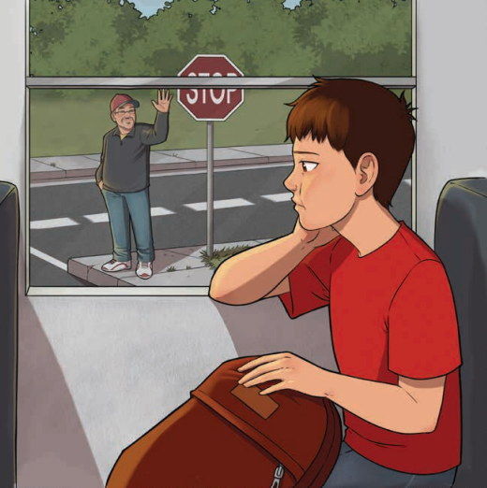
Coping with Troubles

Slide 19
TROUBLES
What are some troubles you’ve had at school?

Slide 20
TROUBLES
Have you ever been in a bad mood?

Slide 21
TROUBLES
Have you ever struggled with several troubles at the same time like Ashton? If so, share how that felt.

Slide 22
TROUBLES
Do you think everyone has troubles at times?

Slide 23
TROUBLES
Is there someone you can talk to when you are having troubles?

Slide 24
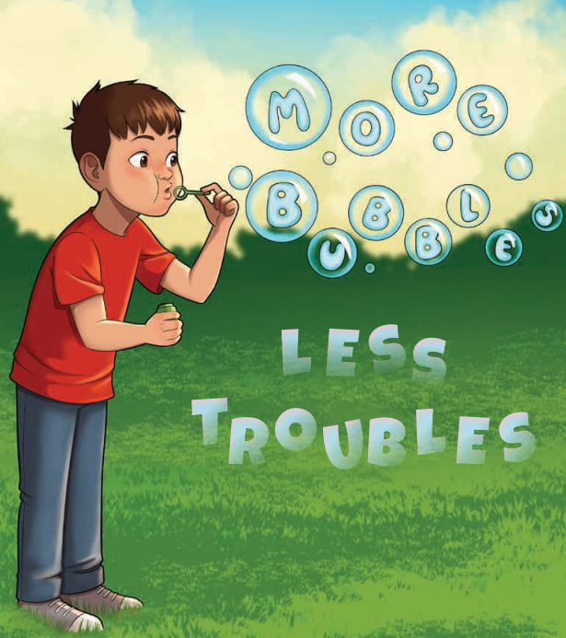
Counting Your Bubbles

Slide 25
BUBBLES
What is your biggest bubble right now?

Slide 26
BUBBLES
What person makes you happy?

Slide 27
BUBBLES
What activity brings you the most joy?

Slide 28
BUBBLES
Where is your favorite place to visit?

Slide 29
BUBBLES
Why is it a good idea to share your bubbles with others?

Slide 30
BUBBLES
What is
something you have accomplished recently that makes you proud?

Slide 31
BUBBLES
Who can you ask to share their biggest bubbles with you?

