Slide 1
Author Visit Jealous Jeter Lisa Conner

Slide 2
Some Background

Slide 3
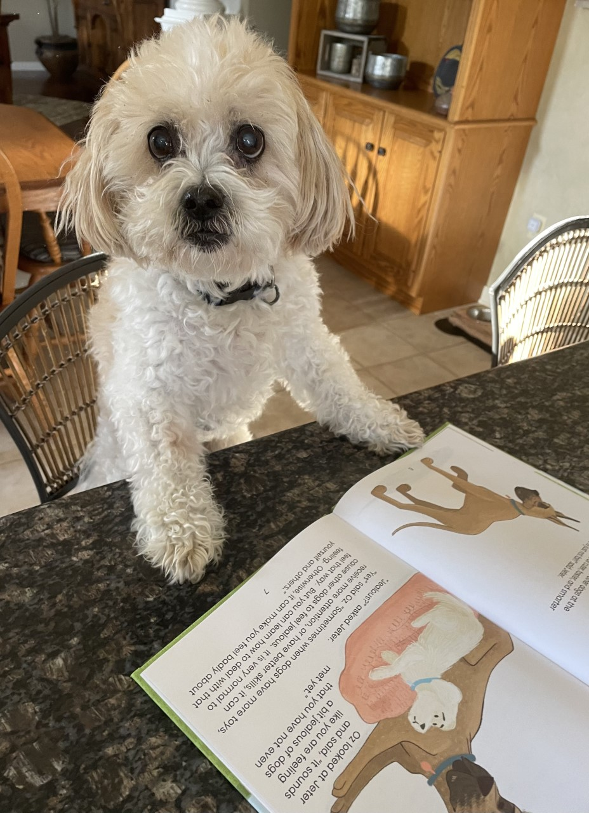
On the left is the cover of the book. On the right is the real-life Jeter who the story was inspired by.

Slide 4
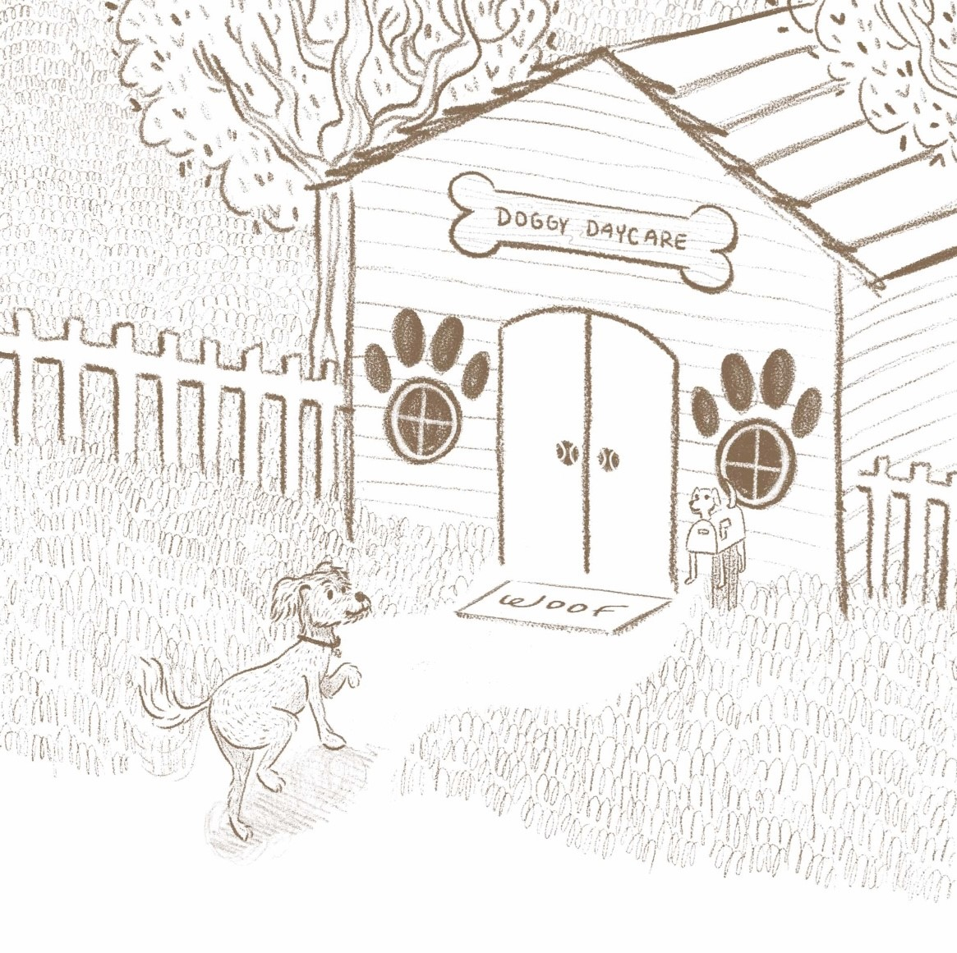
Here is an original sketch of one of the illustrations that shows up in the book. See if you can spot it during the read aloud.

Slide 5
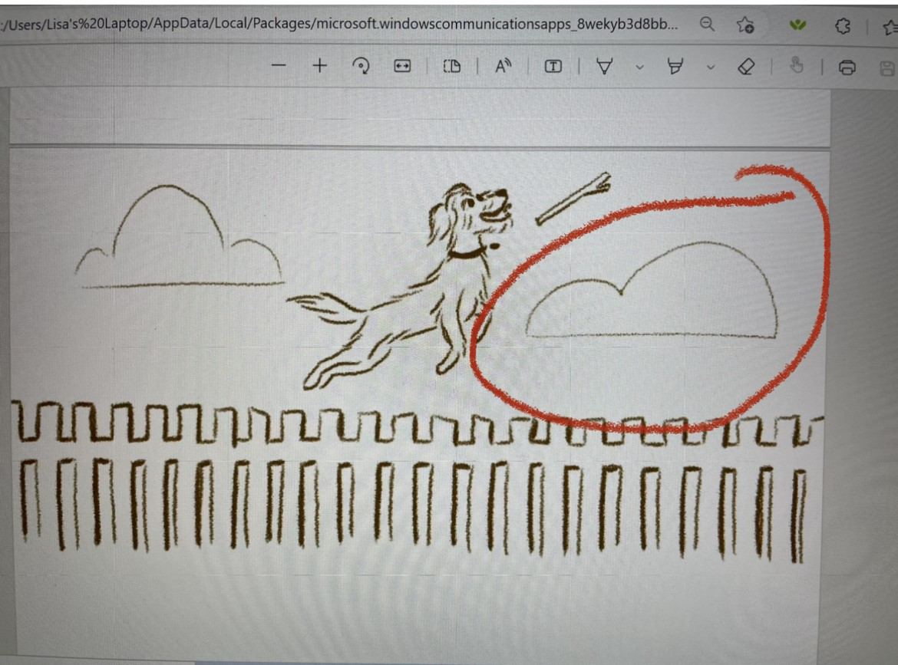
Here is another original sketch of one of the illustrations that shows up in the book. Check out the next slide to see how it changed.

Slide 6
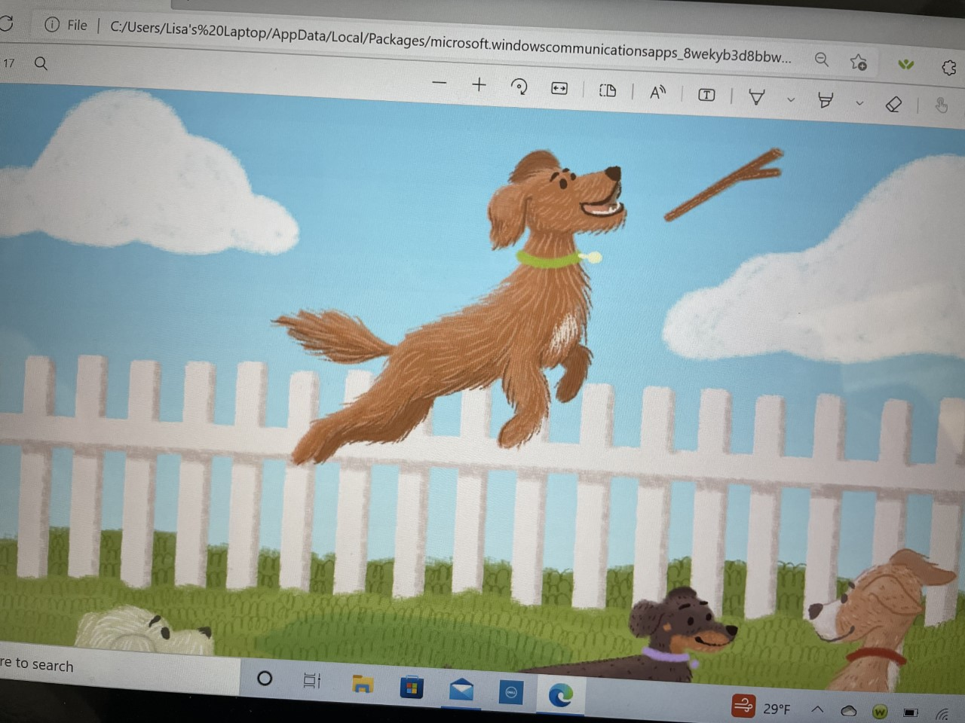
Can you notice the difference between the last sketch and this revised illustration? What changes do you see?

Slide 7
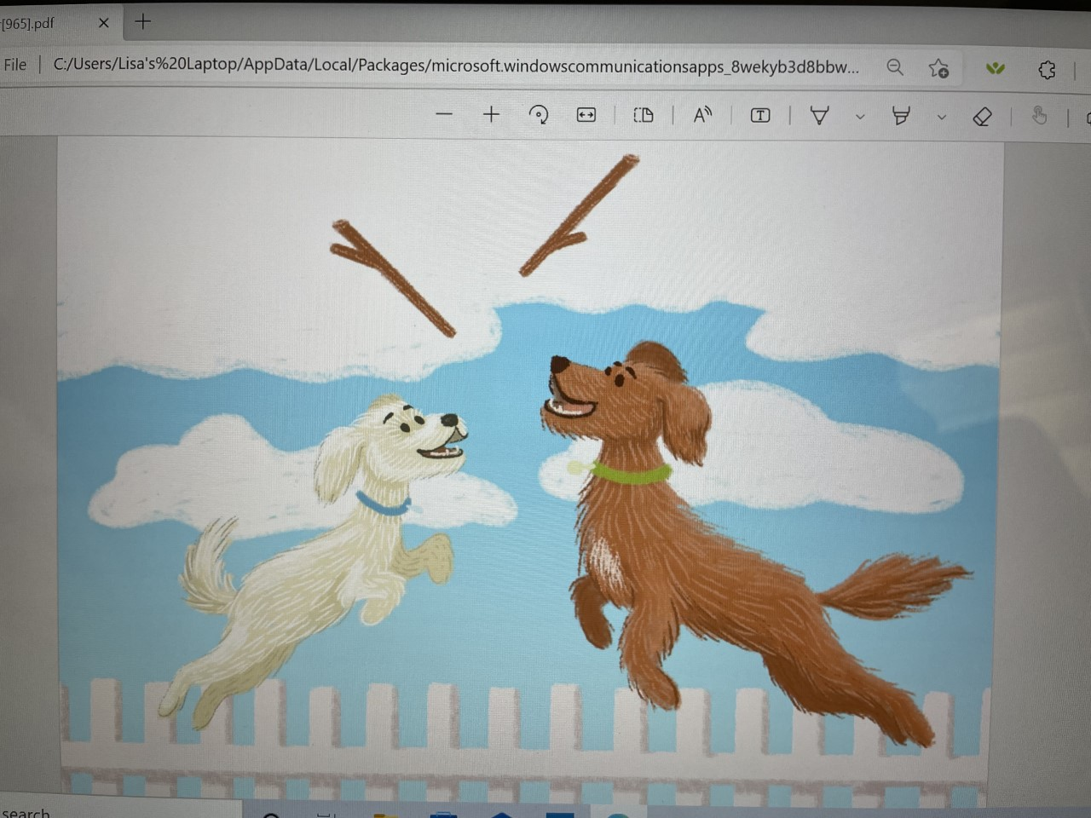
Here is one of the illustrations that was done and shows up in the book. What kind of emotion is showing on the dogs’ faces?

Slide 8
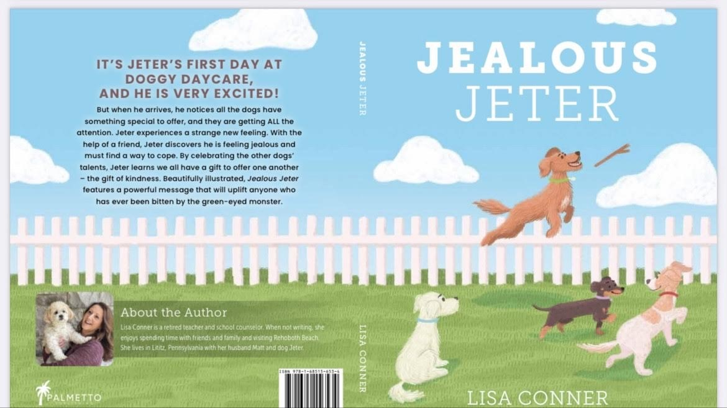
This is a picture of the back cover of the book. It gives you an overview of the story and some information about the author.

Slide 9
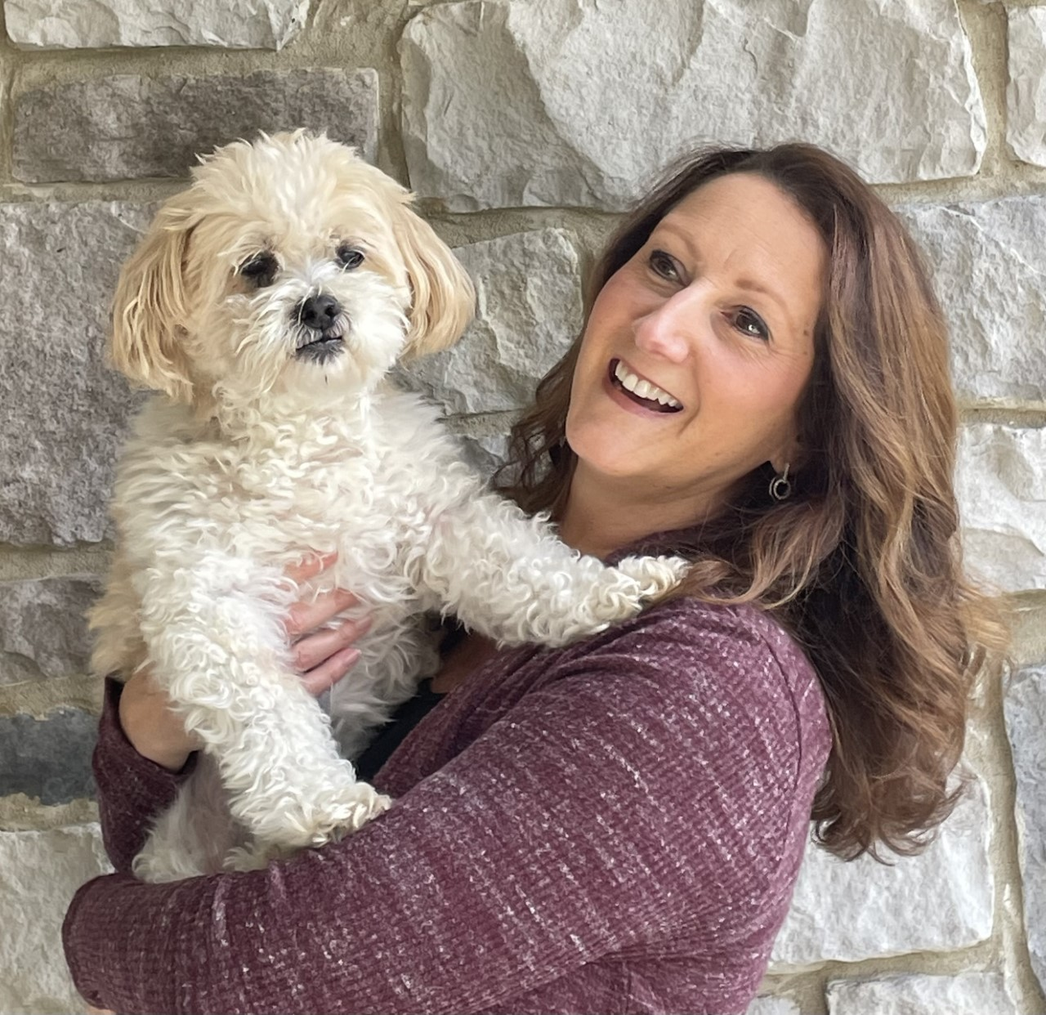
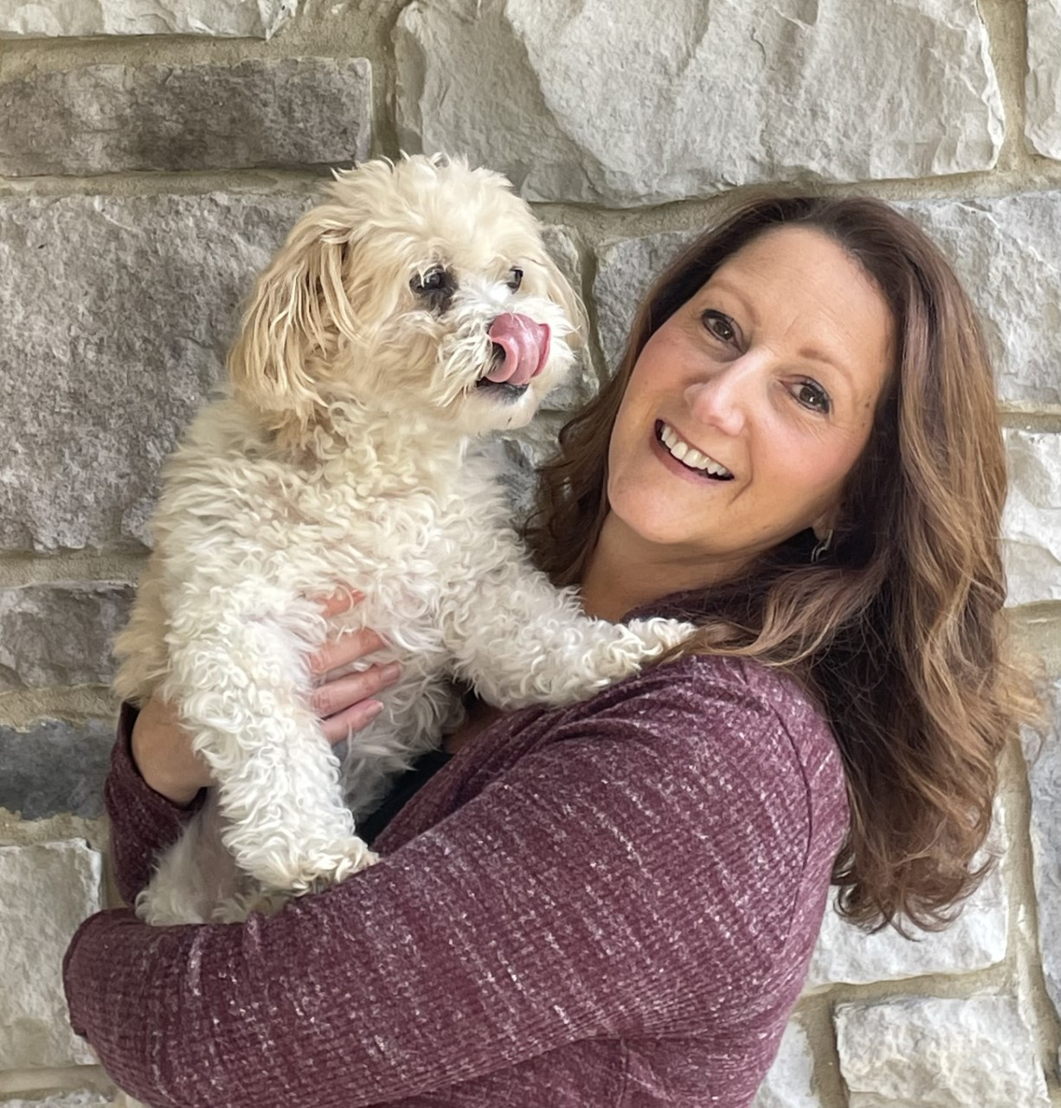
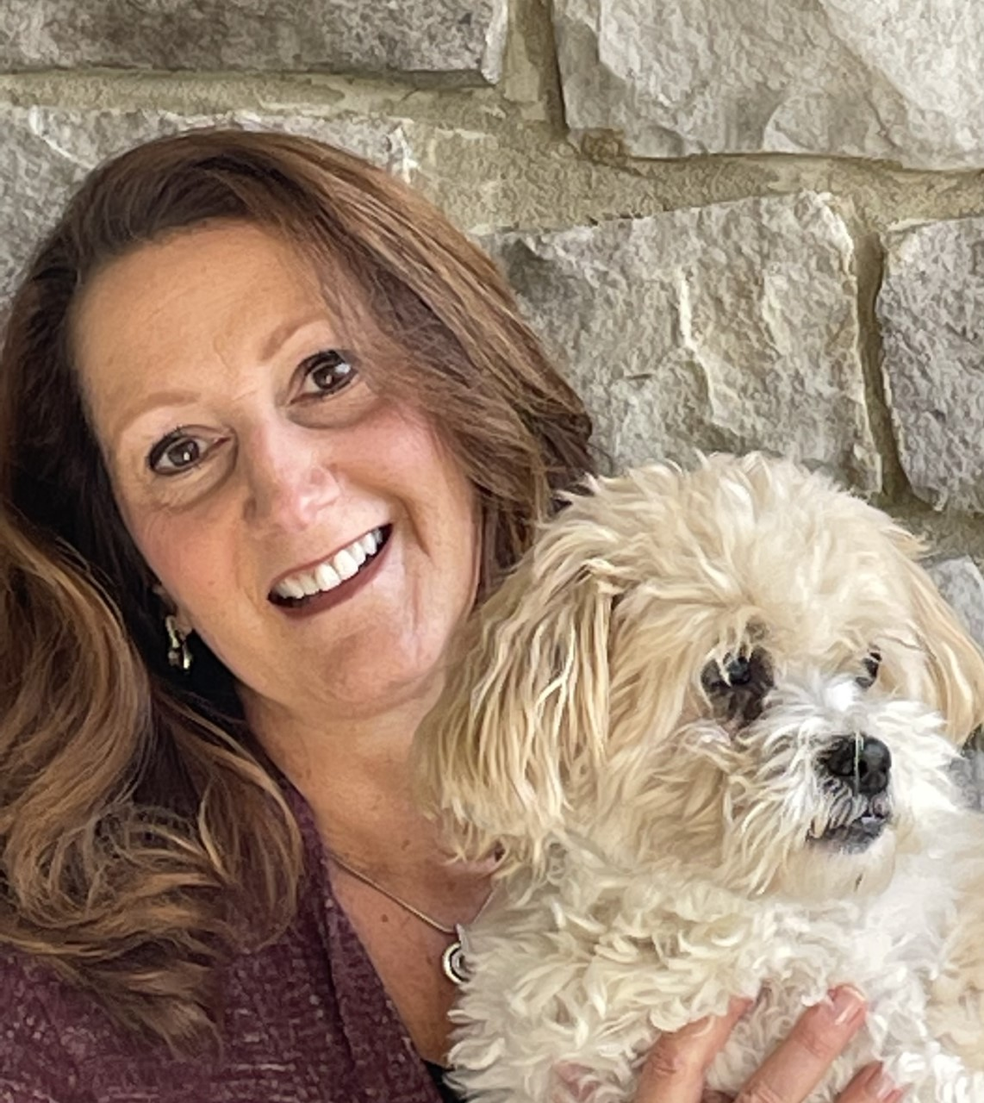
Here are some cute pictures of Jeter and Mrs. Conner.

Slide 10
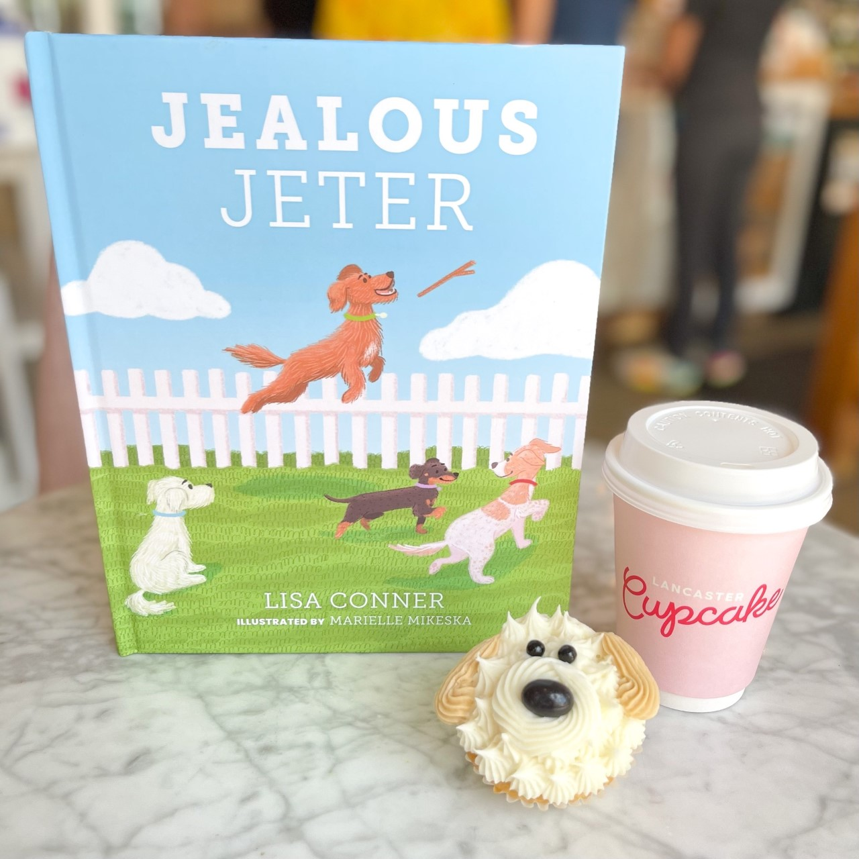
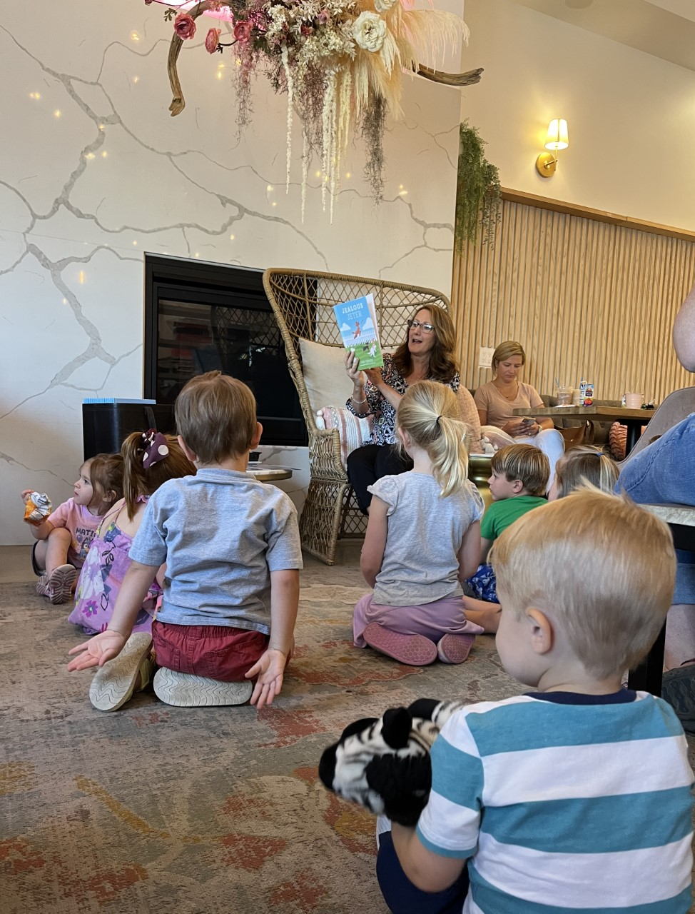
Mrs. Conner enjoyed reading aloud to some children at Lancaster Cupcake.

Slide 11
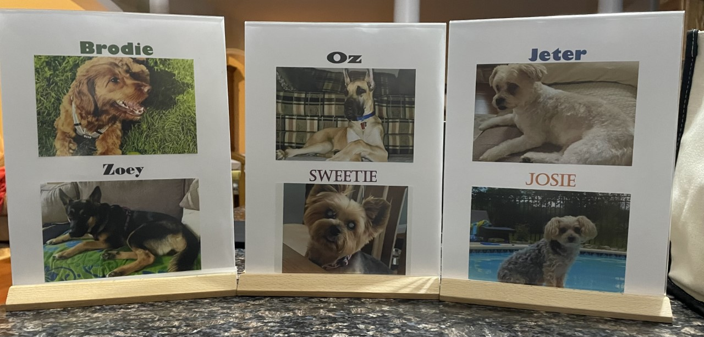
Here are pictures of some of the other
real-life dogs that are part of this book.

Slide 12
When We Read

Slide 13
Before Reading
Cover
Jealousy
01
02
Characters
Setting
03
04
What can we tell from looking at the cover?
What do you know about jealousy?
Who are the characters in the story?
Where does the story take place?

Slide 14
During Reading
K-9 Dogs
Oz
01
02
Advice
Sweetie
03
04
What did you learn about K-9 dogs on page 4?
What are some characteristics of the dog Oz?
What advice did Oz give Jeter?
How did Sweetie show kindness and generosity?

Slide 15
Thinking About Reading
Brodie
Feelings
01
02
More Jealousy
Lesson
03
04
How did Brodie help Jeter?
Why did Jeter’s heart feel happy?
What made Jeter feel jealous again at the end of the book?
What lesson did Jeter learn about jealousy?

Slide 16
Vocabulary Words

Slide 17
Vocabulary Words to Know
adorable
overheard
impressed
praising
unsure
accomplishment
inspiring great affection; delightful; charming
hear (someone or something) without meaning to
feeling or showing admiration or respect for someone or something
express warm approval or admiration of
not feeling, showing, or done with confidence and certainty
something that has been achieved successfully

Slide 18
Vocabulary Words to Know
nervous
offered
timid
generous
impressed
fancy
easily agitated or alarmed; tending to be anxious
Present something for someone to accept or reject
showing a lack of courage or confidence; easily frightened
showing kindness toward others
feeling or showing admiration or respect for someone or something
elaborate in structure or decoration

Slide 19
Vocabulary Words to Know
eventful
handle
marked by interesting or exciting events
manage a situation or problem

Slide 20
Discussion Questions

Slide 21
Why do you think Jeter became jealous of all the other dogs?

Slide 22
Have you ever felt jealous like Jeter? If so, share what that was like.

Slide 23
Do you think everyone gets jealous at times?

Slide 24
Share some reasons people may become jealous.

Slide 25
Have you ever had an “It’s NOT Fair” moment? If so, share what that was like.

Slide 26
Have you ever wanted something that someone else had?

Slide 27
Do you sometimes compare yourself to others?

Slide 28
Have you ever felt jealous or mad when a friend or a classmate achieved something?

Slide 29
List two ways that you can handle your jealous feelings in a positive manner.

Slide 30
Name two things in your life that make you happy.

Slide 31
Name two things in your life that you appreciate.

Slide 32
Name reasons or share examples why kids your age may become jealous.

Slide 33
Name reasons or share examples why kids your age may become jealous.

Slide 34
What is something you can tell yourself the next time you may feel jealous.

